Slide 1

A future for astronomers in the Netherlands: Solving the precarity crisis
Ekaterina Ilin (ASTRON), Shoko Jin (Kapteyn), Jennifer Friske (Kapteyn), Emily Sandford (Leiden U), Elle Hanson (API), Mathilde Bouvier (Leiden U)
May 11, 2026, NAC
Credit: L. Sbordone/ESO

Slide 2
What makes for a thriving astronomy community?
WORKING IN THE NETHERLANDS
Nice working conditions
Decent salary
International environment
Well- connected across institutes (RvdA, NOVA ..)
Healthcare
Pension contributions
FOR TEMPORARY STAFF
High-stress environment
Career prospects are measured by publication and funding record
Lack of grant funding opportunities
Supervision and teaching load
No long-term perspective
Few skills gained for non-academic jobs
Major life milestones delayed
PRECARITY
HIGH STRESS
BAD HEALTH
See, e.g., Burgard et al. (2009); Bhattacharya & Ray (2020)

Slide 3
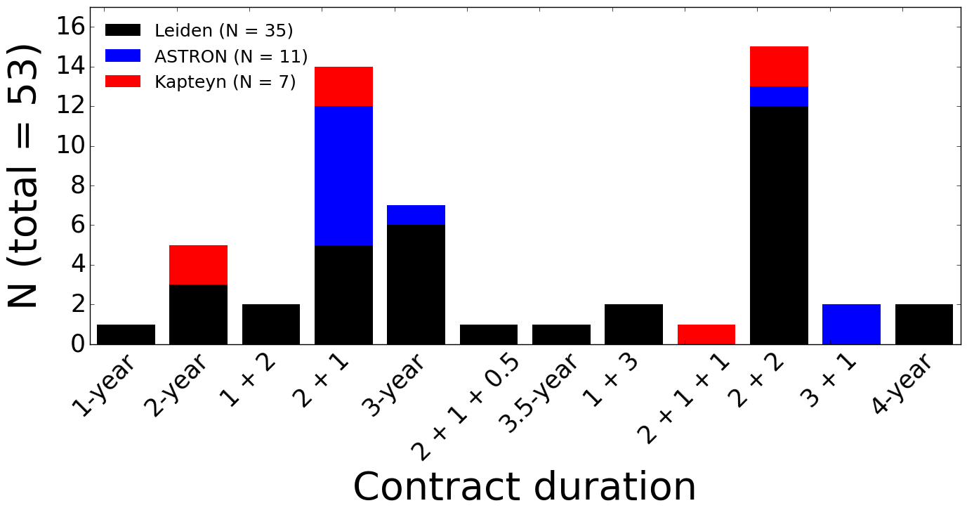
In the Netherlands, postdoc contracts are short and come in chunks.
As of March 2026
≤ 3 yr
Notes:
Kapteyn short survey:
2x 2yr
2x 2+1yr
2x 2+2yr
1x 2+1+1yr
1x 3+1yr

Slide 4
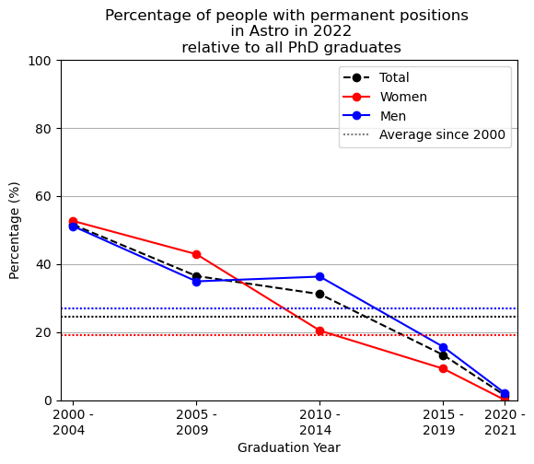
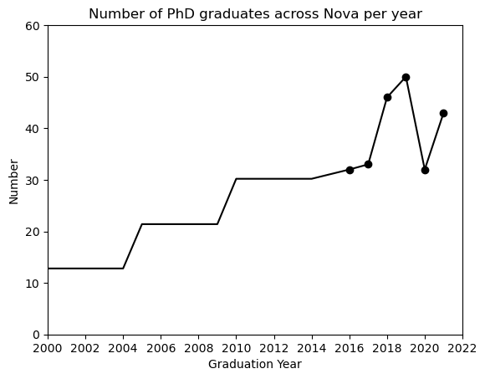
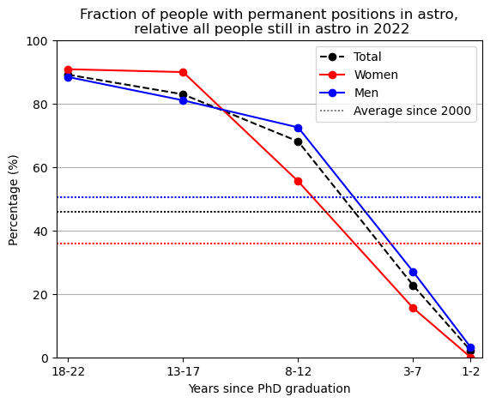
NOVA monitoring survey (2022, n=601)
At least 7 yr post-PhD
At least 8 yr post-PhD
The number of graduates has tripled over the past 20 years.
The fraction of PhD graduates achieving tenure has dropped by 30% (60% for women) over ~10 years.
Of those who have been in astronomy for over 8 years post graduation, 30% are still on temporary contracts (45% for women).
The rest have left academia or are still on temporary contracts.
Notes:
Some notes on these plots: The data was collected in 2022, so ranges only until 2021. My feeling is that things got even worse since after Covid, but of course we cannot prove it with this data The nova PhD data is a bit difficult because it is in 5 year cohorts - so for the first “number of PhD students” I took a yearly average. Since 2016, i also have more detailed data on exact numbers, so I supplemented with that. On the right is the raw data The fraction of people staying in Astro is interesting I think, but maybe hard to interpret. What I think one can see is that since the first cohort, less and less people stay in astro right after finishing their PhD. Also, the fraction of people still in Astro at data collection in 2022 was nearly the same between the youngest and the oldest cohort: i.e., for the fraction of people staying in Astro to be constant over the years, noone from the recent cohort is allowed to leave anymore. As this is unlike, it looks to me like the “fraction of people still in Astro 10yrs after Graduation” is actually dropping significantly. But as we only have the snapshop of 2022, we cannot directly prove that. For the percentage of women, I supplemented the cohort data also with staff data from the Nova 2019-2021 report and plotted the Dutch and EU parliament for comparison Finally, the percentage of people with permanent positions. I played a bit with the x-labels as well, e.g. shifting it to “years since graduation’ and also with a normally increasing x-axis. However, I am not sure that is really true to the data, as one dot of course represents and average over the 5 years of the cohort. Have a look what you think is sensible. The other problem here is that while all these people did all graduate from a uni in the Netherlands, we have no clue where their current jobs are - tentatively, it looks like right after their PhD ~30% find a job in the Netherlands, another 20-30% in the rest of Europe. But this includes people leaving academia and the data only exists for 2 cohorts in the last 10 years.
I will update the “number of phd graduates” plot when/if I get data on the number of staff at nova over the same time period.

Slide 5

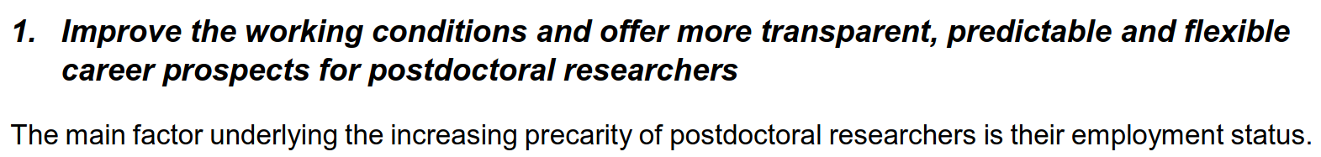
Similar reports from all 38 OECD countries, one recommendation:
*apply to all temporary scientific staff

Slide 6
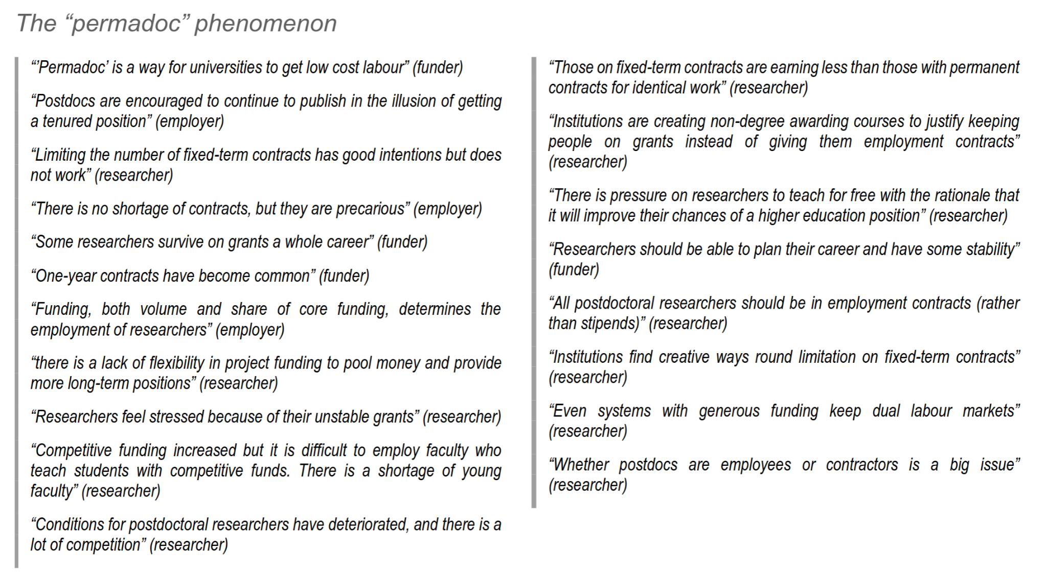

Slide 7
You are part of the matter to be discussed.
This is a political discussion, not a scientific one.
Your story is a valuable data point in the discussion.
Your story is a data point that may or may not be representative.
It is less about searching for a ground truth, and more about integrating perspectives.
The debate revolves around values, priorities, and collective decisions.

Slide 8
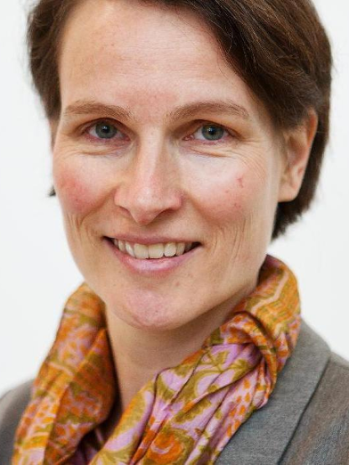
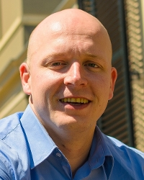
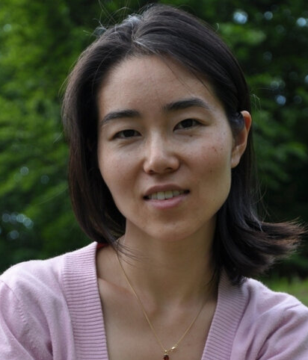
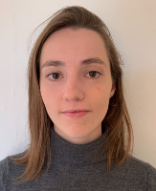
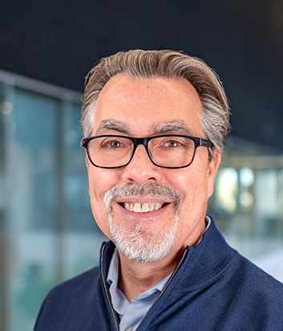
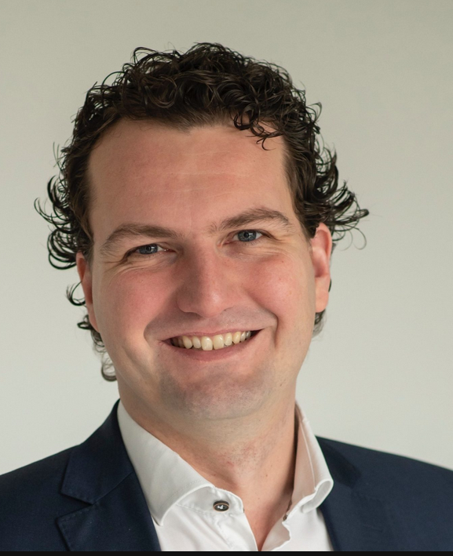
Come discuss with us!
Interactive splinter session tomorrow at 11:00!
… with panel discussion! Moderated by Joe Callingham
Marijke Haverkorn (RU)
Arnout
van Ree (FNV)
Shoko
Jin
(RUG)
Emily
Sandford
(Leiden)
Michael
Wise
(NOVA)
Ralf
Boland
(NWO)

