Slide 1
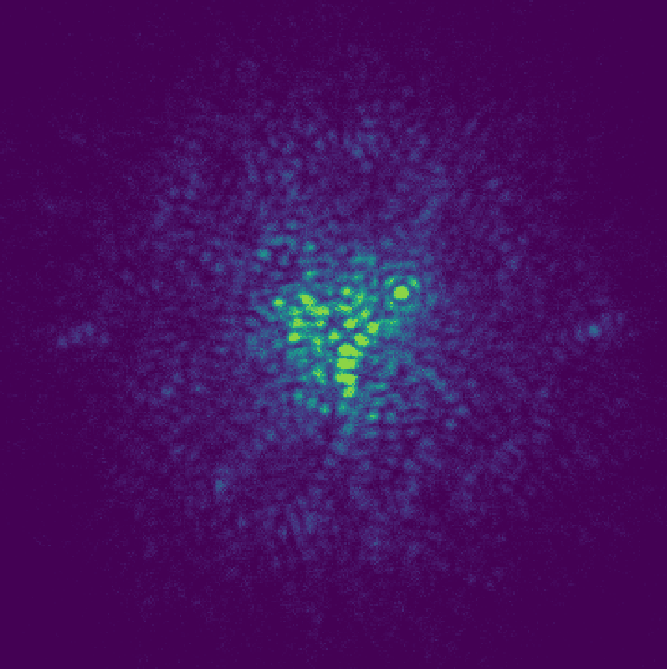

On-sky dark hole digging
with the Self-Coherent Camera
Elena Tonucci,
S. Haffert, M. Mars, R. Landman, & MagAO-X team
12/05/2026 - NAC 2026

Slide 2
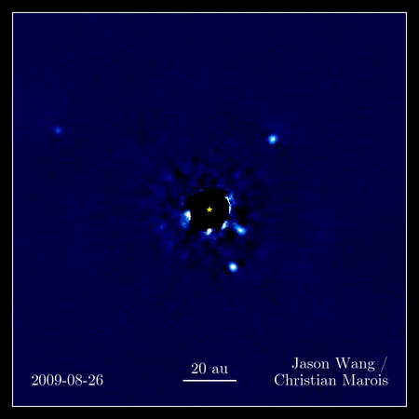

The challenges of direct imaging
CORONAGRAPHY
Contrast
Separation (diffraction $\sim \frac{λ}{D}$ )
+ Wavefront aberrations: 1) Atmospheric turbulence (ground) 2) Non-common path (ground and space)
WAVEFRONT SENSING & CONTROL
Elena Tonucci | tonucci@strw.leidenuniv.nl
2

Slide 3


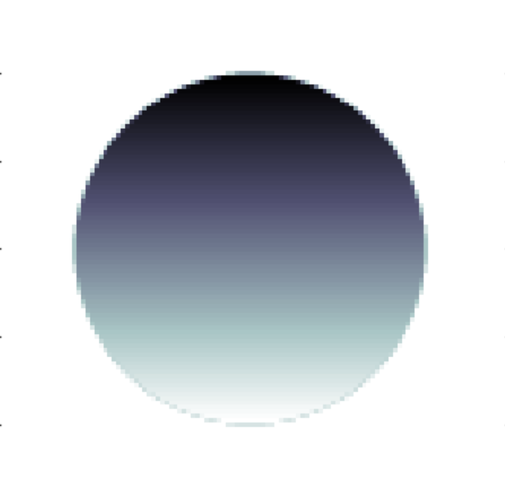
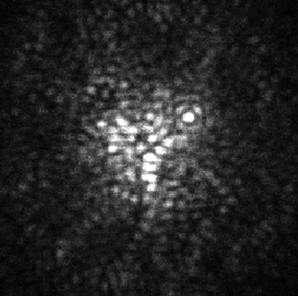
Fast Atmospheric Self-Coherent Camera Technique (FAST)
Aperture
stop
Lyot stop
with pinhole
Deformable
mirror
Focal plane mask
Science plane
Alpha Eridani A + B
Great fun with fringes!
Elena Tonucci | tonucci@strw.leidenuniv.nl
3

Slide 4
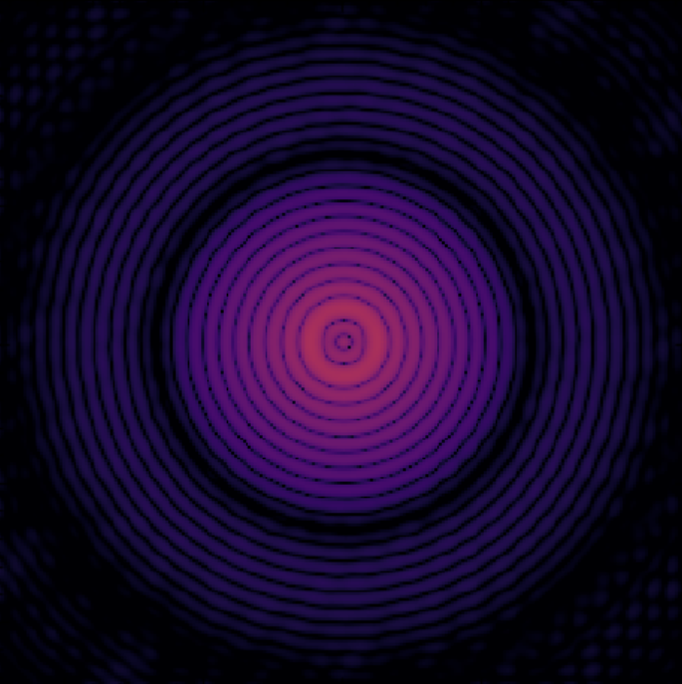
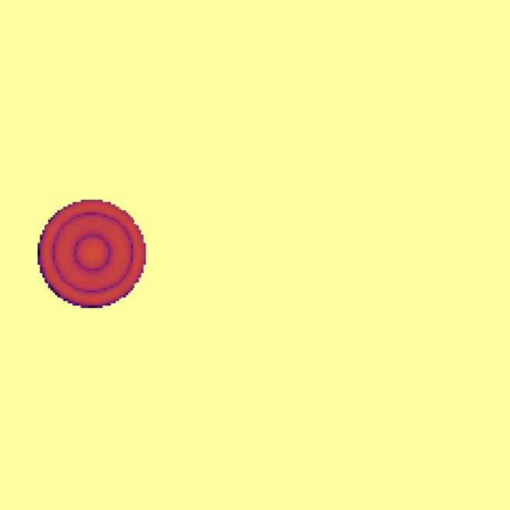
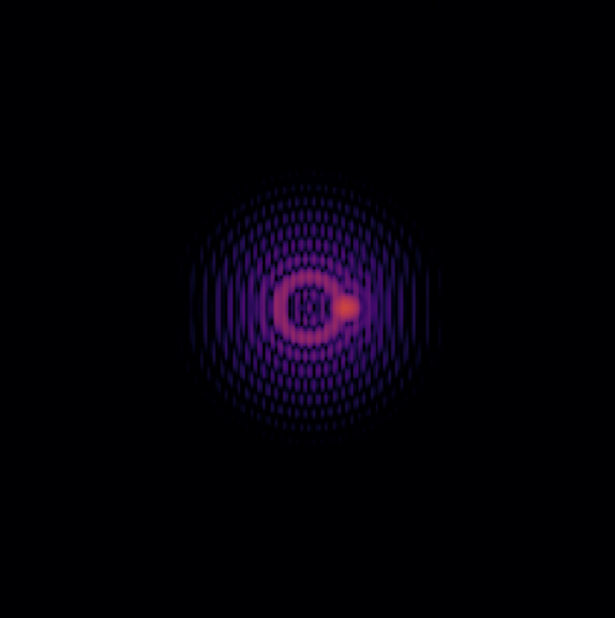
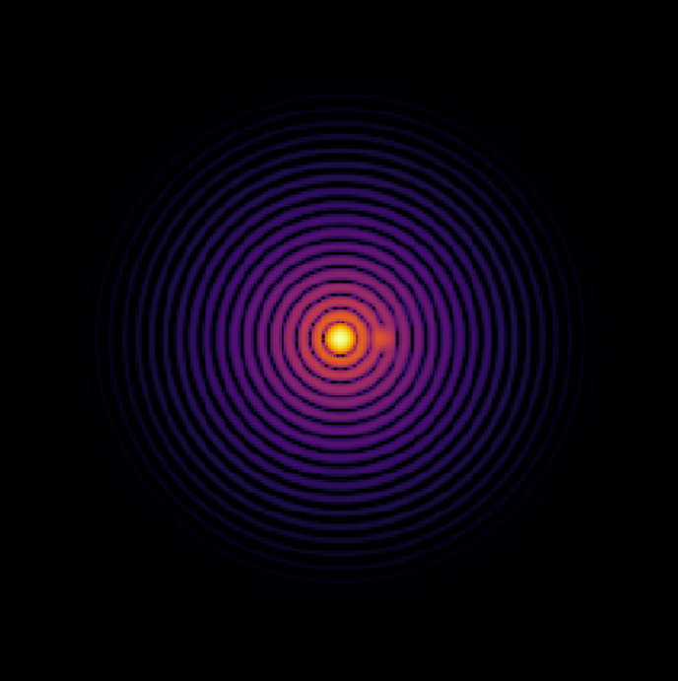
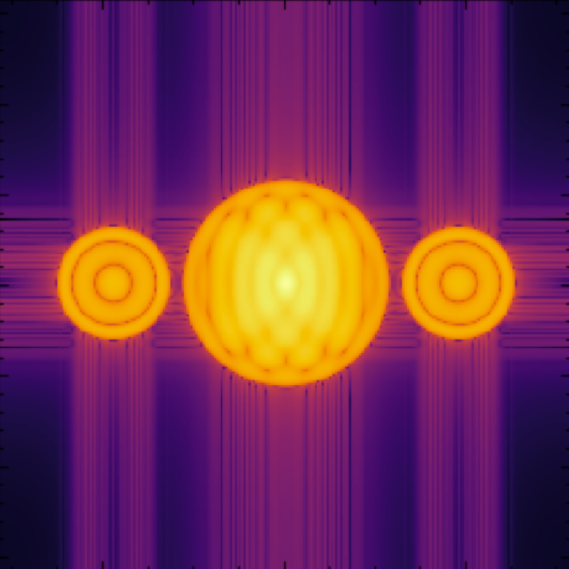
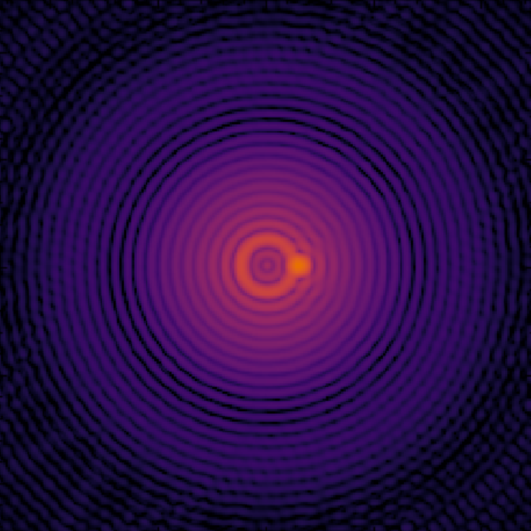
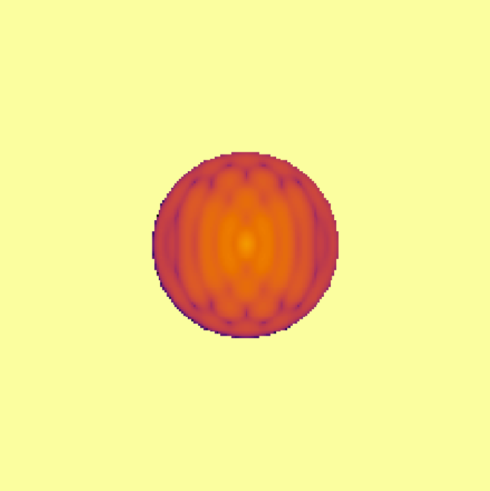


Side band extraction
$${|E}_{S}||E_{R}|$$
$$I={\left|E_{S}\right|}^{2}+{\left|E_{C}\right|}^{2}+{\left|E_{R}\right|}^{2}+2Re\{E_{S}E_{R}^{∗}e^{\frac{i2π\overset{⃑}{x}ε}{λ}}\}$$
ift
OTF
ft
ift
$${\left|E_{S}\right|}^{2}+{\left|E_{C}\right|}^{2}+{\left|E_{R}\right|}^{2}$$
Elena Tonucci | tonucci@strw.leidenuniv.nl
4

Slide 5
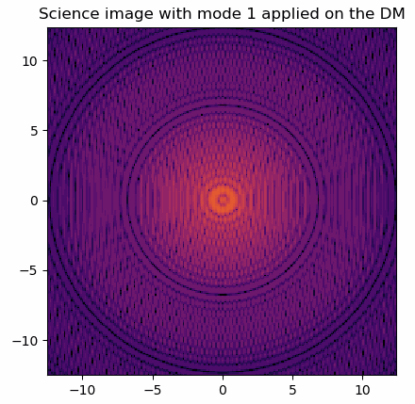
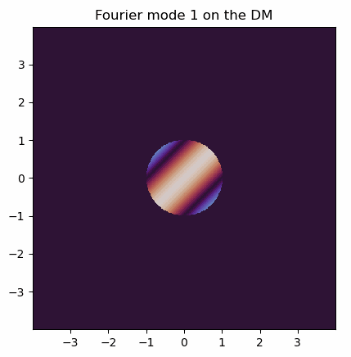
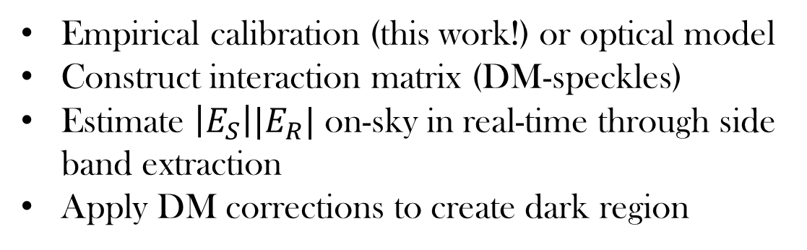
Calibration & wavefront sensing and control
Empirical calibration (this work!) or optical model
Construct interaction matrix (DM-speckles)
Estimate $\left|E_{S}\right||E_{R}|$ on-sky in real-time through side band extraction
Apply DM corrections to create dark region
Elena Tonucci | tonucci@strw.leidenuniv.nl
5

Slide 6
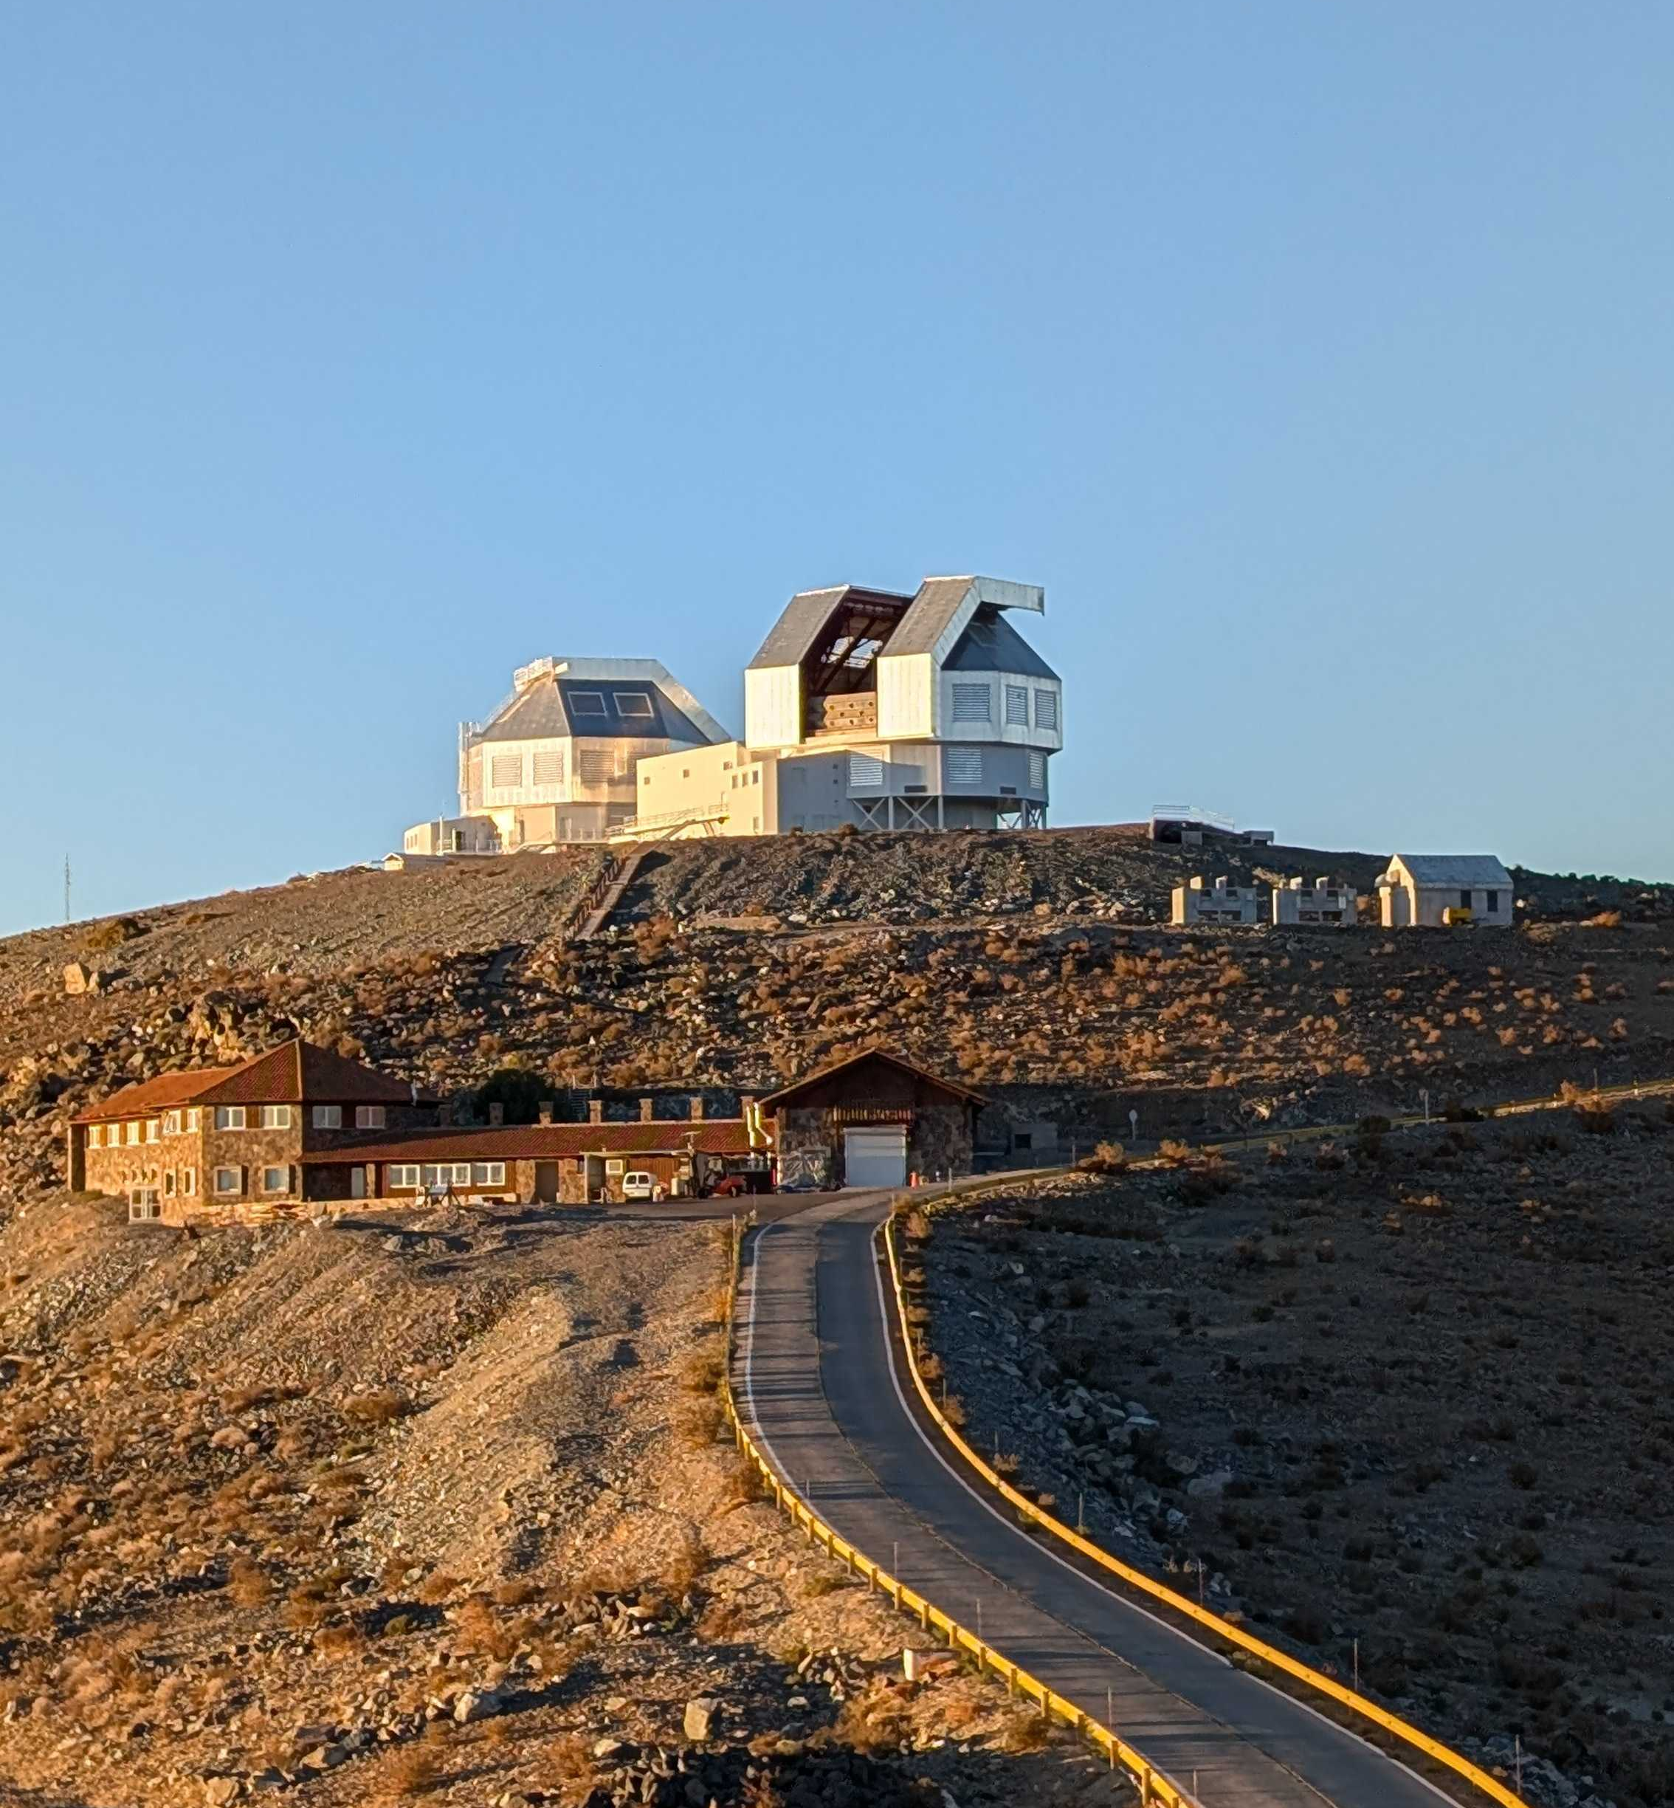

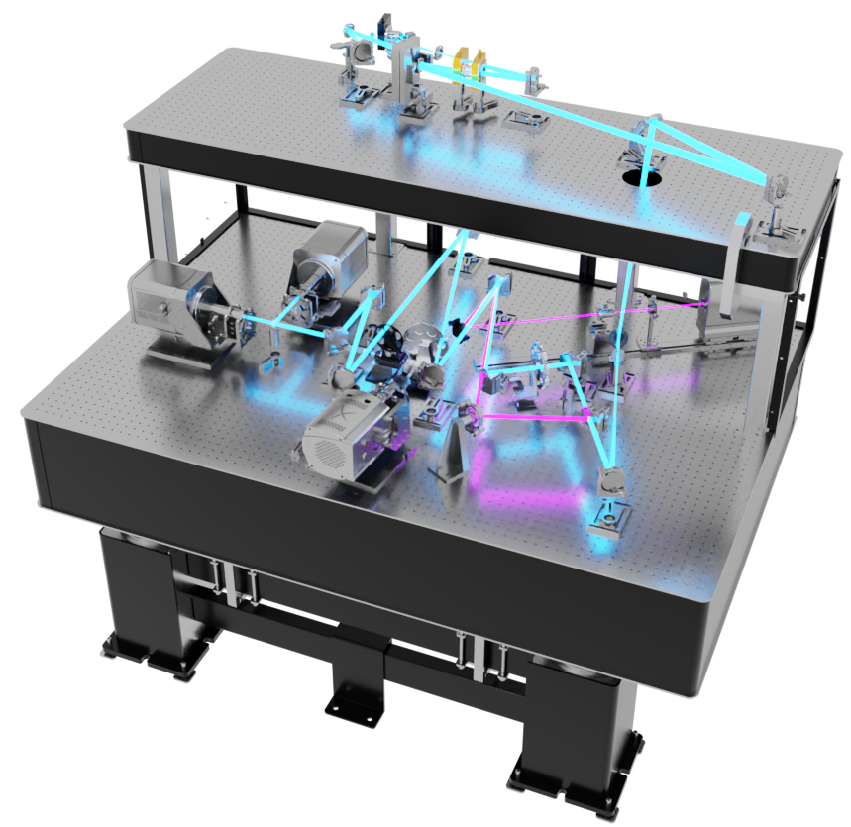
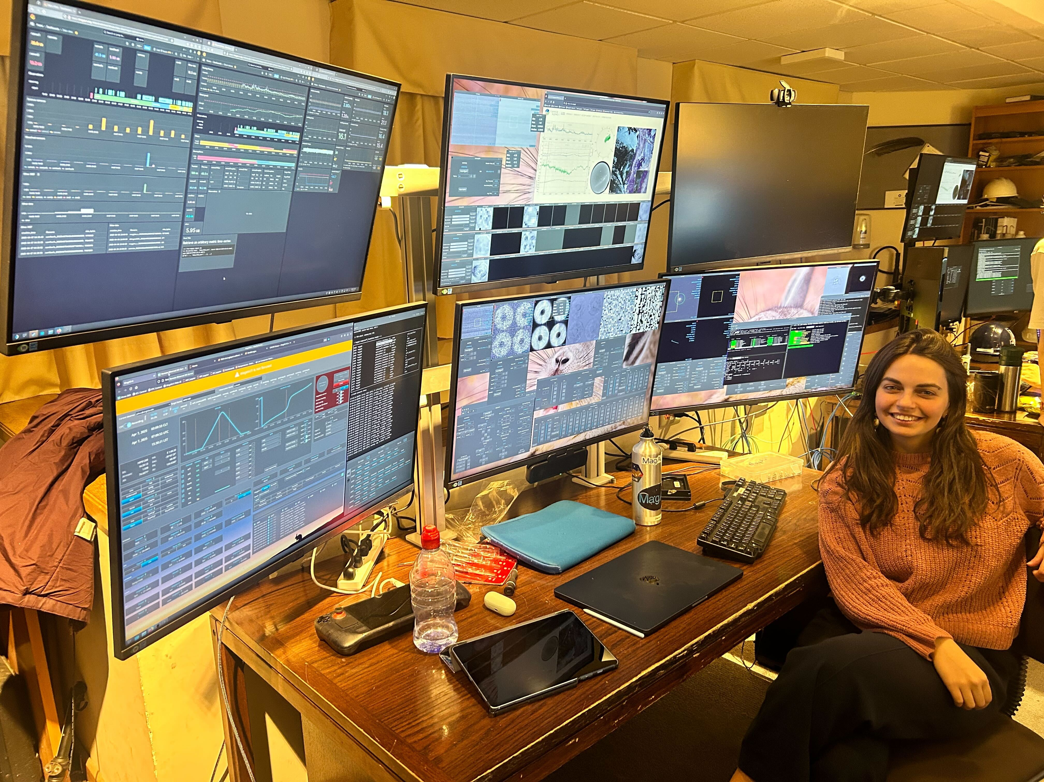
Extreme AO at Las Campanas Observatory
Credit: J. Long
Elena Tonucci | tonucci@strw.leidenuniv.nl
6

Slide 7
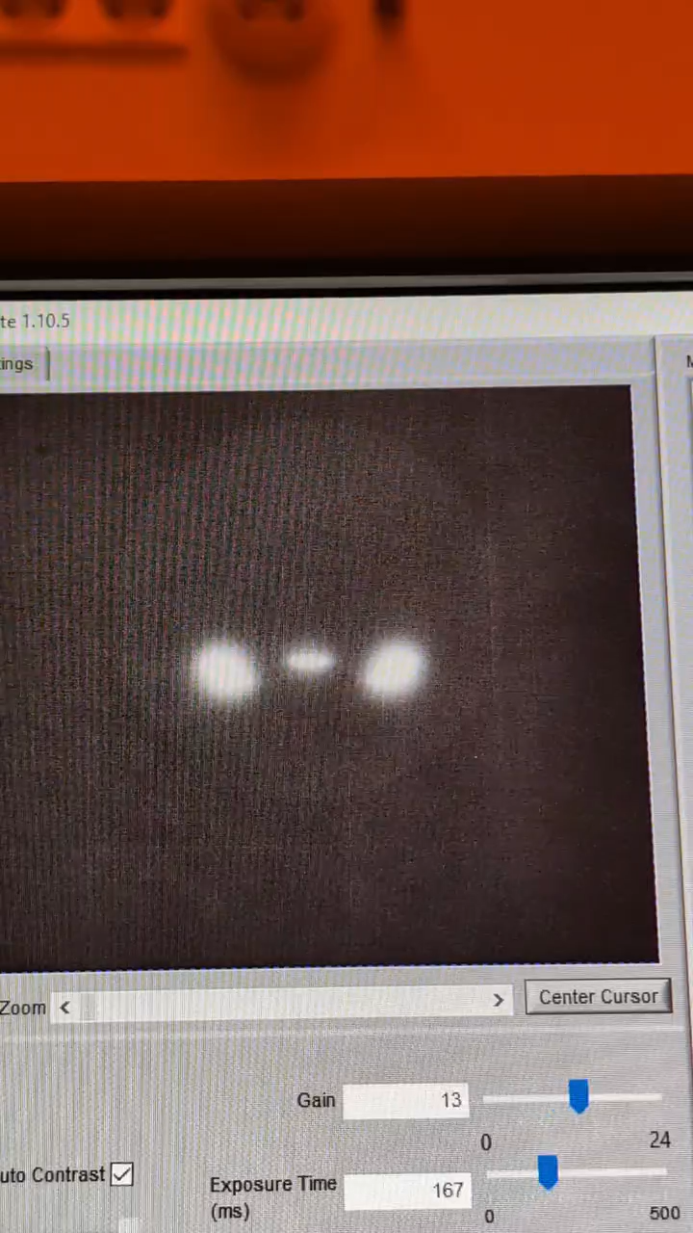
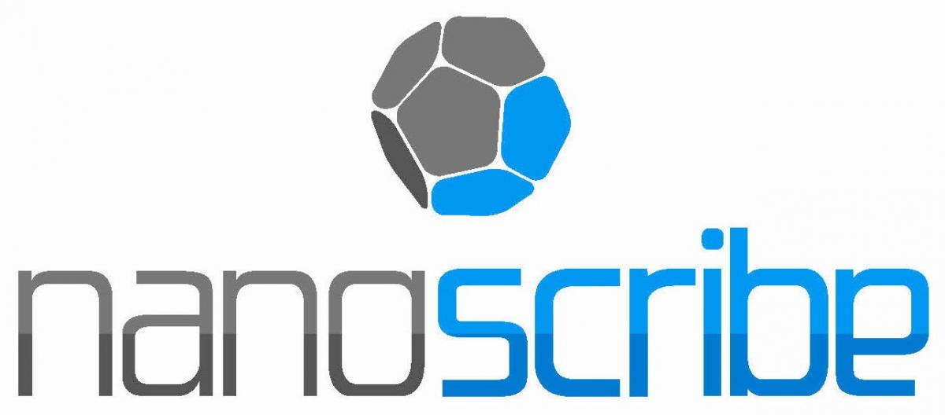
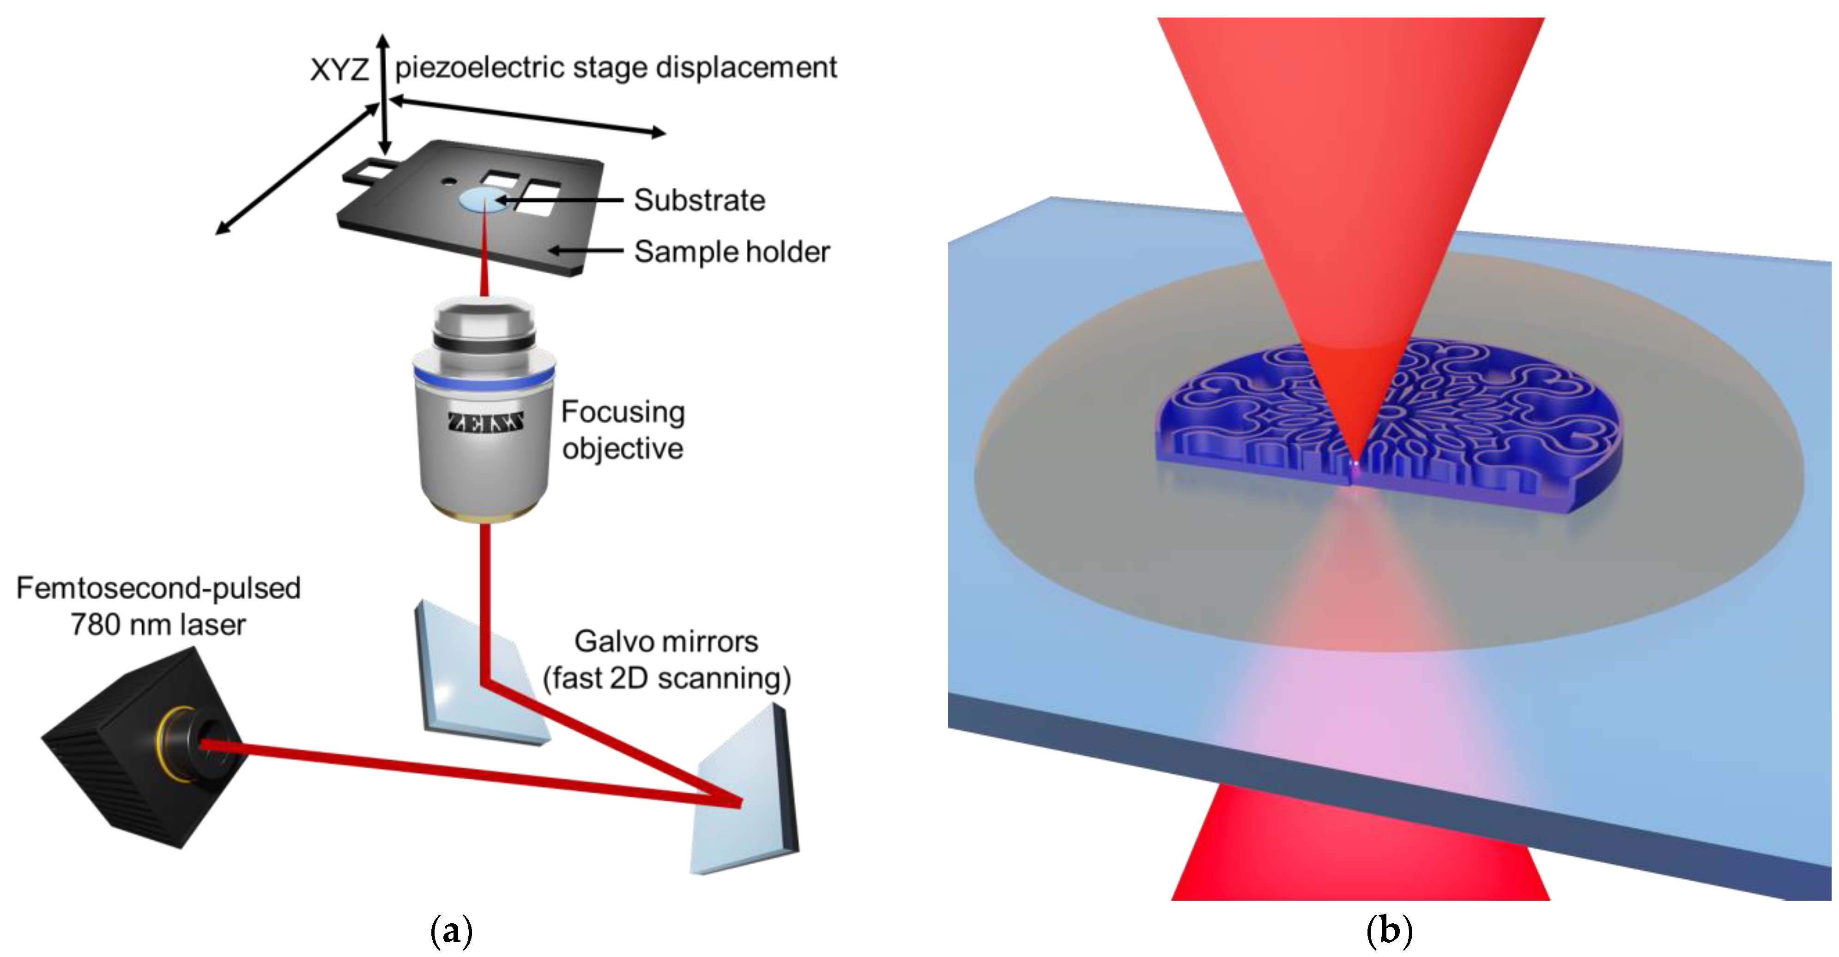
Manufacturing
Bunea+2021
Elena Tonucci | tonucci@strw.leidenuniv.nl
7

Slide 8
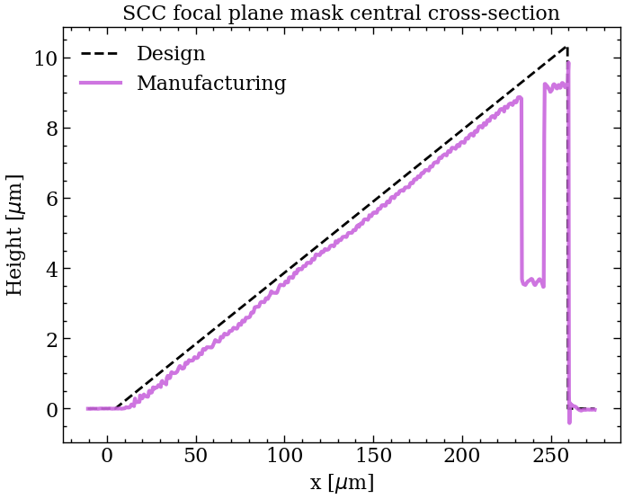
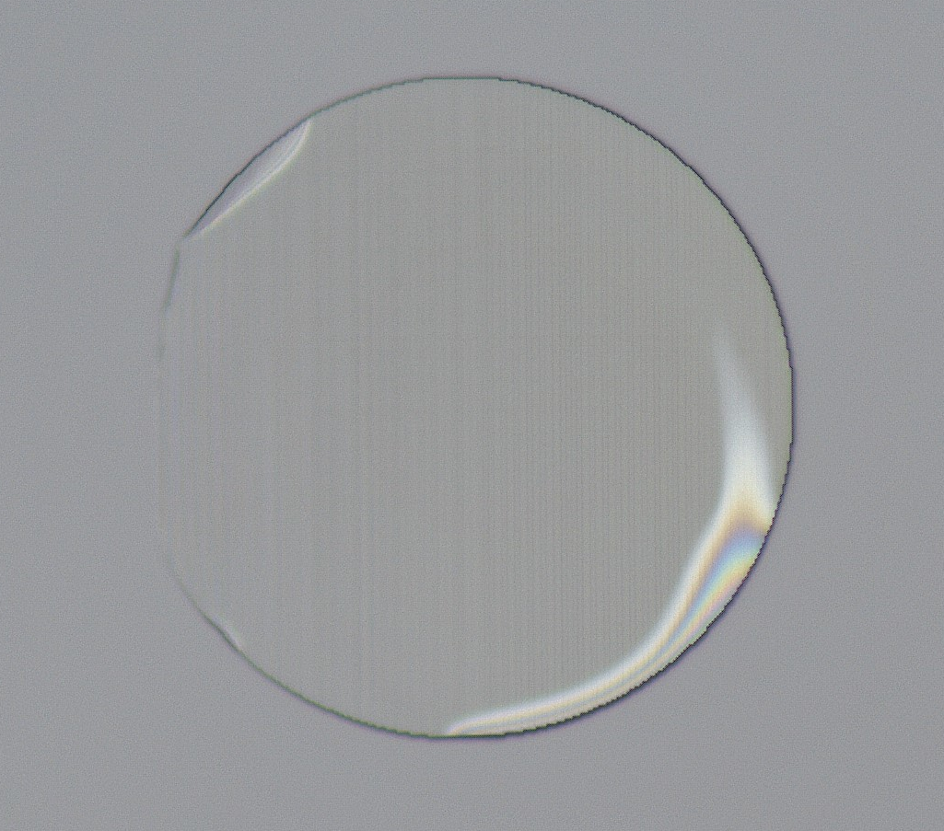
FAST focal plane mask
Tonucci+ in prep
Elena Tonucci | tonucci@strw.leidenuniv.nl
8

Slide 9
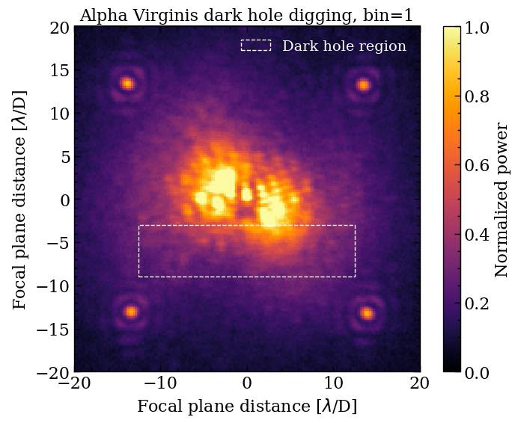
Creating a dark region
Diggy diggy hole
Tonucci+ in prep
Elena Tonucci | tonucci@strw.leidenuniv.nl
9

Slide 10
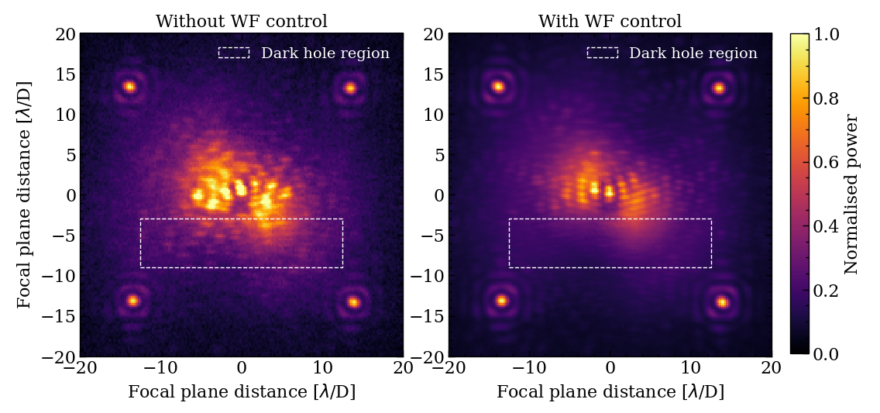
Alpha Virginis without and with WF control
Alpha Virginis (Spica)
Tonucci+ in prep
Elena Tonucci | tonucci@strw.leidenuniv.nl
10

Slide 11
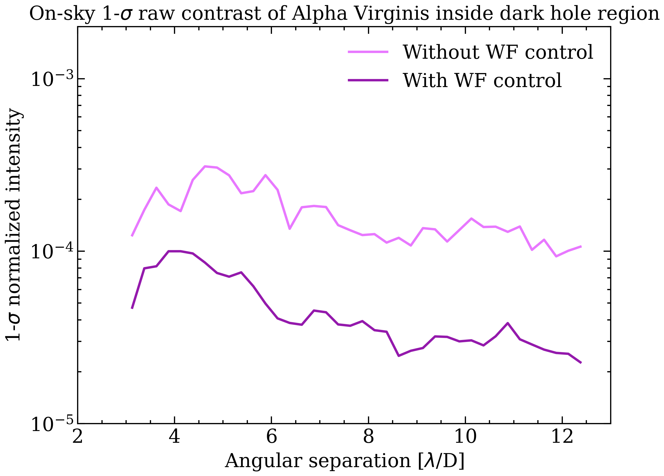
Alpha Virginis closed loop contrast
Tonucci+ in prep
Elena Tonucci | tonucci@strw.leidenuniv.nl
11

Slide 12
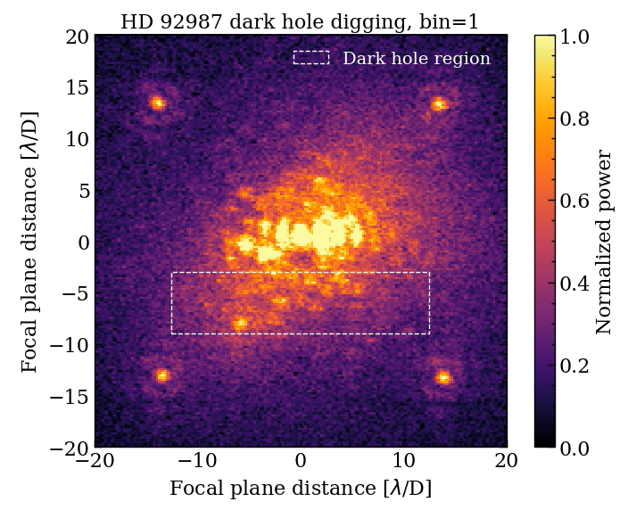
Diggy diggy hole
Tonucci+ in prep
Elena Tonucci | tonucci@strw.leidenuniv.nl
12

Slide 13
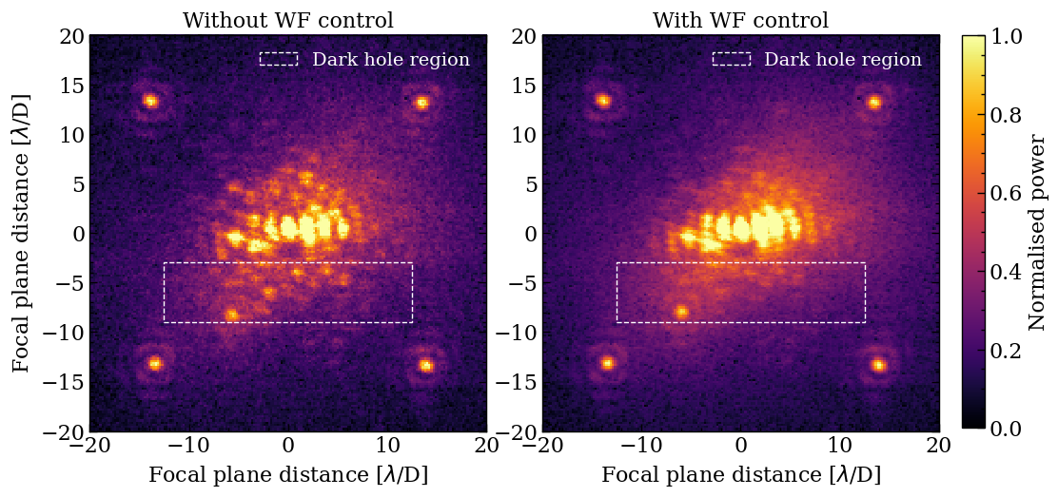
HD 92987 without and with WF control
HD 92987
Tonucci+ in prep
Elena Tonucci | tonucci@strw.leidenuniv.nl
13

Slide 14
FAST as a post-processing differential imaging technique
But why not trying the funky and trendy
forward modeling??
Inverse modeling
(side band extraction):
Further suppress stellar speckles, and isolate companion term
Wiggle star and planet separately until model matches the data + fit anything in the system
Elena Tonucci | tonucci@strw.leidenuniv.nl
14

Slide 15
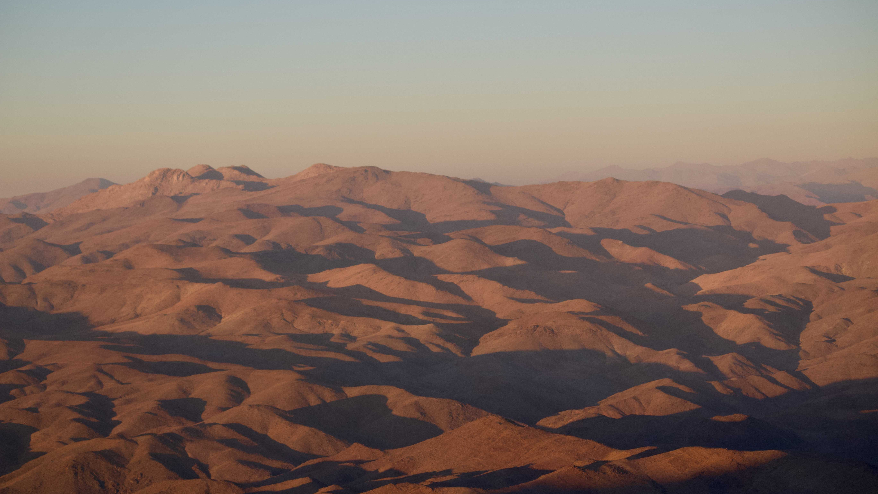

Conclusions
Wavefront sensing and control is of outmost importance for high-contrast imaging both on ground and in space -> Developing new technologies
We have demonstrated FAST closed-loop on sky for the *first* time ever!
Further enhance contrast and detect companions with FAST in post-processing
Merging best coronagraphs and best wavefront sensing techniques, in preparation for ELT!
Elena Tonucci | tonucci@strw.leidenuniv.nl
15

Slide 16
Extra slides

Slide 17
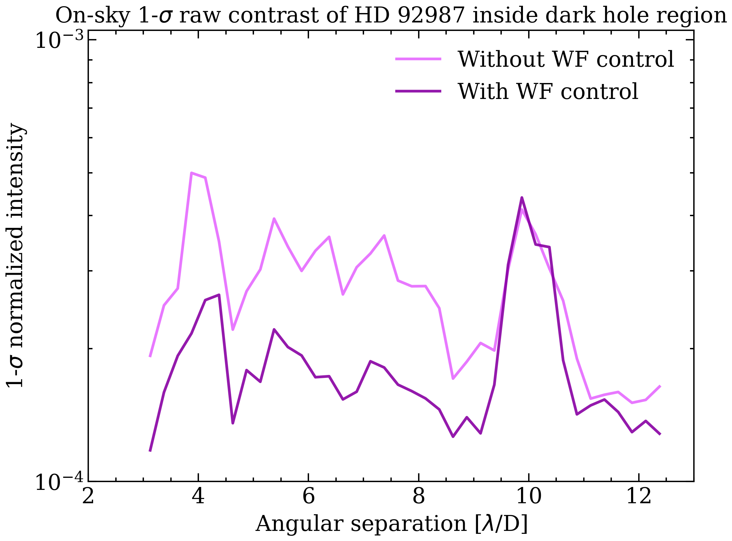
HD 92987 closed loop contrast
Tonucci+ in prep
Elena Tonucci | tonucci@strw.leidenuniv.nl

Slide 18
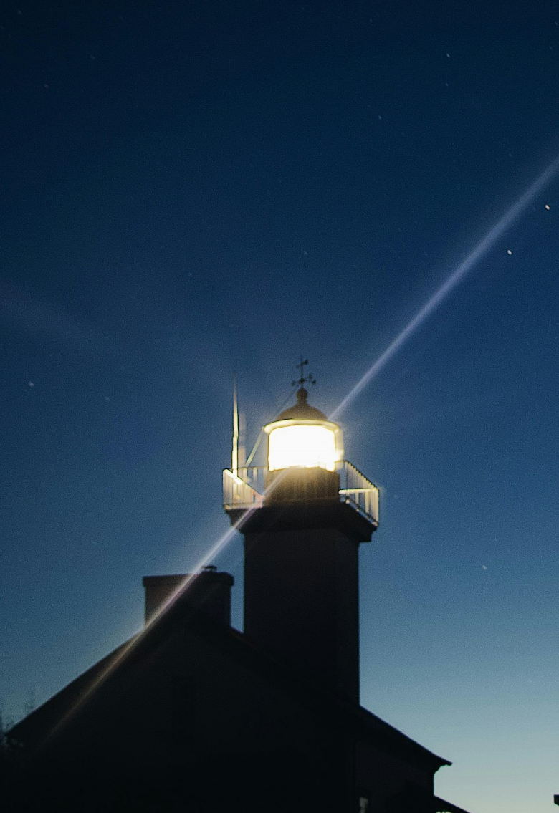
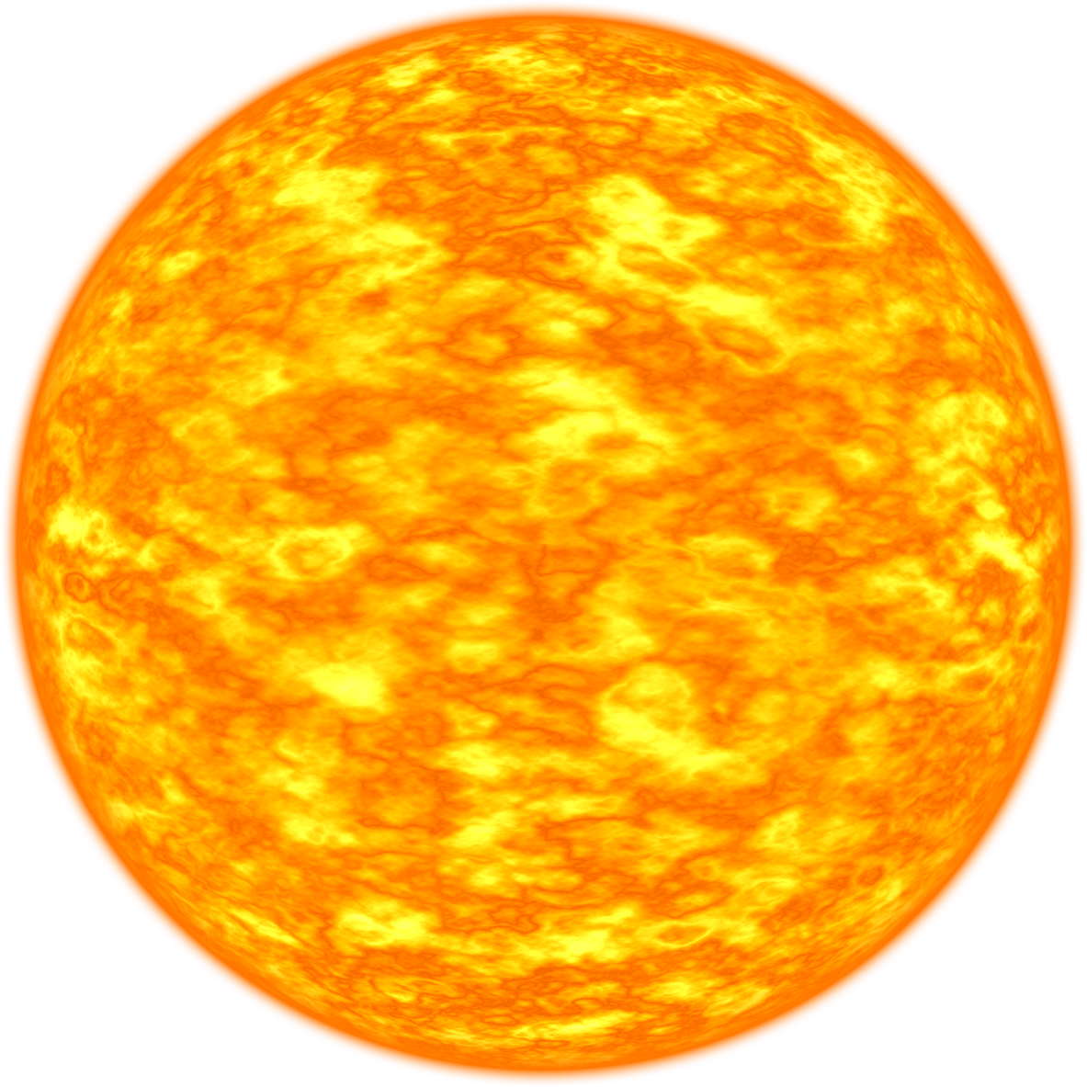
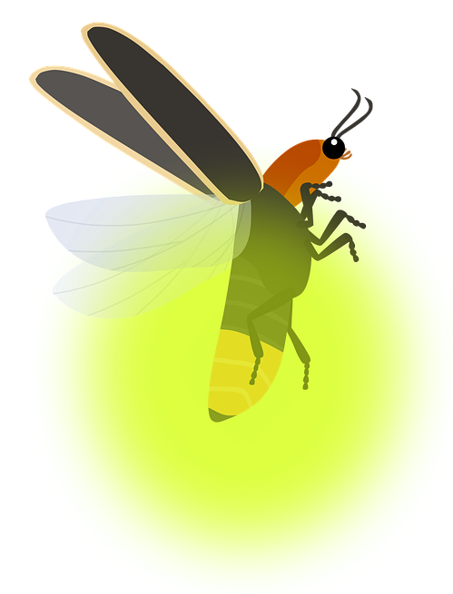
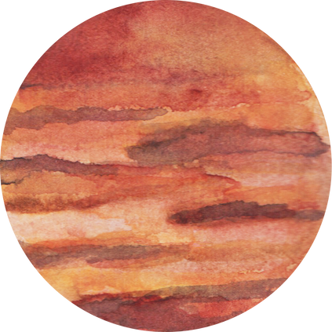
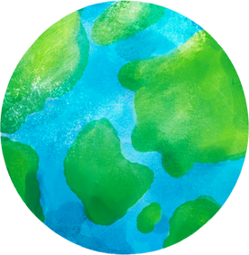



Contrast and separation
$${\sim 10}^{−6}$$
$${\sim 10}^{−10}$$
$$\sim \frac{λ}{D}$$
Elena Tonucci | tonucci@strw.leidenuniv.nl

Slide 19
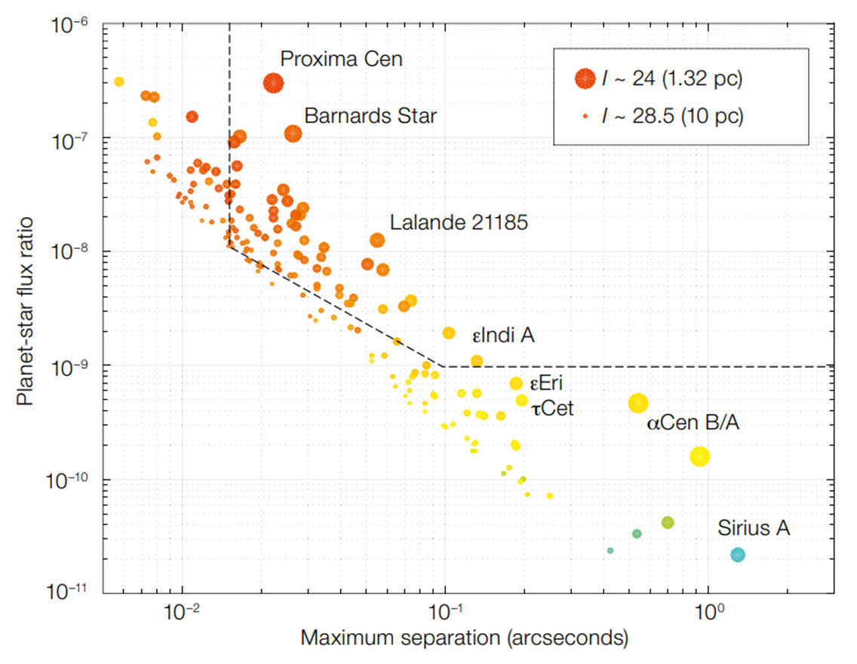
Where are we at?
With coronagraphs operating at the diffraction limit!
Current MagAO-X
MagAO-X goal
ELT-PCS goal
Kasper+2021
Elena Tonucci | tonucci@strw.leidenuniv.nl

Slide 20
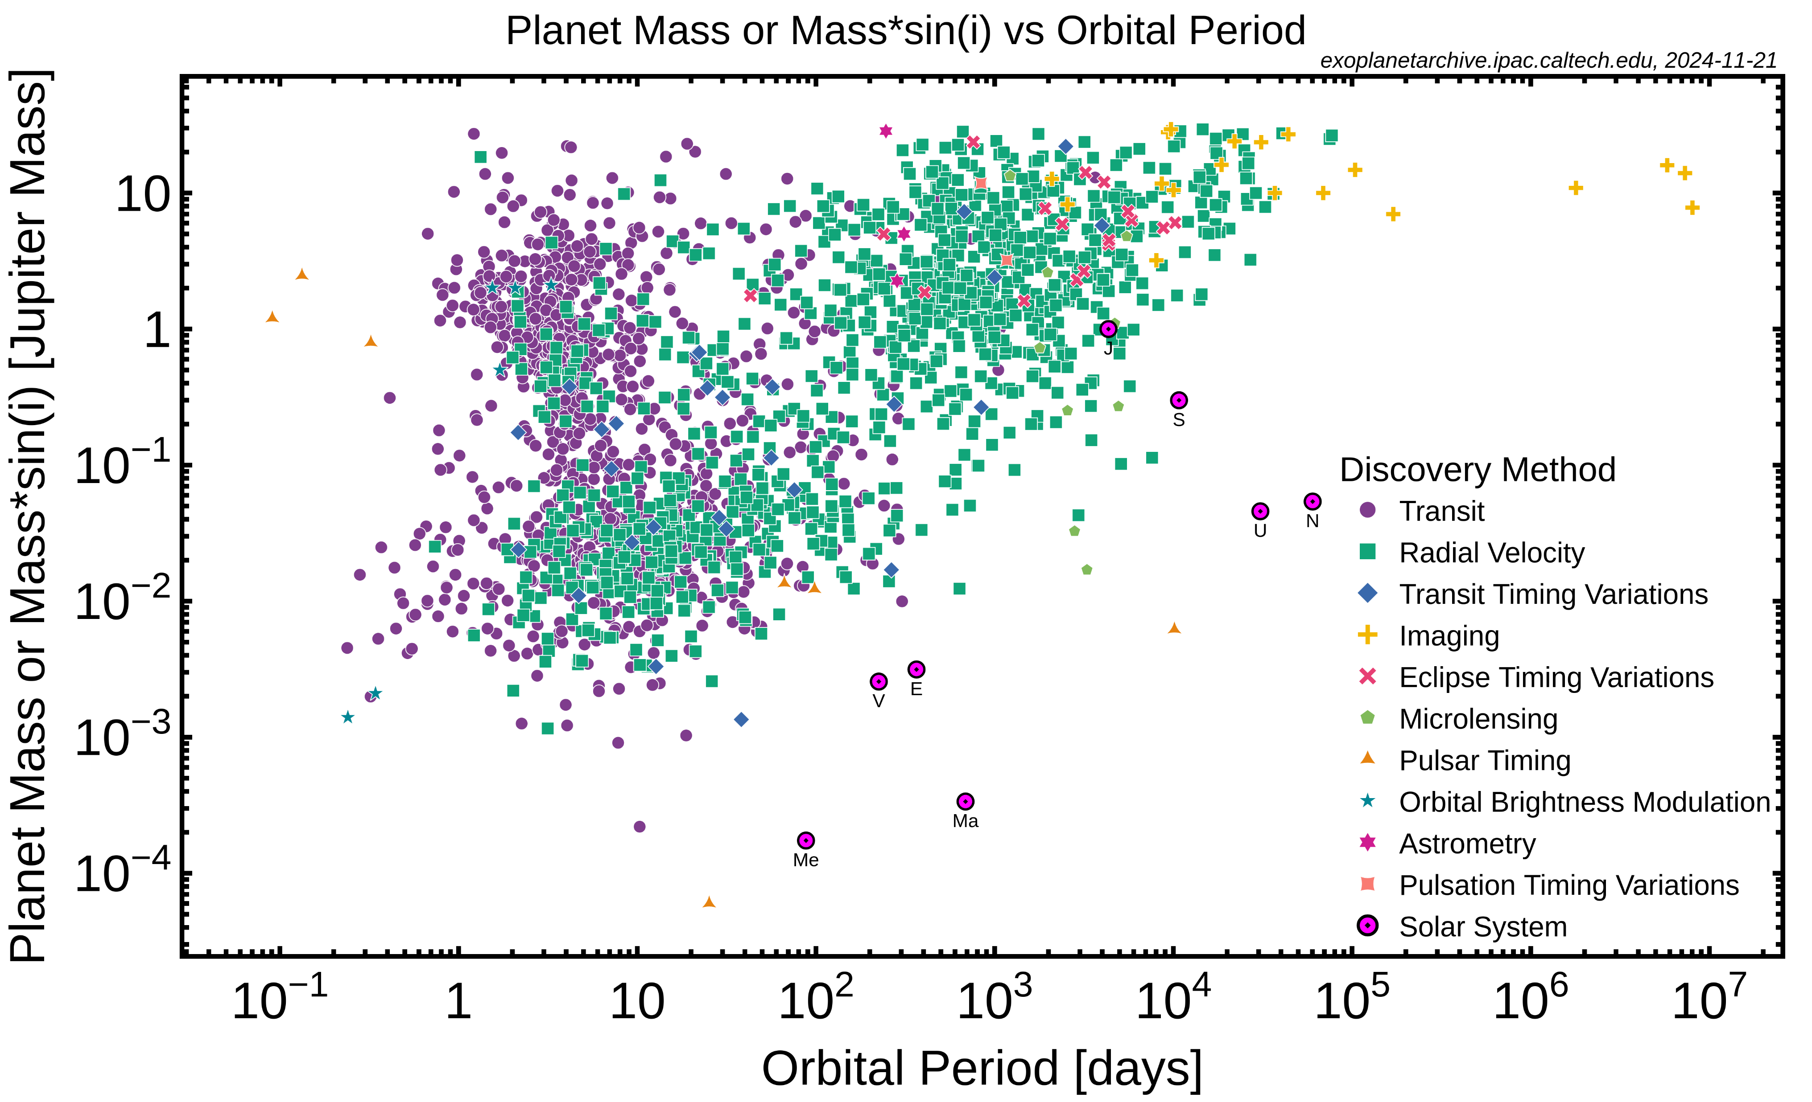
Current exoplanets
Elena Tonucci | tonucci@strw.leidenuniv.nl

