Slide 1


The SED of YSES 1 b and its circumplanetary disk
Michiel Darcis | 4th year PhD candidate
Thanks to: S. Haffert, T. Stolker, R. van Capelleveen, M. Kenworthy, P. de Visser, MagAO-X team

Slide 2
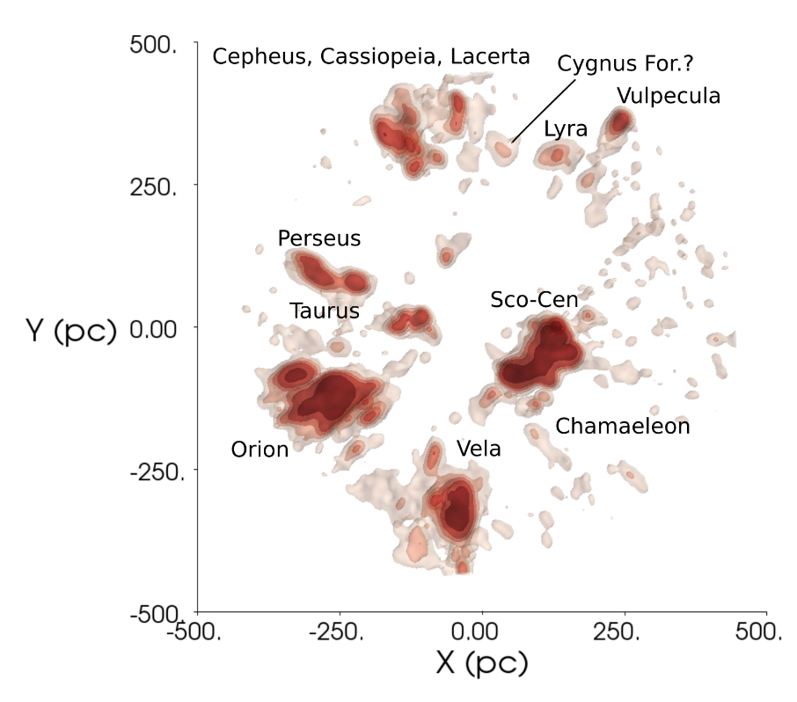
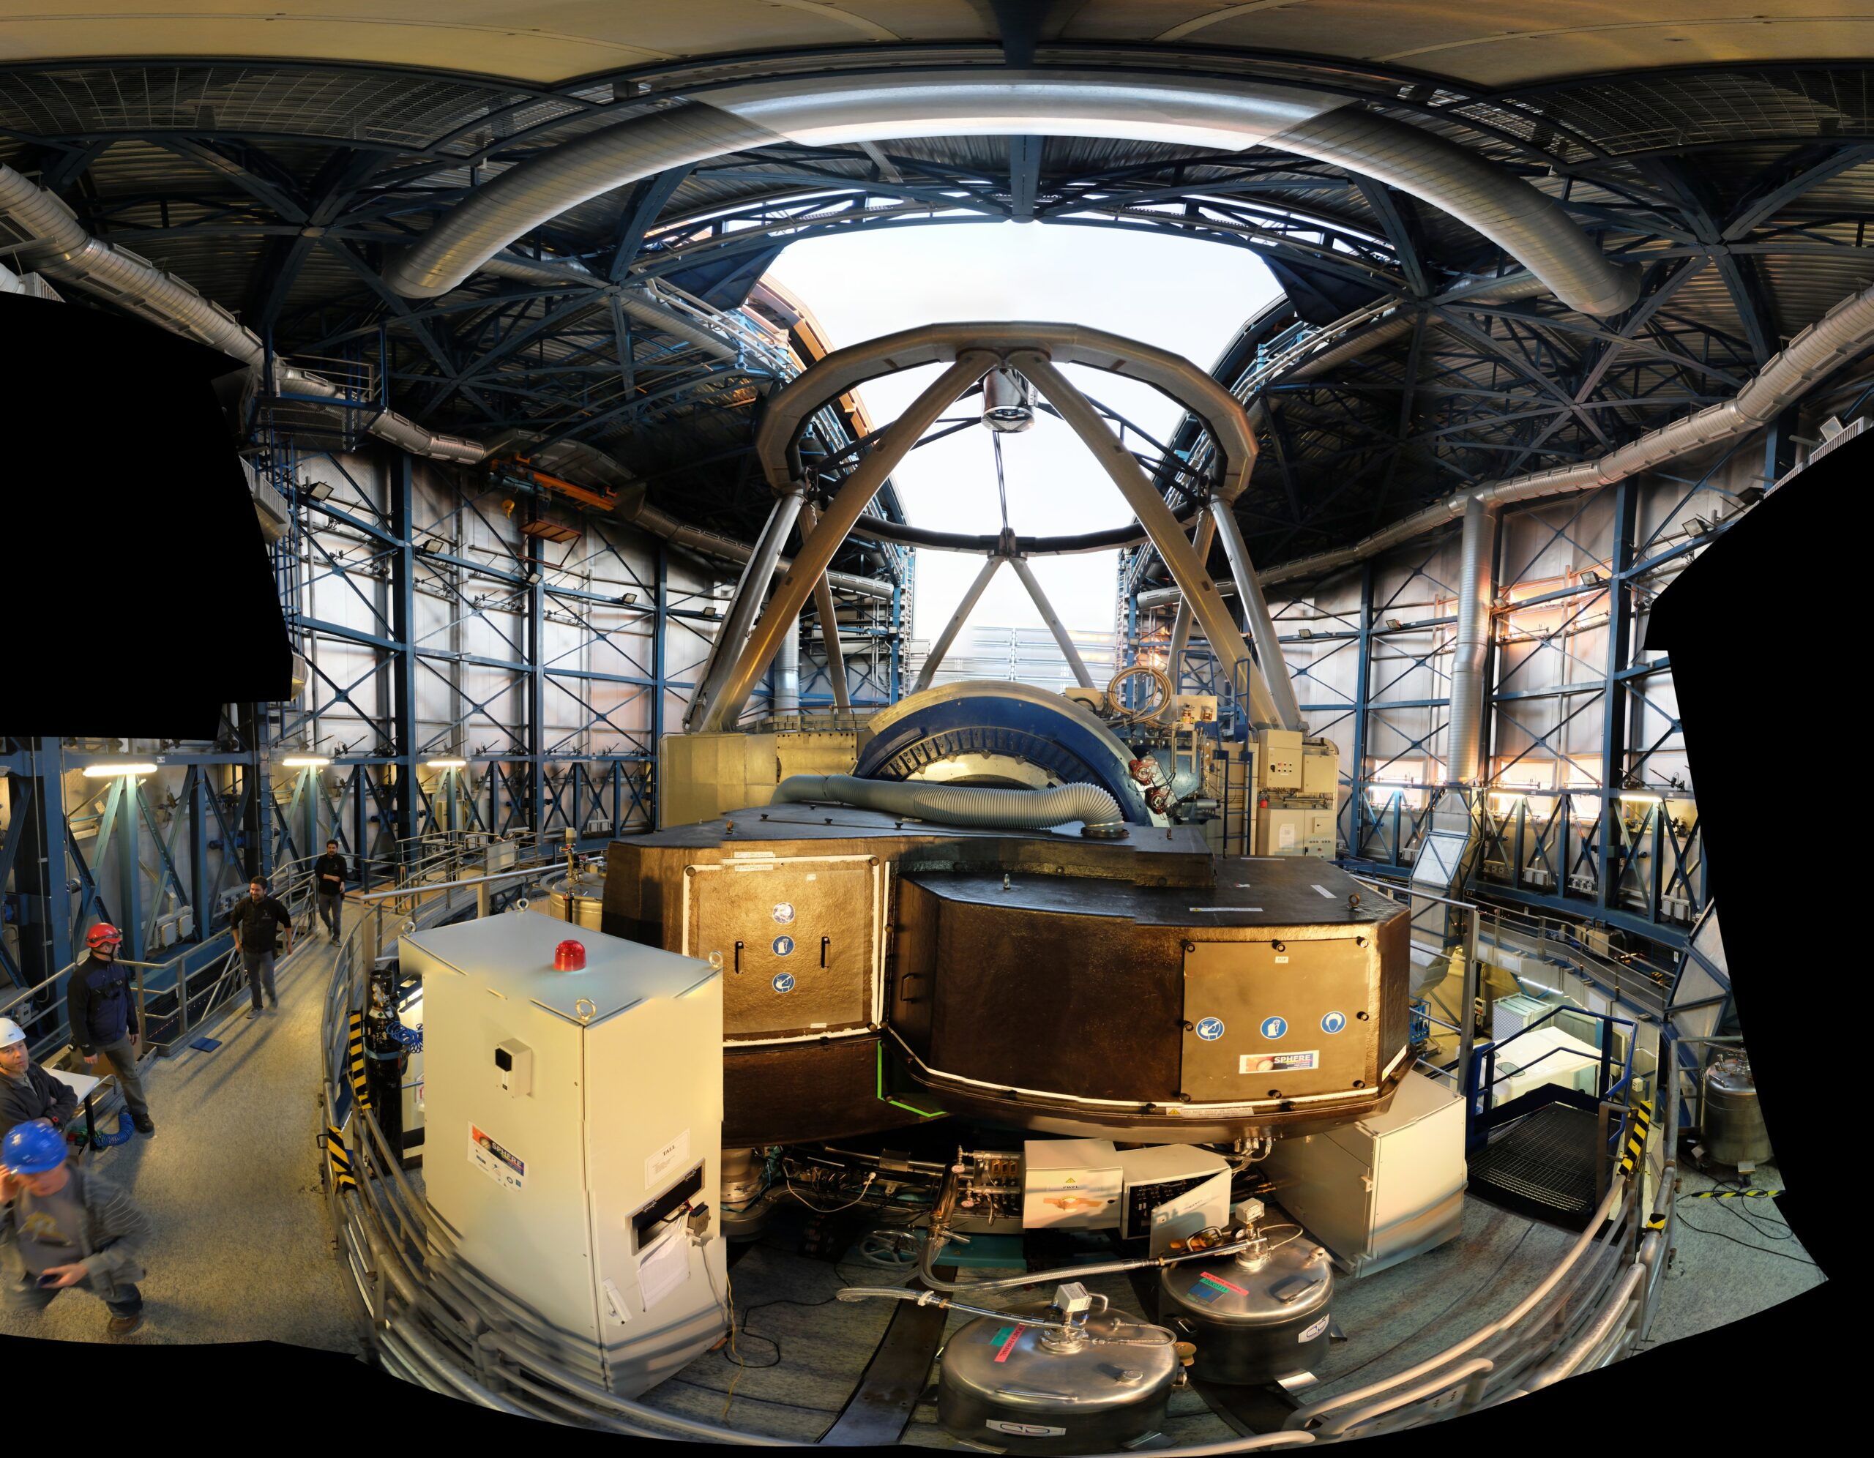

YSES: Young Sun Exoplanet Survey
Statistics of giant substellar companions on wide orbits around solar type stars
Direct imaging → Young objects
VLT/SPHERE
70 targets chosen
14 – 17 Myr
Zari et al. (2018)
LAM

Slide 3
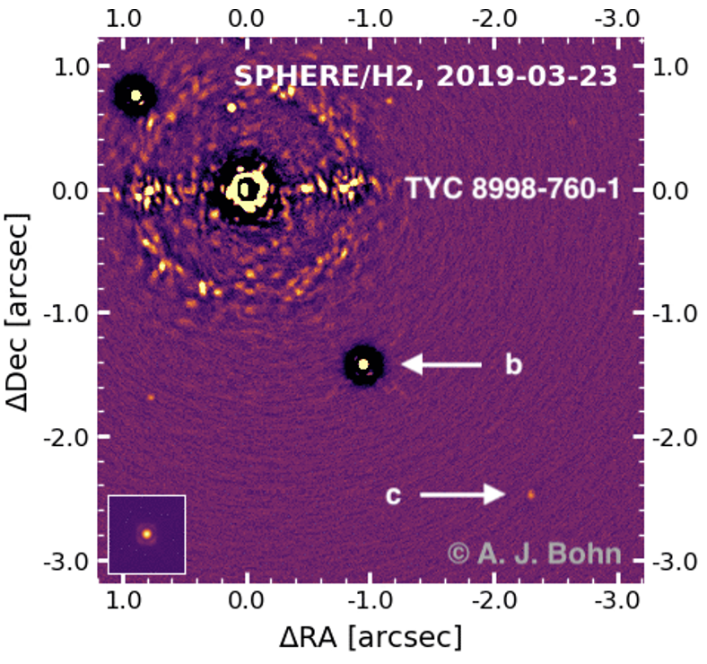
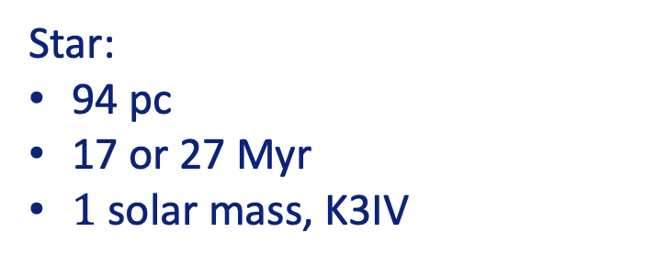
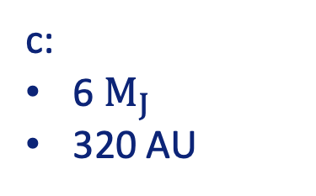
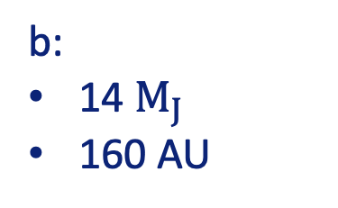
YSES 1 system
Star:
94 pc
17 or 27 Myr
$1$solar mass, K3IV
b:
14 $M_{J}$
160 AU
c:
6 $M_{J}$
320 AU

Slide 4
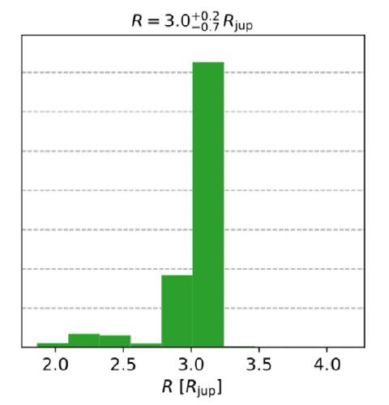


YSES 1 b problem
BT-Settl model
Why is it so big?
Expected: $\sim$1-1.5 $R_{J}$
Fit: $\sim 3 R_{J}$
Bohn et al. (2020)

Slide 5
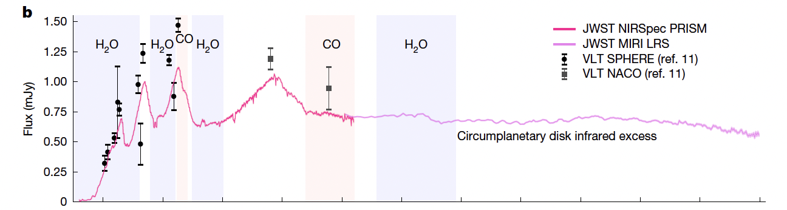
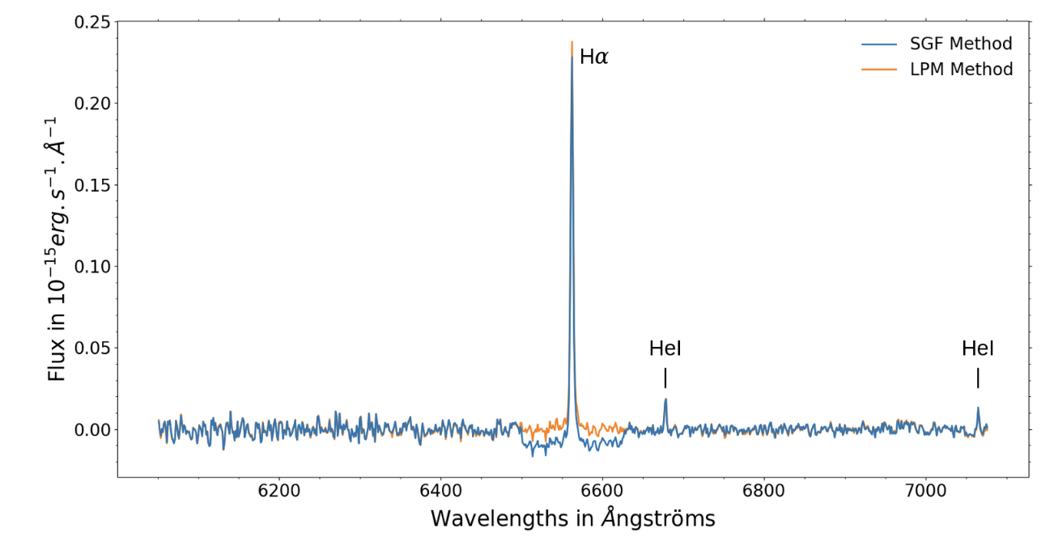
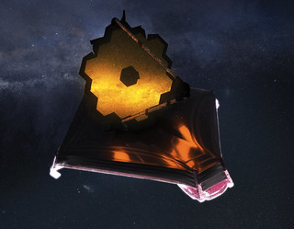
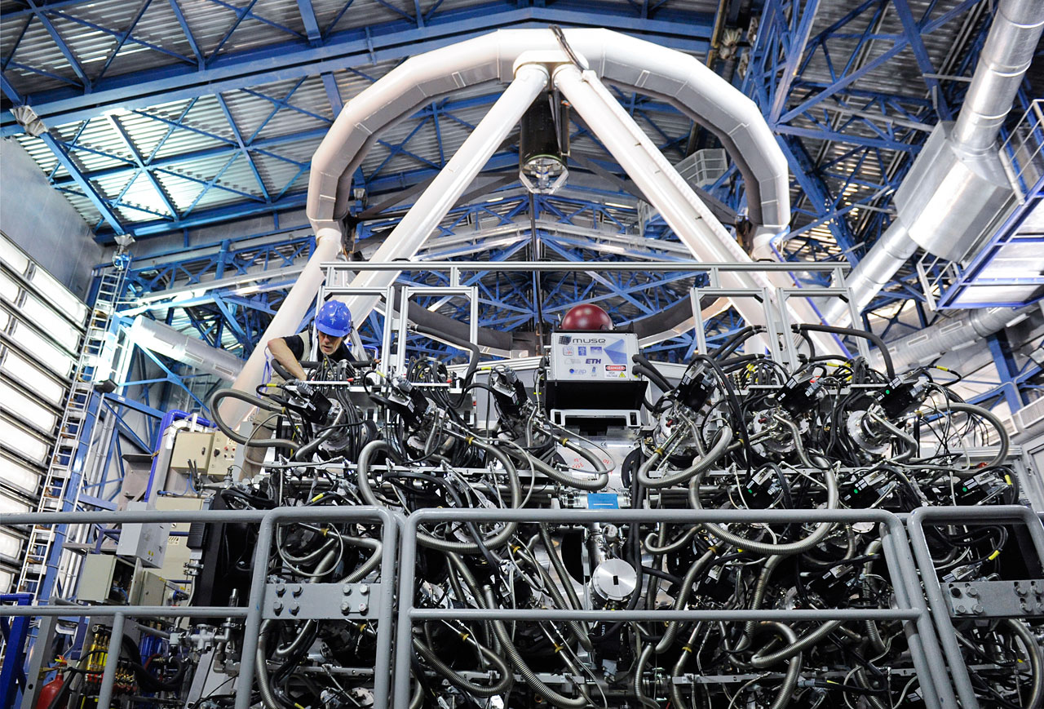


Progessive insight
Infrared excess
$Hα$ emission
Julo et al. (2025)
Hoch et al. (2025)
JWST
$$VLT/MUSE$$
ESO

Slide 6
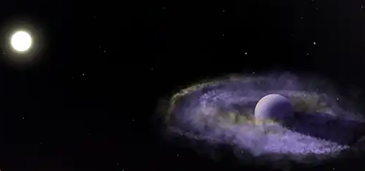
Circumplanetary disk
Ellis Bogat
Need to revisit the original modelling of YSES 1 b

Slide 7
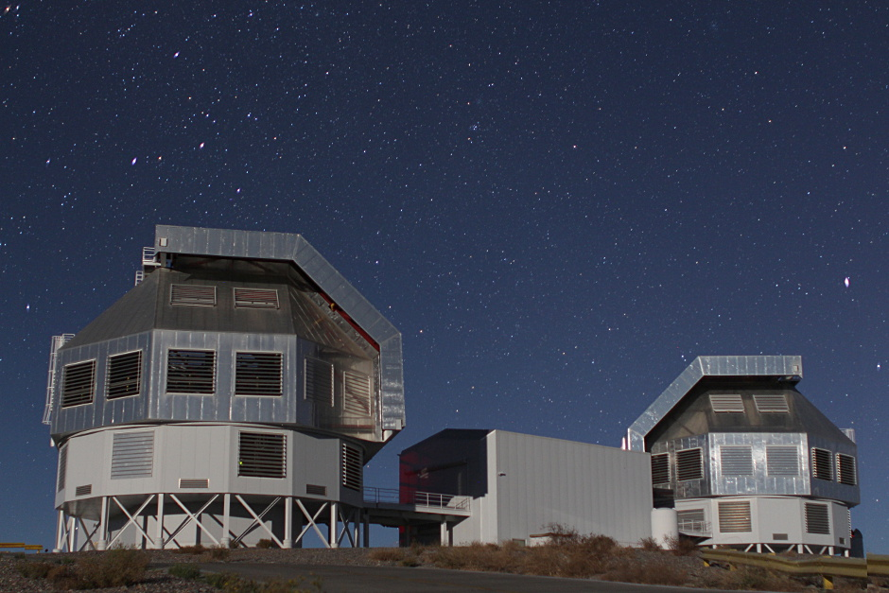
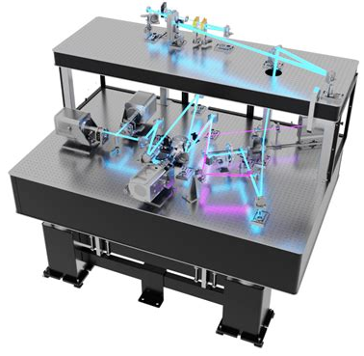
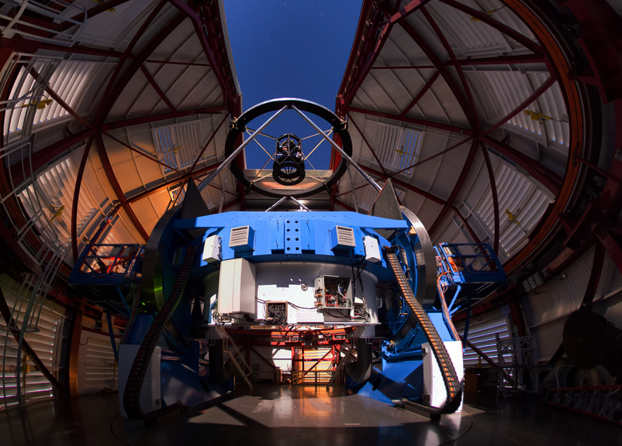

Fresh observations
Magellan Telescopes
Jan Skowron
Magellan Clay Telescope (6.5 m)
Yuri Beletsky

Slide 8
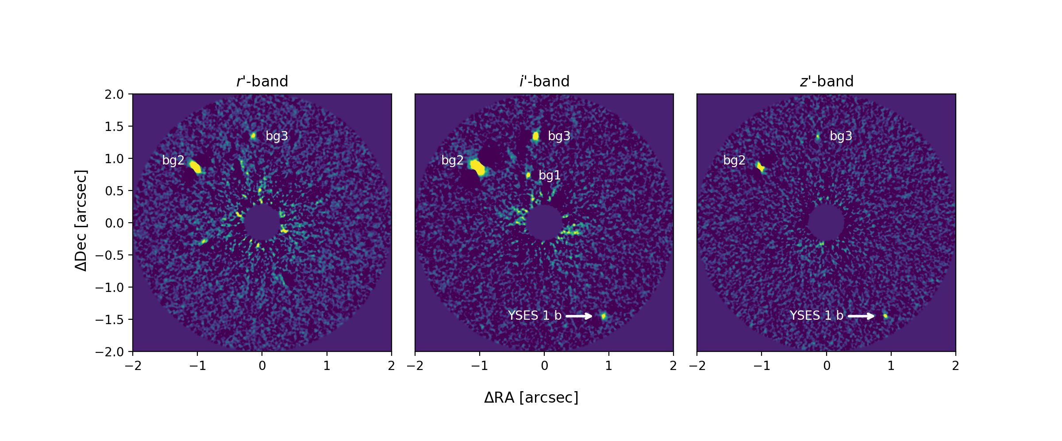
MagAO-X observations

Slide 9
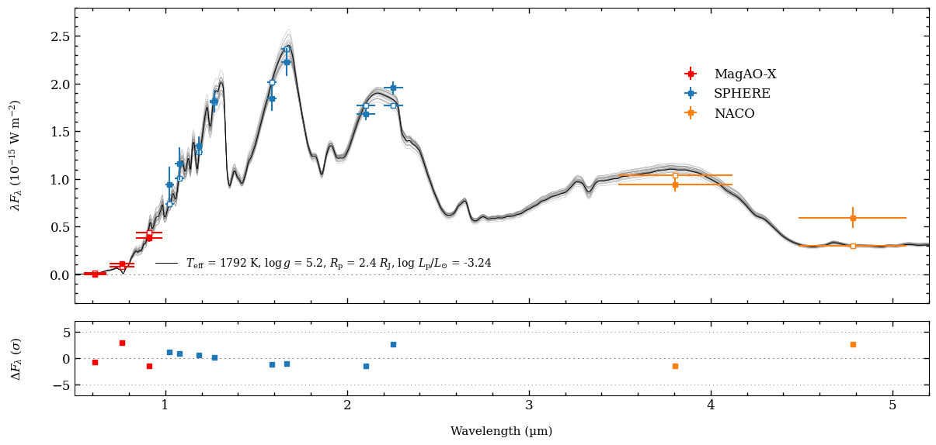

SED fit (atmosphere only)
BT-Settl-CIFIST model
$$χ_{ν}^{2}=3.37$$

Slide 10
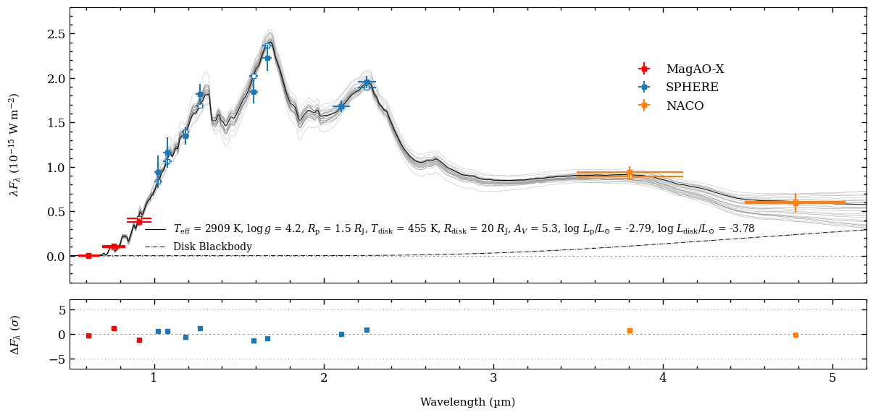

SED fit (atmosphere + CPD)
BT-Settl-CIFIST model
Blackbody + dust extinction
$$χ_{ν}^{2}=1.46$$

Slide 11


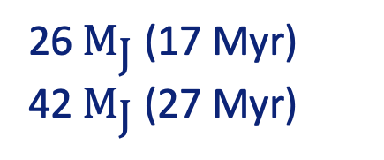
Mass estimate
Luminosity, age → Mass
BT-Settl evolutionary model
Gas giant → Brown dwarf
14 ${\text{M}}_{\text{J}}$ (17 Myr)
26 ${\text{M}}_{\text{J}}$ (17 Myr)
42 $M_{\text{J}}$ (27 Myr)

Slide 12
Conclusions
YSES 1 b succesfully observed at optical wavelengths with MagAO-X
Young objects can be difficult the characterize
CPD can significantly change interpretation of companion
  Dust extinction matters!
YSES 1 b is probably a brown dwarf

