Slide 1
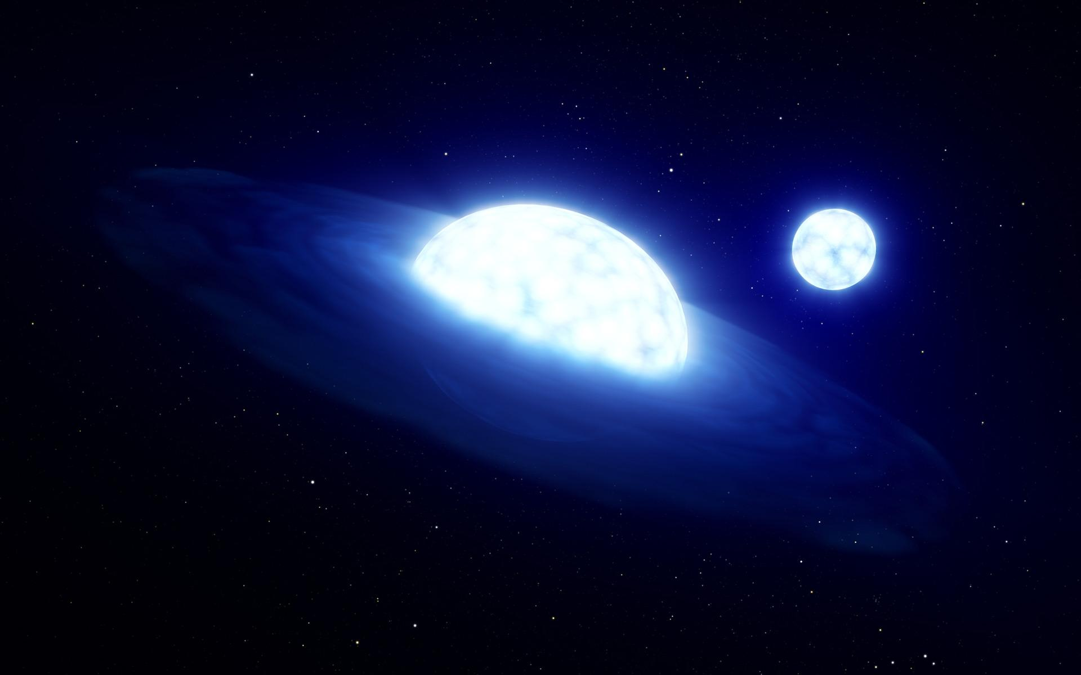


You don’t have to Be alone
Multiplicity survey of OBe stars in the SMC
Sebastián Vilaza-Dallago
PhD Candidate at UvA
s.j.vilazadallago@uva.nl
Collaborators: Julia Bodensteiner, Alex de Koter, Tomer Shenar, Pablo Marchant,
+BLOeM collaboration
Image: L. Calçada/ESO.

Slide 2
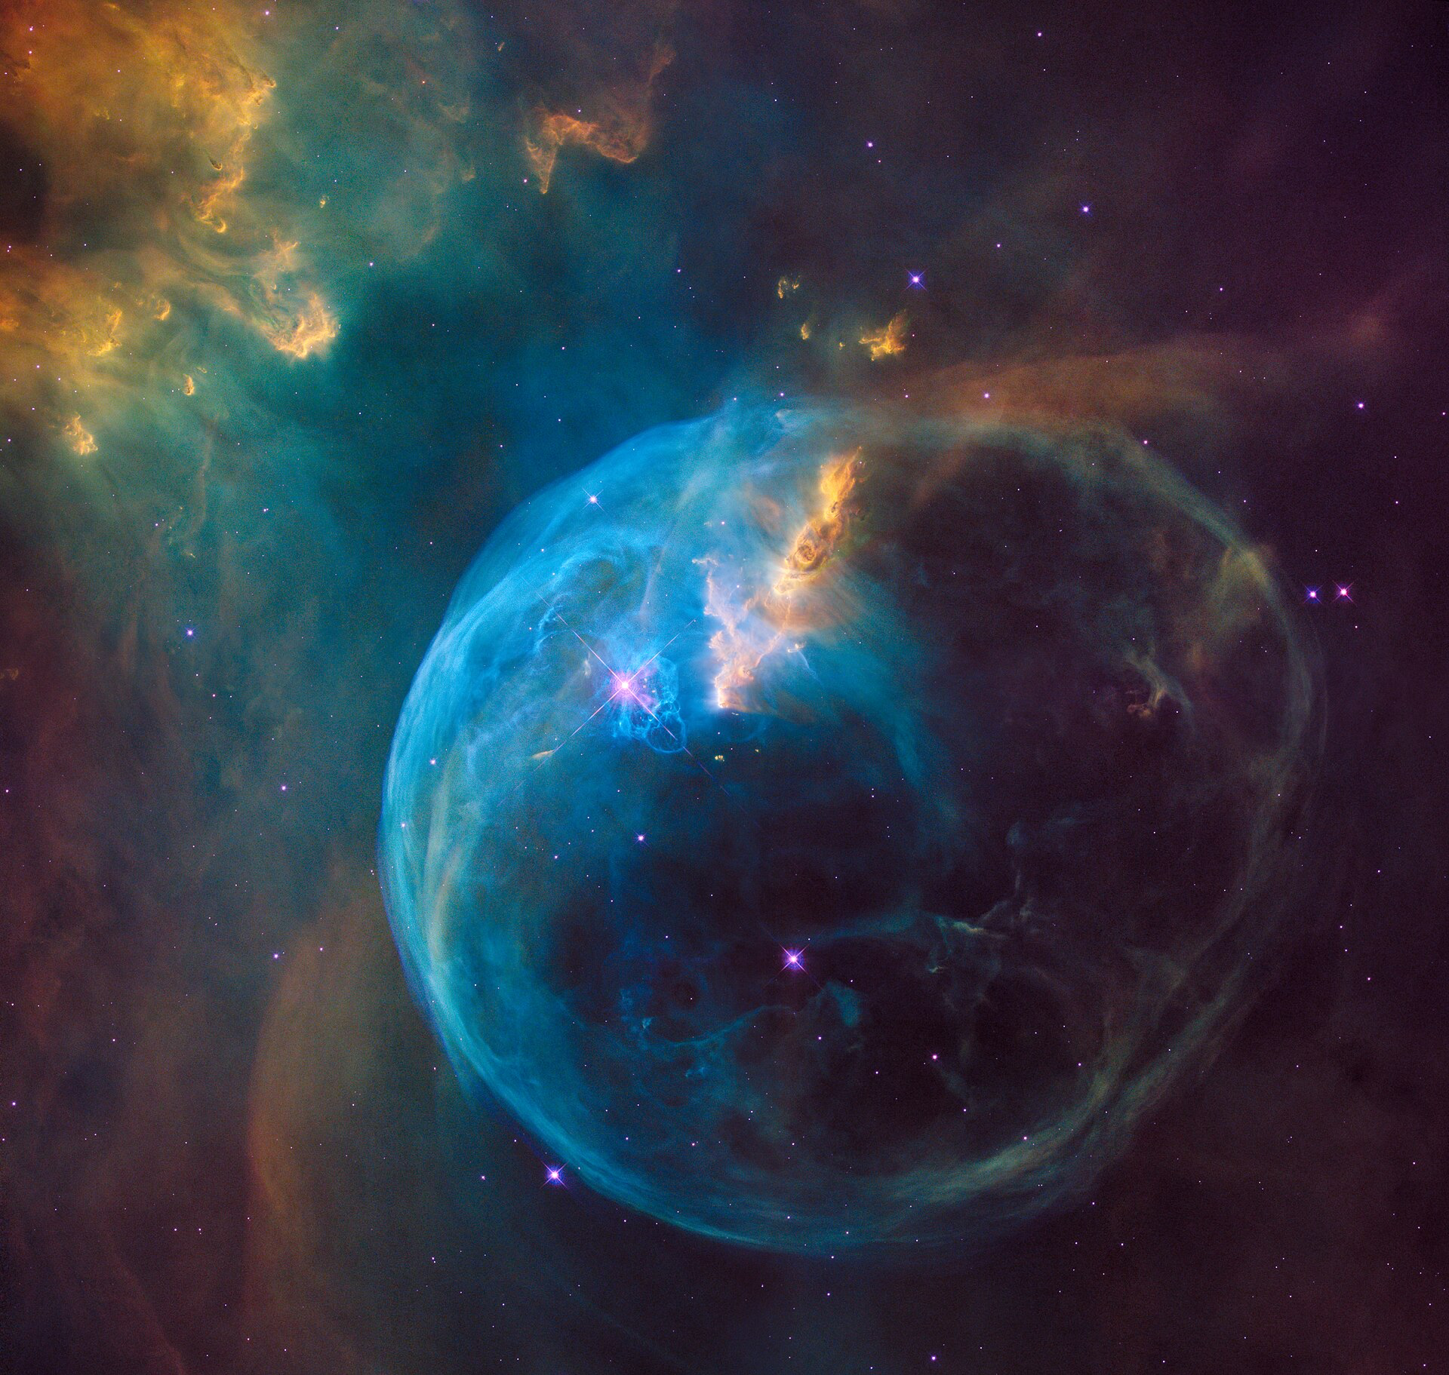
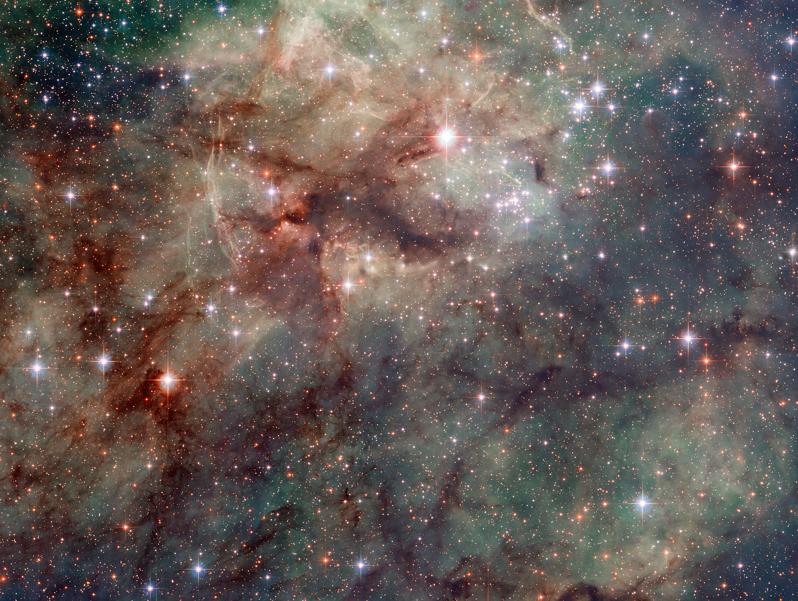
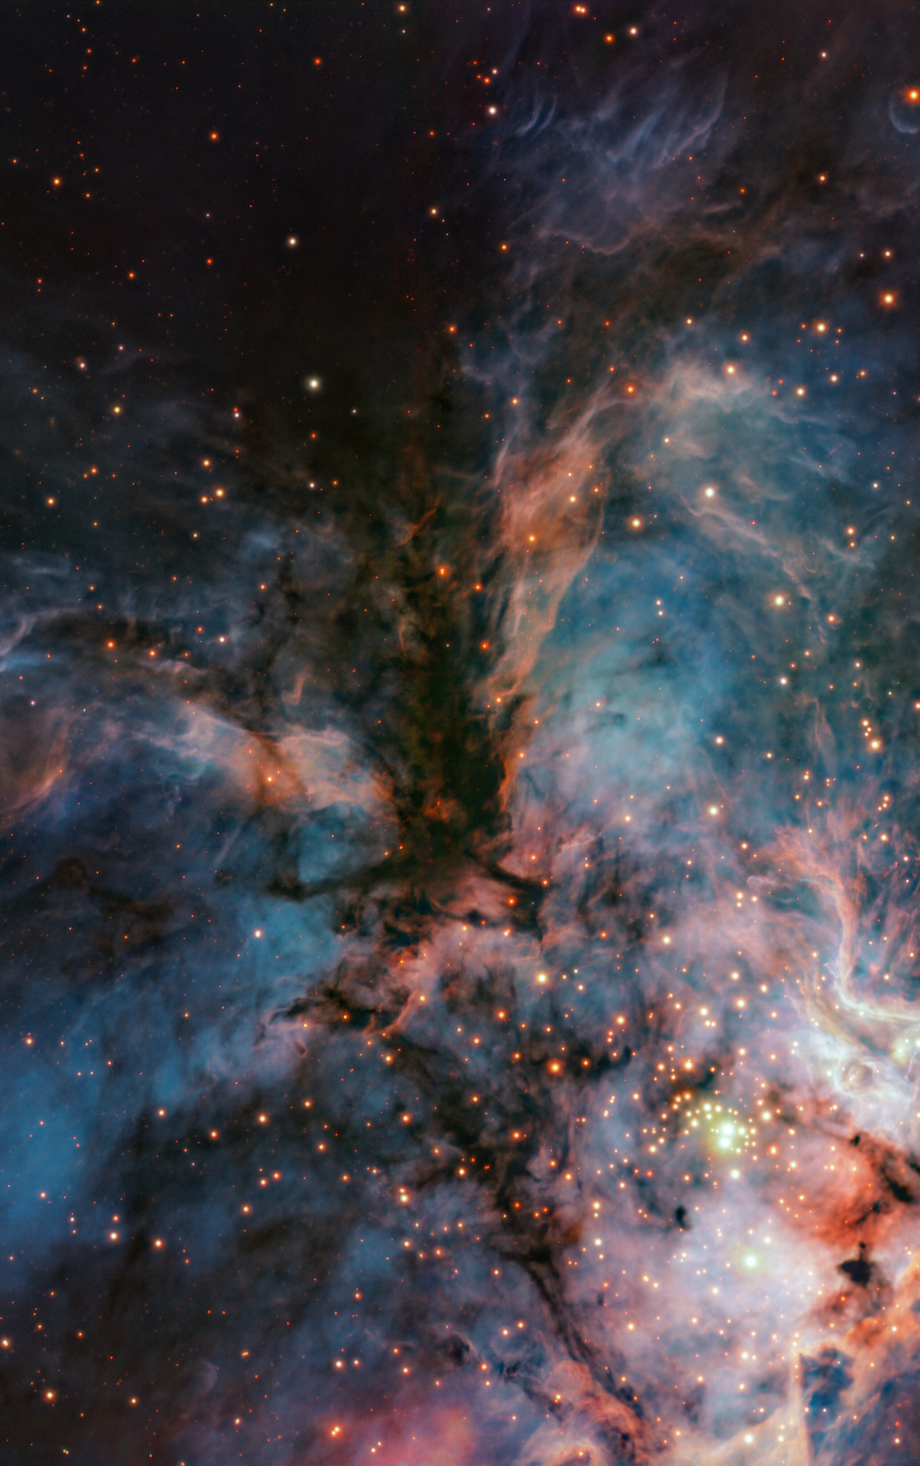
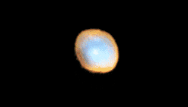
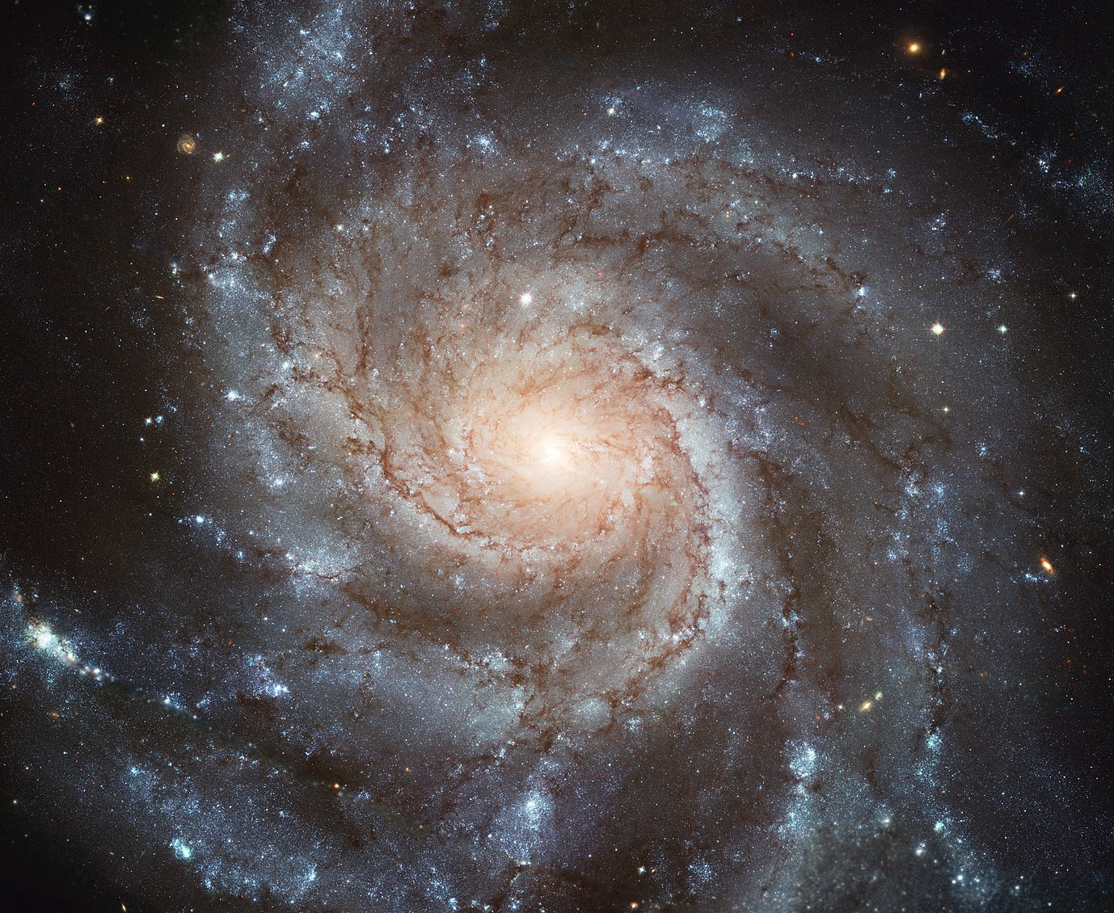
Why are massive stars important?
1
Massive stars are fundamental drivers of cosmic evolution
Source of ionizing radiation
Mechanical feedback
Chemical enrichment
Building blocks of galaxies
Supernova progenitors
e.g., Salpeter 1955, Heger et al. 2003,
Jamet et al. 2004, Bresolin et al. 2008,
Langer 2012, Tanvir et al. 2013,
Hopkins et al. 2014, Aoki et al. 2014,
Belczynski et al. 2016, Abbott et al. 2019.
Images: ESA/NASA/STScI

Slide 3
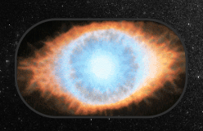
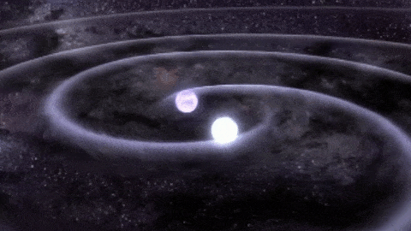
Why are massive stars important?
1
Massive stars are fundamental drivers of cosmic evolution
Source of ionizing radiation
Mechanical feedback
Chemical enrichment
Building blocks of galaxies
Supernova progenitors
Gravitational wave progenitors
e.g., Salpeter 1955, Heger et al. 2003,
Jamet et al. 2004, Bresolin et al. 2008,
Langer 2012, Tanvir et al. 2013,
Hopkins et al. 2014, Aoki et al. 2014,
Belczynski et al. 2016, Abbott et al. 2019.
Images: ESA/NASA/STScI

Slide 4
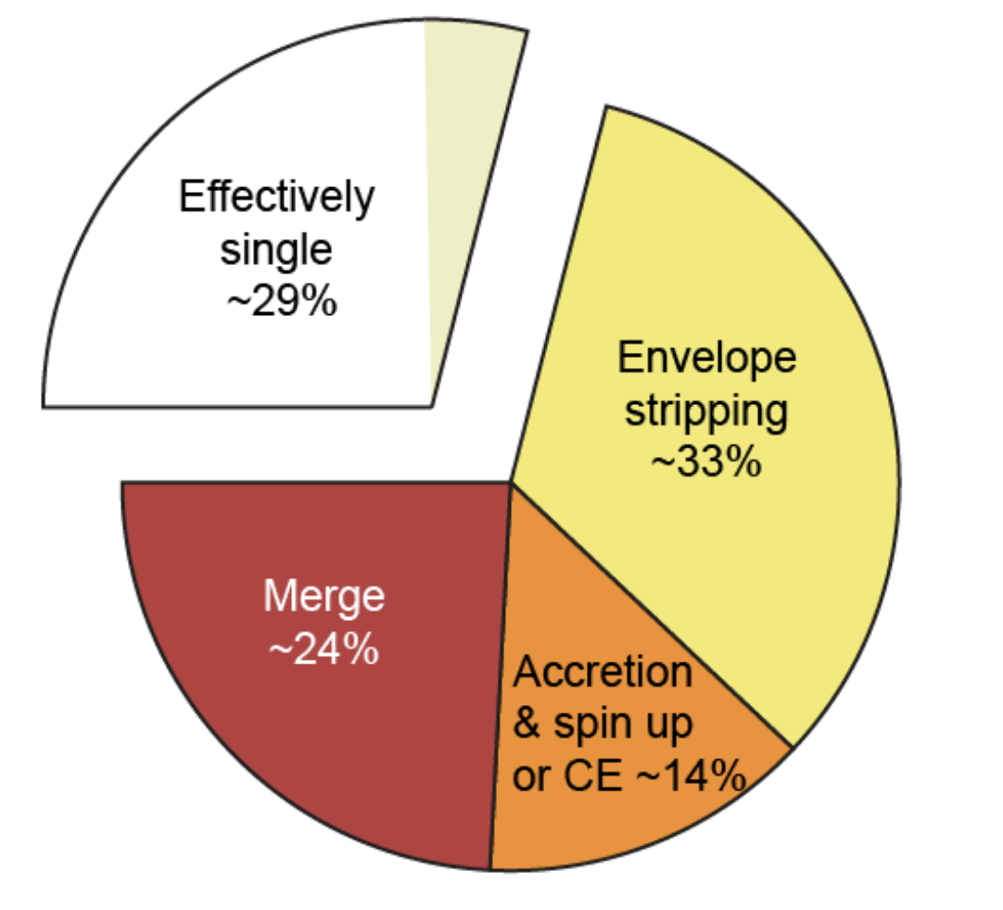
The importance of binary stars
2
The vast majority of massive stars live in interacting binary systems (Sana et al. 2012)
Sana et al. 2012

Slide 5
The importance of binary stars
2
The vast majority of massive stars live in interacting binary systems (Sana et al. 2012)
Interactions impact evolution and final outcomes
Sana et al. 2012

Slide 6
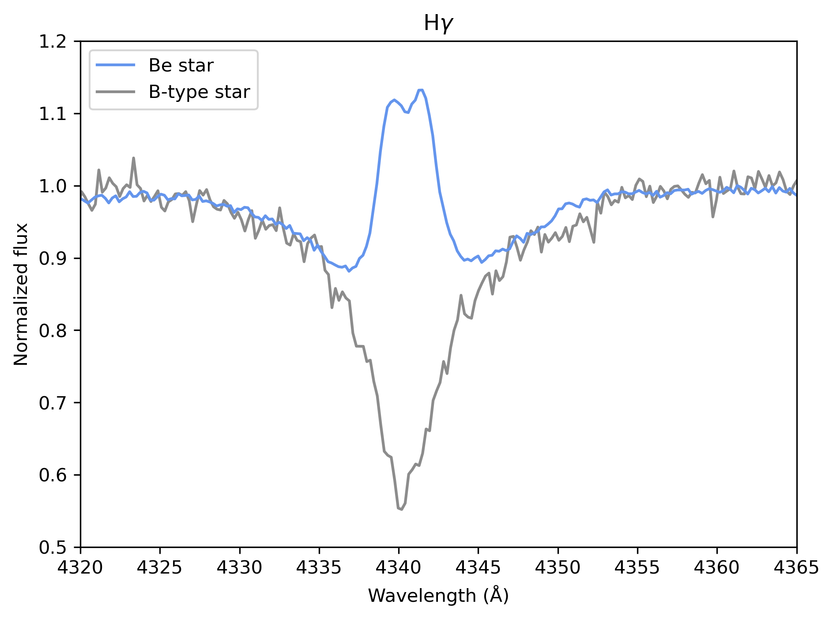

Classical OBe stars as probes of binary interaction
3
e.g., Rivinius et al. 2013, Marchant & Bodensteiner 2024, Rivinius & Klement 2026.
Classical OBe stars are rapidly rotating O- and B- type stars with emission in their spectra due to the presence of a decretion disk
Believed to be post-interaction systems
Can help us constrain binary interaction physics
Image: F. Bodensteiner
Notes:
Show binary only when mentioning post interaction systems
From theory if they are post interaction systems. No detailed study, except for bloem given the large scale, multi epoch homogenous sample of OBe star which would allow us to determine if OBe are post interaction or not

Slide 7
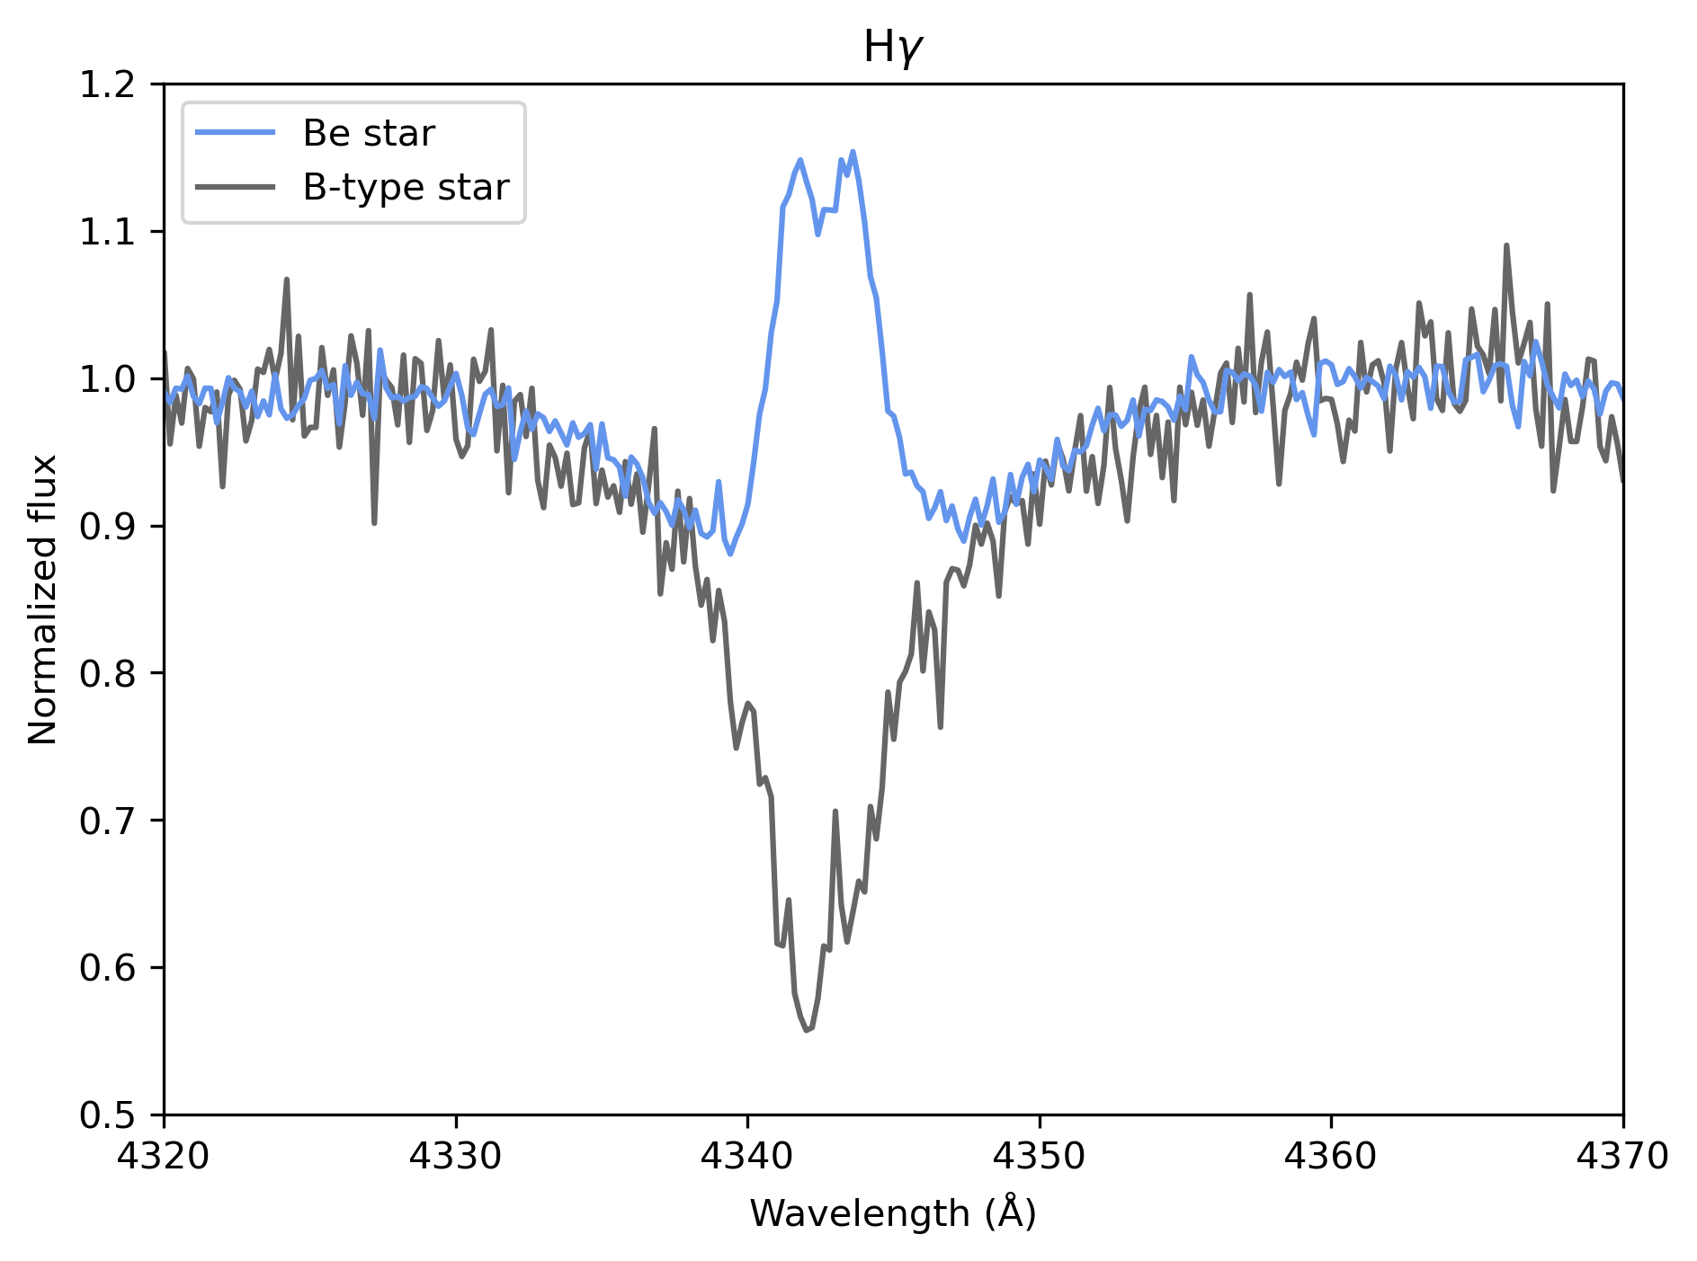

Classical OBe stars as probes of binary interaction
3
e.g., Rivinius et al. 2013, Marchant & Bodensteiner 2024, Rivinius & Klement 2026.
Classical OBe stars are rapidly rotating O- and B- type stars with emission in their spectra due to the presence of a decretion disk
Believed to be post-interaction systems
Can help us constrain binary interaction physics
Image: F. Bodensteiner
Notes:
Show binary only when mentioning post interaction systems
From theory if they are post interaction systems. No detailed study, except for bloem given the large scale, multi epoch homogenous sample of OBe star which would allow us to determine if OBe are post interaction or not

Slide 8

Classical OBe stars as probes of binary interaction
3
e.g., Rivinius et al. 2013, Marchant & Bodensteiner 2024, Rivinius & Klement 2026.
Classical OBe stars are rapidly rotating O- and B- type stars with emission in their spectra due to the presence of a decretion disk
Believed to be post-interaction systems
Can help us constrain binary interaction physics
Image: F. Bodensteiner
Notes:
Show binary only when mentioning post interaction systems
From theory if they are post interaction systems. No detailed study, except for bloem given the large scale, multi epoch homogenous sample of OBe star which would allow us to determine if OBe are post interaction or not

Slide 9


Classical OBe stars as probes of binary interaction
3
e.g., Rivinius et al. 2013, Marchant & Bodensteiner 2024, Rivinius & Klement 2026.
Classical OBe stars are rapidly rotating O- and B- type stars with emission in their spectra due to the presence of a decretion disk
Believed to be post-interaction systems
Can help us constrain binary interaction physics
OBe stars
Image: F. Bodensteiner
Notes:
Show binary only when mentioning post interaction systems
From theory if they are post interaction systems. No detailed study, except for bloem given the large scale, multi epoch homogenous sample of OBe star which would allow us to determine if OBe are post interaction or not

Slide 10
4
What are the binary properties of OBe stars?
What are the companions of classical OBe stars?
Notes:
State as question. Finding binaries and what are the companions

Slide 11
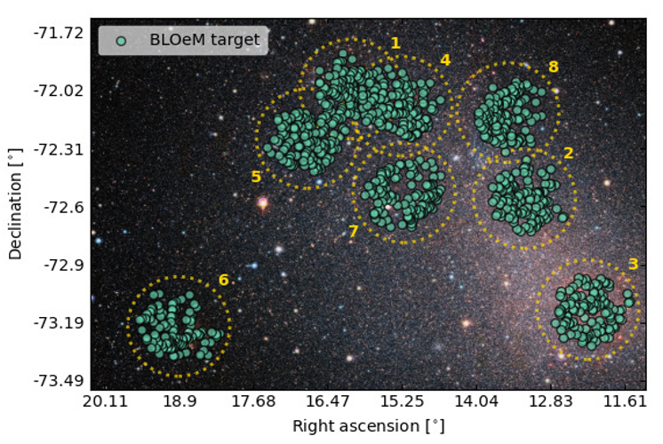
Binarity at LOw Metallicity: BLOeM
5
PI: T. Shenar
dPI: J. Bodensteiner
+ ~100 collaborators
Spectroscopic survey of 929 massive stars in the small magellanic cloud (SMC)
929 massive stars selected based on color and magnitude
Shenar et al. 2024

Slide 12
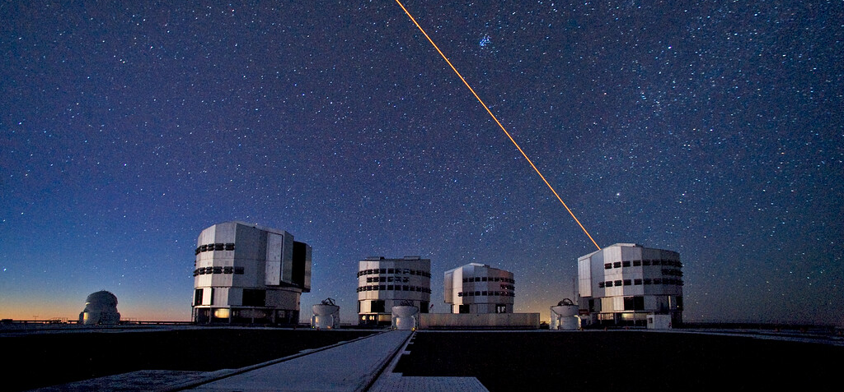
Binarity at LOw Metallicity: BLOeM
5
PI: T. Shenar
dPI: J. Bodensteiner
+ ~100 collaborators
Spectroscopic survey of 929 massive stars in the small magellanic cloud (SMC)
929 massive stars selected based on color and magnitude
VLT-FLAMES
3950 - 4550 Å
R ~ 6200
S/N > 30
ESO - VLT
Image: S. Brunier/ESO
Shenar et al. 2024
Notes:
Image of vlt

Slide 13
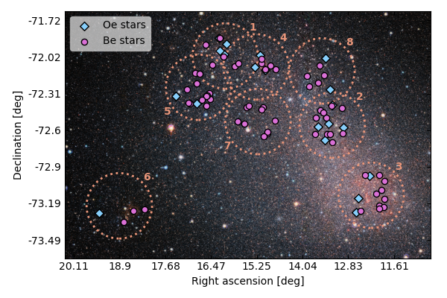
Binarity at LOw Metallicity: BLOeM
5
PI: T. Shenar
dPI: J. Bodensteiner
+ ~100 collaborators
Spectroscopic survey of 929 massive stars in the small magellanic cloud (SMC)
929 massive stars selected based on color and magnitude
VLT-FLAMES
96 OBe stars
Bodensteiner et al. 2025

Slide 14
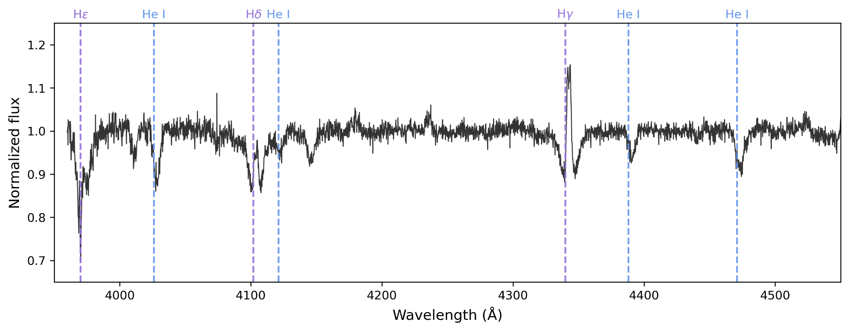

Binarity at LOw Metallicity: BLOeM
5
PI: T. Shenar
dPI: J. Bodensteiner
+ ~100 collaborators
Spectroscopic survey of 929 massive stars in the small magellanic cloud (SMC)
929 massive stars selected based on color and magnitude
VLT-FLAMES
96 OBe stars
25 epochs over 2 years
25x

Slide 15
6
What are the binary properties of OBe stars in the SMC?
What are the companions of classical OBe stars in the SMC?
Notes:
State as question. Finding binaries and what are the companions

Slide 16
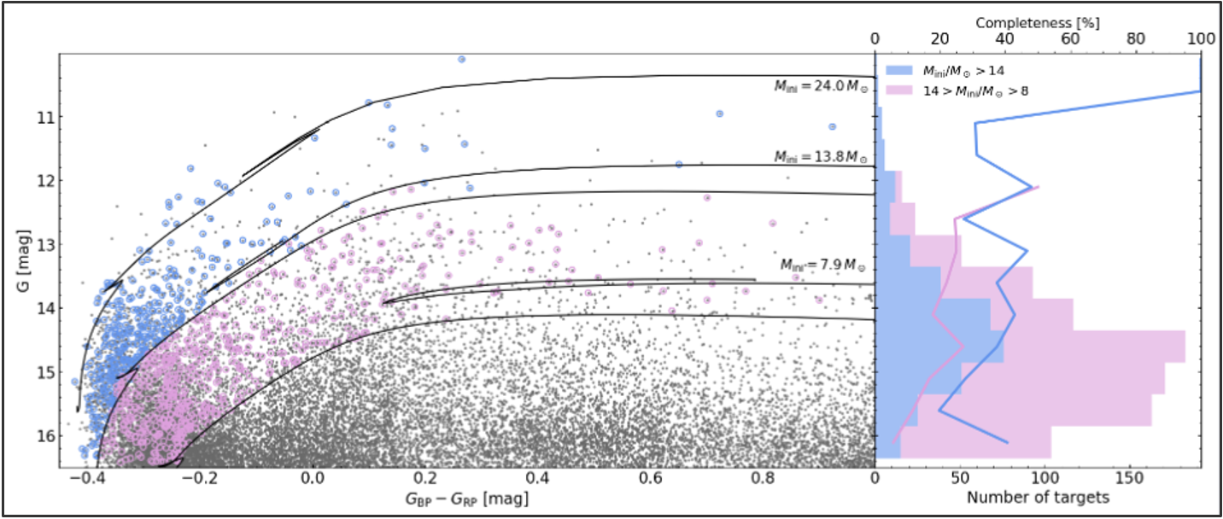
Shenar et al. 2024

Slide 17
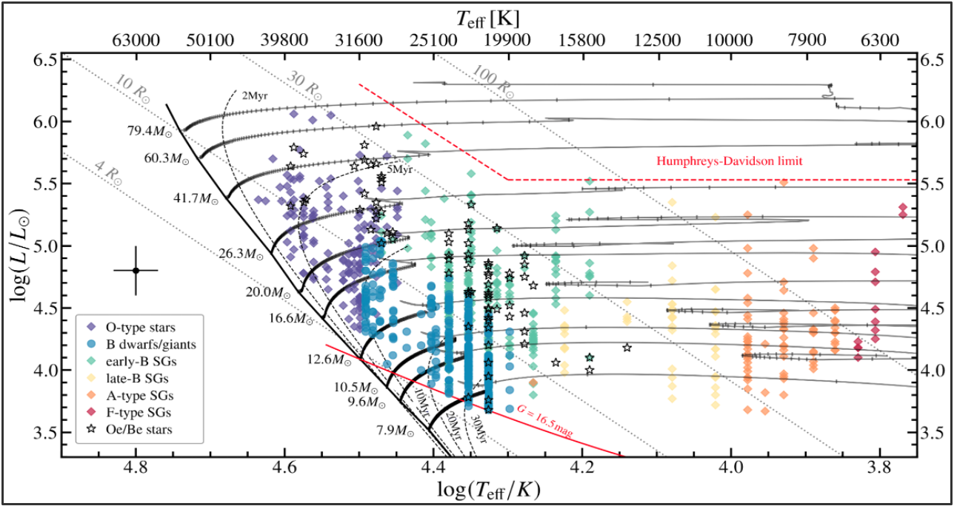
Bestenlehner et al. 2025

Slide 18
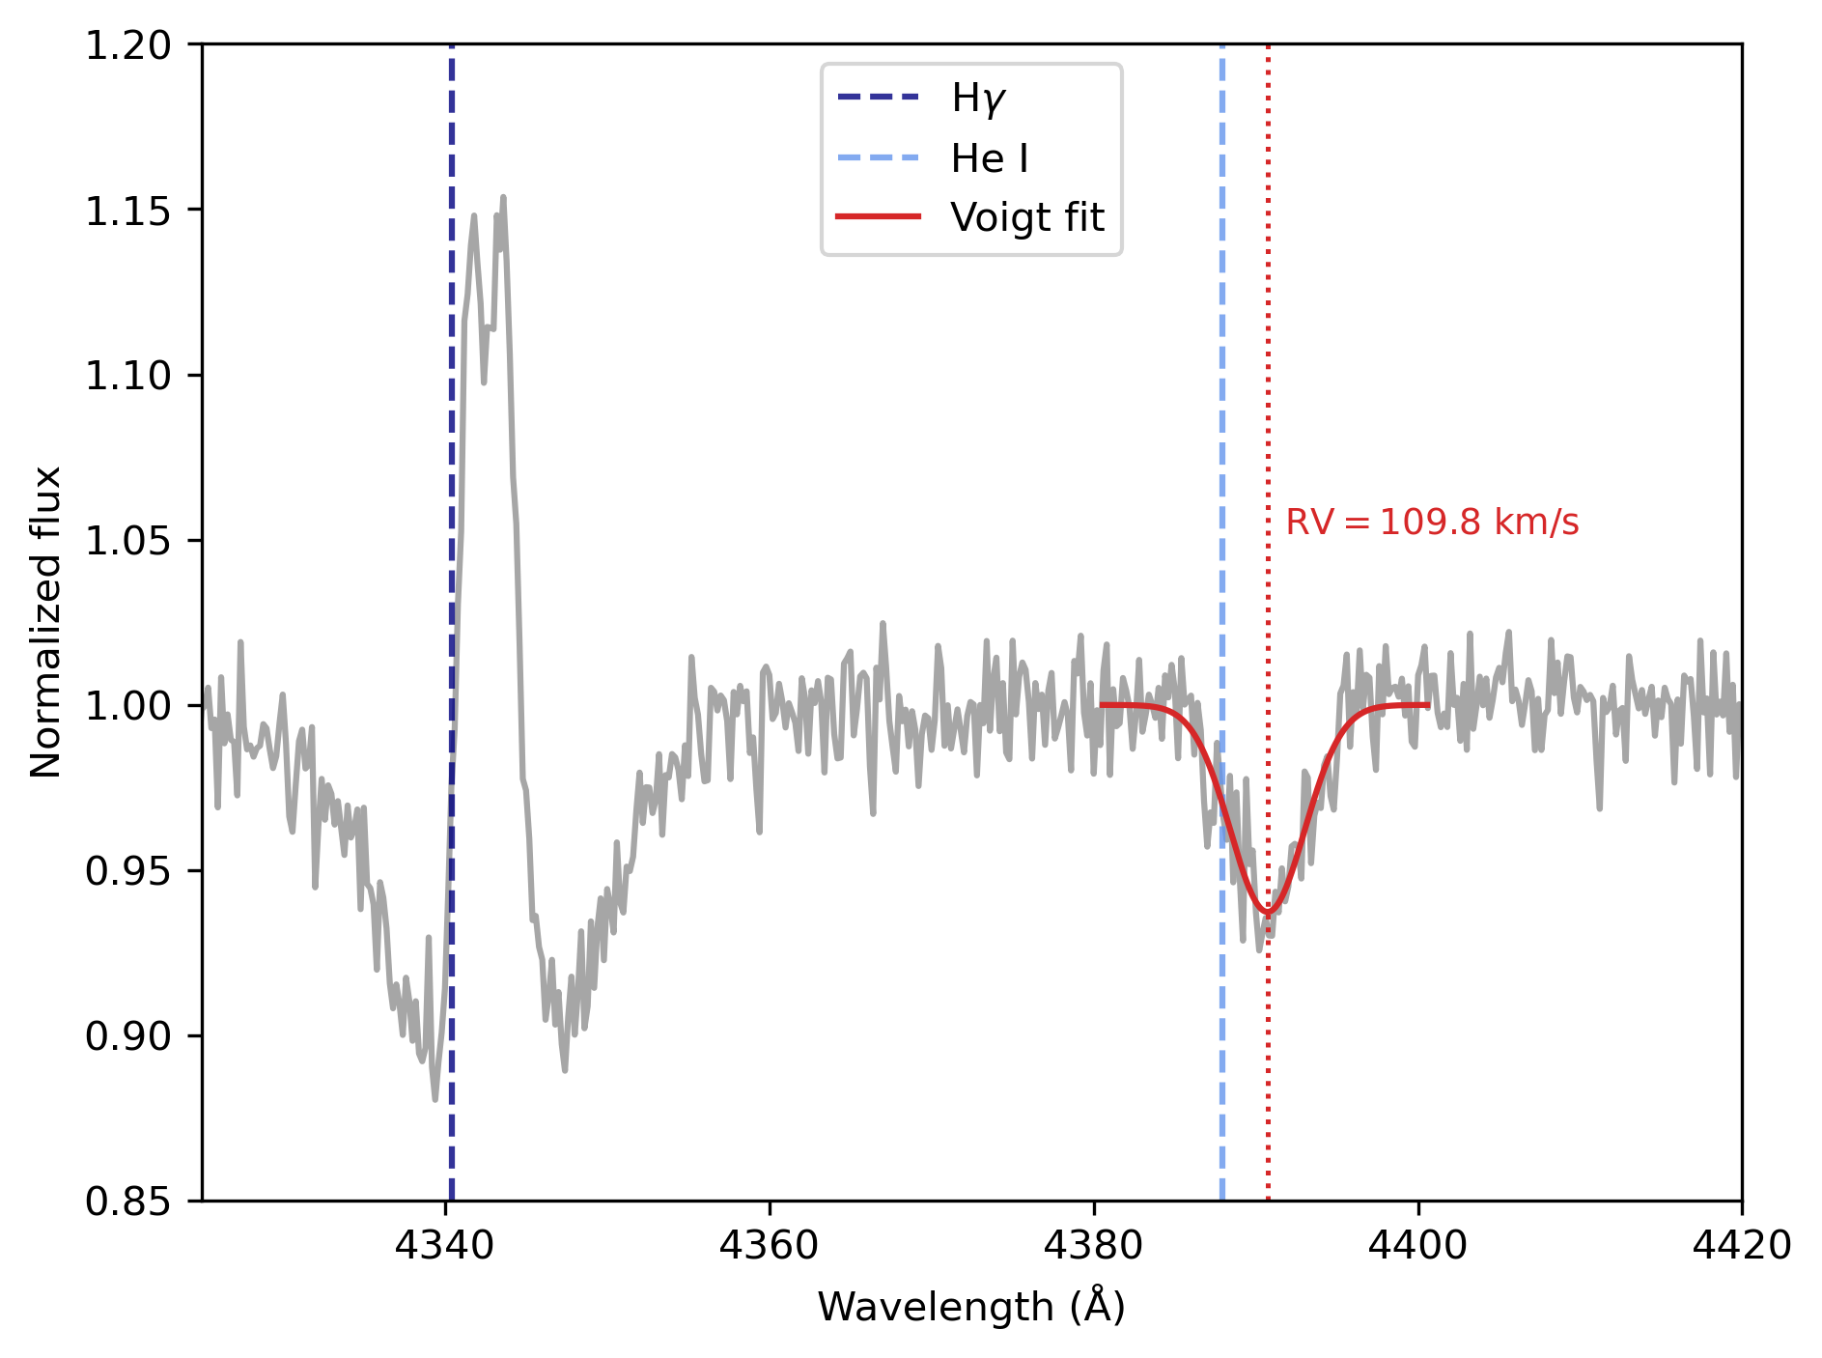
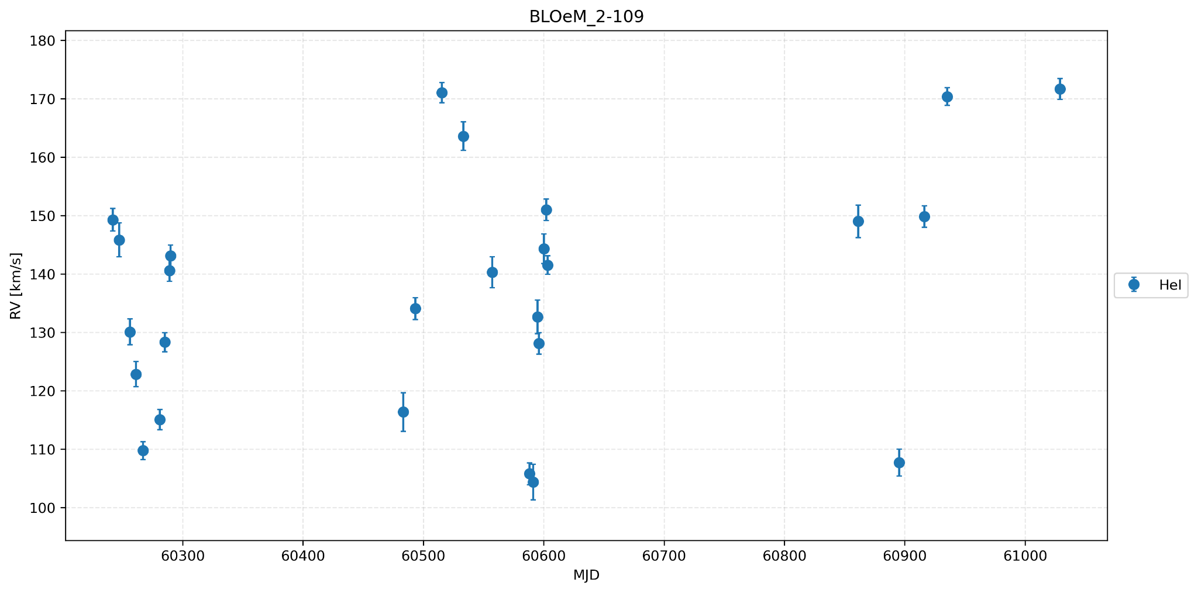
How to identify binaries
7
Measured radial velocities (RVs) by performing voigt profile fitting and CCF method to suitable HeI and HeII lines

Slide 19
How to identify binaries
7
Measured radial velocities (RVs) by performing voigt profile fitting and CCF method to suitable HeI and HeII lines

Slide 20
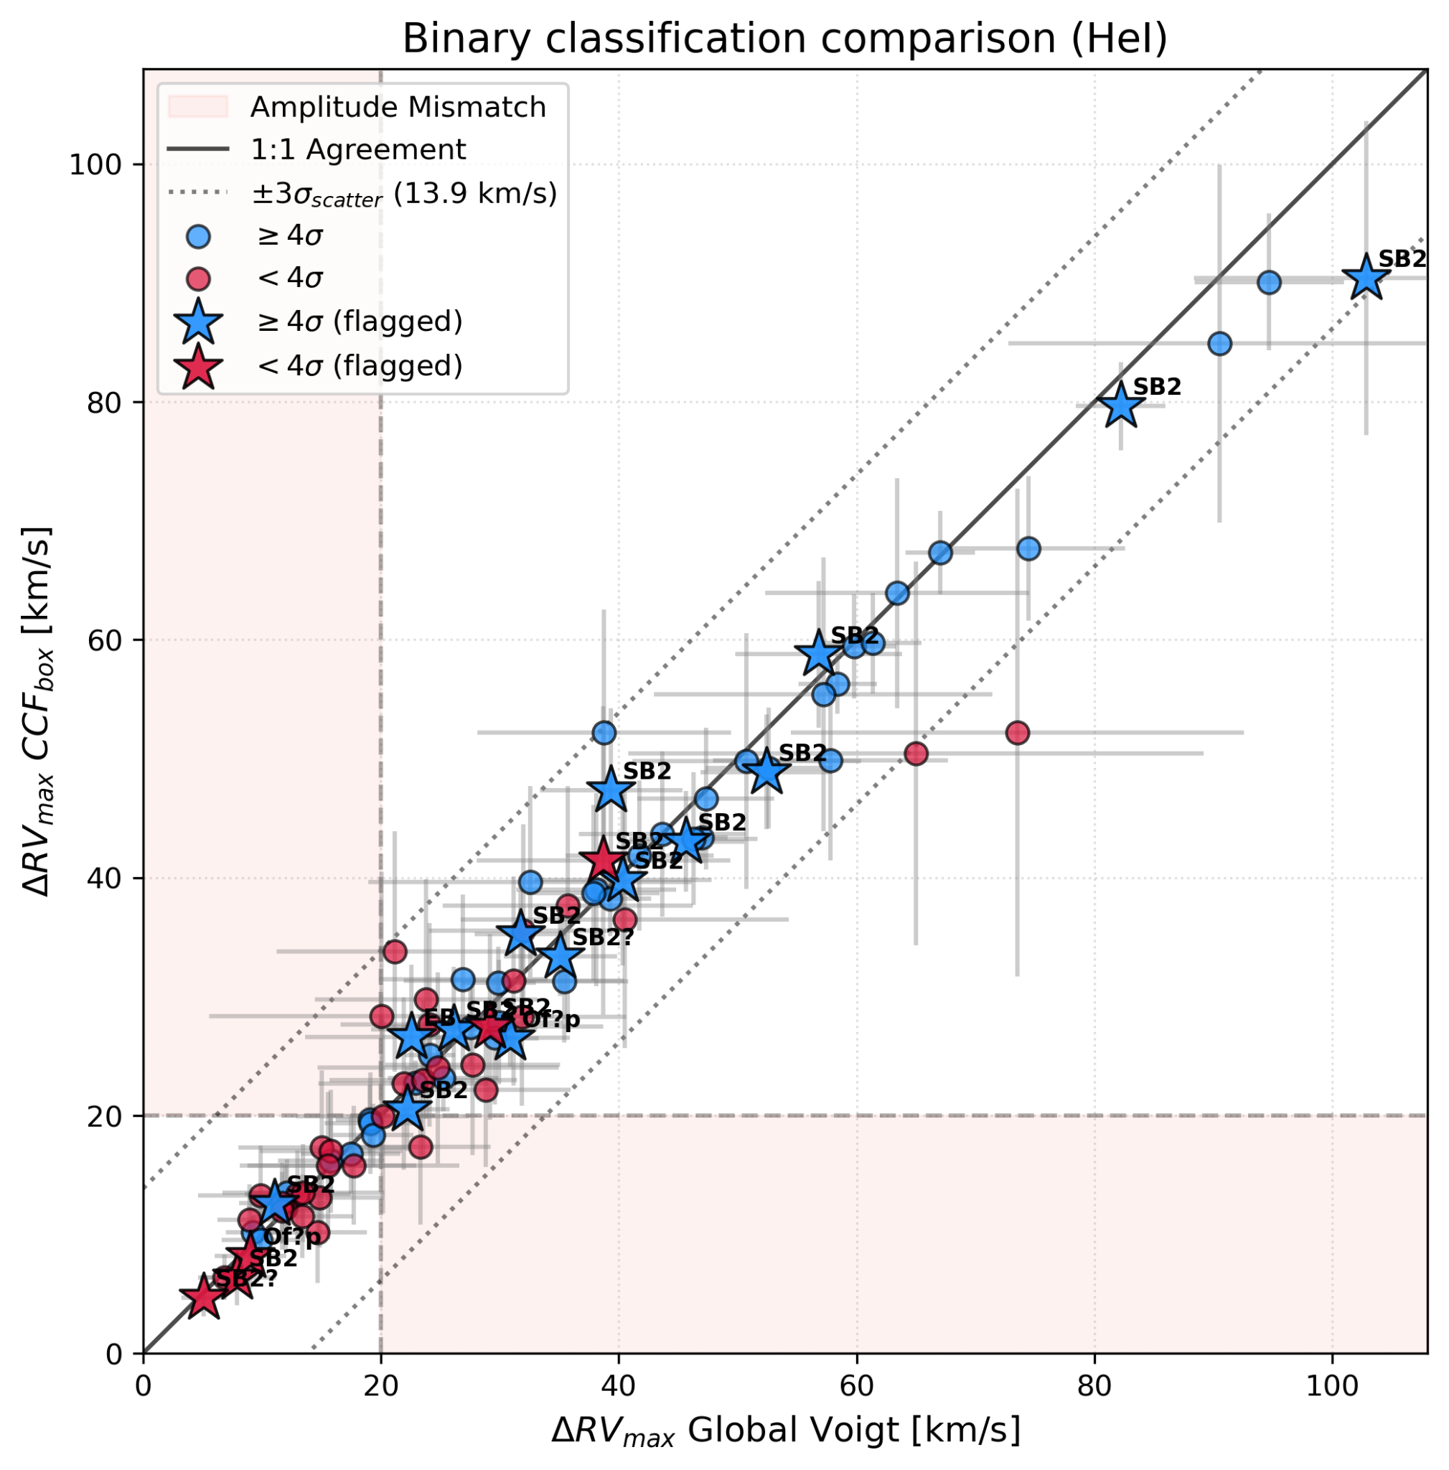
Preliminary

Slide 21
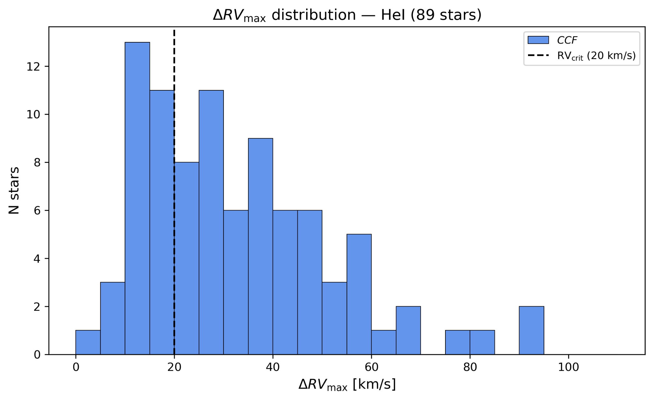
Binary classification and observed fraction
8
Preliminary
Current binary criteria:
ΔRV_{max} > 20 km/s
Binary candidate
Notes:
Don’t forget all the caveats for the binary fraction: Contamination reduces fraction, bias correction. Ask on friday. Bodensteiner 2020 investigating
First homogenous survey of Be stars and a handful of Be binaries are known. We are changing the approach. First time we have a number from a large and unbiased sample

Slide 22
Binary classification and observed fraction
8
Preliminary
Current binary criteria:
ΔRV_{max} > 20 km/s
2. ΔRV_{max} > 4σ_{err}
Observed binary fraction with 25 epochs:
f_{bin} = 48.3 ± 5.2%
Contamination: Magnetic stars, Interacting binaries, Young stellar objects, etc…
Notes:
Don’t forget all the caveats for the binary fraction: Contamination reduces fraction, bias correction. Ask on friday. Bodensteiner 2020 investigating
First homogenous survey of Be stars and a handful of Be binaries are known. We are changing the approach. First time we have a number from a large and unbiased sample
Talk about why fraction is important, either compared to others (BLOeM O/B stars or other Be surveys)

Slide 23
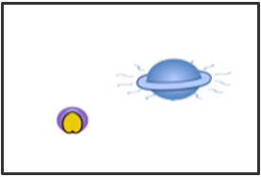

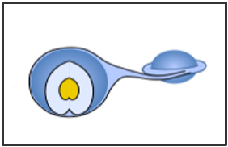
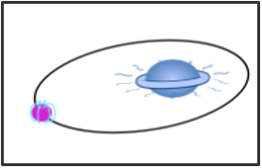
Binary classification and observed fraction
8
Preliminary
What are the natures of the companions?
Pre-interaction
Interaction
Post-interaction
Current binary criteria:
ΔRV_{max} > 20 km/s
ΔRV_{max} > 4σ_{err}
Observed binary fraction with 25 epochs:
?
?
OBe + stripped star
?
OBe + main sequence
interacting binary
?
f_{bin} = 48.3 ± 5.2%
OBe + compact object

Slide 24
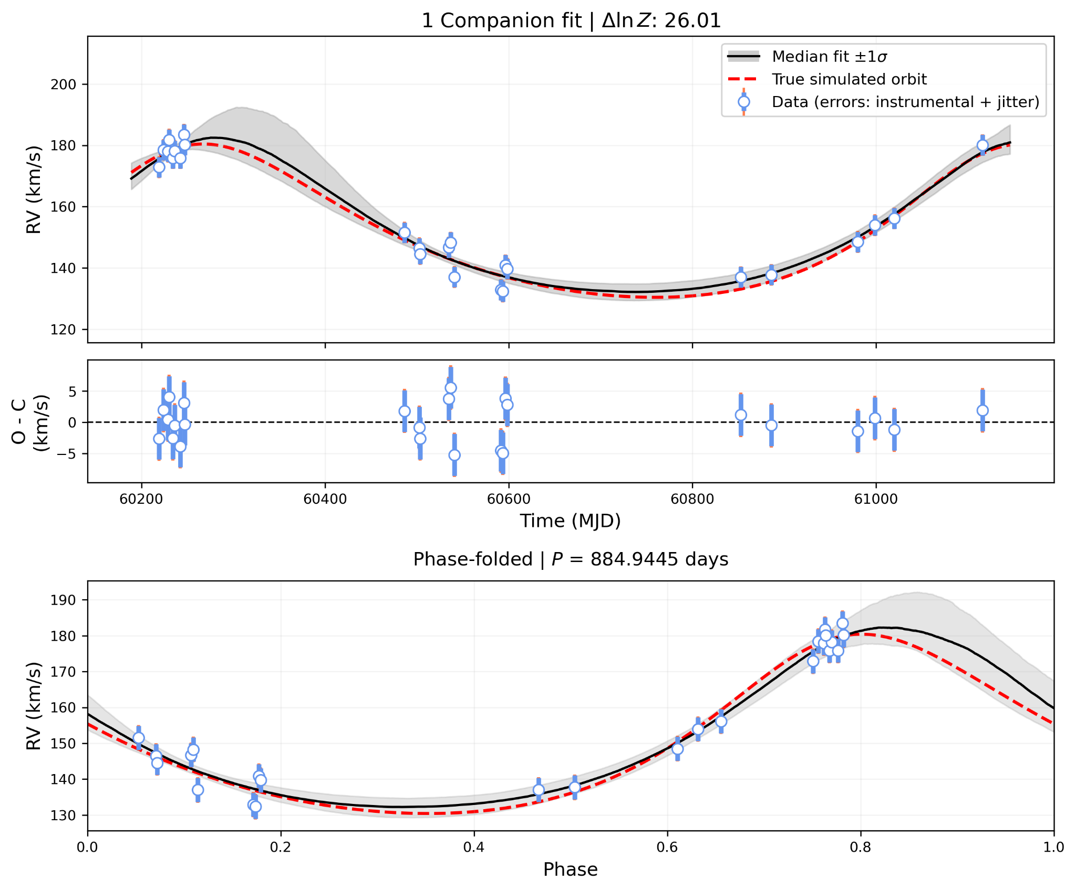
Orbital properties
Preliminary
Simulated data
We use Juliet (Espinoza et al. 2019) determine orbital parameters
Test with simulated data to understand the limitations of the code
Notes:
If anyone has experience with juliet/radvel please let me know

Slide 25
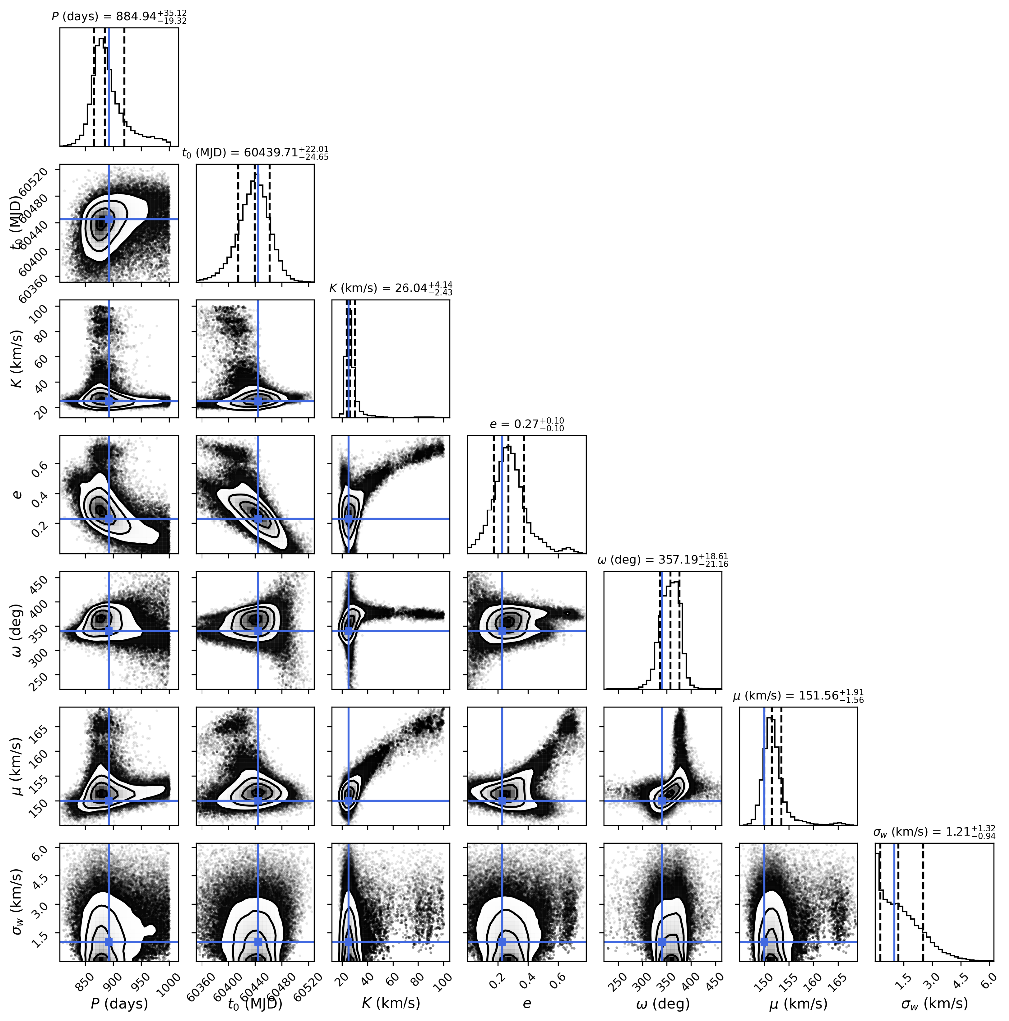
Preliminary

Slide 26
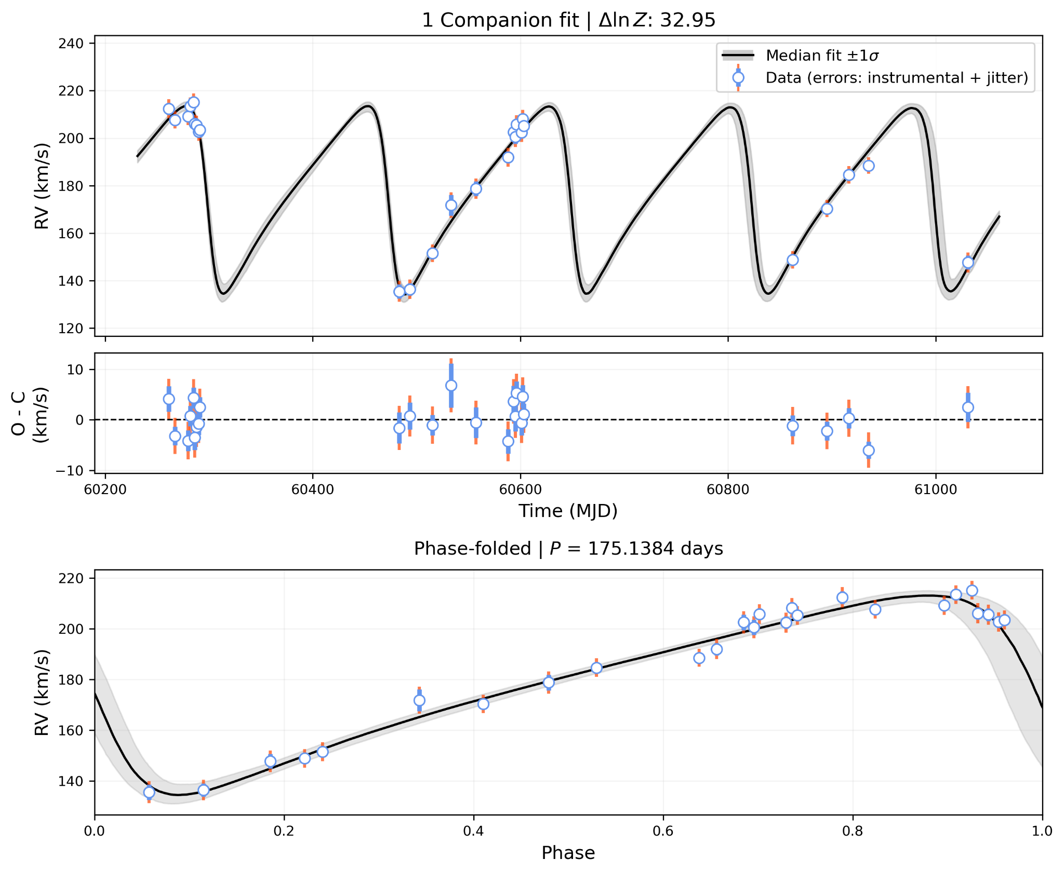
Orbital properties
9
Preliminary
We use Juliet (Espinoza et al. 2019) to determine orbital parameters
Orbit for one of the promising binaries (BLOeM 6-084)
Long period and eccentric (e=0.49) orbit
Notes:
We have a system which we see 1 star and we DONT see the companion

Slide 27
Orbital properties
7
Preliminary
9 epochs!
We use Juliet (Espinoza et al. 2019) to determine orbital parameters
Orbit for one of the promising binaries (BLOeM 6-084)
Long period and eccentric (e=0.49) orbit

Slide 28
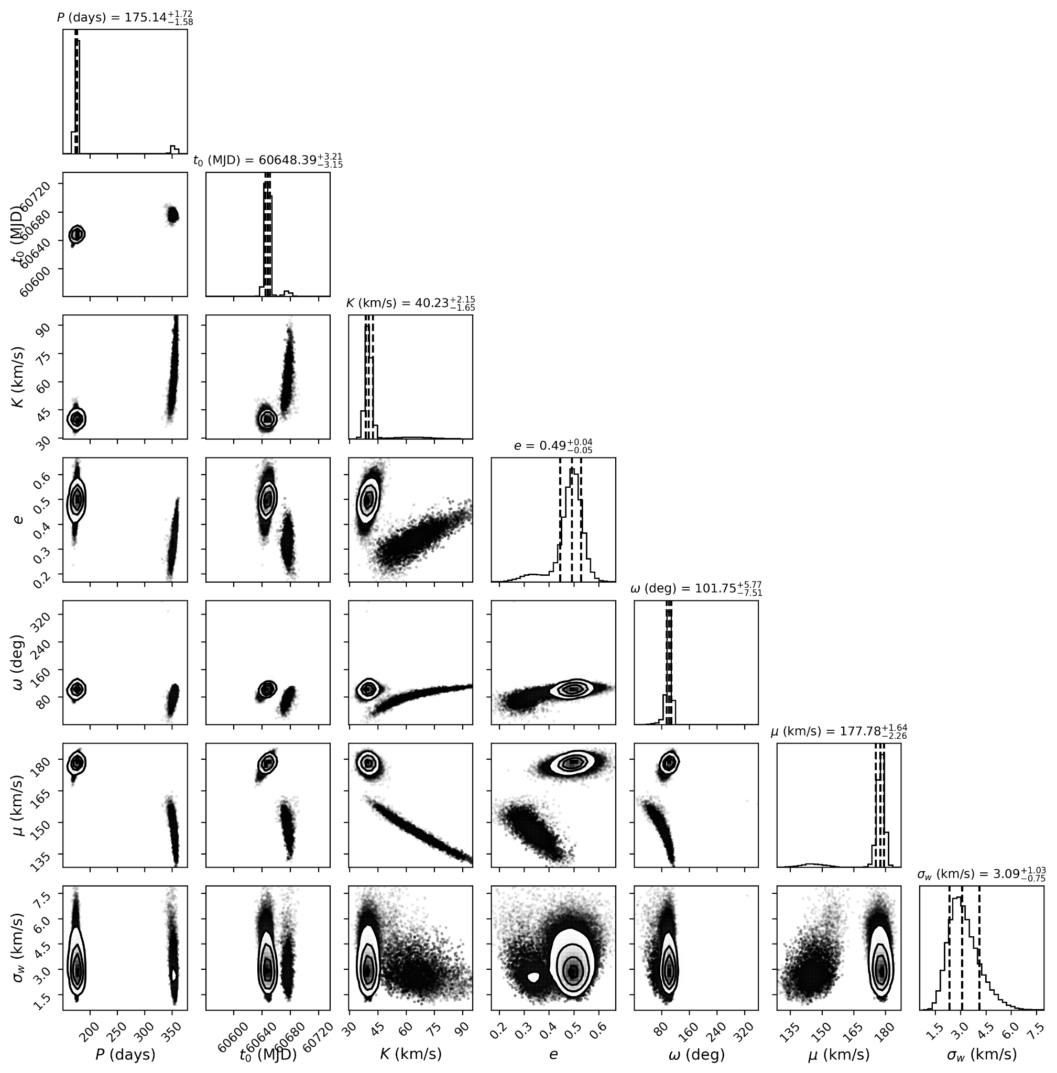
Preliminary

Slide 29
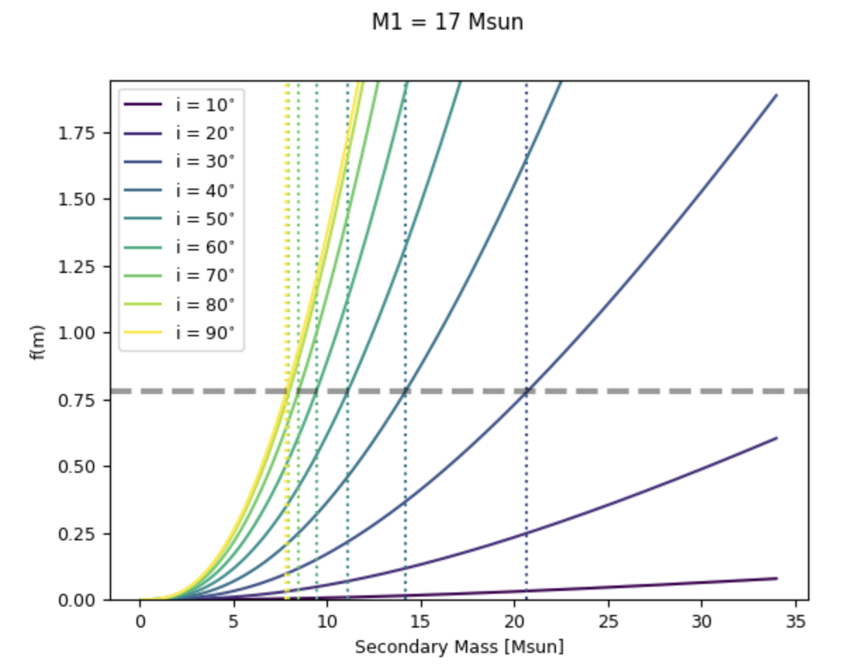
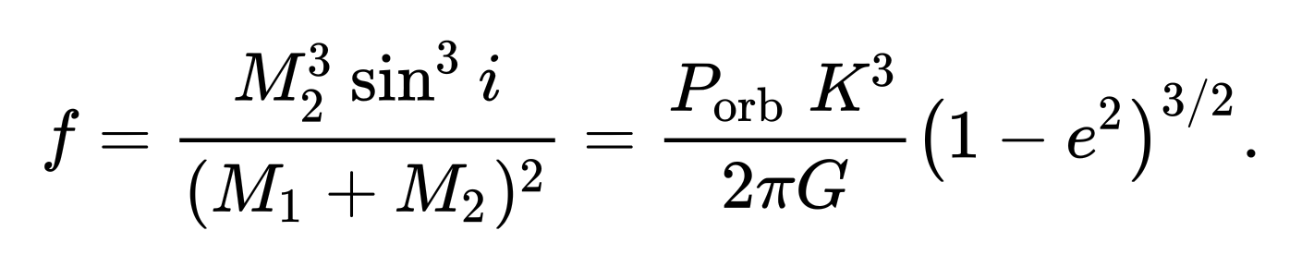
Preliminary

Slide 30
Orbital properties
9
Preliminary
What is the nature of the companion?
Pre-interaction
Interaction
Post-interaction
We use Juliet (Espinoza et al. 2019) to determine orbital parameters
Orbit for one of the promising binaries (BLOeM 6-084)
Long period and eccentric (e=0.49) orbit
?
?
OBe + stripped star
?
OBe + main sequence
interacting binary
?
OBe + compact object

Slide 31
Summary
10
Using BLOeM to analyze a large, homogeneous and unbiased sample of 96 OBe stars in the SMC
Measured RVs → Revealed observed f_{bin} ~ 50%, which needs to be scrutinized to remove contaminants
Goal is to detect binaries, determine orbital parameters and asses the nature of the companions
If large fraction of companions are post-interaction then this supports hypothesis that (at least part of) classical OBe phenomena is related to binary interaction
Stay tuned!

