Slide 1

TIME DEPENDENT ATMOSPHERIC SIGNATURES
NAC 2026
YAMILA MIGUEL
AMY LOUCA
Leiden Observatory
SRON
what JWST really sees

Slide 2
NOTES after the presentation at ESTEC:
Add that I am particularly interested in SO2
Add some explanation with this that shows that SO2 is good to show metallicity
On slide 8 add that the plot was made particularly for SO2

Slide 3
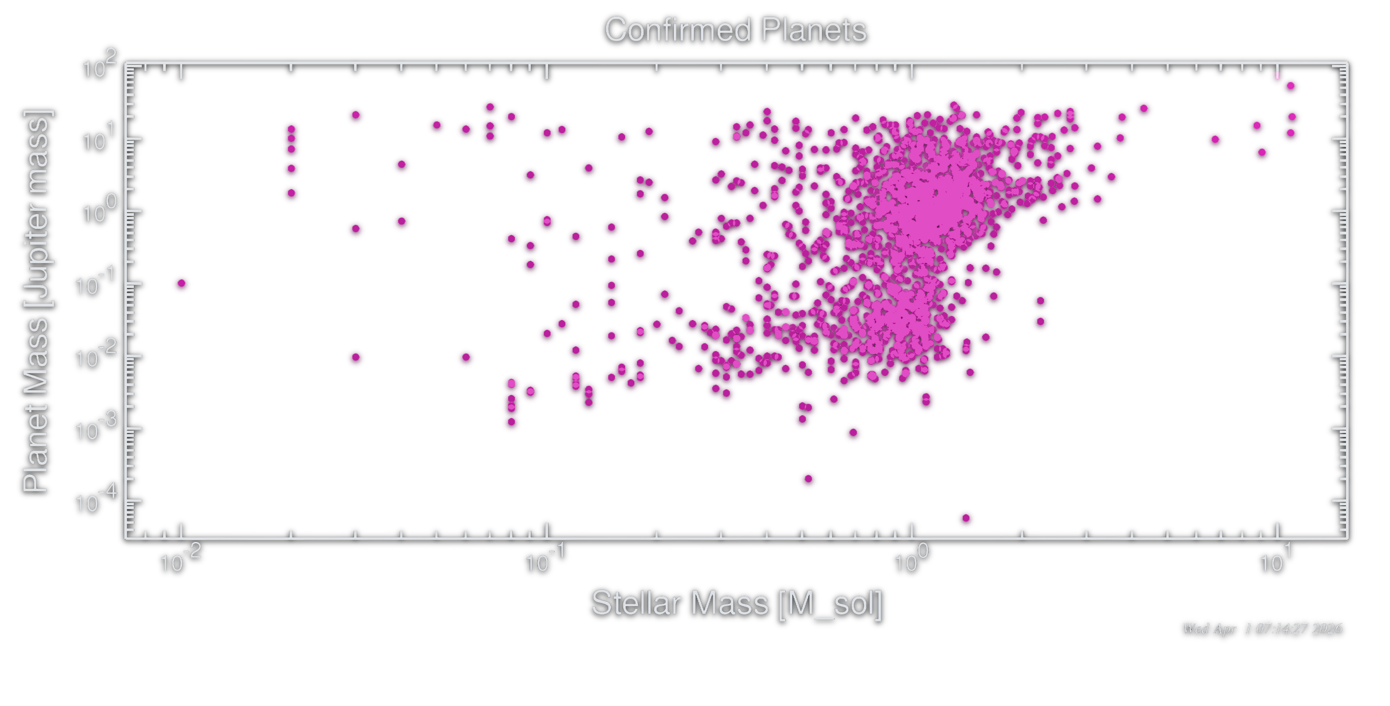
MOTIVATION
There is a growing population of Giant and Neptune –like planets around M stars
These stars are very active
Flares can affect the photochemistry (Venot+2016, Louca+2023, Nicholls+2023)
This affects the atmospheric abundances and spectra with time
YAMILA MIGUEL

Slide 4

HOW VARIABLE ARE PLANETARY SPECTRA ON SHORT TIMESCALES?
&
HOW DOES THIS VARIABILITY SHAPE WHAT WE OBSERVE?
YAMILA MIGUEL

Slide 5
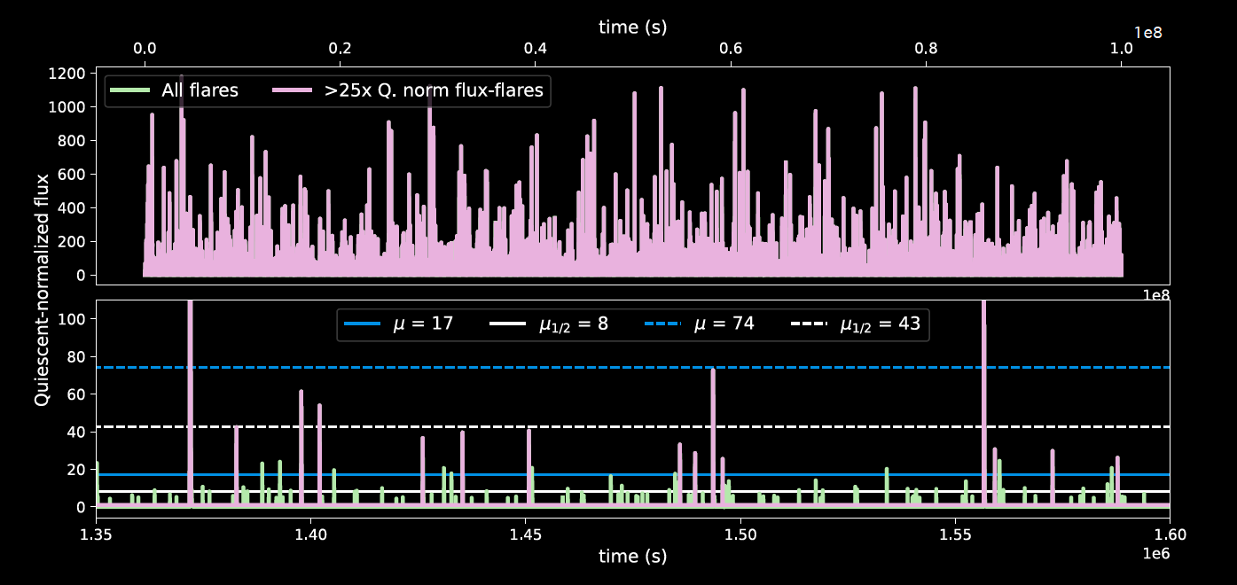
METHODS Stellar spectra
Quiescent spectra: taken from observations by the MUSCLES collab (France+2016, Youngblood+2016, 2017, Loyd+2016, 2018, Brown+2023)
Flares: synthetic sequence based on Loyd+2018
YAMILA MIGUEL
Louca, Tsai & Miguel, submitted

Slide 6
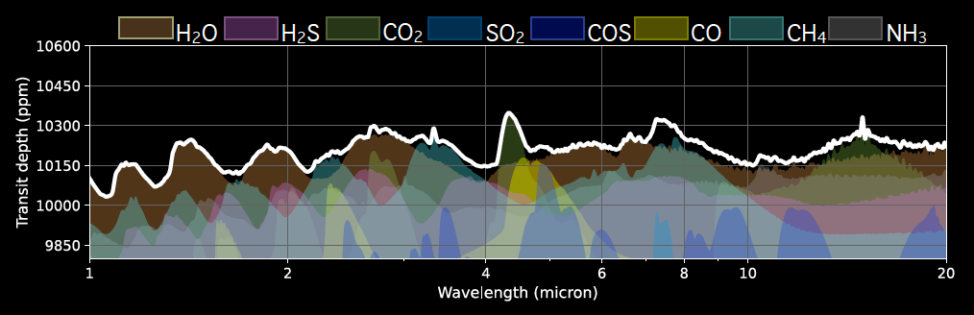
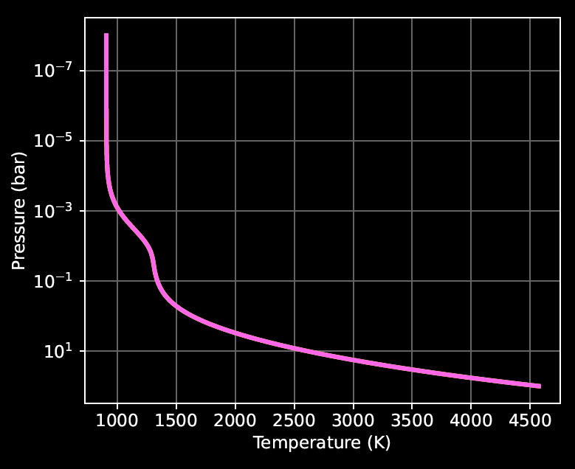
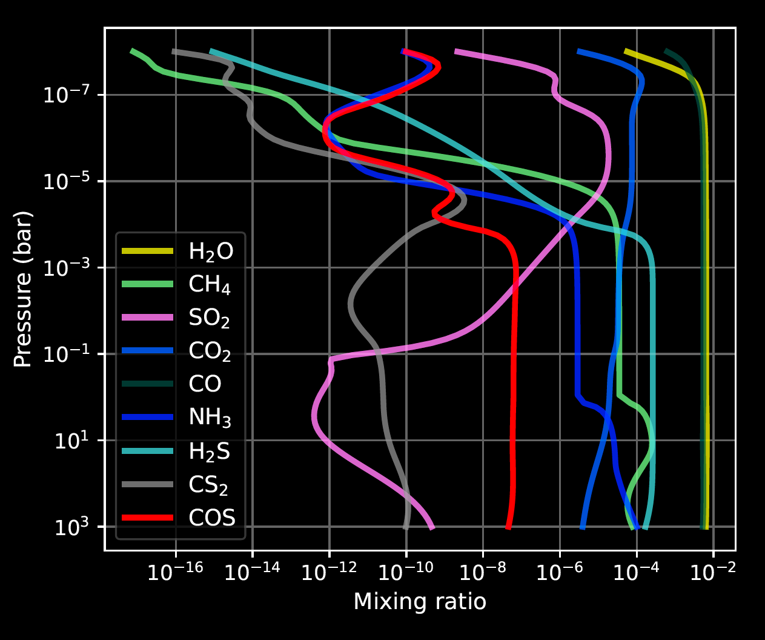
METHODS Exoplanet Atmosphere
Warm Jupiter orbiting a M at 0.01 AU
The planet has a metallicity of 10xsolar
We computed radiative transfer using petitRADTRANS (Mollière+2019, Alei et al. 2022)
Chemical kinetics using VULCAN (Tsai+2017, 2021)
We consider diffusion-limited escape of H
Stellar Flux (t)
Spectra (t)
T-P profile
Chemical abundances (t)
YAMILA MIGUEL

Slide 7
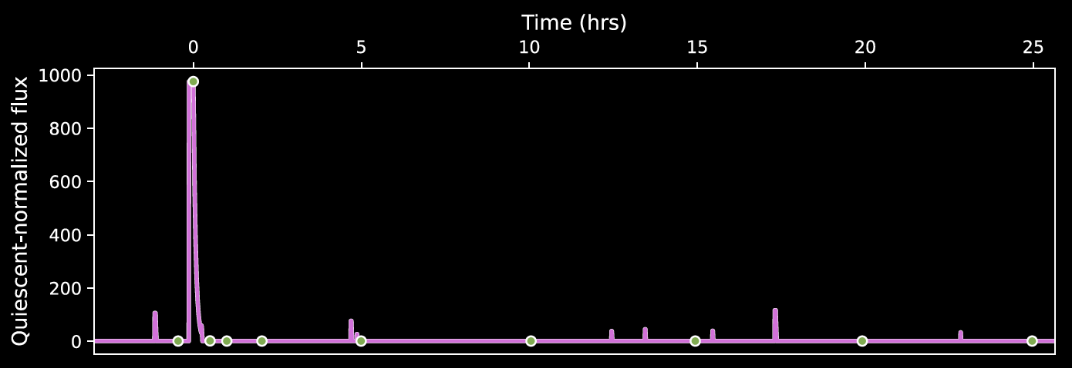
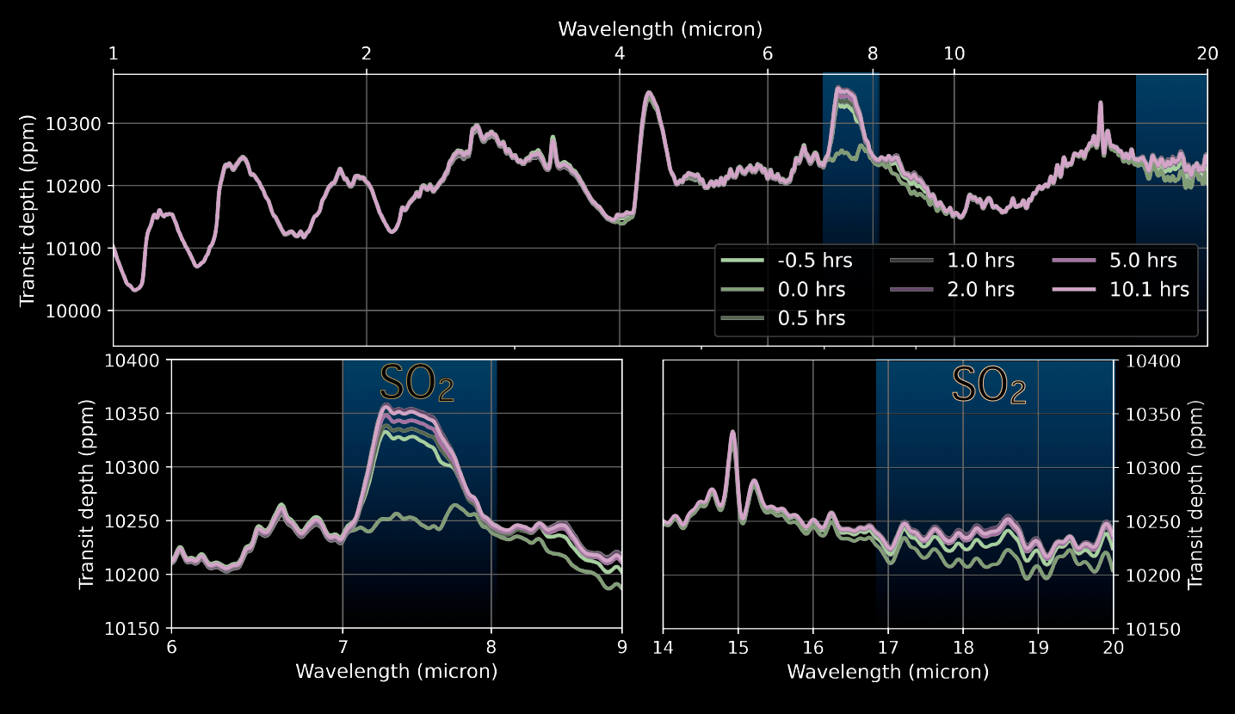
RESULTS 1 Extreme Flare
Louca, Tsai & Miguel, submitted
YAMILA MIGUEL
Notes:
Before the flare, at the quiescent state, we already have a lot of SO2 (bright green). SO2 is formed by SO+OH -> SO2 + H.
When the extreme flare hits, it destroys SO2 due to photodissociation (SO2 dissociates through two different pathways). The extreme flare also dissociates H2O, so then more OH be and SO and S became available.
After the flare, the OH available due to water dissociation allows extra formation of SO2 and we have an overabundance in the atmosphere.
This also leads to an underproduction of water, since OH is used to produce more SO2. This also affects CO2 and CH4 formation. CH4 also dissociates but it is difficult for the species to form again.

Slide 8
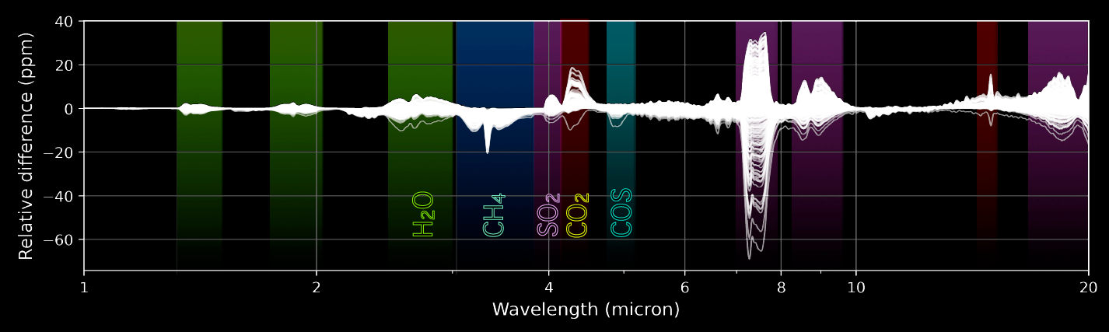
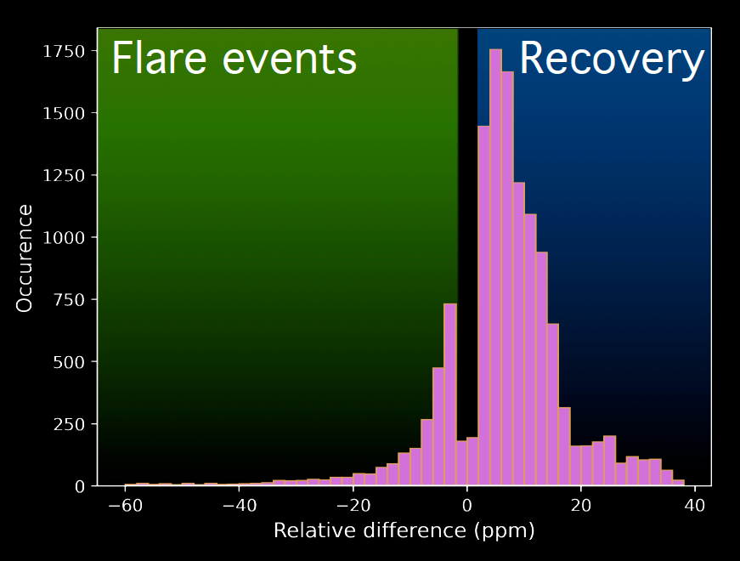
RESULTS Run for ≈ 3.17 yr
Louca, Tsai & Miguel, submitted
YAMILA MIGUEL
Notes:
While large flares are the ones that have the most effect, smaller flares, since they are more frequent, they also slowly alter permanently the atmospheric composition. This is mostly seen in the decrease of H2O and CH4 with the years.
Here we show the variability of the atmosphere in 3 years. The lines are 1000 random points that we choose to plot in this time. The most significant change is in SO2 with a variability of 100ppm. Bur aso CH4, CO2 and H2O change!

Slide 9
TAKE HOME MESSAGES
ATMOSPHERES ARE NOT STATIC, BUT 4D!
The atmosphere is almost never in quiescent equilibrium
Flares drive rapid chemical changes on SO₂, H₂O, CH₄
Spectral features can disappear and reappear, with a variability up to 100 ppm in minutes to hours
Variability leaves long-term imprints: H₂O and CH₄ decrease over years
Implication: abundances, metallicities and C/O inferred may be biased
We are not observing a static atmosphere, we are observing a moment in its evolution
Many thanks to Amy Louca and Shami Tsai
YAMILA MIGUEL
Leiden Observatory
SRON
www.YamilaMiguel.com

