Slide 1



Understanding AGN Molecular Outflows:
Combining Radiative Transfer and Kinematics
Yuze Zhang (张宇泽), Serena Viti, Michiel R. Hogerheijde, & Santiago García-Burillo
Notes:
Flip the title: Understanding the AGN Molecular Outflows: Combining …. (DONE)

Slide 2
Roles of AGN Molecular Outflows in Galaxies
Prevent cooling + Expelling gas from galaxies
Harrison 2017
Triggering star formation by conpressing the gas
e.g. Marconi & Hunt 2003
Maiolino et al. 2017; Gallagher et al. 2019
M_{BH}
Co-evolution between galaxies and their SMBHs
Most impact
M_{bulge}; σ
Molecular outflow: most massive phase
Buldge velocity dispersion
Yuze Zhang - yuzezhang@mail.strw.leidenuniv.nl
2
Notes:
Roles of molecules in AGN outflows in galaxy (DONE)
Add a slide of my previous paper and say why it is not enough and introduce the talk (add plot here) (DONE)

Slide 3
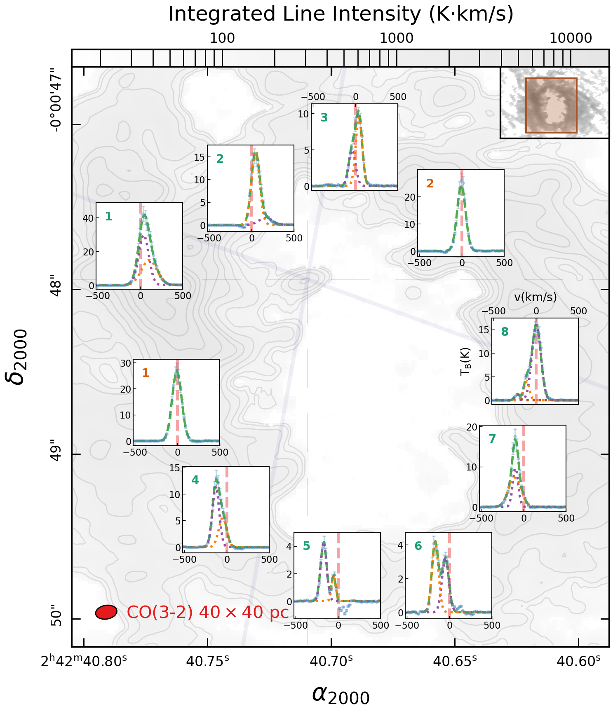
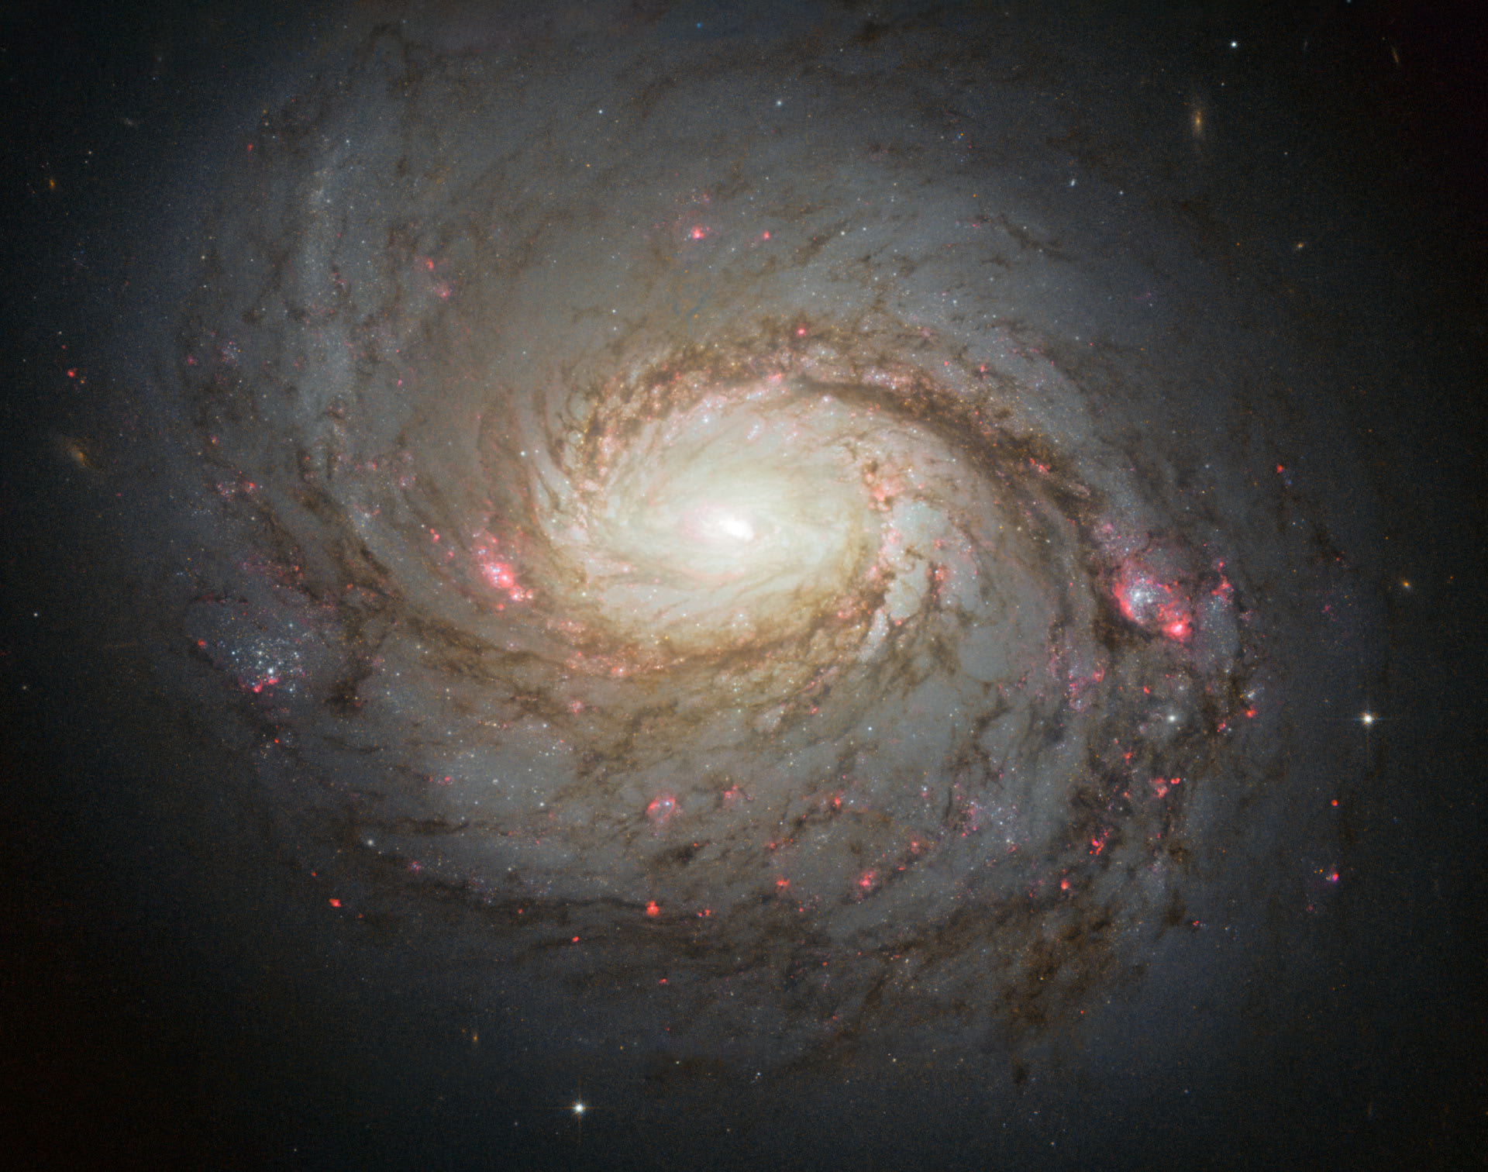
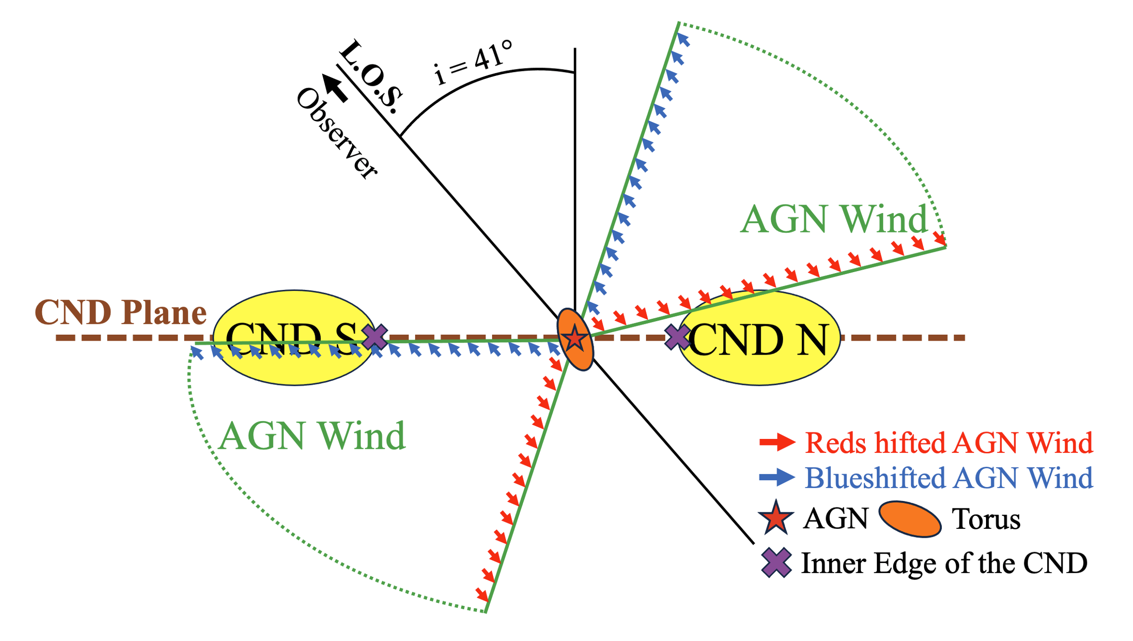
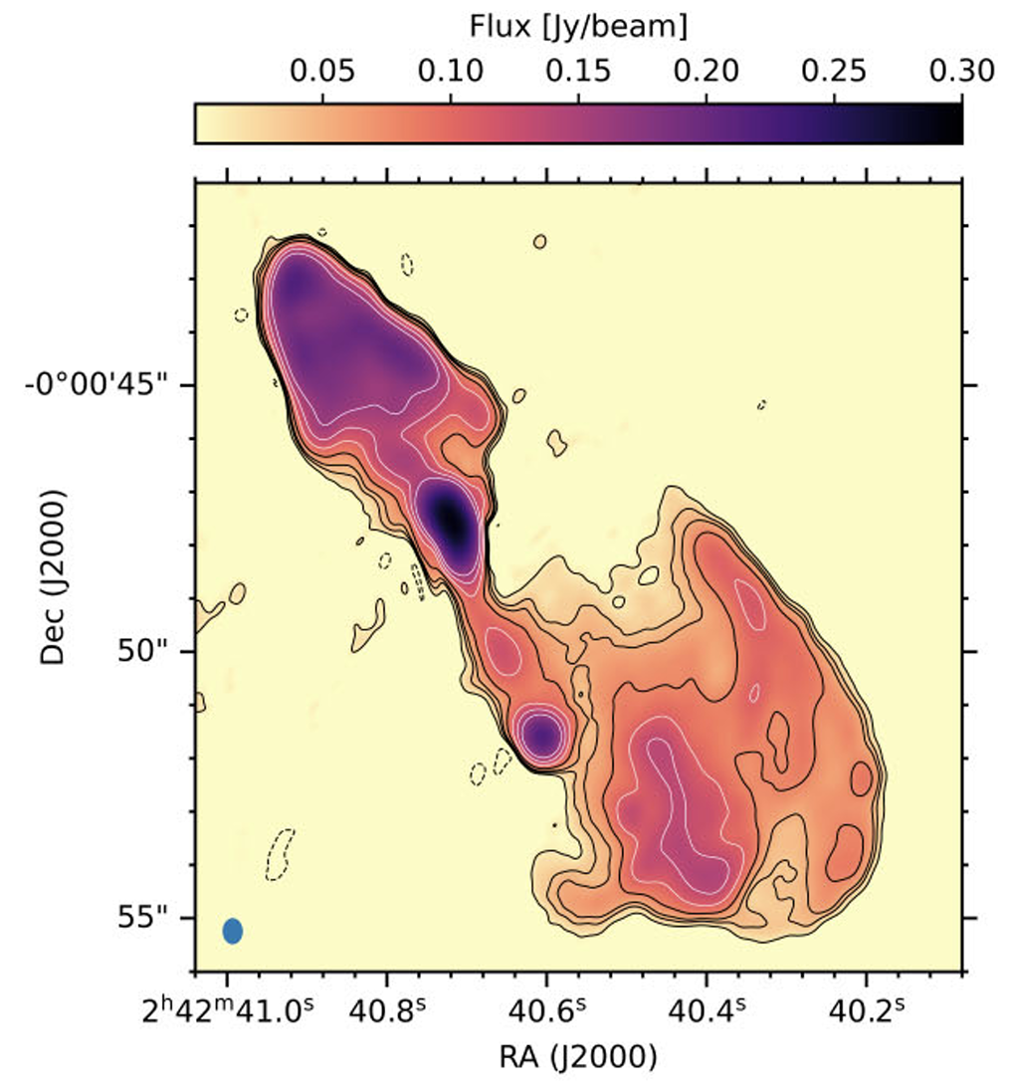
From an Empirical Perspective (NGC 1068)
Previous study of the Circumnuclear Disk (CND) in NGC 1068:
Zhang et al. 2025
No outflow
Multi-component molecular outflow
Strongest
outflow
Kinematic variations across the CND
Asymmetry between the northern and southern outflows
No outflow
No underlying physics involved!
Mutie et al. 2024
Strongest
outflow
1
AGN
5
Yuze Zhang - yuzezhang@mail.strw.leidenuniv.nl
3
Notes:
Roles of molecules in AGN outflows in galaxy (DONE)
Add a slide of my previous paper and say why it is not enough and introduce the talk (add plot here) (DONE)

Slide 4
Modeling AGN Molecular Outflows
Potential drivers of some molecular gas kinematics behaviors
Relative importance of their physical properties
Perform sensitivity analyses on synthetic outputs
from molecular gas kinematics models:
Using 3D radiative transfer code (LIME)
Brinch & Hogerheijde 2010
Guided by high resolution ALMA CO observations of
the circumnuclear disk (CND) in NGC 1068
Yuze Zhang - yuzezhang@mail.strw.leidenuniv.nl
4
Notes:
Change title to something specific (models of …in a prototypical …) (DONE)

Slide 5
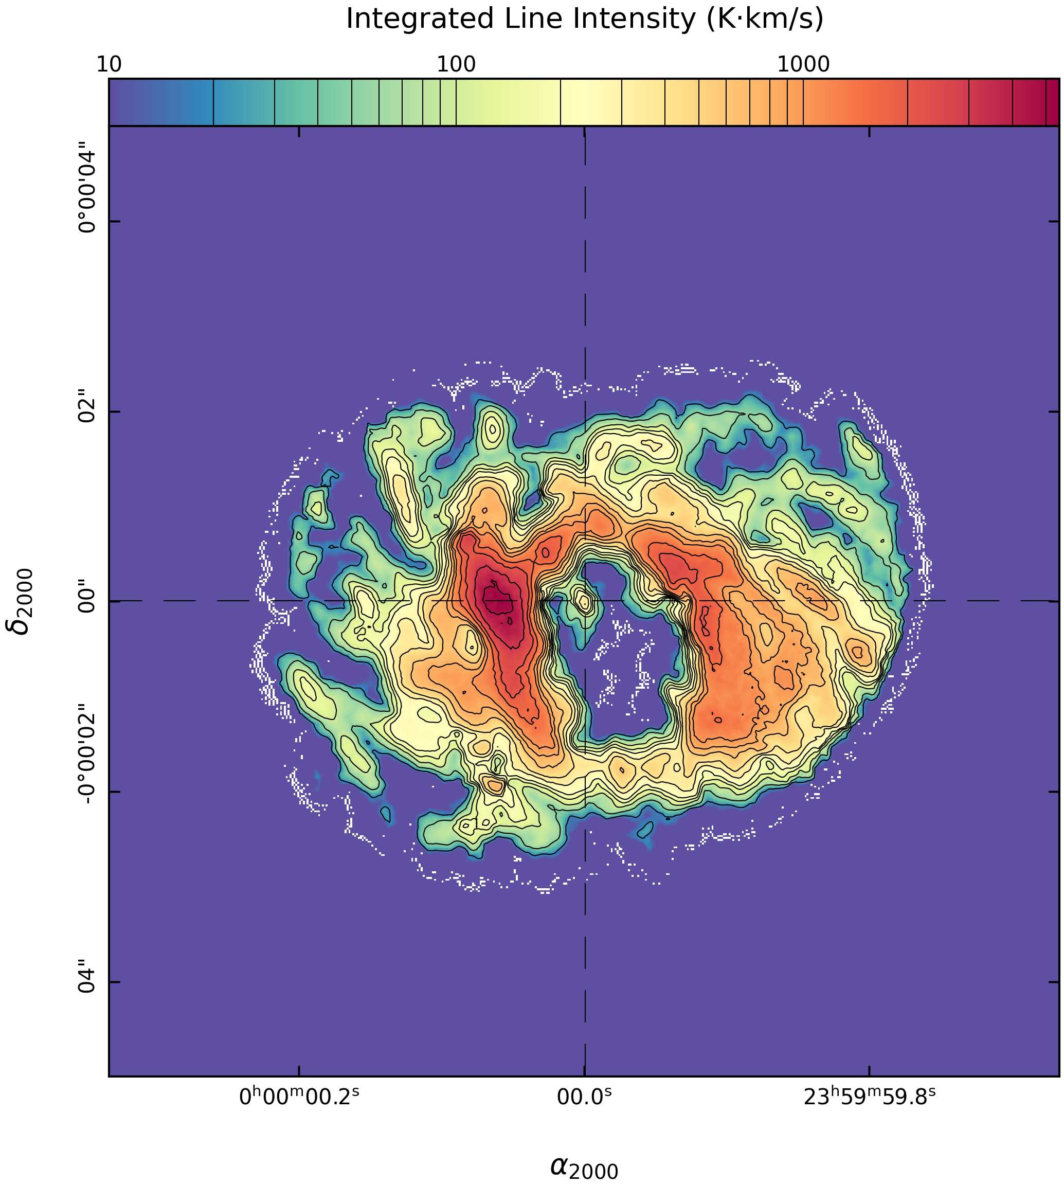
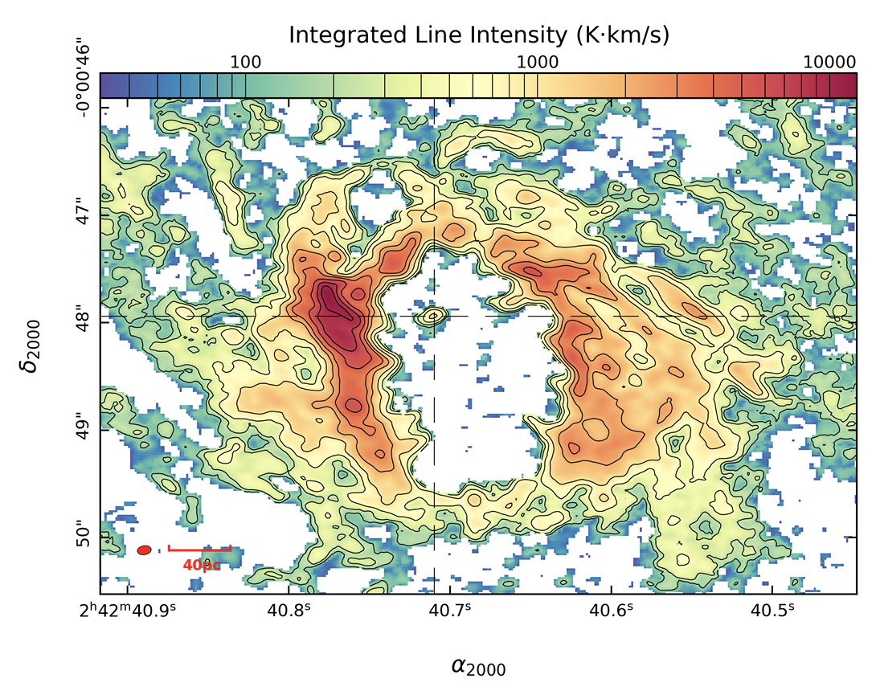
Model Setup
CO high resolution
observations
Model
Observation
Velocity Field
Temperature &
Density distributions
Momentum-based
Models
Velocity-based
Models
VS
Velocity-based
Synthetic line profiles
VS
Momentum-based
Synthetic line profiles
Yuze Zhang - yuzezhang@mail.strw.leidenuniv.nl
5
Notes:
Put a plot in the end of mom0 map (DONE)

Slide 6
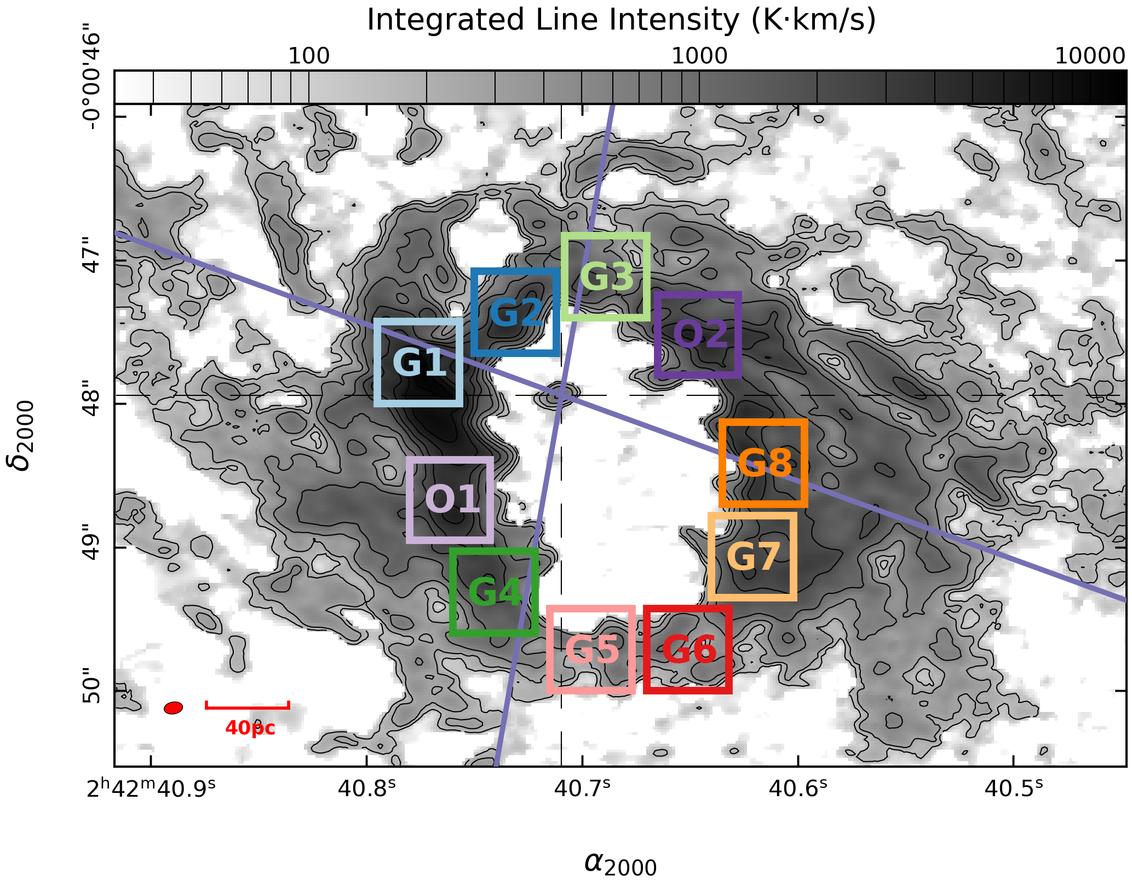
Region Selection
Example: NGC 1068
40 ⨉ 40 pc regions
Based on the outflow:
G: within AGN wind bicone
O: outside AGN wind bicone
Das et al. 2006
Yuze Zhang - yuzezhang@mail.strw.leidenuniv.nl
6
Notes:
Don’t forget to mention that NGC1068 is an example (DONE)

Slide 7
Post-processing
Synthetic
line profiles
Velocity-based models
Momentum-based models
Fit line profiles:
single & multi-component Gaussians
Determine best fit:
F-test & AIC
Output parameters:
number of components, mean, width, etc.
VS
Input parameters
Spearman
Yuze Zhang - yuzezhang@mail.strw.leidenuniv.nl
7

Slide 8
Input Parameters
1. Concentration of molecular gas in the CND (β)
2. Inclination of the AGN outflow (outflow deflection angle; °)
3. Different parameters for complete- vs partial-outflow scenarios
Velocity-based Models
Momentum-based Models
Speed along the cone axis
(km s⁻¹)
Efficiency of momentum transfer
(ε)
345 Distinct Models: 11,100 Synthetic Line Profiles
Yuze Zhang - yuzezhang@mail.strw.leidenuniv.nl
8

Slide 9
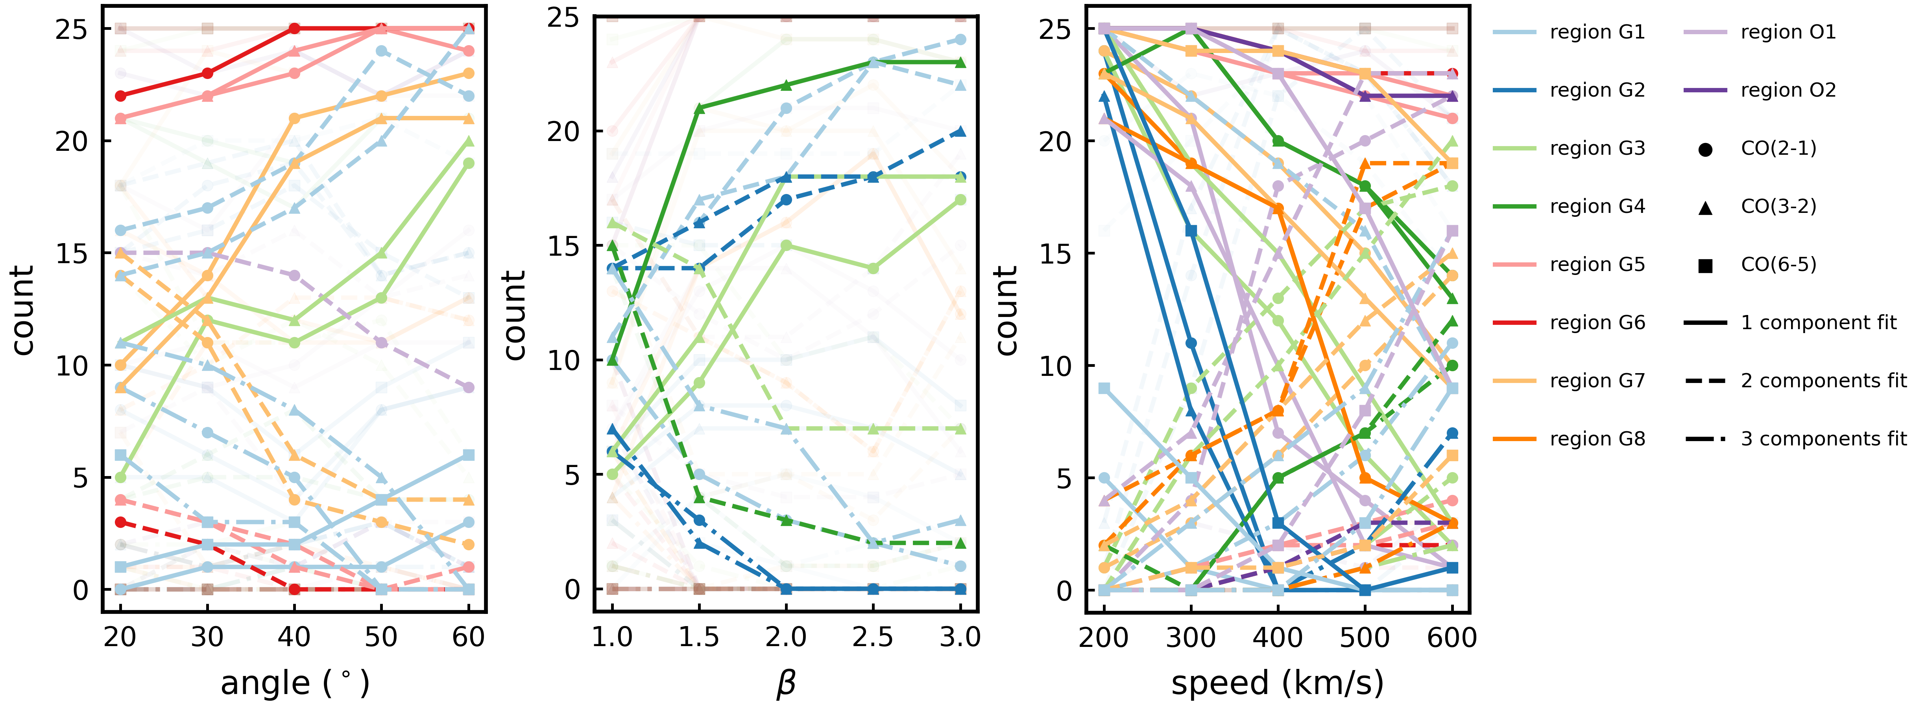
Sensitivity Analysis (complete outflow)
Inclination
Concentration
Increase inclination (decrease in angle)
Decrease in concentration (decrease in β)
Increase in speed
More complex
kinematics
Yuze Zhang - yuzezhang@mail.strw.leidenuniv.nl
9
Notes:
Say complexity of the gas kinematics instead of line profiels or number of components (DONE)

Slide 10
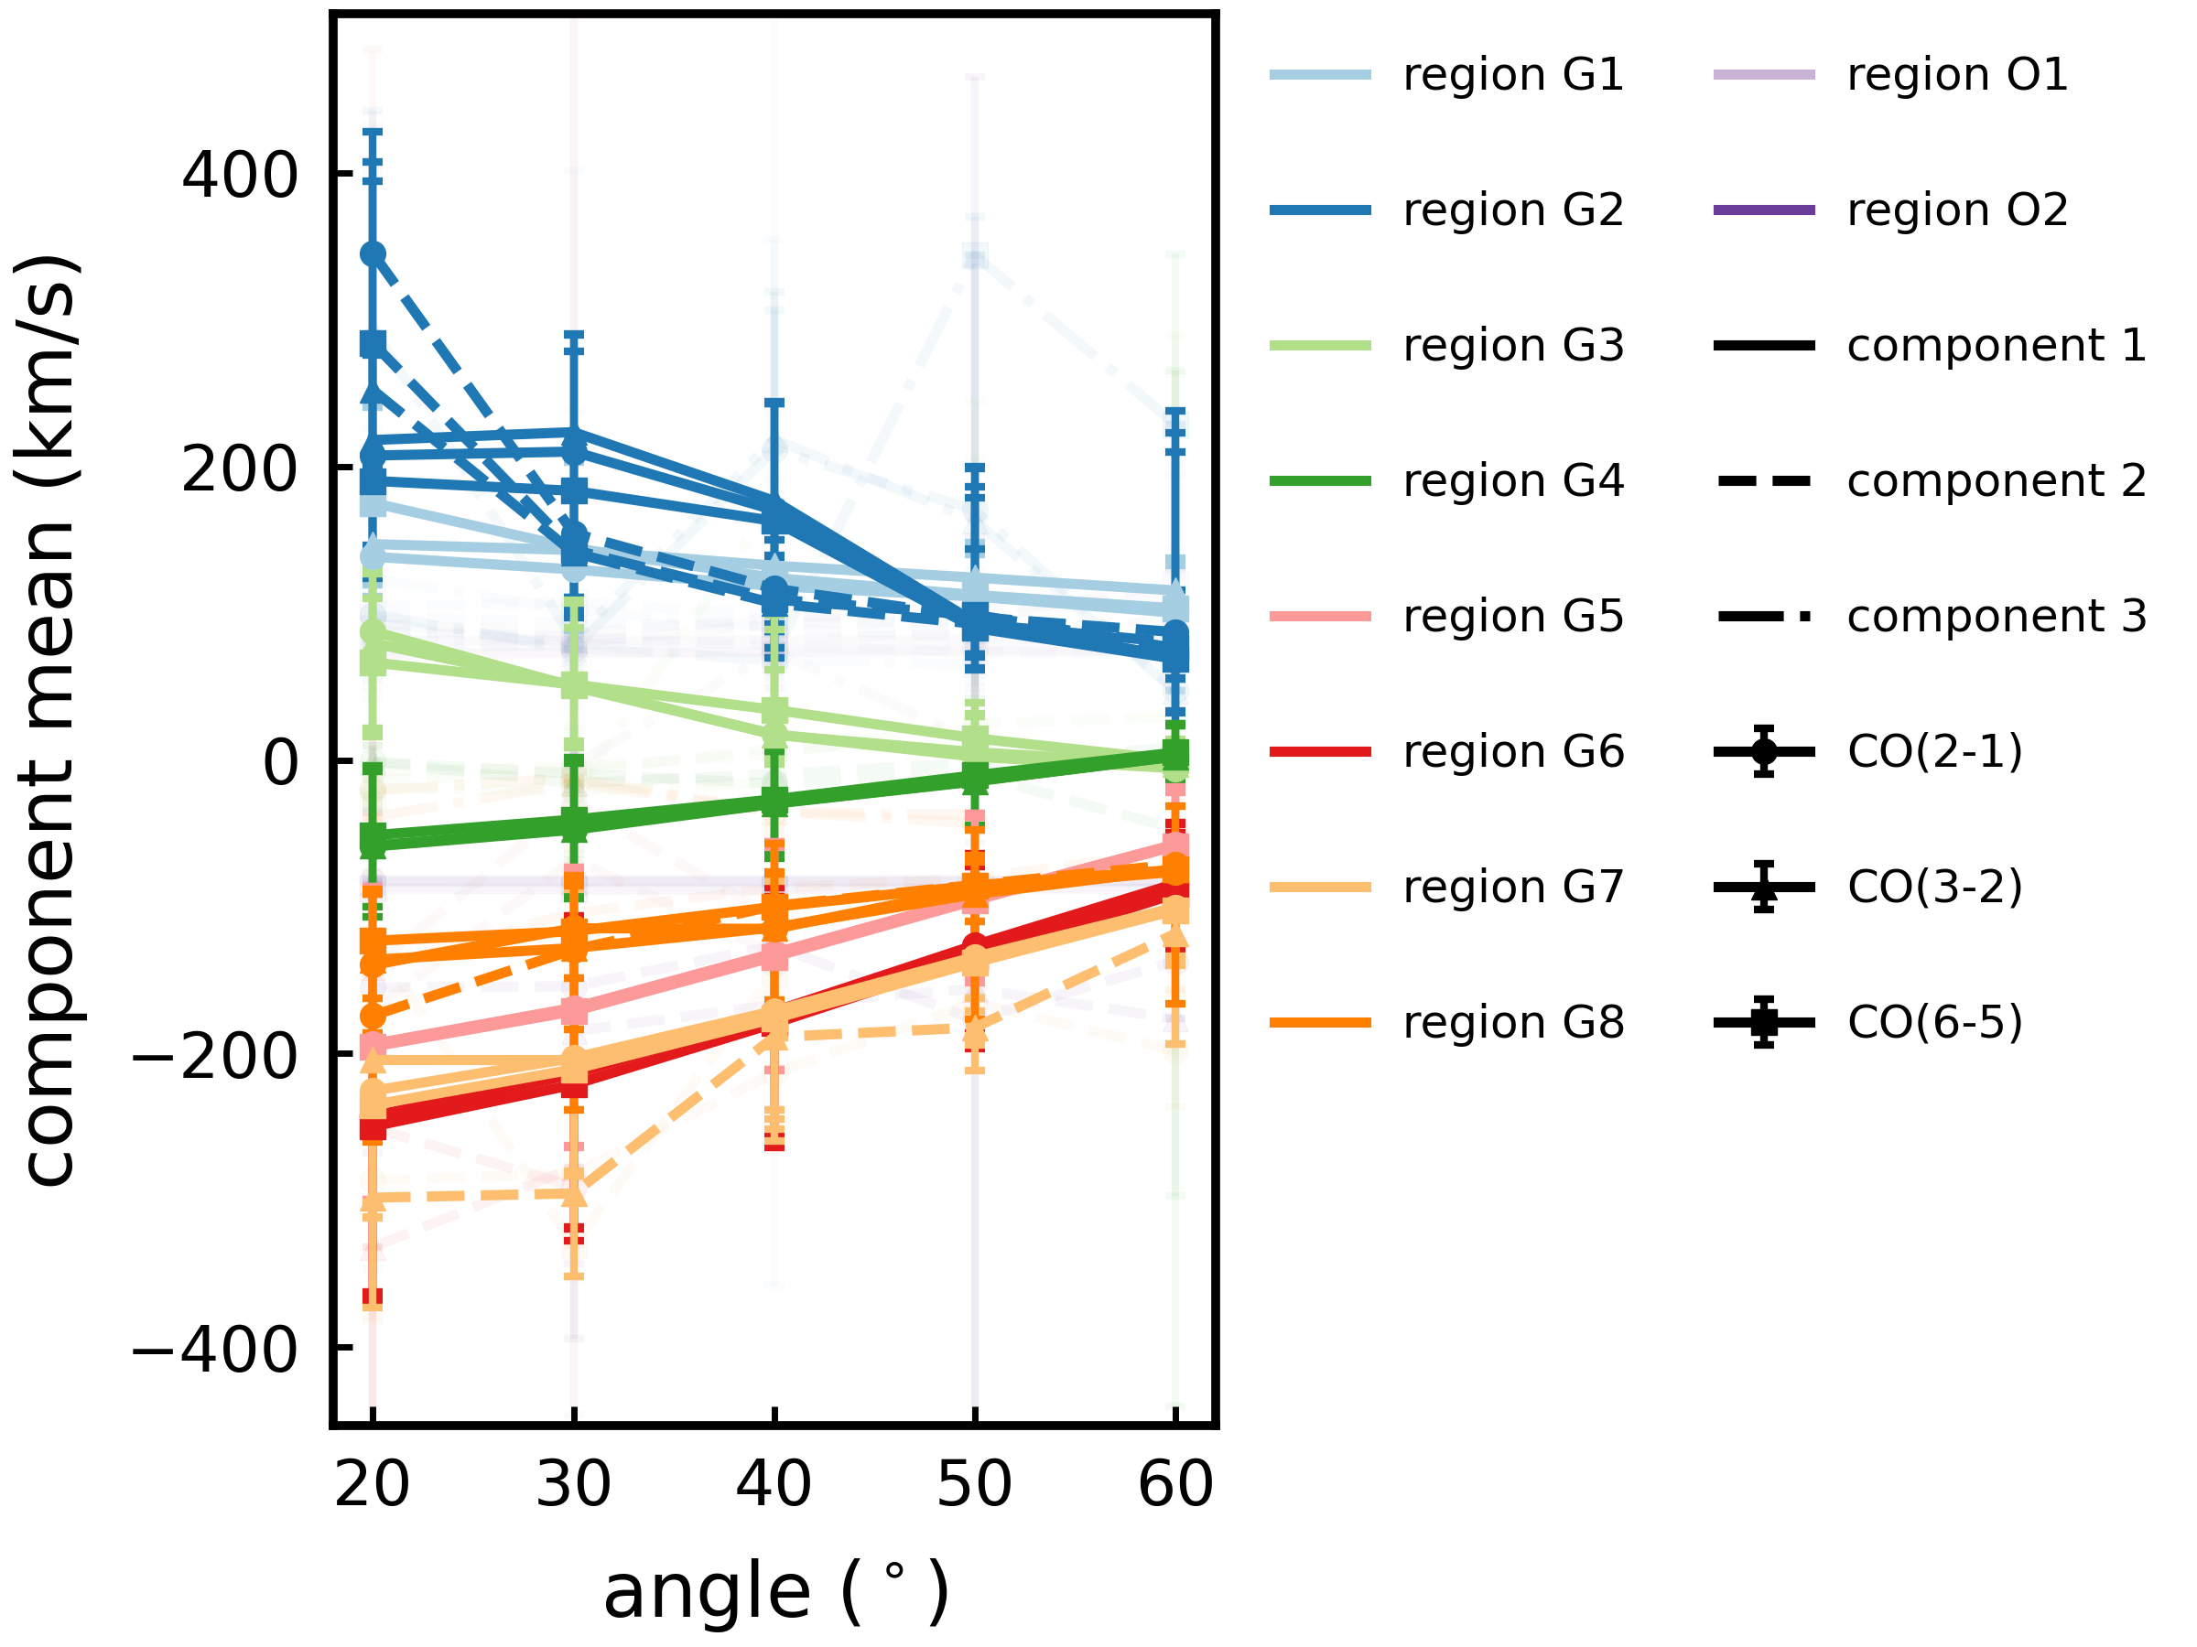
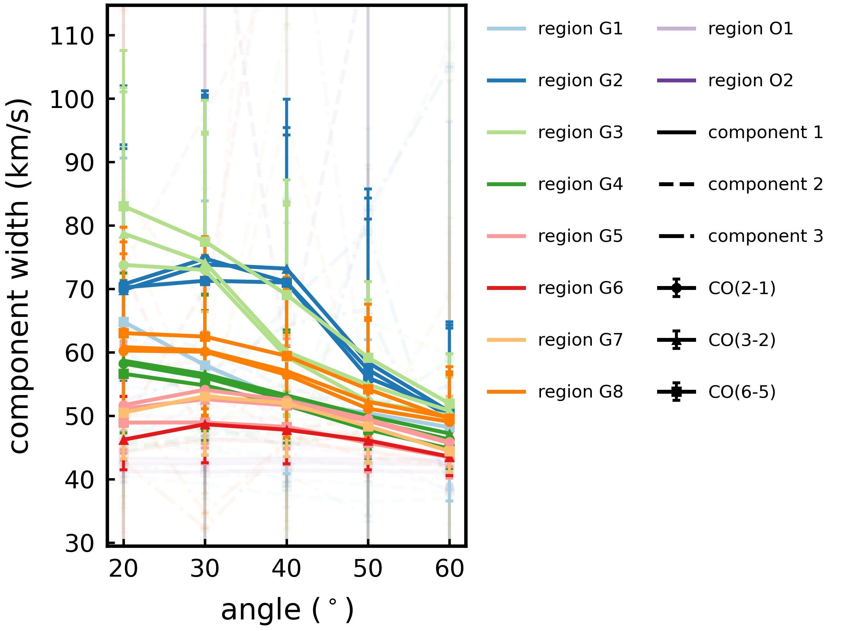
Sensitivity Analysis (complete outflow)
Inclination
Inclination
More gas
influenced
by the outflow
+
More
“turbulence”
Increase in inclination
Yuze Zhang - yuzezhang@mail.strw.leidenuniv.nl
10
Notes:
Less gas deviated from the mean motion of the galaxy (influenced by the outflow) (DONE)
Width as turbulence (in quotes) (DONE)

Slide 11
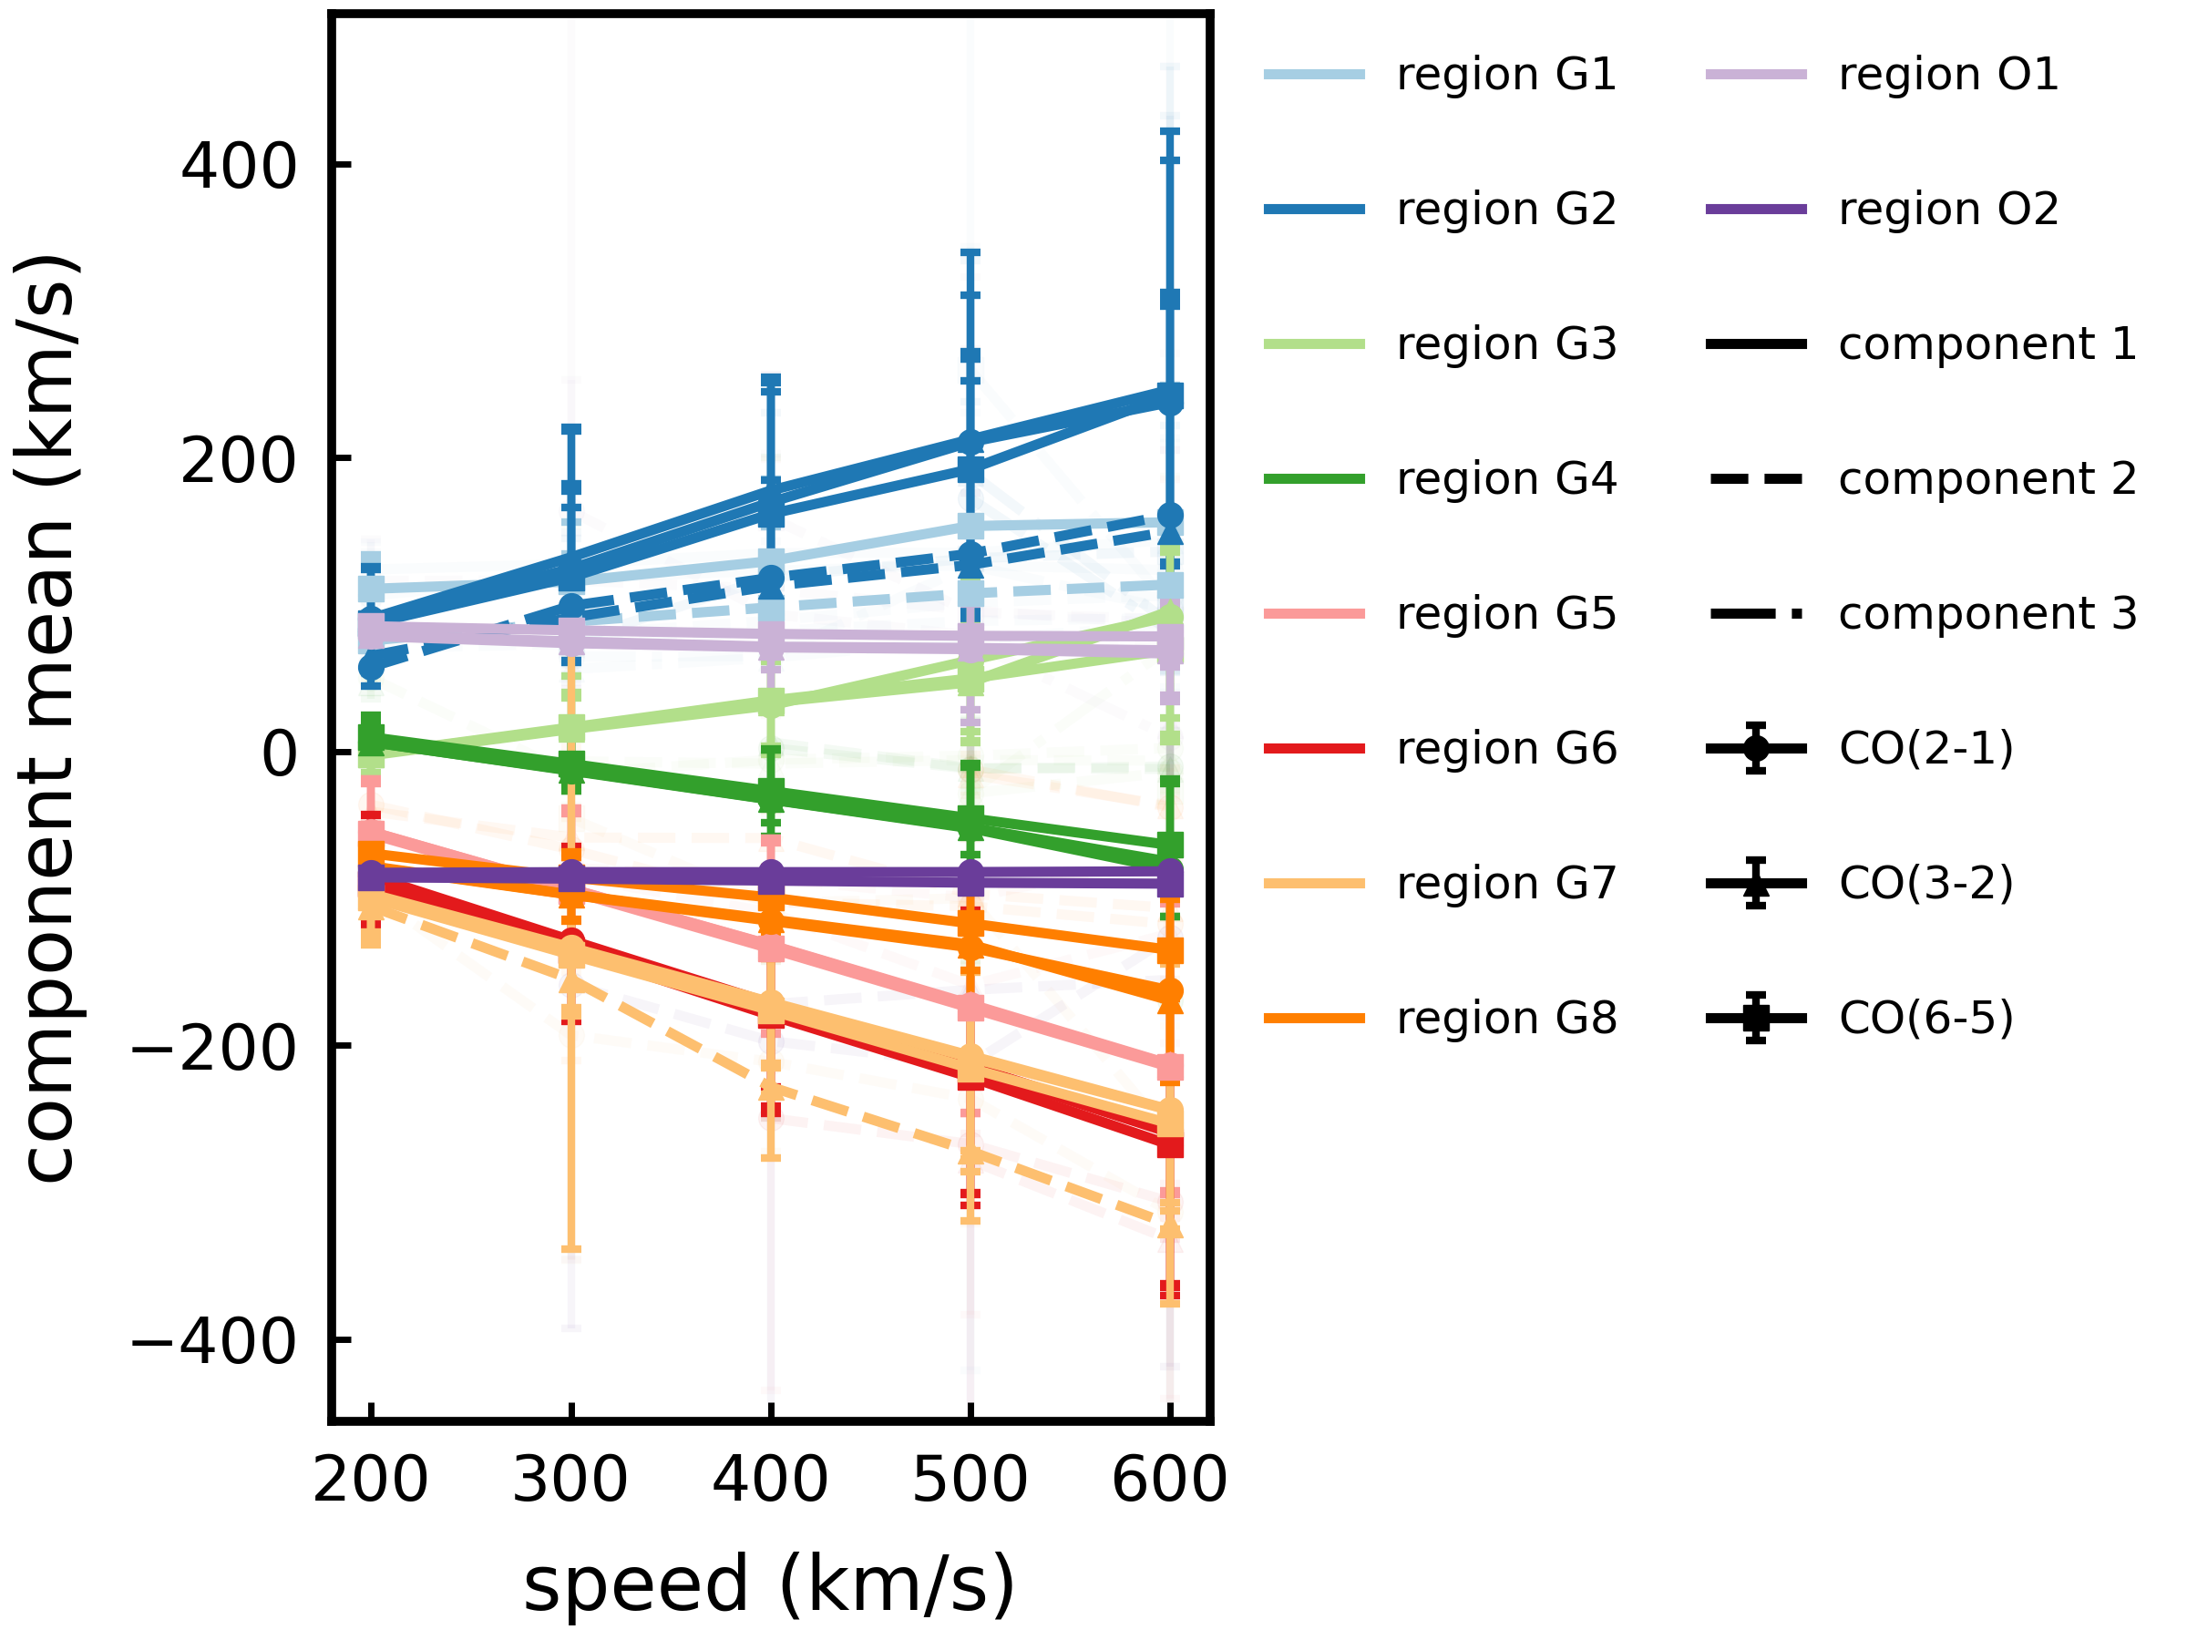
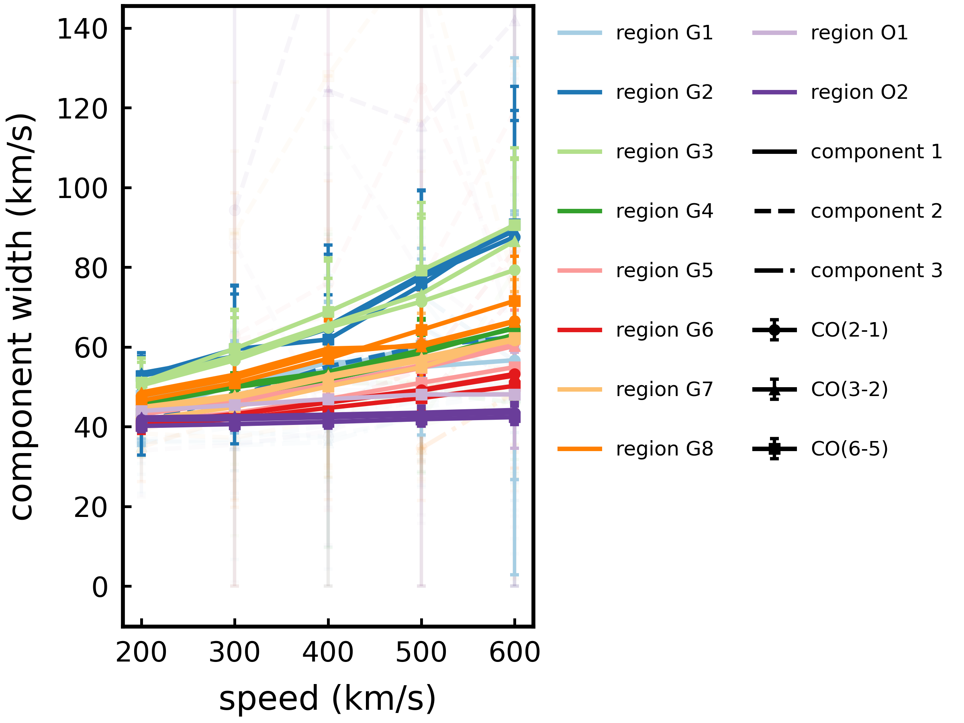
Sensitivity Analysis (complete outflow)
More gas
influenced
by the outflow
More
“turbulence”
+
Increase in speed
Yuze Zhang - yuzezhang@mail.strw.leidenuniv.nl
11
Notes:
Same as previous page

Slide 12
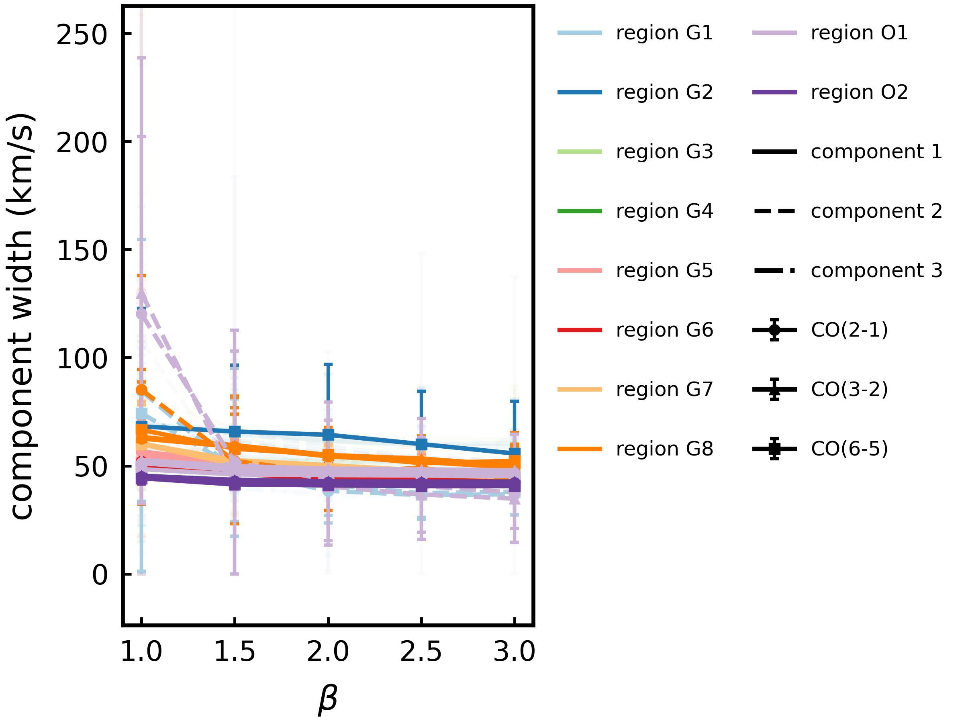
Sensitivity Analysis (complete outflow)
Concentration
Less
“turbulence”
Increase gas concentration
Yuze Zhang - yuzezhang@mail.strw.leidenuniv.nl
12

Slide 13
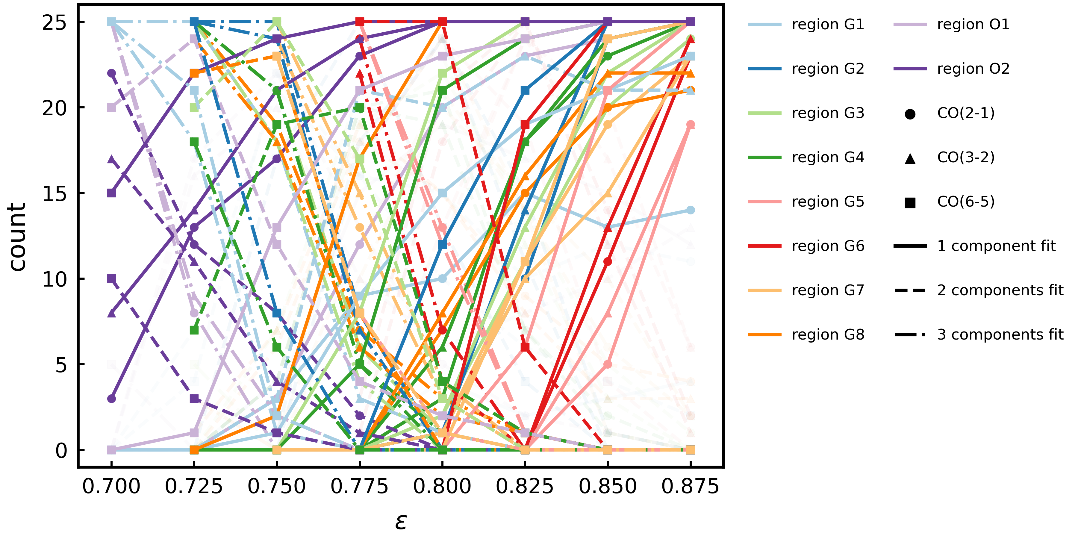
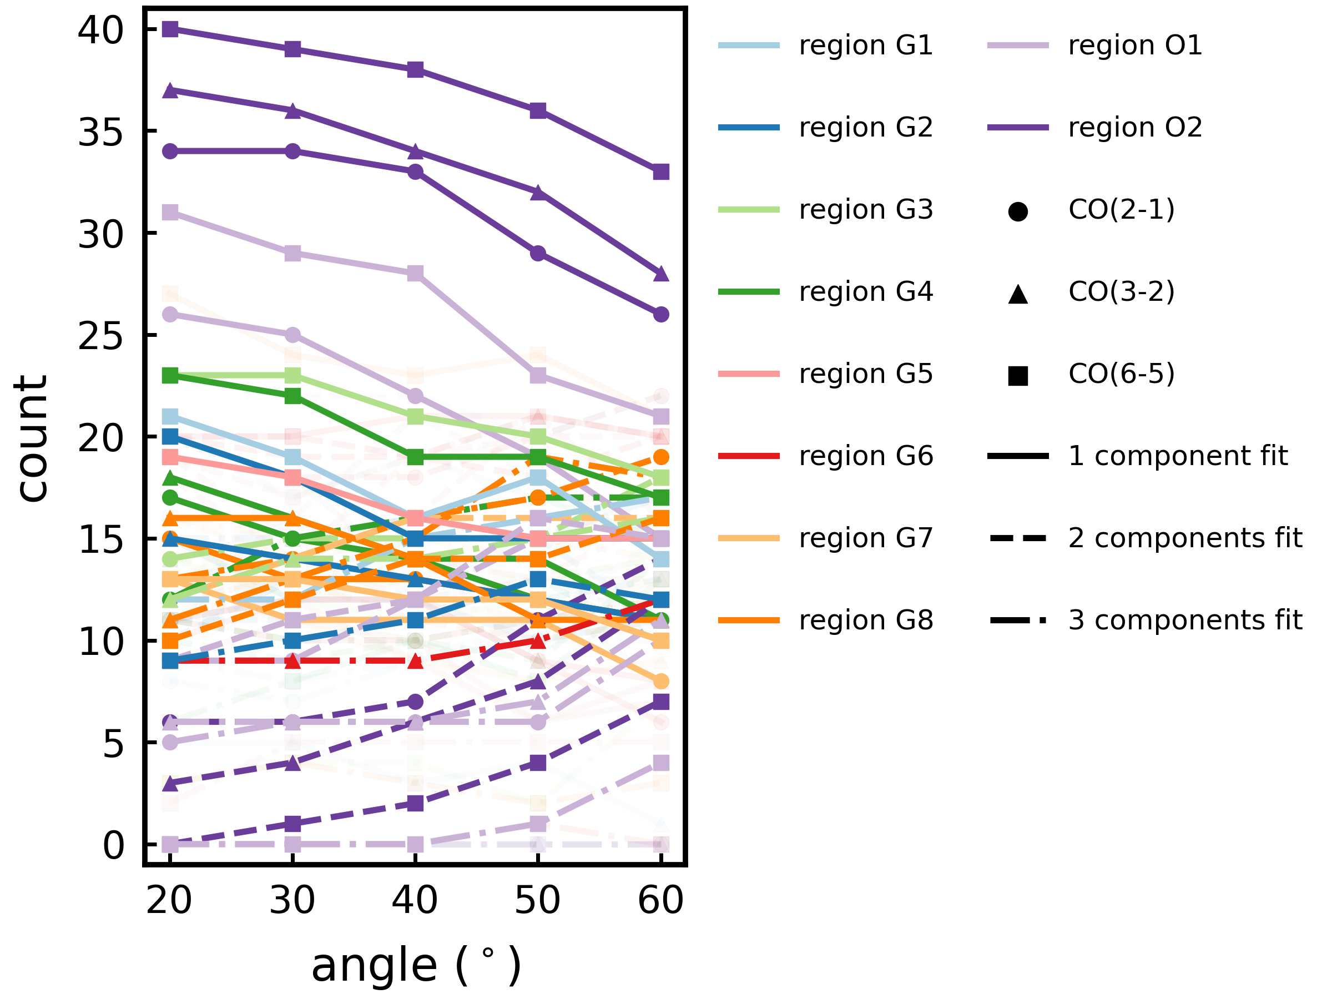
Sensitivity Analysis (partial outflow)
More efficient momentum transfer
Inclination
Decrease in inclination
More efficient momentum transfer
(decrease in ε)
More complex
kinematics
Yuze Zhang - yuzezhang@mail.strw.leidenuniv.nl
13

Slide 14
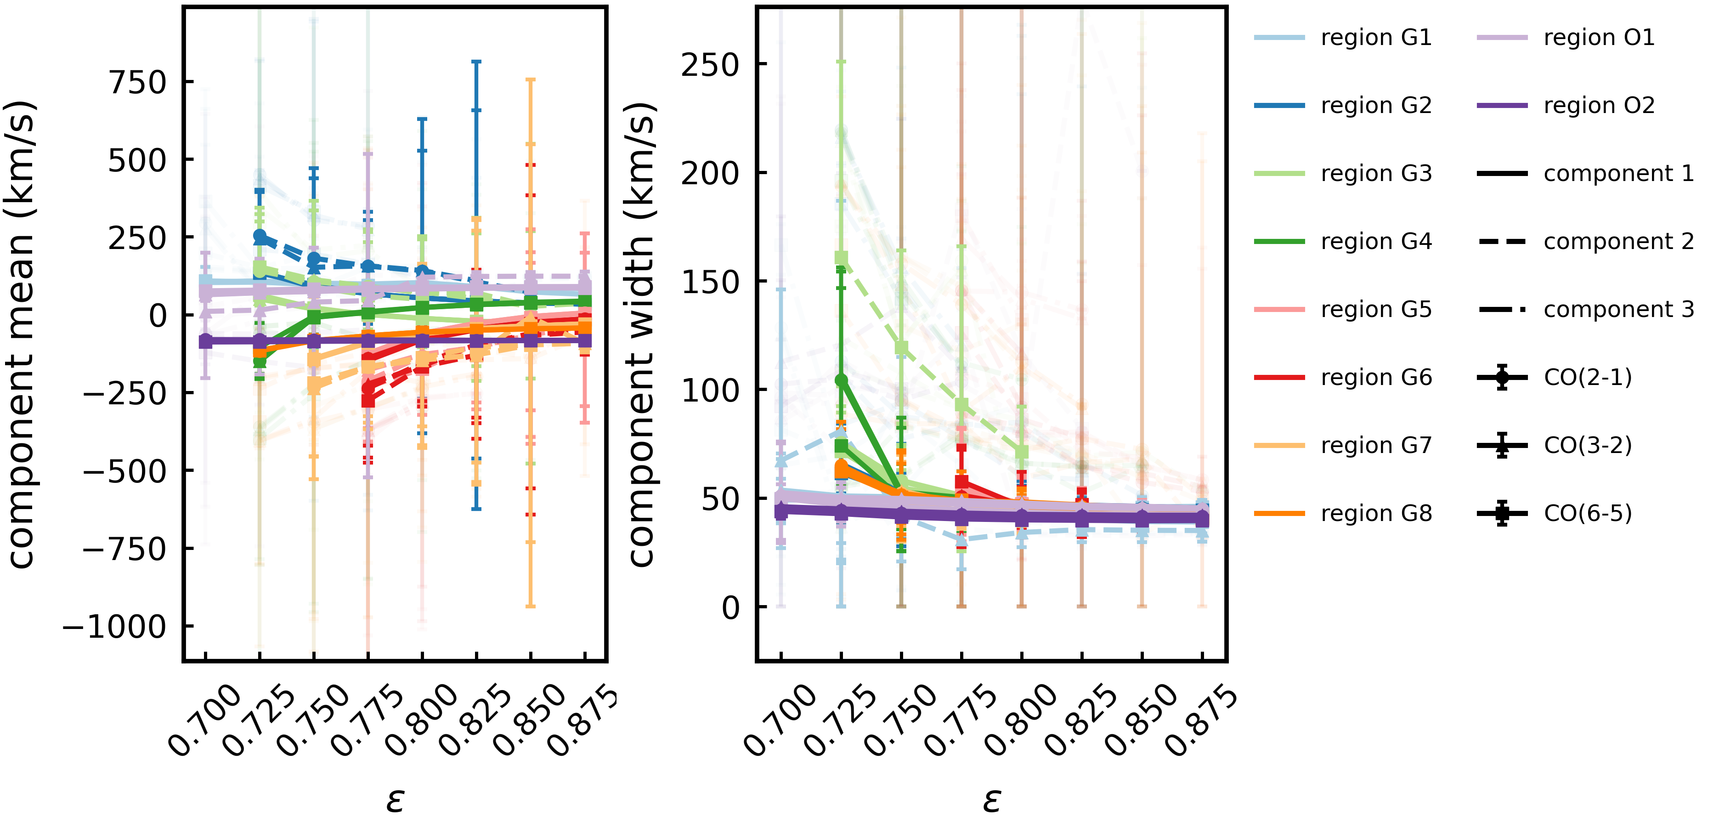
Sensitivity Analysis (partial outflow)
More efficient momentum transfer
More gas
influenced
by the outflow
More efficient
momentum transfer
More
“turbulence”
+
Yuze Zhang - yuzezhang@mail.strw.leidenuniv.nl
14

Slide 15
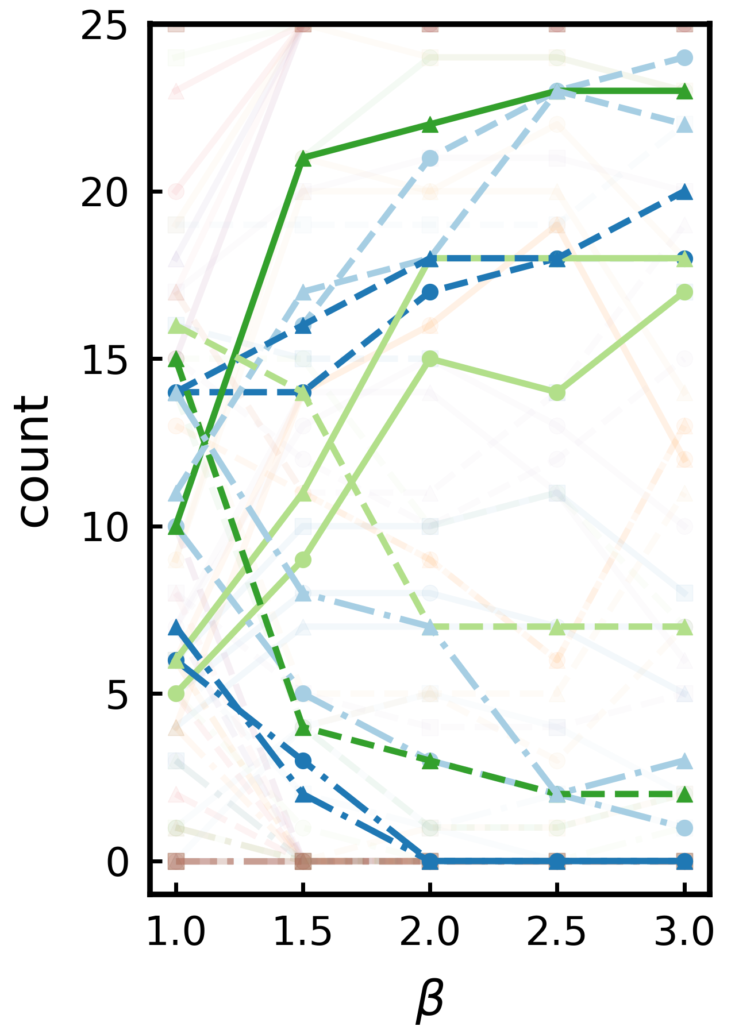
Sensitivity Analysis (comparisons)
Concentration
More efficient momentum transfer
Velocity-based
Momentum-based
Kinematics more
complex in the
northern CND
Kinematics most complex around center of southern CND
VS
Yuze Zhang - yuzezhang@mail.strw.leidenuniv.nl
15
Notes:
Circle on the small plot instead of the trends (also simplify the points) (DONE)

Slide 16
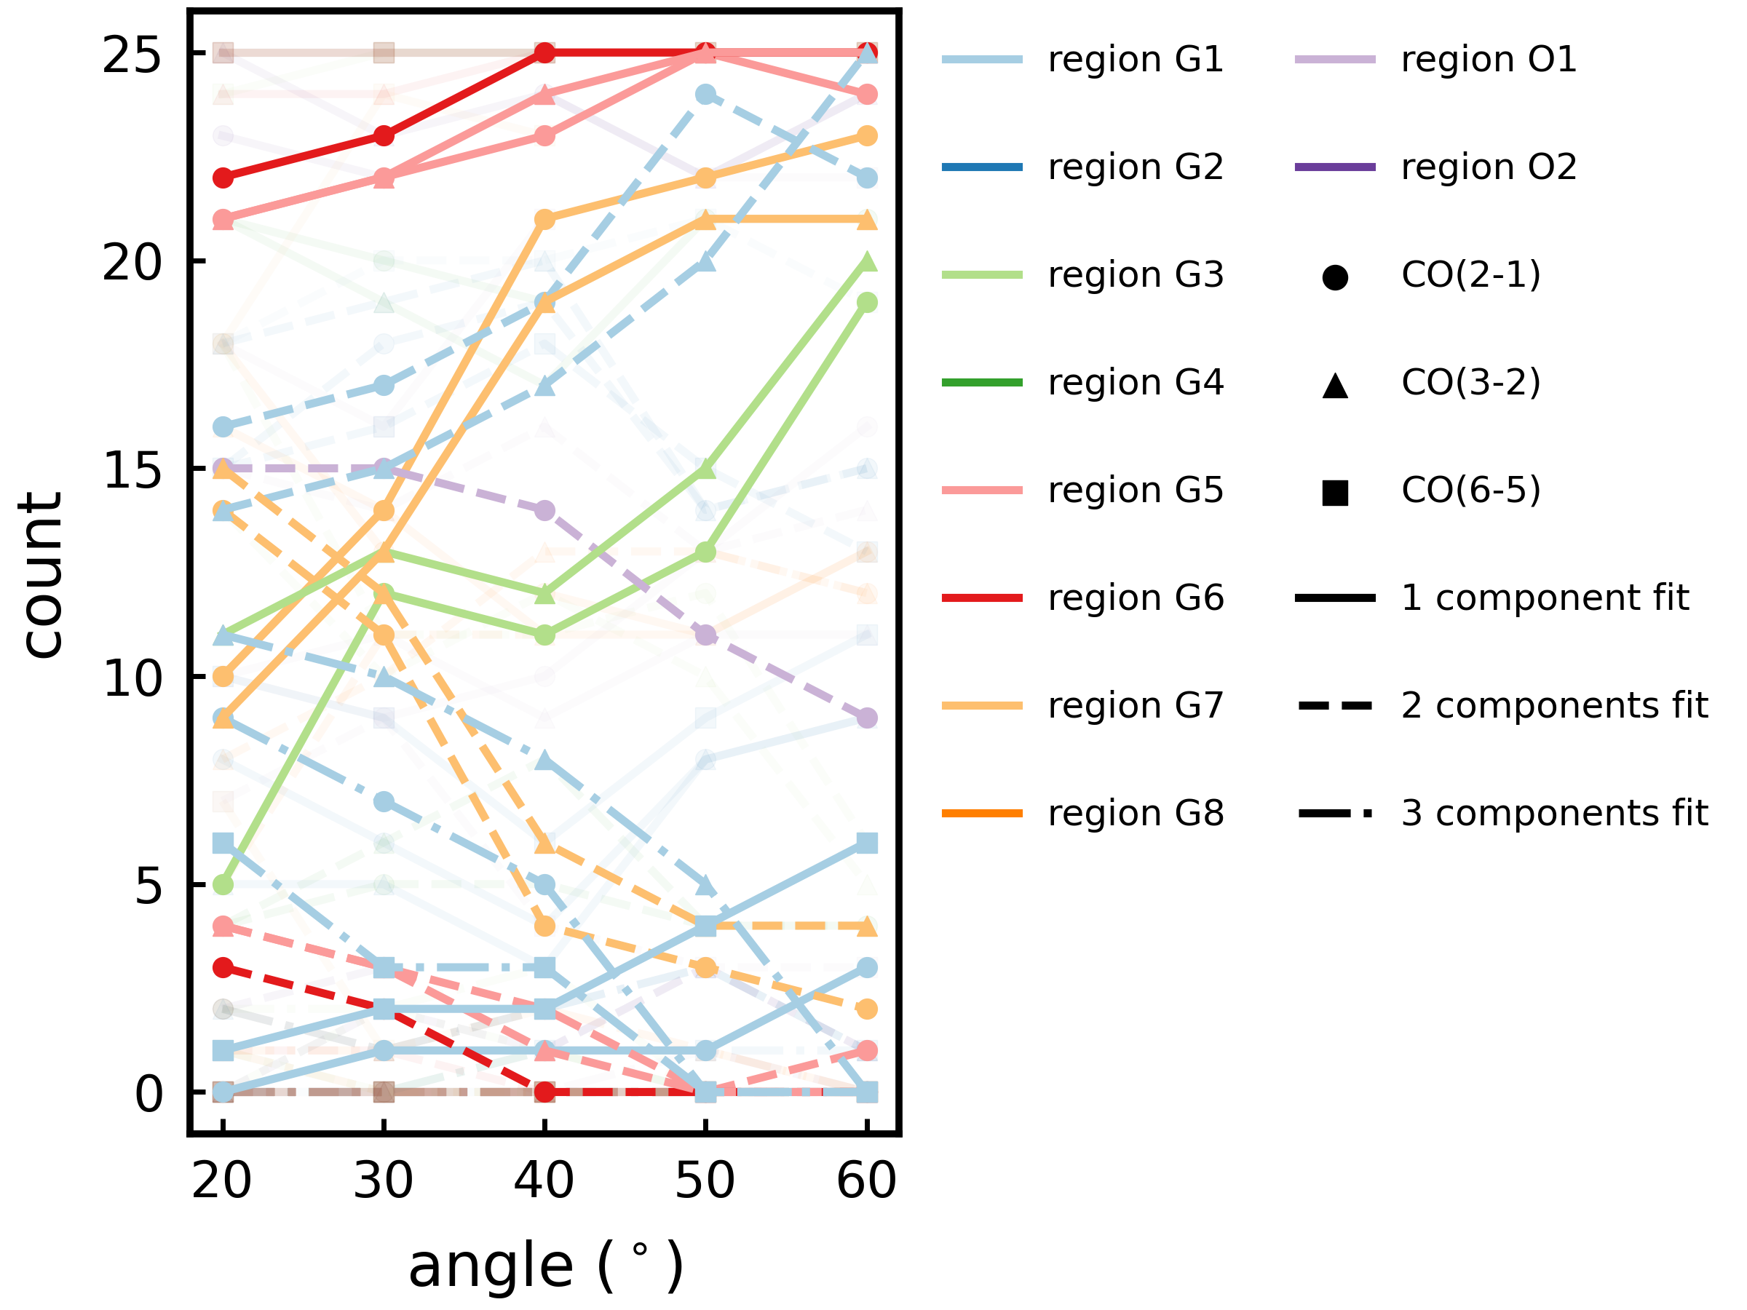
Sensitivity Analysis (comparisons)
Inclination
Inclination
Velocity-based
Momentum-based
More complex
kinematics
Less complex
kinematics
Increase in inclination
VS
Yuze Zhang - yuzezhang@mail.strw.leidenuniv.nl
16

Slide 17
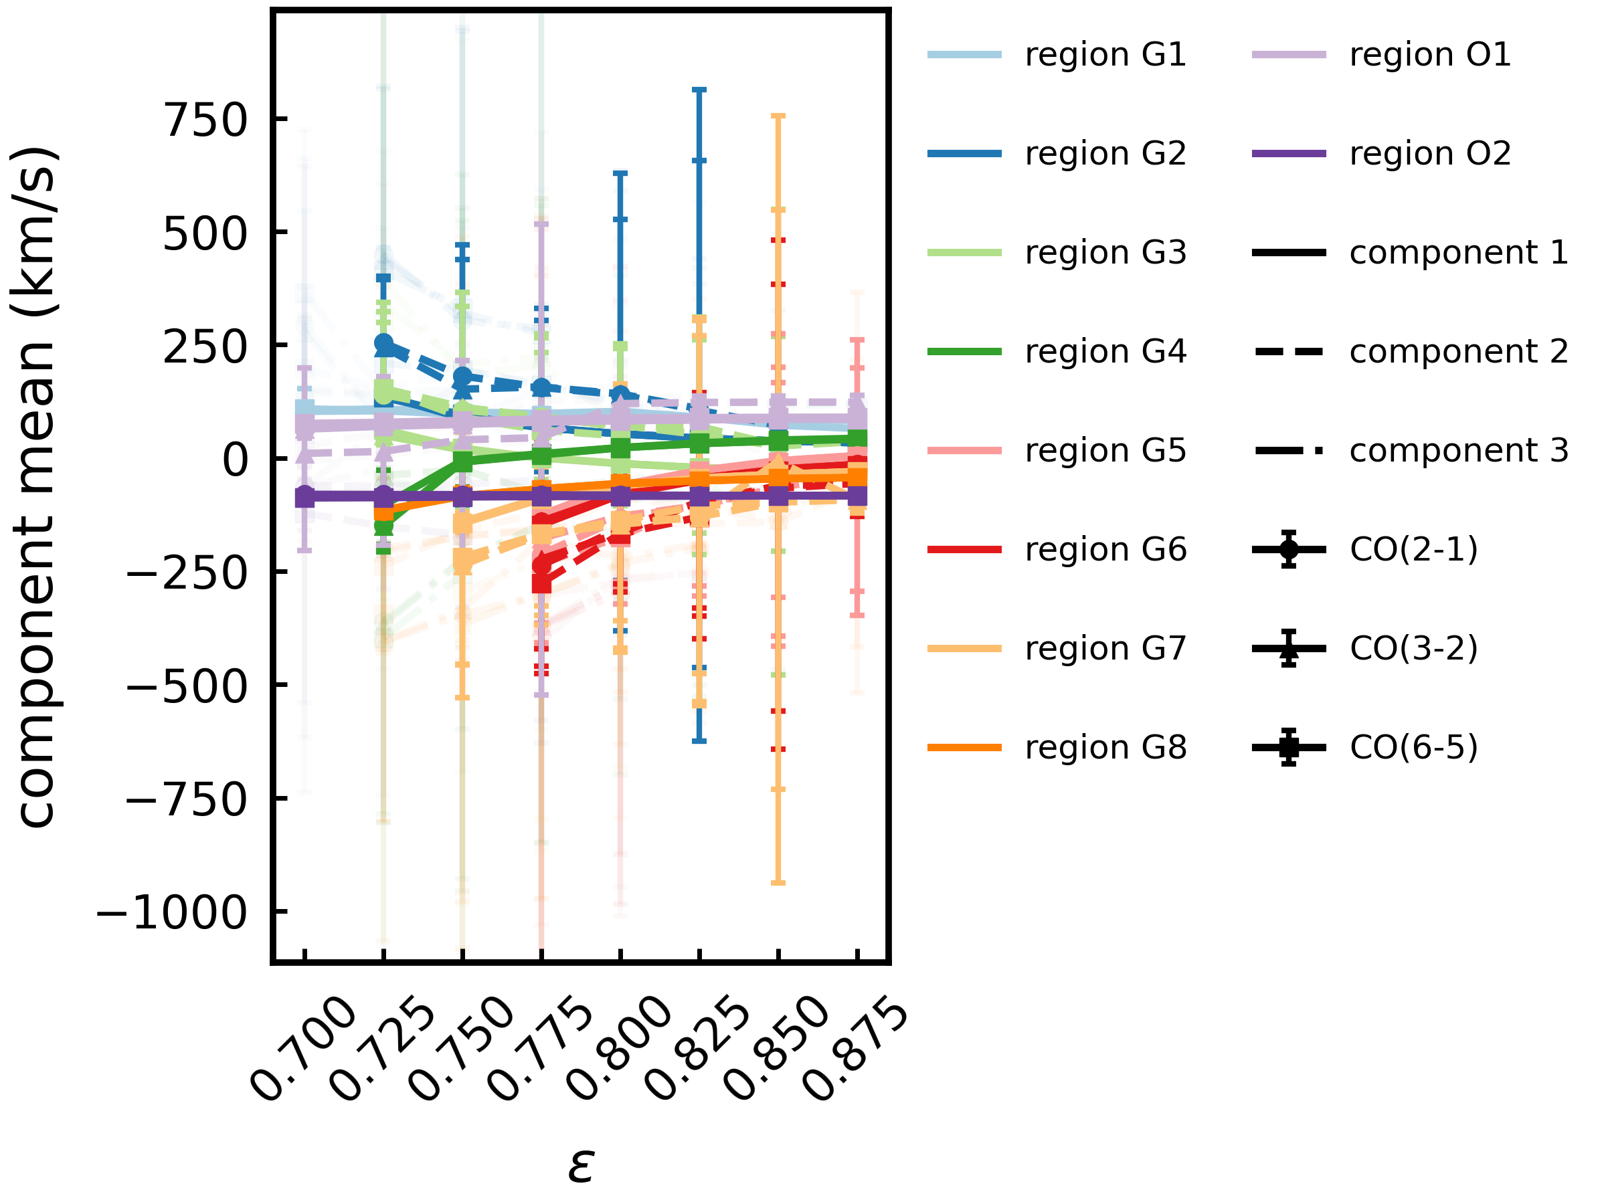
Sensitivity Analysis (comparisons)
Velocity-based
Momentum-based
Wing components
can be either high- or low-
velocity components
Wing components are only high velocity components
VS
More sensitive to change of input parameters
Yuze Zhang - yuzezhang@mail.strw.leidenuniv.nl
17
Notes:
Say wing components instead of major / minor components (DONE)

Slide 18
Conclusions
A: Significant relations:
Input
Output
Outflow inclination
Outflow speed
Disk compactness
Momentum transfer efficiency
Line profile (kinematics) complexity
Line-of-sight velocity
Line of sight widths
B: Local density & temperature conditions also influences kinematics
C: Higher velocity components more sensitive to model input
Yuze Zhang - yuzezhang@mail.strw.leidenuniv.nl
18
Notes:
Also mention FWHM influence (thickness) (add previous slides also) (DONE)
Mention that we’ll also compare with observation in the end (orally)
Ask Mathilde to squeeze me in (kasia also)

Slide 19
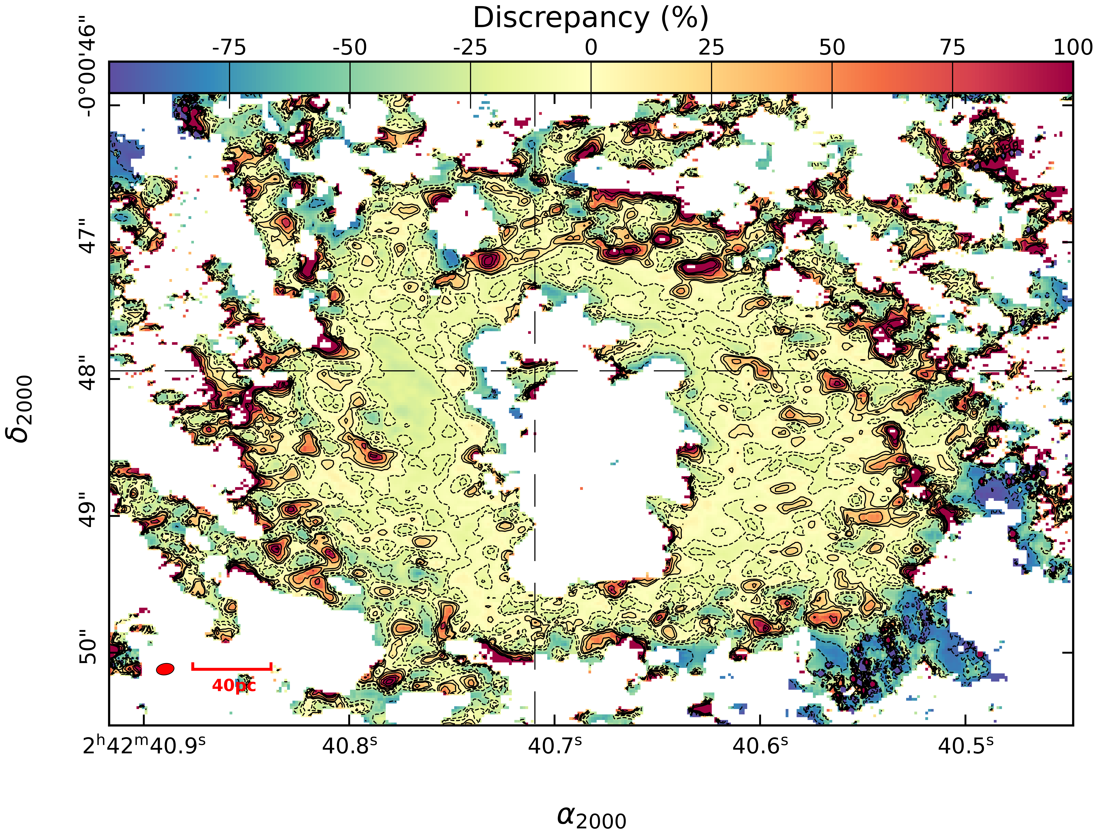
Model versus Observation: CO(3-2)/(2-1)
VS
Yuze Zhang - yuzezhang@mail.strw.leidenuniv.nl
A1

Slide 20
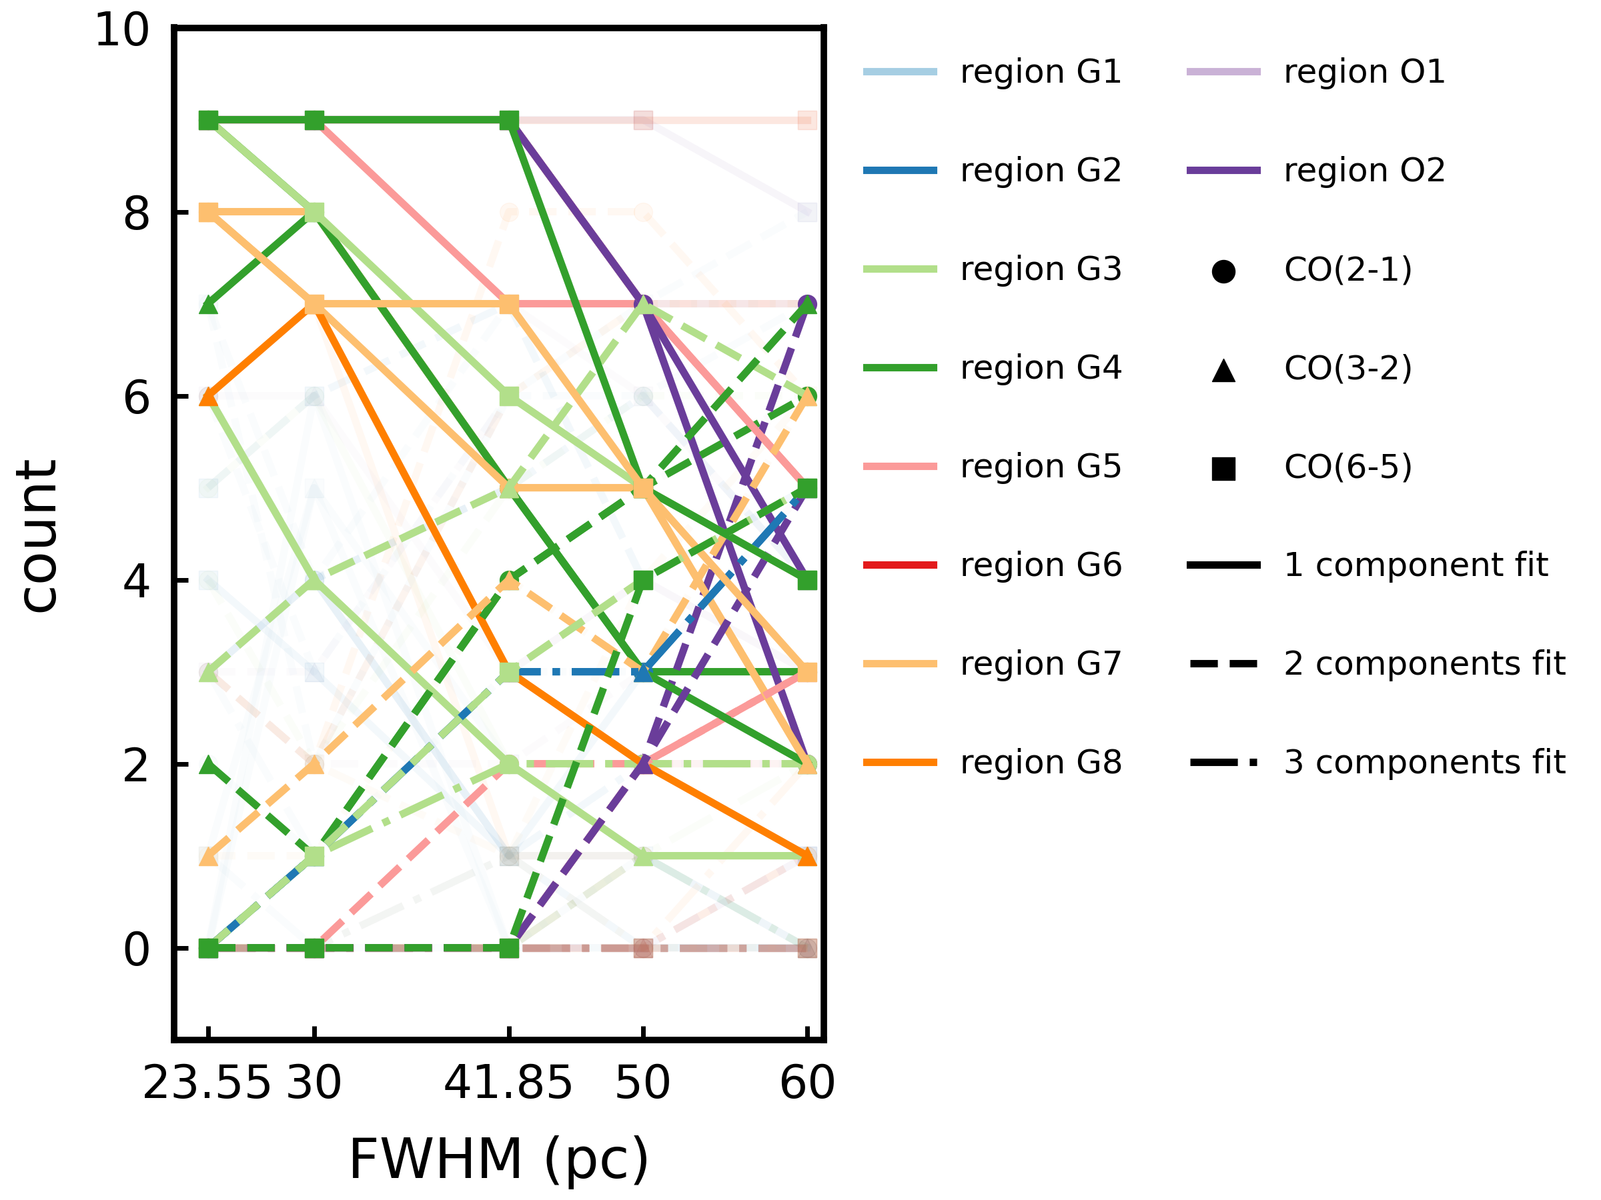
Sensitivity Analysis (CND thickness)
Concentration
Thickness
More complex
kinematics
Increase CND thickness
Yuze Zhang - yuzezhang@mail.strw.leidenuniv.nl
A2

Slide 21
Sensitivity Analysis (CND thickness)
Concentration
Thickness
Degeneracy between thickness of CND & concentration of materials in the CND
in terms of kinematics complexity
Yuze Zhang - yuzezhang@mail.strw.leidenuniv.nl
A3

Slide 22
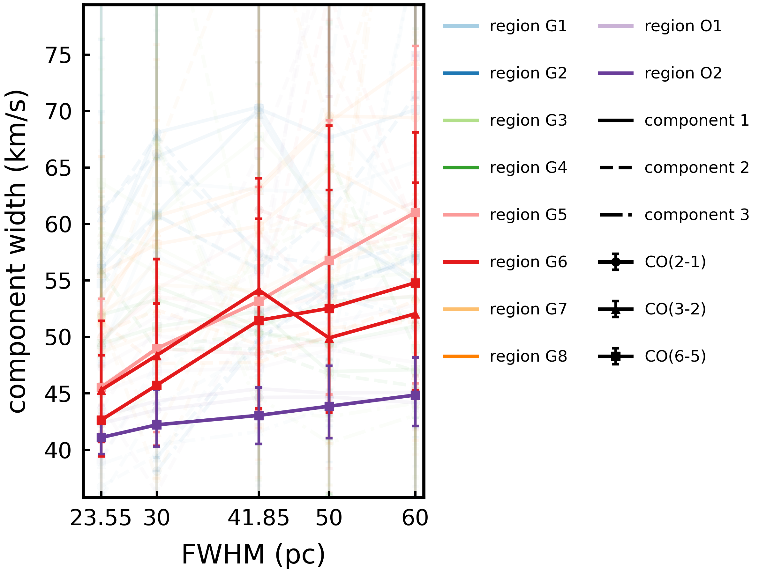
Sensitivity Analysis (CND thickness)
Too few significant trends
Concentration
Thickness
But not for output parameters from specific components
(no degeneracy for kinematics behaviors)
Yuze Zhang - yuzezhang@mail.strw.leidenuniv.nl
A4
Notes:
Say wing components instead of major / minor components

Slide 23
Conclusions
A: Significant relations:
Outflow inclination
Outflow speed
Disk compactness
Momentum transfer efficiency
Line profile (kinematics) complexity
Line-of-sight velocity
Line of sight widths
B: Local density & temperature conditions also influences kinematics
C: Higher velocity components more sensitive to model input
D: Degeneracy between thickness and compactness of the CND
For kinematics complexity, not for kinematics behaviors
Yuze Zhang - yuzezhang@mail.strw.leidenuniv.nl
A5
Notes:
Also mention FWHM influence (thickness) (add previous slides also) (DONE)
Mention that we’ll also compare with observation in the end (orally)
Ask Mathilde to squeeze me in (kasia also)

