Slide 1




Exploring dense gas in
dusty star-forming galaxies
with ALMA Band 1
Beth Westoby
PhD Student, Leiden Observatory
With M. Rybak, J. Hodge,
T. Greve, P. van der Werf, G. Sallaberry,
N. Geesink, M. Polvora da Fonesca,
J. van Marrewijk
Netherlands Astronomy Conference 2026
Beth Westoby | westoby@strw.leidenuniv.nl

Slide 2
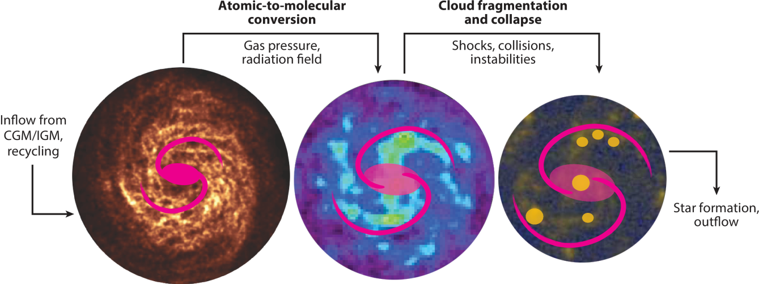
Galaxy Gas Content
Dense
Molecular Gas
Diffuse
Molecular Gas
Atomic Gas
Saintonge & Catinella 2022 Review
Beth Westoby | westoby@strw.leidenuniv.nl

Slide 3
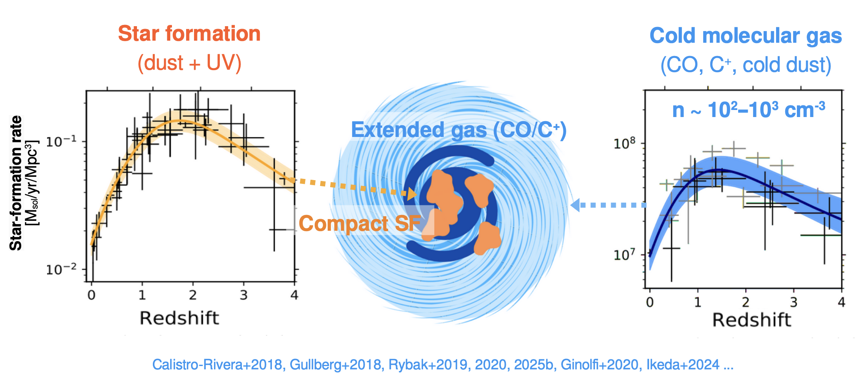
Galaxy Gas Content
What about dense gas?
Slide from Rybak Monsters with empty bellies
Beth Westoby | westoby@strw.leidenuniv.nl

Slide 4
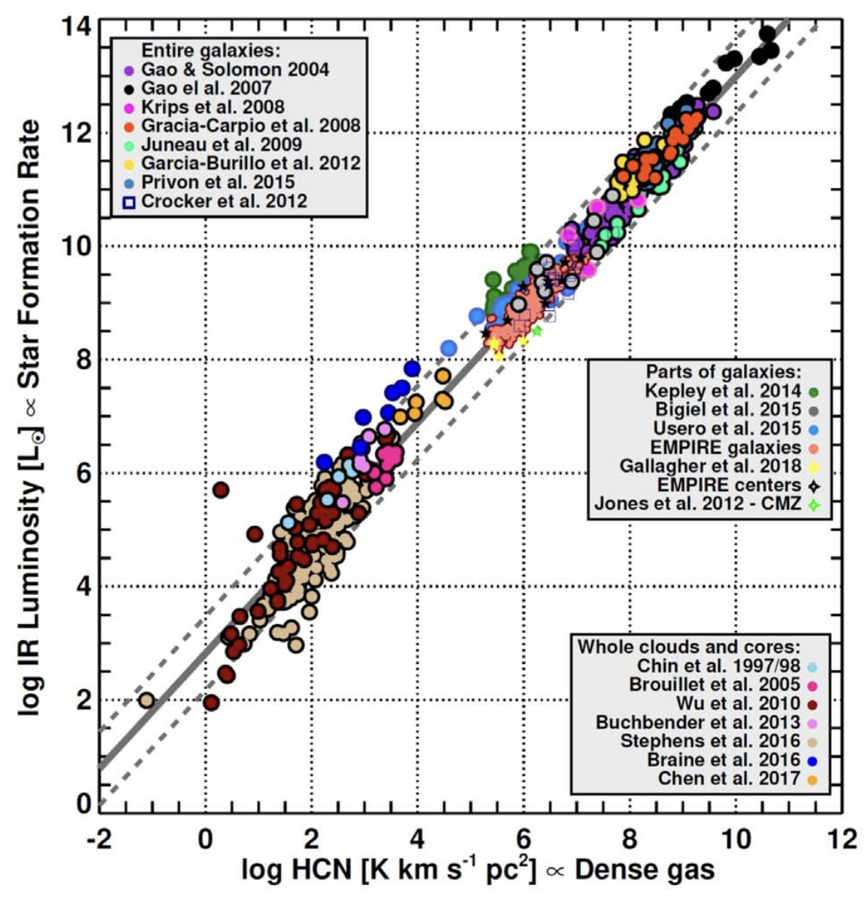
Dense Gas
Observing HCN, HNC and HCO⁺
helps us to understand star-formation
Traces higher densities
than CO and [CII] (10⁵ vs 10²⁻³/cm³)
HCN(1-0) linearly correlates
with SFR over ~10 dex
HNC & HCO⁺ can probe
thermodynamics of dense gas
10-100x fainter than CO and [CII]
Jiménez-Donaire+19
Beth Westoby | westoby@strw.leidenuniv.nl

Slide 5
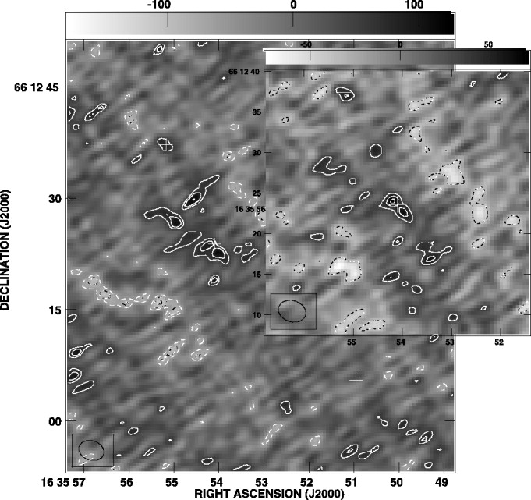
History of High-z Dense Gas Observations
Few HCN(1-0) detections
(e.g. Gao+07, Oteo+17)
Handful of mid-J/high-J lines
-mainly from ALMA
-sensitive to non-thermal heating
(e.g. Oteo+17, Bethermin+18,
Canameras+21, Yang+23)
-stacking
(e.g. Spilker+14,Reuter+22,
Hagimoto+23)
Difficult to draw conclusions
Gao+07
Beth Westoby | westoby@strw.leidenuniv.nl

Slide 6
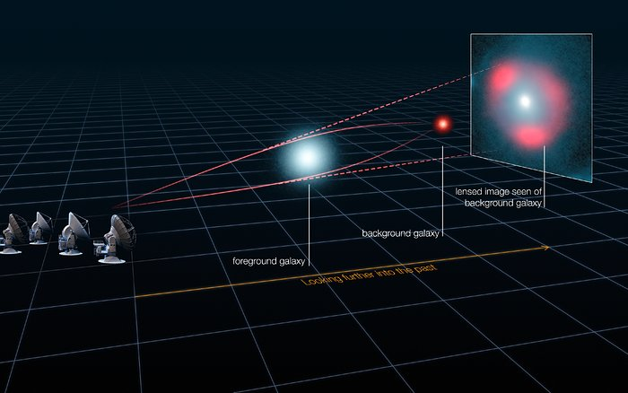
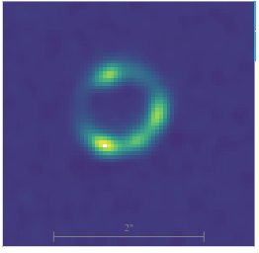
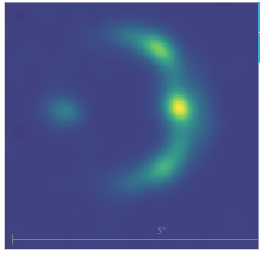
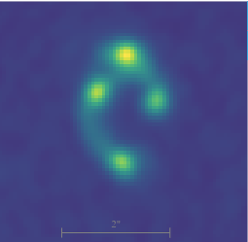
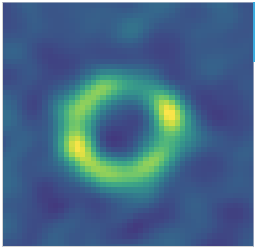
Gravitational Lensing
Reduces observing time!
ALMA (ESO/NRAO/NAOJ), L. Calçada (ESO), Y. Hezaveh et al.
Example SPT ALMA Band 7
Continuum Sky Maps (median 𝝁~6)
Beth Westoby | westoby@strw.leidenuniv.nl

Slide 7
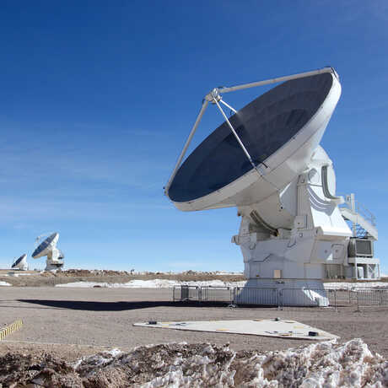
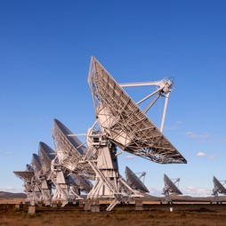
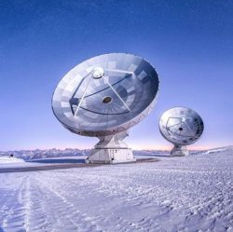
PRUSSIC Dense Gas Survey
Prussic acid = HCN
Targeting HCN, HCO⁺ and HNC in z=1-5 strongly lensed galaxies
Presented in PRUSSIC I, II and III (Rybak+2022, 2023 & 2026)
ALMA: ~ 130hrs
VLA:~180hrs
NOEMA:~90hrs
Beth Westoby | westoby@strw.leidenuniv.nl

Slide 8
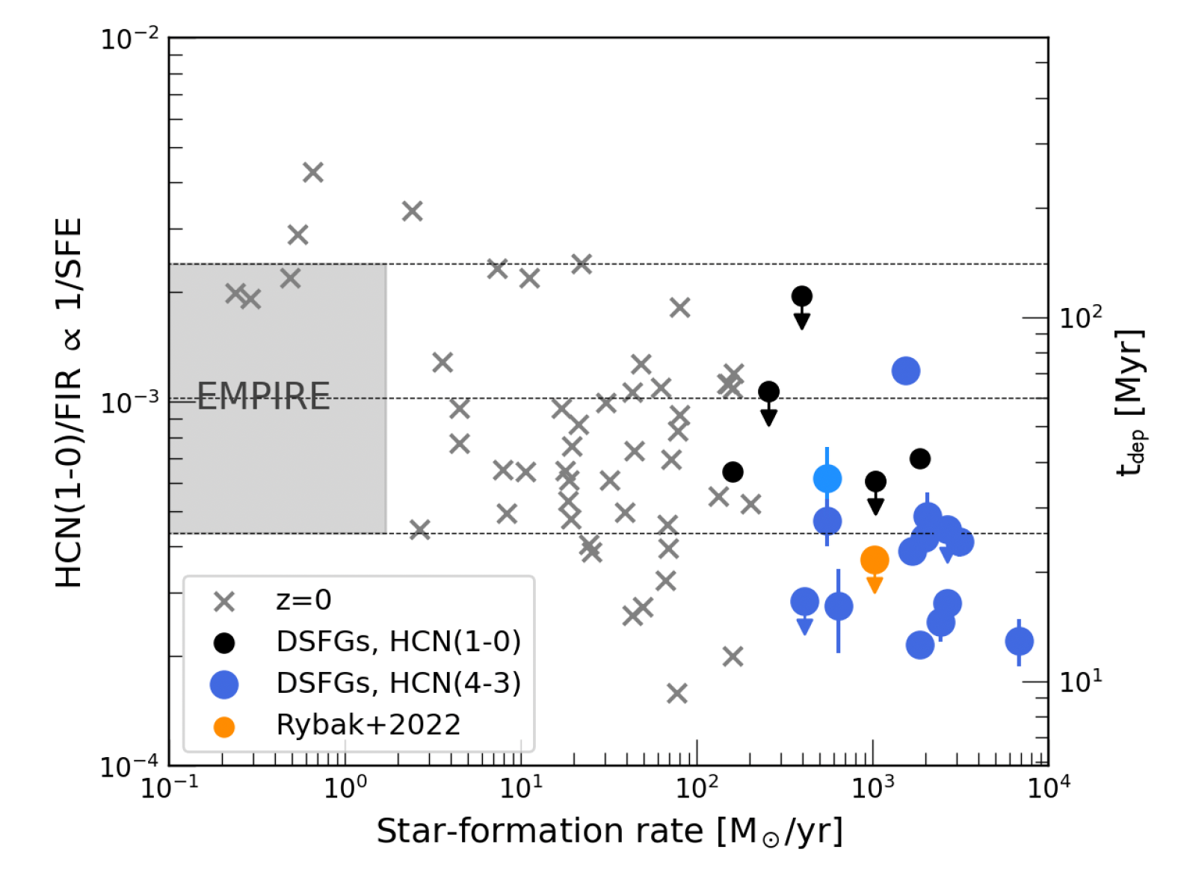
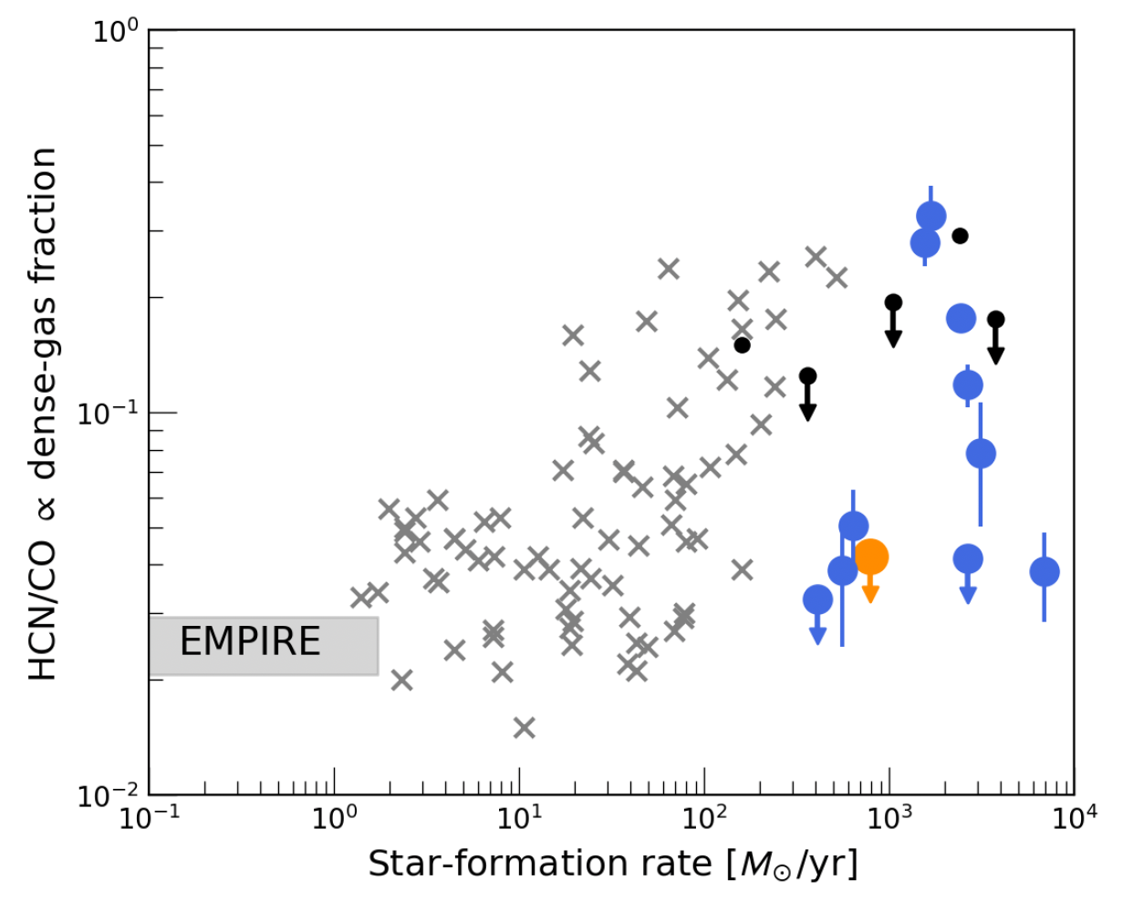
PRUSSICIII: 10 mid-J HCN detections
HCN/CO is a proxy for
dense gas fraction
HCN/FIR is a proxy for SFE
~ ÷8
Rybak+26
Beth Westoby | westoby@strw.leidenuniv.nl

Slide 9
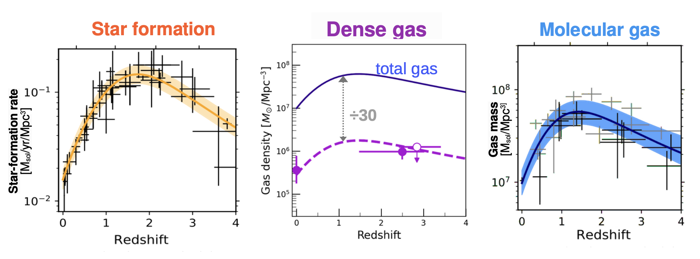
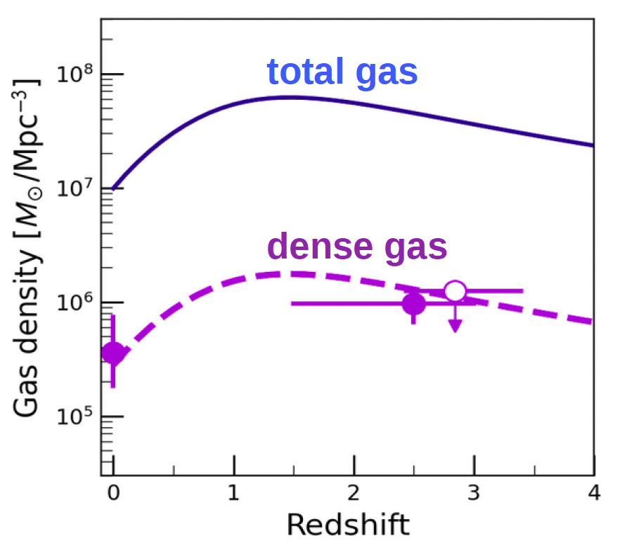
Galaxy Gas Content
From PRUSSIC III, Rybak+26
Beth Westoby | westoby@strw.leidenuniv.nl

Slide 10
Only 10 detections
Inhomogenous sample
Excitation correction
Galaxy Gas Content
Limitations:
From PRUSSIC III, Rybak+26
Beth Westoby | westoby@strw.leidenuniv.nl

Slide 11
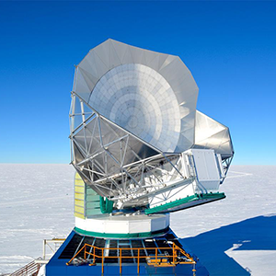
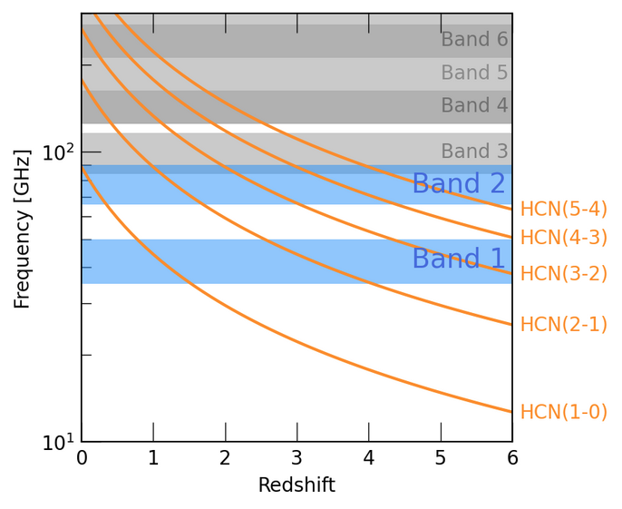
SPT Dense Gas Survey
First Detected With
SPT
Aiming for detections of
(2-1) emission lines of
HCN, HCO⁺ and HNC
10 SPT galaxies
(Wei𝜷+13, Reuter+20,
Reuter+23)
z=2.5-3.5 with beam ~2-8”
Previous CO detections
(Reuter+20)
Band 6/7 Continuum
(Archive: Reuter, McKean,
Strandet, Hezaveh, Bethermin)
Dense Gas Observed
With ALMA
25hrs with
ALMA Band 1
Beth Westoby | westoby@strw.leidenuniv.nl

Slide 12

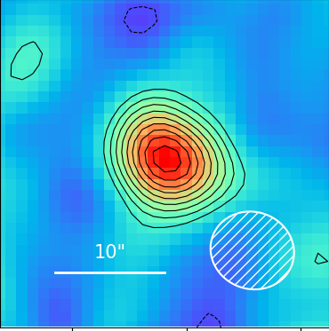
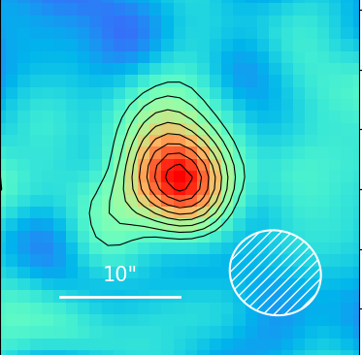
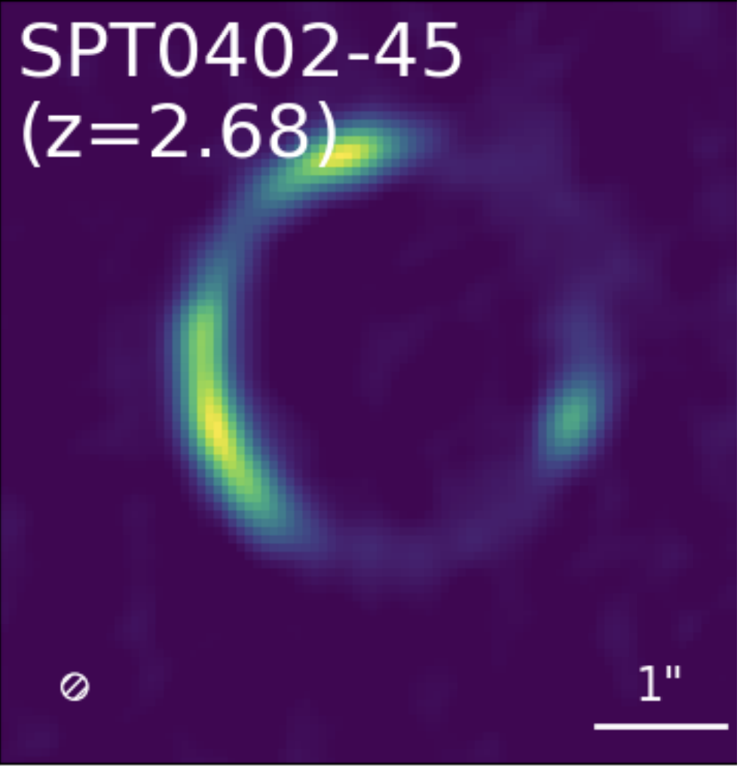
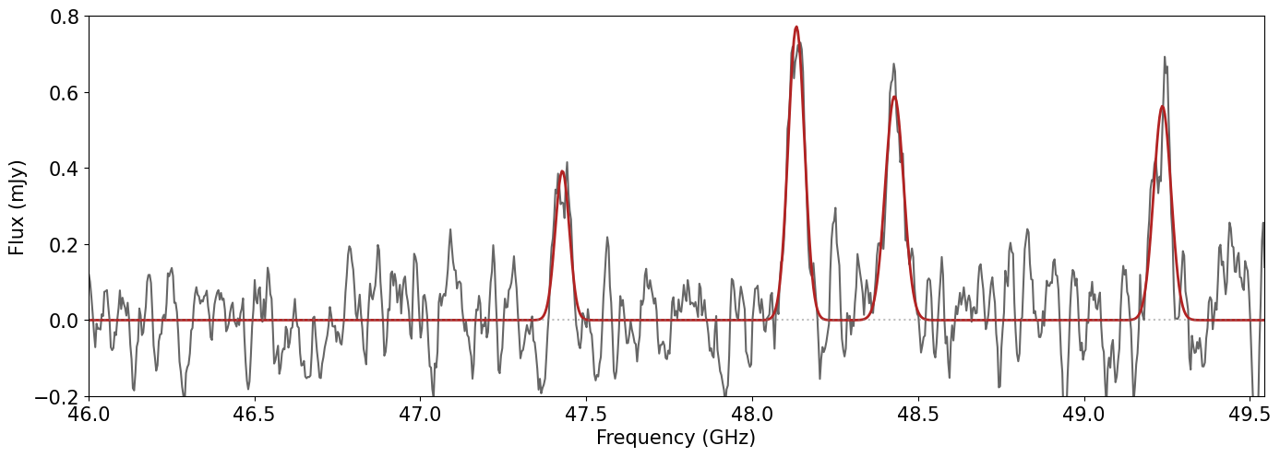
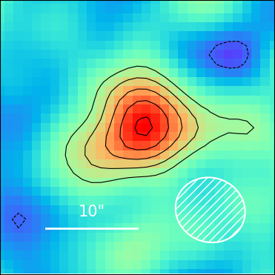
Detections of HCN, HNC & HCO⁺
in all 10 sources!
HCN(2-1)
HCO⁺(2-1)
Example:
SPT402-45
z=2.68
High-res
ALMA
Band 7
Continuum
HCN
HNC(2-1)
HNC
HCO⁺
Bonus
CCH!
Unresolved
ALMA
Band 1
Emission
Lines
Beth Westoby | westoby@strw.leidenuniv.nl

Slide 13
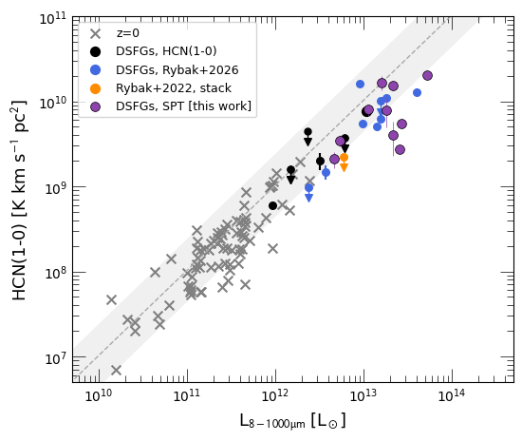
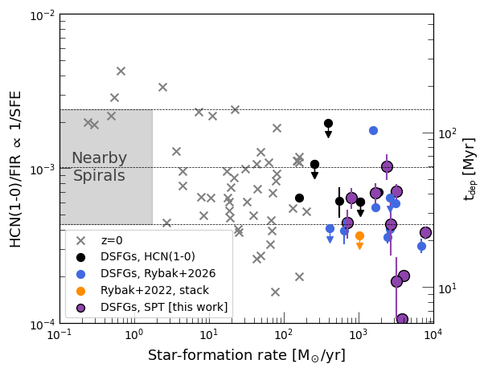
Enhanced SFE
Beth Westoby | westoby@strw.leidenuniv.nl

Slide 14
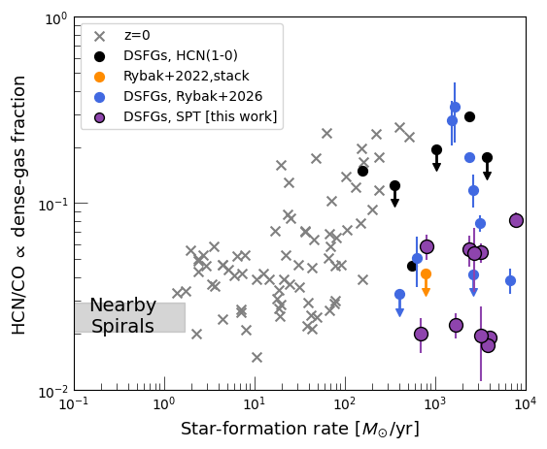
Low dense gas fractions
Beth Westoby | westoby@strw.leidenuniv.nl

Slide 15
What next?
Stack spectra to increase sensitivity to fainter species
Improve constraints of cosmic dense gas density
Compare the dense gas lines to other lines available (eg OH+, [CI])
Expand parameter space with larger samples
PRUSSICIII
Rybak+26
Beth Westoby | westoby@strw.leidenuniv.nl

Slide 16
Thank you
Beth Westoby | westoby@strw.leidenuniv.nl

Slide 17
Back-up Slides
Beth Westoby | westoby@strw.leidenuniv.nl

Slide 18
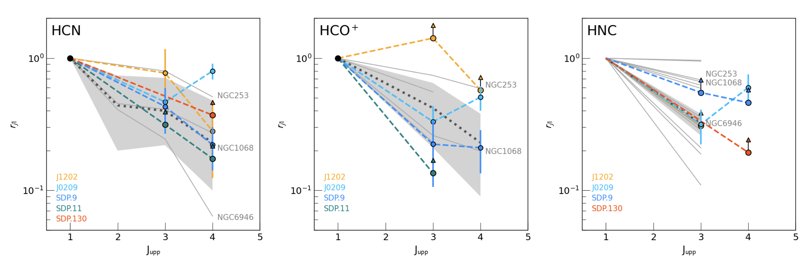
PRUSSICIII
Rybak+26
Beth Westoby | westoby@strw.leidenuniv.nl

Slide 19
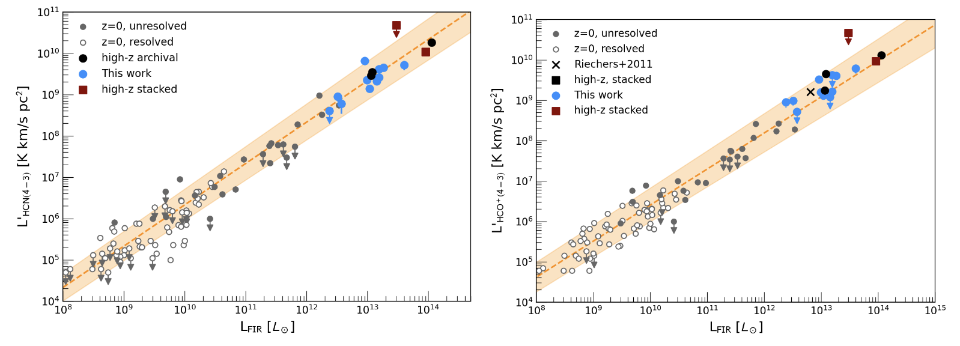
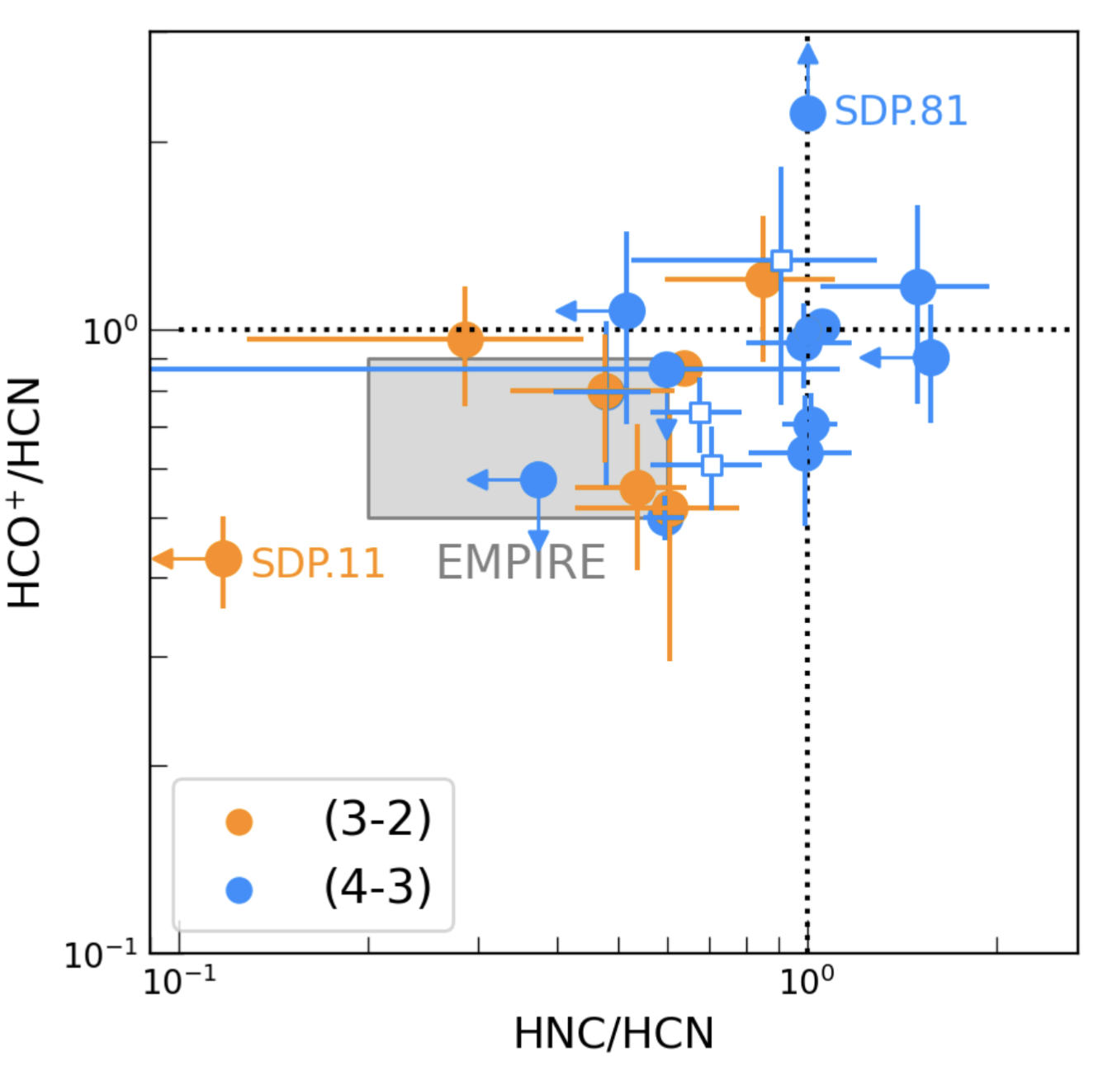
HCN
HCO⁺
PRUSSICIII
Rybak+26
Beth Westoby | westoby@strw.leidenuniv.nl

Slide 20
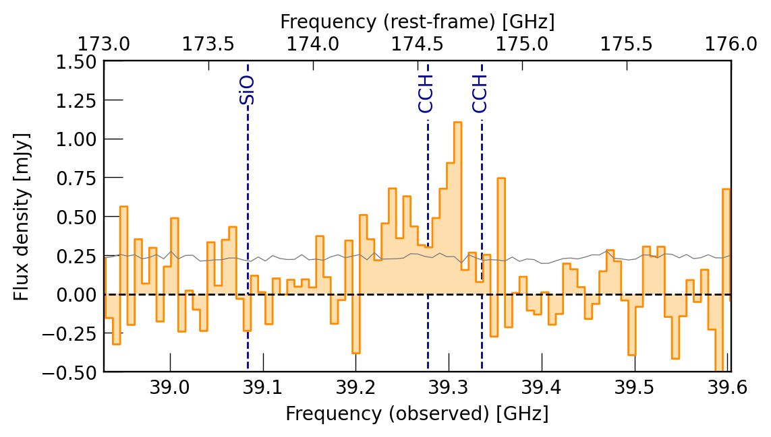
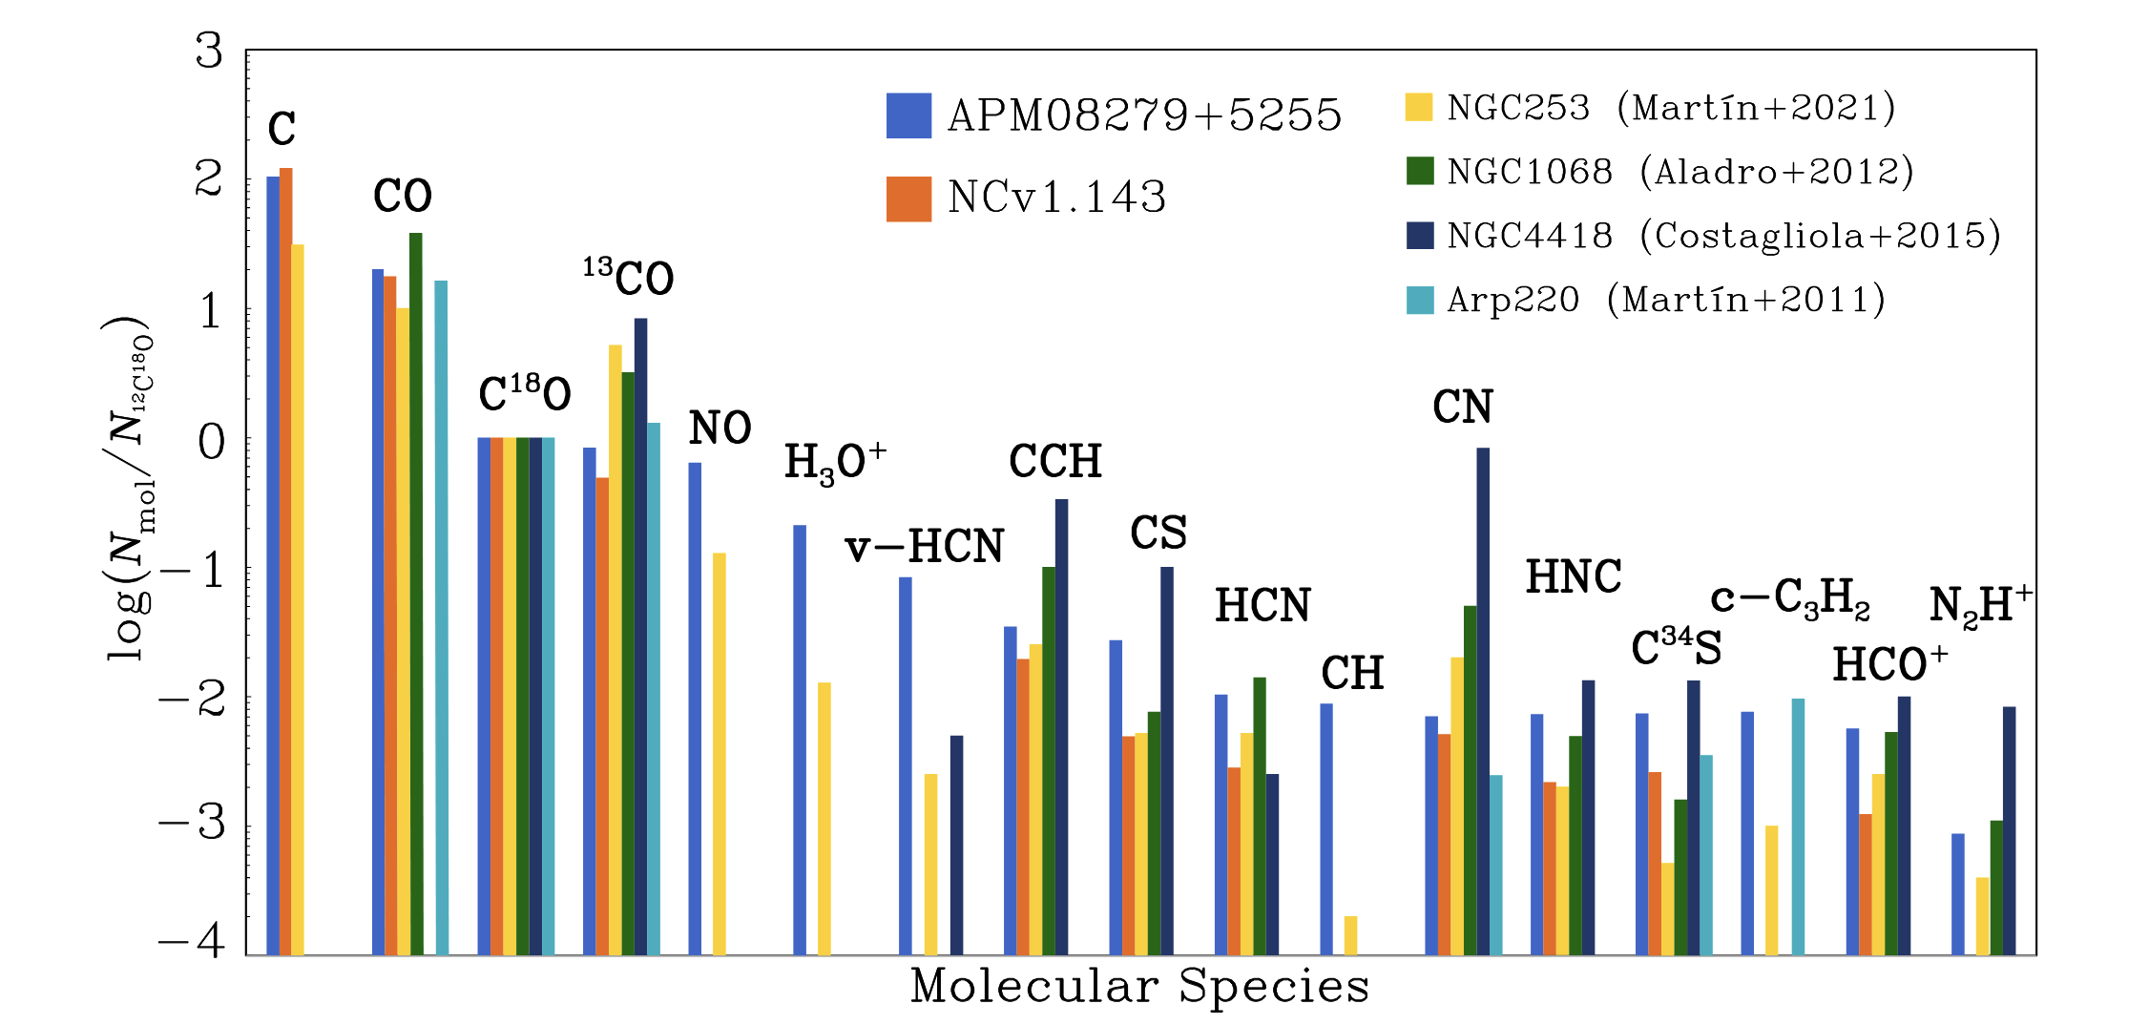
SPT0027-50
SUNRISE
Yang+23
Beth Westoby | westoby@strw.leidenuniv.nl

