Slide 1
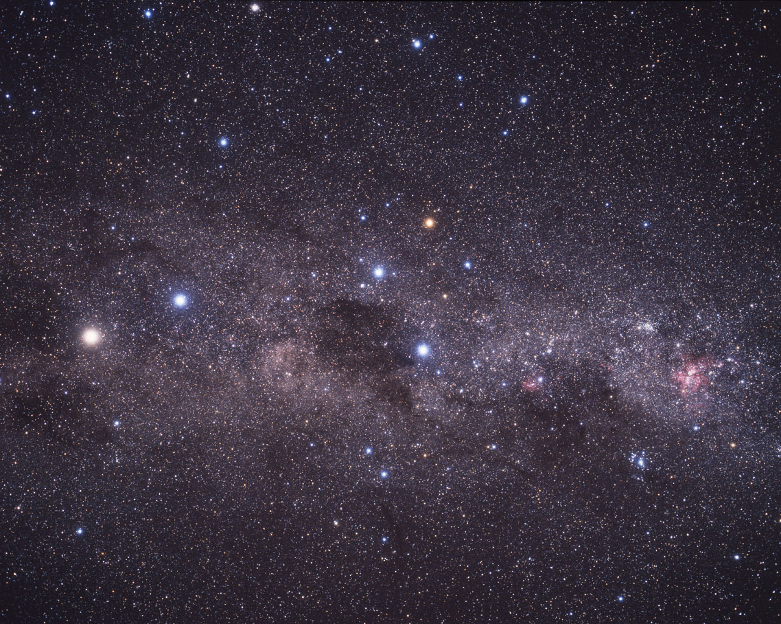




Phase Spirals induced by the Gas Warp
Shuyu Wang
Leiden University
Collaborators: Anthony G. A. Brown, Victor P. Debattista, Tigran Khachaturyants
swang@mail.strw.leidenuniv.nl
NAC 2026 | Hotel Zuiderduin, Egmond aan Zee
https://doi.org/10.48550/arXiv.2604.06862
Background image credit: Spacecraft: ESA/ATG medialab; Milky Way: ESA/Gaia/DPAC; CC BY-SA 3.0 IGO.

Slide 2
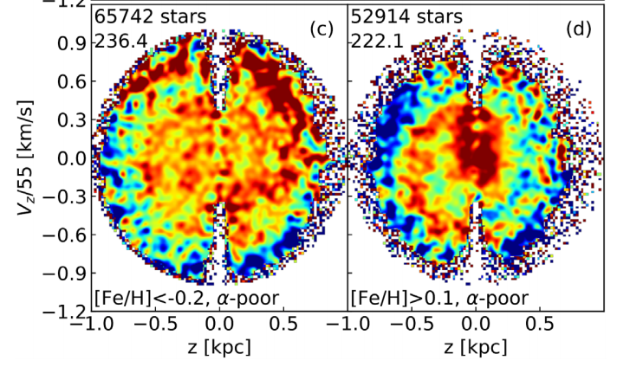
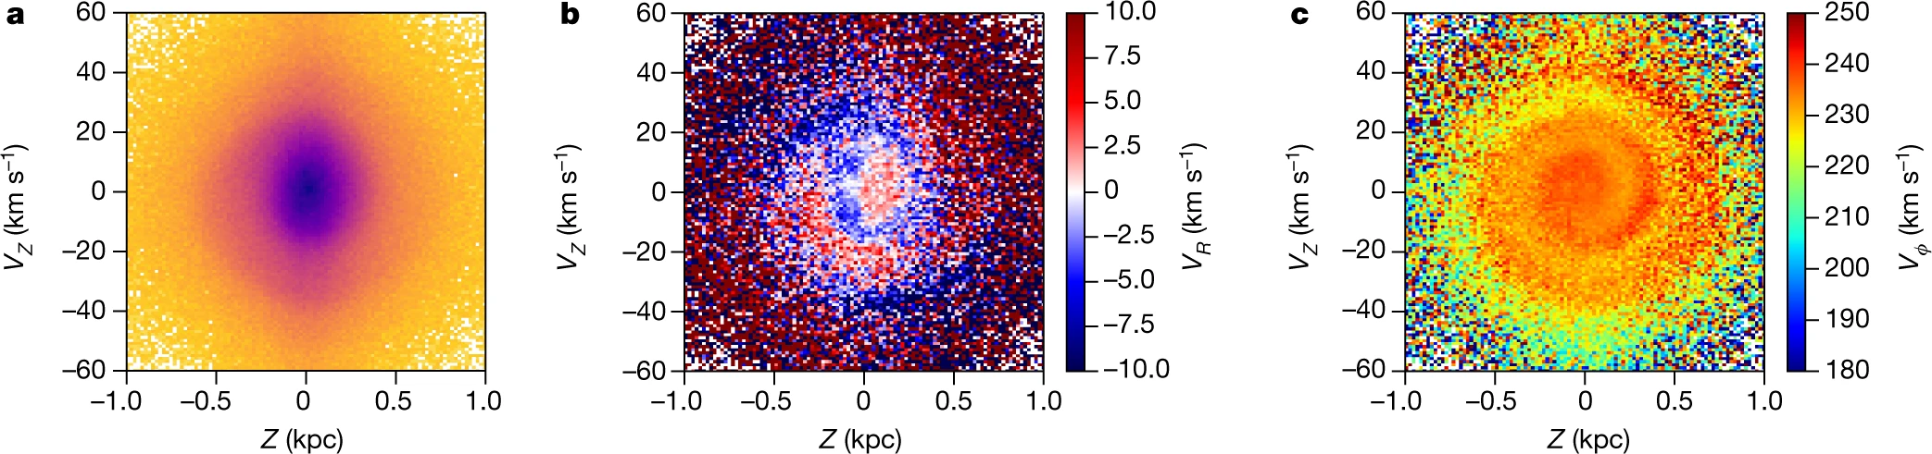
Introduction
Discovery of the Phase Space Spirals
A spiral-like pattern in the vertical phase space of the Milky Way disk, first discovered in the Solar neighborhood in Gaia DR2
Visible in the phase space diagram weighted by density, V_{R} and V_{ϕ}
Signature of recent vertical perturbations in the Milky Way disk
Top right: Fig 10 in Bland-Hawthorn et al. 2019
Bottom: Fig 1 in Antoja 2018

Slide 3
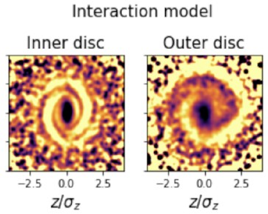
Introduction
Origin of the Phase Spirals
One-armed phase spirals (vertical bending mode)
External perturbation: Sagittarius (Sgr) passage, dark matter wake produced by the LMC, etc.
Internal perturbation: bar buckling
Combined: stochastic heating by dark matter subhalos
Two-armed phase spirals (vertical breathing mode)
Slowing bar
Transient spirals, etc.
Fig 3 in Hunt et al. 2022

Slide 4
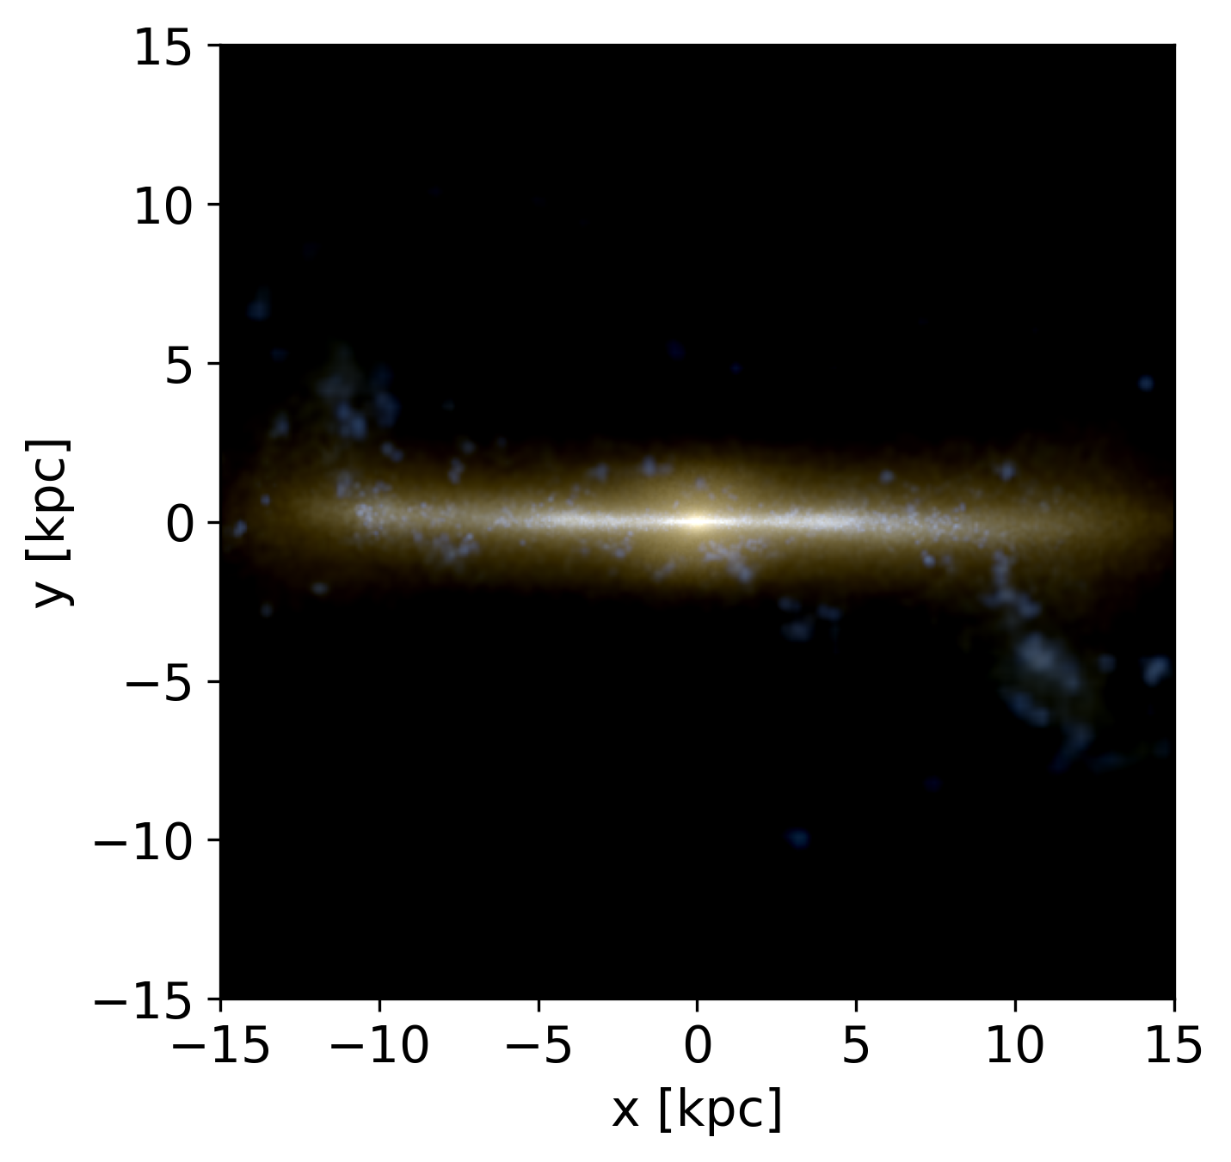
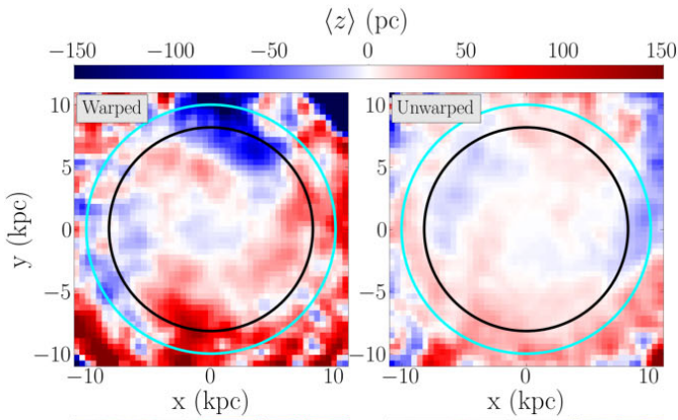
Introduction
Motivation
“Phase spirals are a record of perturbation histories”
Khachaturyants et al. (2022) found that the gas warp can excite bending waves, which could be recorded by one-armed phase spirals
Simulation
N-body + SPH simulations of a warped and an unwarped, isolated galaxy from Khachaturyants et al. (2022), the former containing ~ 2 million star particles
The warped excites strong bending waves in the simulation
Fig 5 in Khachaturyants et al. 2022

Slide 5
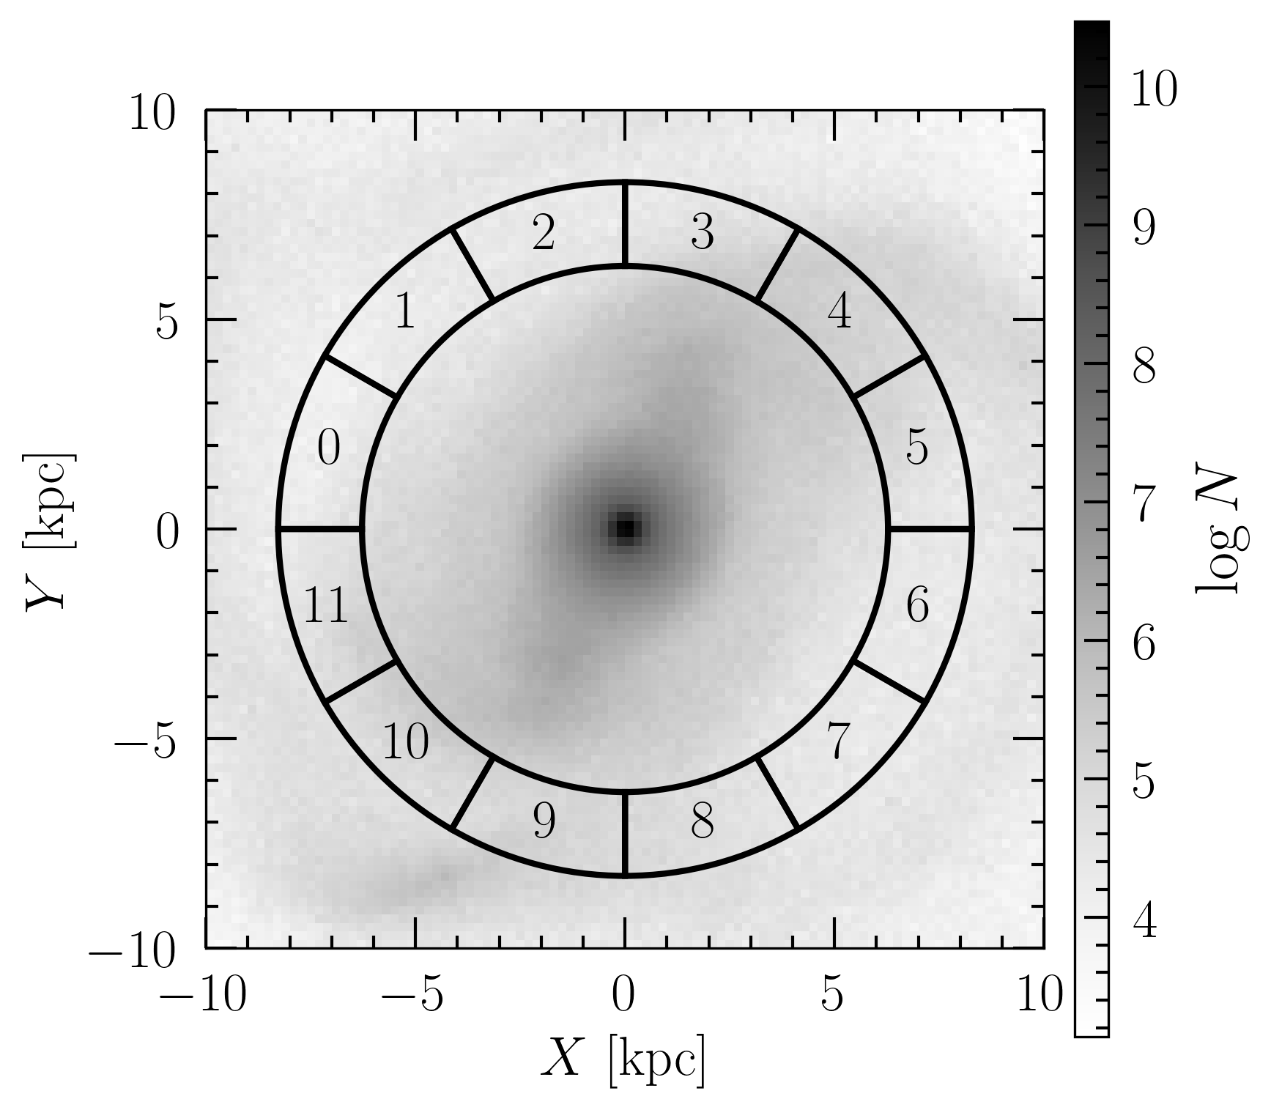
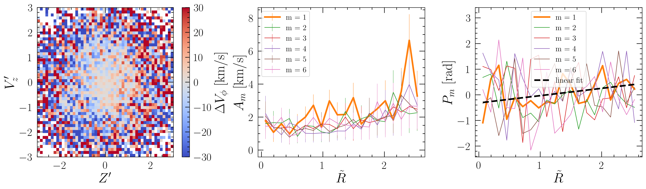


Phase spiral identification
Divide the annulus from 6.22 to 8.22 kpc into 12 regions
For each region, obtain the phase space histogram Z - V_{z}, weighted by $∆Vφ$ = V_{ϕ} - median(V_{ϕ})
Fourier decompose the weighted histogram using 20 equal-width annuli
$$∆V_{φ}(R,φ)=\sum_{m=0}^{6}{A_{m}(R)}\sin{(mφ−P_{m}(R))}$$
One-armed phase spiral detection: dominant $A_{1}$ and linearly increasing $P_{1}(R)$
Left: 12 regions in the warped galaxy
Right: (1) phase space diagram of region 4, color-coded by $∆$V_{ϕ} (2) Fourier amplitudes versus phase space radius;
(3) Fourier phase angles versus phase space radius

Slide 6
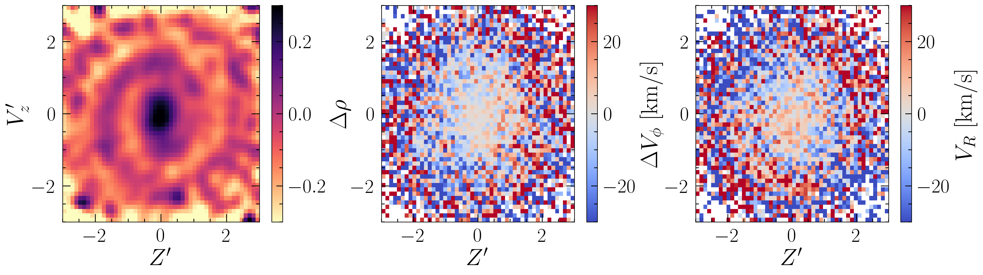
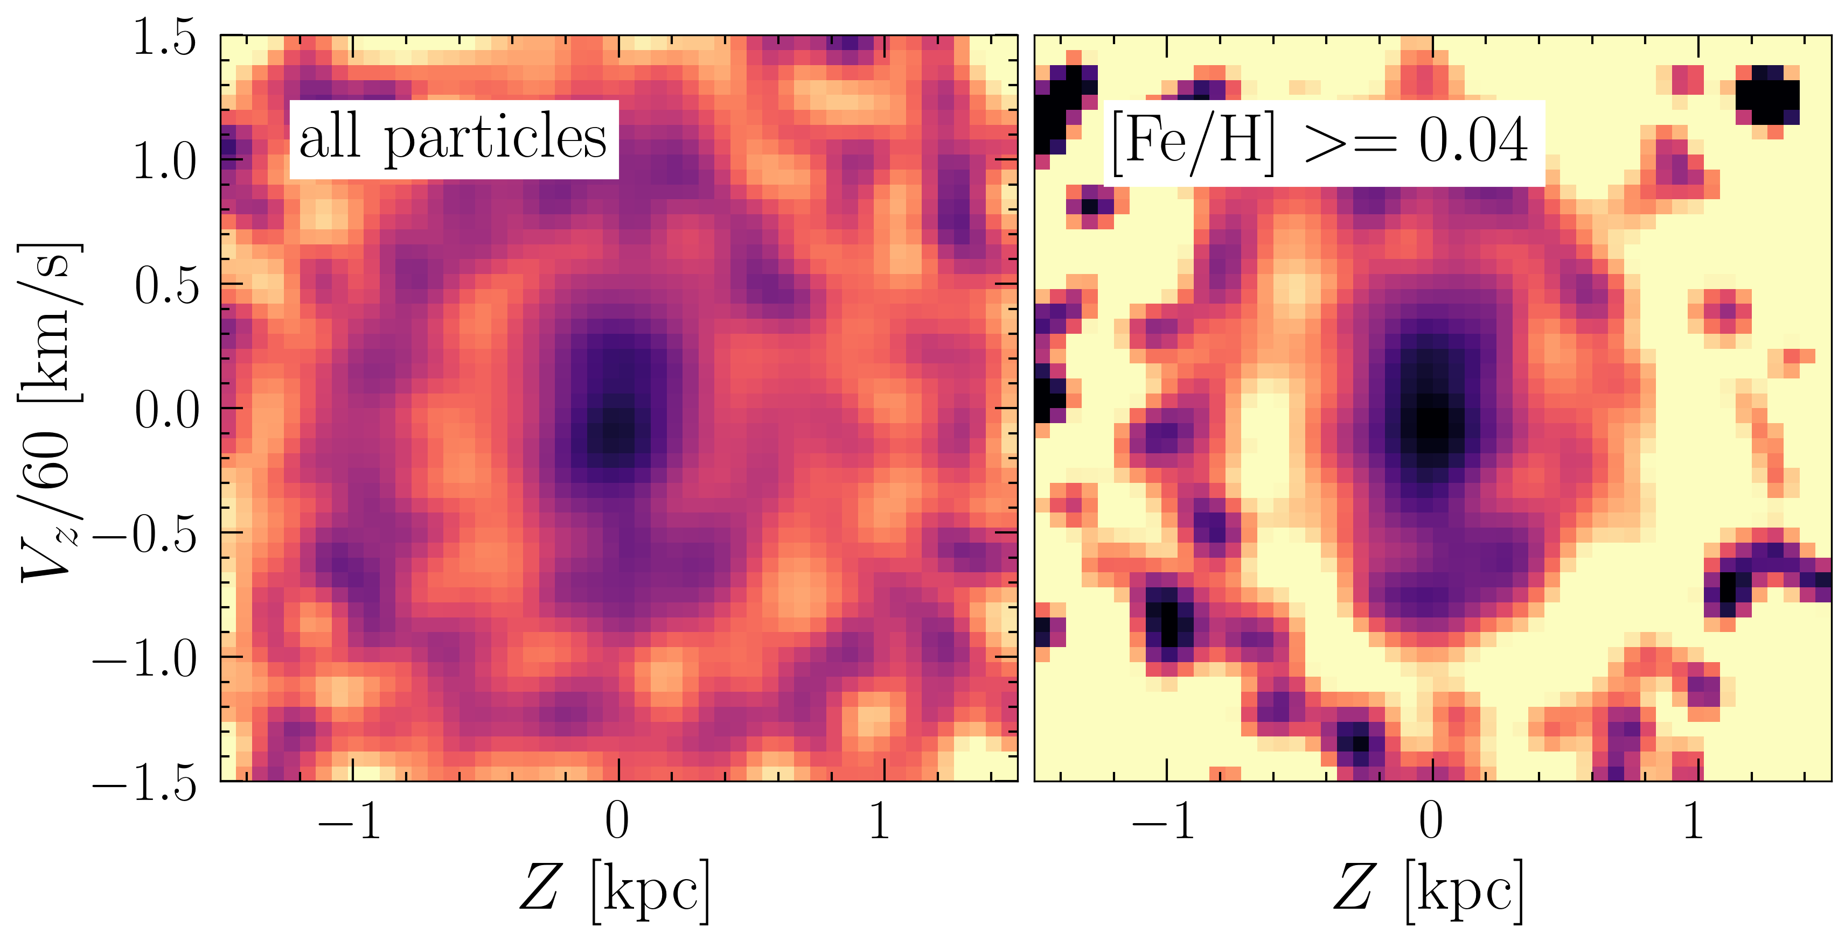
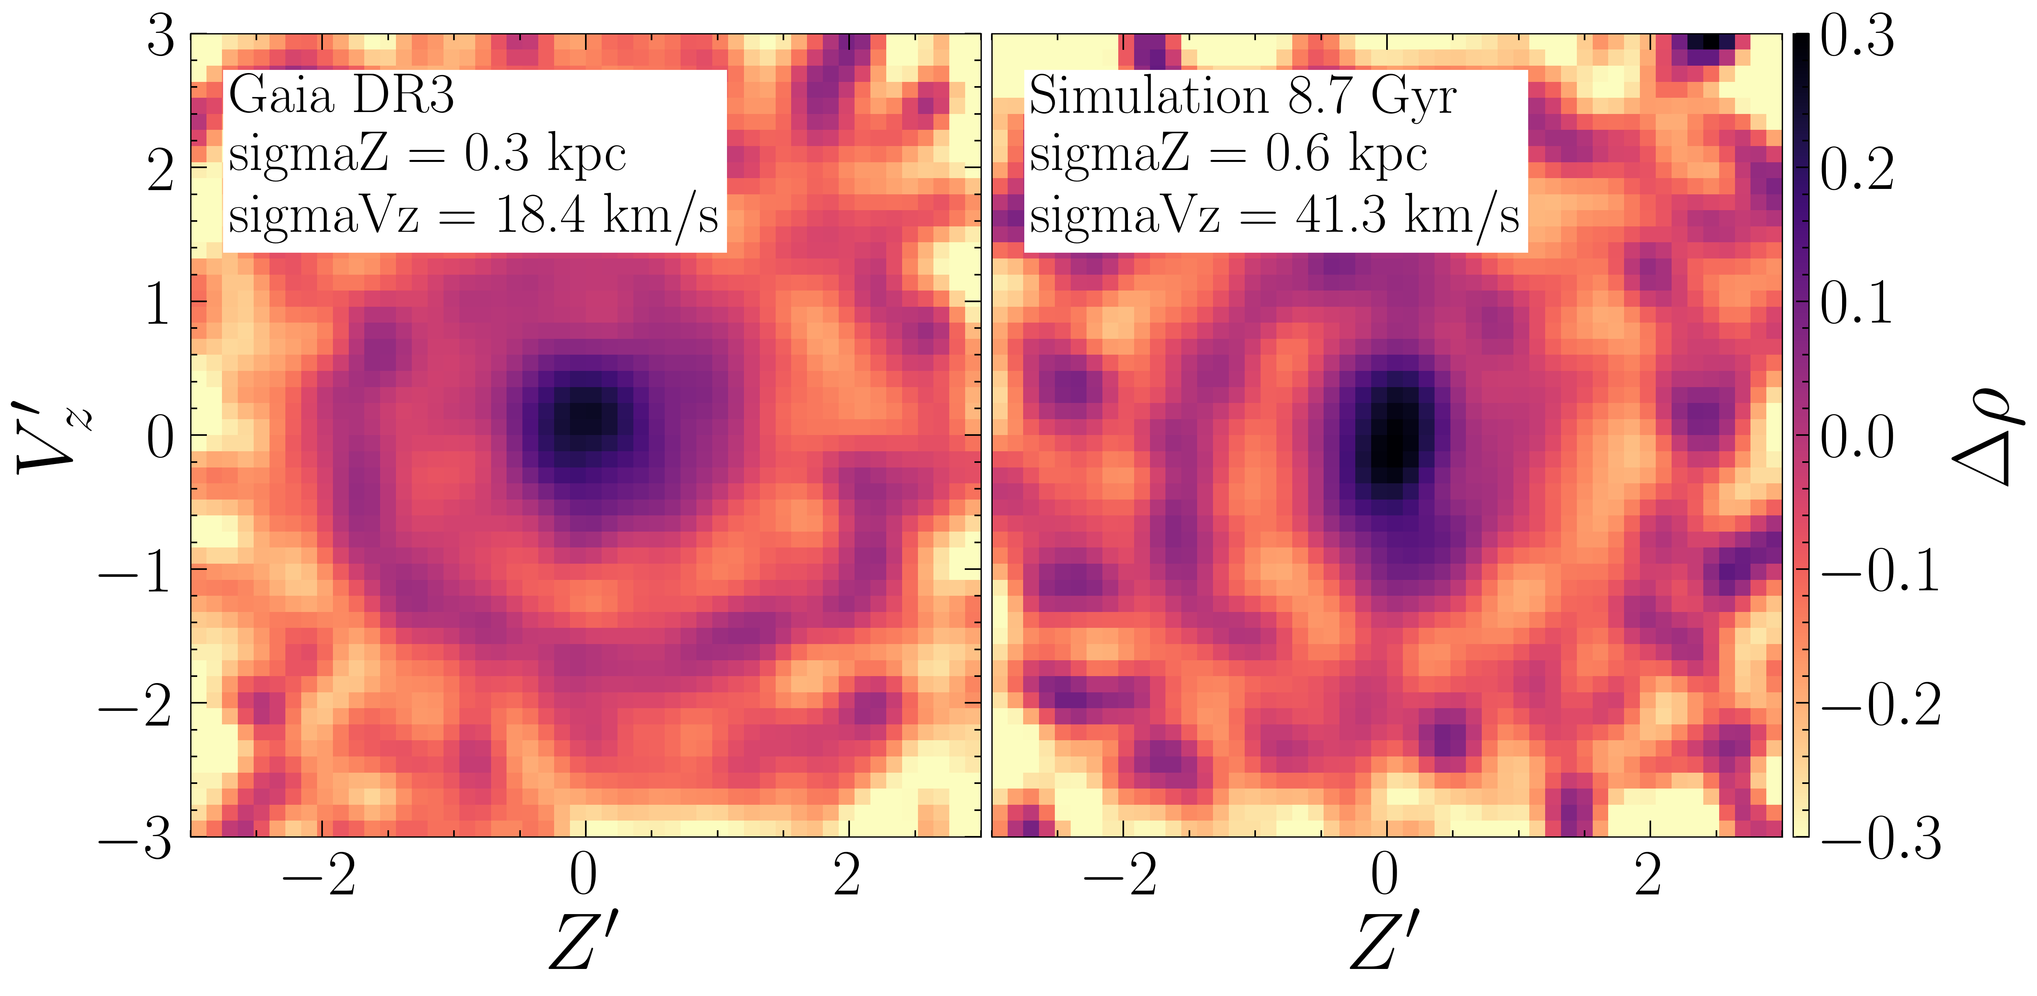
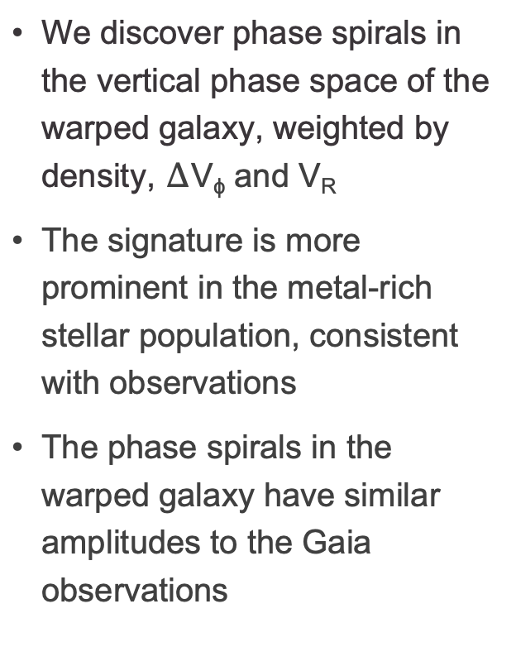
Phase spirals in the warped simulation
We discover phase spirals in the vertical phase space of the warped galaxy, weighted by density, $∆$V_{ϕ} and V_{R}
The signature is more prominent in the metal-rich stellar population, consistent with observations
The phase spirals in the warped galaxy have similar amplitudes to the Gaia observations
Example: the phase spiral in region 4 of the warped galaxy at 8.7 Gyr

Slide 7
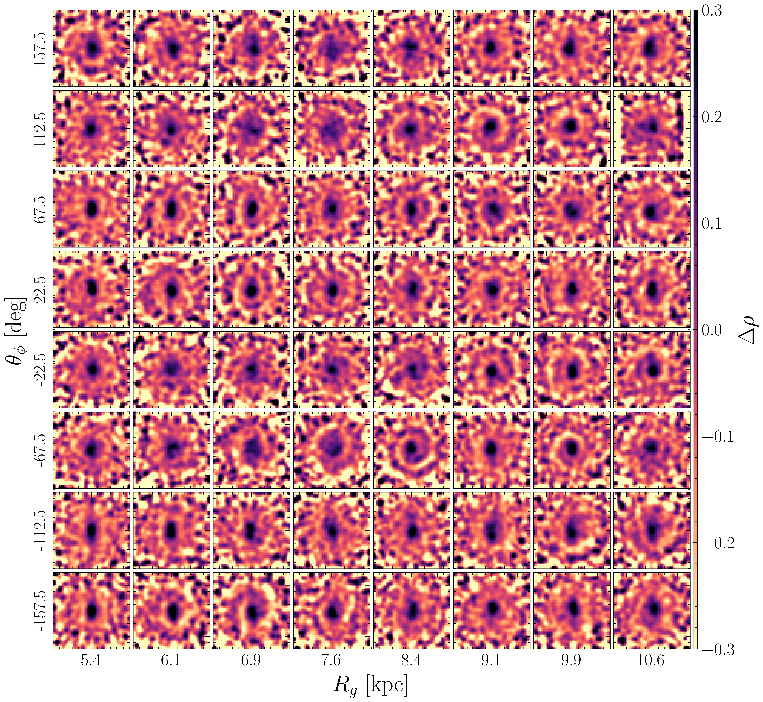
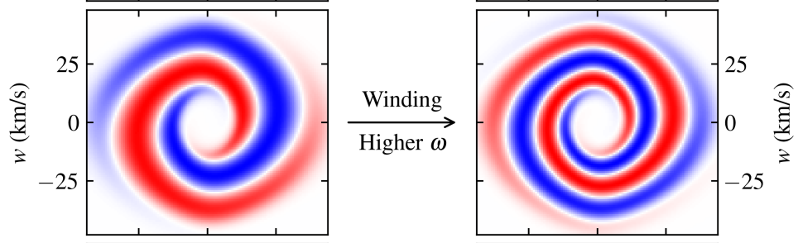
Phase spirals in the warped simulation
Spatial variation of the phase spirals
The majority of the phase space diagrams show strong one-armed phase spirals
The phase spirals are widespread
The winding of the phase spirals varies with guiding center radius, but does not show a monotonically declining trend
Fig 3 in Widmark et al. 2025

Slide 8
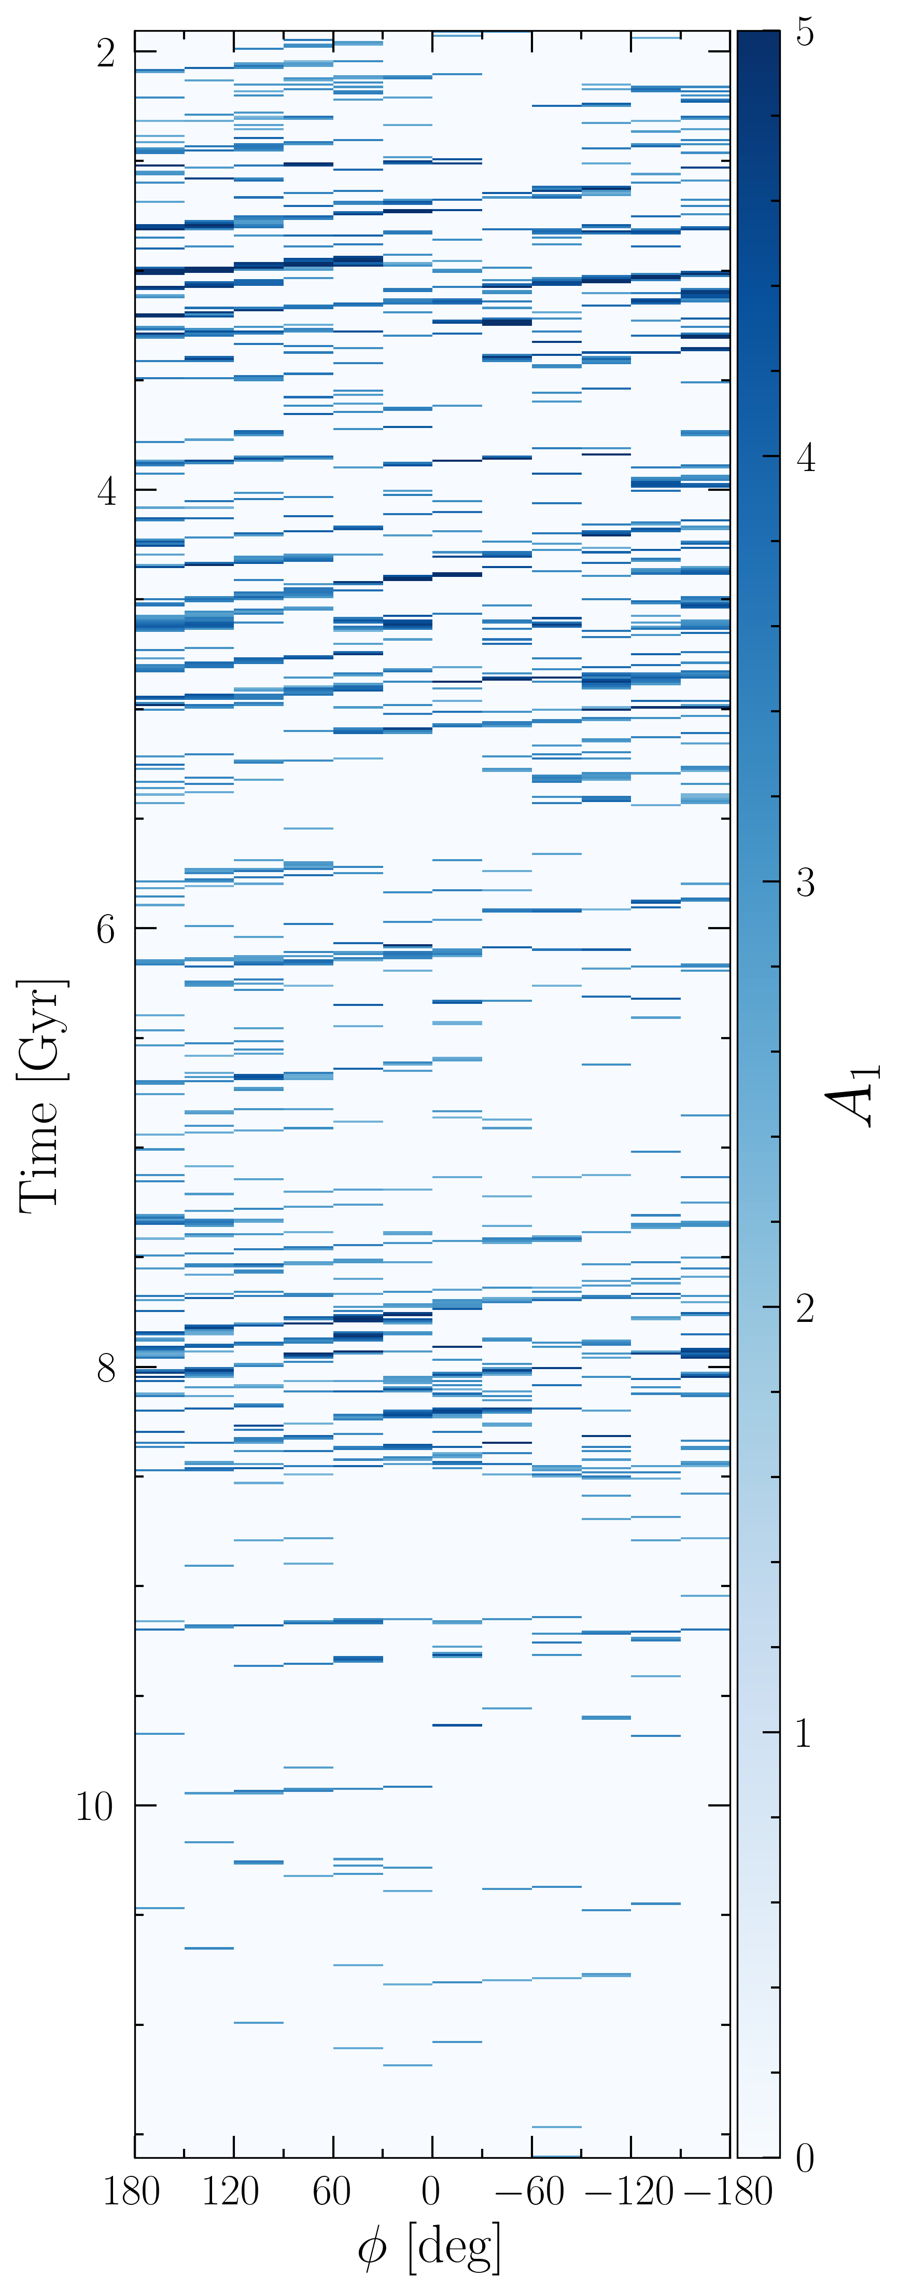
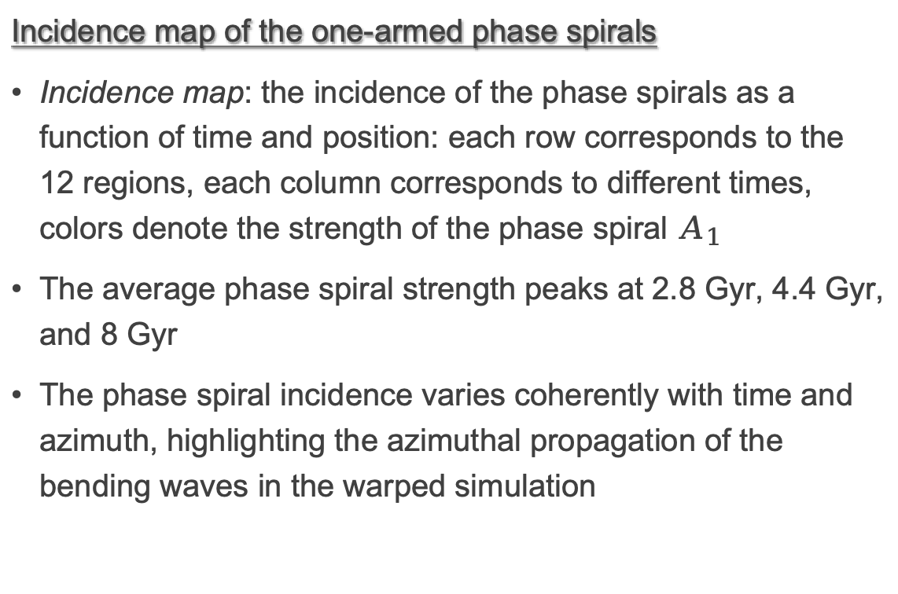
Time evolution of the phase spirals in the warped galaxy
Incidence map of the one-armed phase spirals
Incidence map: the incidence of the phase spirals as a function of time and position: each row corresponds to the 12 regions, each column corresponds to different times, colors denote the strength of the phase spiral $A_{1}$
The average phase spiral strength peaks at 2.8 Gyr, 4.4 Gyr, and 8 Gyr
The phase spiral incidence varies coherently with time and azimuth, highlighting the azimuthal propagation of the bending waves in the warped simulation

Slide 9
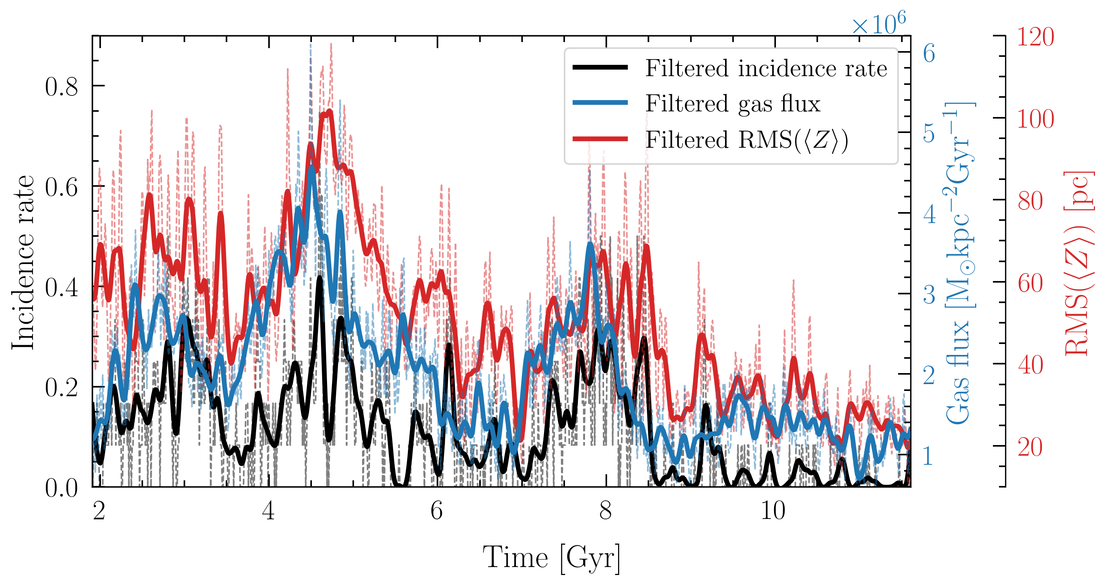
Time evolution of the phase spirals in the warped galaxy
Incidence rate of the one-armed phase spirals
Incidence rate = (# of regions with a phase spiral detection) / (total # of regions)
The incidence rate of the one-armed phase spirals in the warped galaxy correlates strongly with the bending wave amplitudes
The incidence rate of the phase spirals correlates with the gas flux, and is delayed by ~ 281 Myr, consistent with literature estimates
One-armed phase spirals are induced by the gas warp, and are sustained for ~ 10 Gyr
Time evolution of the phase-spiral incidence rate in the warped galaxy versus the gas inflow and the bending wave amplitudes in the same region

Slide 10
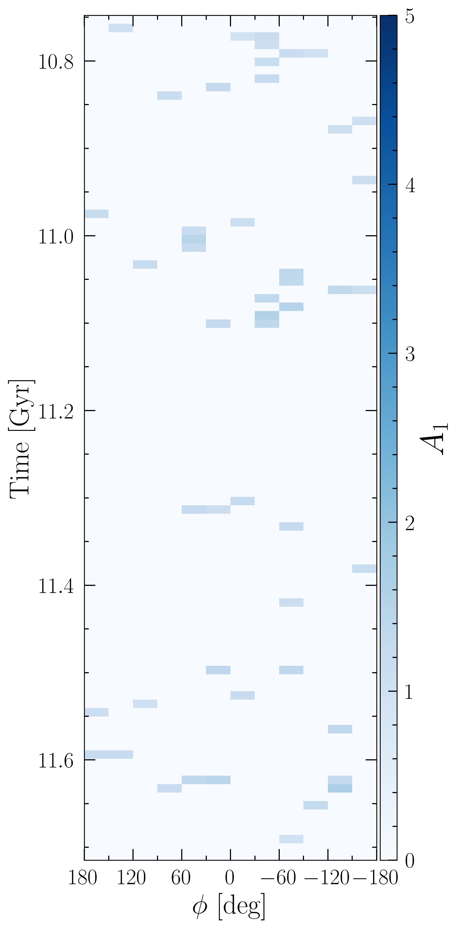
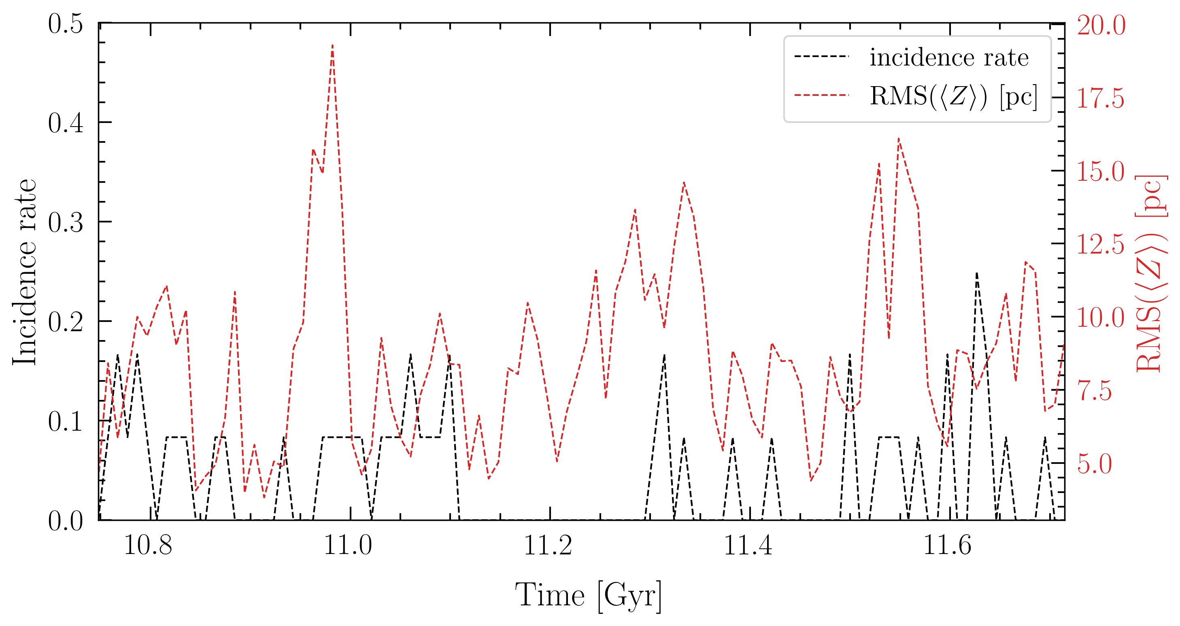
Phase spirals in the unwarped galaxy
One armed phase spirals in the unwarped galaxy are weak and stochastically distributed
The phase spirals show no strong correlation with the bending waves
Phase spirals in the unwarped galaxy may be induced by stochastic heating or the weak bending waves
Left: time evolution of the phase-spiral incidence rate in the unwarped galaxy versus the bending wave amplitudes in the same region
Right: incidence map of the one-armed phase spirals in the unwarped galaxy

Slide 11
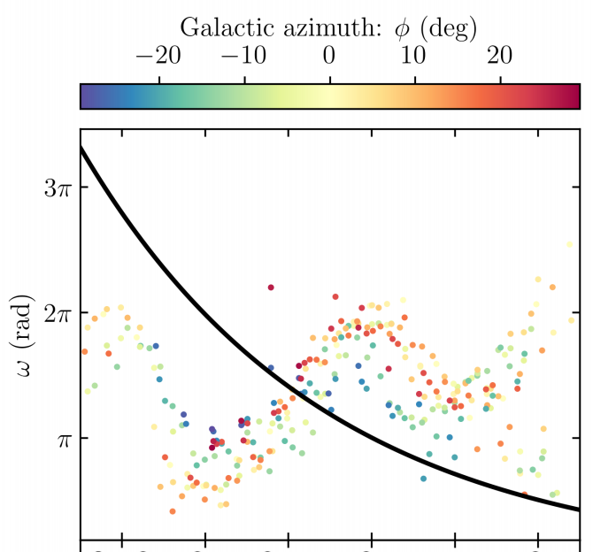
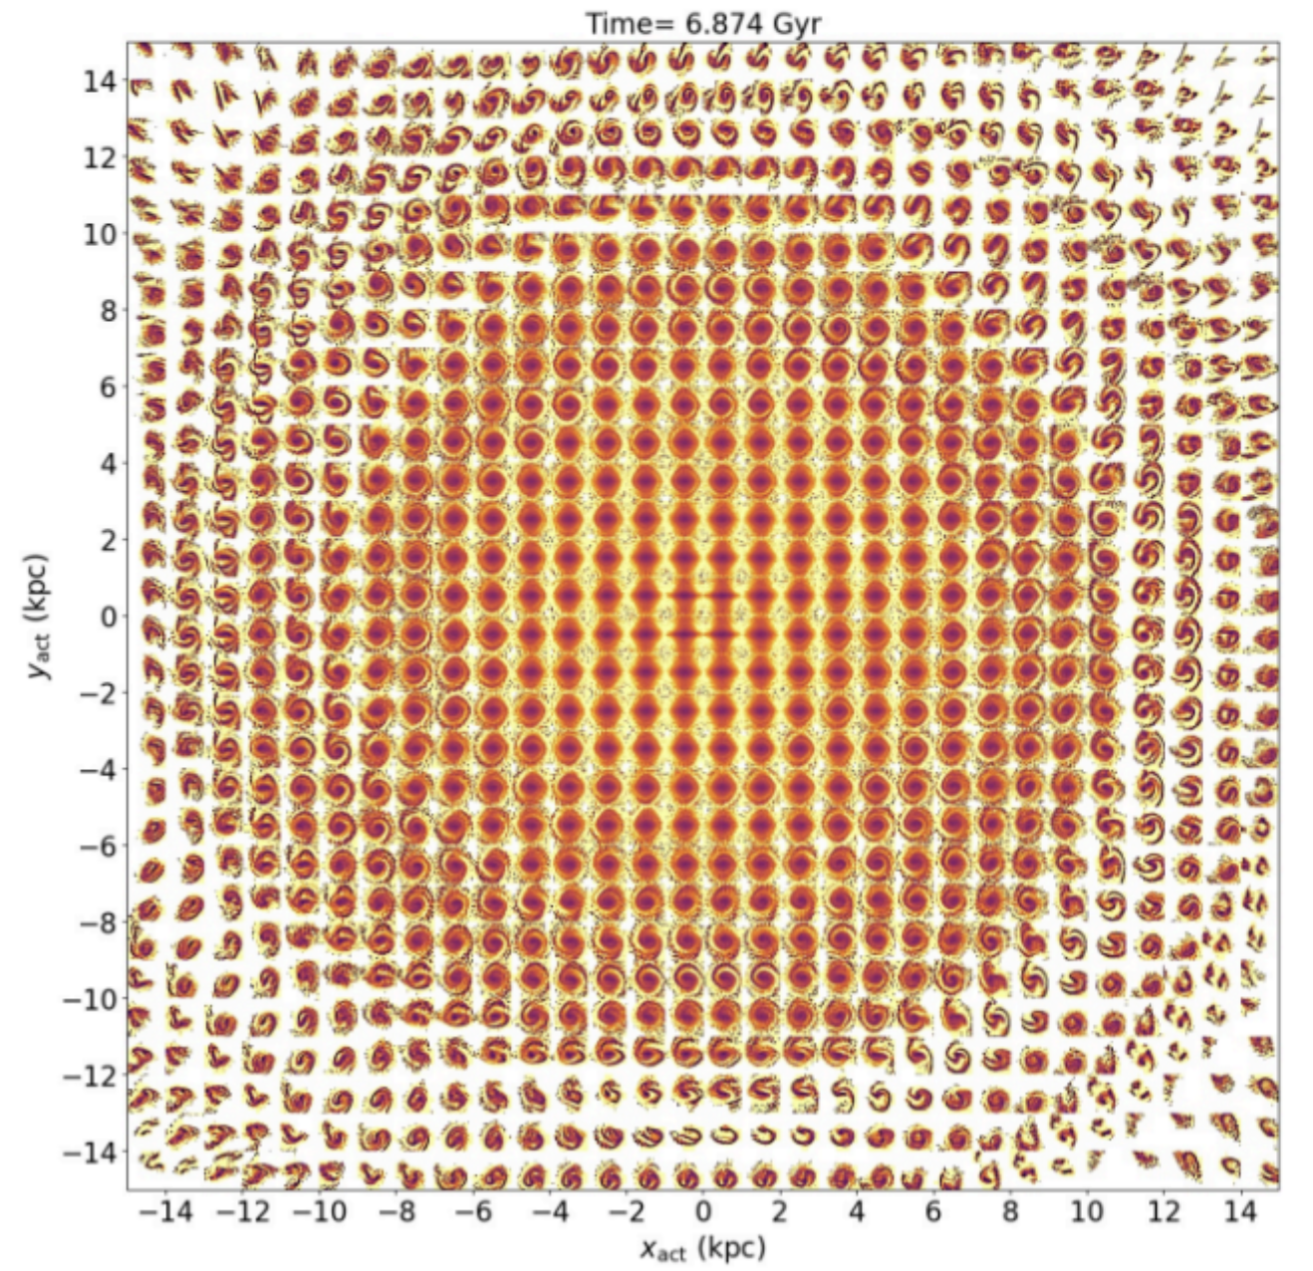
Future prospect
Characteristics of the warp-induced phase spirals (winding, amplitude, phase angle)
A single perturbation model predicts that the phase spiral winding monotonically decreases with guiding center radius. What will be the signature of a multiple perturbation scenario?
Two-armed phase spirals
Are there two-armed phase spirals in the warped simulation?
Macro-spiral
Can we observe the macro-spiral in the warped simulation?
Top: Gaia observations show that phase spiral winding has a flat radial profile (Widmark et al. 2025)
Bottom: local phase spirals can collectively form a macro-spiral (Hunt et al. 2021)

Slide 12
Summary
One-armed phase spirals can be induced by irregular gas accretion along the warp
The morphology of the one-armed phase spirals vary with location within the galaxy and evolves with time
The response of phase spirals to the irregular gas inflow is delayed by a few hundred Myr
The warp continuously excites phase spirals, sustaining the phase spirals for ~ 10 Gyr
Warp-induced phase spirals have consistent amplitudes with the Gaia observations
Analysis of the warp-induced phase spirals will provide further insight into the interpretation of Gaia observations

