Slide 1


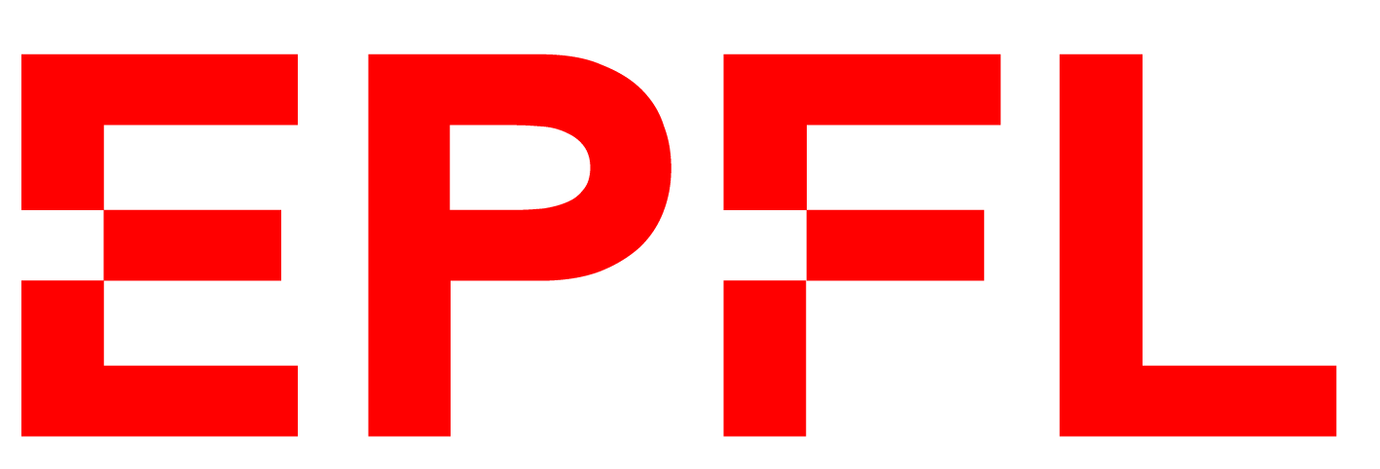

What can plasma researchers learn from astronomers about science communication?
Calum T. Ryan, Ralf Mackenbach, Marieke Baan, Margriet van der Heijden

Slide 2
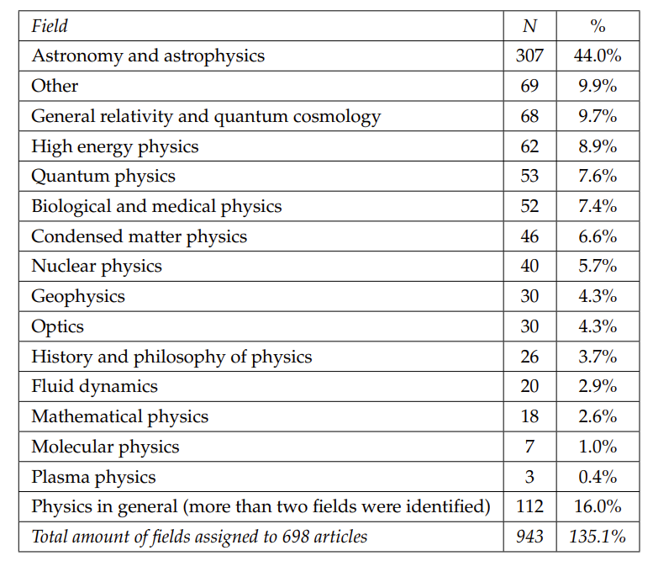
Astrophysics is represented 100 times more in media than plasma physics
Kristensen, S.W. et al. ‘The matter of complex anti-matter. The portrayal and framing of physics in Dutch newspapers.’ JCOM, 20, 7, 2021, 1-19.
Notes:
In Dutch newspapers, astrophysics gets 100 times more attention than plasma physics ☹

Slide 3
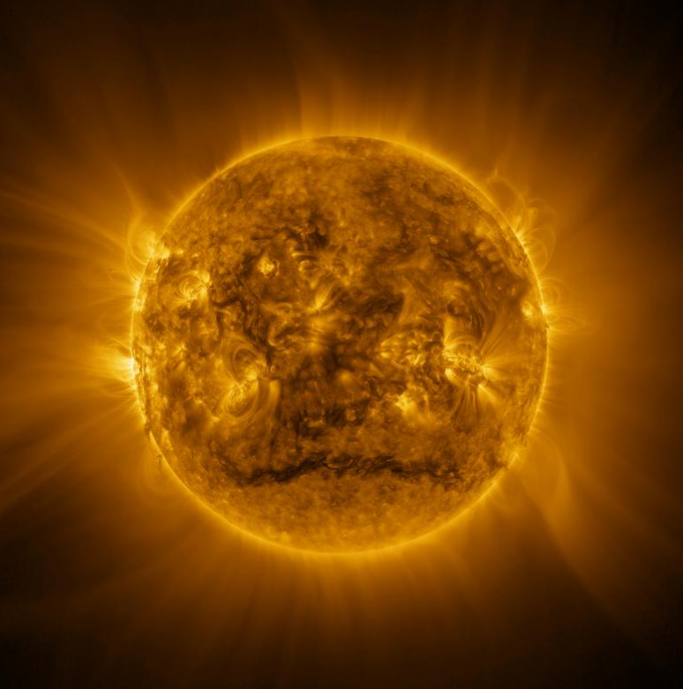
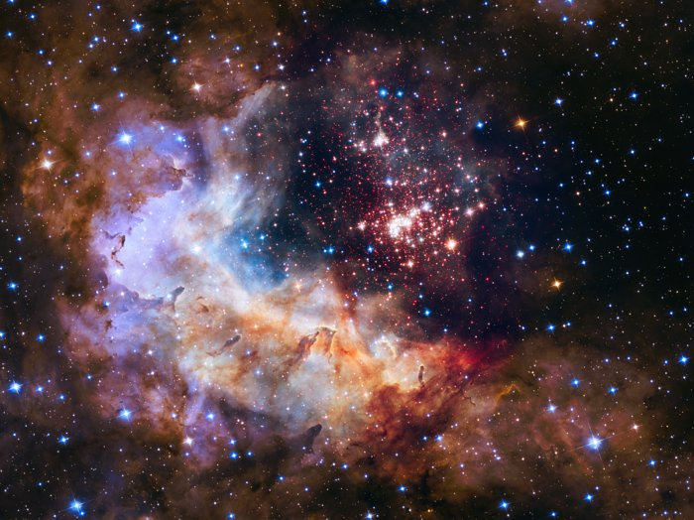
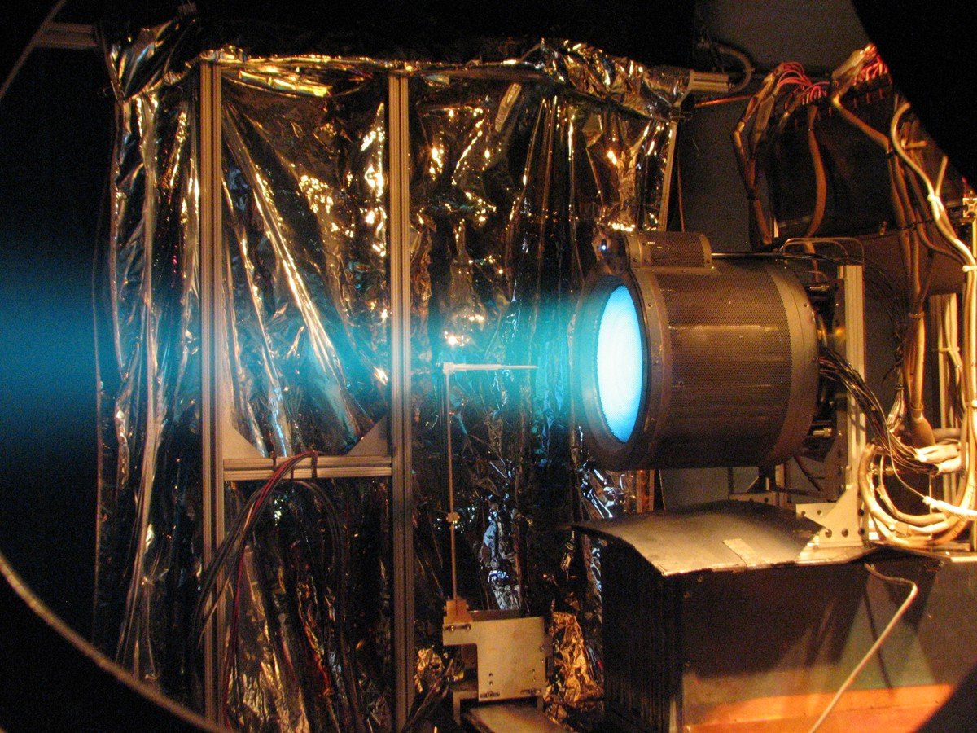
Large discrepancy in representation – despite huge overlap?
99.9% of the universe is made of plasma!
Image sources: ESA

Slide 4
The public are unaware of what plasma is
Informal survey (n=15) Waaraan denkt u als u plasma hoort?
What do you think of when you hear the word plasma?
11 - Blood plasma
2 - Plasma televisions
1 - Some sort of sci-fi energy
1 - Some sort of disgusting slime
(ectoplasm)

Slide 5
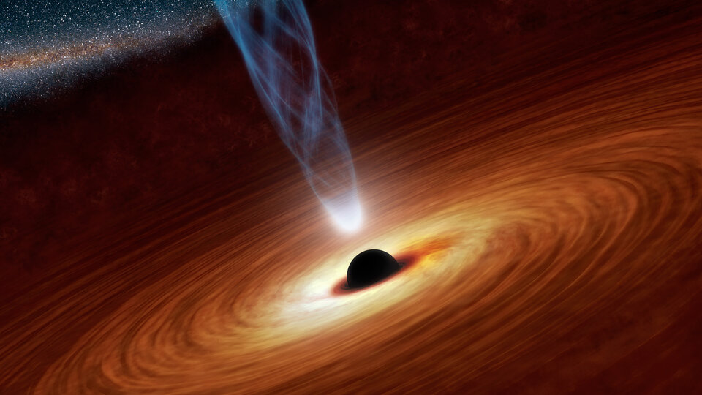
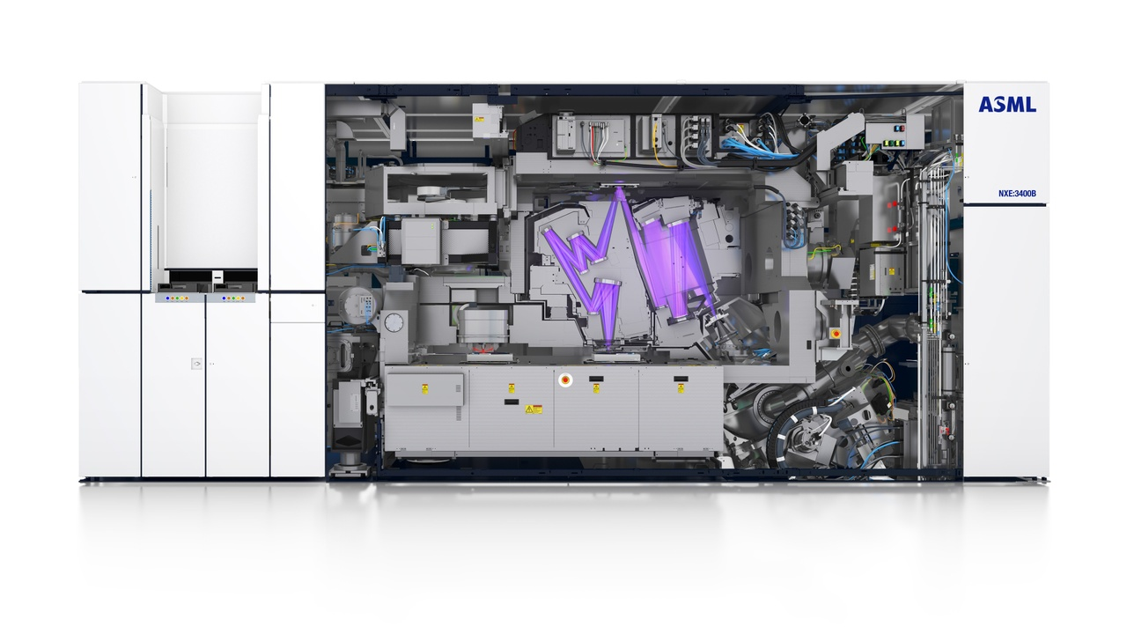
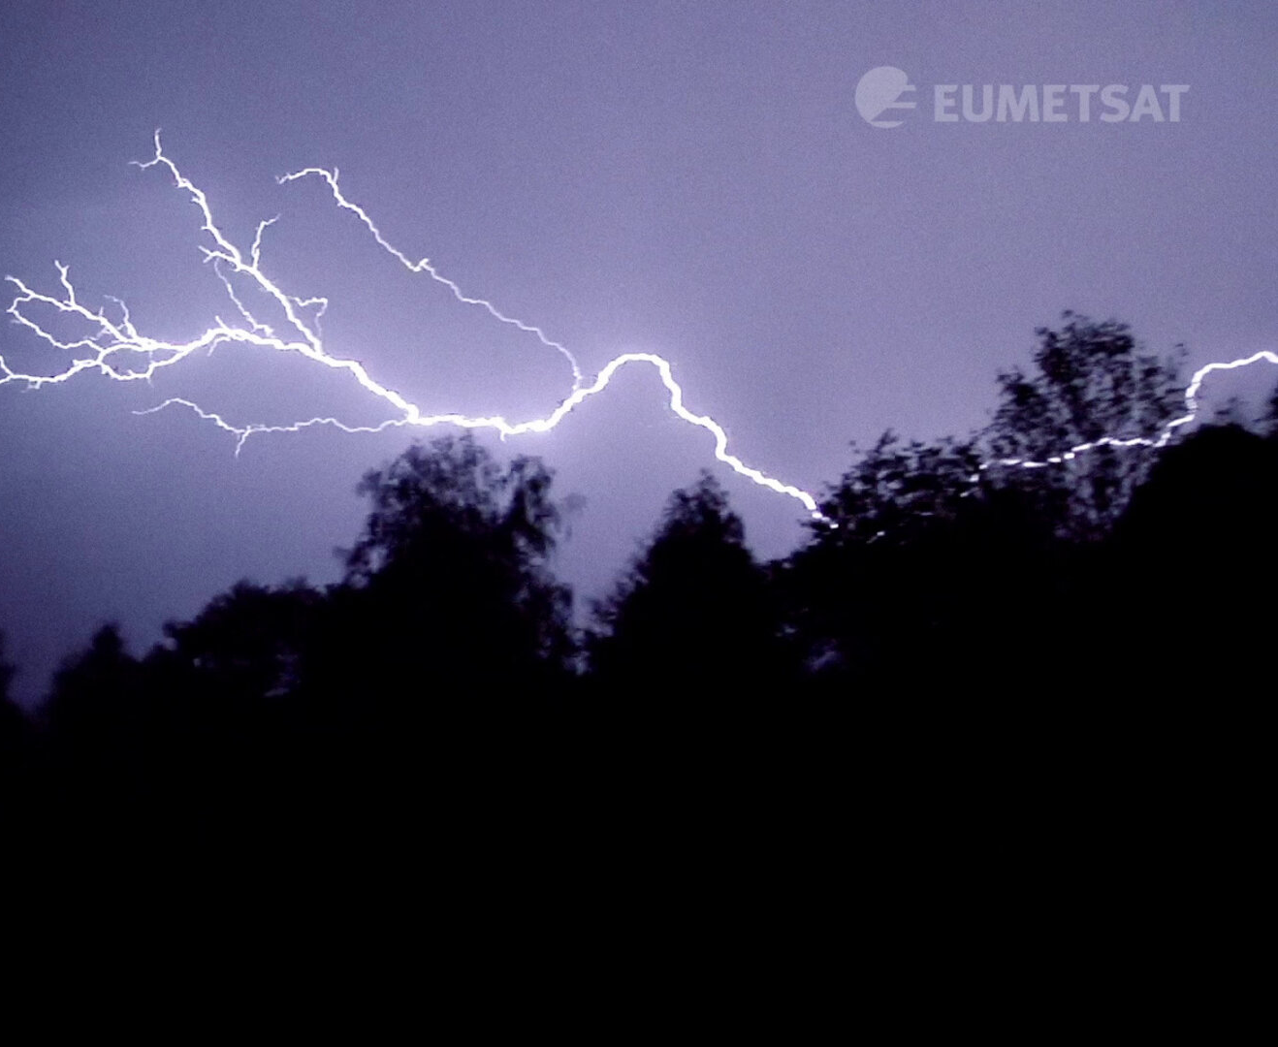
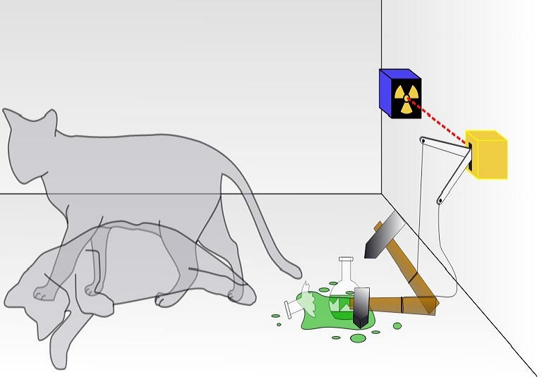
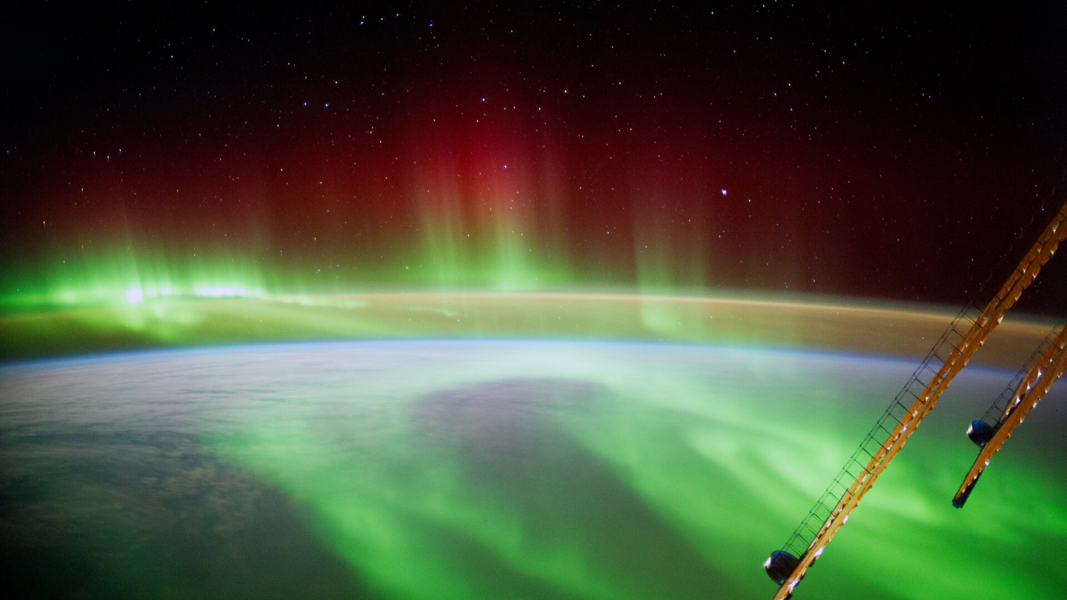
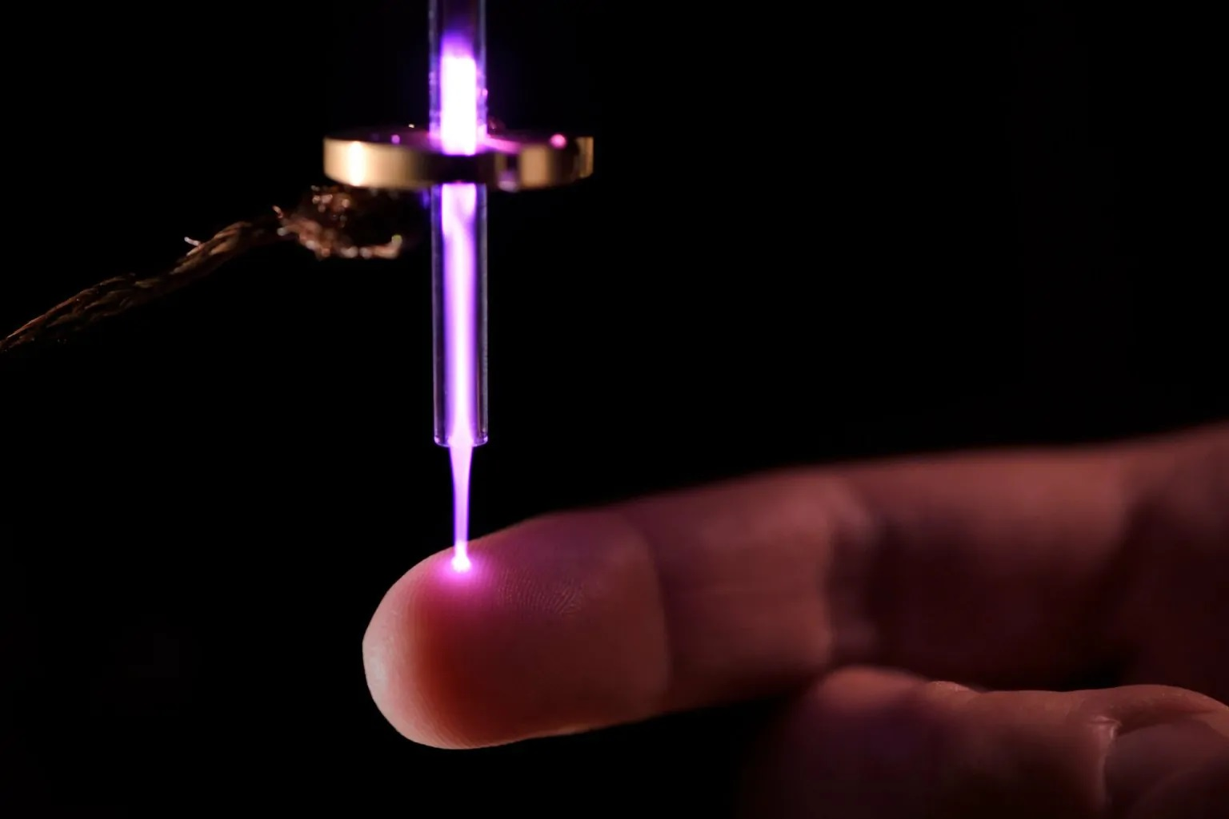
Plasma Makes a Great Sci-Com Case Study
Lack of preconceptions related to the topic
Covers very fundamental and very applied research
2 case study research questions
How do astronomers and plasma researchers tackle communication differently?
How do the public respond to fundamental and applied science?
ESA
ASML
Libre Texts
ESA

Slide 6
Scientist
Engineer
Miller, D., et al. (2018). The Development of Children's Gender-Science Stereotypes: A Meta-analysis of 5 Decades of U.S. Draw-A-Scientist Studies. Child Development 89(6); Fralick, B., Kearn, J., Thompson, S., & Lyons, J. (2009). 1943-1955. How Middle Schoolers Draw Engineers and Scientists. Journal of Science Education and Technology, 18(1), 60–73. http://www.jstor.org/stable/23036166
Notes:
Also, when children are asked to draw an engineer, a human figure is missing in about 30-40 % of their drawings! Or: their perception of what applied research and innovation entail is not too clear. And likely this is the case for many adults as well.

Slide 7
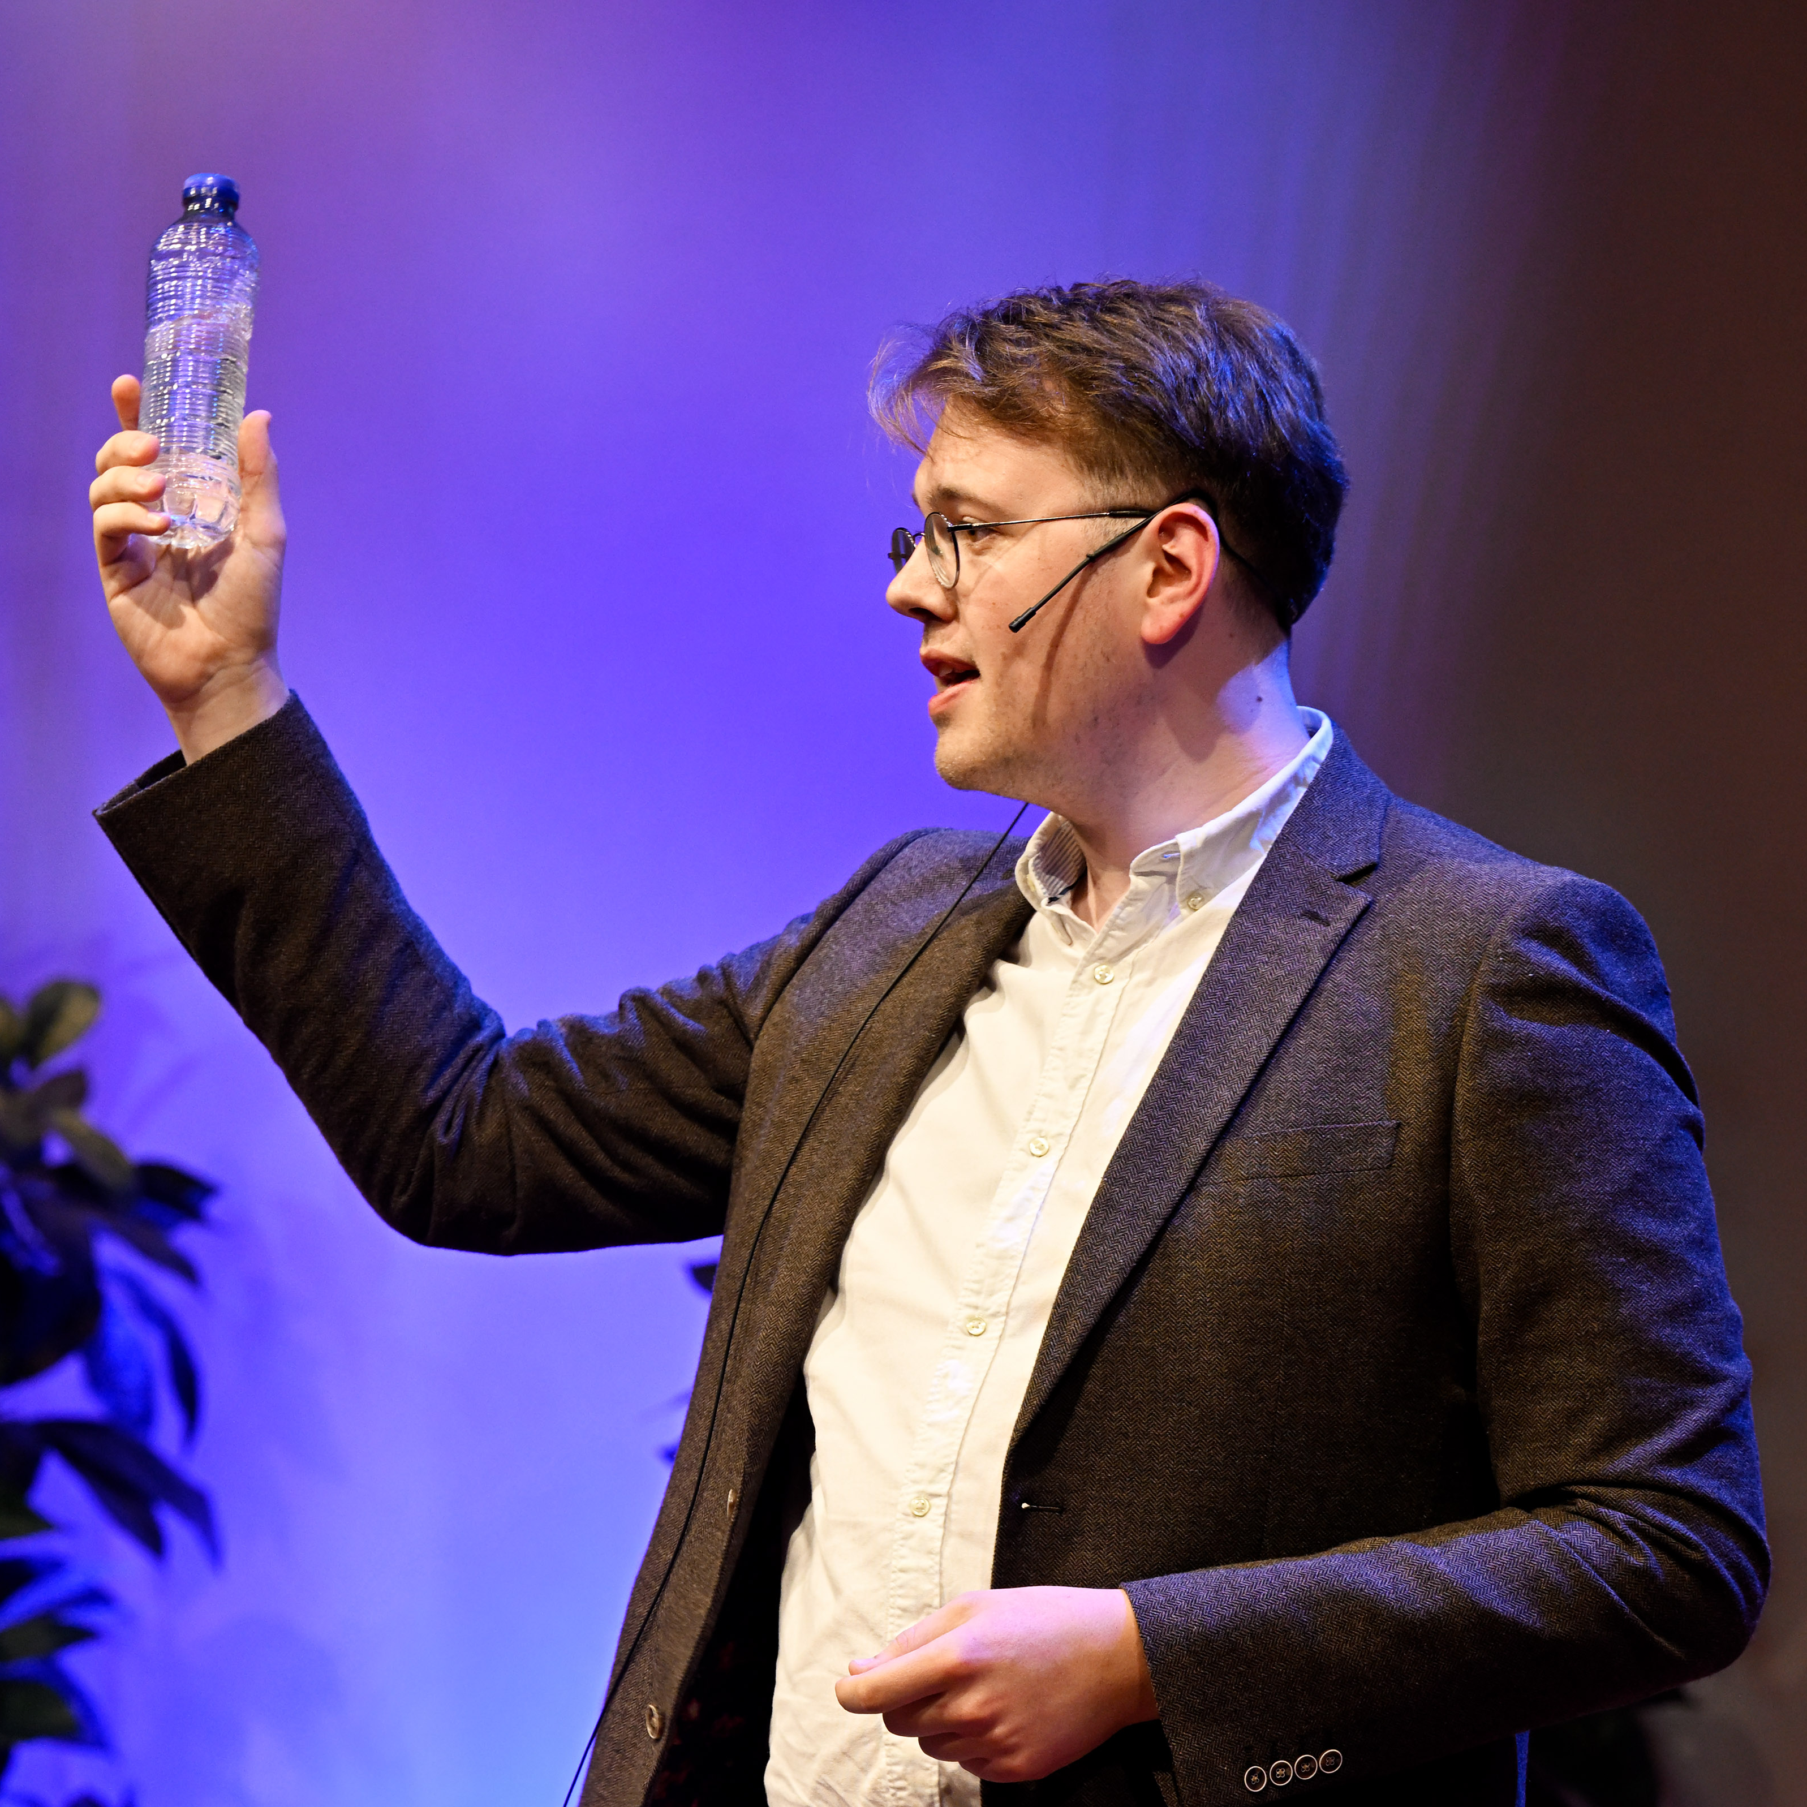
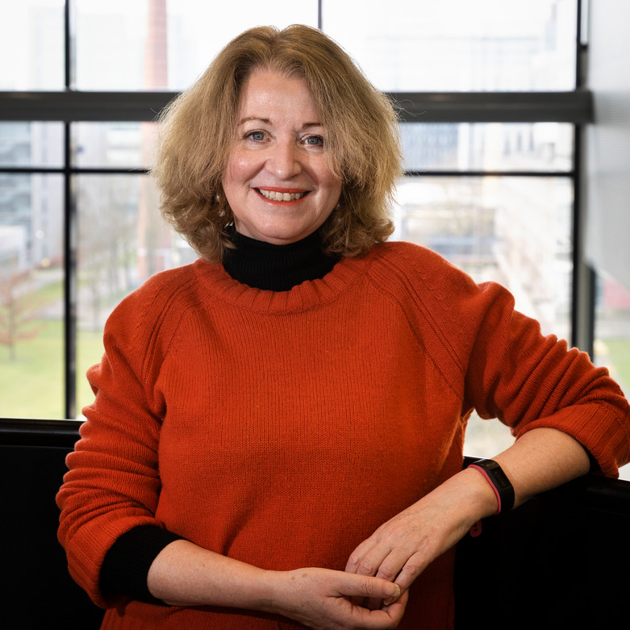
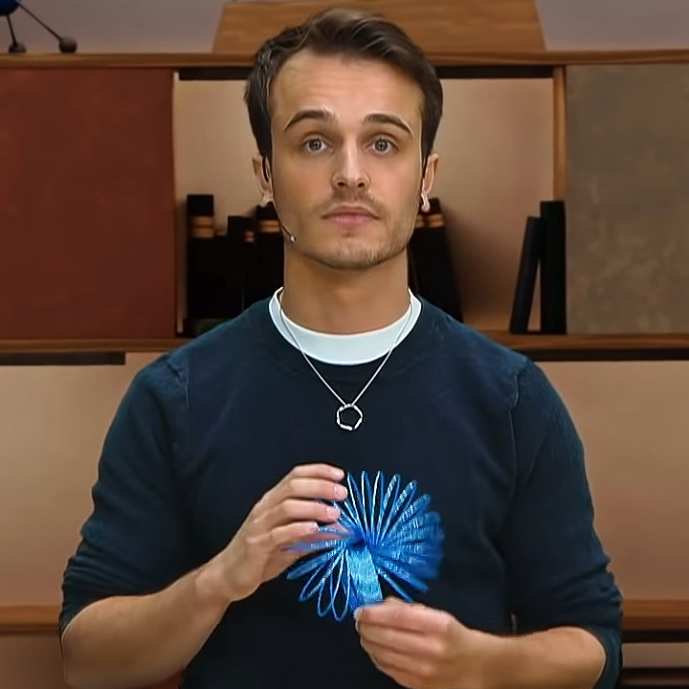
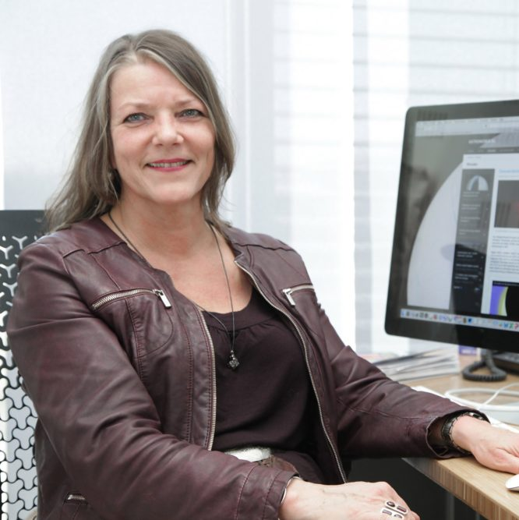
Introducing the Plasma-Com project
Calum T. Ryan
TU/e
Margriet van der
Heijden
TU/e
Ralf Mackenbach
EPFL
Marieke Baan
NOVA

Slide 8
Introducing the Plasma-Com project
How do astronomers and plasma researchers tackle communication differently?
How do the public respond to fundamental and applied science?
Learn from researchers their attitudes to Sci-Com
Develop interactive exhibition
Learn how to effectively expose public to a new topic

Slide 9
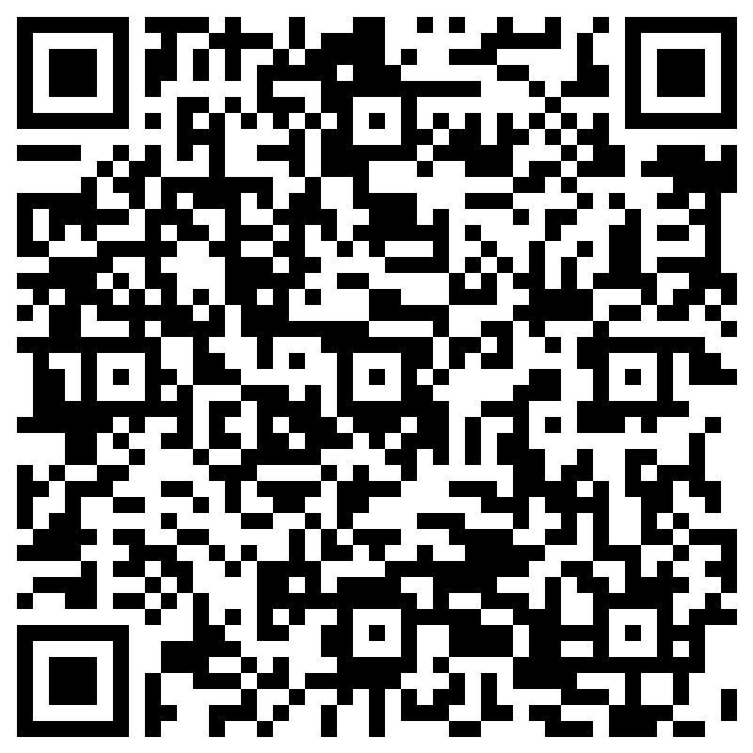
We need your help!
Please fill in this survey!
Most importantly!
sum up research into one
communicable sentence
For contact:
c.t.ryan@tue.nl
m.w.v.d.heijden@tue.nl
Thank you for listening!

Slide 11
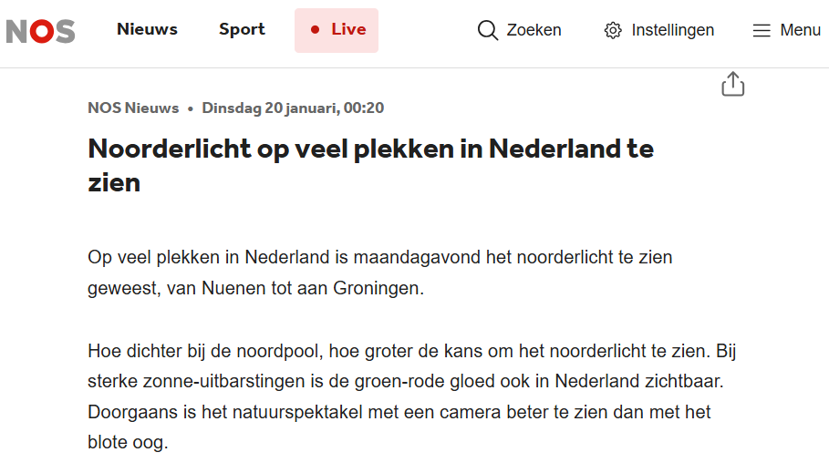
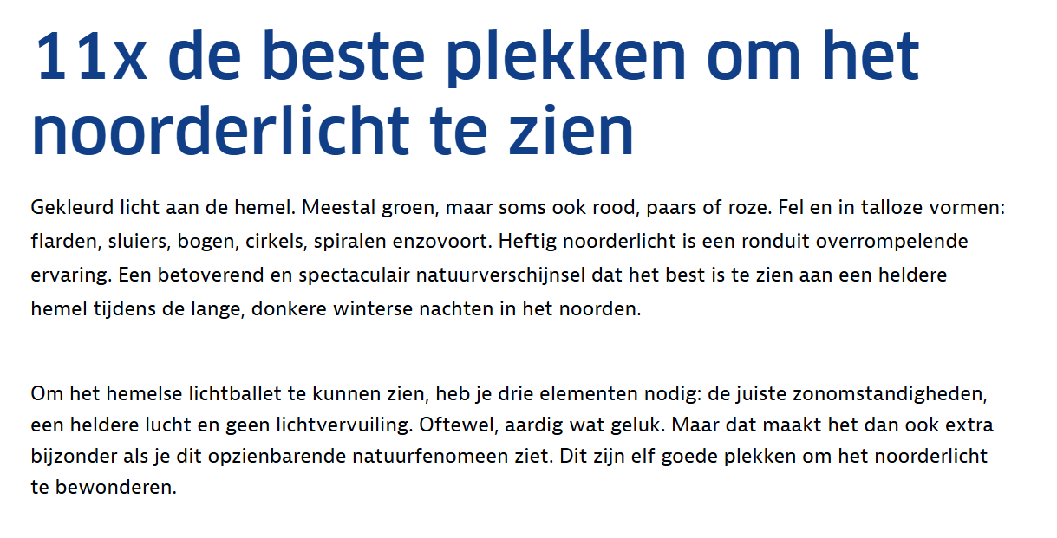
https://nos.nl/artikel/2598905-noorderlicht-op-veel-plekken-in-nederland-te-zien
https://www.anwb.nl/vakantie/inspiratie/beste-plekken-noorderlicht

