Slide 1
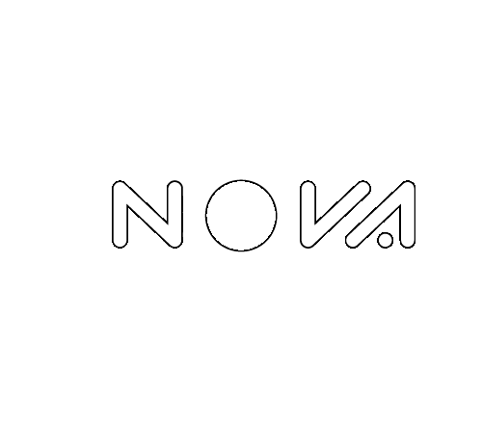
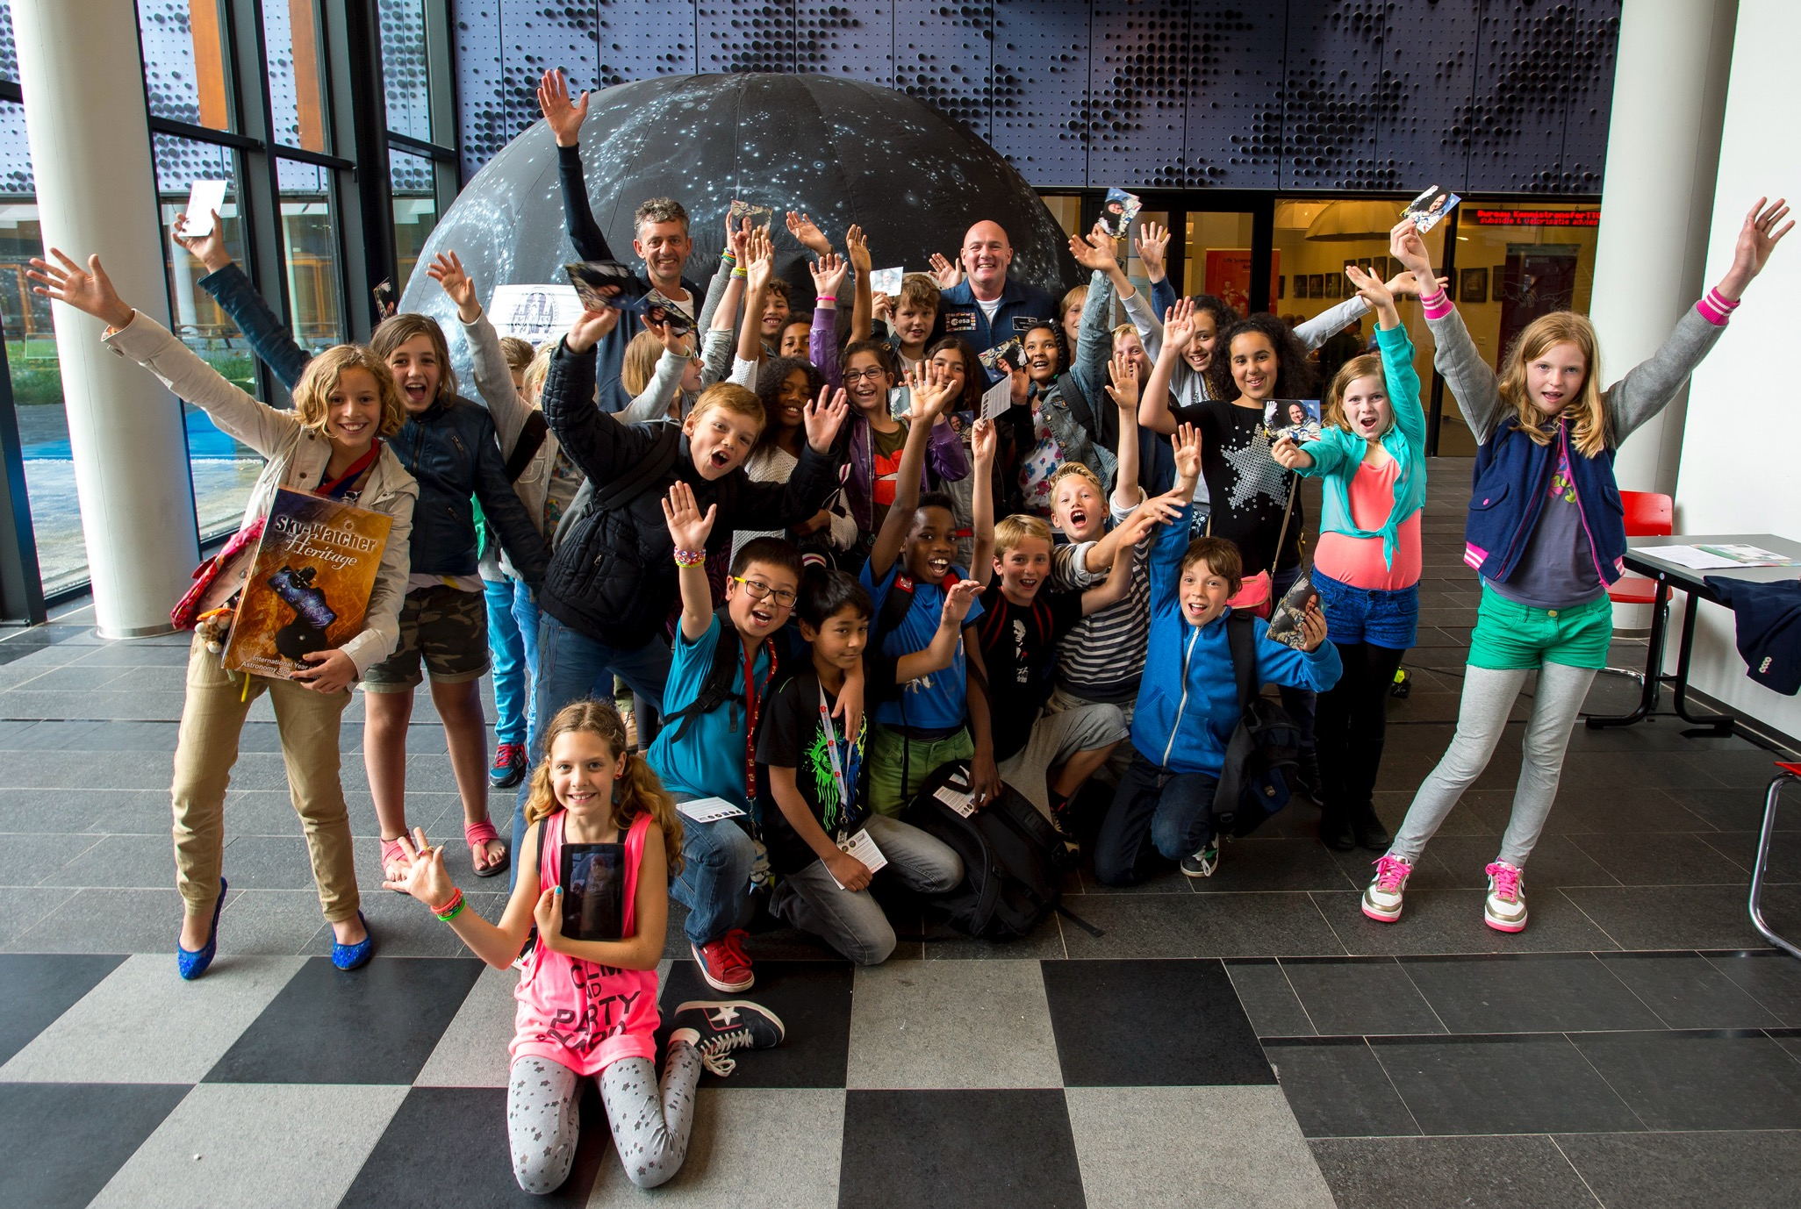
Bringing the universe to underserved communities
Joris Hanse¹
Joanna Holt^{1,2,*}, Marieke Baan^{1,**}, Nelleke Theijssen¹, Lotte Langerak^{1,5}, Steven Bloemen³, Jacco Vink⁴, Ralph Wijers⁴, Frans Snik⁵, Sebastiaan de Vet^{6,7}, Frans Stavers⁹, Yvonne Knobel⁸
¹ The Netherlands Research School for Astronomy (NOVA); ² Amsterdam University of Applied Sciences, The Netherlands; ³ Radboud University, Nijmegen, The Netherlands; ⁴ Anton Pannekoek Institute, University of Amsterdam; ⁵ Leiden Observatory, University of Leiden; ⁶ Delft University; ⁷ KNVWS; ⁸ The Weekend School. ⁹ Netherlands Institute for Space Research (SRON), The Netherlands.
* NAEC chair for the Netherlands ** NOC for the Netherlands

Slide 2
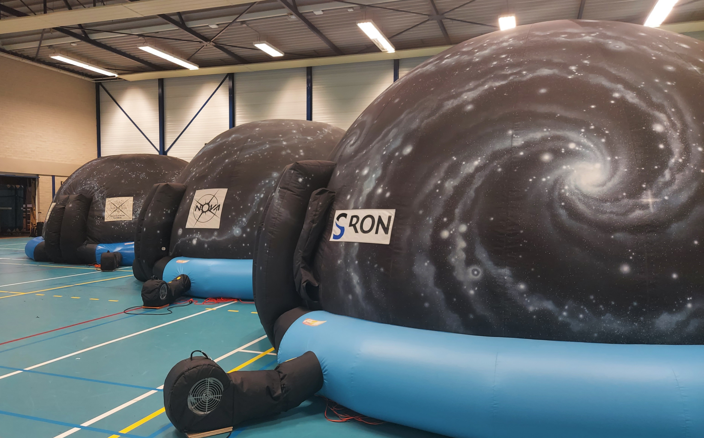
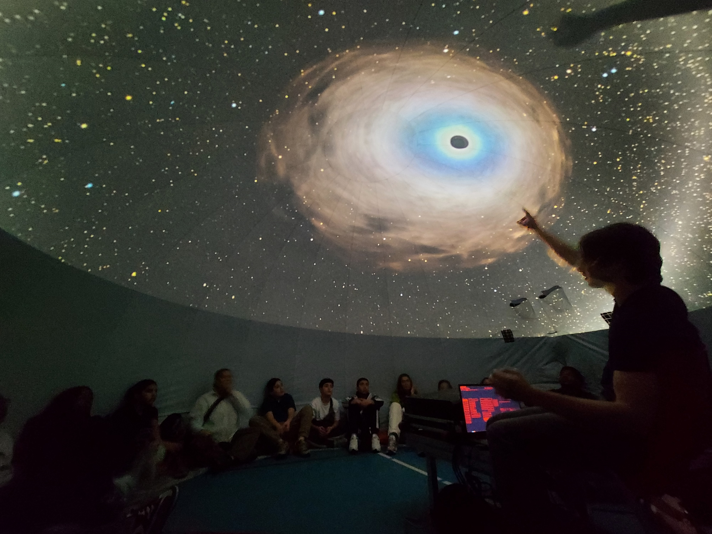
NOVA Mobile Planetarium
In a nutshell:
3 NOVA domes (+ sister dome @ RuG)
9/12 provinces
>600,000 school children since 2009
12 schools/week
Unique approach
Live & interactive shows
Actively engage leaners
Interests/questions of audience/school influence content
→ Team expertise & flexibility
Holt, Hanse & Baan (2023) (CAP Journal nr 33)
Notes:
NOVA’s flagship educational project is the NOVA Mobile Planetarium
Started in 2009 with 1 dome coordinated by NOVA serving 9 of the 12 provinces and 1 in Groningen covering the 3 northern provinces
Since then the project has grown and NOVA now has 3 domes
Since the beginning, we have reached more than 500,000 children
The NOVA domes currently visit, on average, around 12 schools per week
2nd photo
One of the reasons the planetarium is so successful is because of it’s educational approach
All shows are live and interactive and no two shows are the same
We engage the audience and their interests and questions (and of course the wishes of the school) shape the content of the lesson
this is a unique approach, the majority of planetariums run films and even when doing live shows, the full show is scripted from start to finish
Our live and interactive approach is only possible because of the combination of expertise in the team
In house at NIC, we have expertise in astronomy, science education and planetarium software
This means we can customise the software as and when needed
and we only work with 2nd year plus astronomy students to ensure they already have a good grounding in astronomy

Slide 3
NOVA Education vision
To give every child in NL an unforgettable STEM experience during his/her school career.
Notes:
The Mobile Planetarium has been a successful project for years but it has expanded dramatically since the corona pandemic.
During the pandemic, rather than sitting still, we used the time to critically reflect on the project and to innovate.
[GOAL]
We also reflected on where we were and where we wanted to be.
The NOVA Education vision is to ………….
Physically reaching every child is difficult; but making it as likely that each child will be able to have this experience is possible.
But do we do that? Do we reach every region? Every neighbourhood?

Slide 4
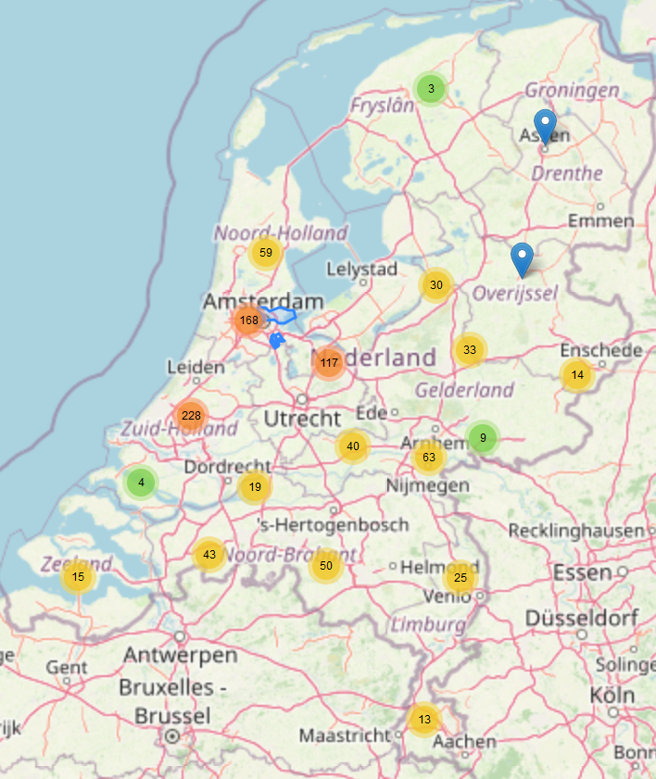
Visit distribution in 2023
Project structurally misses:
Poorer neighbourhoods in cities
Rural areas
Notes:
We decided to map our booking data.
It quickly became clear that, whilst we were visiting many schools and reaching many children, where a child lives has a huge impact on whether they are likely to experience a visit of the NOVA Mobile Planetarium.
Our project structurally misses both poorer neighbourhoods in the big cities, and large swathes of more rural areas.
This is not really surprising – many projects struggle with this problem….
……….and of course, it would therefore be easy to shrug shoulders and do nothing about it, especially with the reach this project is already having……
…….. but our team isn’t like that, so we came up with a plan

Slide 5
Action plan
Understand
Small research project:
Why do we miss schools in
cities and rural areas?
Survey of schools in target areas
Complex answer including:
Lack of resources (including time)
Project not known
Incorrect perceptions (‘my area is too far away’)
Notes:
Whilst we already had a good feeling regarding the various reasons schools may not book us, we wanted to be sure we really understood the problem.
We carried out a small research project, contacting schools we had never visited in both poorer city neighbourhoods and rural areas, to find out why schools had not booked the planetarium.
The results confirmed a complex situation, including:
Schools just not knowing about the project
Schools thinking that we would not visit areas of the country far from where the project coordination is based (Randstad)
To a lack of resources – in city schools, this is both a lack of time and funds as so much time and money is spent on extra support for challenges faced in these areas, and in rural areas, schools are often small, meaning our standard flat rate is much more expensive per child than for large schools which can efficiently fill a day with shows.

Slide 6


Action plan
Understand
Build capacity
Funding for:
new planetarium
subsidised visits
special training for planetarium students
Thanks to:
sponsorship of new dome
NWO-NWA Science Communication grant

Slide 7

Action plan
Understand
Build capacity
Intervention (cities)
Targeted visits to schools in poorer neighbourhoods in cities
Primary schools
‘Weekend’ schools
Structural collaboration with IMC Weekendschool
New training for students
Reach:
~ 35 locations
~ 1600 students / 70 teachers

Slide 8
Action plan
Understand
Build capacity
Intervention (cities)
Intervention (rural areas)
Initial results
Targeted visits to missed rural areas
2 approaches
Individual schools
Intensive area visits: 1 per province
→ Pilot intensive visit: island of Texel

Slide 9
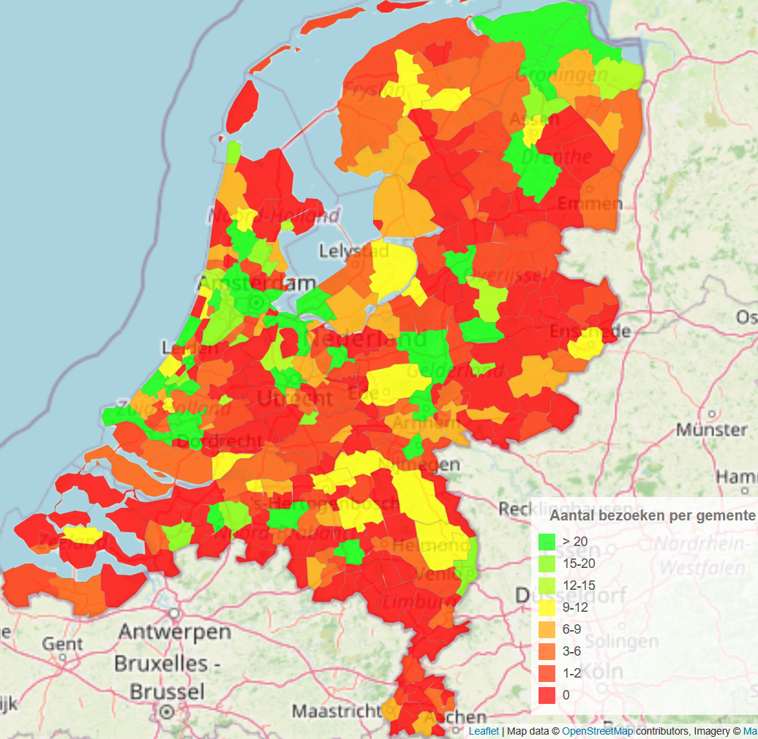
Island of Texel – intensive visit pilot
Texel
Why Texel?
Never visited
Geography defines visit boundaries
Small student population (~1500)
1 secondary/11 primary schools
Goal
To reach all students within a 2-3 week period
Secondary goal
Reach parents & other residents → increase impact

Slide 10
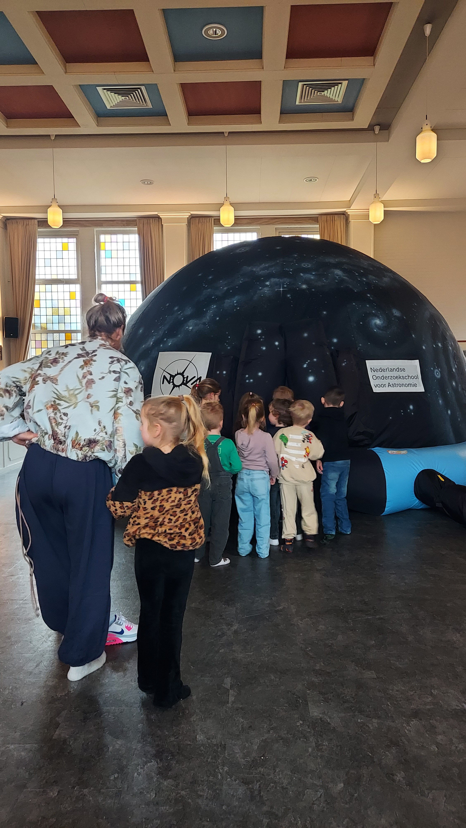
Island of Texel – intensive visit pilot
Results
All 12 schools reached (76% of students)
350 other visitors
→ 10.85% of island population
‘We all had a wonderful visit. The children watched in awe and had lots of questions. The presenter was happy to answer any question, no matter how unusual, and had an answer for everything, which was immediately demonstrated. Afterwards, we all felt as though we’d briefly been in space. Thank you so much for this unforgettable experience!’

Slide 11
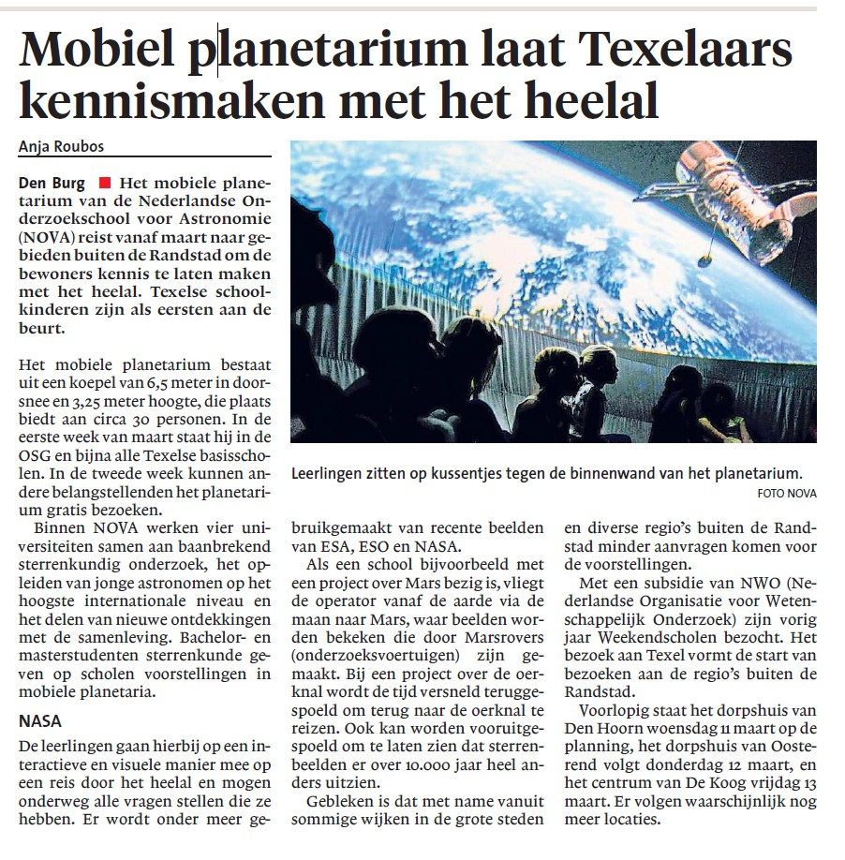
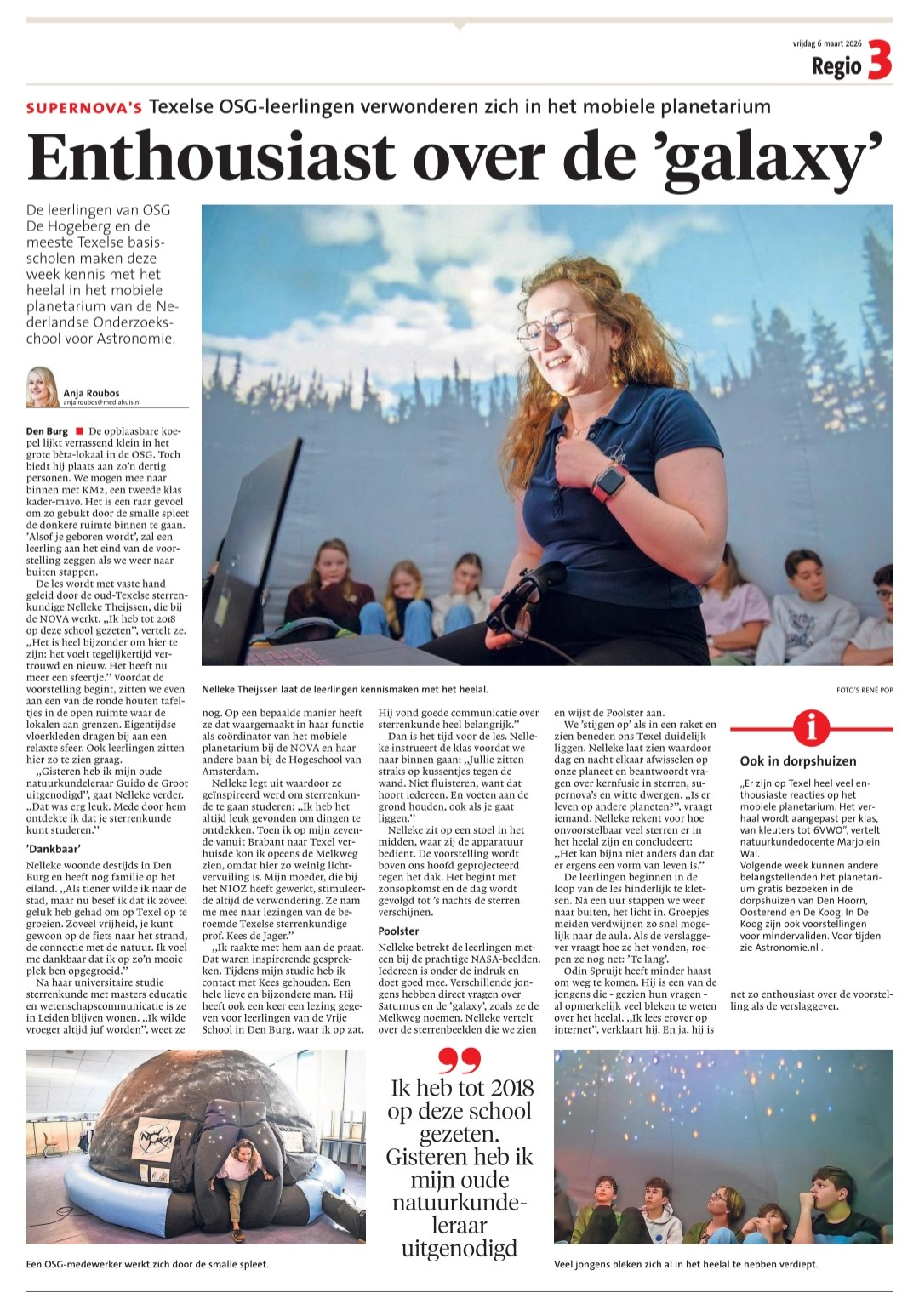
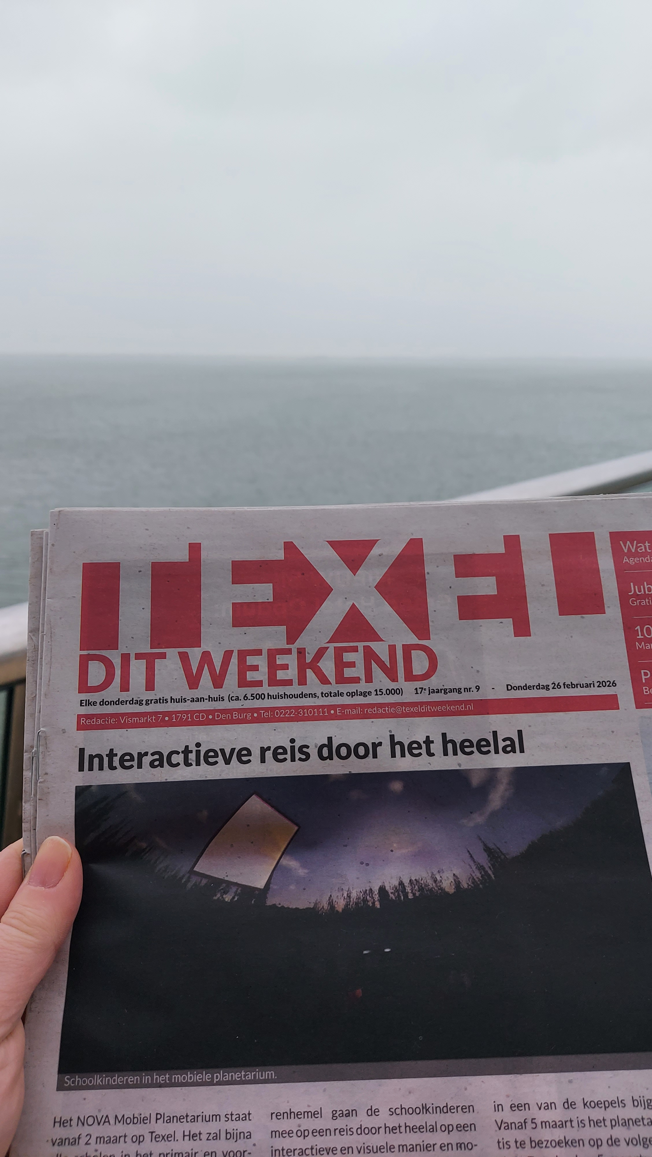
Island of Texel – intensive visit pilot
Success through collaboration:
Local contact (science teacher & coordinator for Bètapartners)
Community centres (for general public)
Local council
Good local press coverage
“Everyone was very interested in the unique experience during which you feel as though you’re travelling through space…..Many people thanked us, the village committee, for bringing you here, but of course it wasn’t that difficult, given that you offered to do this for us. So, above all, a word of thanks from us to you and your team for making it possible for us to host this in our village hall."

Slide 12
Looking ahead
Targeted visits in remaining 11 provinces
Continued collaboration with IMC Weekendschool
Notes:
But of course, the mobile planetarium team is not like that. We like to push the boundaries, as demonstrated by our determination to continue operations during the pandemic.
So we came up with a plan of action
We realised we needed more capacity and went about trying to acquire funds for a third NOVA-coordinated dome. And we’re very happy that we managed to agree a generous sponsorship with SRON. The new dome was installed in July 2023 and has been operating alongside the other domes for the whole of this school year.
The SRON sponsorship also includes funds to develop new content related to the Athena mission, and to visit at least 60 under-represented schools within the next 5 years.
We were also generously sponsored by Ignas Snellen to carry out a small research project to find out why schools we don’t currently reach don’t book the planetarium. As expected, the results for primary schools show that this is a combination of not knowing about the planetarium and not having the funds to pay for a visit.
We were also granted a Science Communication grant from NOW in the 2023 round. This grant will enable us to reach many more under-represented schools.
We are also collaborating with the weekendschool, a non-profit organisation with an already established programme and network, to reach schools in underprivileged areas. We will also work with the weekendschool to develop a new training for our planetarium students to help them engage better with these groups.
Finally, as many schools have indicated that they are unaware of the planetarium project at all, we have reserved some funds to give workshops at educational conferences across the Netherlands.

Slide 13
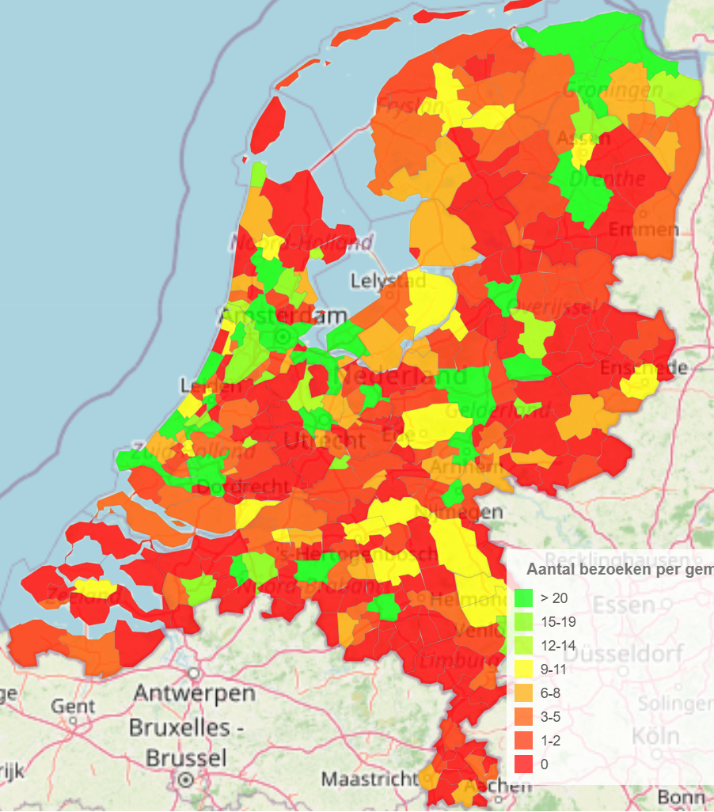
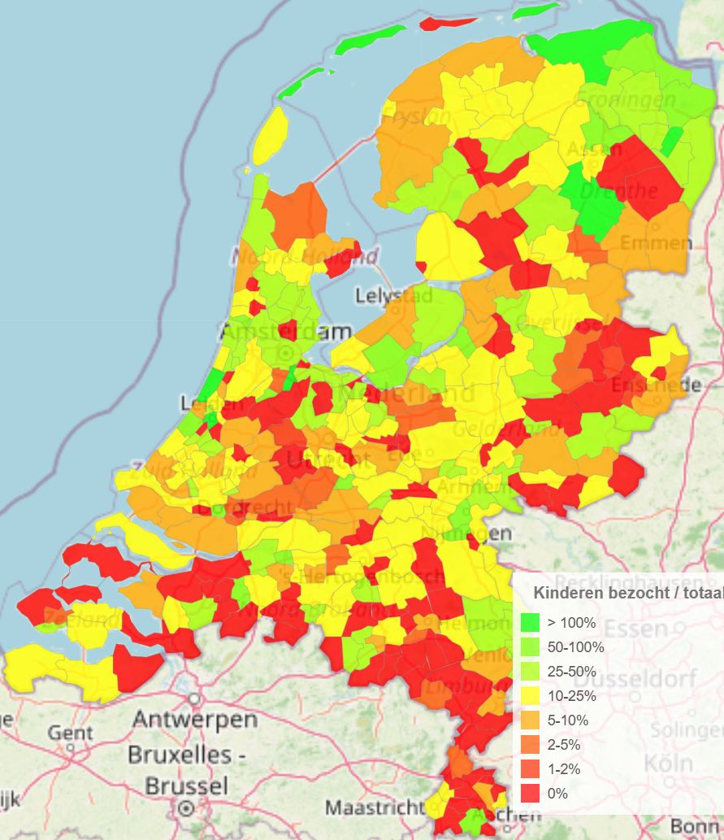
Notes:
But of course, the mobile planetarium team is not like that. We like to push the boundaries, as demonstrated by our determination to continue operations during the pandemic.
So we came up with a plan of action
We realised we needed more capacity and went about trying to acquire funds for a third NOVA-coordinated dome. And we’re very happy that we managed to agree a generous sponsorship with SRON. The new dome was installed in July 2023 and has been operating alongside the other domes for the whole of this school year.
The SRON sponsorship also includes funds to develop new content related to the Athena mission, and to visit at least 60 under-represented schools within the next 5 years.
We were also generously sponsored by Ignas Snellen to carry out a small research project to find out why schools we don’t currently reach don’t book the planetarium. As expected, the results for primary schools show that this is a combination of not knowing about the planetarium and not having the funds to pay for a visit.
We were also granted a Science Communication grant from NOW in the 2023 round. This grant will enable us to reach many more under-represented schools.
We are also collaborating with the weekendschool, a non-profit organisation with an already established programme and network, to reach schools in underprivileged areas. We will also work with the weekendschool to develop a new training for our planetarium students to help them engage better with these groups.
Finally, as many schools have indicated that they are unaware of the planetarium project at all, we have reserved some funds to give workshops at educational conferences across the Netherlands.

Slide 14
Want to know more?
NOVA Mobile Planetarium
www.astronomie.nl/planetarium
Holt, J., Hanse, J., Baan, M., (2023), CAP Journal 33, p35-42.
nova@astronomie.nl / j.hanse@uva.nl

