Slide 1


Fast Inference
for Pulsar Timing Arrays
Netherlands Astronomy Conference - 2026
Kevin de Man – Master Student
University of Groningen
Working with and supervised by Aditya Parthasarathy · ASTRON
Supervised by Prof. Dr. M. Mendez · University of Groningen

Slide 2
Motivation - how to solve the data bottleneck?
We are entering the era of big data in astronomy
New Telescopes
Galactic Electron Density
Gravitational Wave Impact
SKA and DSA-2000 will generate enormous data volumes
demanding scalable pipelines to extract meaningful information.
The ISM electron density model drives pulsar distance estimates
It is a critical source of systematic uncertainty.
Unmodelled propagation effects can mimic or obscure GW signatures in pulsar timing arrays.
Improving inference would improve gravitational wave searches
Current Challenge: Classical Bayesian methods becomes expensive in high dimensions due to strong degeneracies.
This work: Build an efficient, large-scale inference pipeline for astrophysical data an early but crucial step forward.

Slide 3
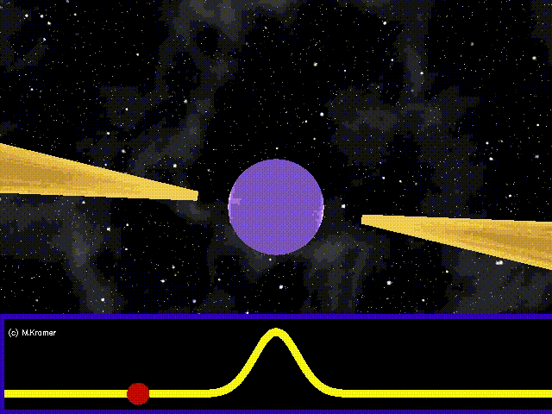
What Is a Pulsar?
Rapidly rotating neutron stars
with extremely strong magnetic fields
Radiation
beams
Rotation axis
Emit beams of radiation
Beams are misaligned with the rotation axis
If the beam sweeps across Earth → we detect regular pulses
Some millisecond pulsars are among the most stable clocks in the universe
NS

Slide 4
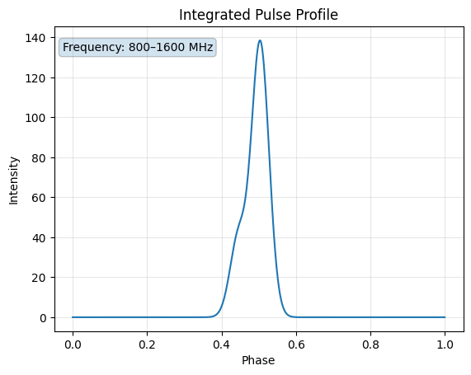
What Do We Observe?
The data : intensity as a function of pulse phase and observing frequency
Simulated Pulse profile
What is a Pulse Profile?
Each pulse is a burst of radiation which we observe as an intensity vs pulse phase.
• X-axis: pulse phase (0 to 1 = one full rotation)
• Y-axis: measured intensity
• Integrated over all frequencies: 800–1600 MHz
This double-peak profile is fairly simple; real observations look significantly more complex.

Slide 5
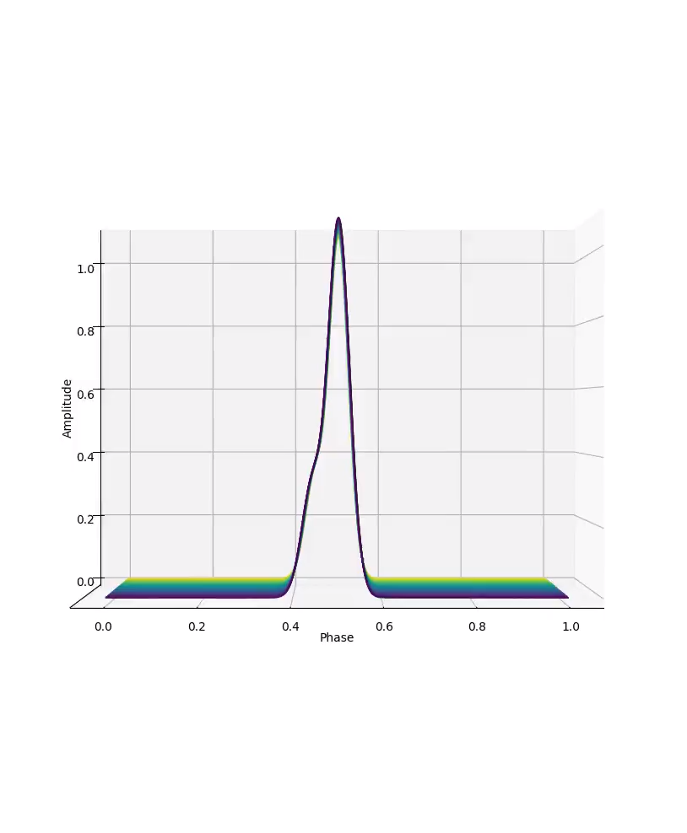
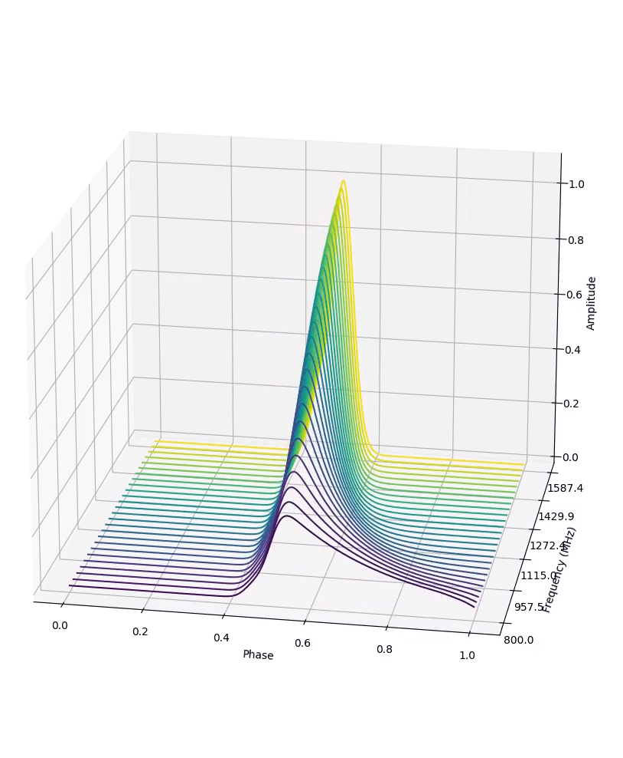
What Do We Observe? Waterfall Plots
The data : intensity as a function of pulse phase and observing frequency
Simulated Data
From 2D to 3D: Adding Frequency
Viewing the pulse across observing frequencies reveals the true richness of the signal.
Scattering Tail
ISM interactions delay pulses asymmetrically → exponential tail on the trailing edge. Size of tail represented by tau.
Frequency Evolution
Pulse shape and width can change with frequency due to pulsar emission geometry.
Dispersion Sweep
Lower-frequency signals arrive later → visible diagonal sweep. Quantified by Dispersion Measure (DM).
Noise
High noise levels often require stacking multiple observations to recover the signal. Unknown sources creating effects in the signal.

Slide 6
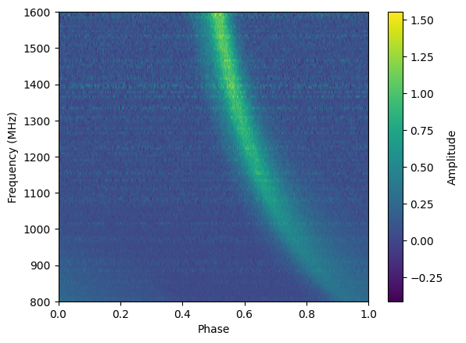
What Do We Observe? Frequency-Phase plot
The data : intensity as a function of pulse phase and observing frequency
Simulated Data
Scattering Tail
ISM interactions delay pulses asymmetrically → exponential tail on the trailing edge.
Frequency Evolution
Pulse shape and width can change with frequency due to pulsar emission geometry.
Dispersion Sweep
Lower-frequency signals arrive later → visible diagonal sweep. Quantified by Dispersion Measure (DM).
Noise
High noise levels often require stacking multiple observations to recover the signal. Unknown sources creating effects in the signal.
Figure parameters |dm – 8pc cm^-3 | tau – 10ms | period – 100ms |index – -4.4|

Slide 7
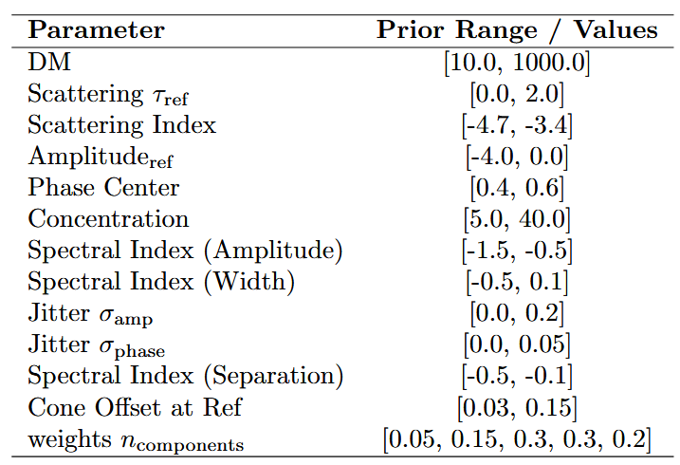
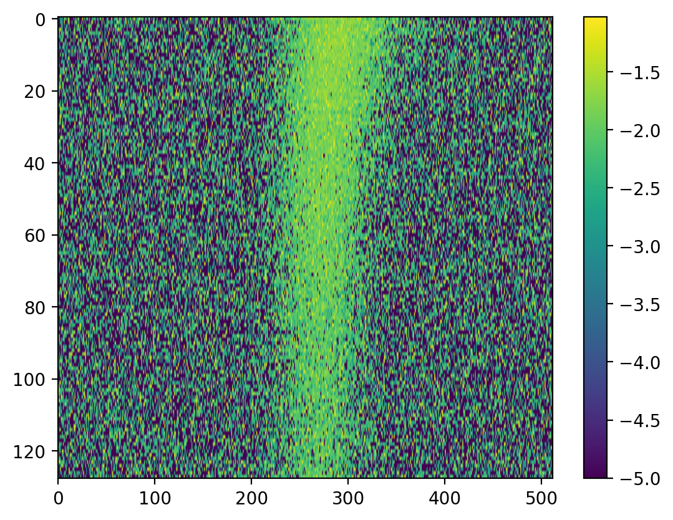
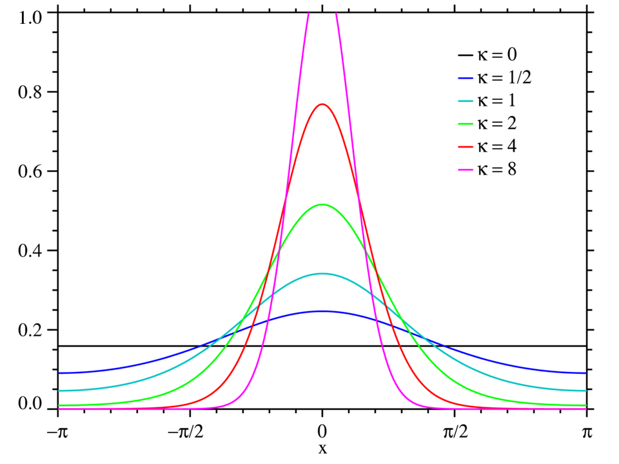
Simulating the Signal: Our data
We build a forward simulator to generate realistic synthetic waterfall plots from known parameters
Model Parameters
Physical Parameters
Von Mises Pulse
ISM Effects
Frequency-Phase Plot
Pulse shape: Von Mises functions (location, width, amplitude)
ISM effects: DM, scattering (τ, ζ)
Frequency evolution & frequency-dependent behavior
RFI injections
Von Mises Function
⚠ Degeneracies
Frequency bins
Intensity
Different parameter combinations can produce nearly identical observed signals.
Example: Increased scattering may be offset by changes in pulse width → similar profile shapes.
Analogy: A ball thrown at different angles with different air resistance can land at the same point. Same outcome, different parameters.
Time bins

Slide 8
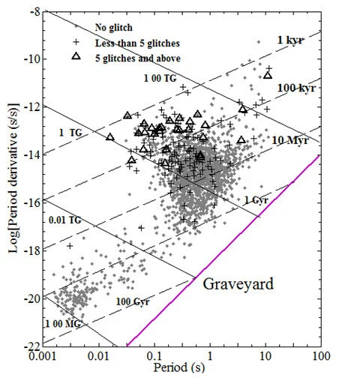
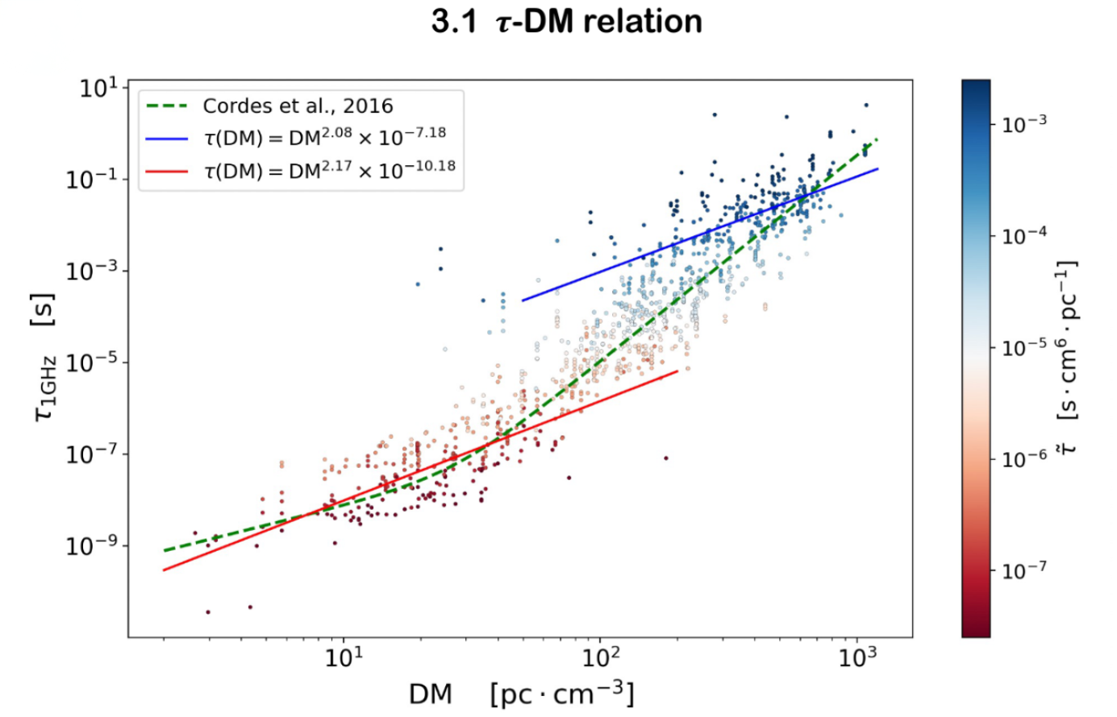
Simulating the Signal: Parameter space
Cordes et al. 2016 scattering relation paper James M. Cordes, Ryan M. Shannon, & Daniel R. Stinebring (2016), “Frequency Structure of Radio Pulsar Signals due to Interstellar Scattering”,
Espinoza et al. 2011 glitch catalog paper Cristóbal M. Espinoza, Andrew G. Lyne, B. W. Stappers, & Michael Kramer (2011), “A study of 315 glitches in the rotation of 102 pulsars”

Slide 9
Inference Pipeline: Neural Networks & SBI
Simulation-Based Inference; a likelihood free Bayesian approach
Simulate
260,000
Waterfall Plots
ResNet18
Encoder
(128-dim)
Neural
Posterior
Estimator
Posterior
Distribution
of Parameters
▶
▶
▶
260,000
2,000
~0.05 sec
Inference
Training samples
Validation samples
Inference per sample
Dispersion Measure
Scattering Tail
Scattering Index
Number of peaks
~30 hours/model
After training | Per 500 samples
Why SBI? SBI learns the posterior directly from simulations; scalable and fast.

Slide 10
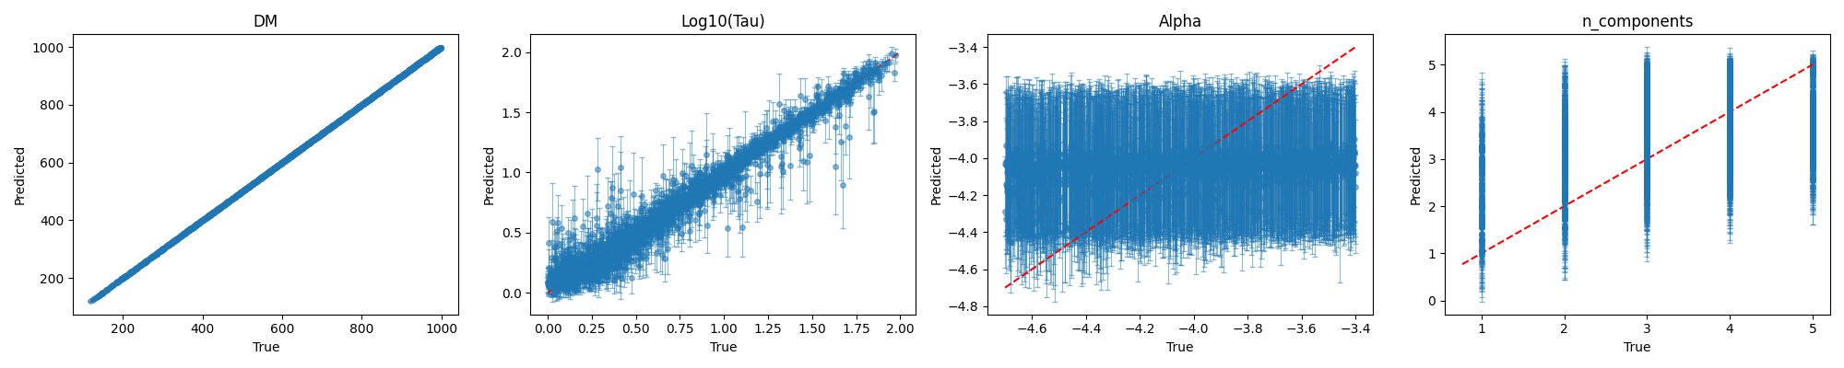
Results
X-axis: True value
Y-axis: Predicted value
Difficulty in
Scattering index; alpha
Number of components
Smarter data representation and
More Data Needed

Slide 11
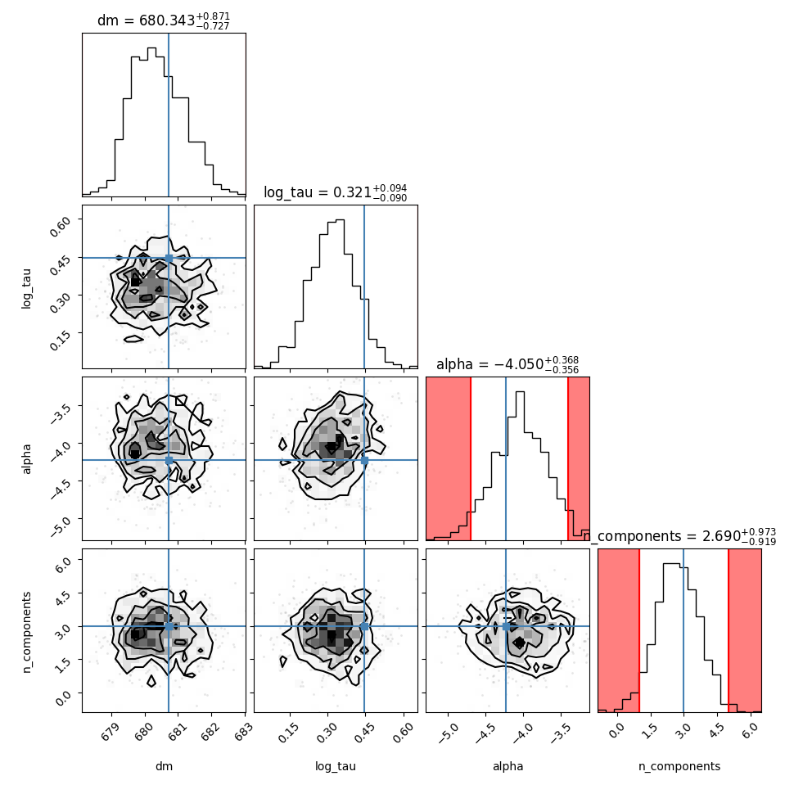
Results
Corner plot More insight when we look at the corner plot of a single pulse profile and the error it generates
SBI
Frequency bins
Intensity
Time bins

Slide 12
Looking Ahead
Next: Fourier Space
Only intensities vs time
Degeneracies remain an issue
Fourier transform may make overlapping features more separable
Von Mises functions have favorable Fourier properties
Could improve posterior accuracy for degenerate parameters

Slide 13
Conclusion
✓
Built a realistic simulator to generate pulse profiles (Von Mises + ISM effects + Intrinsic effects)
✓
Applied Simulation-Based Inference for fast posterior parameter estimation
✓
~0.05s inference per waterfall; orders of magnitude faster than MCMC
⚡
Fourier space representations may resolve degeneracy challenges
▶
A step toward large scale, efficient inference for pulsar timing & GW research
Thank you · Questions welcome

Slide 14
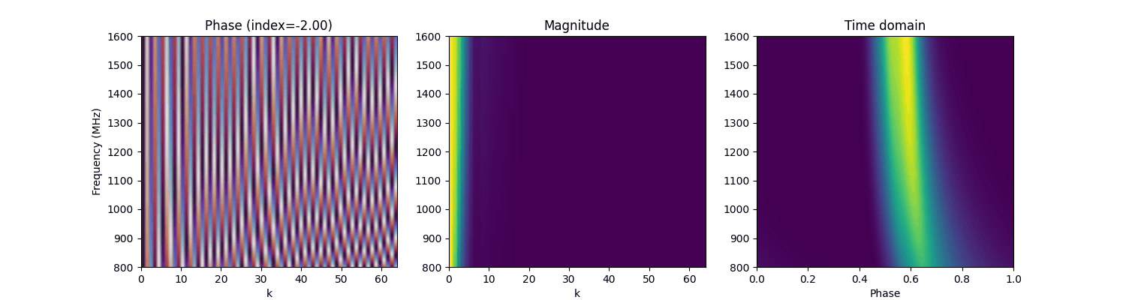
Looking Ahead – Scattering index seperation
Small demonstration: Show casing how the plot changes when increase the scattering index.
Early results show that the absolute pixel difference is 7x larger in a Fourier plot when changing the scattering index.
Angle
Magnitude
Intensity

Slide 15
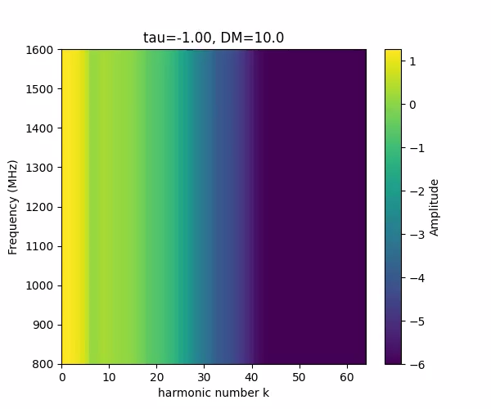
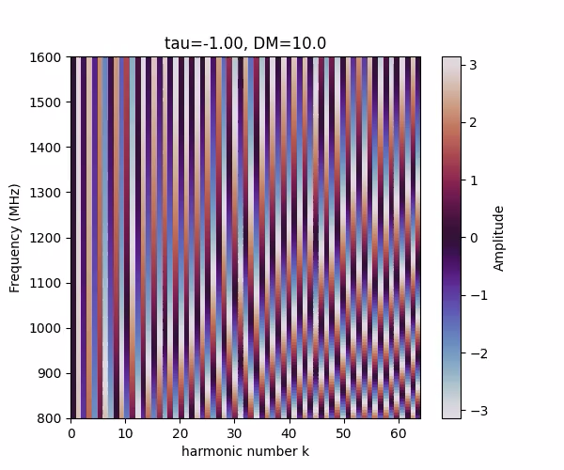
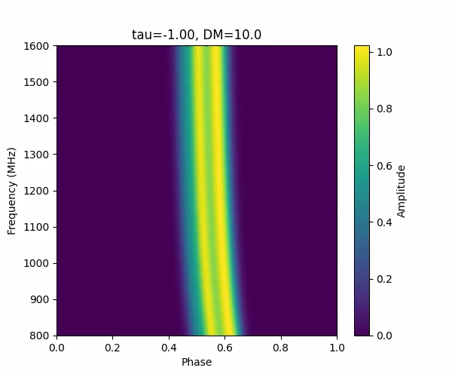
Looking Ahead – DM and Tau
Small demonstration: Show casing how the plot changes when increase the scattering tail.
Magnitude
Angle
Intensity

Slide 16
Parameters and effects added

Slide 17
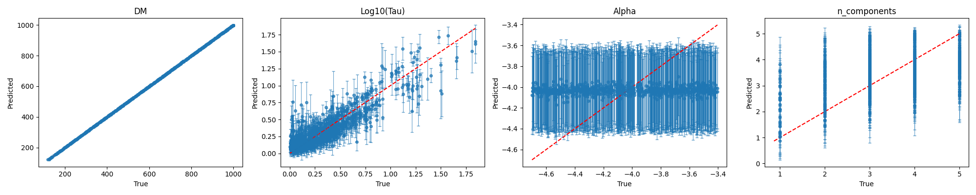
The Bad parameter – when Tau is 10% off the true value

Slide 18
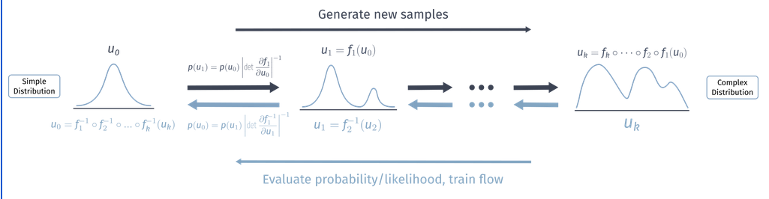
Normalizing Flows
Figure: T.Quadfasel, M.Sommerhalder and S.Diefenbacher, Normalizing flows exercise

