Slide 1
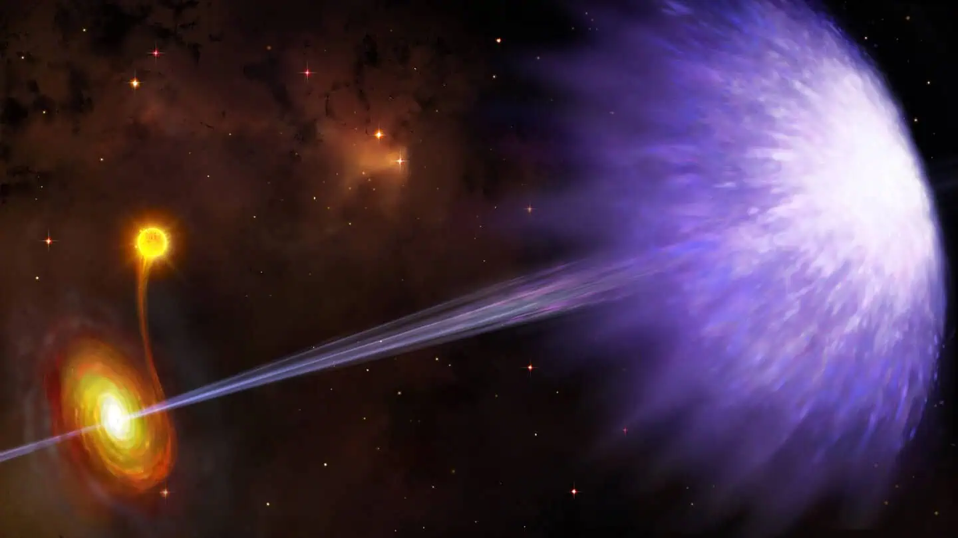


A dramatic jet reorientation in GRS 1915+105: VLBI
Lieuwe de Regt, 2nd year PhD student
Supervisors: Dr. Pikky Atri, Dr. Sara Motta
NAC 2026
Artist impression by Danielle Futselaar

Slide 2
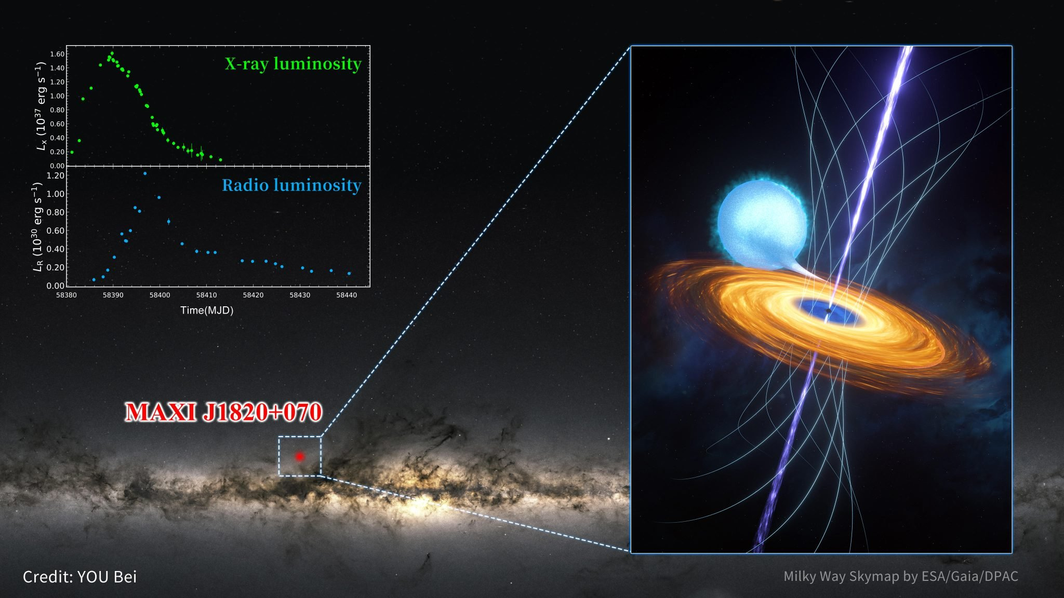

Slide 3
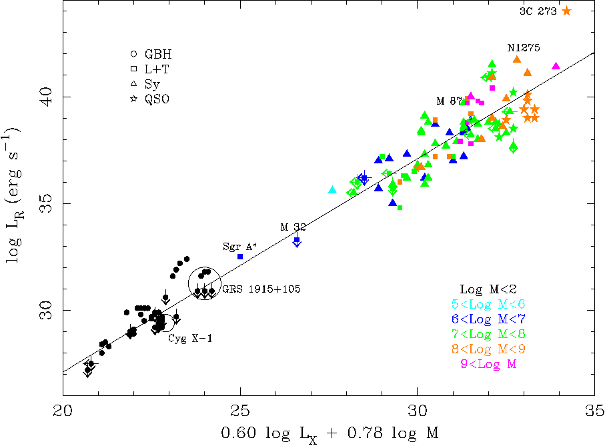
Merloni, Heinz & Di Matteo 2003

Slide 4
Merloni, Heinz & Di Matteo 2003

Slide 5
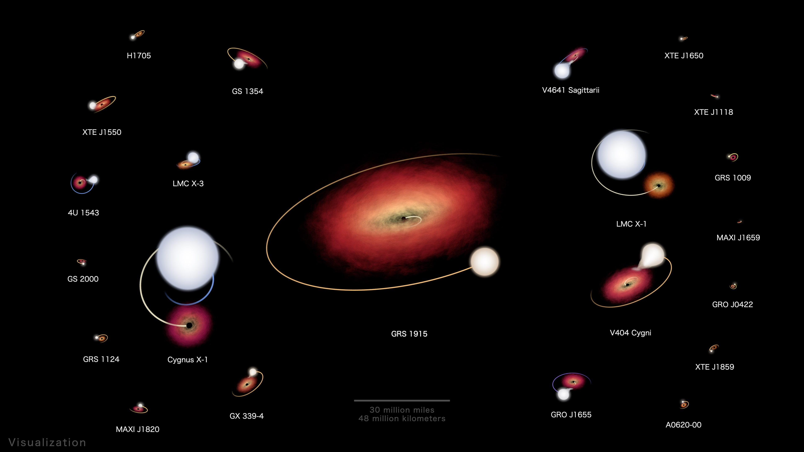



Visualizations by:
Andrew J Christensen
$$M_{BH} \sim \text{1}\text{2} \text{M}\text{⨀}$$
$i=66±$ 2º
K-type donor star
$$M_{∗} \sim 0.5 \text{M}\text{⨀}$$

Slide 6
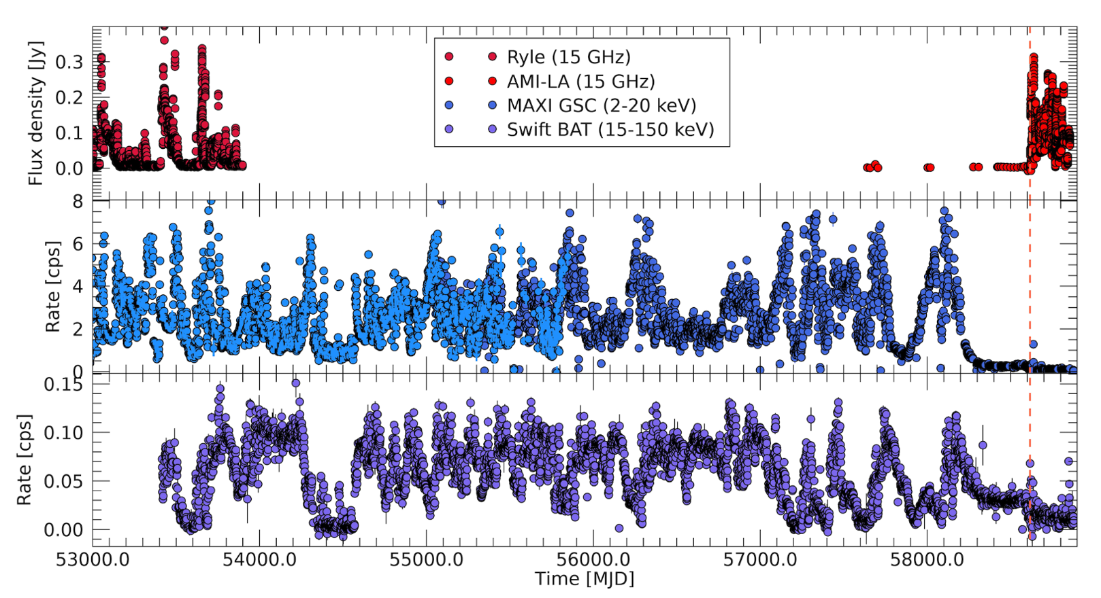
RADIO
SOFT X-RAY
HARD X-RAY
Image credit: Sara Motta

Slide 7
RADIO
SOFT X-RAY
HARD X-RAY
Image credit: Sara Motta

Slide 8
RADIO
SOFT X-RAY
HARD X-RAY
Image credit: Sara Motta

Slide 9
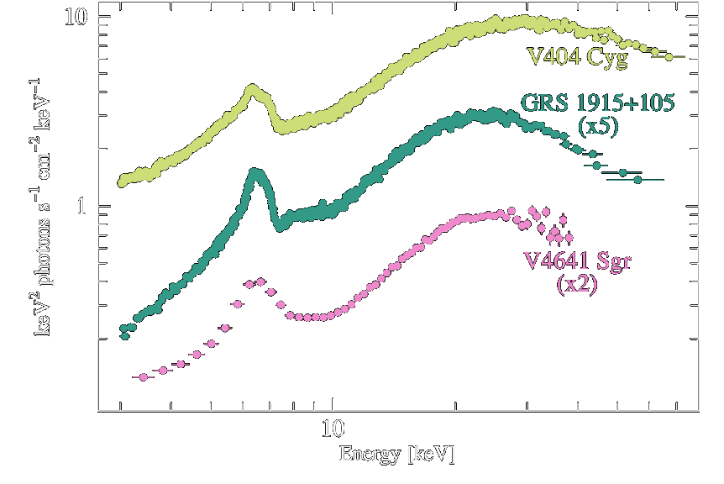
Other low X-ray, radio bright BHXBs
Curvature at ~20-30 keV points to heavy obscuration
V404 Cyg
Koljonen & Tomsick 2020
V4641 Sgr
GRS 1915+105

Slide 10
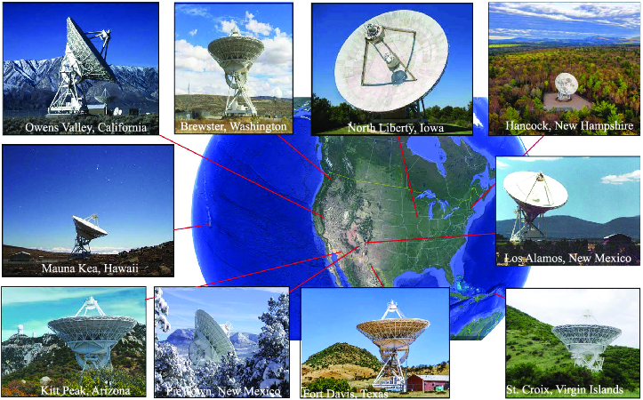
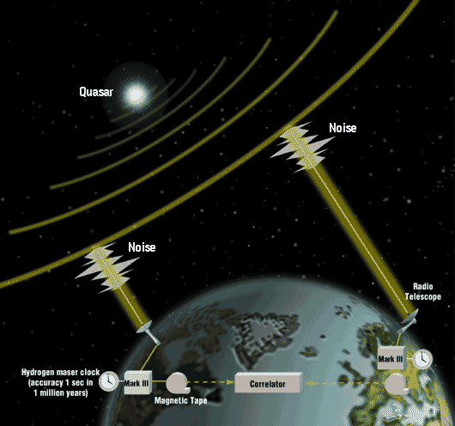

VLBI (Very Long Baseline Interferometry)
Very Long Baseline Array (VLBA)
European VLBI Network (EVN)

Slide 11
de Regt et al. in prep

Slide 12




All four epochs are different
$S_{tot} \sim 6$mJy
$S_{tot} \sim 90$ mJy
$S_{tot} \sim 6$mJy
$S_{peak}<0.03$ mJy
?
VLBA – Oct 2019
EVN E1 – Oct 2020
EVN E2 – Mar 2021
EVN E3 – Jun 2021
de Regt et al. in prep

Slide 13
Jet orientation
Archival VLBA/VLA jets are aligned at ~140°
de Regt et al. in prep

Slide 14
Jet orientation
Archival VLBA/VLA jets are aligned at ~140°
de Regt et al. in prep

Slide 15

Jet orientation
Archival VLBA/VLA jets are aligned at ~140°
Our VLBI epochs show jets at distinctly different angles ($\sim {55}^{∘}$ offset)
de Regt et al. in prep

Slide 16
Jet orientation
Archival VLBA/VLA jets are aligned at ~140°
Our VLBI epochs show jets at distinctly different angles ($\sim {55}^{∘}$ offset)
de Regt et al. in prep

Slide 17
Jet orientation
Archival VLBA/VLA jets are aligned at ~140°
Our VLBI epochs show jets at distinctly different angles ($\sim {55}^{∘}$ offset)
de Regt et al. in prep

Slide 18

Jet orientation
Archival VLBA/VLA jets are aligned at ~140°
Our VLBI epochs show jets at distinctly different angles ($\sim {55}^{∘}$ offset)
2023 VLA jet matches EVN Epoch 2, confirming the change
de Regt et al. in prep

Slide 19
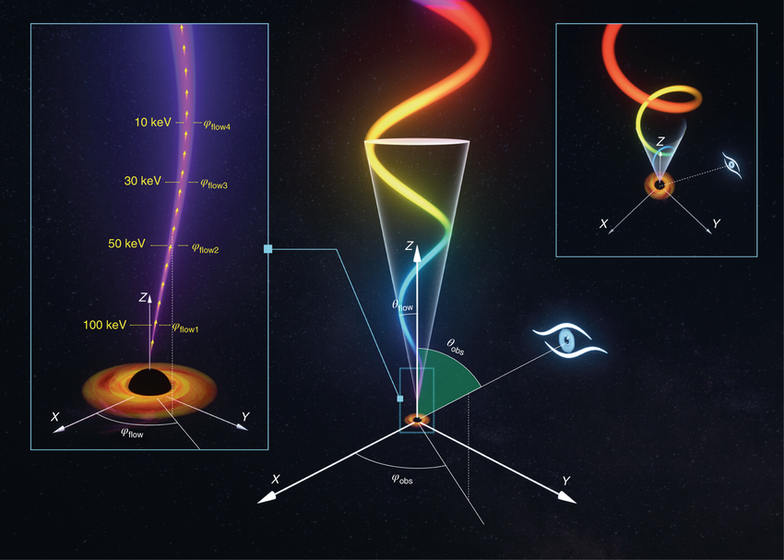
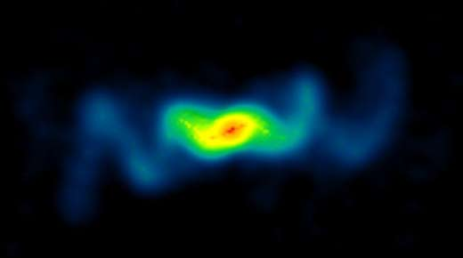
Steady precession?
SS 433 ; Blundel & Bowler 2004
Ma et al. 2020

Slide 20
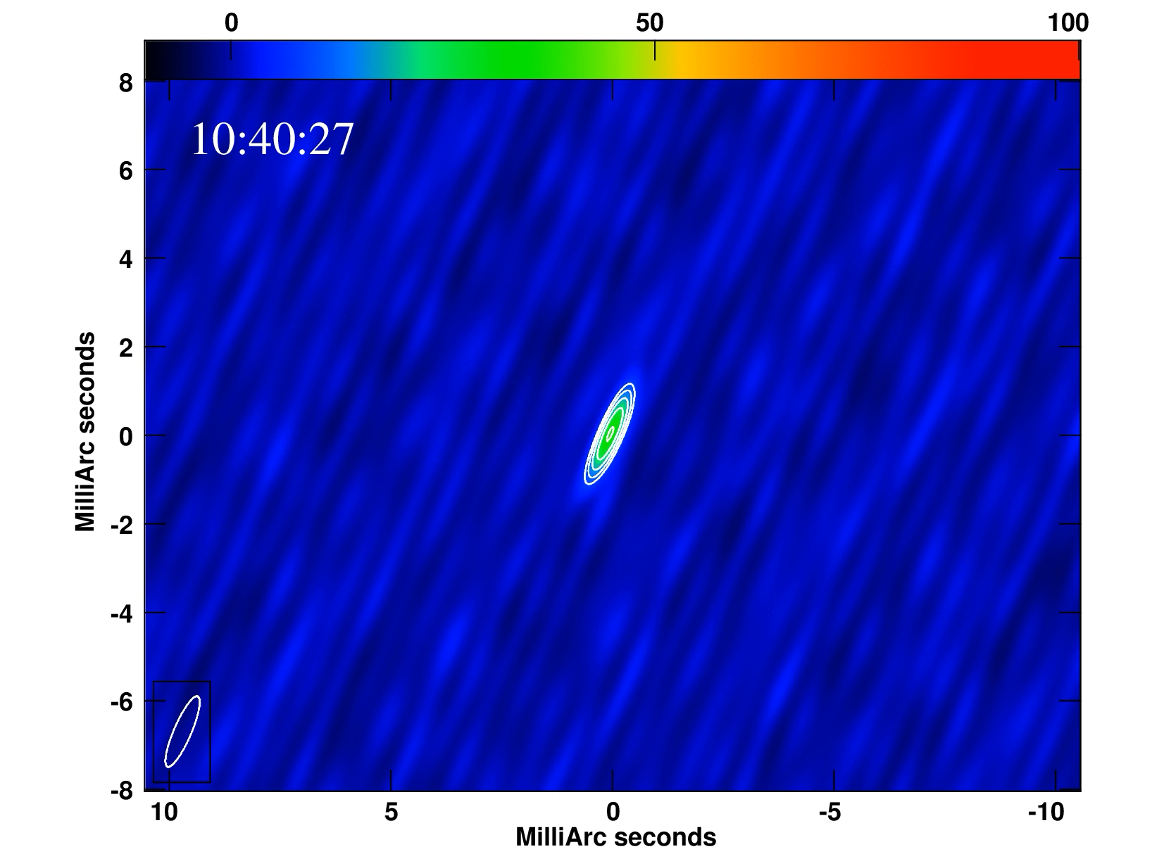
Steady precession?
V404 Cygni
Ma et al. 2020
Miller-Jones et al. 2021

Slide 21
Steady precession? Or something else?
Ma et al. 2020

Slide 22
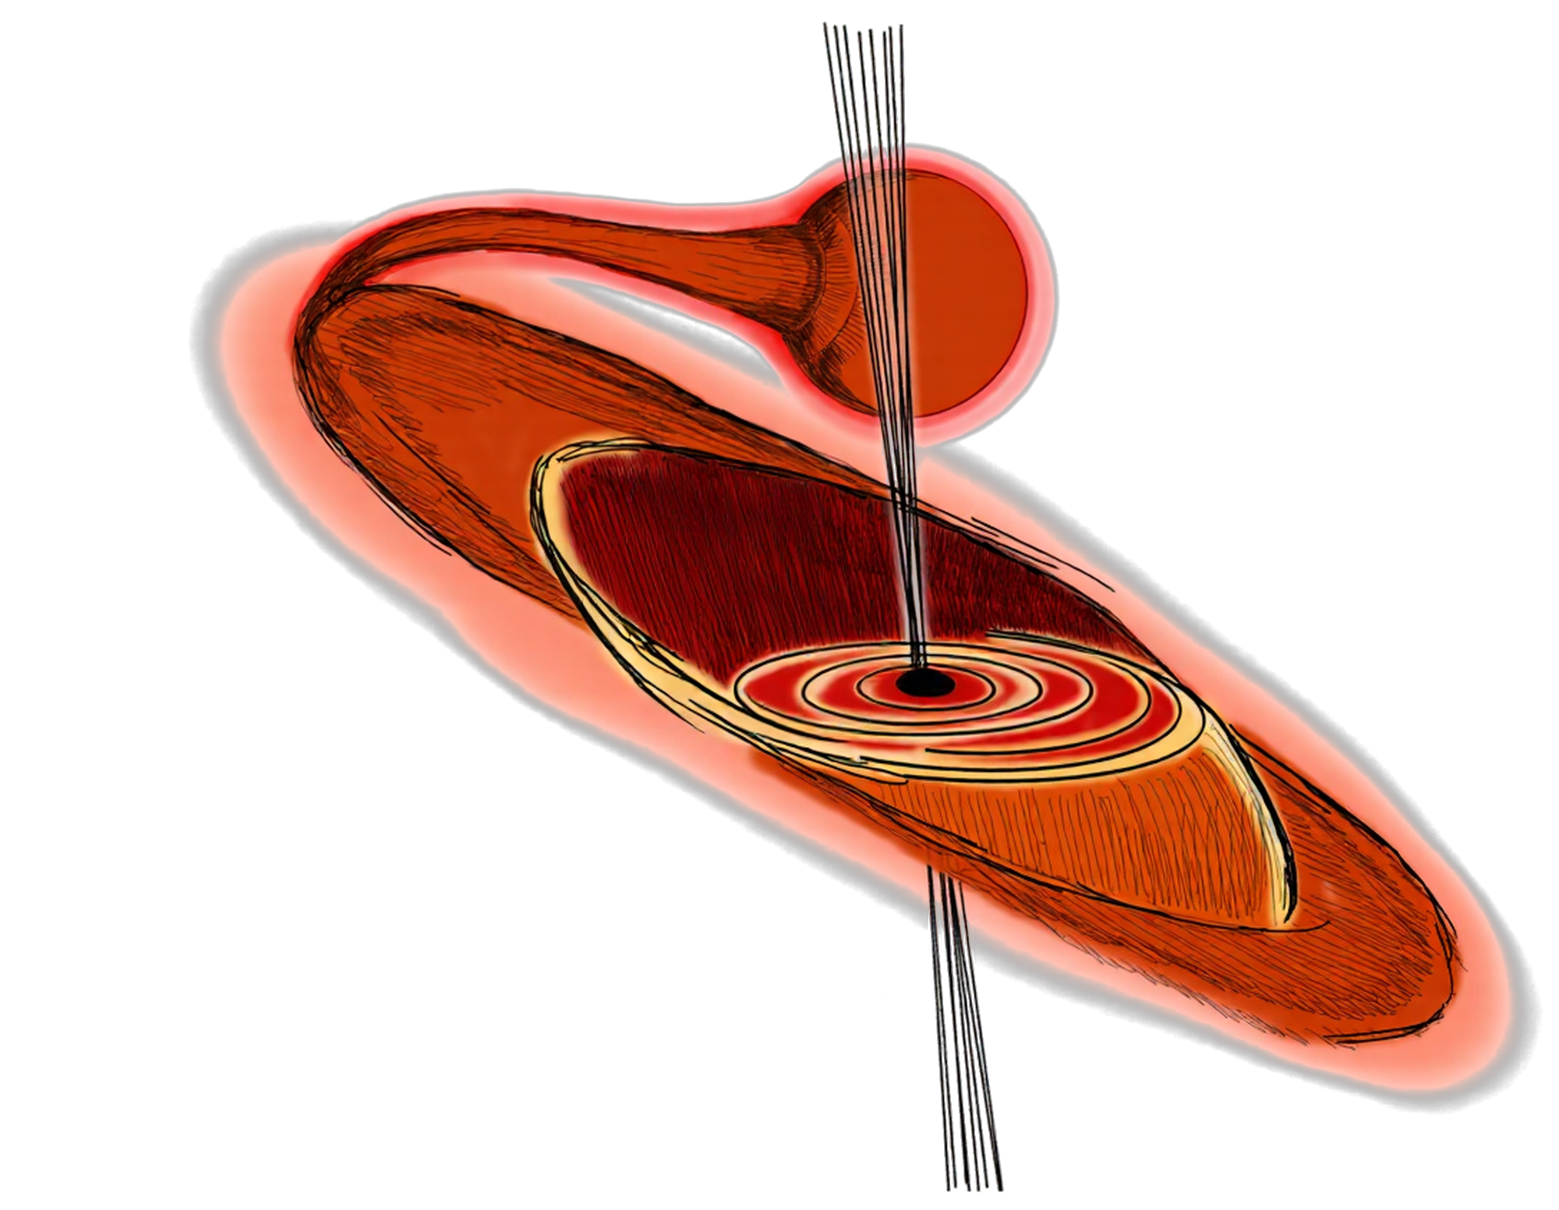
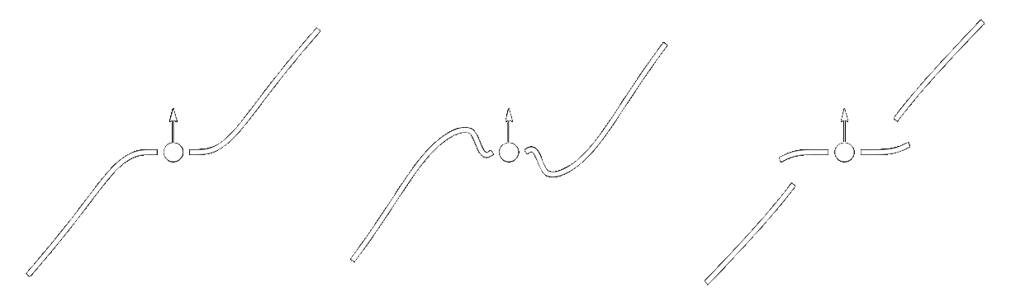
Possible explanations
Warped accretion disk
Longer timescale jet changes
Near complete absorption
Lower intrinsic brightness temperature (Miller et al. 2025)
Radiation-driven warping
Can drive a stable, precessing, bending mode
GRS 1915+105’s large disk makes it susceptible to radiation
Changes in accretion efficiency and viscosity could have a large effect on the disk geometry
Simulations show that large warps can cause disk tearing
Could explain one-sided jet changes and irregular precession
But disk tearing has never been observed before
Miller et al. 2025
Fragile et al. 2026

Slide 23
Summary – GRS 1915+015
Breaks the standard radio–X-ray correlation → Likely due to a local Compton-thick obscurer (winds / puffed-up disk)
VLBI imaging: jets at a new position angle vs. archival VLBA/VLA data
Dramatic jet angle change is likely connected to the obscuration → a warped or torn disk?
Future directions:
New higher-cadence EVN observations incoming

Slide 24
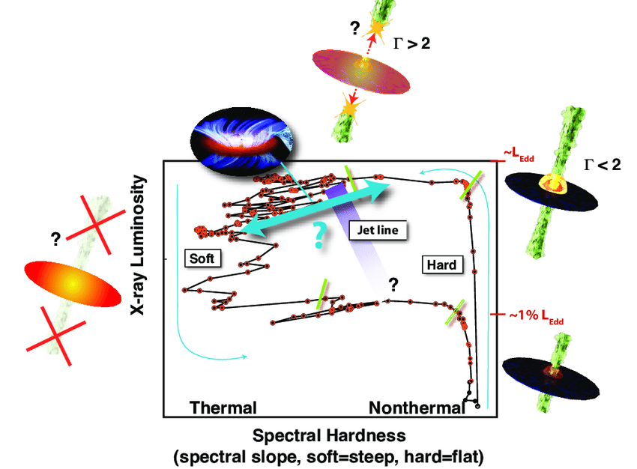
Accretion states
The hardness-intensity diagram (HID) for the LMXB GX339-4 (Romero et al. 2016)

Slide 25
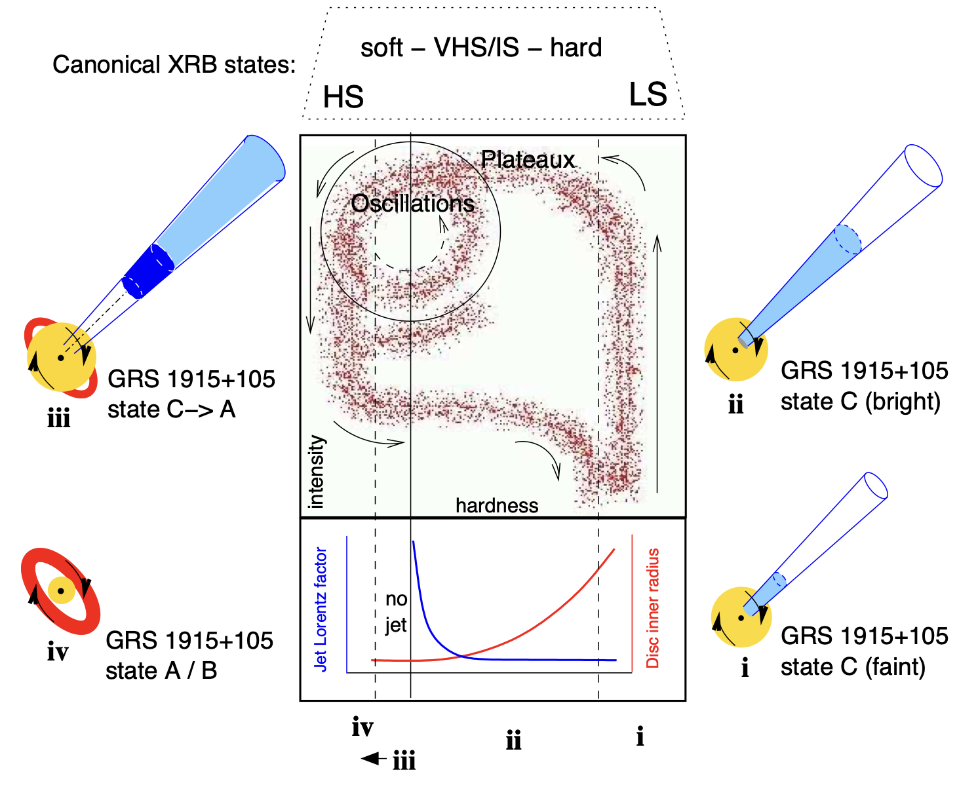
GRS1915+105
Fender et al. 2004

Slide 26
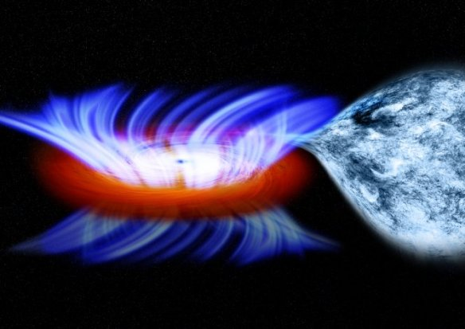
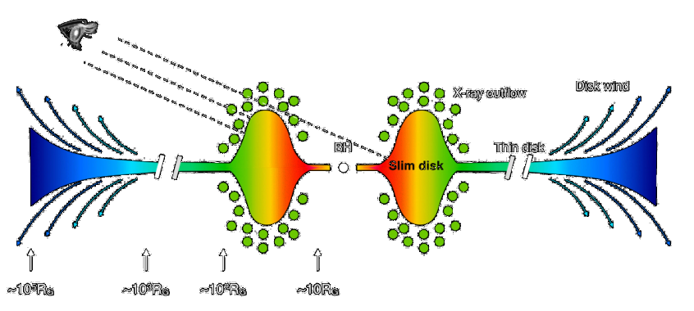
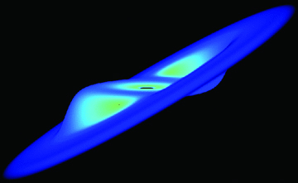
Explaining GRS 1915+105’s low X-ray state
Fast near-infrared winds (Sanchez-Sierras et al. 2023)
Failed winds (Miller et al. 2020)
Slim disk scenario (Ambramowicz et al. 1988):
Disk puffed-up → may block view of inner regions
Credit: NASA’s Goddard Space Flight Center / Chandra X-ray observatory / M. Weiss
Motta et al. 2017
Failed winds
Warped disk blocking our view of the inner disk (Miller et al. 2025)
Lodato & Price 2010

Slide 27
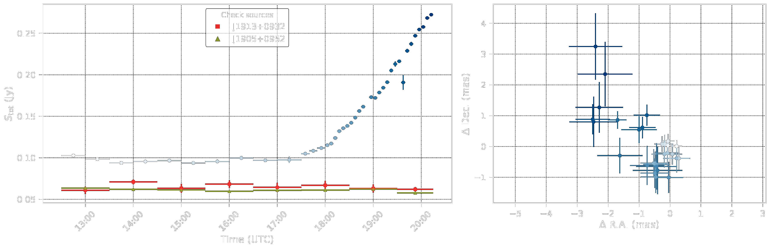
EVN Epoch 1 – Oct 2020 – Flaring

Slide 28
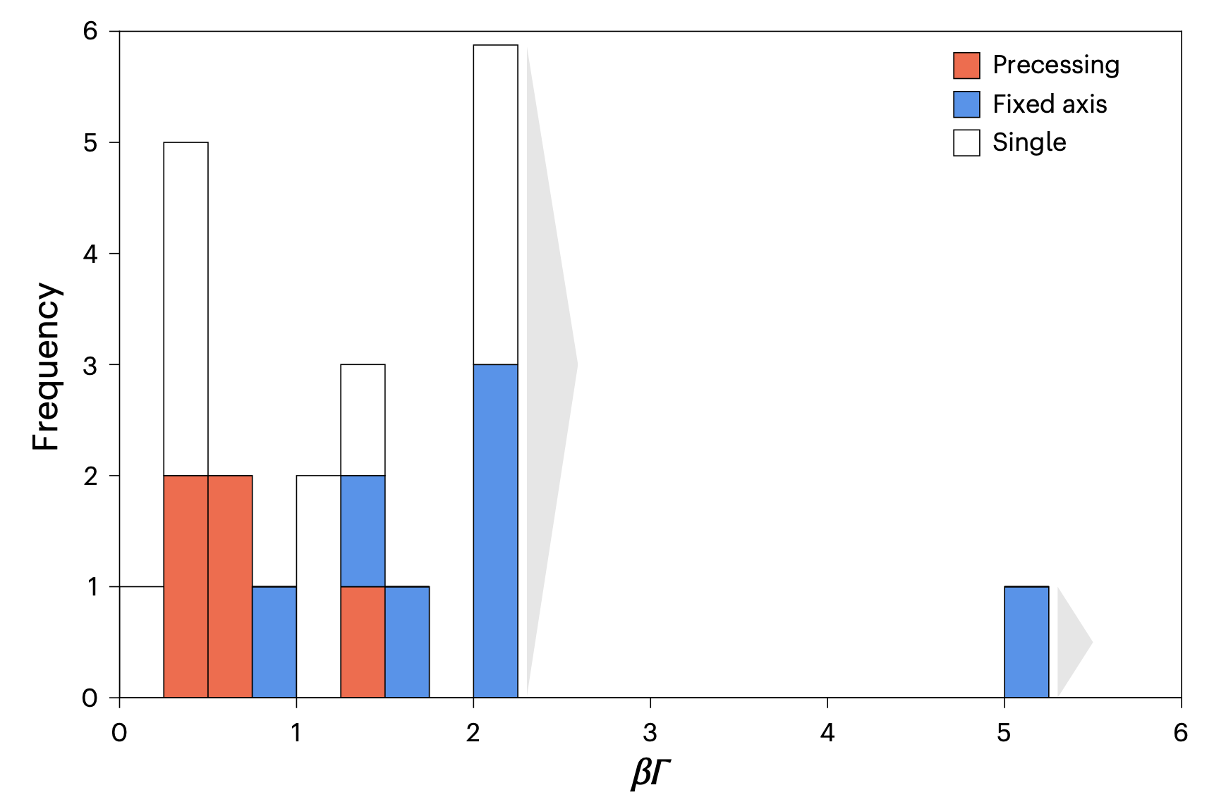
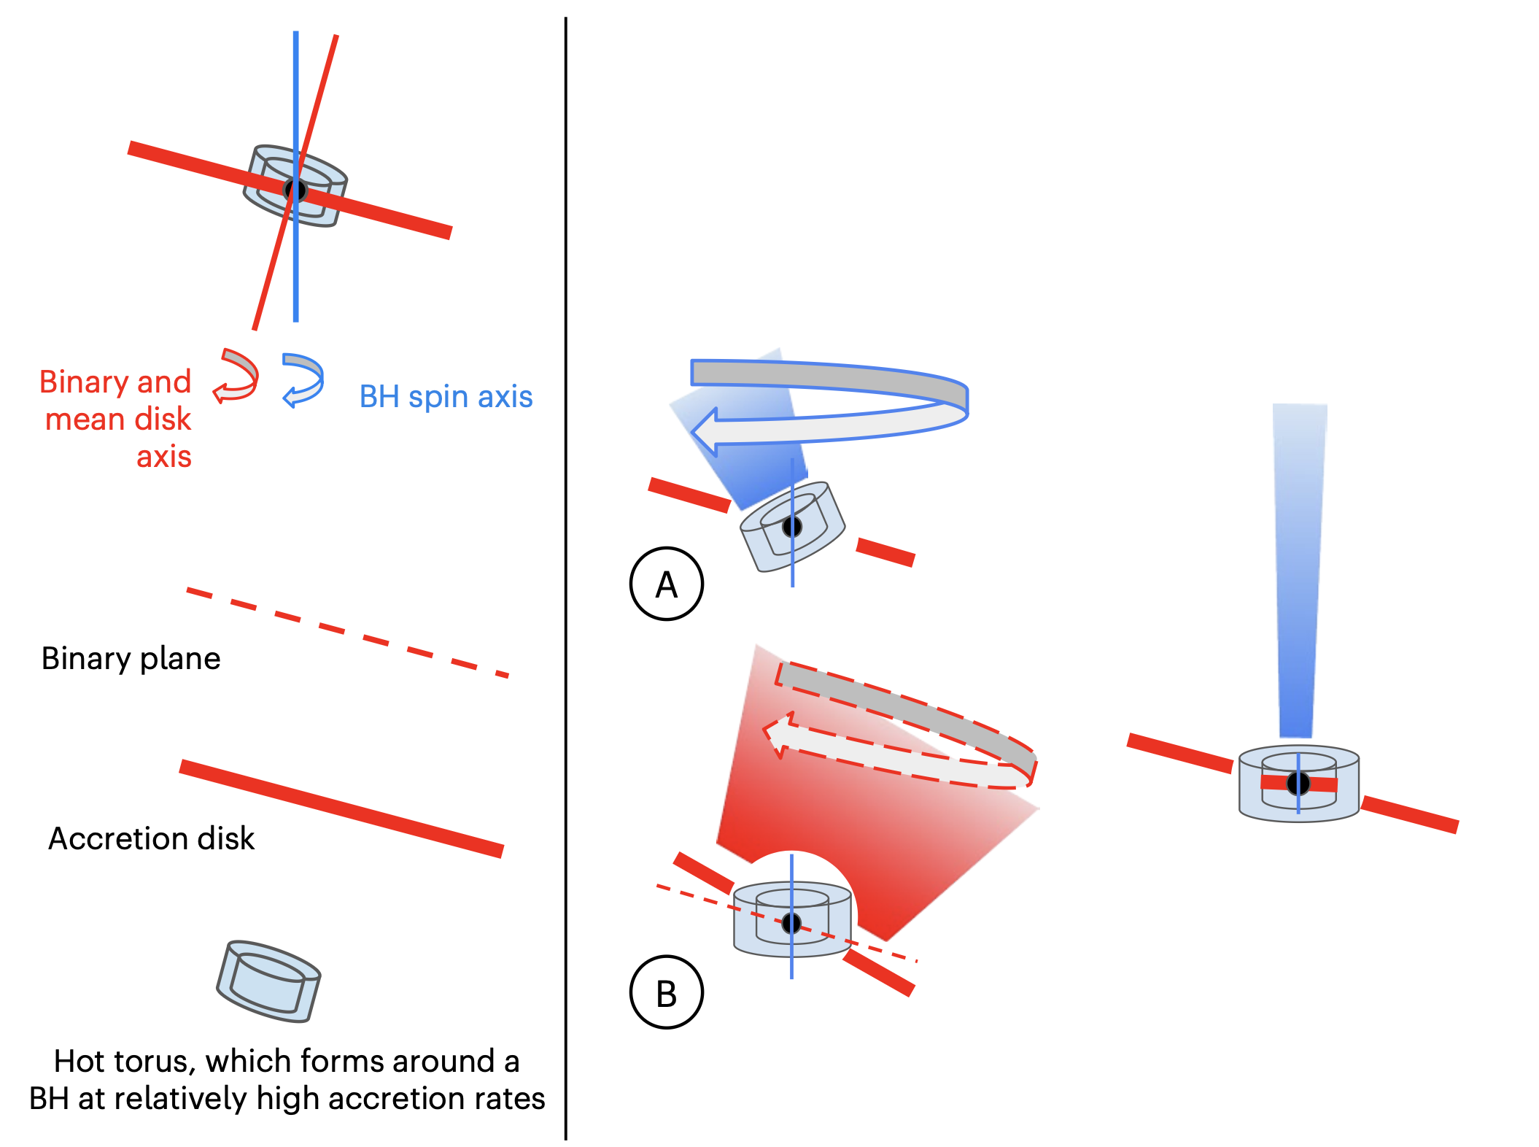
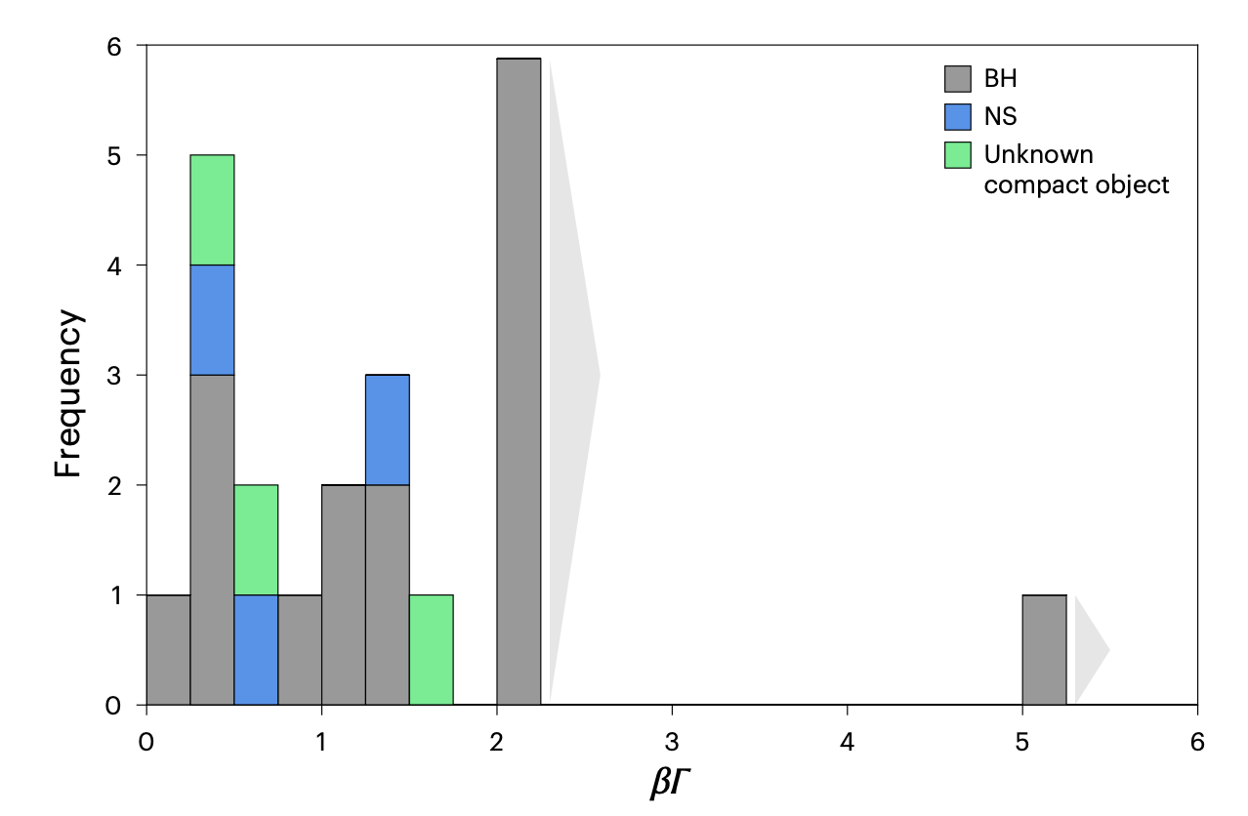
Fixed vs. precessing jets
Fender & Motta 2025

Slide 29

V404 Cygni – Rapidly changing jet orientation
V404 Cyg in a state of super-Eddington accretion
But GRS 1915+105 seems to change on much longer timescales
This suggests precession at larger radii
X-ray spectroscopicc studies implicate the mid-disk as the obscuring region
$\sim {10}^{3}−{10}^{4} R_{g}$
(Nielsen et al. 2020 ; Athulya & Nandi 2023)
Miller-Jones et al. 2021

Slide 30
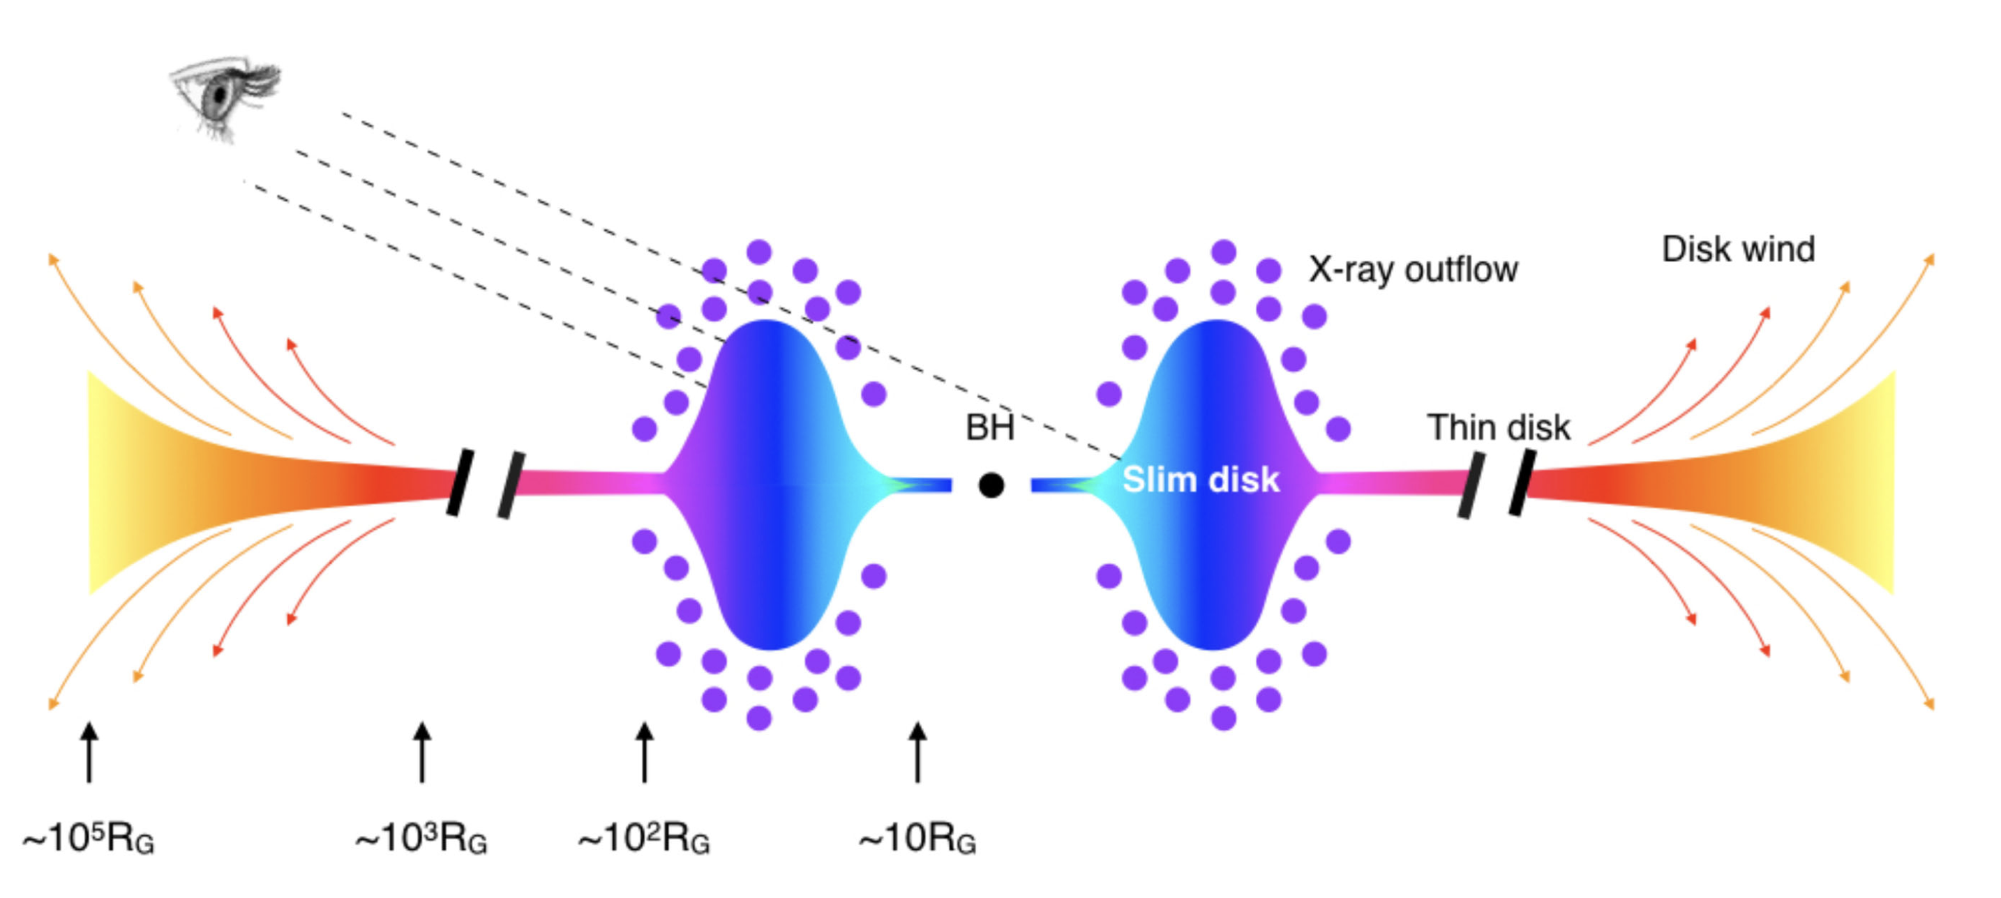
How is it explained?
Lense-Thirring precession
Misalignment between disk and black hole spin
Frame dragging tilts the inner disk
Slim disk model
Super-Eddington accretion means photons can no longer escape efficiently
Cooling no longer efficient enough
→ trapped radiation puffs up the disk
Inclination angle ~ 67◦
Blundel & Bowler 2004
Motta et al. 2017
Lodato & Price 2010

Slide 31
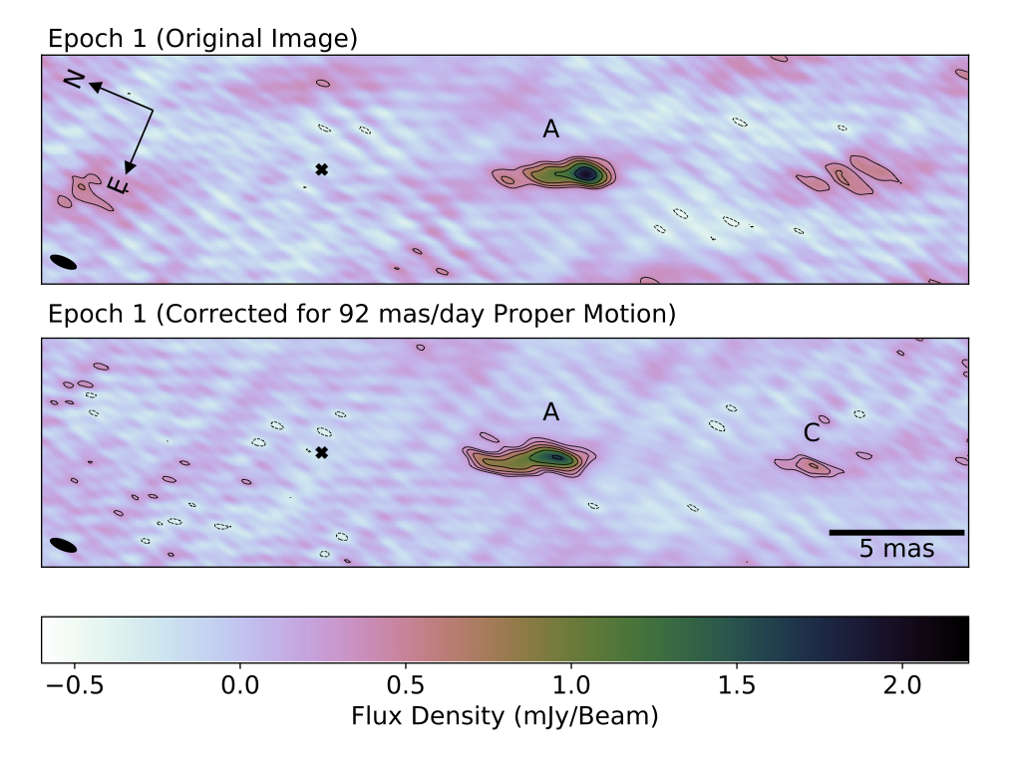
Wood et al. 2021 – dynamic phase tracking
Observation split in many small time bins such that image isn’t blurred
Phase center is shifted with a user defined proper motion
Once concatenated you have a single image whose phase center follows the component

Slide 32
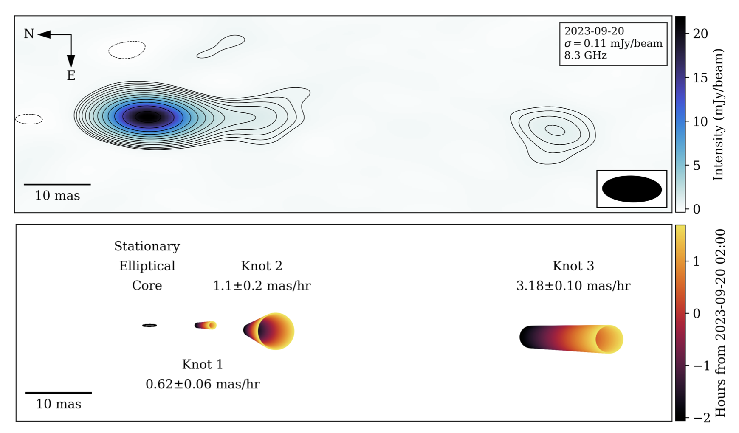


Future directions
✓
EVN observing proposal submitted
To track the PA with higher cadence
Time-variable modeling in the UV-plane: dynamic phase tracking
Fit for a second moving gaussian on top of the stable component
Capture increasing flux: $F=F_{0}+\dot{F}⋅max(t−t_{flare})$
Possible discrete ejecta launching:
$x = \left(x_{0} + \dot{r} ⋅\max\left(0, t − t_{eject}\right)\right) sin(θ)$
$y = \left(y_{0} + \dot{r} ⋅\max\left(0, t − t_{eject}\right)\right)cos⁡(θ)$
Wood et al. 2025

