Slide 1
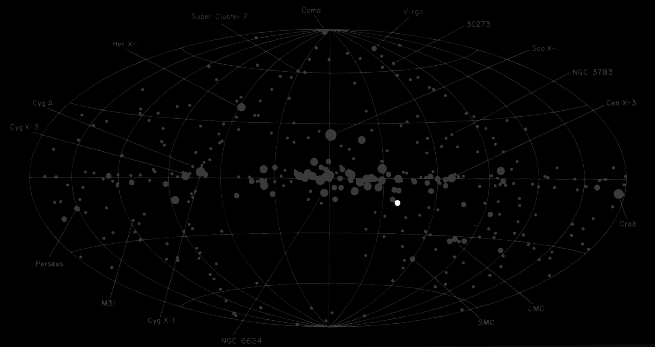

The curious case of 4U 1556-60: an unusual ultracompact X-ray binary hiding in plain sight for 50 years?
Eliot Pattie (University of Amsterdam, API)
e.c.pattie@uva.nl
NAC 2026
Thomas Maccarone, Thomas Russell, Nathalie Degenaar, Matteo Bachetti, Thomas Kupfer

Slide 2
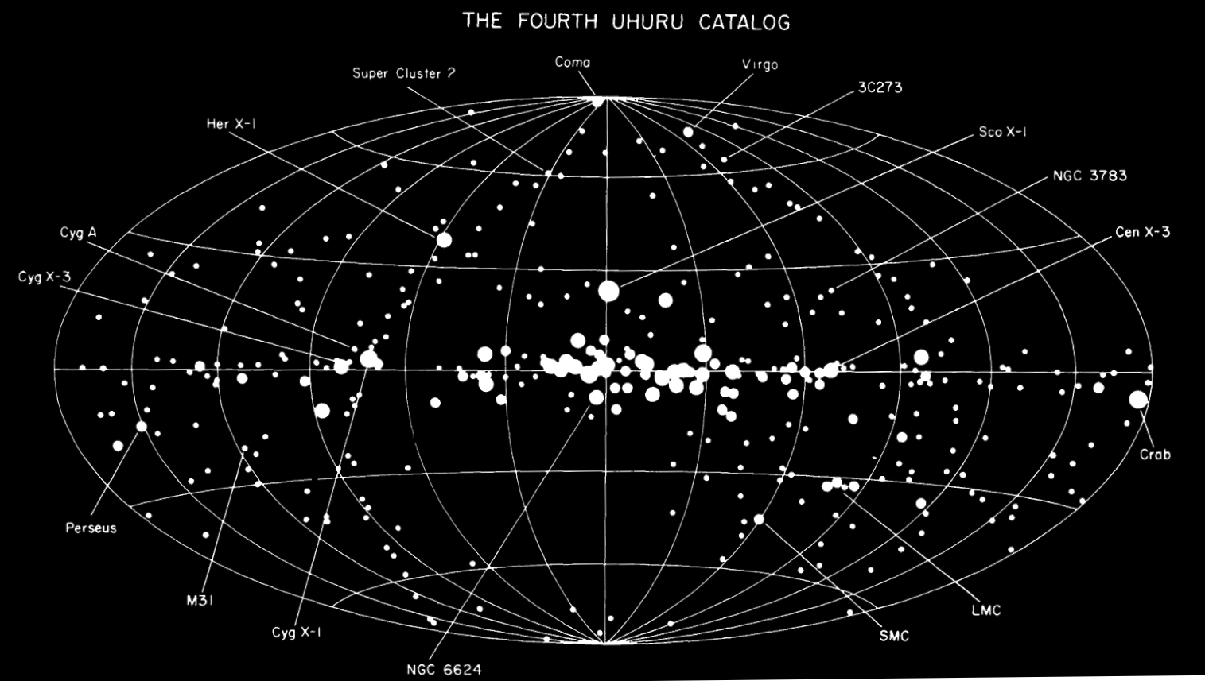
The first all-sky X-ray image made, by the Uhuru satellite in early 1970s
4U 1556-60

Slide 3
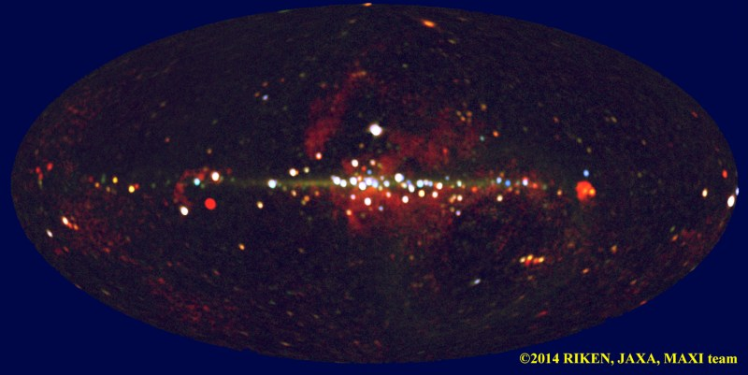
All-sky X-ray image by current X-ray telescope MAXI
4U 1556-60
Persistently active since its discovery >50 years ago
4U 1556-60

Slide 4
History of 4U 1556-60
1972: Discovered as a persistent X-ray source by Uhuru (Giacconi et al. 1972)
1979: Optical counterpart → L_{X}/L_{opt} → X-ray binary (Charles et al. 1979)

Slide 5
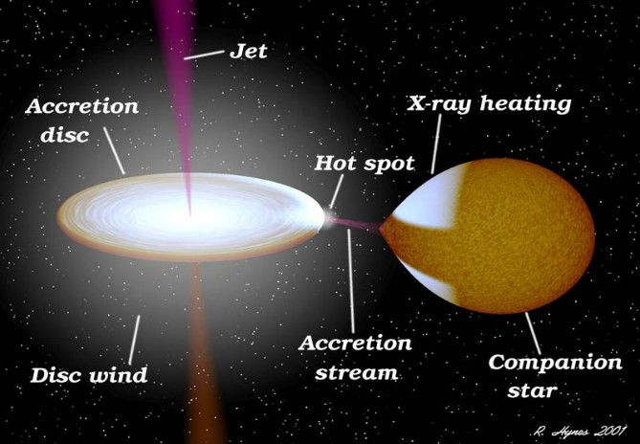
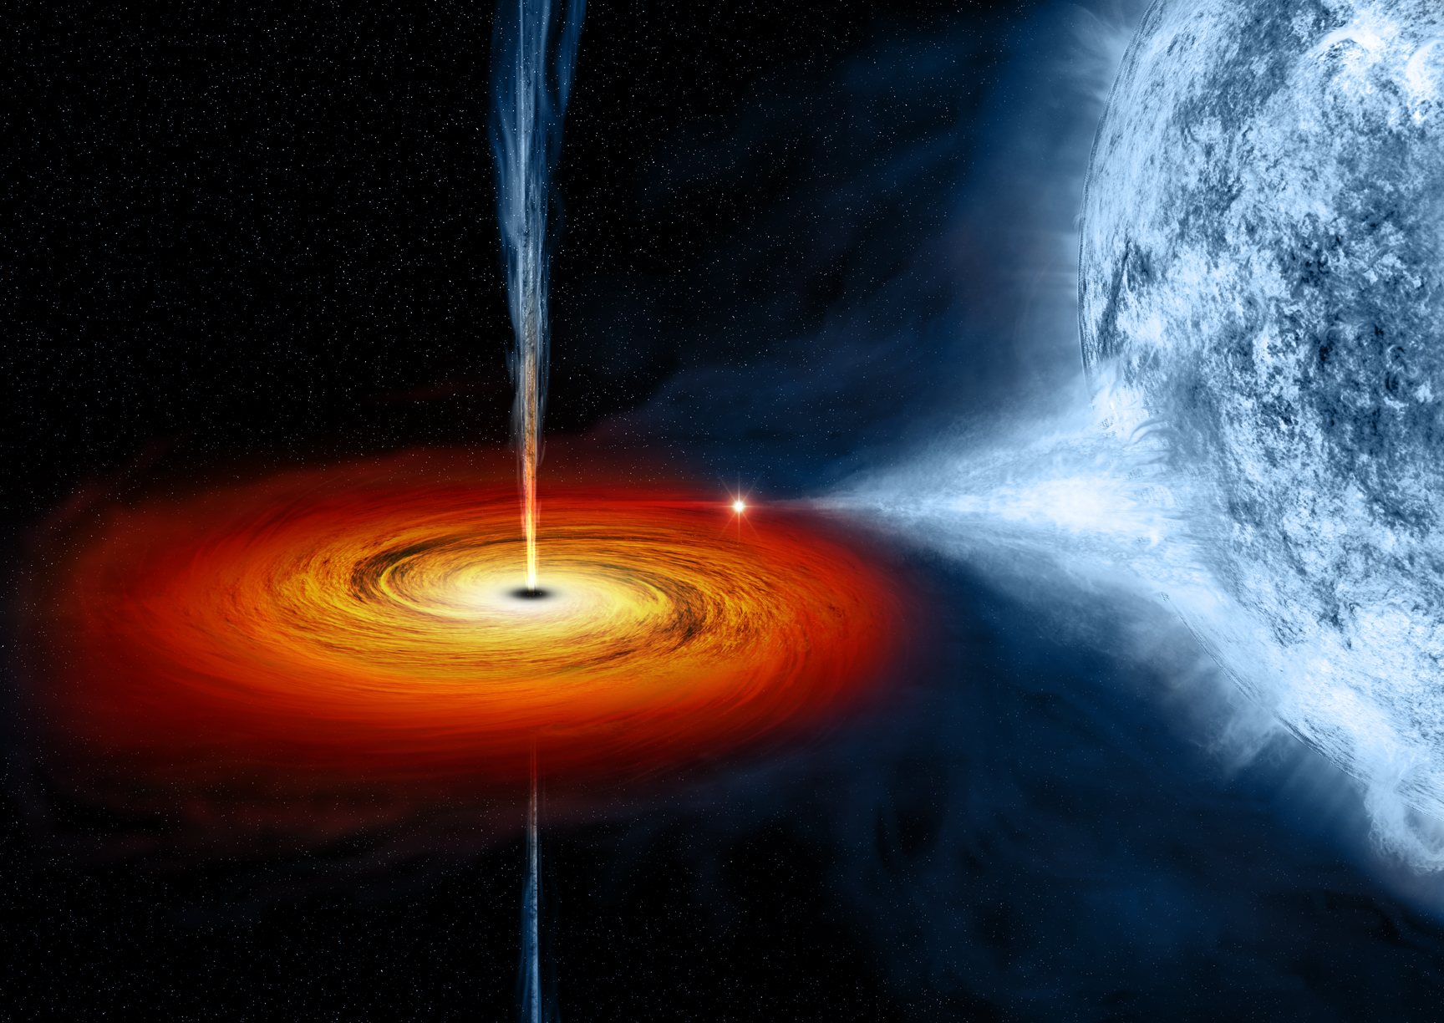
X-ray binaries (XRBs)
Black hole (BH) or neutron star (NS) accreting from a binary companion/donor star
Multiwavelength emission
Radio
Robert Hynes
X-rays
OIR
NASA

Slide 6

E. Pattie & J. van den Eijnden

Slide 7
History of 4U 1556-60
1972: Discovered as a persistent X-ray source by Uhuru (Giacconi et al. 1972)
1979: Optical counterpart → L_{X}/L_{opt} → X-ray binary (Charles et al. 1979)
1979: radio upper limit < 5 mJy (Duldig et al. 1979)
1989: optical spectrum #1: very weak hydrogen lines (Motch et al. 1989)
2006: optical spectrum #2: strong hydrogen lines (Nelemans et al. 2006)

Slide 8
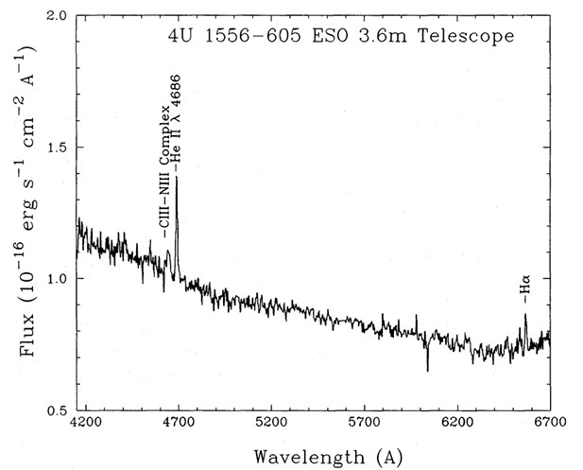
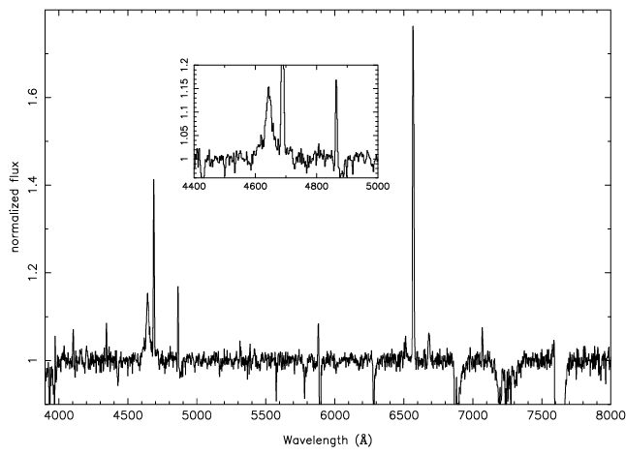
Strong
CN complex
“Bowen blend”
1989
Strong He
2006
Nelemans et al. 2006
Motch et al. 1989
H ionization?
Disk albedo?
Drastic difference in strength of H

Slide 9
History of 4U 1556-60
1972: Discovered as a persistent X-ray source by Uhuru (Giacconi et al. 1972)
1979: Optical counterpart → L_{X}/L_{opt} → X-ray binary (Charles et al. 1979)
1979: radio upper limit < 5 mJy (Duldig et al. 1979)
1989: optical spectrum #1: very weak hydrogen lines (Motch et al. 1989)
2006: optical spectrum #2: strong hydrogen lines (Nelemans et al. 2006)
Would like to know:
  Distance
  BH/NS accretor
  Orbital period

Slide 10

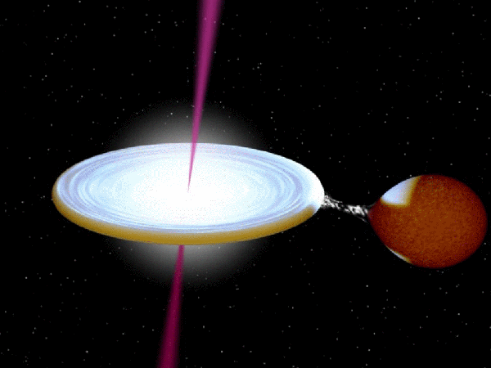
History of 4U 1556-60
(4U 1556-60 waiting to be understood)
1972: Discovered as a persistent X-ray source by Uhuru (Giacconi et al. 1972)
1979: Optical counterpart → L_{X}/L_{opt} → X-ray binary (Charles et al. 1979)
1979: radio upper limit < 5 mJy (Duldig et al. 1979)
1989: optical spectrum #1: very weak hydrogen lines (Motch et al. 1989)
2006: optical spectrum #2: strong hydrogen lines (Nelemans et al. 2006)
Would like to know:
  Distance
  BH/NS accretor
  Orbital period
… but observations were stuck

Slide 11
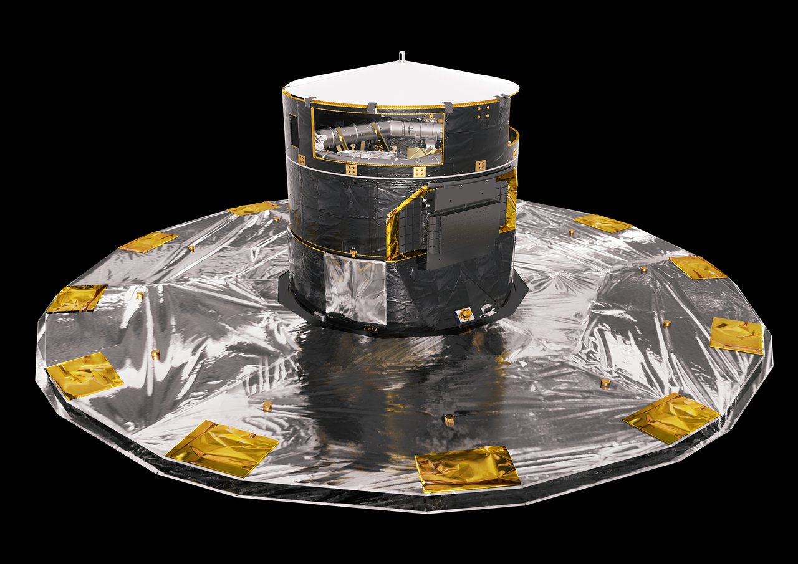


History of 4U 1556-60
(4U 1556-60 waiting to be understood)
1972: Discovered as a persistent X-ray source by Uhuru (Giacconi et al. 1972)
1979: Optical counterpart → L_{X}/L_{opt} → X-ray binary (Charles et al. 1979)
1979: radio upper limit < 5 mJy (Duldig et al. 1979)
1989: optical spectrum #1: very weak hydrogen lines (Motch et al. 1989)
2006: optical spectrum #2: strong hydrogen lines (Nelemans et al. 2006)
Would like to know:
  Distance
  BH/NS accretor
  Orbital period
… but observations were stuck
… until Gaia DR3
1/plx = 688 pc!

Slide 12

4U 1556-60 is only 700 pc away?
10x closer than previously assumed (had assumed Galactic center distance)
  The closest known Roche lobe overflowing low-mass XRB
L_{X} drops to 10³⁴ erg/s → very unusual value for a persistent system!
  Quiescence at ~10³² erg/s; typical persistence at >10³⁶ erg/s
Probability that there is an interloper star $≃$10⁻⁵

Slide 13
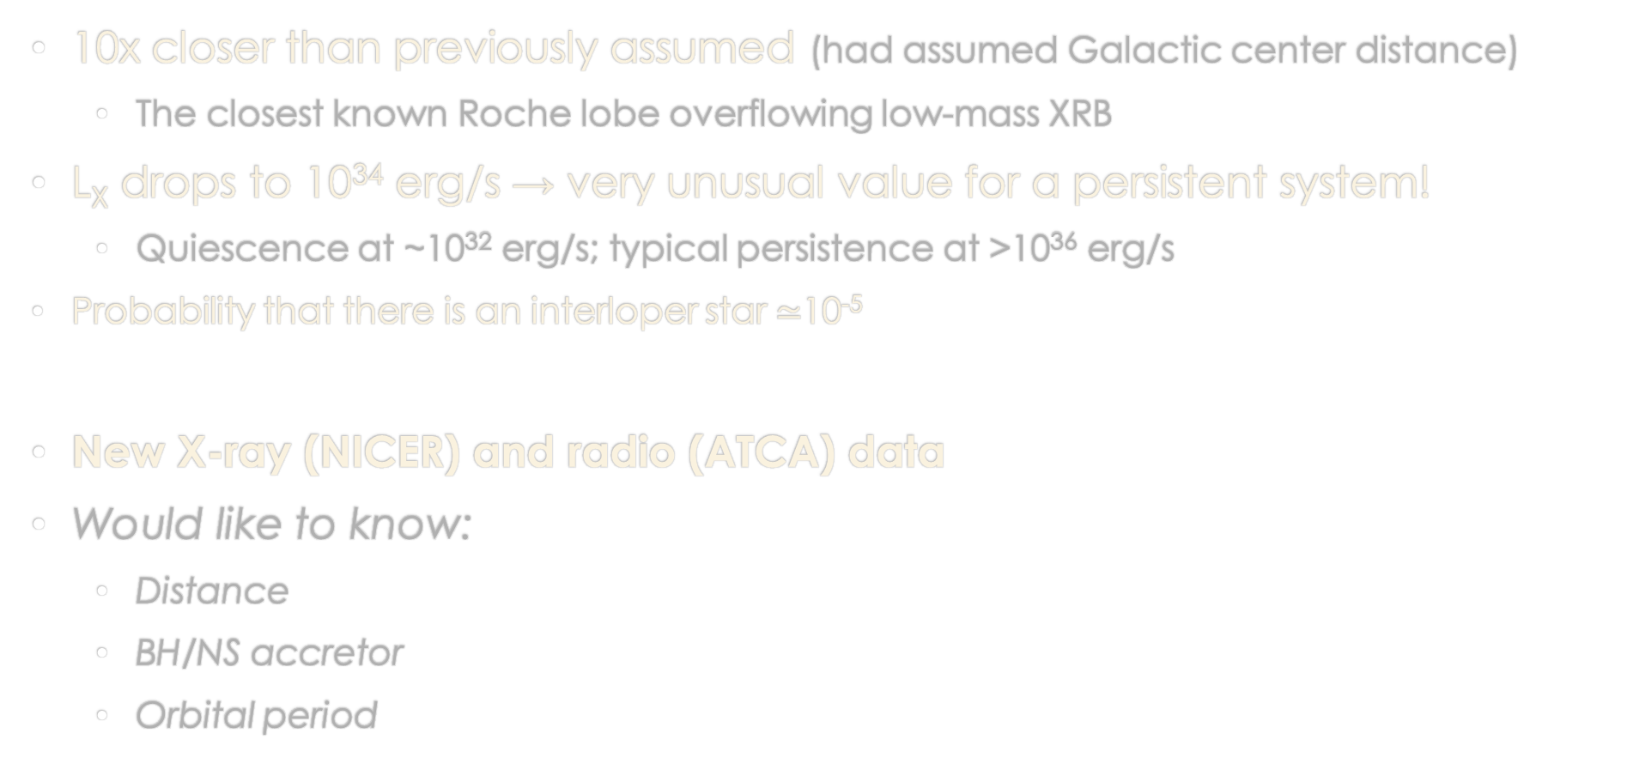
4U 1556-60 is only 700 pc away?
10x closer than previously assumed (had assumed Galactic center distance)
  The closest known Roche lobe overflowing low-mass XRB
L_{X} drops to 10³⁴ erg/s → very unusual value for a persistent system!
  Quiescence at ~10³² erg/s; typical persistence at >10³⁶ erg/s
Probability that there is an interloper star $≃$10⁻⁵
New X-ray (NICER) and radio (ATCA) data
Would like to know:
  Distance
  BH/NS accretor
  Orbital period

Slide 14
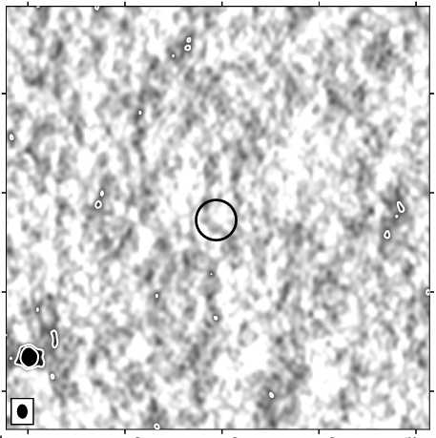
The radio data
12 hour ATCA observation
< 11 μJy (7.75 GHz)

Slide 15
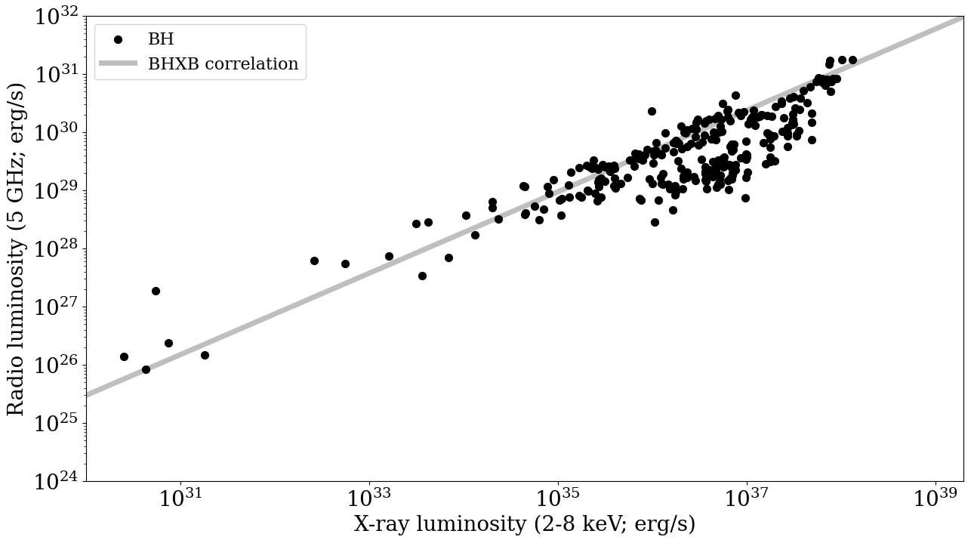
“Fundamental plane” L_{R}/L_{X}
Jet power vs. mass accretion rate

Slide 16
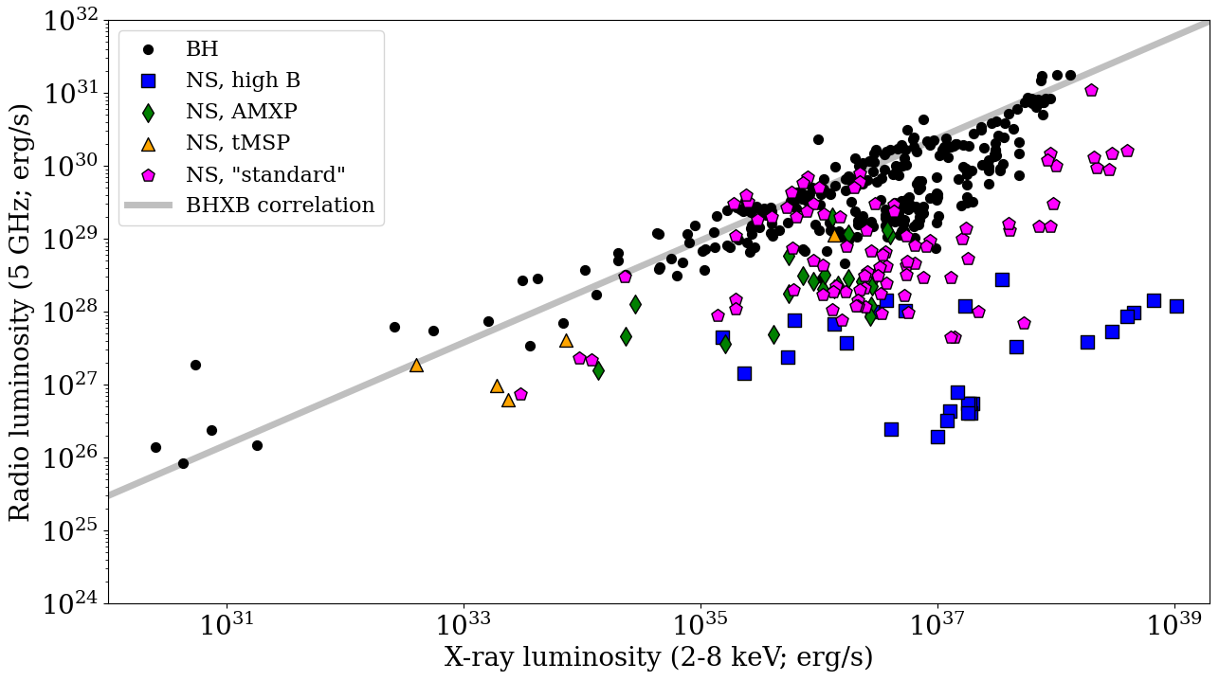
“Fundamental plane” L_{R}/L_{X}
Jet power vs. mass accretion rate

Slide 17
“Fundamental plane” L_{R}/L_{X}
Jet power vs. mass accretion rate
12 hour ATCA observation
< 11 μJy (7.75 GHz)

Slide 18
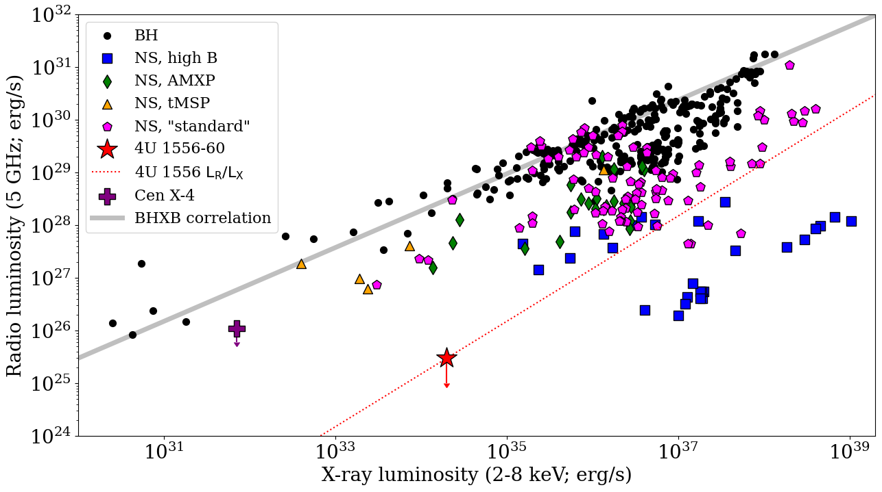

“Fundamental plane” L_{R}/L_{X}
Jet power vs. mass accretion rate
12 hour ATCA observation
< 11 μJy (7.75 GHz)

Slide 19
L_{R} is >1000x fainter than expected for a BHXB jet…
4U 1556-60 is a NSXB!
The lowest upper limit on L_{R} to date for any XRB
Why can NSXB jets be so weak? Jet launching mechanism?
12 hour ATCA observation
< 11 μJy (7.75 GHz)

Slide 20
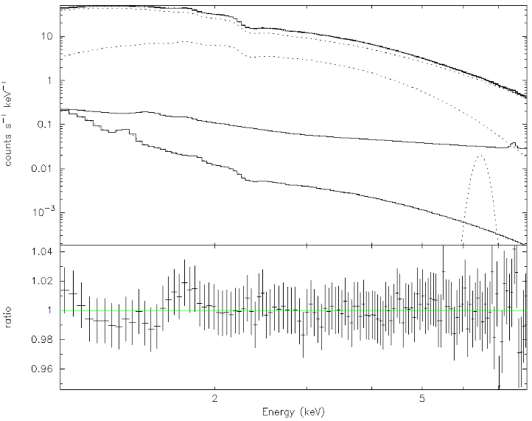
X-ray spectrum and timing
75 ks (21 hours) of NICER data
Power law
Blackbody
Background models
Power law dominated: low accretion rate
Blackbody: 0.2 km radius, supports NSXB
diskbb radius would be < 1 km

Slide 21

X-ray spectrum and timing
75 ks (21 hours) of NICER data
Power law
Blackbody
Iron line
Background models
Power law dominated: low accretion rate
Blackbody: 0.2 km radius, supports NSXB
diskbb radius would be < 1 km
Tiny iron line (eqw ~ 8 eV): truncated disk?
High carbon/oxygen abundance?

Slide 22
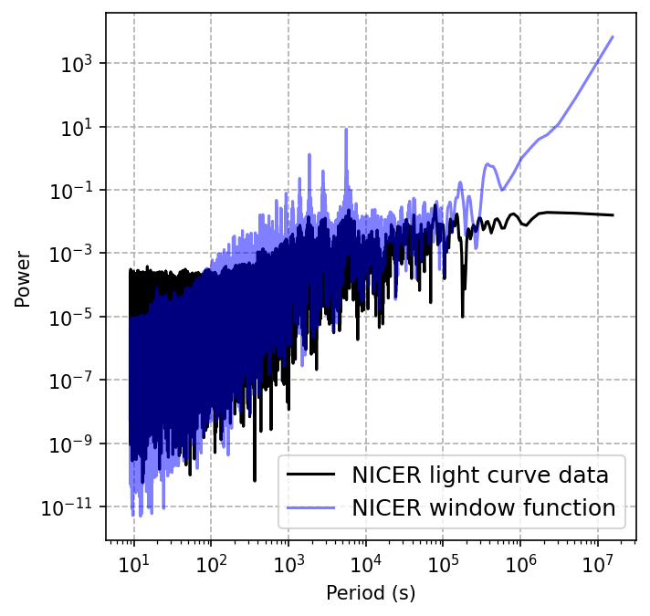
X-ray spectrum and timing
75 ks (21 hours) of NICER data
Power law
Blackbody
Iron line
No orbital period (<5% frac)
No spin period (<1% frac)
No sign of magnetosphere
→ Low magnetic field NSXB
Background models
Power law dominated: low accretion rate
Blackbody: 0.2 km radius, supports NSXB
diskbb radius would be < 1 km
Tiny iron line (eqw ~ 8 eV): truncated disk?
High carbon/oxygen abundance?

Slide 23
Orbital period estimate
P_{orb} not found in X-rays, other way to estimate?
Back of the envelope: faint OIR counterpart
  P_{orb} cannot be longer than 2 hours or else the donor star would be too large and bright (18-19 mag OIR)

Slide 24
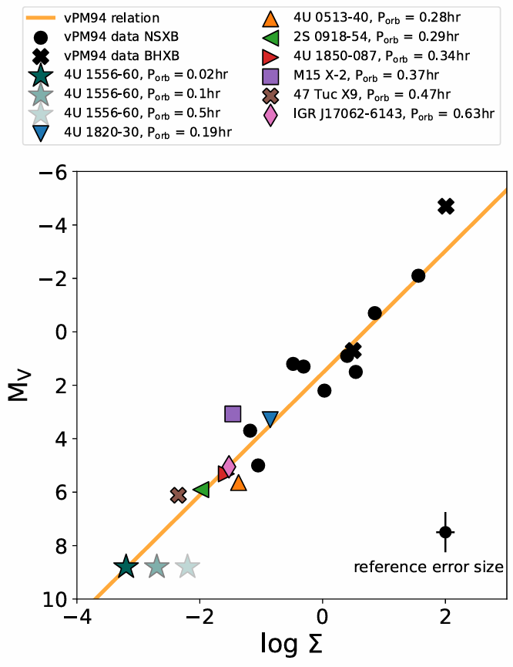
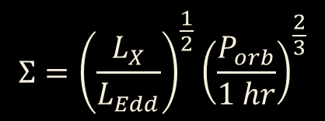
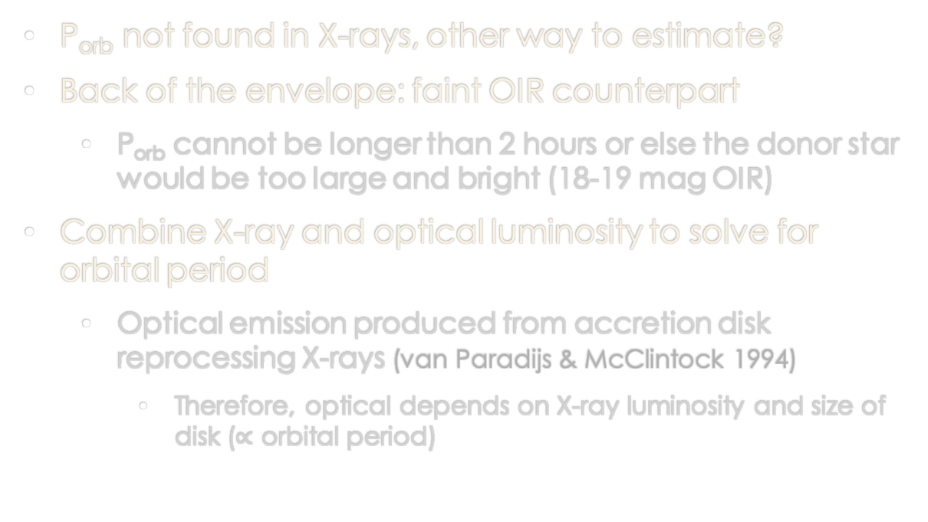
Orbital period estimate
P_{orb} not found in X-rays, other way to estimate?
Back of the envelope: faint OIR counterpart
  P_{orb} cannot be longer than 2 hours or else the donor star would be too large and bright (18-19 mag OIR)
Combine X-ray and optical luminosity to solve for orbital period
  Optical emission produced from accretion disk reprocessing X-rays (van Paradijs & McClintock 1994)
    Therefore, optical depends on X-ray luminosity and size of disk ($∝$ orbital period)
$$Σ={\left(\frac{L_{X}}{L_{Edd}}\right)}^{\frac{1}{2}}{\left(\frac{P_{orb}}{1 hr}\right)}^{\frac{2}{3}}$$

Slide 25
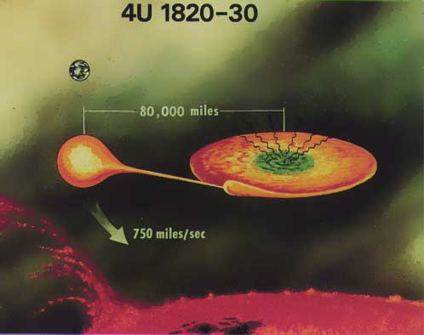
Orbital period estimate
P_{orb} not found in X-rays, other way to estimate?
Back of the envelope: faint OIR counterpart
  P_{orb} cannot be longer than 2 hours or else the donor star would be too large and bright (18-19 mag OIR)
Combine X-ray and optical luminosity to solve for orbital period
  Optical emission produced from accretion disk reprocessing X-rays (van Paradijs & McClintock 1994)
    Therefore, optical depends on X-ray luminosity and size of disk ($∝$ orbital period)
P_{orb} ≲ 30 minutes! “Ultracompact” XRB (UCXB)
  UCXB can also explain persistent L_{X} of 10³⁴ erg/s
UCXBs are vital to accretion physics, evolutionary models, and gravitational waves
$$Σ={\left(\frac{L_{X}}{L_{Edd}}\right)}^{\frac{1}{2}}{\left(\frac{P_{orb}}{1 hr}\right)}^{\frac{2}{3}}$$

Slide 26
4U 1556-60 seems to be a NS ultracompact XRB at a distance of only 700 pc
Great! … right?
129,000 km
1200 km/s
Schematic of a known NS UCXB with P_{orb} = 11.4 minutes

Slide 27

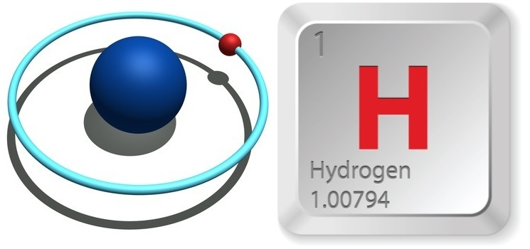
4U 1556-60 seems to be a NS ultracompact XRB at a distance of only 700 pc
Great! … right?
129,000 km
1200 km/s
UCXBs are not “supposed” to have hydrogen
Schematic of a known NS UCXB with P_{orb} = 11.4 minutes

Slide 28
4U 1556-60 seems to be a NS ultracompact XRB at a distance of only 700 pc
Great! … right?
129,000 km
1200 km/s
UCXBs are not “supposed” to have hydrogen
Schematic of a known NS UCXB with P_{orb} = 11.4 minutes
It is possible that the donor star is not a white dwarf, but rather an evolved star core with residual hydrogen
This is observed in the UCWD ZTF J1813+4251 (Burdge et al. 2022)
4U 1556-60 may be a unique UCXB
hiding in plain sight for 50 years!

Slide 29
Summary
Pattie et al. 2026
4U 1556-60 was discovered more than 50 years ago, but remained poorly understood
A Gaia parallax places it only 700 pc away, drastically changing assumptions
New radio data: 4U 1556-60 is a NS XRB with the lowest limit on L_{R} to date
  Why is its jet so weak? NSXB jet launching mechanism?
New X-ray data: Weak magnetic field and very weak iron line
X-ray + optical suggest an ultracompact orbital period
  But with hydrogen… 1st of its kind?
Extra: very low inclination angle estimated and no thermonuclear bursts detected
Is 4U 1556-60 a unique UCXB that has been hiding in plain sight for 50 years?
4U 1556-60?
Future
UV/OIR spectroscopy for disk lines/composition and radial velocity orbital period
X-ray polarization for a very low accretion rate XRB?

