Slide 1
LOFAR2.0 COMMISSIONING
M.A. Brentjens (ASTRON)
On behalf of the LOFAR2.0 commissioning team
13/05/2026

Slide 2
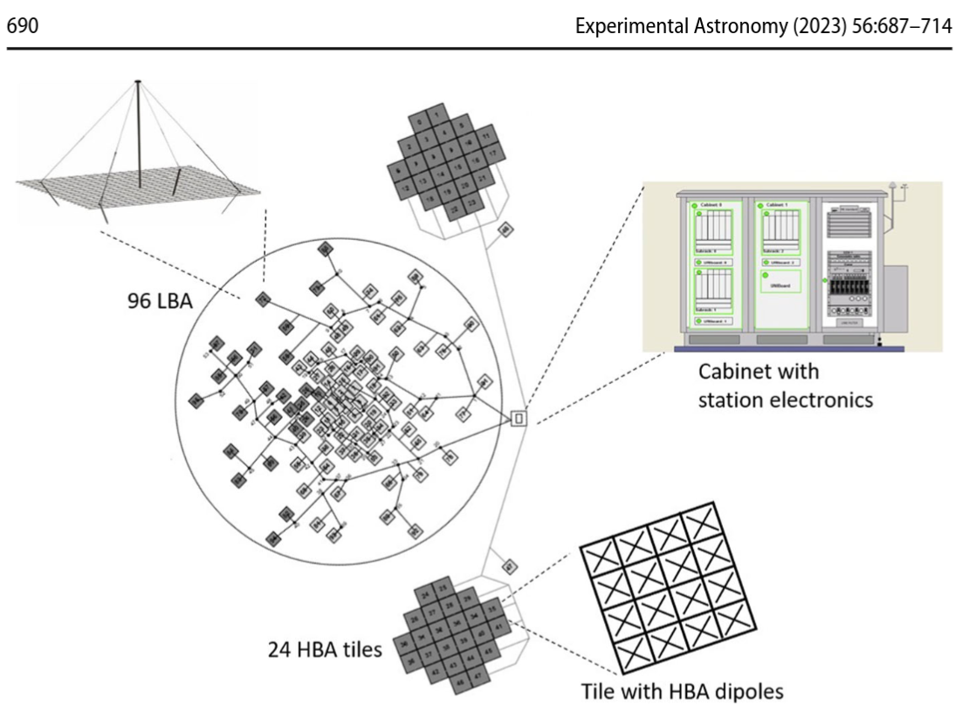
LOFAR2.0 upgrade: new...
Observing mode:
  Use all LBA (10-90 MHz) and HBA (110-250 MHz) antennas simultaneously
Clock system
Station electronics (beam formers, correlators)
Network (max 100 Gb/s/station)
Central correlator
Monitoring, control & QA
Central (pre)processing cluster
Science processing pipelines
User-facing tools
… surely something I forgot...

Slide 3
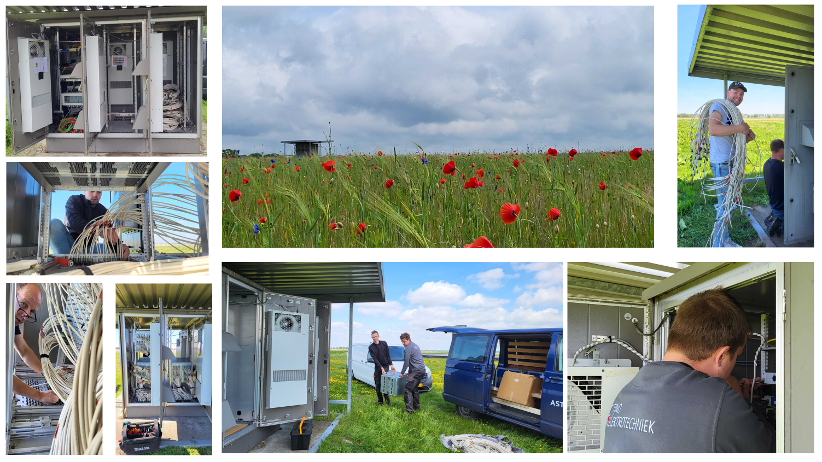
Notes:
All Dutch stations have LOFAR2.0 hardware
11 stations delivered to Commissioning

Slide 4
Commissioning
Bridges AIV and initial operations / Science verification
Prove 57 LOFAR2.0 science requirements (level 0)
  ~1500 Level 1 (system), 2 (sub-system),…5 (individual component) requirements
  Demonstrated at varying levels of rigour during engineering, (pre-) production, and AIV
Prove in Operational context

Slide 5
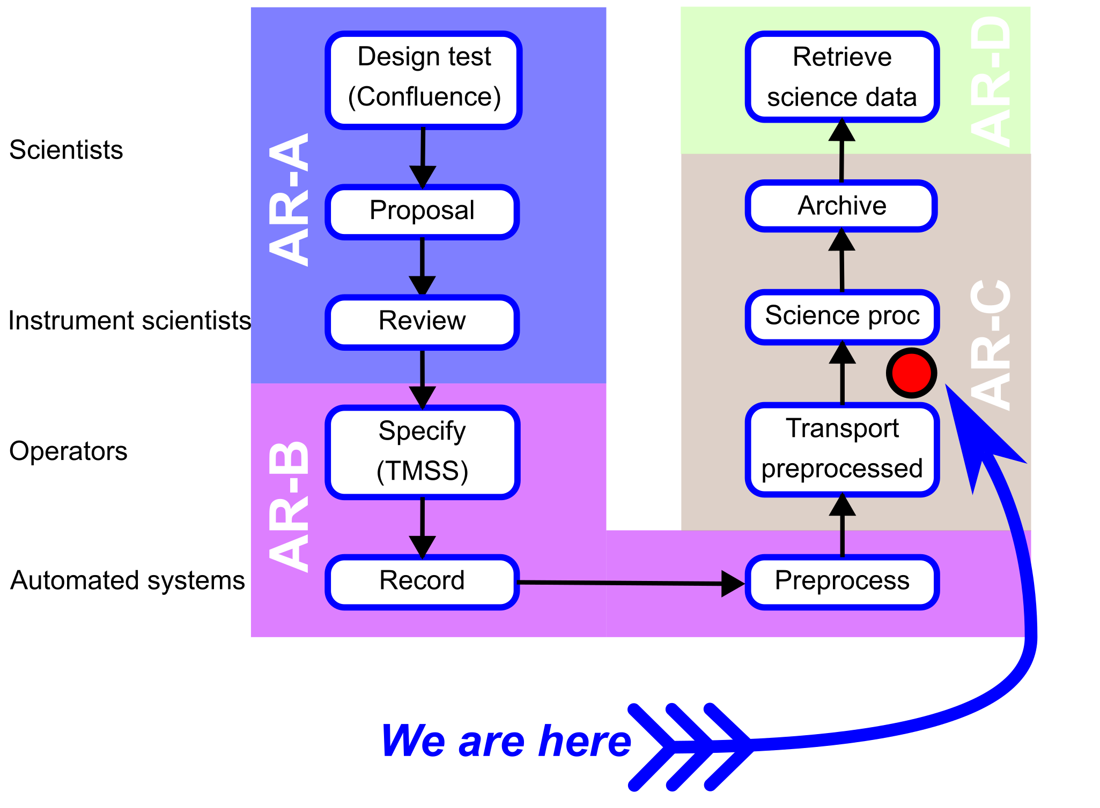
Process

Slide 6
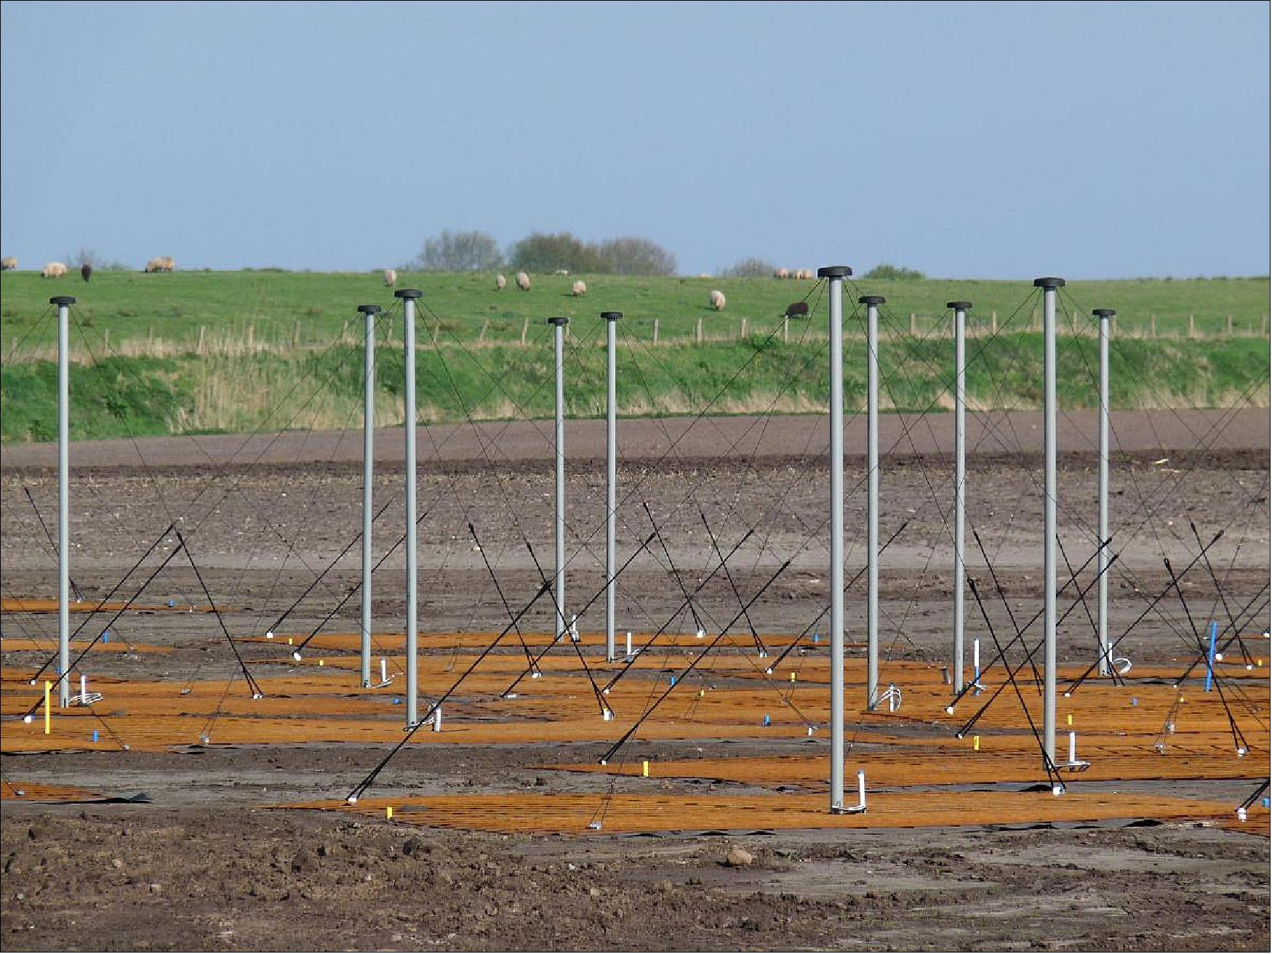
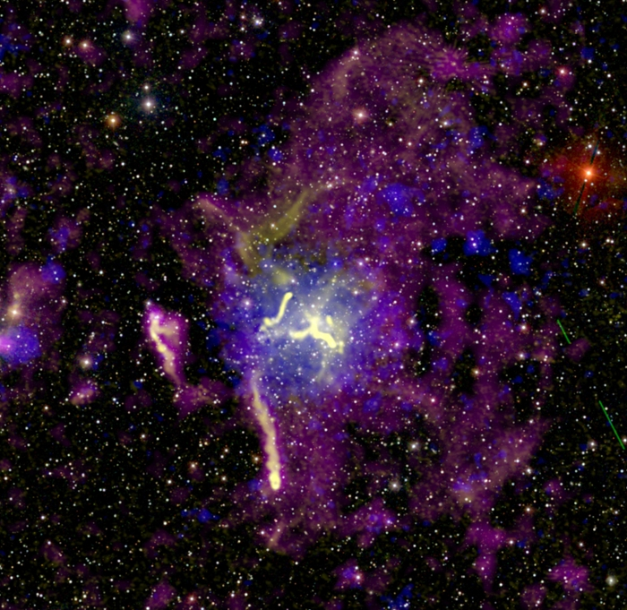
Three teams (themes?)
Telescope Bassa, Kondratiev
Antennas
Stations
Timing
Real-time processing
Operations Orru', Asabere
Proposal management
Specification
Observing workflow
Archiving
Pipelines Shimwell, Iacobelli
Commissioning with pipelines
Resource measurement
Operations manuals

Slide 7
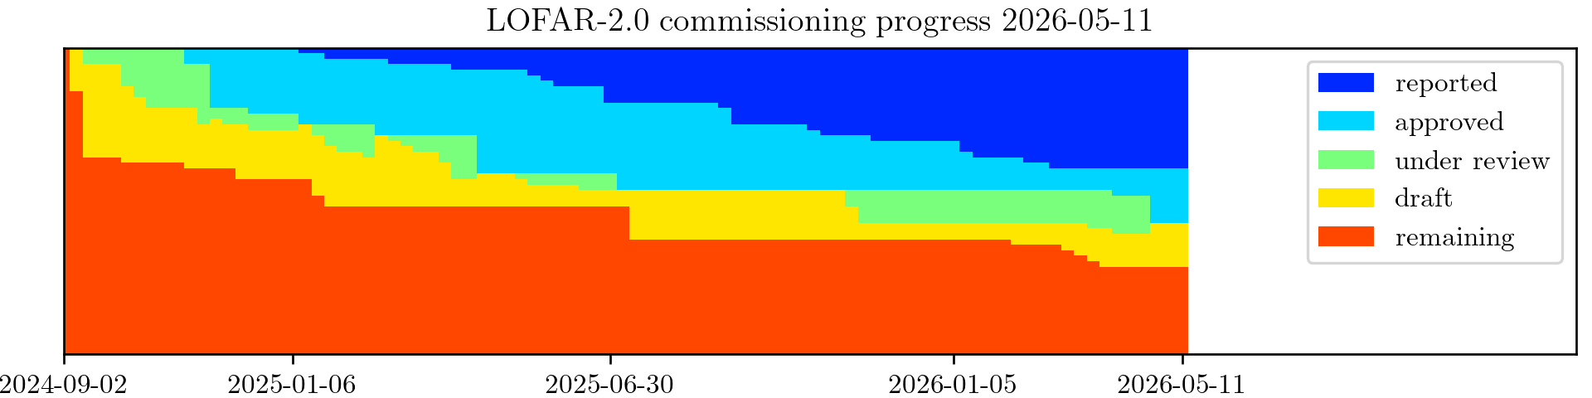
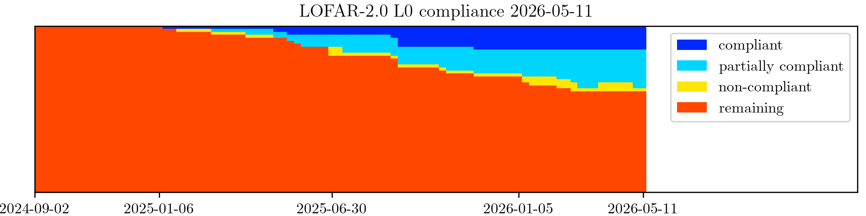
Status

Slide 8
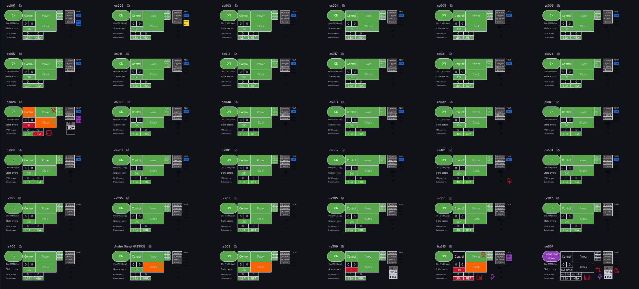
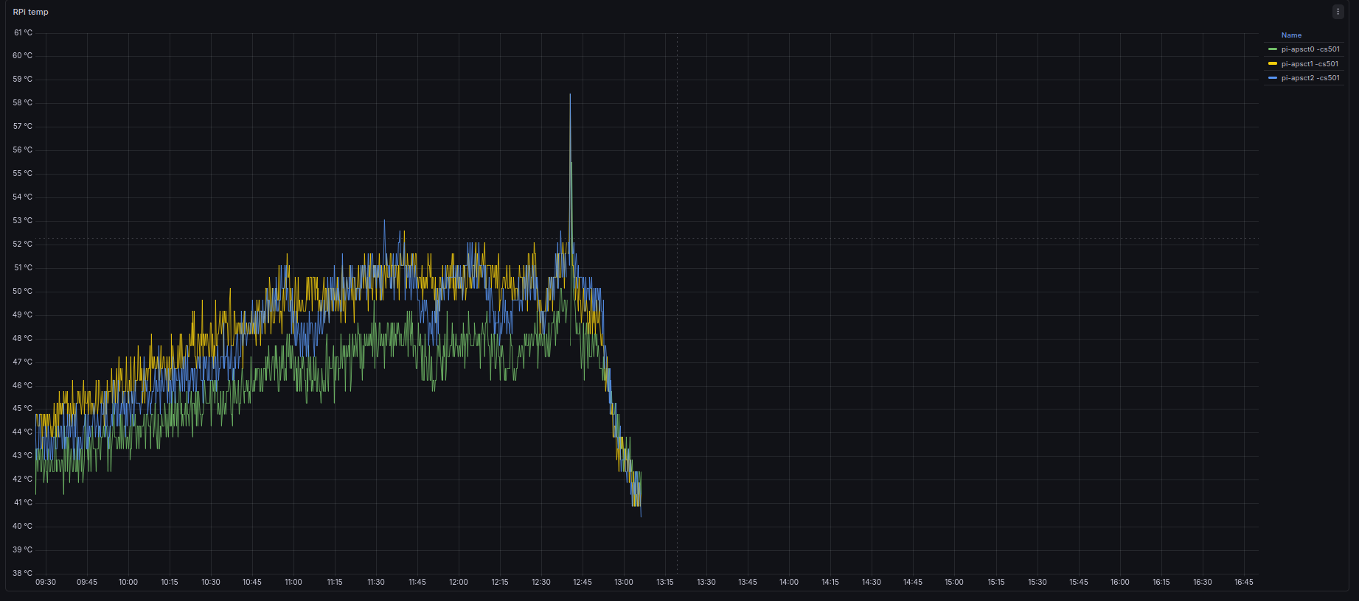
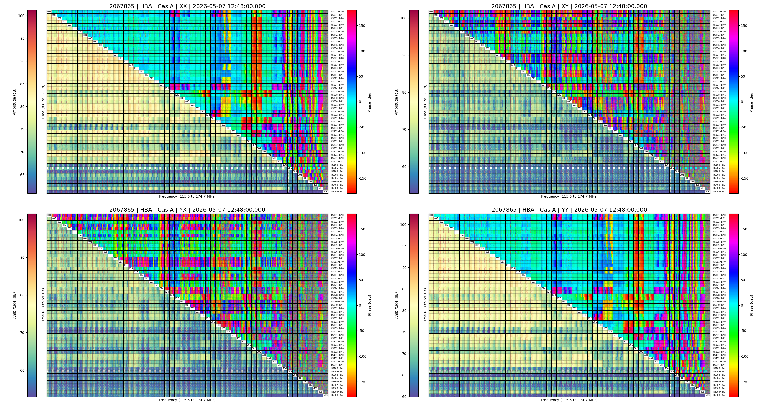
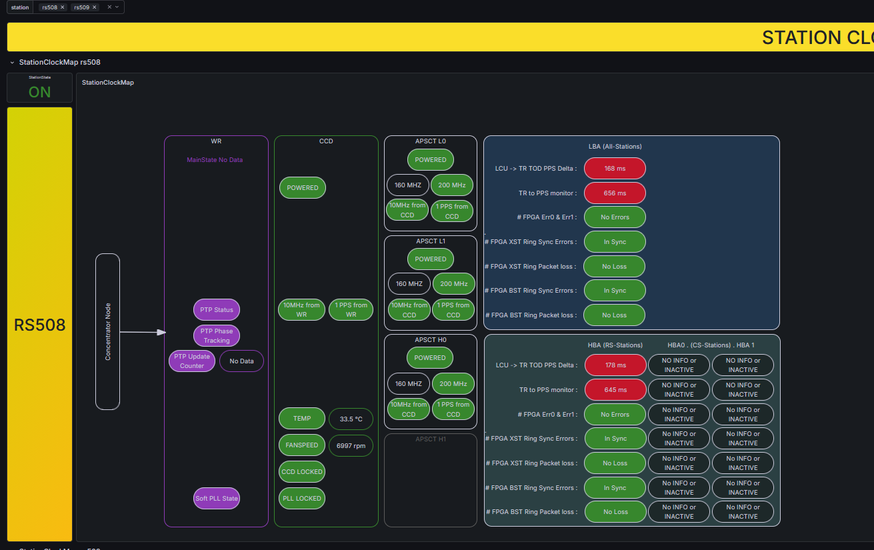
Monitoring and QA
(Henk Mulder, Jurjen Sluman, Aida Ahmadi, Aleksandar Shulevski,...)

Slide 9
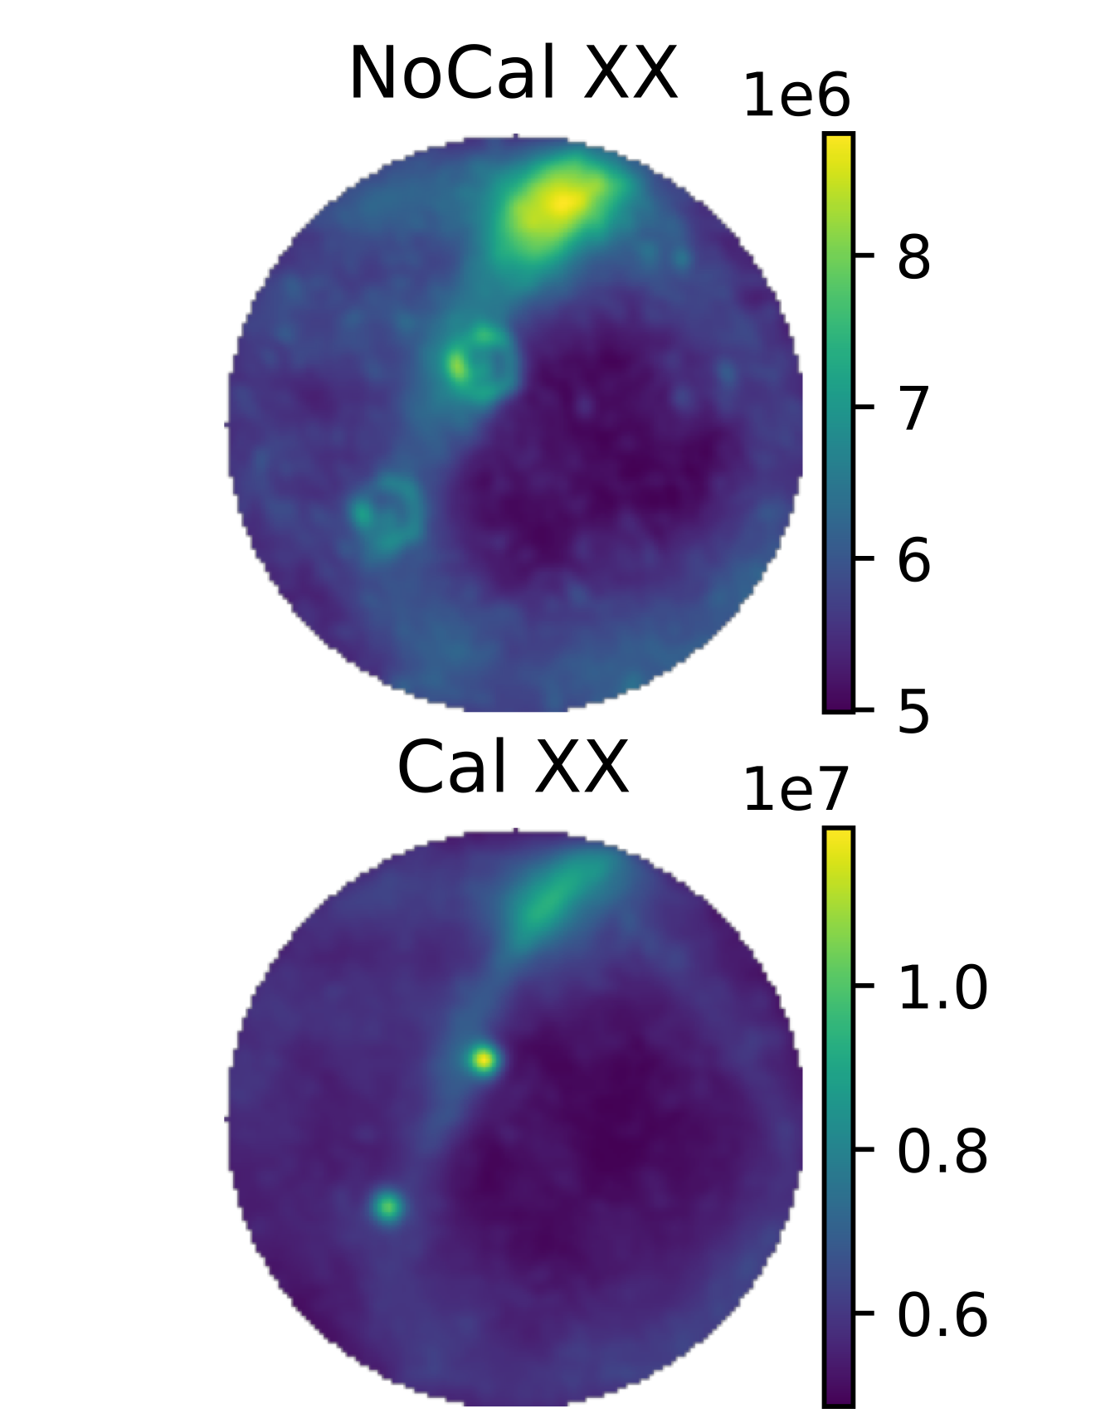


Station calibration
(David McKenna, Cristina Cordun, Michel Arts, Cees Bassa,...)
All dipoles within a station MUST add coherently
Well-defined station beam, required for accurate imaging
Without it, array calibration fails → loss of sensitivity, artifacts, and unusable images
Using full EM models of antennas improves sensitivity
  1.2-2x better!
Example of before and after for CS004 at 53 MHz

Slide 10
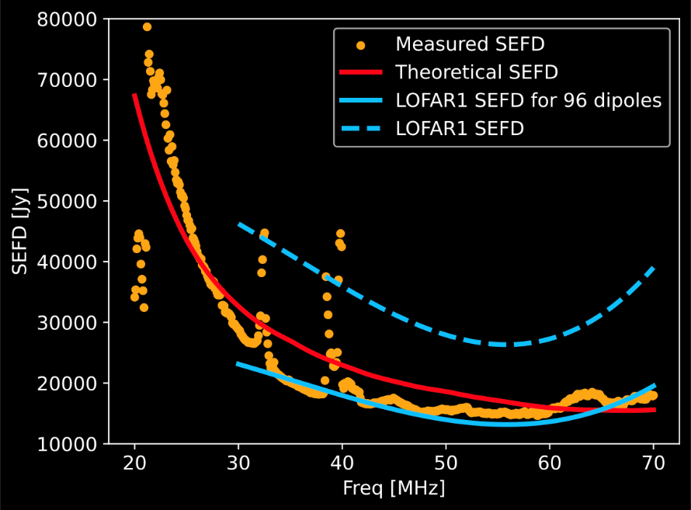
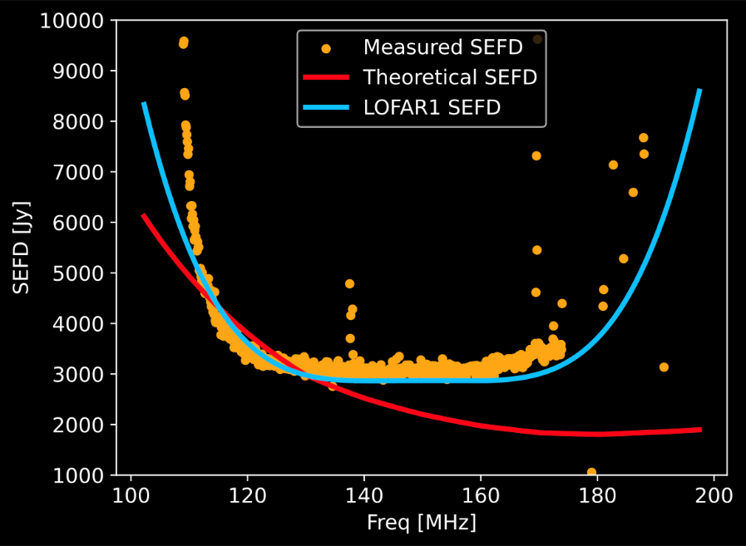
Noise performance (Cristina Cordun, Henrik Edler)

Slide 11
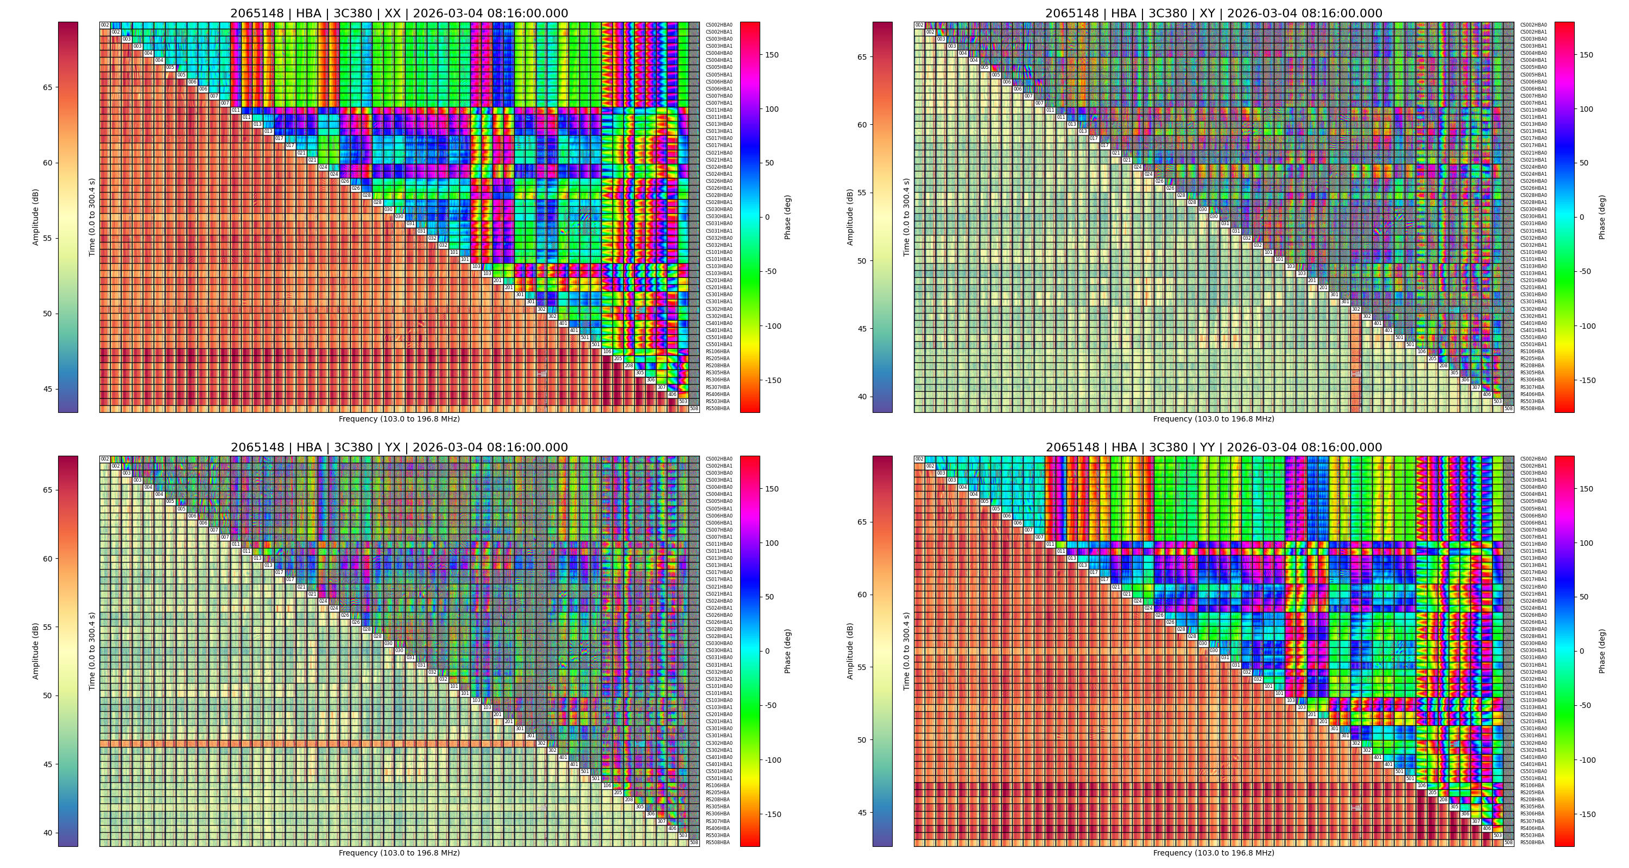
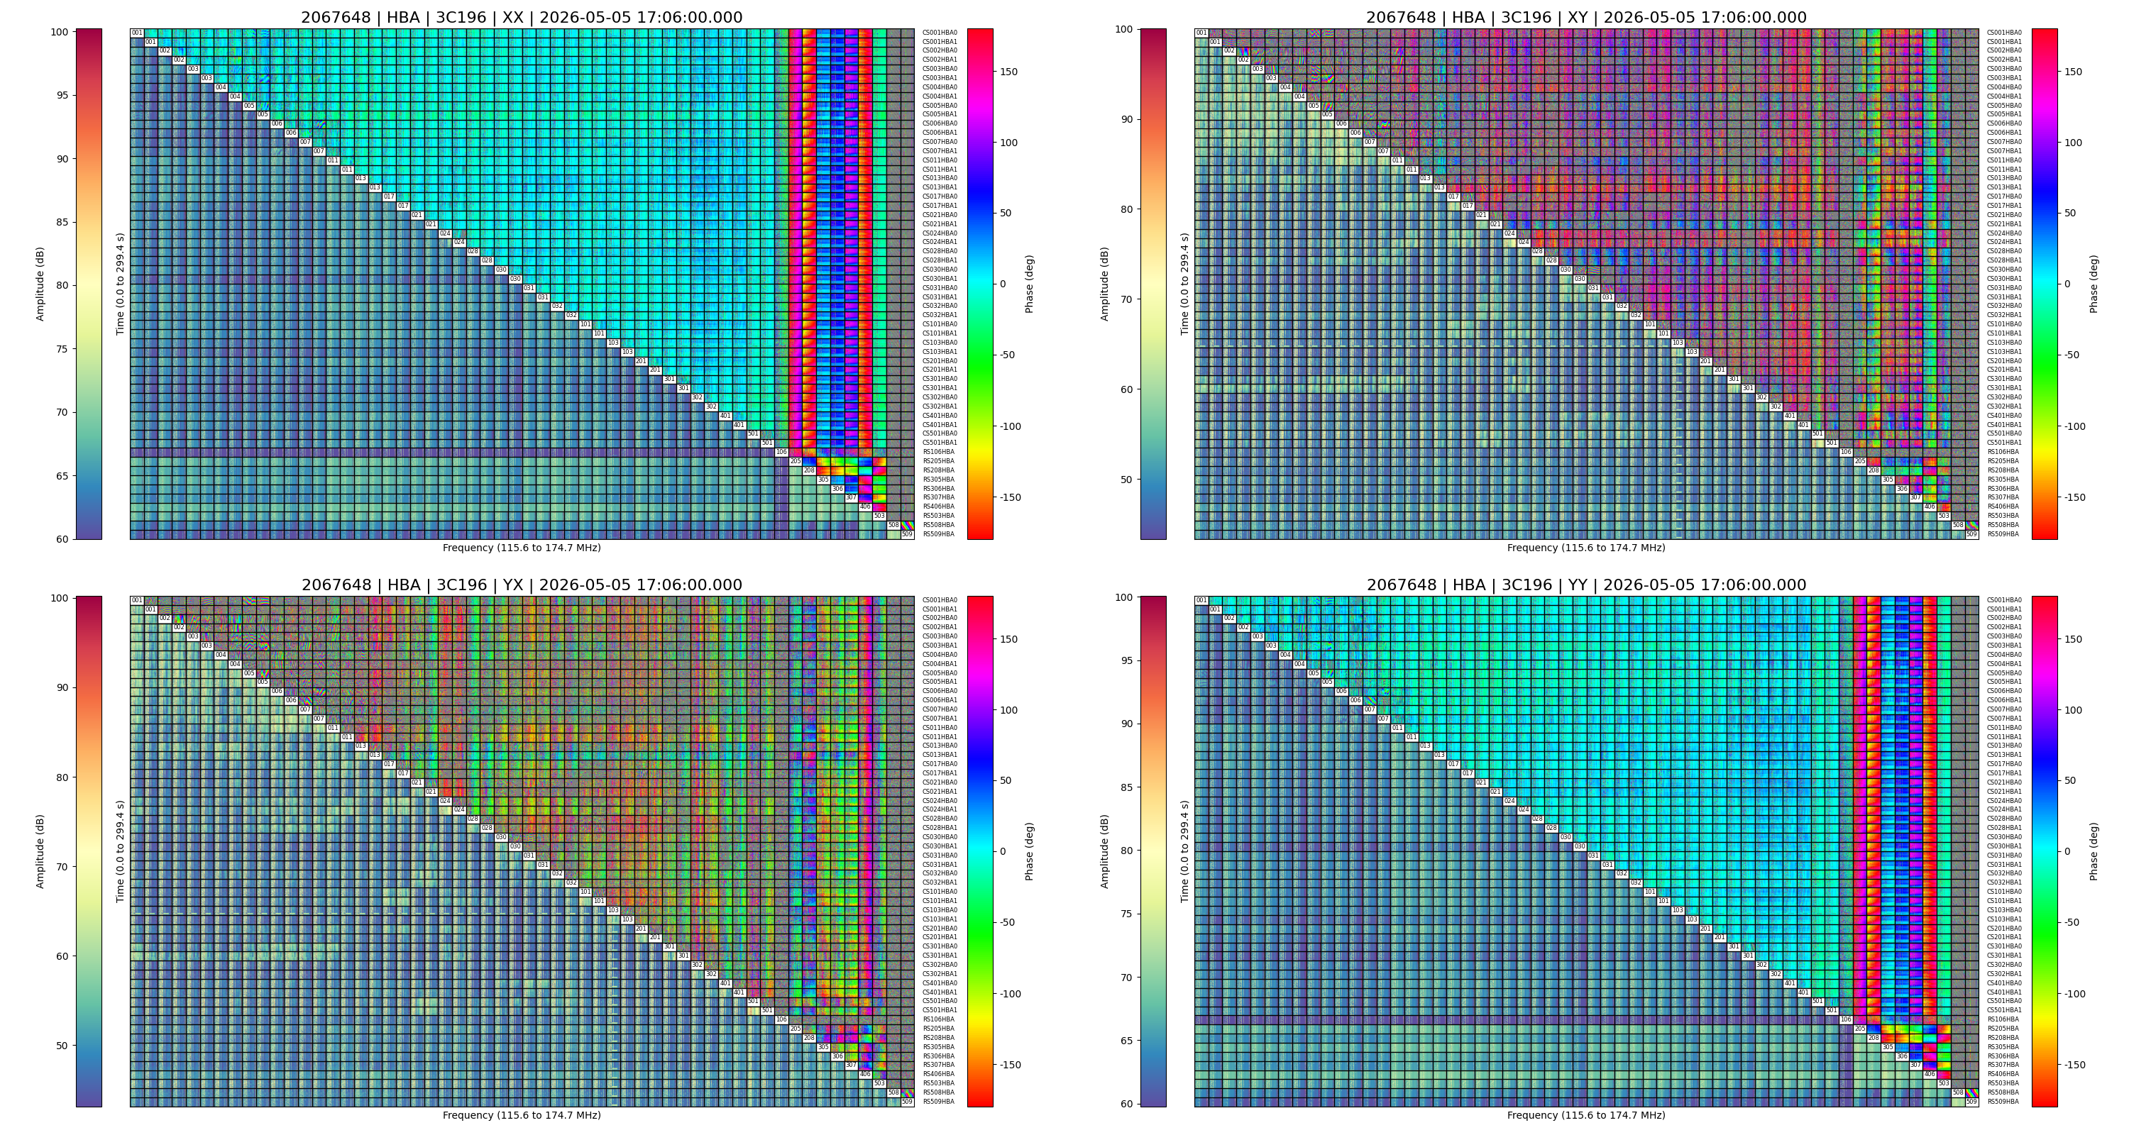
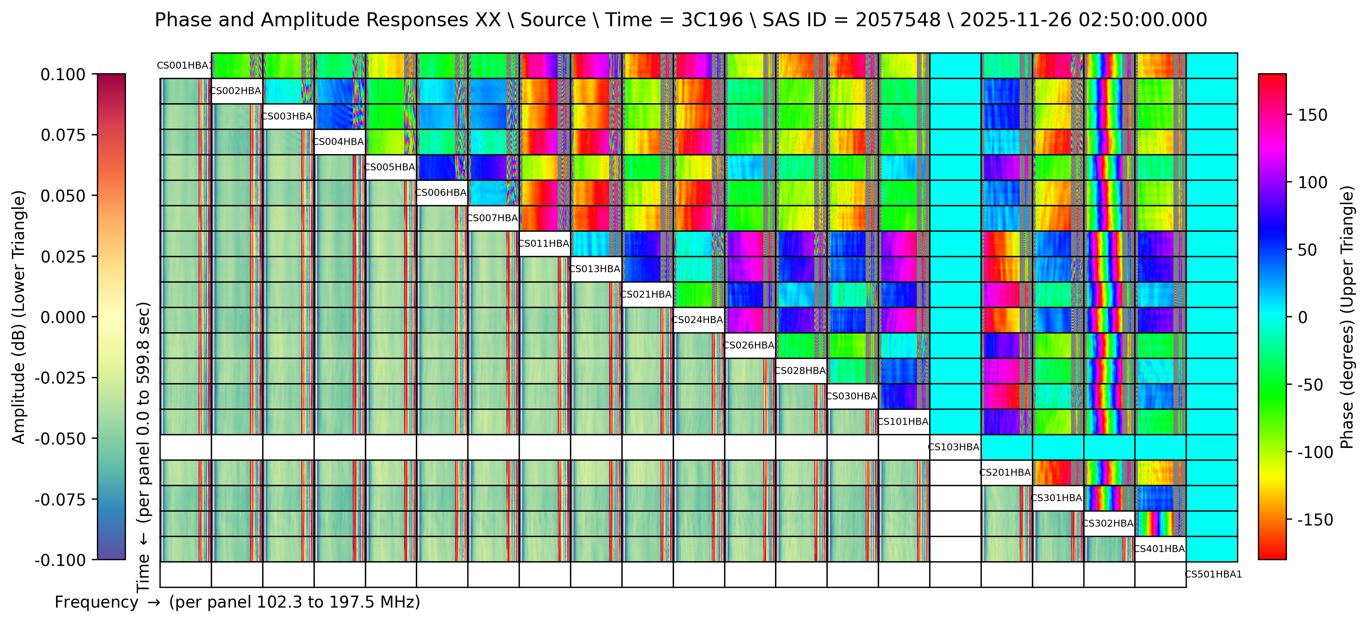
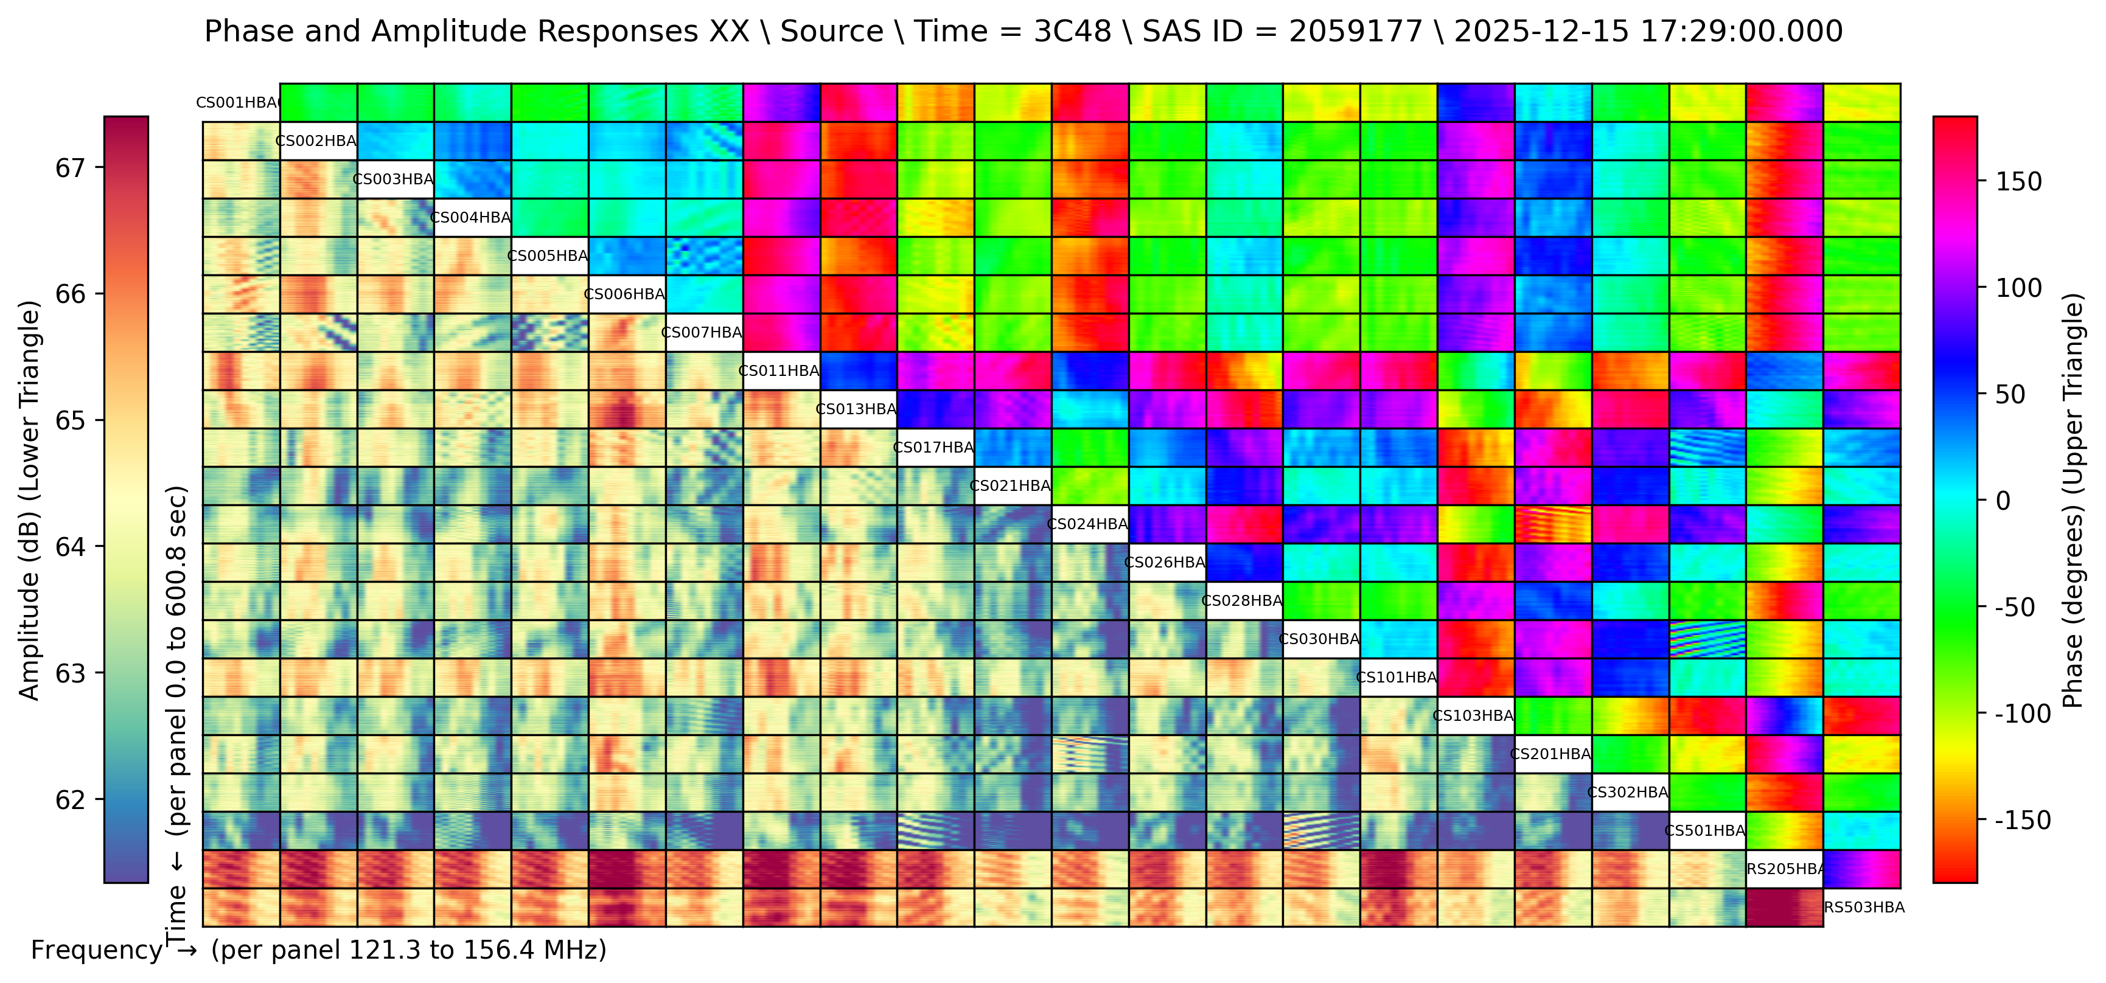
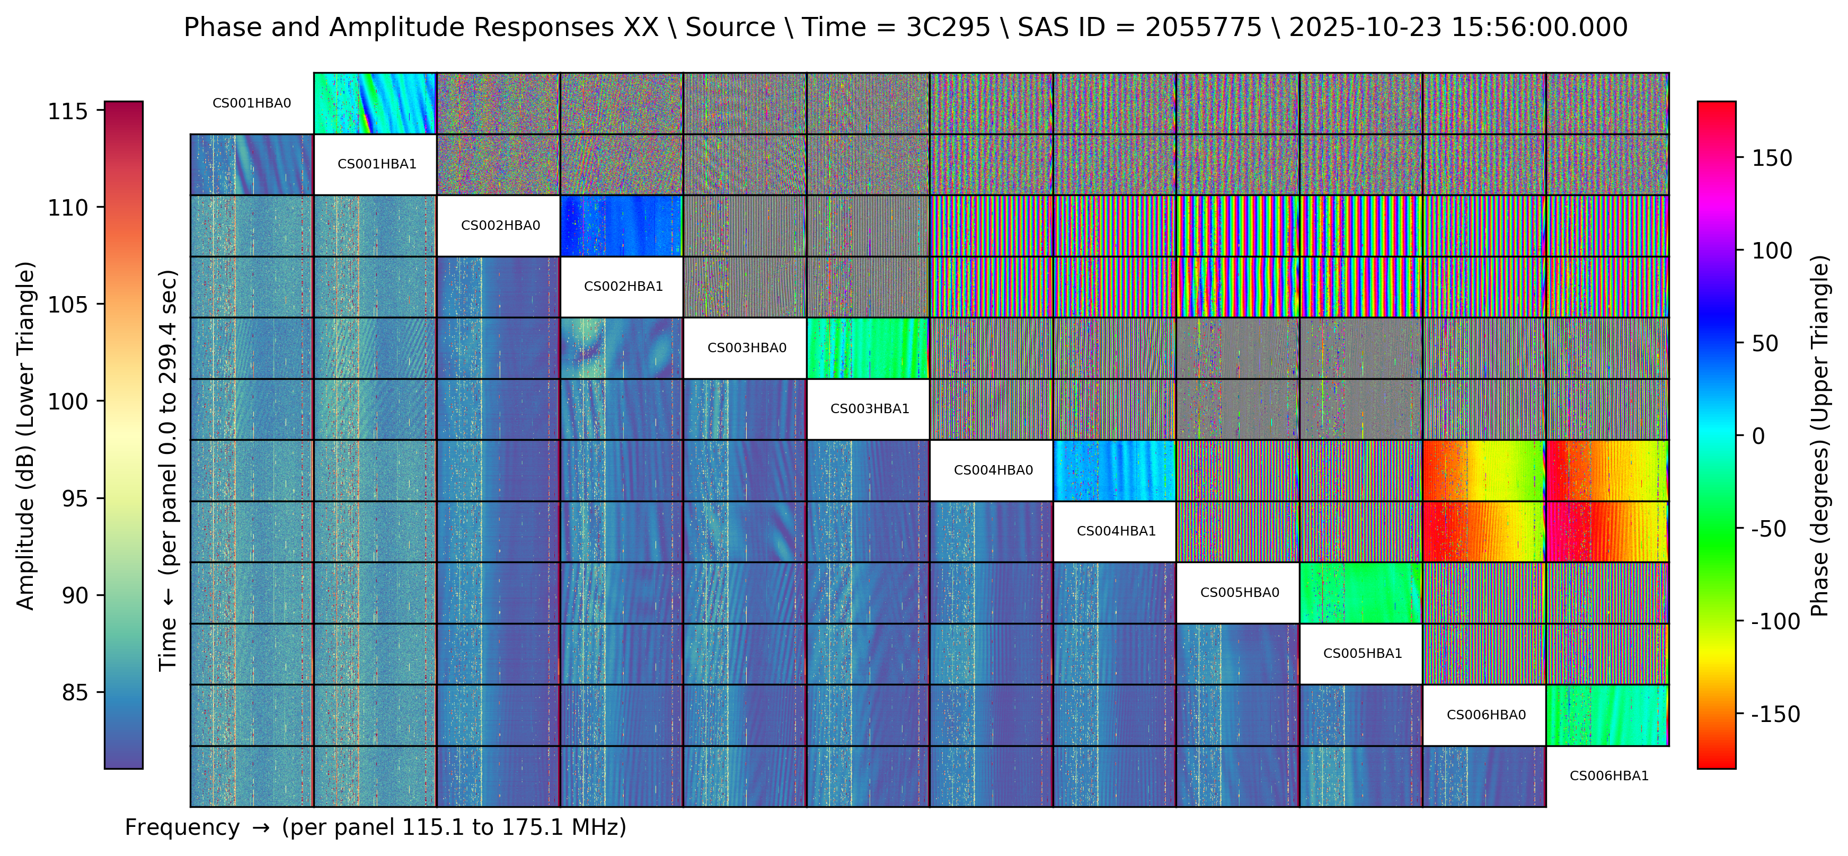
Clock delays (Henrik Edler, Cristina Cordun, Maaijke Mevius, Manu Orrú,...)

Slide 12
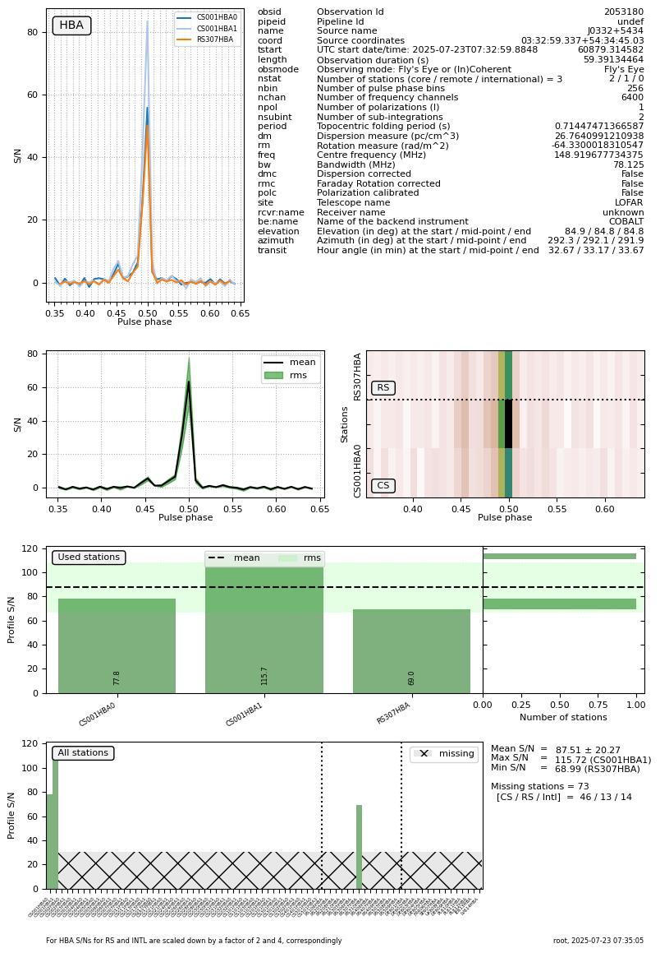
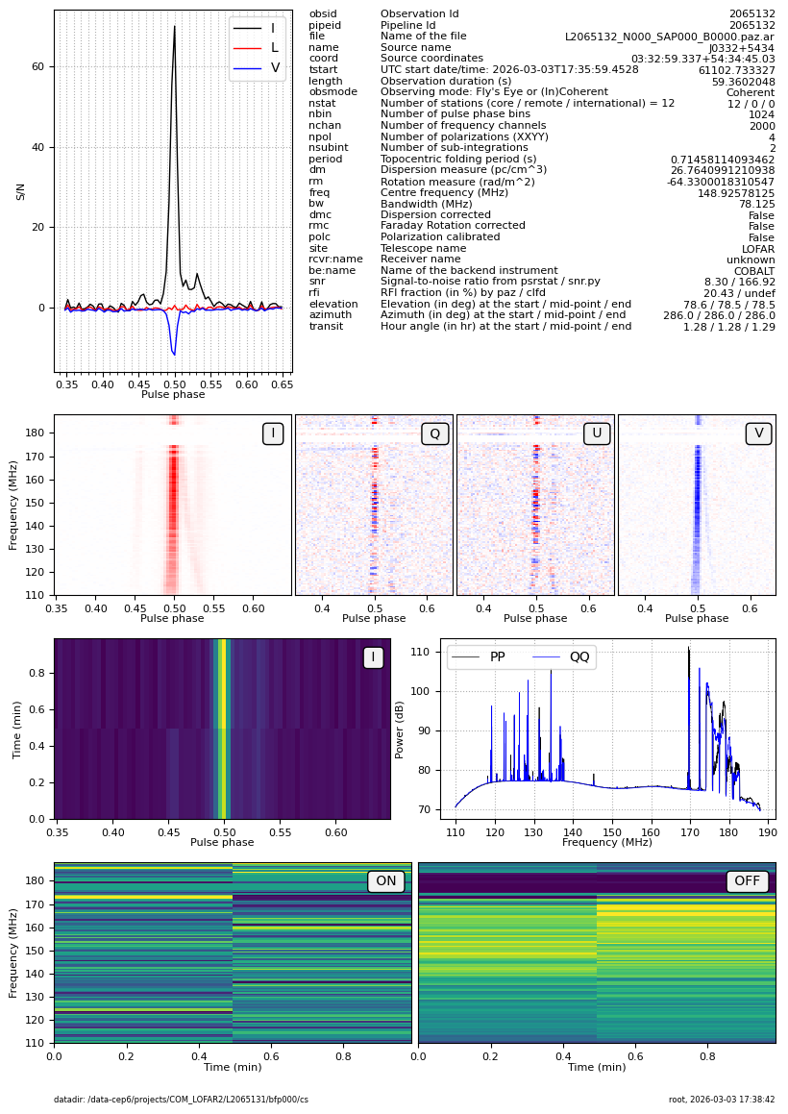
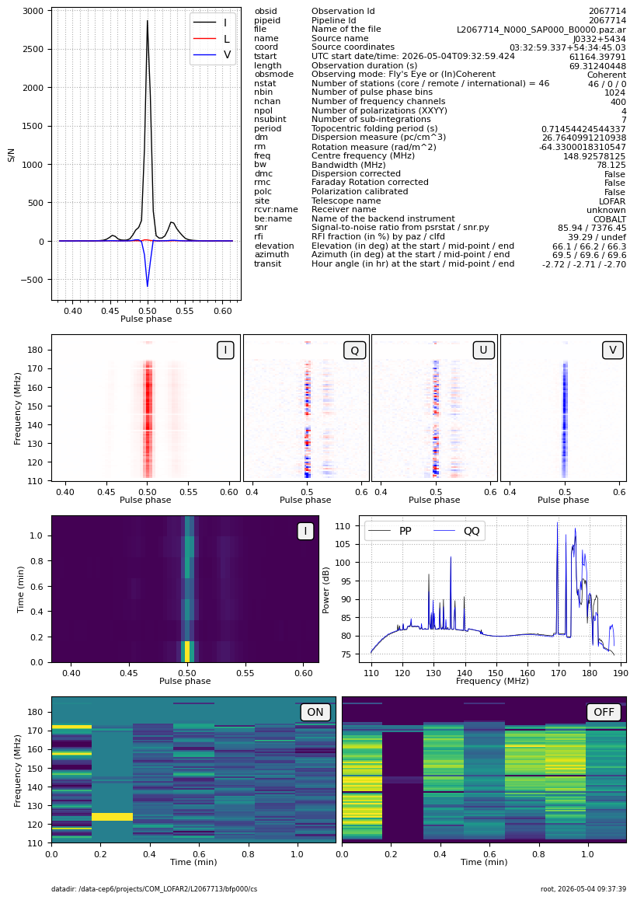
Pulsar folding (Vlad Kondratiev)

Slide 13
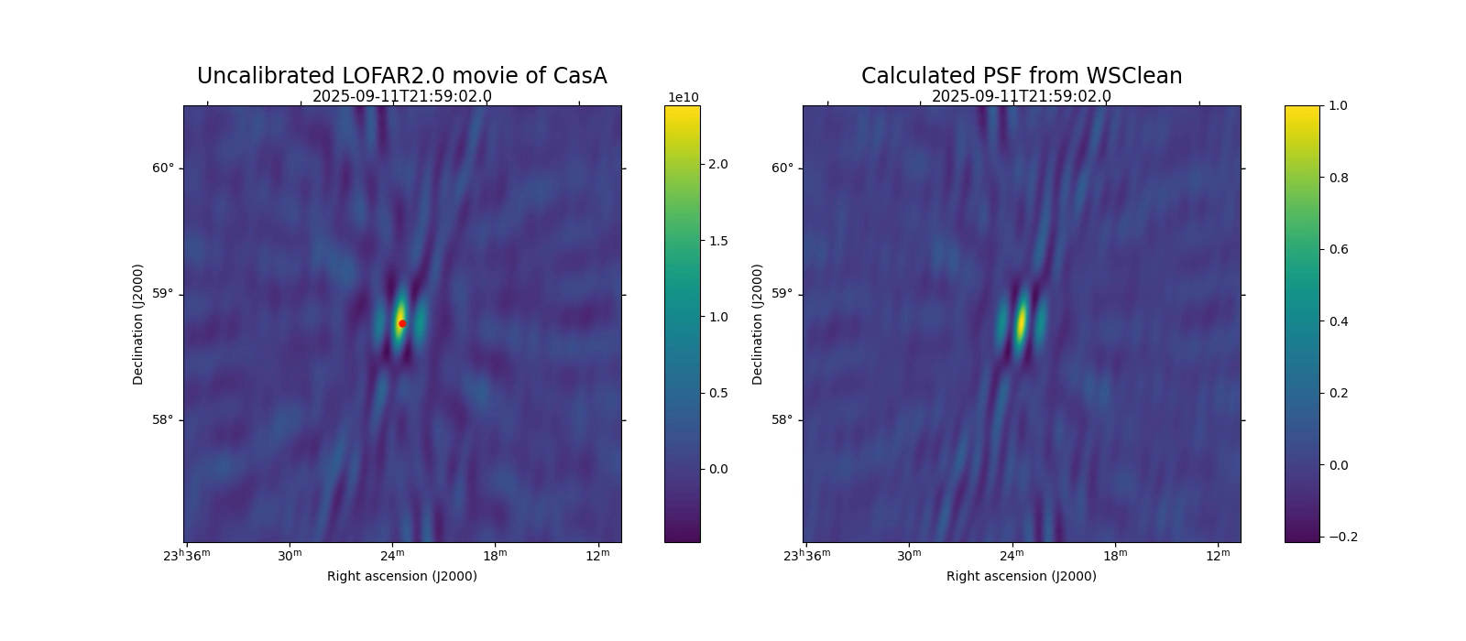
Tracking Sep 2025 (Noa Peters, Aleksandar Shulevski)

Slide 14
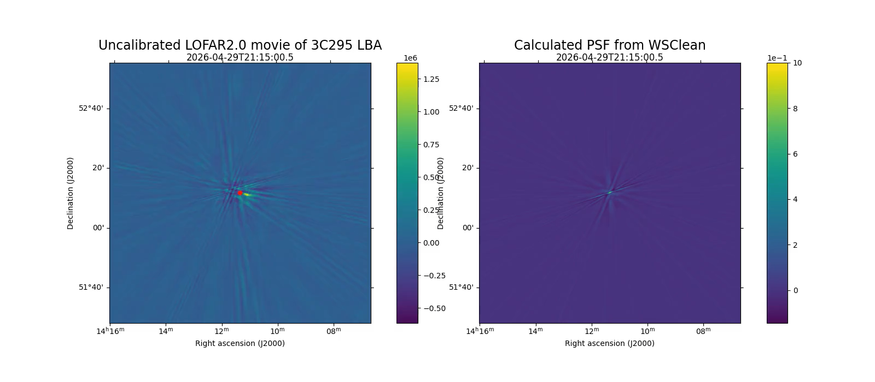
Tracking NOW (Noa Peters, Aleksandar Shulevski)

Slide 15
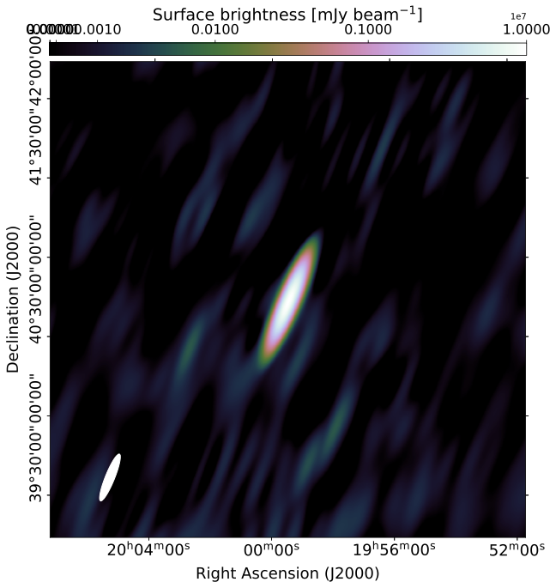

The first calibrated LOFAR 2.0 image (H. Edler)
Cygnus A (Sep 2025)
8 stations
Joint LBA+HBA 20 – 168 MHz
Resolution: 18' x 4'
Noise level ~ 5 Jy/beam
New one coming up soon!

Slide 16
What's next?
NL-resolution imaging (next month?)
Jointly imaging LBA and HBA (2026)
Transient Buffer Mode
Deployment of international stations (Sweden NEXT WEEK!)
Pipeline processing at archive sites
Preparations for Science Verification
All sky imaging
Further operational automation

