Slide 1



The H2O vapour reservoirs of disks around T-Tauri stars
Milou Temmink
temmink@strw.leidenuniv.nl
13/05/2026 – NAC 2026

Slide 2
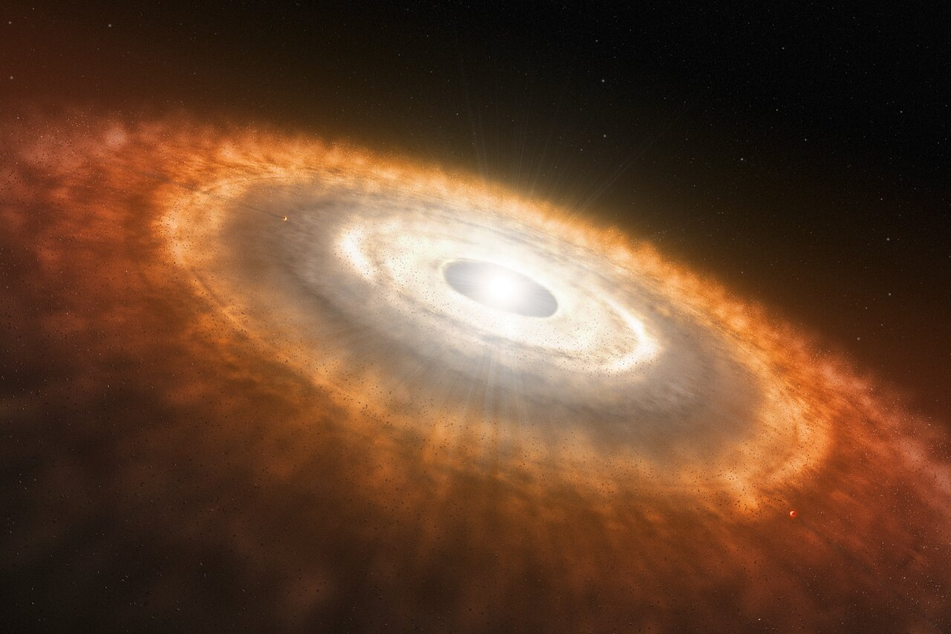
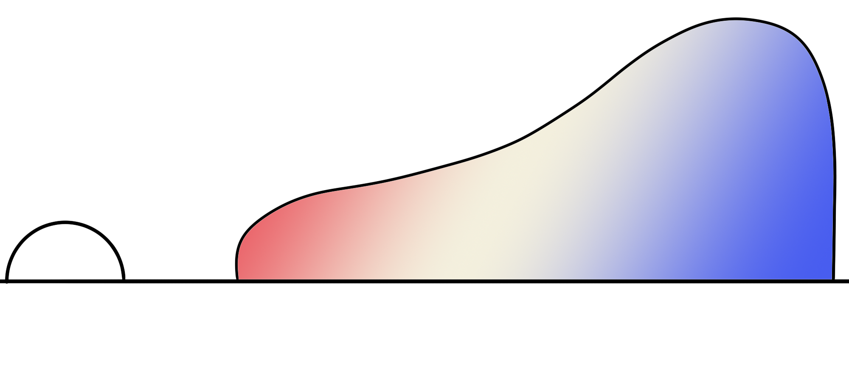
Planet-forming disks
Milou Temmink – NAC, 13/05/2026 – temmink@strw.leidenuniv.nl
~99% mass → gas
~1% mass → dust
Unique opportunities!
Outer disk - ALMA
Inner disk - JWST
JWST (<10 au)
Varying temperature structure with radius and height
Radius [au]
Ever evolving systems
→ i.e., radial drift
ALMA (>10 au)
Image credit: ESO/L. Calçada

Slide 3
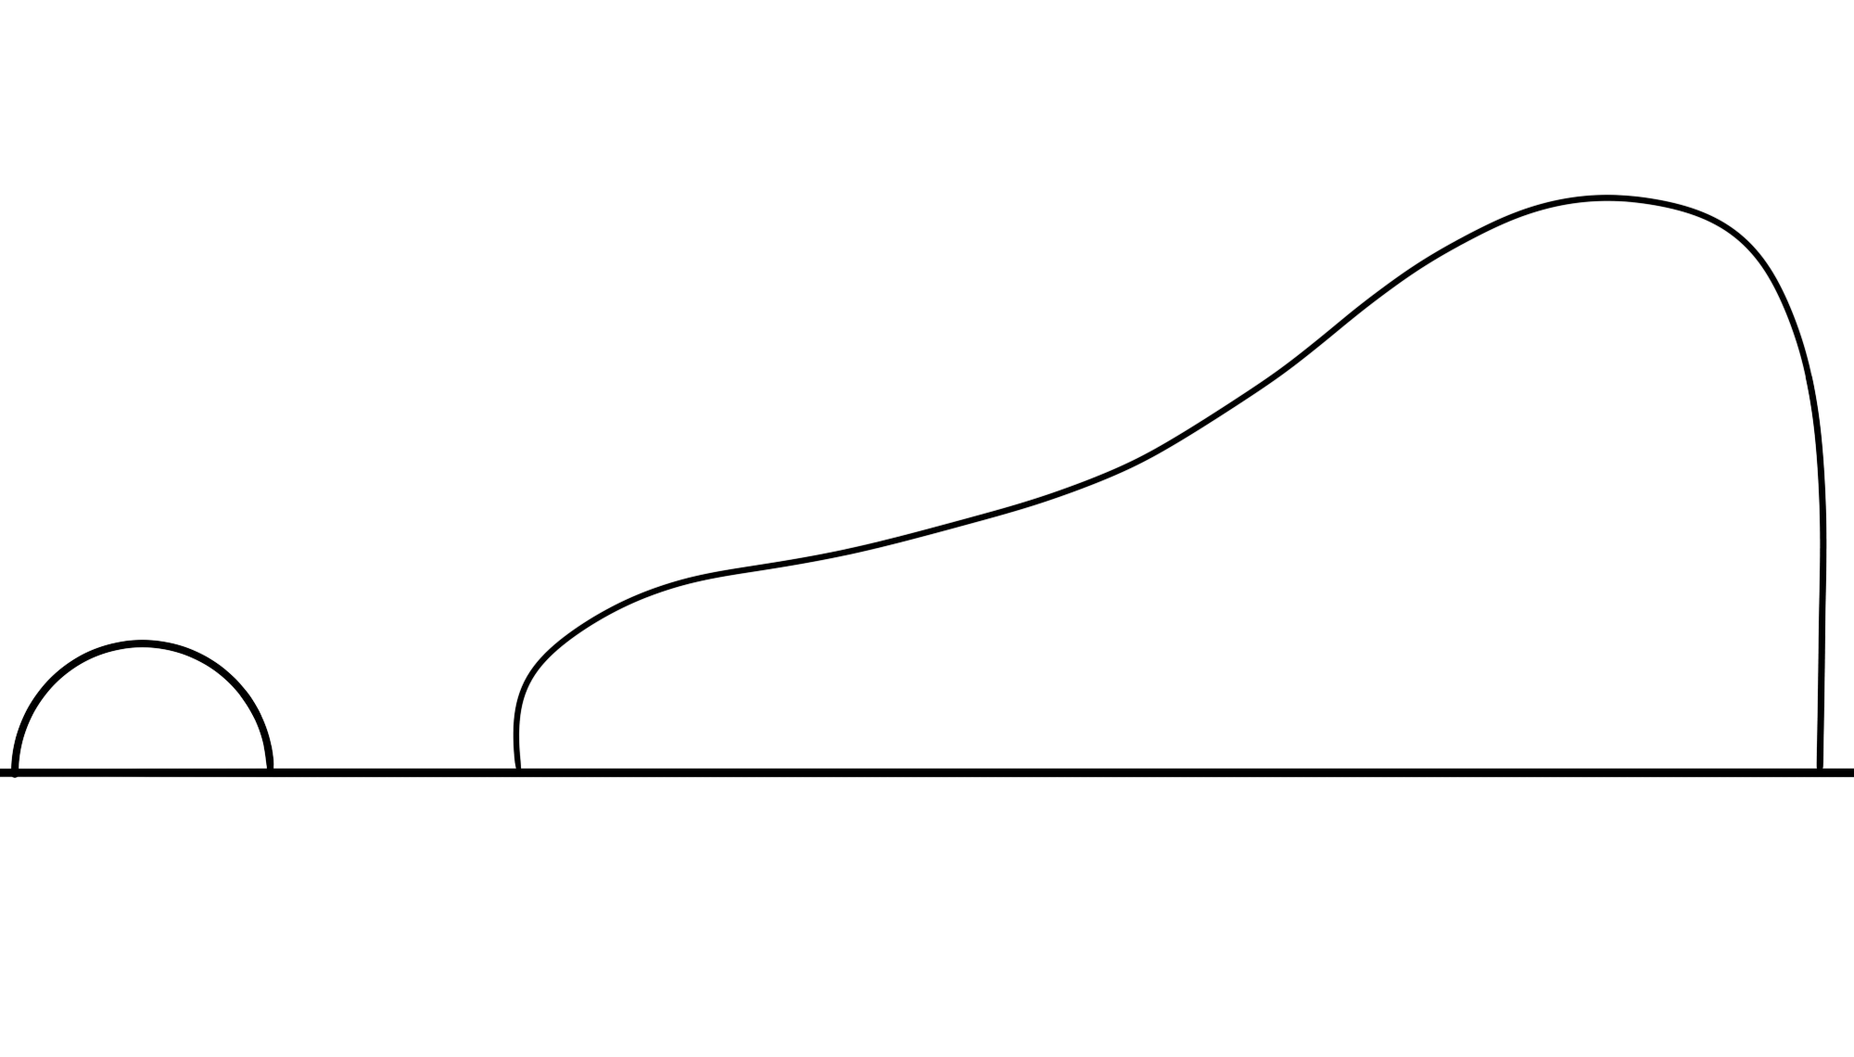
Radial drift – A curse or a blessing?
Milou Temmink – NAC, 13/05/2026 – temmink@strw.leidenuniv.nl
What is the pebble flux across the snowline?
Krijt et al. (2025) → 10⁻³-10⁻⁵ MEarth/year
Small grains coupled to the gas
(3) Sublimation
(1) Growth & Settling
Snowline
Icy layers
Large grains decoupled
(2) Inward drift
“Sublimation” → Phase transition from solid to gas
“Snowline” → Midplane location beyond which 50% of a molecular species is frozen out

Slide 4
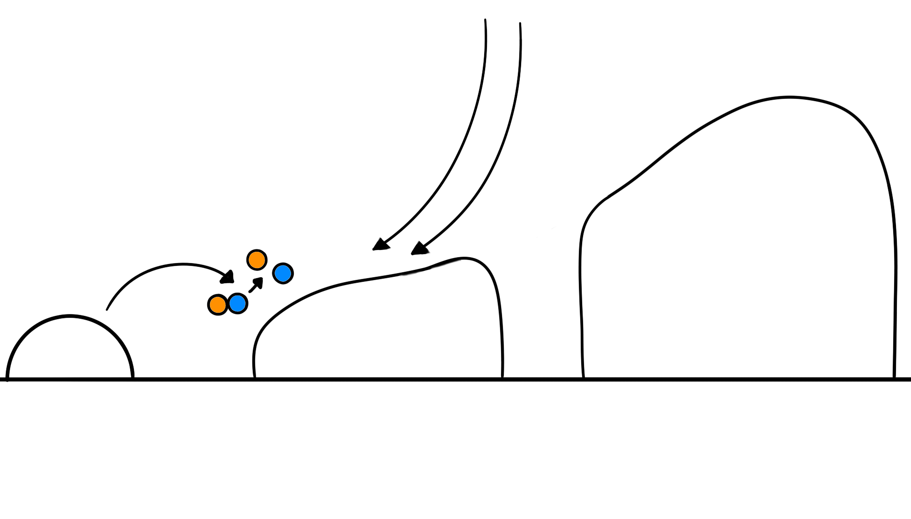
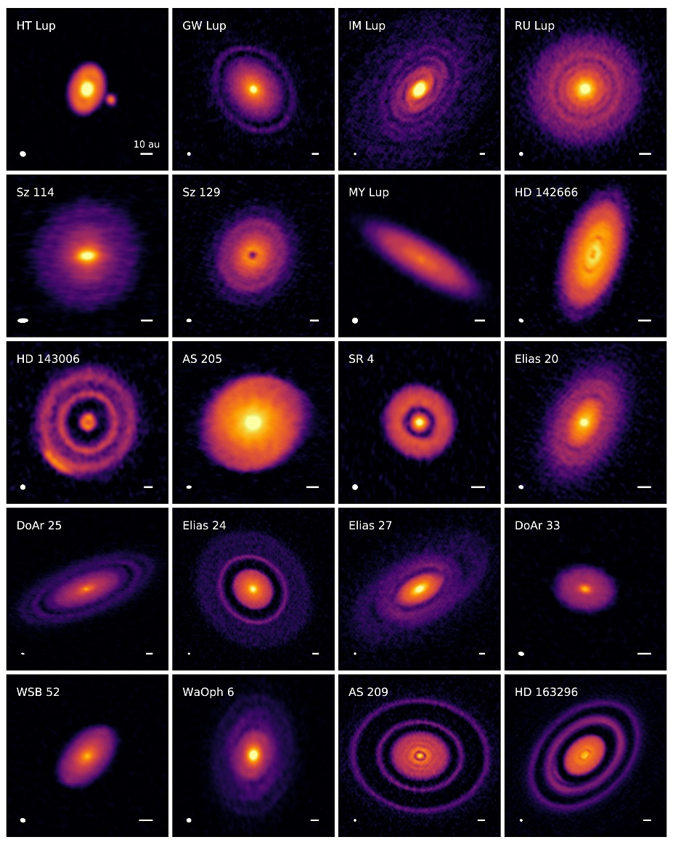

Radial drift – A curse or a blessing?
The role of substructures?
Milou Temmink – NAC, 13/05/2026 – temmink@strw.leidenuniv.nl
Dust trap!
Snowline
?
Andrews et al. (2020)
Substructures → No grains crossing the snowline, no sublimation?
Substructures are everywhere!

Slide 5
Radial drift – Why is it important?
Milou Temmink – NAC, 13/05/2026 – temmink@strw.leidenuniv.nl
Smooth disk
Structured disk
Snowline
Terrestrial planet-forming regions!
Radial drift and sublimation may play a crucial role in setting the chemical composition in the terrestrial planet-forming regions!

Slide 6
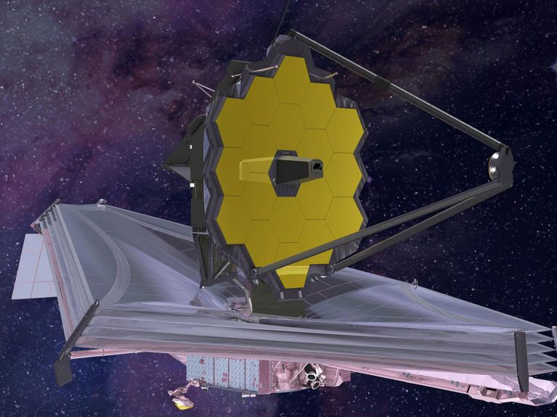

How does this all tie into the H2O reservoirs?
Milou Temmink – NAC, 13/05/2026 – temmink@strw.leidenuniv.nl
JWST-MIRI gives the prime opportunity to study H2O in those terrestrial planet-forming regions!
PI: Thomas Henning (MPIA)
Cycle 1 GTO program
>100 hours on disks!
“What is the chemical composition in
the terrestrial-forming regions?”

Slide 7
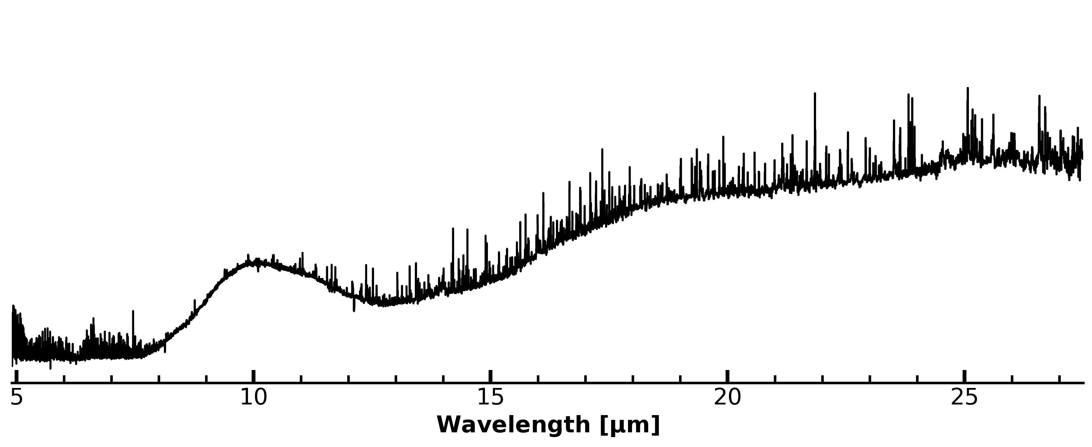
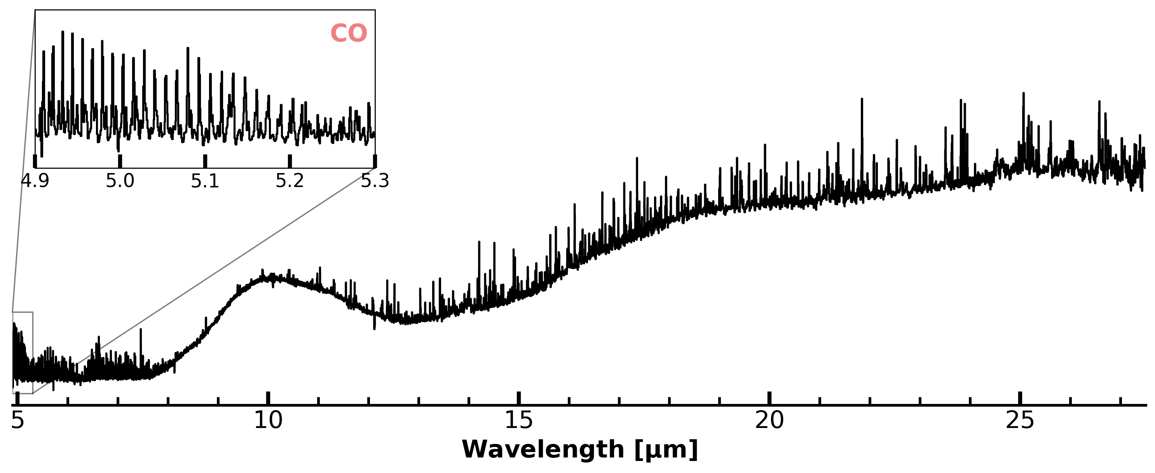
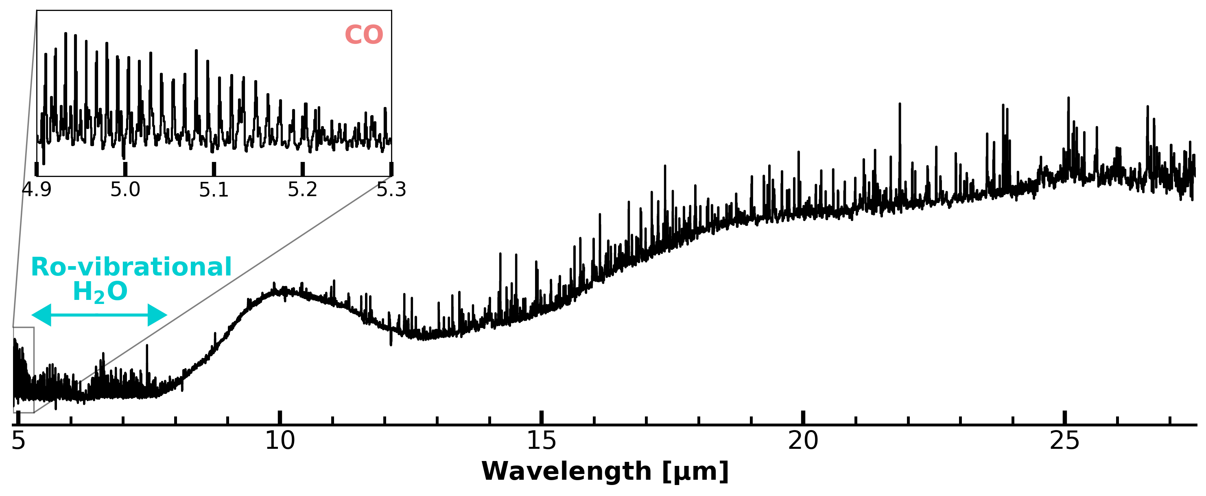
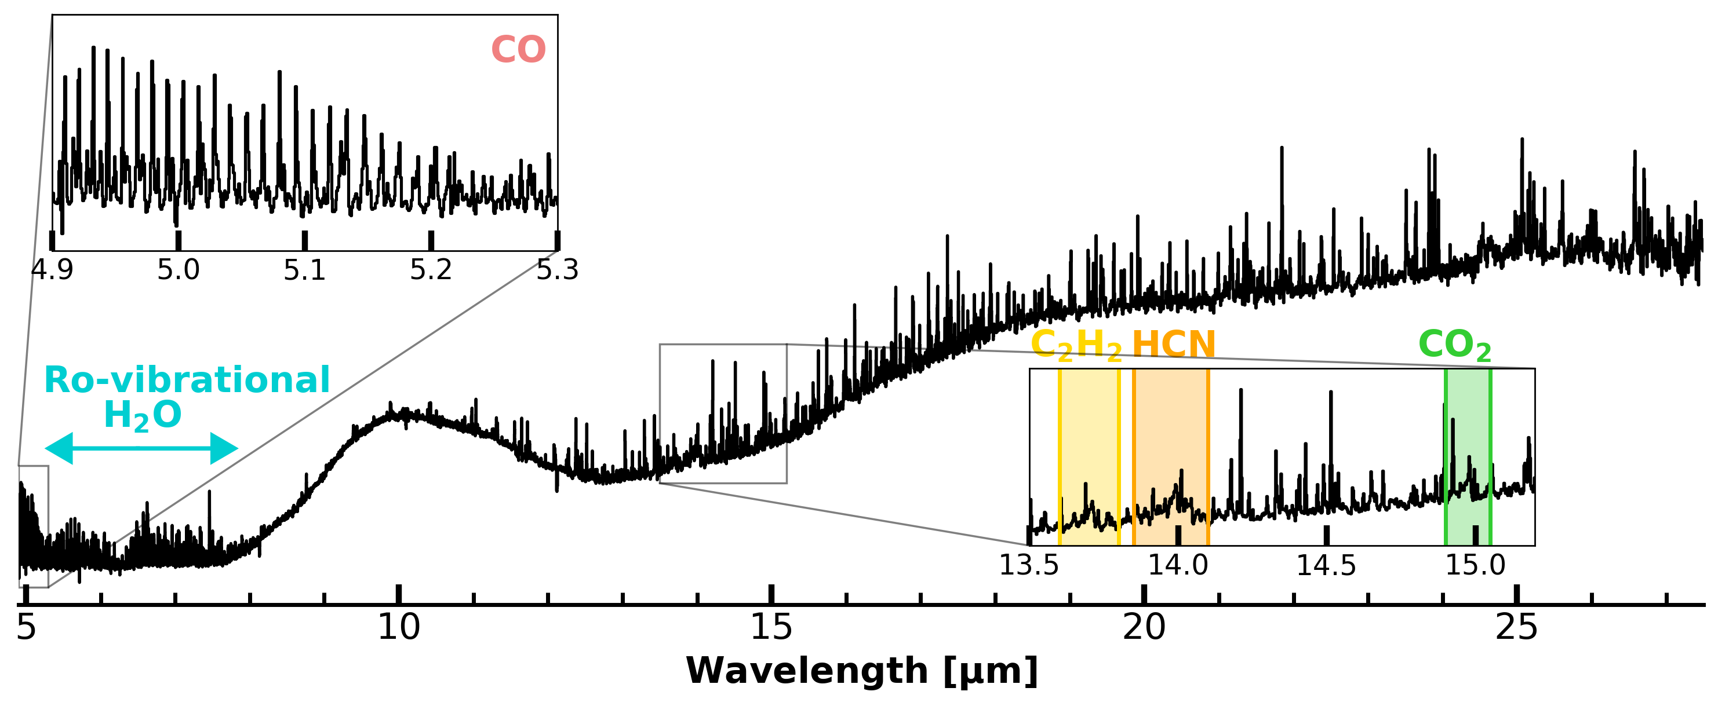
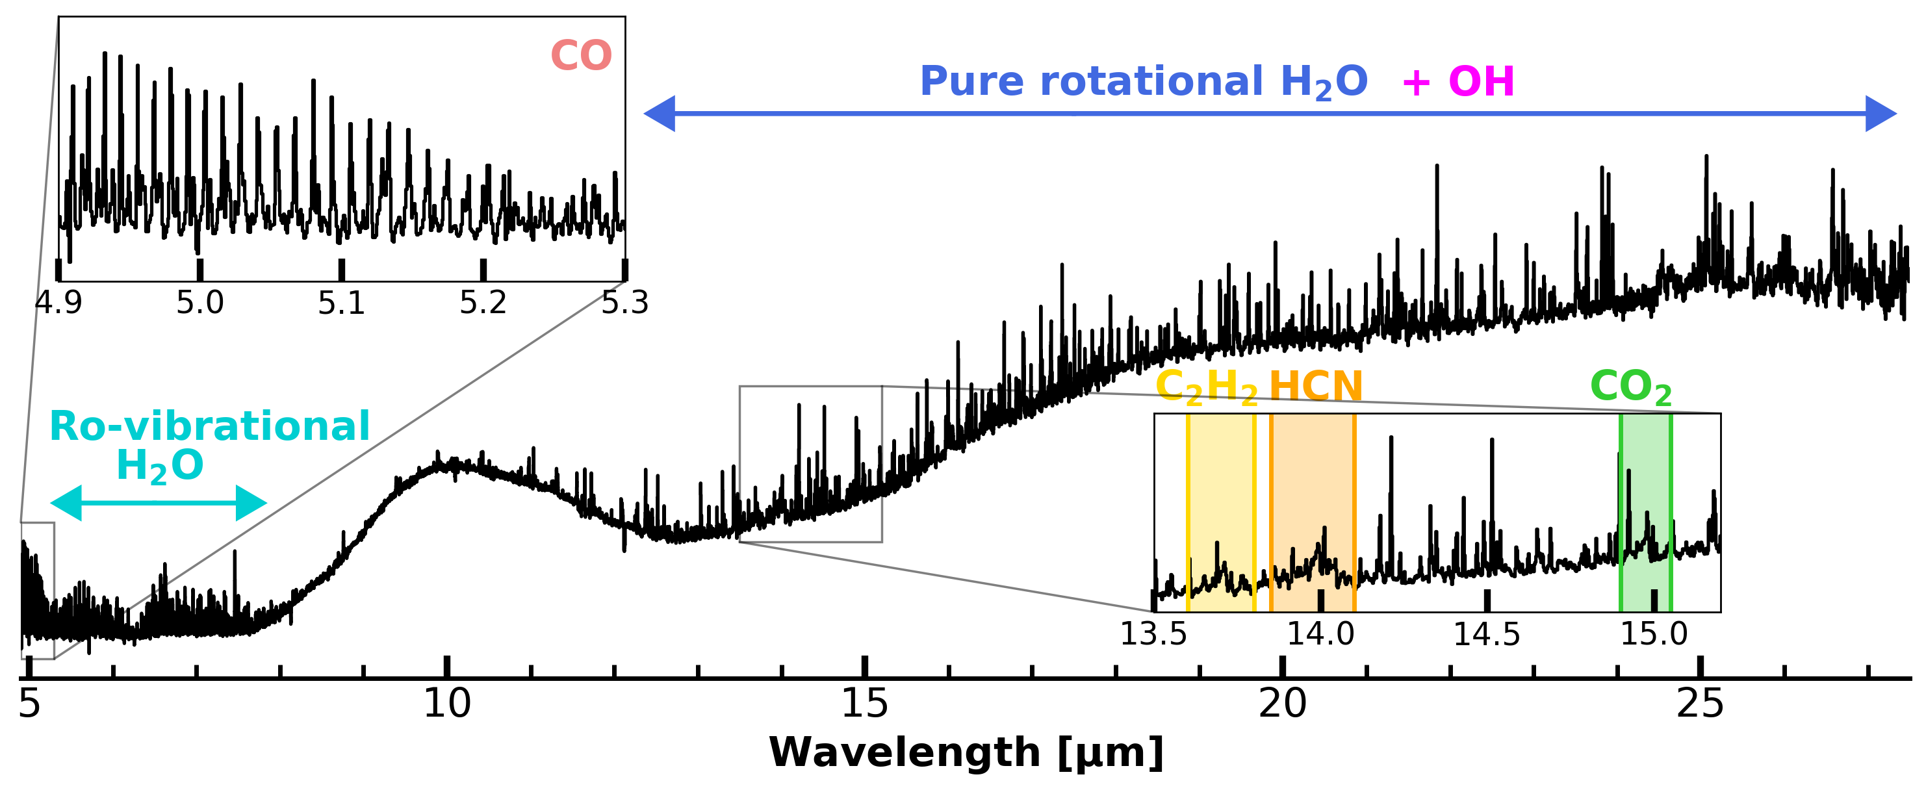
A JWST-MIRI view of a disk
Milou Temmink – NAC, 13/05/2026 – temmink@strw.leidenuniv.nl
Dust continuum emission with superimposed molecular lines!
Temmink et al. (2024a,b)

Slide 8
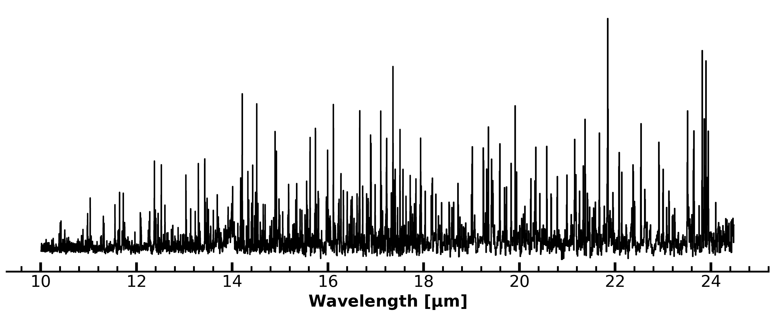
The pure rotational H2O spectrum
Milou Temmink – NAC, 13/05/2026 – temmink@strw.leidenuniv.nl
Molecular excitation: We know what lines will be excited under what conditions!
→ Longer wavelengths trace colder reservoirs!
Meijerink et al. (2009), Gasman et al. (2023), Temmink et al. (2024b), Banzatti et al. (2025)
Key question:
Is the cold reservoir enhanced by drift and sublimation at the snowline?
Temmink et al. (2024a,b)
Hot (>800 K)
Cold (<200 K)

Slide 9
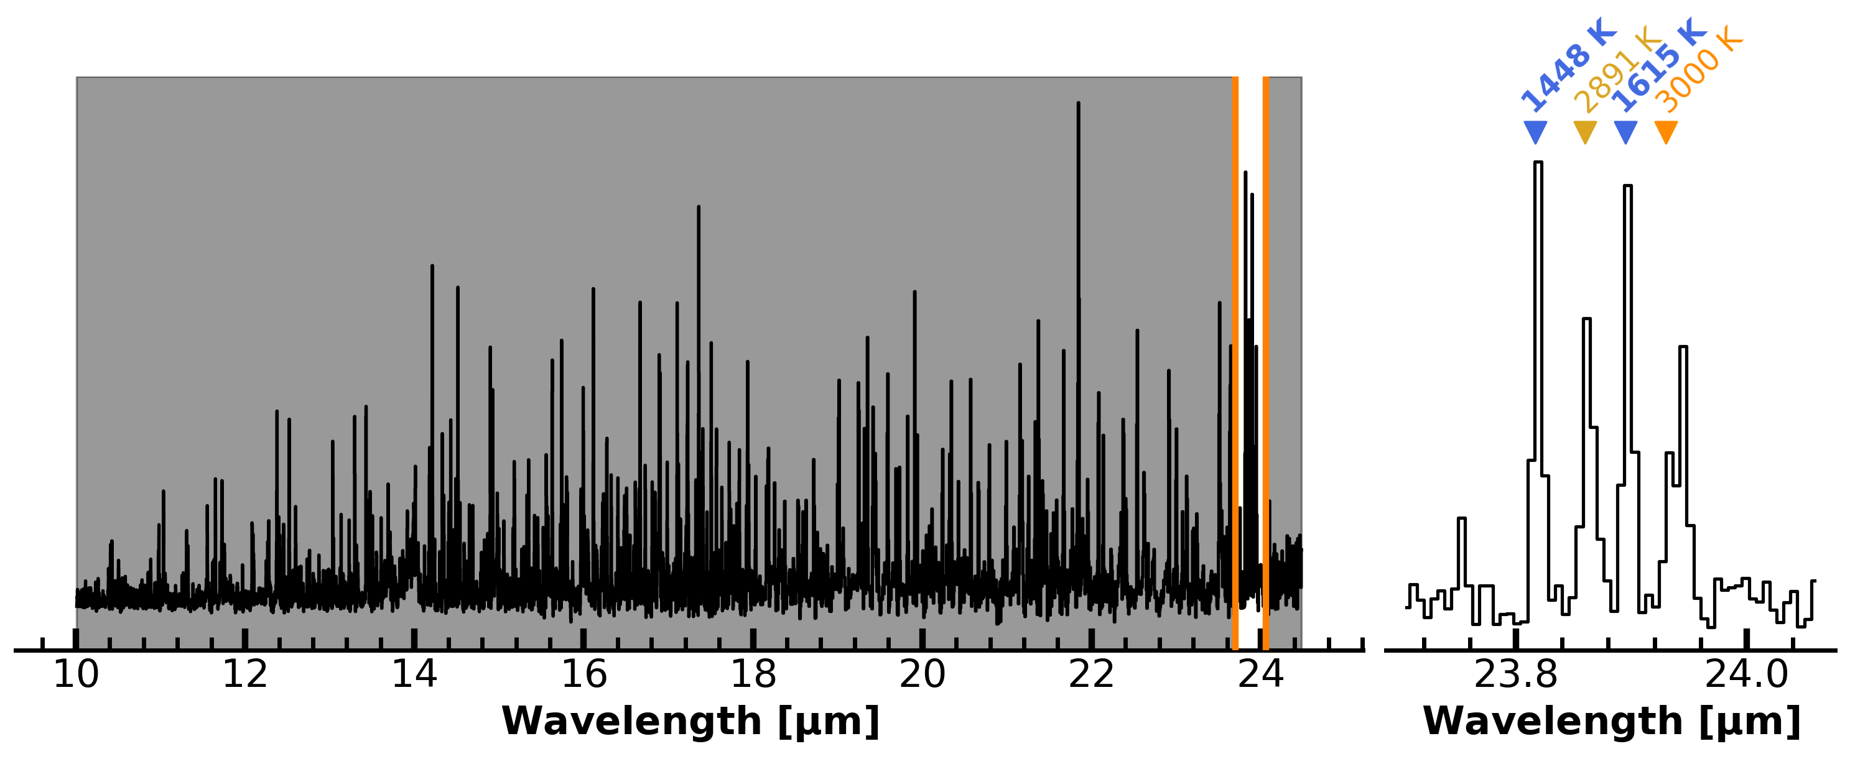
Our key cold H2O lines
Milou Temmink – NAC, 13/05/2026 – temmink@strw.leidenuniv.nl
Temmink et al. (2024a,b)

Slide 10
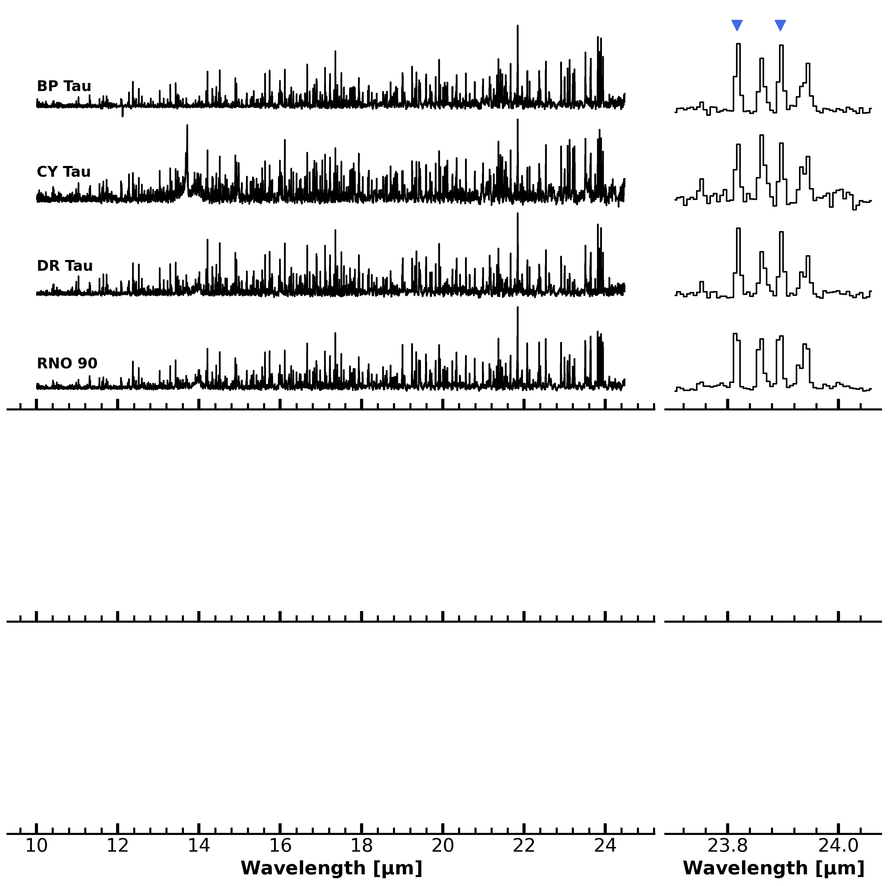
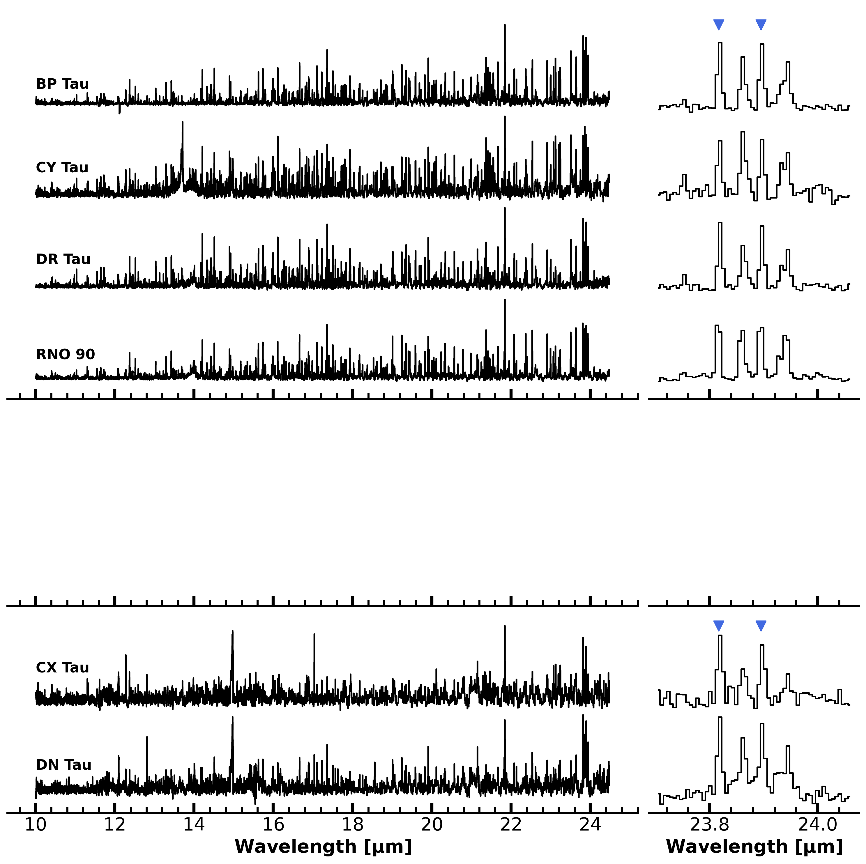
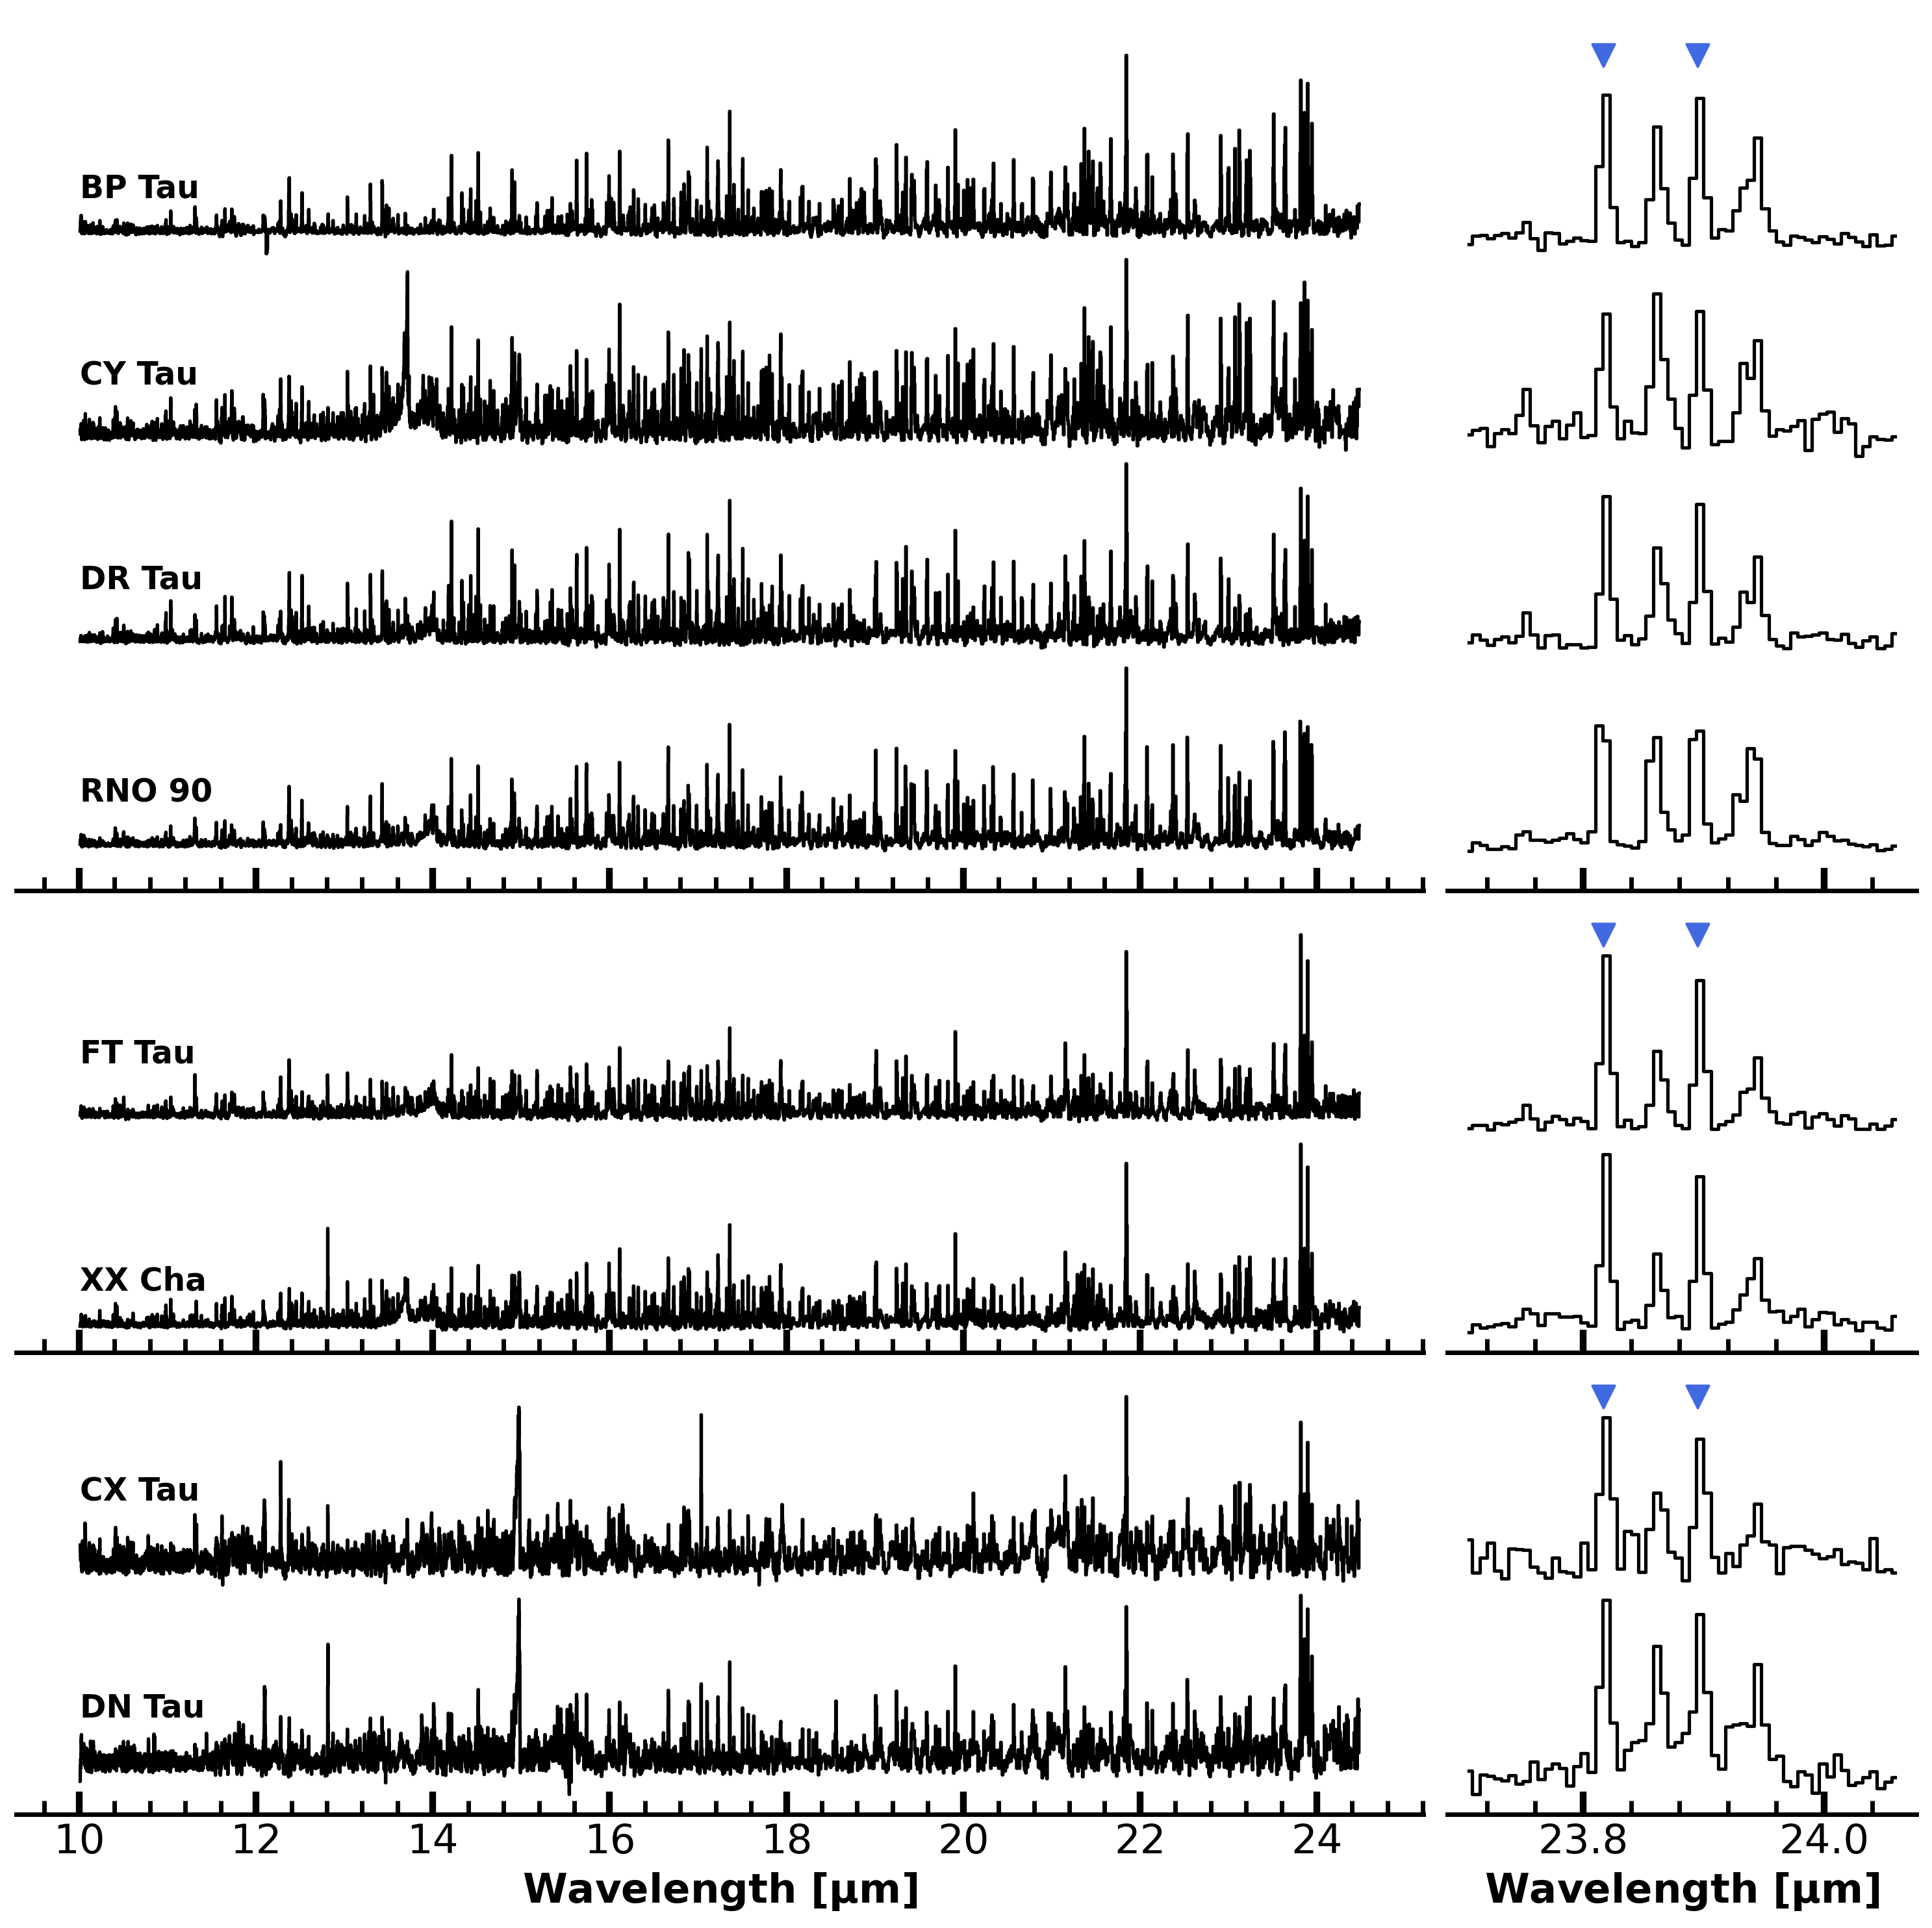
Cold H2O → (1) Compact disks
Milou Temmink – NAC, 13/05/2026 – temmink@strw.leidenuniv.nl
Banzatti et al. (2020), Vlasblom et al. (2025)
Compact? → Rdust < 60 au
Why? → Compactness due to efficient radial drift?
Hypothesis? → Compact disks should show enhanced cold H2O
reservoirs
KEY CONCLUSION:
Not all compact show enhanced cold H2O reservoirs due to radial drift!
Extremely strong cold H2O!
Dominated by drift?
Alternative explanation:
Outbursts pushing the H2O snowline further out
Dominated by CO2!
Temmink et al. (2025)

Slide 11
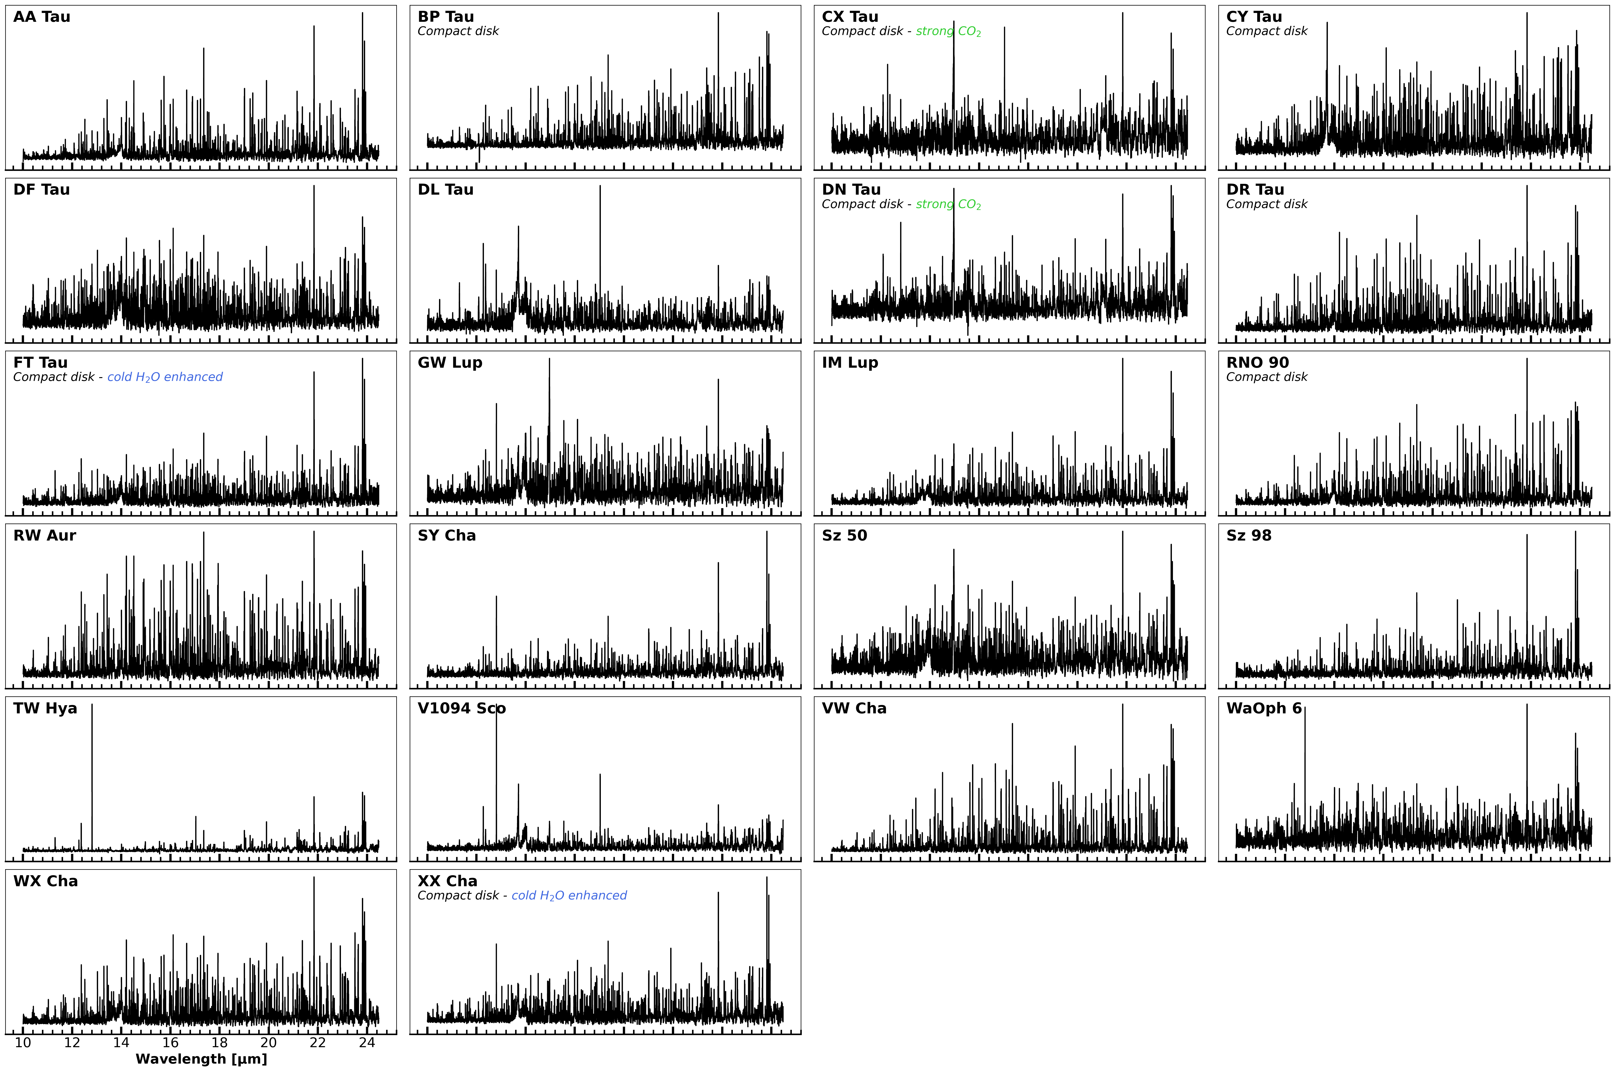
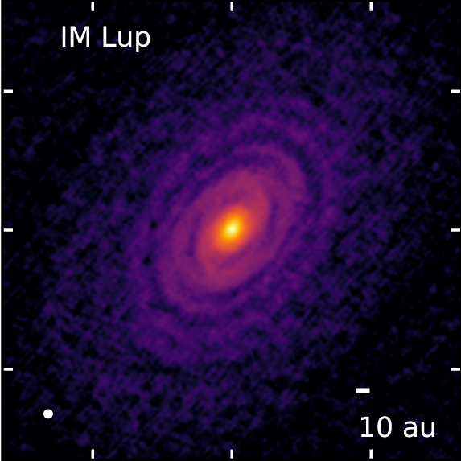
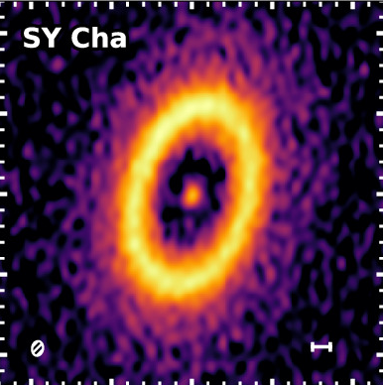
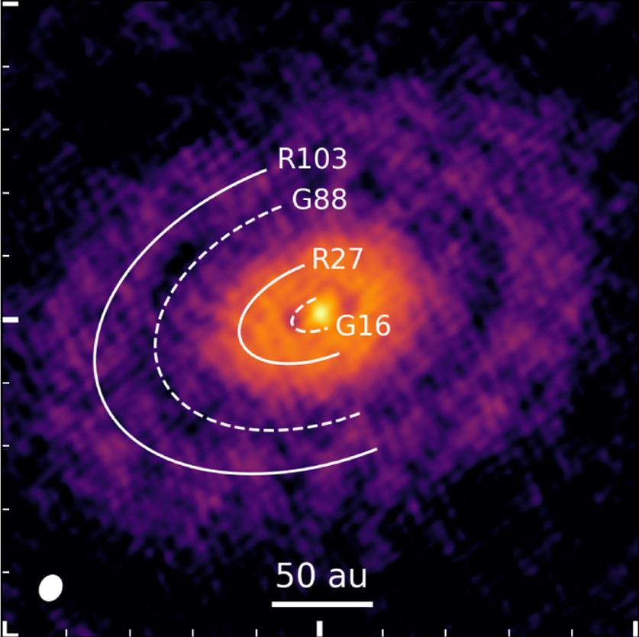
Cold H2O → (2) Full MINDS sample
Milou Temmink – NAC, 13/05/2026 – temmink@strw.leidenuniv.nl
Sz 98
Huang et al. (2016)
Gasman et al. (2023)
Curone et al. (2026)
Massive and structured disks also showing
enhanced cold H2O?!
→ Leaky dust traps!
Temmink et al. (in prep.)
Perotti et al. (2023), Gasman et al. (2025)

Slide 12
Take-away messages
Milou Temmink – NAC, 13/05/2026 – temmink@strw.leidenuniv.nl
JWST provides unique opportunities to study inner regions of planet-forming disks
We can trace the strengths of different H2O reservoirs
  Cold H2O best traced at ~24 μm
Not all compact disks show enhanced cold H2O due to efficient radial drift
  Hidden (not-leaky) substructures? Disks born small?
Large and structured disks also show enhanced cold H2O
  Leaky dust traps?

Slide 13
Supplementary Slides
Milou Temmink – NAC, 13/05/2026 – temmink@strw.leidenuniv.nl

Slide 14
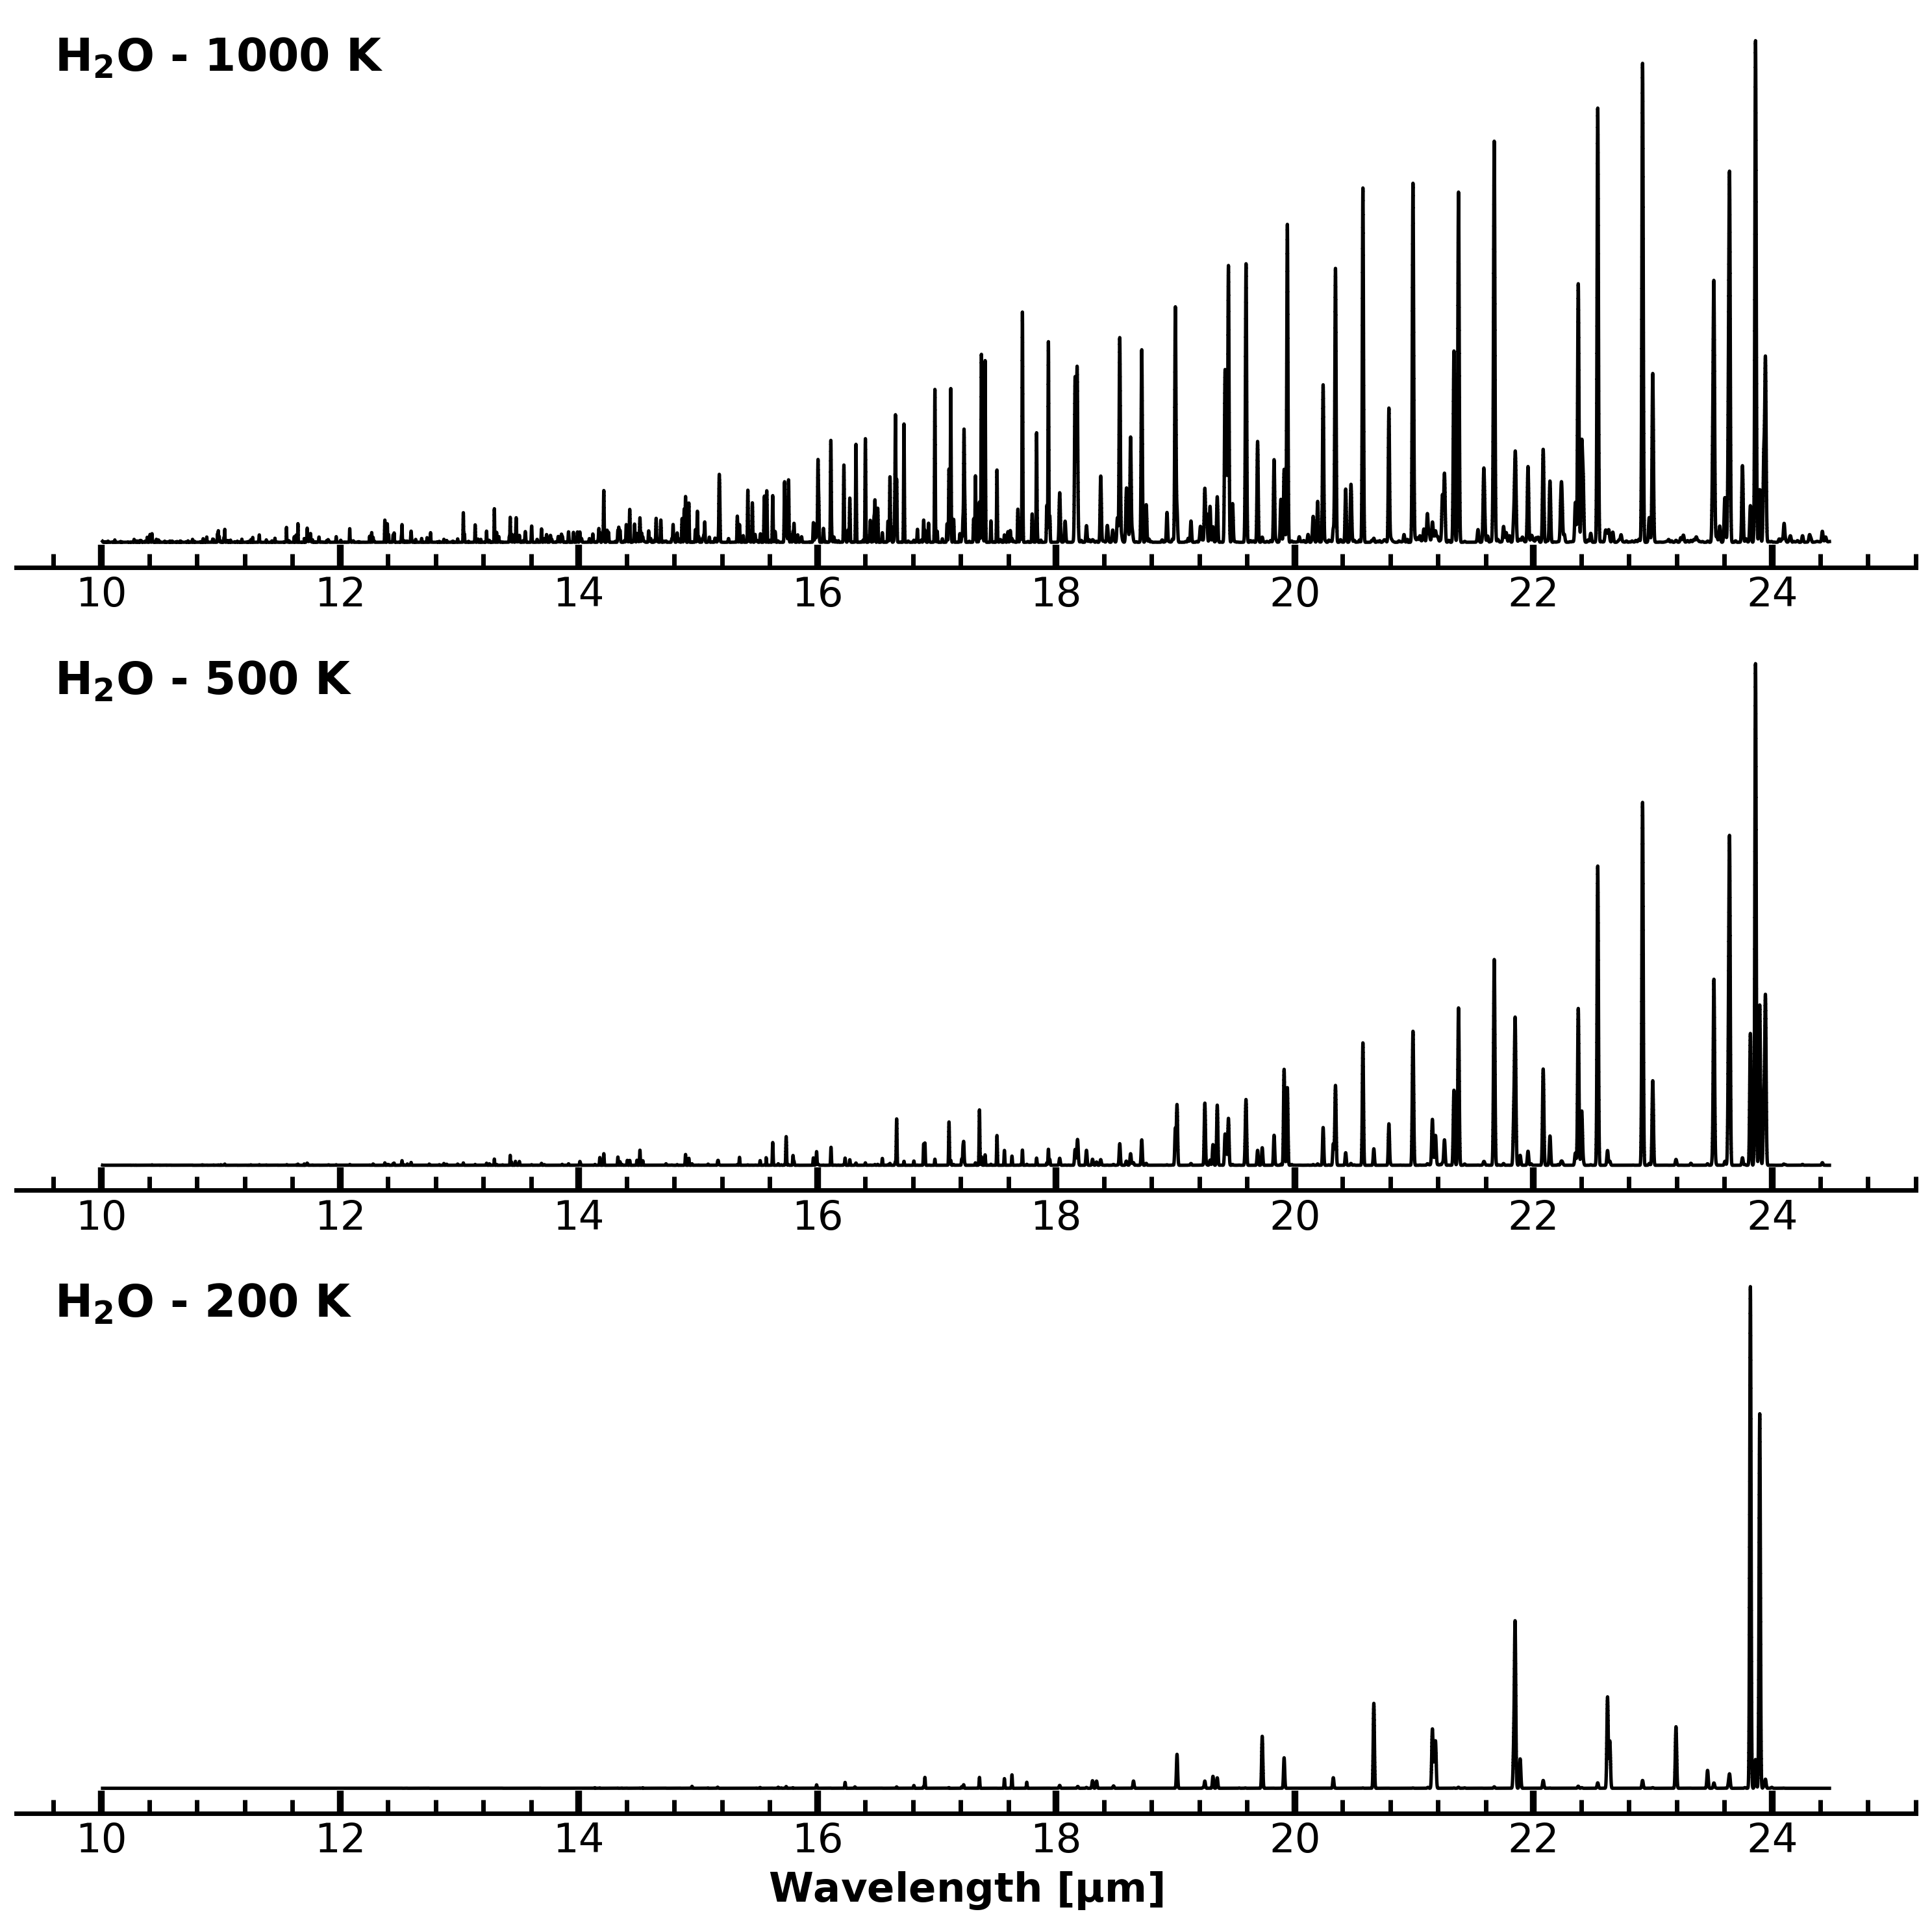
Supplement #1 – LTE slab models
Milou Temmink – NAC, 13/05/2026 – temmink@strw.leidenuniv.nl
Molecular excitation, we can model a spectrum using:
Column density (N in cm⁻²)
Temperature (T in K)
Emitting radius (Rem in au)
Rem
N
T

Slide 15
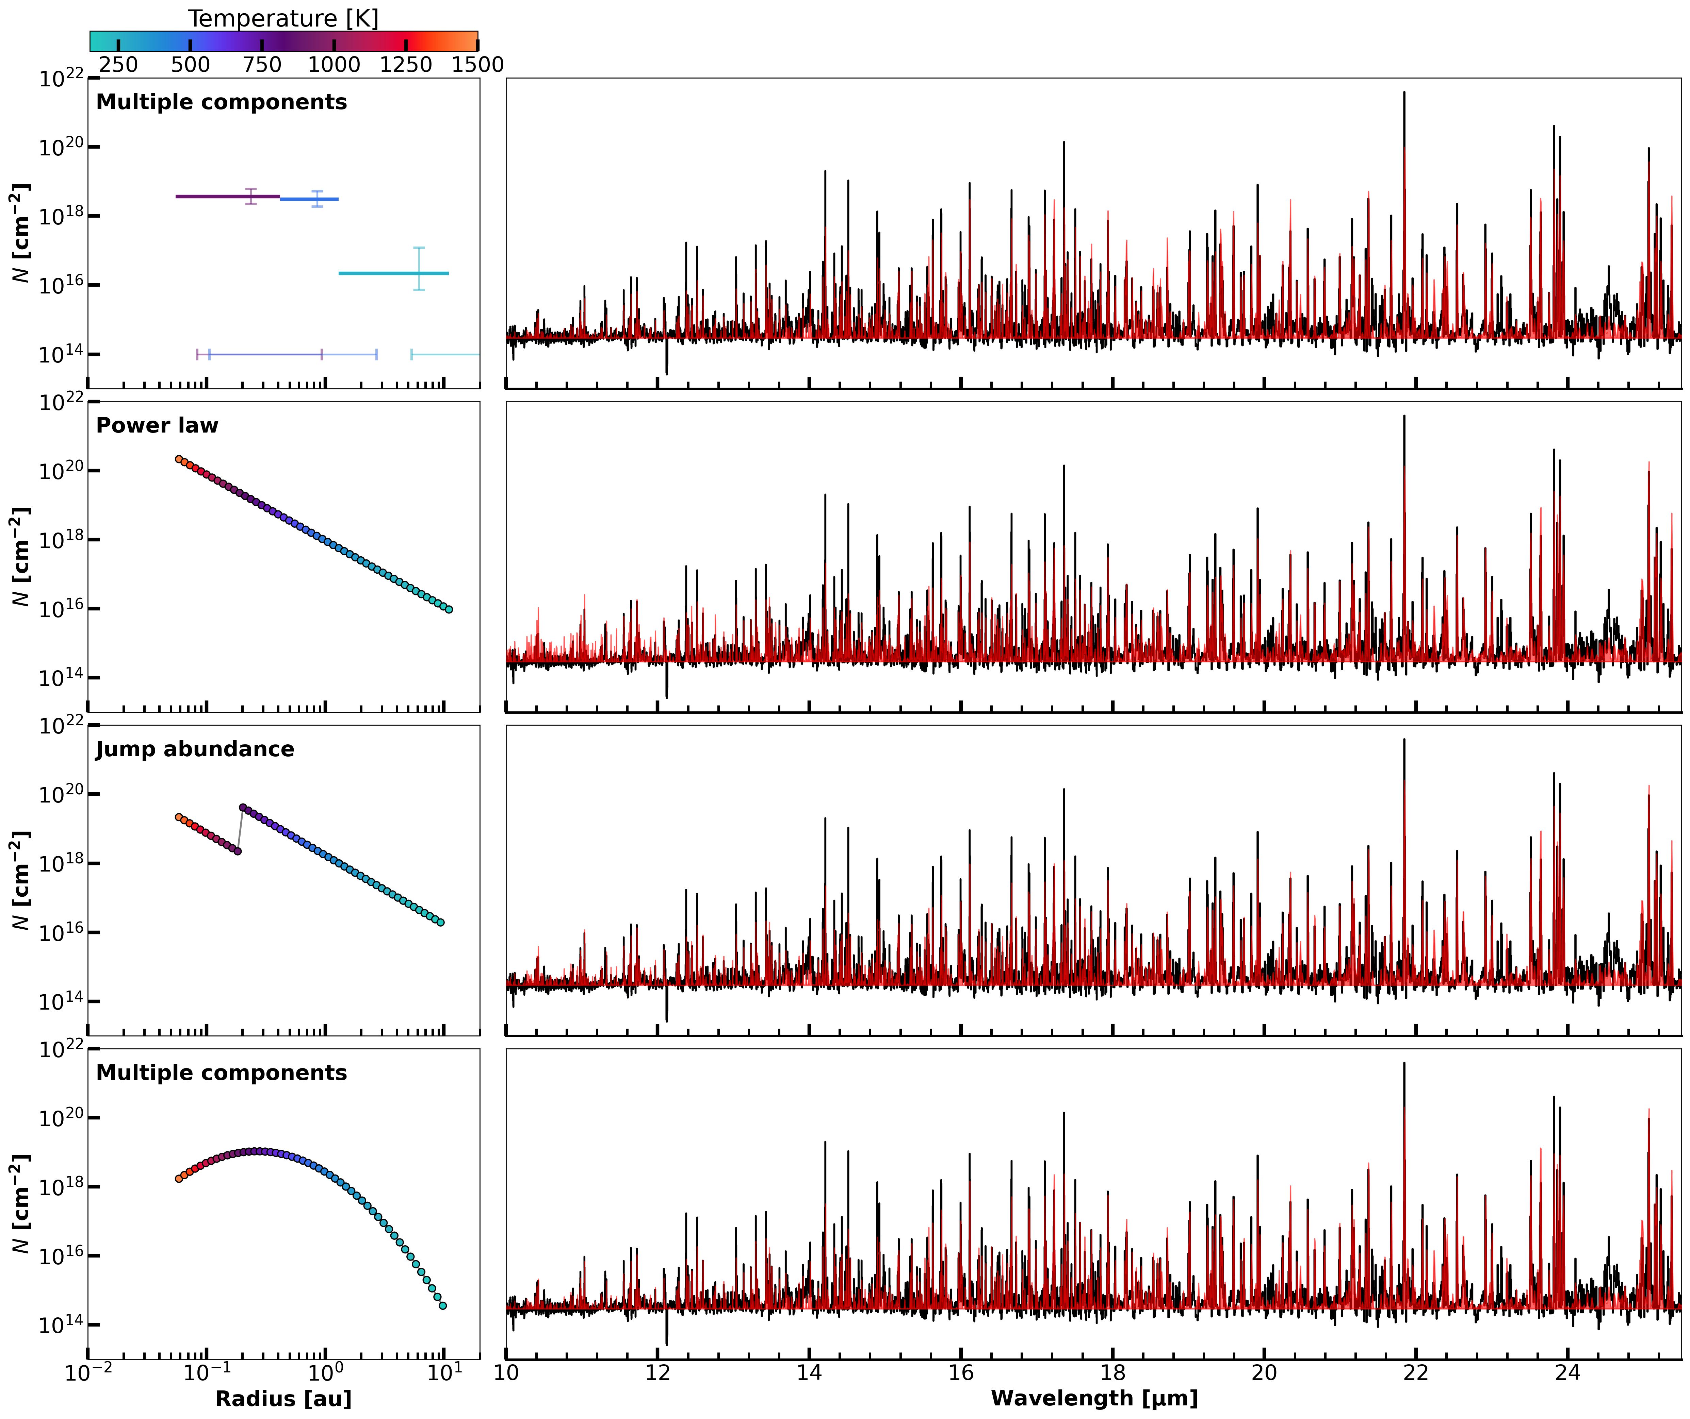
Supplement #2 – Slab model analysis
Milou Temmink – NAC, 13/05/2026 – temmink@strw.leidenuniv.nl
Different approaches to investigate the different reservoirs:
(1) – Multiple components (2 or 3 slabs)
(2) – Profile fitting (~50 slab models)
→ Temperature, T(R): Power law
→ Column density, N(R): Power law,
Jump abundance,
Parabola in log space

