Slide 1
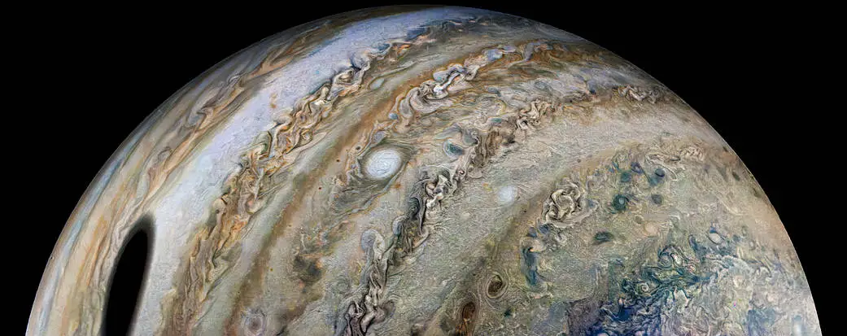


Hidden Layers: How Stable Layers Shape Jupiter’s Atmosphere
The only Jupiter talk or poster in NAC 2026!!!
Keren Duer-Milner, Louis Siebenaler, and Yamila Miguel

Slide 2
What Are Stable Layers?
Stable layers are regions where convection is suppressed.
They arise when the temperature gradient becomes subadiabatic.
These layers alter heat transport, chemistry, and atmospheric dynamics.

Slide 3
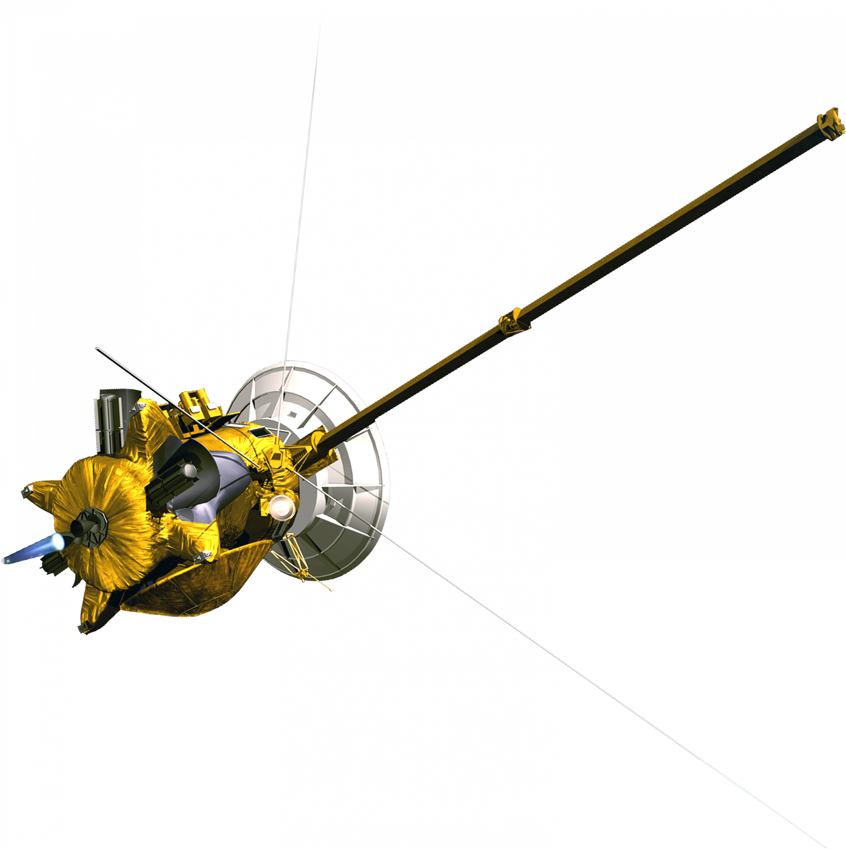
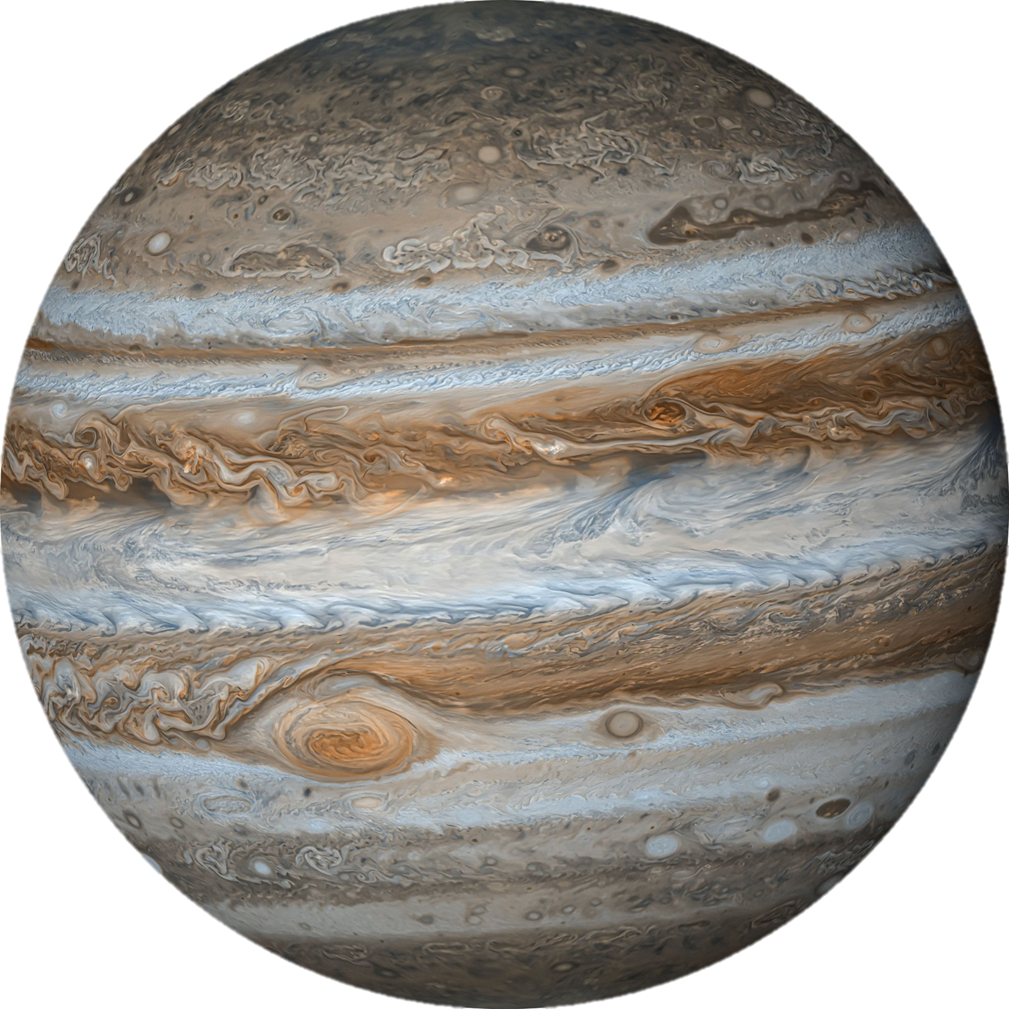
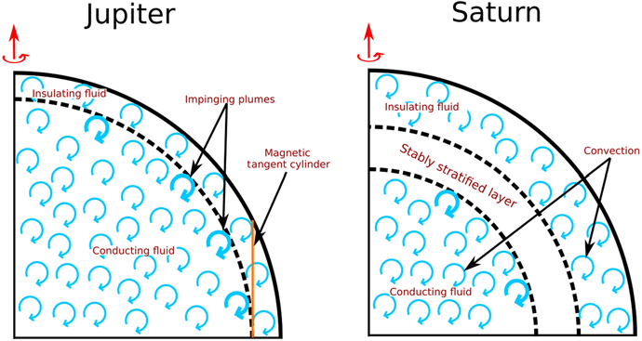
Giant planets interiors – fully convective?
Measurements from Juno (Jupiter) and Cassini (Saturn) revealed that the interiors of Jupiter and Saturn are likely not fully convective.
Multiple stable layers are possible.
What about the atmospheres?
Yadav et al. (2020)

Slide 4
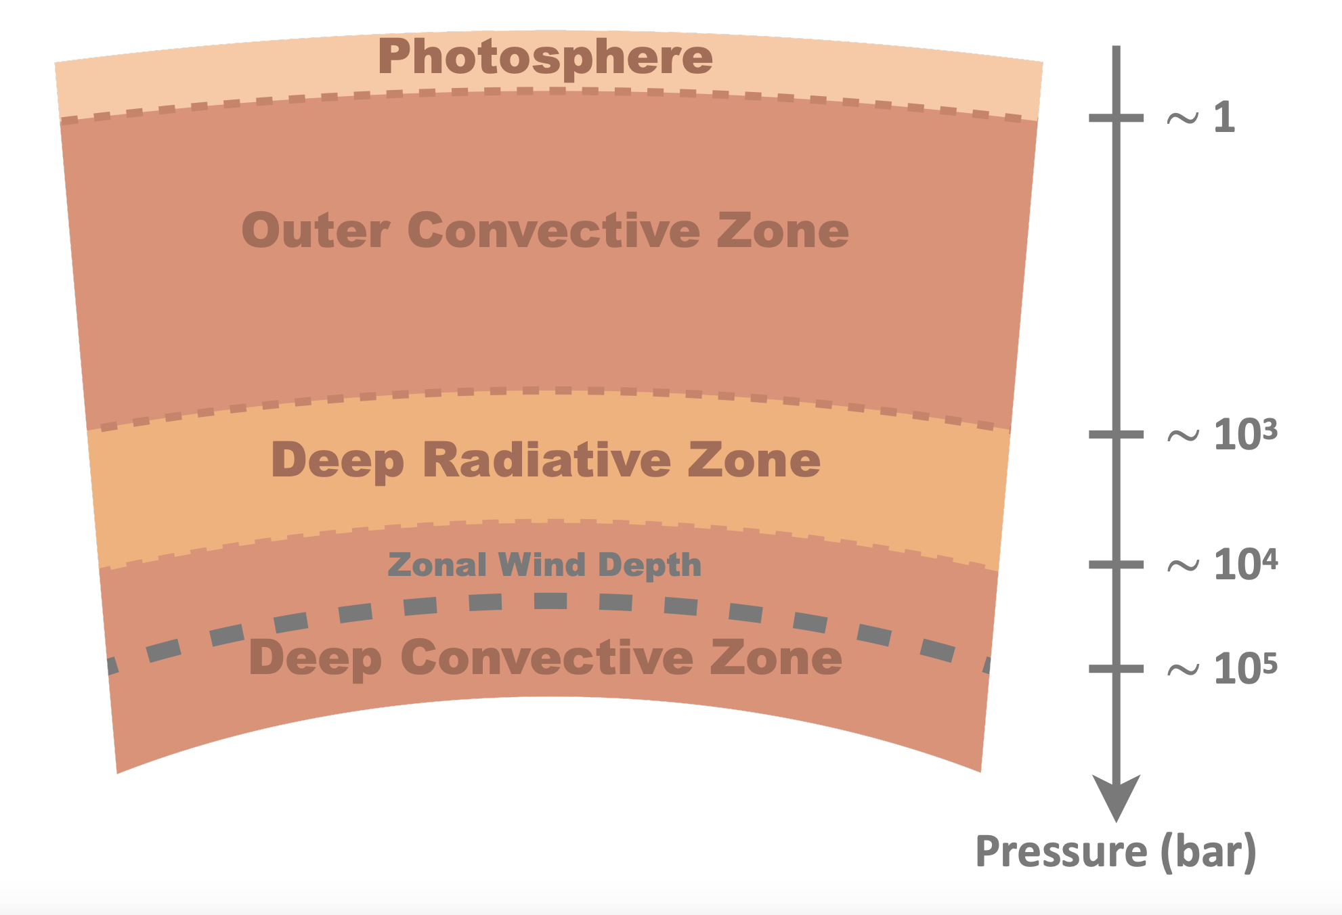
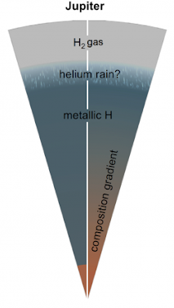
What can cause a stable layer?
A radiative zone due to depletion of alkalis ~10⁴ bar.
Helium rainout ~10⁶ bar.
Composition gradient (dilute core) ~10⁷ bar.
Heat release from Ohmic dissipation ???.
Siebenaler et al. (2025)
Brygoo et al. (2021)
Notes:
Not clear!!!

Slide 5
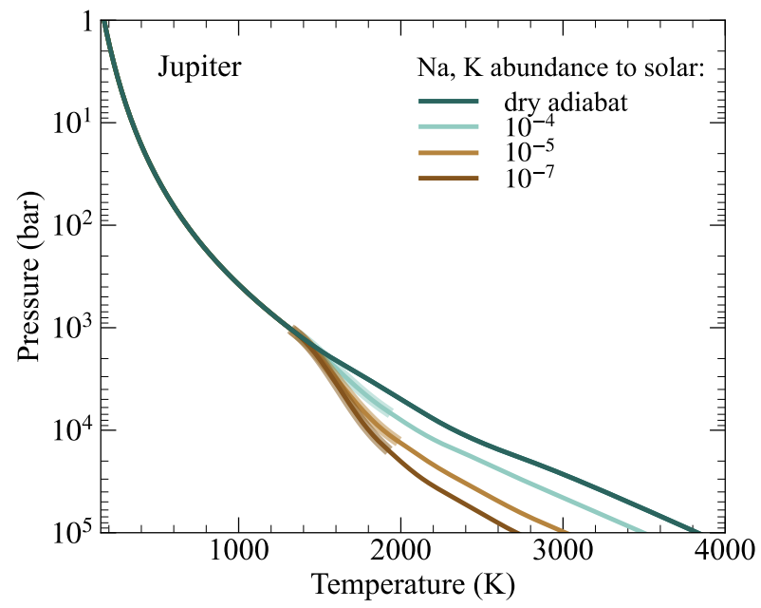
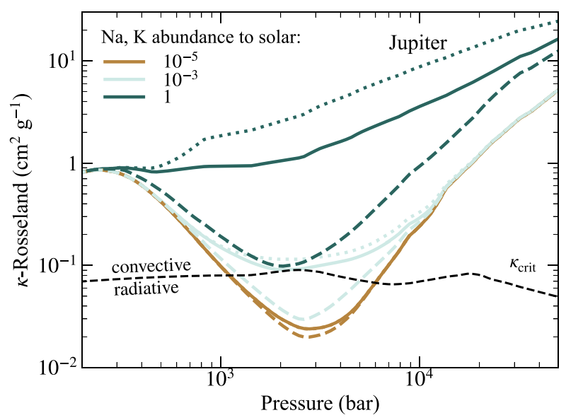
A Stable Layer in Jupiter’s atmosphere?
Juno MWR data suggest a depletion in alkali metals in Jupiter’s atmosphere (Bhattacharya et al. 2023; Aglyamov et al. 2025)
Discrepancy between Interior models’ metallicity values and atmospheric measurements (Howard & Guillot 2023)
CO abundance & deep-water abundance require small mixing coefficient. (Bézard et al. 2002; Bjoraker et al. 2018, Li et al. 2020)
Quenching of jet streams favors a stable layer (Christensen & Wulff 2024)
Siebenaler et al. (2025)
Notes:
Not clear!!!

Slide 6

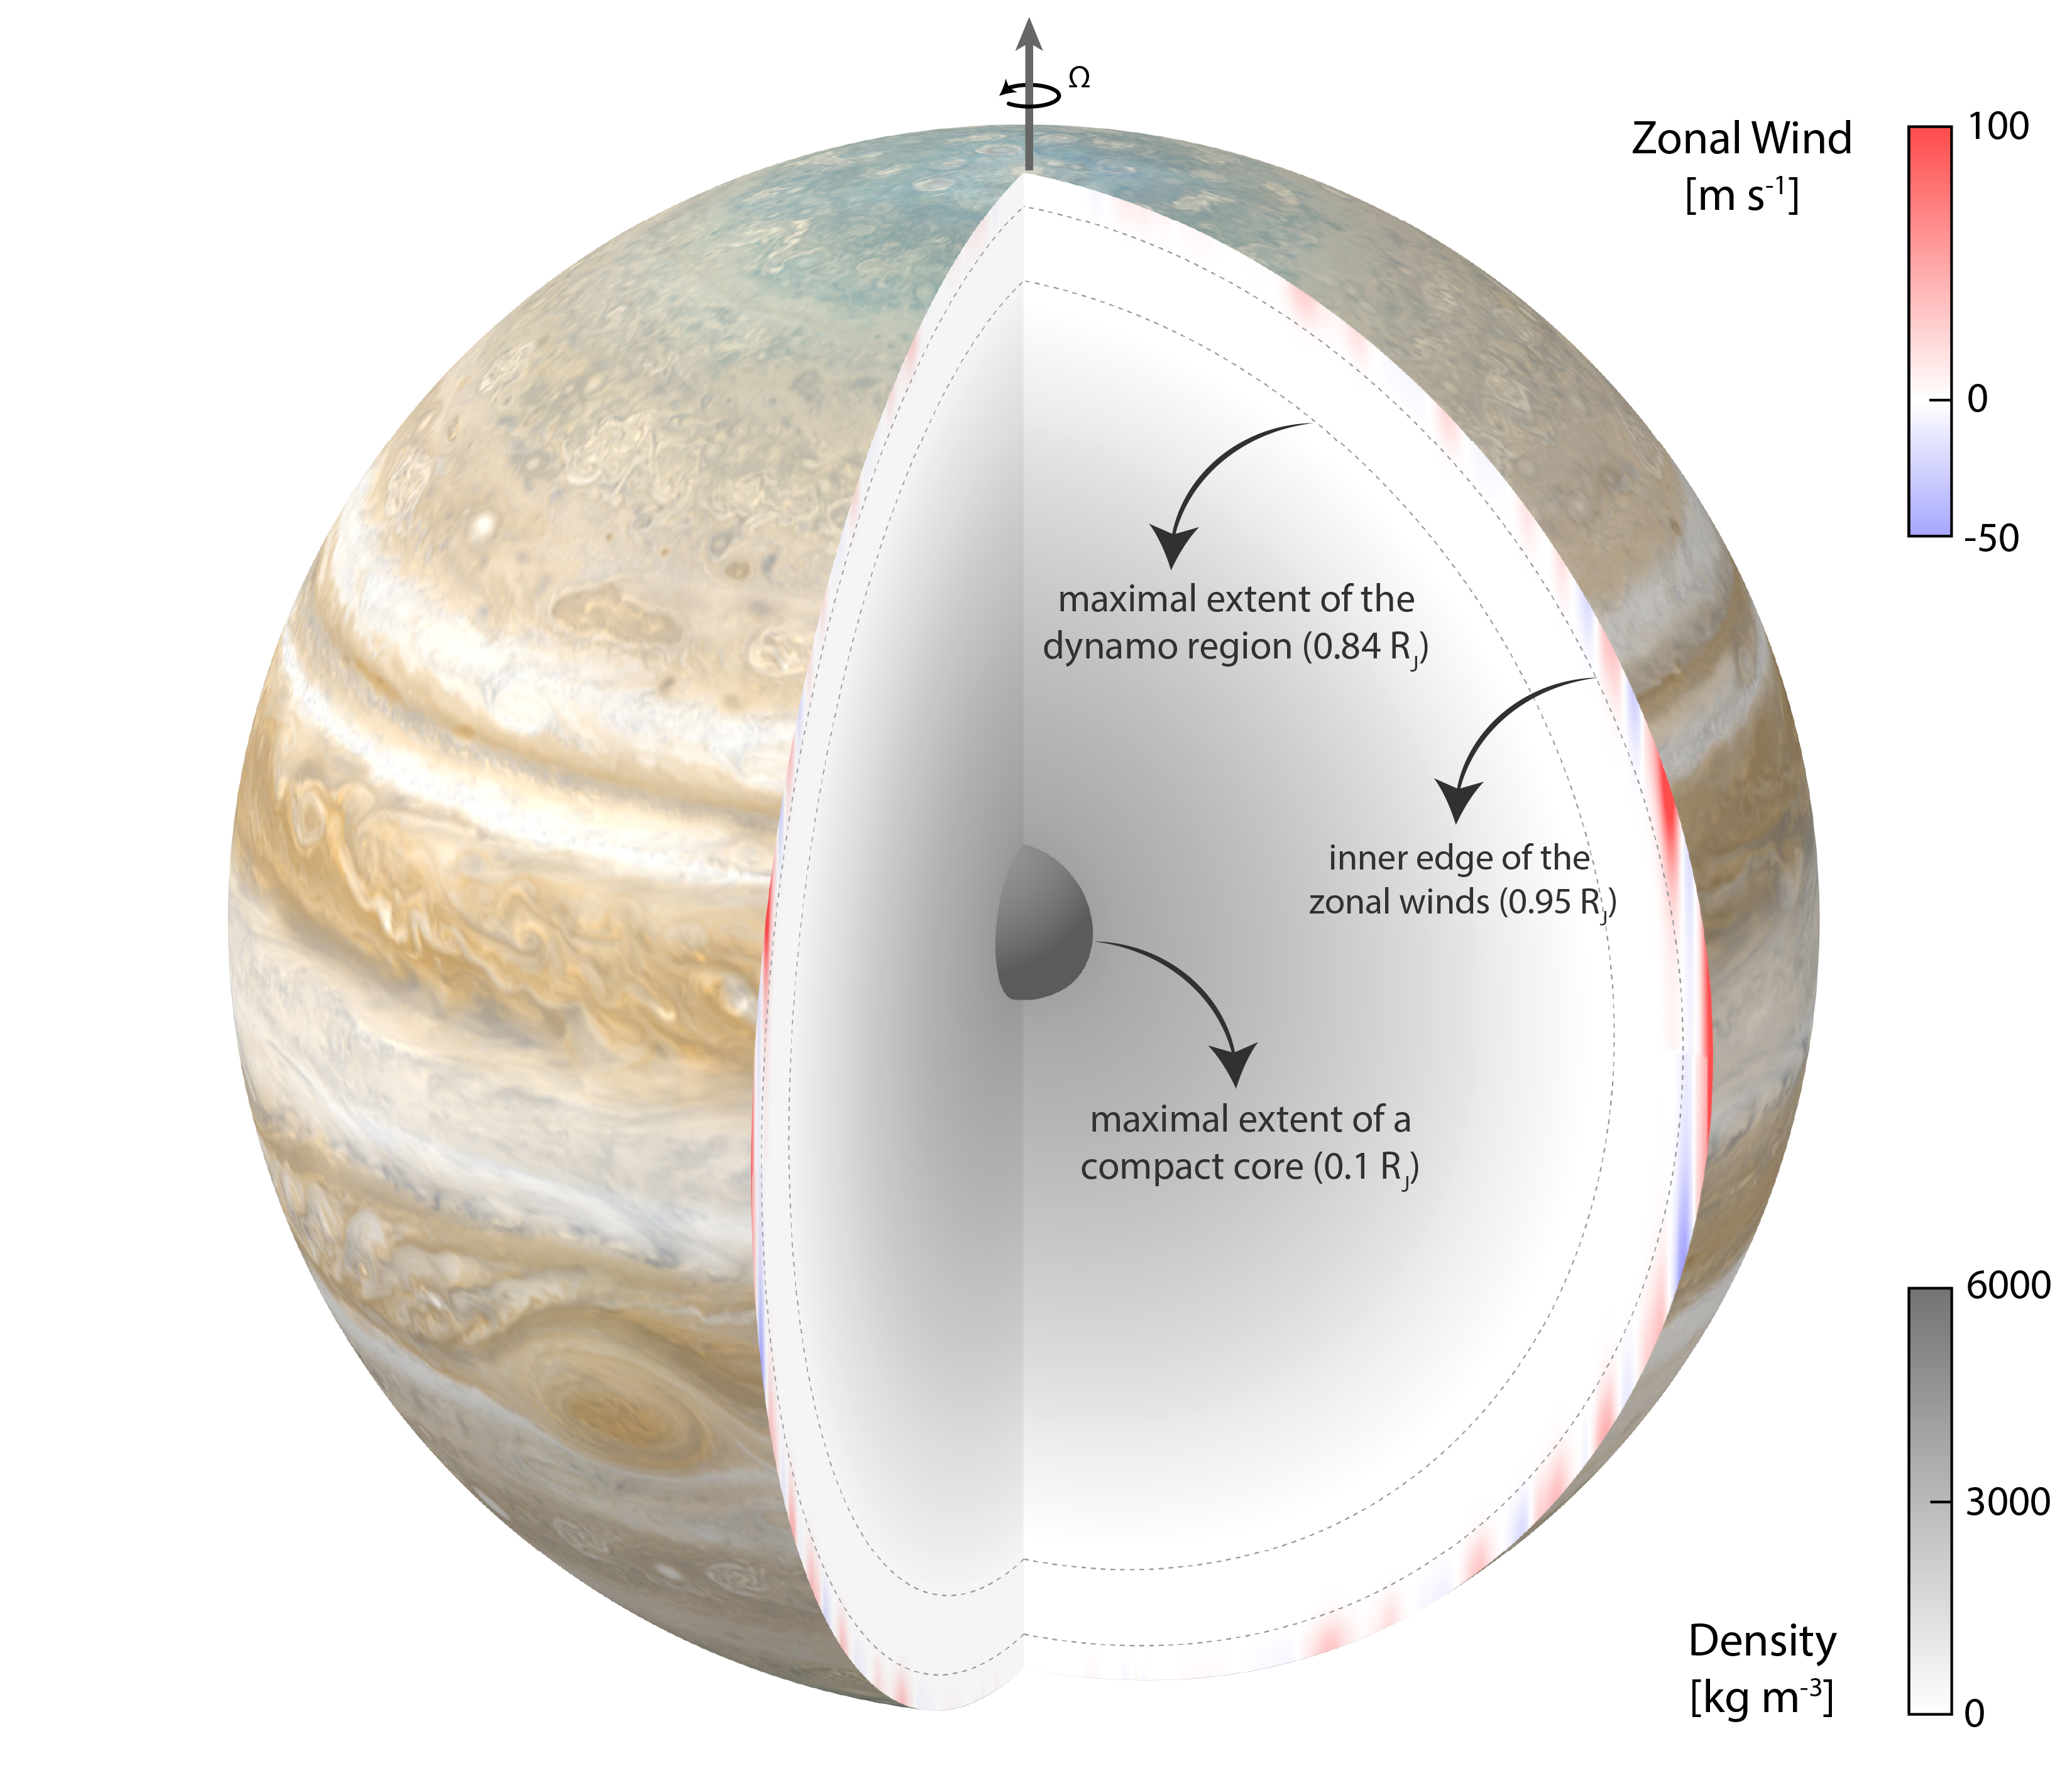
Will stable layers influence the gravity field?
Duer-Milner, Nat. Comm. (2026)

Slide 7
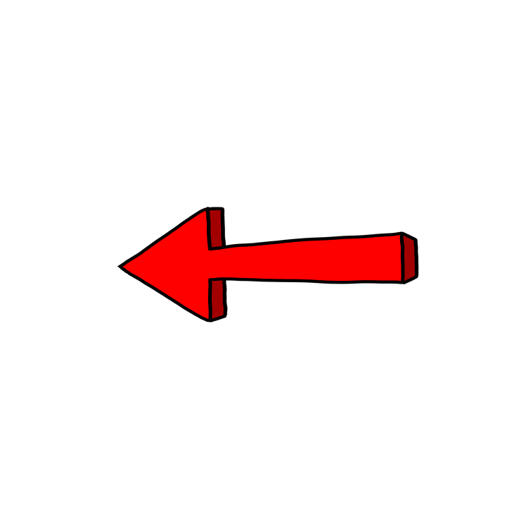
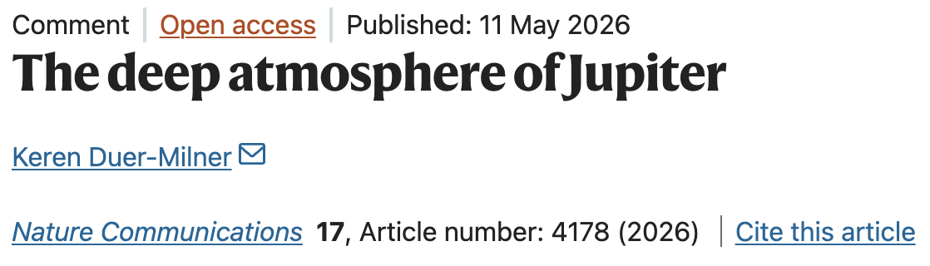

Will stable layers influence the gravity field?
Duer-Milner, Nat. Comm. (2026)

Slide 8
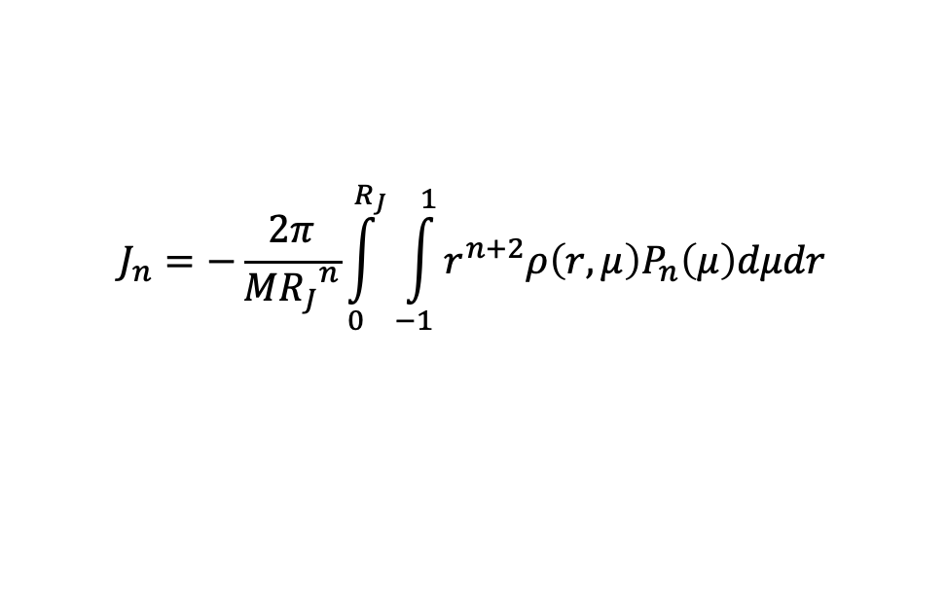
Will stable layers influence the gravity field?
The gravity field is an integrative measure of the density field.
$$J_{n}=−\frac{2π}{M{R_{J}}^{n}}\int_{0}^{R_{J}}{\int_{−1}^{1}{r^{n+2}ρ\left(r,μ\right)P_{n}\left(μ\right)dμdr}}$$
It is determined by the interior structure (~1D) and atmospheric structure (~2D).
Deep zonal jets will influence the gravity field significantly.
Duer-Milner, Nat. Comm. (2026)

Slide 9
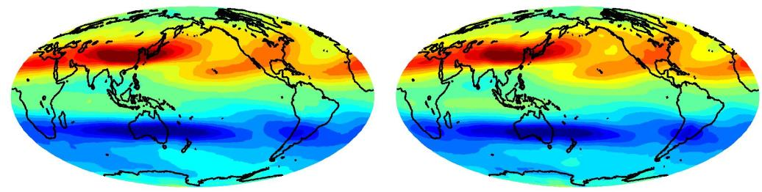


Connecting winds to the density field
Example from Earth:
(assuming ideal gas and hydrostatic atmosphere)
NCEP reanalysis data
1970-2009 mean
Thermal-wind balance
$$2Ωr\frac{∂\left(uρstat\right)}{∂z}=g_{0}\frac{∂ρ′}{∂θ}.$$
$$ρ\left(r,μ\right)=\overline{ρ}+ρ׳$$
Notes:
Not clear!!!

Slide 10
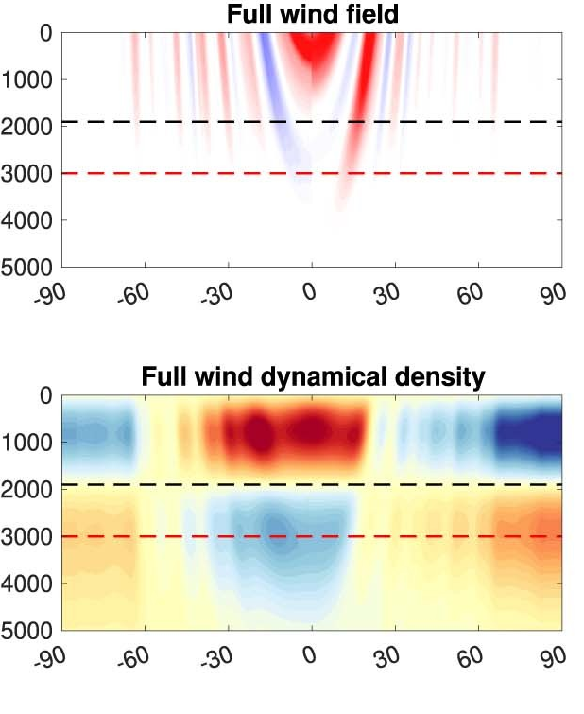

Connecting winds to the density field
$$u$$
Thermal-wind balance
$$2Ωr\frac{∂\left(uρstat\right)}{∂z}=g_{0}\frac{∂ρ′}{∂θ}.$$
$$ρ′$$
Notes:
Not clear!!!

Slide 11

Gravity inferred wind depth
Thermal-wind balance
$$2Ωr\frac{∂\left(uρstat\right)}{∂z}=g_{0}\frac{∂ρ′}{∂θ}.$$
40 available gravity harmonics (2023 update).
Kaspi et al. (2018, 2023)

Slide 12
Gravity inferred wind depth
Thermal-wind balance
$$2Ωr\frac{∂\left(uρstat\right)}{∂z}=g_{0}\frac{∂ρ′}{∂θ}.$$
40 available gravity harmonics (2023 update).
Very good match to cylindrical winds penetrating ~3000 km.
Kaspi et al. (2018, 2023)
Notes:
Not clear!!!

Slide 13
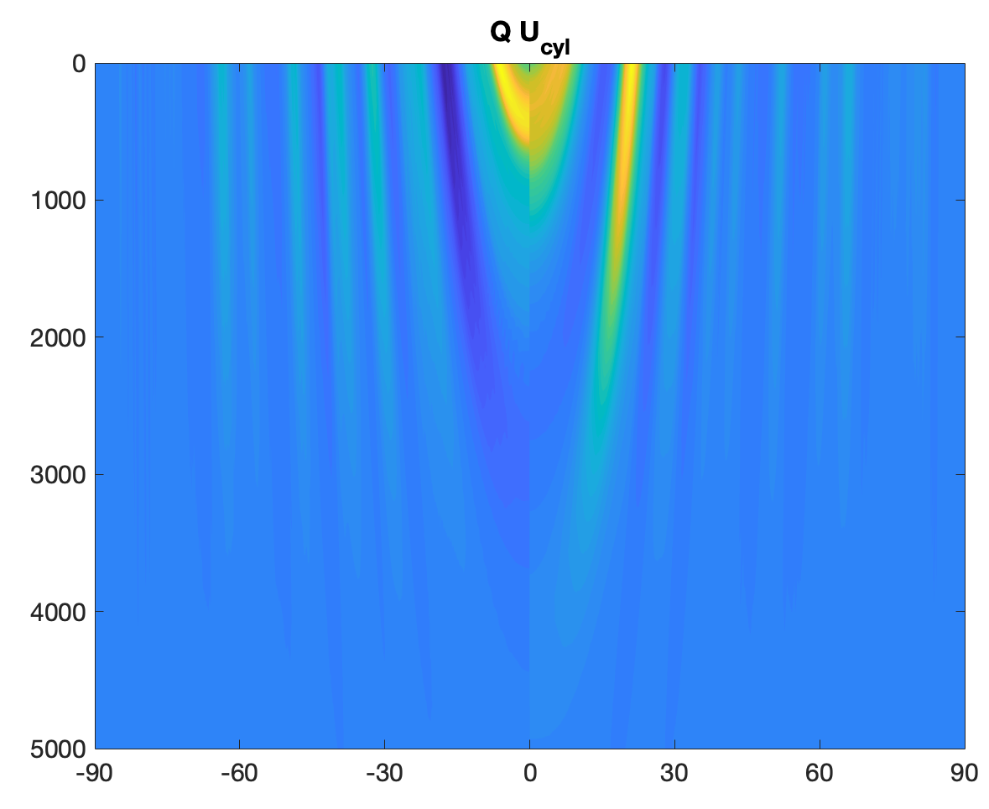
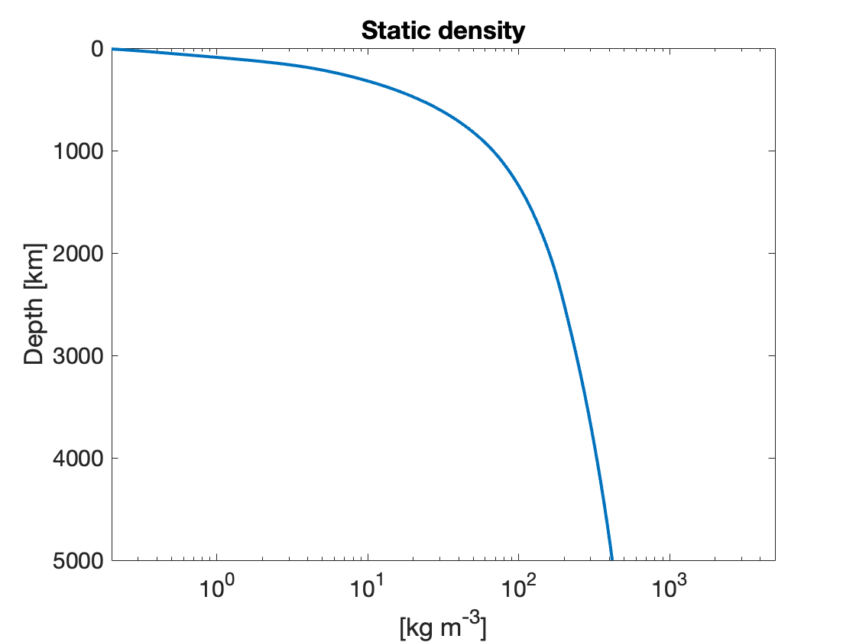



What controls the density anomaly?
U = Q u_{cyl}
Thermal-wind balance
$$2Ωr\frac{∂\left(uρstat\right)}{∂z}=g_{0}\frac{∂ρ′}{∂θ}.$$
The static density holds information about stable layers!
Notes:
Not clear!!!

Slide 14
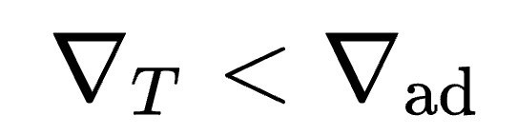
Construct TP profiles with a SL
Stable according to the Schwarzschild stability criterion
Stable layer at 1-10⁵ bar
Stable layer at 10³-10⁷ bar
Up-to-date EOS for a H-He mixtures including non-ideal mixing terms to construct density profiles
Duer-Milner et al. In rev.
Notes:
Not clear!!!

Slide 15
Construct density profiles with a SL
Deep SLs have little effect on the density field.
Duer-Milner et al. In rev.
Notes:
Not clear!!!

Slide 16
The direct effect of stable layers
Assuming a fixed decay of winds (Q)
Duer-Milner et al. In rev.
Notes:
Not clear!!!

Slide 17
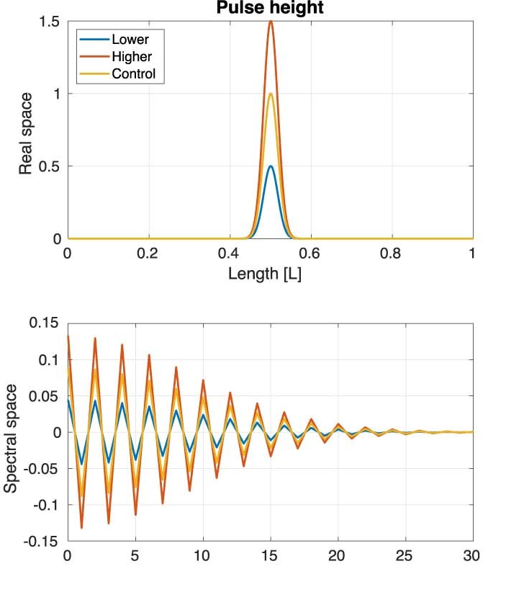

Explaining the trend
$$2Ωru_{cyl}\left(Q\frac{∂ρ_{stat}}{∂z}+ρ_{stat}\frac{∂Q}{∂z}\right)=g_{0}\frac{∂ρ′}{∂θ}$$
$$\frac{∂ρ_{ad}}{∂z}<\frac{∂ρ_{SL}}{∂z}$$
Duer-Milner et al. In rev.
Notes:
Not clear!!!

Slide 18
Optimal vertical wind structure
Shallow, extensive, SLs will be compensated by faster wind decay.
Duer-Milner et al. In rev.

Slide 19
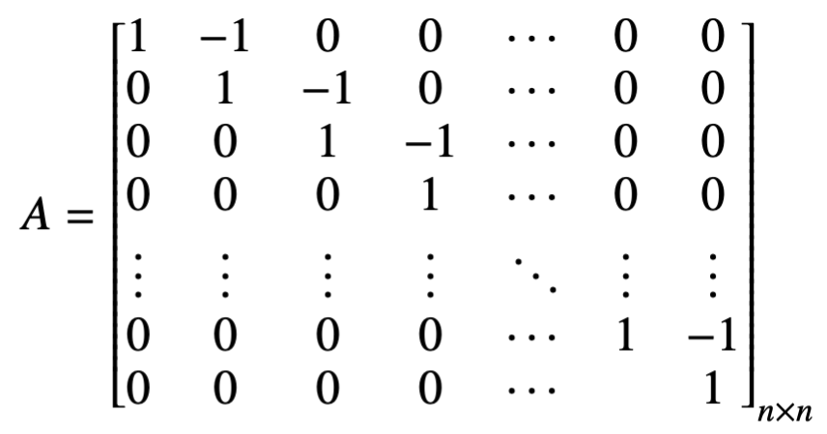

Optimal vertical wind structure
Constraints from the magnetic field Duer et al. (2019,2020)
Duer-Milner et al. In rev.

Slide 20
Optimal vertical wind structure
Fitting every grid point extends the possibilities of vertical jet structure.
Completely different vertical wind solutions, all fit very well to the observations from Juno.
Duer-Milner et al. In rev.

Slide 21
Conclusions
Jupiter envelope is likely not fully convective.
The mechanism generating stable layers is still an open question.
A shallow and extensive stable layer affects the density distribution (and hence, J_{n}).
We introduce a new dimension of degeneracy that must be accounted for in analyzing Jupiter’s interior and atmosphere.
SLs are compensated by faster decay of winds, consistent with theoretical and numerical studies. (Christensen & Wulff 2024, Wulff et al. 2022)
Duer-Milner et al. In rev.

Slide 22
Comparison between eddy driven jets
Eddy-driven jets dominate Jupiter’s midlatitudes
Let’s compare with the vertical structure of other eddy-driven jets.
Duer et al. (2023), Duer-Milner et al. In rev.

Slide 23
Other vertical profiles?
Use of GCMs and Earth data
Duer et al. (2023)
Young et al. (2019)

Slide 24
Other vertical profiles?
Use of GCMs and Earth data
Climatology data from ERA5

Slide 25
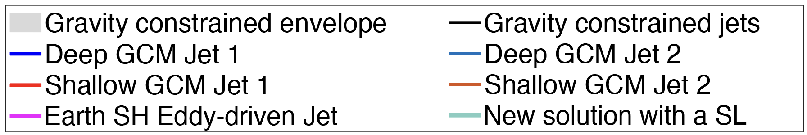
Comparison between eddy driven jets
Vertical structure of eddy driven jets shows a fast decay near the clouds top – the source of the momentum.
Solutions including a SL seems more compatible with the general trend.
Duer-Milner et al. In rev.

