Slide 1
Unveiling the Secrets of Molecular Outflows in NGC1068's Circumnuclear Disk with ALMA
Yuze Zhang (张宇泽), Serena Viti, Santiago García-Burillo , and Ko-Yun Huang
Notes:
Hey everyone, today I’m going to talk about tracing AGN feedback through the kinematics of the circumnuclear disk in NGC1068

Slide 2
Why AGN Outflow? Why Molecules?
Prevents cooling + Expelling gas from galaxies
Trigger star formation by compressing gas
Harrison 2017
Maiolino et al. 2017; Gallagher et al. 2019
e.g. Marconi & Hunt 2003
M_{BH}
Co-evolution between galaxies and their SMBHs
Bulge
velocity dispersion
Most impact
M_{bulge}; σ
Molecular outflow: most massive phase
2
Notes:
That is all for my project for now. I will leave the main conclusions here so everyone can ask questions.
Restate the question here, what I have done:
Can leave this for the audience to read in the end and take questions directly
To conclude, out observations matches the 3D outflow geometry I mentioned previously. Basically the gas behaviour in the northeastern part of the CND is different from the gas behaviour in the southern part of the CND. We also found a mismatch between the moelcular outflow and the ionized outflow, which has been seen from other galaxies as well.

Slide 3
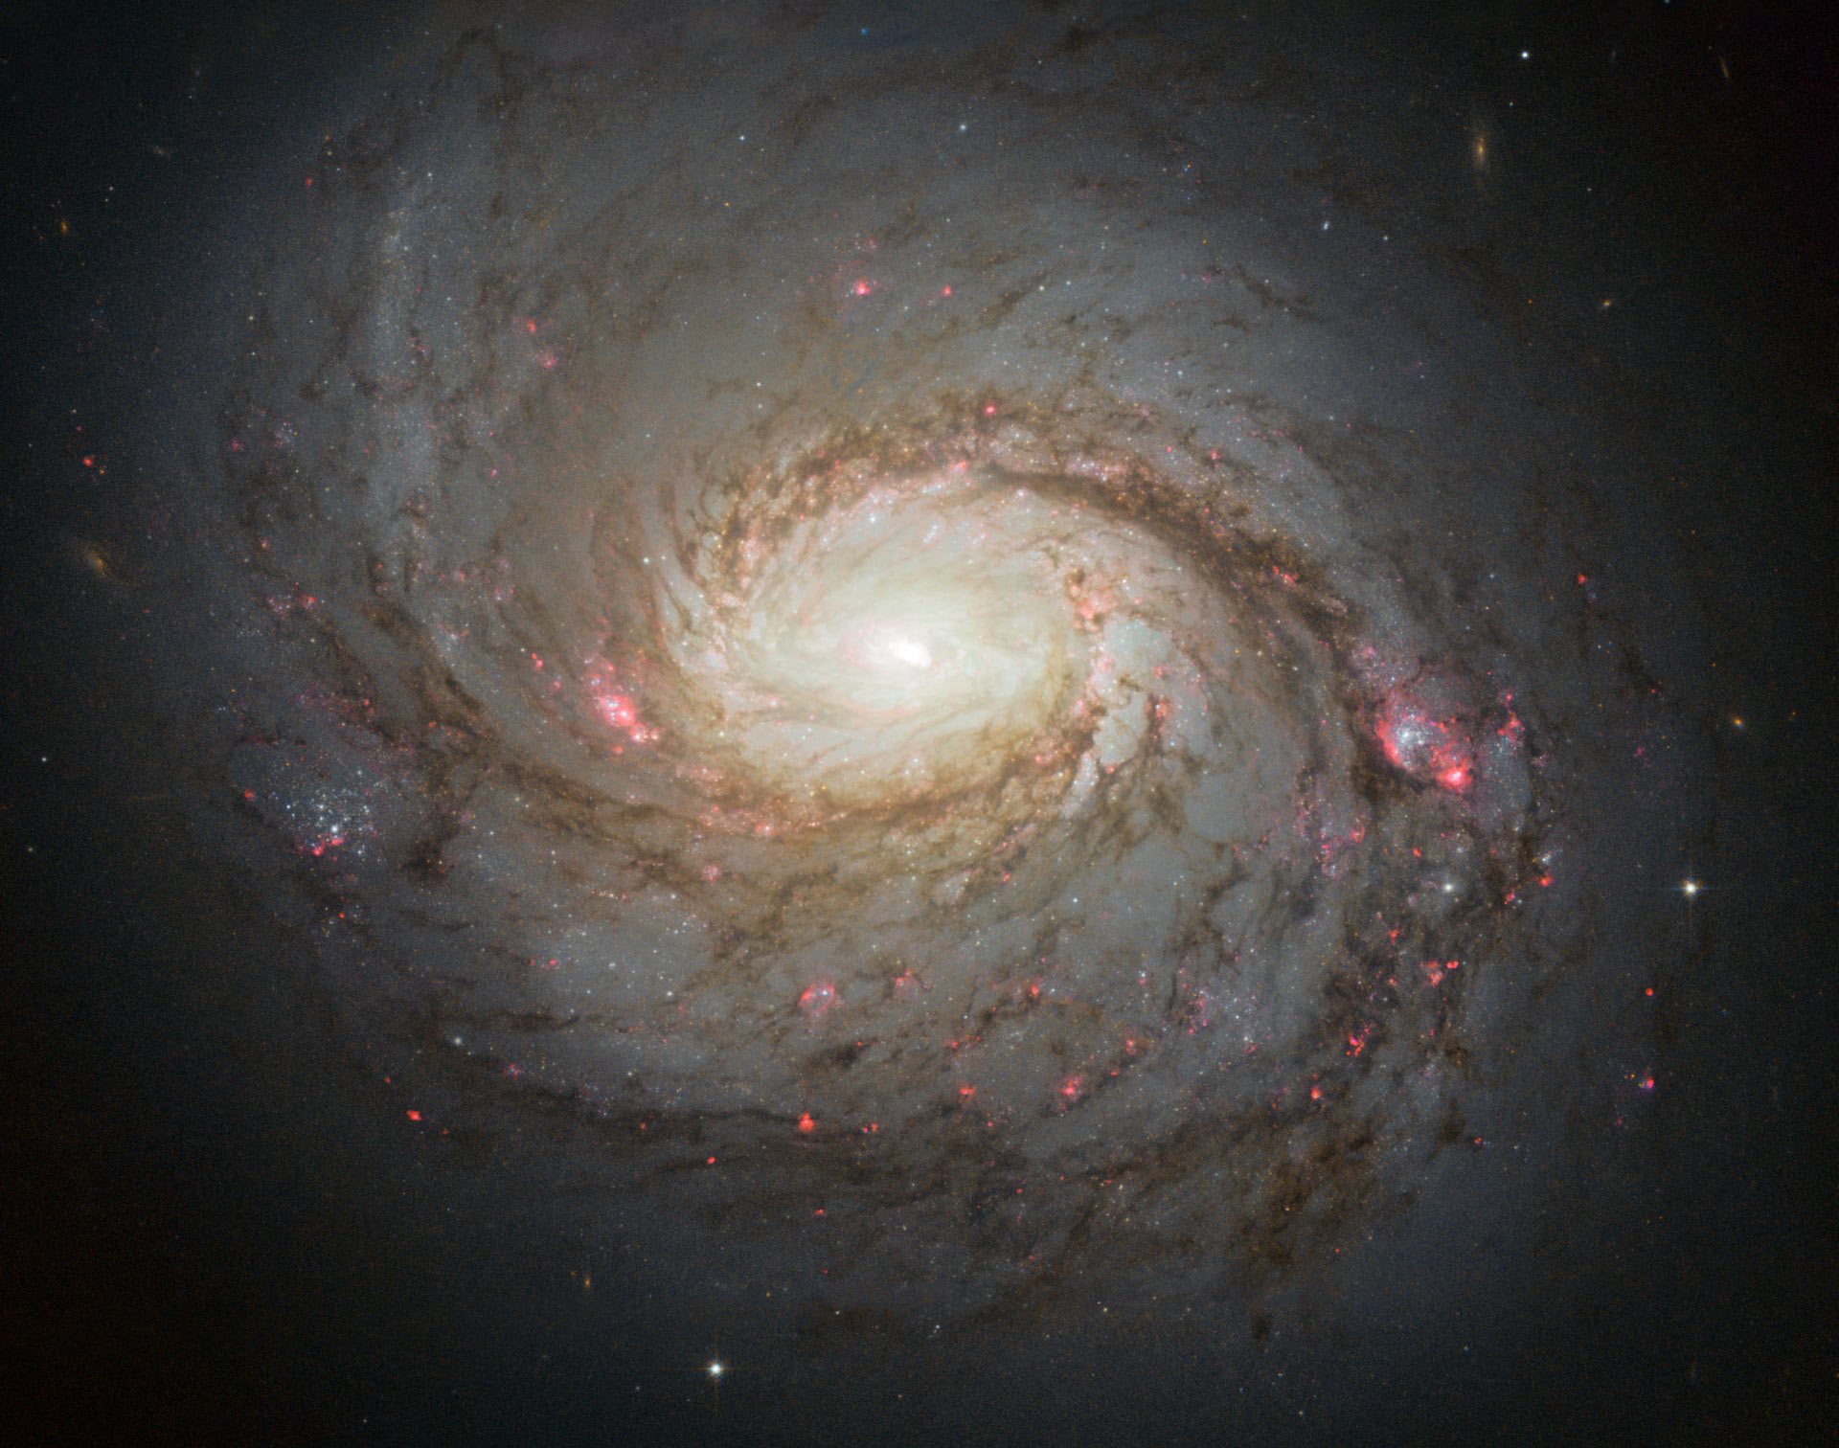
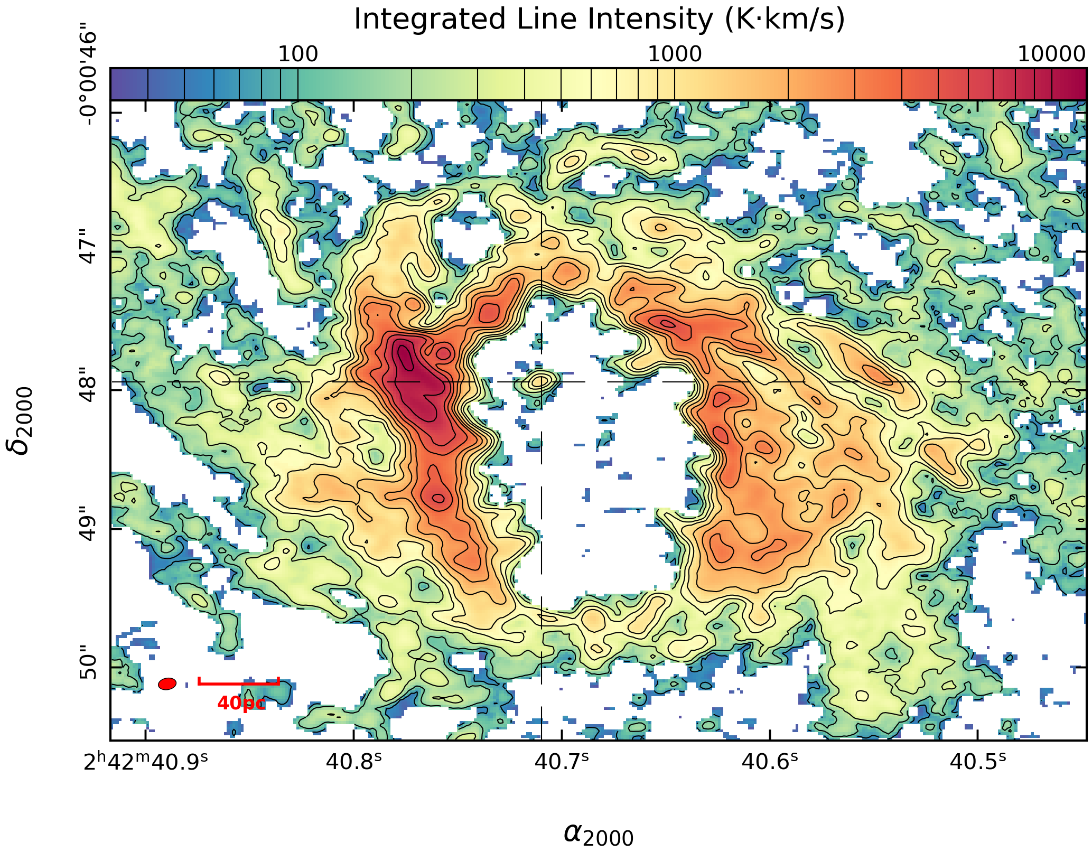
Introduction of NGC1068
Seyfert II Galaxy
Edge on dusty molecular
Torus
Circumnuclear Disk (CND)
with an asymmetric ringed
morphology
Yuze Zhang - yuzezhang@mail.strw.leidenuniv.nl
Notes:
Just to begin with introducing the galaxy. NGC1068 is a prototypical Seyfert II galaxy, and if we zoom in around the central region of this galaxy we can see this edge on dusty molecular torus at the center obscuring the AGN, and surrounding this torus is a relatively large scale circum nuclear disk with an asymmetric ringed morphology offset from the central engine

Slide 4
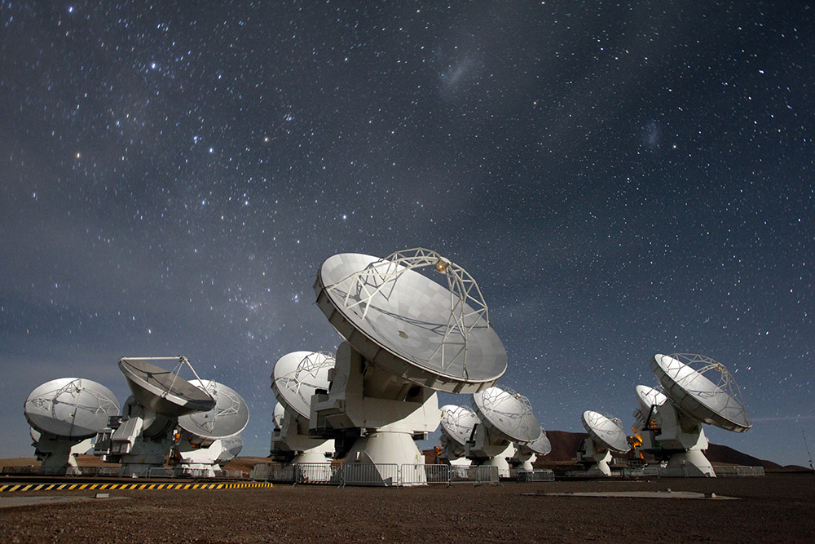
Why ALMA?
Direct image of
AGNs & surroundings
in nearby galaxies
IR interferometry
Limited (u, v) coverage
X
ALMA
Better (u, v) coverage
Distribution & kinematics
of gas around
AGNs of nearby Seyferts
Image from SRON website
Yuze Zhang - yuzezhang@mail.strw.leidenuniv.nl
3
Notes:
Based on several recent studies, our group has proposed this model of AGN outflow in NGC1068 high lighting a 3D outflow geometry. We think there is this wide angle ionized AGN wind sweeping the molecular gas reservoir around the central region of the galaxy and created two components of the molecular outflow, a blueshifted component and a redshifted component. Since the molecular reservoir around the central region is tilted with a certain inclination angle along the line of sight, if we look away from the central engine into the CND or beyond, we can only see a single component of the molecular outflow. However, if we look towards the central engine close to the torus location, we can see both the blueshifted and the redshifted components of the molecular outflow.
(Address this really quick, could also skip, mention this briefly in the next couple of slides)

Slide 5
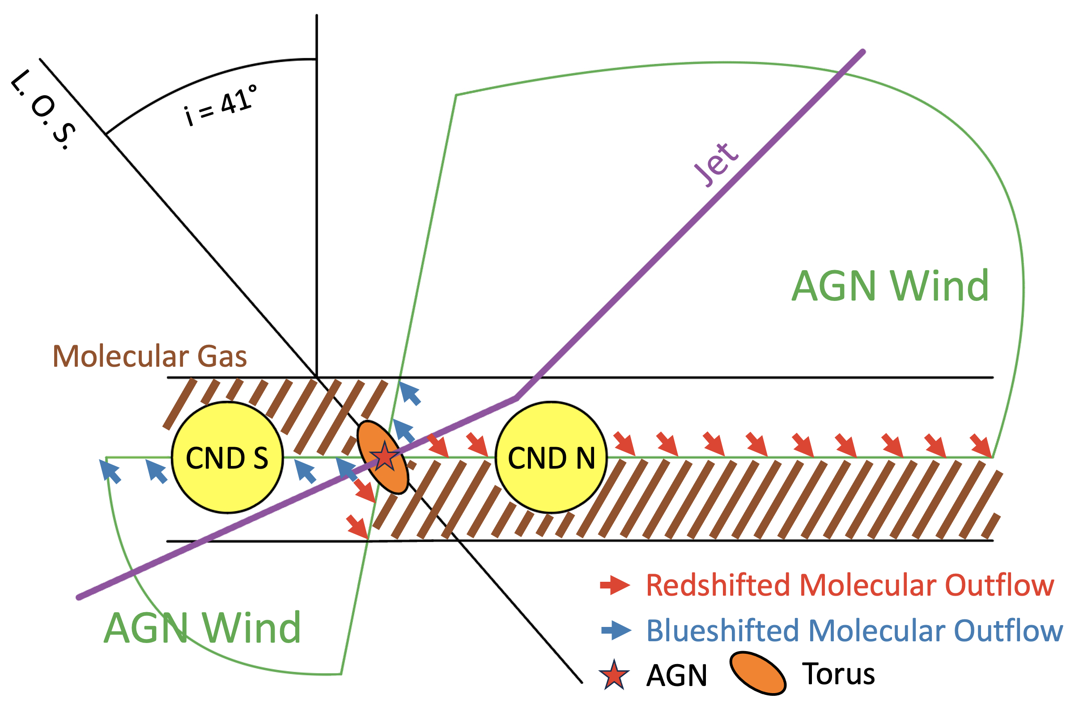
Proposed Model of AGN Outflow in NGC1068
2 Components
vs
1 Component
García-Burillo et al. 2019
Yuze Zhang - yuzezhang@mail.strw.leidenuniv.nl
4
Notes:
Based on several recent studies, our group has proposed this model of AGN outflow in NGC1068 high lighting a 3D outflow geometry. We think there is this wide angle ionized AGN wind sweeping the molecular gas reservoir around the central region of the galaxy and created two components of the molecular outflow, a blueshifted component and a redshifted component. Since the molecular reservoir around the central region is tilted with a certain inclination angle along the line of sight, if we look away from the central engine into the CND or beyond, we can only see a single component of the molecular outflow. However, if we look towards the central engine close to the torus location, we can see both the blueshifted and the redshifted components of the molecular outflow.

Slide 6
This Study
Understand the temperature, density, and kinematics from line profiles of molecular gas in the CND (outflow)
Impact of the ionized outflow on molecular gas in the CND
High resoltuion ALMA data used in the study:
Yuze Zhang - yuzezhang@mail.strw.leidenuniv.nl
5
Notes:
Based on this 3D outflow geometry, this study aims to first analyze high spatial resolution CO observations across the CND to understand the outflow kinematics inside the CND so we can test the proposed model first on the CND scale
(Emphasize that we are studying the line profiles and the rest can be smaller)

Slide 7
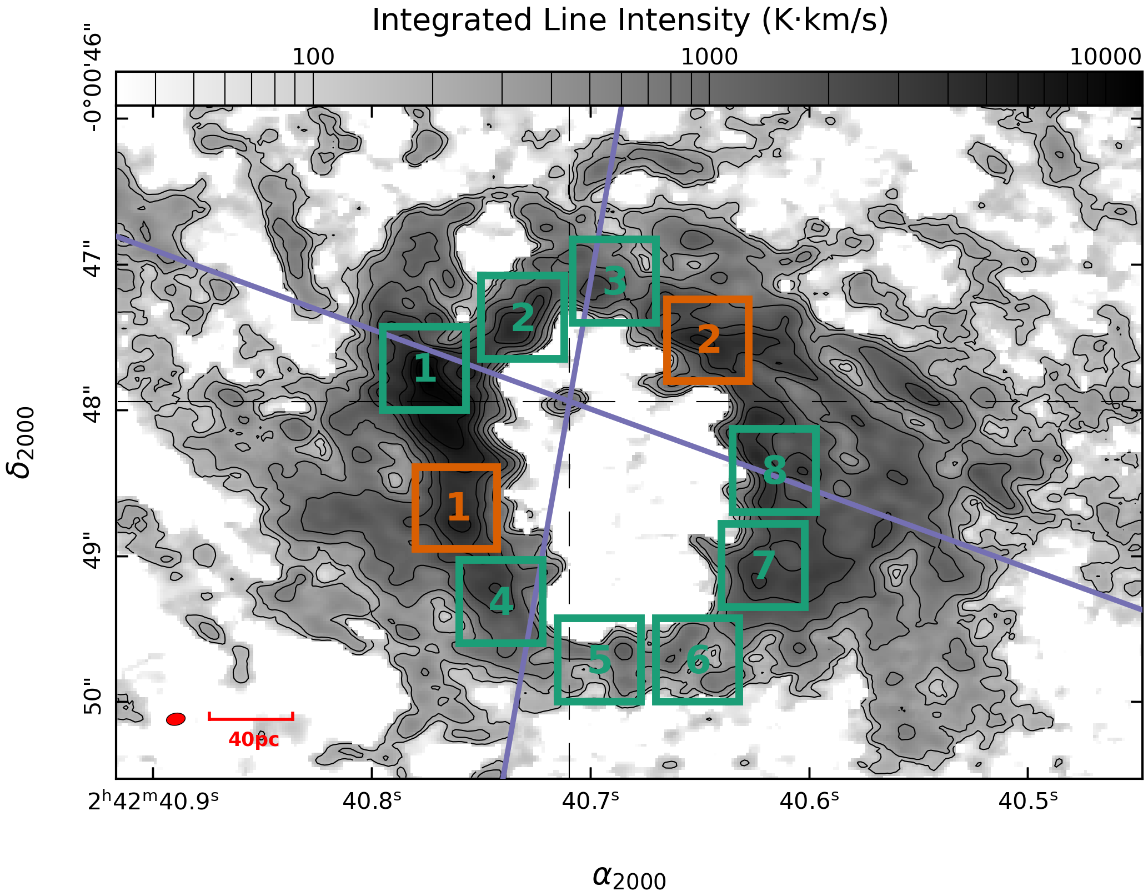
Region Selection & LTE Analysis
Das et al. 2006
Based on the outflow
LTE & RADEX (LVG) analysis:
1. LTE condition
2. Optically thin
3. Roughly uniform temperature
(∼34 - 56.4 K)
Yuze Zhang - yuzezhang@mail.strw.leidenuniv.nl
6
Notes:
After making the moment maps, we decided to define some regions around the CND to further investigate the kinematics of gas within each region. We first defined these regions based on the basic physical property of the ionized outflow. So again, I provided the AGN wind bicone model, and all the green regions are either within the ionised AGN wind bicone or along the edge of the bicone, while all the orange regions are outside the bicone. We also defined these regions on a scale of 40 by 40 pc because we zoomed in to smaller scales first and found large variance between the kinematics behaviours of these regions. So we’re going to stick with the larger regions first and if we find something interesting within one of these regions, we can zoom in further to investigate the kinematics in more details.
After defining these regions, we conducted a LTE analysis to trace the temperature and density structure across the CND. And we found that gas within each region is optically thin (based on our RADEX analysis) and from the rotational diagrams, each region only contains one single component of gas. We also calculated the temperature and CO column densities of the gas within each region and found that the temperature and density distribution is roughly uniform throughout the CND.
Afterwards, we defined different regions around the CND to further characterize the kinematics of the gas. We tried to define these regions based on the basic physical property of the ionized outflow. Again the AGN wind bicone is plotted here as purple lines, and all the green regions are either within the ionized outflow or along the edge of the outflow, and all the orange regions are outside the outflow. We also defined these regions on a scale of 40 by 40 pc because we zoomed in earlier and found large variance of the kinematics behaviours of the gas, so we stick to the 40 by 40 pc regions first and if we can zoom in later to analyze the kinematics in more details. After defining the regions, we first did a local thermodynamic equilibrium analysis first and found that all the regions satisfy the LTE condition. Which is the gas within each region is optically thin and there ‘s only one component of gas within each region. In this case the rotational temperatures form the LTE analysis is the same as the kinetic temperature of the gas. We also found that the tmperature distribution is roughly uniform around the CND, which means the previously seen large linewidth is not due to a temperature gradient across the CND but rather due to the dynamic interactions between the ionized outflow and the gas inside the CND

Slide 8
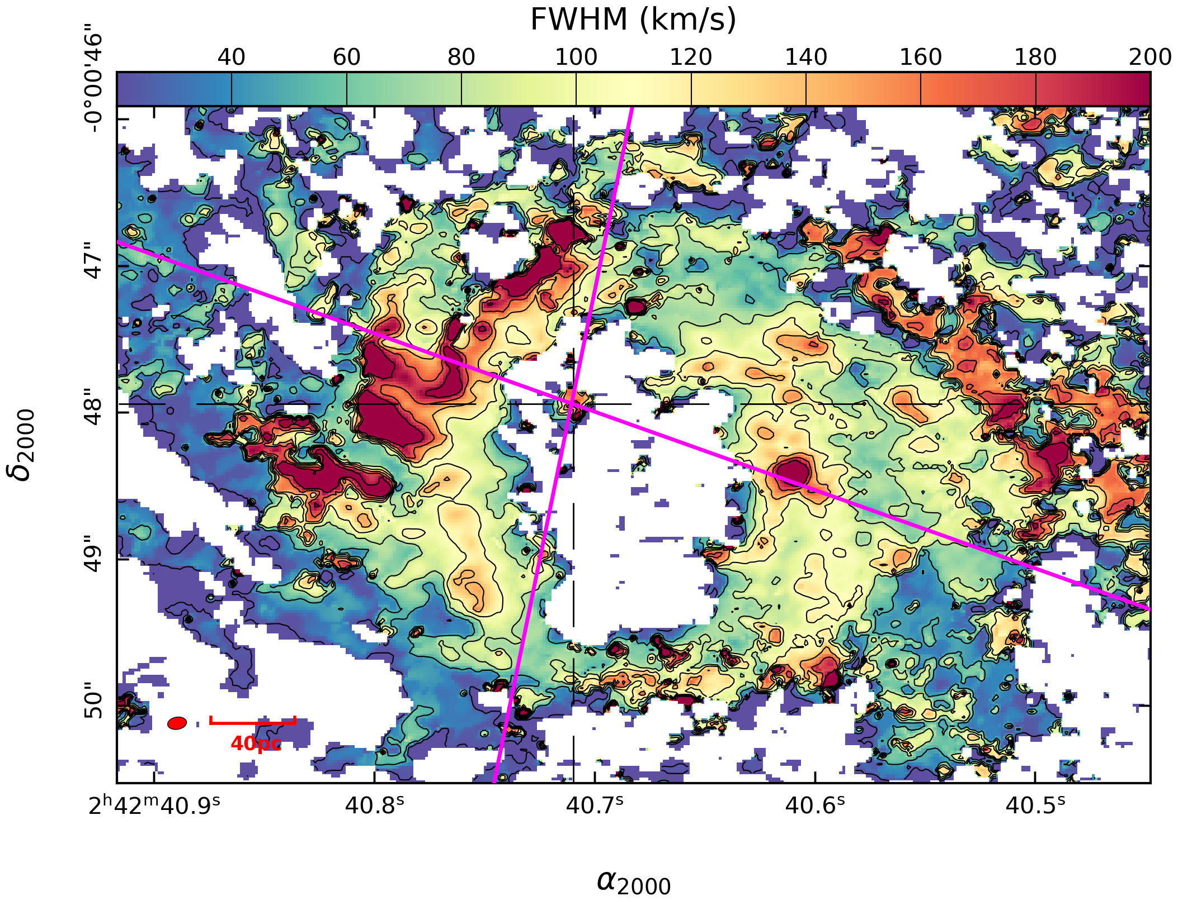
CO(2-1) Linewidth
(Moment 2) Map
LTE Analysis & Moment 2 Map
Large Linewidths:
Direct Jet-ISM Interaction
Narrow Linewidths:
Indirect Jet-ISM Interaction
Yuze Zhang - yuzezhang@mail.strw.leidenuniv.nl
7
Notes:
We also made the moment 2 maps, and here is an example for the CO(2-1) transition linewidth map to trace the FWHM of the emission line around the CND. The gas in the northeastern part of the CND has large line wdiths while the gas in the southern part of the CND has narrow linewidhts. This kind of reflects the 3D outflow geometry. Since the ionized outflow is in front of the CND in the northeast and is behind the CND in the south, the large linewdiths we are seeing in the northeast indicate the working surface of the ionized AGN wind interacting with the molecular gas, while the gas we see in the south is being indirectly pushed by the ionized outflow.

Slide 9
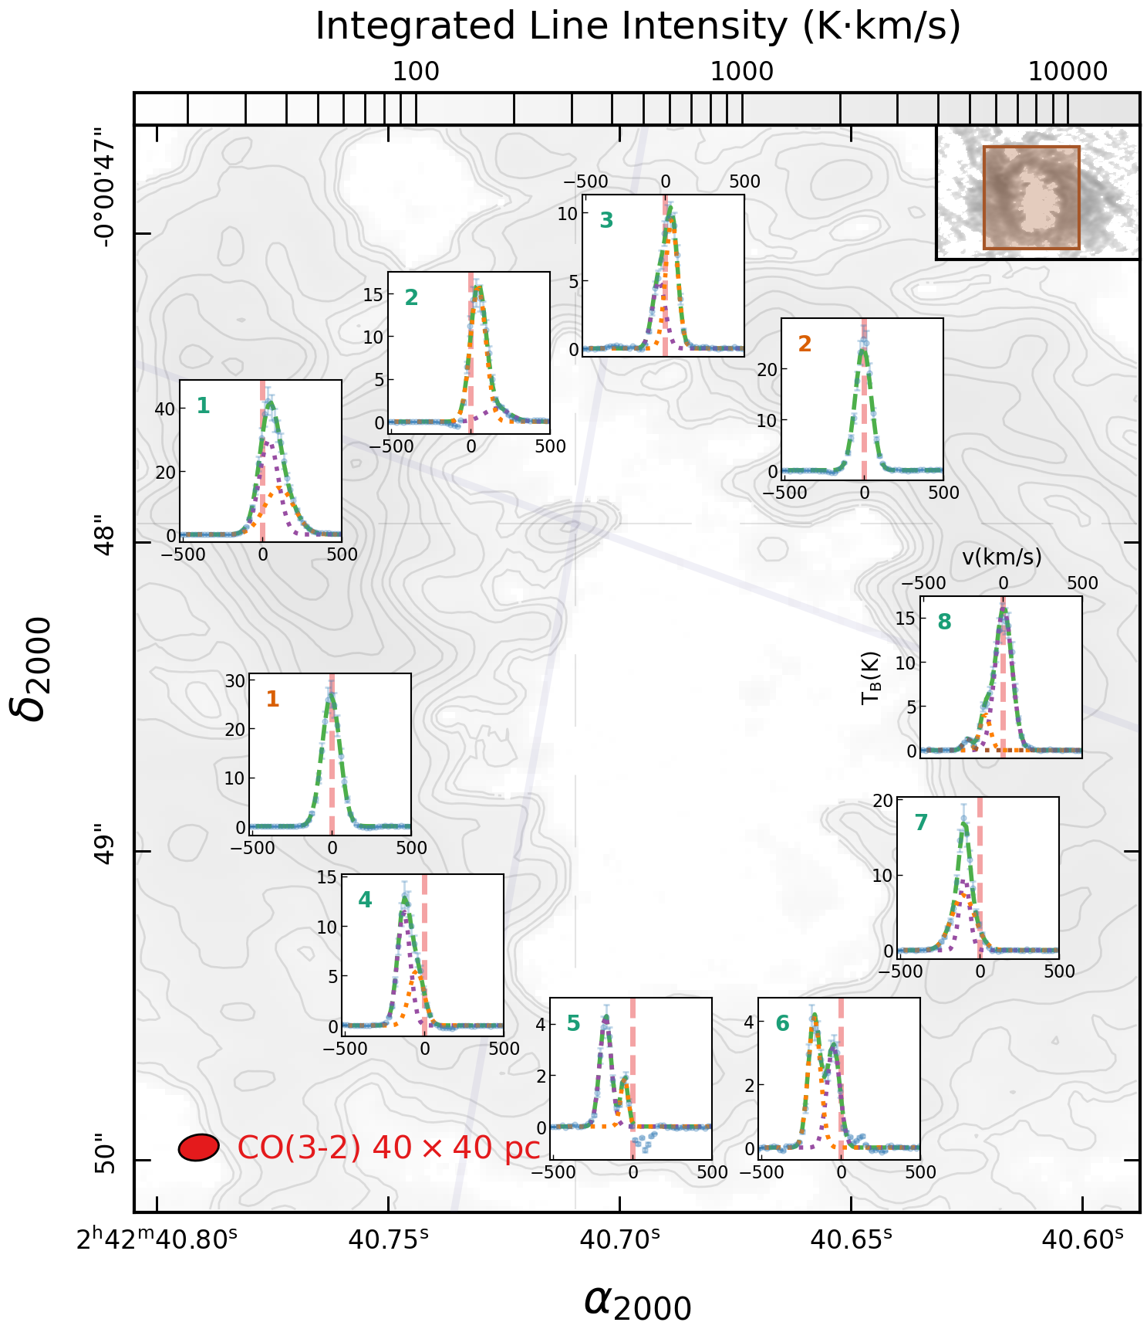
Investigate Line Profiles: 1, 2, or 3 Gaussian Components
Outside the bicone:
Almost no outflow
Inside or along the edge of the bicone:
Outflow centred around
R1, R5 (circled regions)
Yuze Zhang - yuzezhang@mail.strw.leidenuniv.nl
8
Notes:
To break the homogeneity of the temperature and density behaviours across the CND, we decided to investigate the line profiles averaged within each region by fitting two different simple models to the line profiles, a weighted double Gaussian and a single Gaussian model. Then the two sets of fits were compared based on two criteria. First we check whether both Gaussian peaks from the double Gaussian profile is above 3 sigma level, so they are significant enough to be considered. Then we used an extra sum of squares F-test to compared the two sets of fits. So basically this test assumes a null hypothesis that the simpler model is better at fitting the lineprofile compared to a more complex model, so if we have a p value smaller than 0.05, we can use the weighted double Gaussian model, otherwise we stick to the simple Gaussian model. Later we also expanded the analysis to a comparison between the weighted triple Gaussian and the weighted double Gaussian models.
So here are the examples of the line profiles based on the original 40 by 40 pc regions on the left and more zoomed in regions on the scale of 20 by 20 pc on the right, and these zoomed in regions are centred at the midpoints of the original regions on the left. Again I provided the ionized AGN wind bicone on the plots. We found that most of the line profiles which can be fiteed with the weighted double Gaussian are either within the bicone or along the edge of the bicone, while most of the regions outside the bicone can only be fitted with a single Gaussian. The orange region one here can be fitted with the weighted double Gaussian with the secondary Gaussian component further blueshifted away from the systematic velocity marked by the vertical red line, indicating that the region might actually contain some of the outflowing gas. We also found that the line profiles in the northeast are more complex than in the south. So line profiles from green regions 1 and 2 can be fitted with the weighted double Gaussian model while line profiles from green regions 4 and 5 can only be fitted with a single Gaussian. This again kind of reflects the 3D outflow geometry. Since the gas in the northeast is at the working surface of the ionized AGN wind, so they exhibit more complex line profiles. I also want to highlight these three regions which potentially indicate the boundaries of molecular outflows.
Here are the examples of the CO 2-1 line profiles. On the right are line profiles defined on a scale of 20 by 20 pc, and these 20 by 20 pc regions are centered at the midpoints of the original 40 by 40 pc regions. The systematic velocity of the galaxy is also marked by red dashed lines within each inset plot. Again, I provided the AGN wind bicone with the two purple dashed lines. We found that most regions that can be fitted with the double gaussian are either within the bicone or along the edge of the bicone, while most of the regions outside the bicone can only be fitted with a single gaussian. We also found differences between the line profile behaviours in the northeastern and southern parts of the CND. The line profiles in green regions 1 and 2 can be fitted with a double gaussian while the line profile in green regions 4 and 5 can only be fitted with a single gaussian. This again reflects the three outflow geometry. The northeastern part of the CND is being directly swept by the ionized AGN wind, so the regions there have more complex line profiles compared to the southern regions. I also want to highlight these three regions. What we think marks the boundary of the molecular outflow, especially for orange region 1 outside the bicone. When we zoom to a smaller scale, it picks up the second gaussian component that is significantly blueshifted away from the systematic velocity as part of the molecular outflow.
(just mention the direction of the outflow, where it is centered, don’t mention the region numbers)

Slide 10
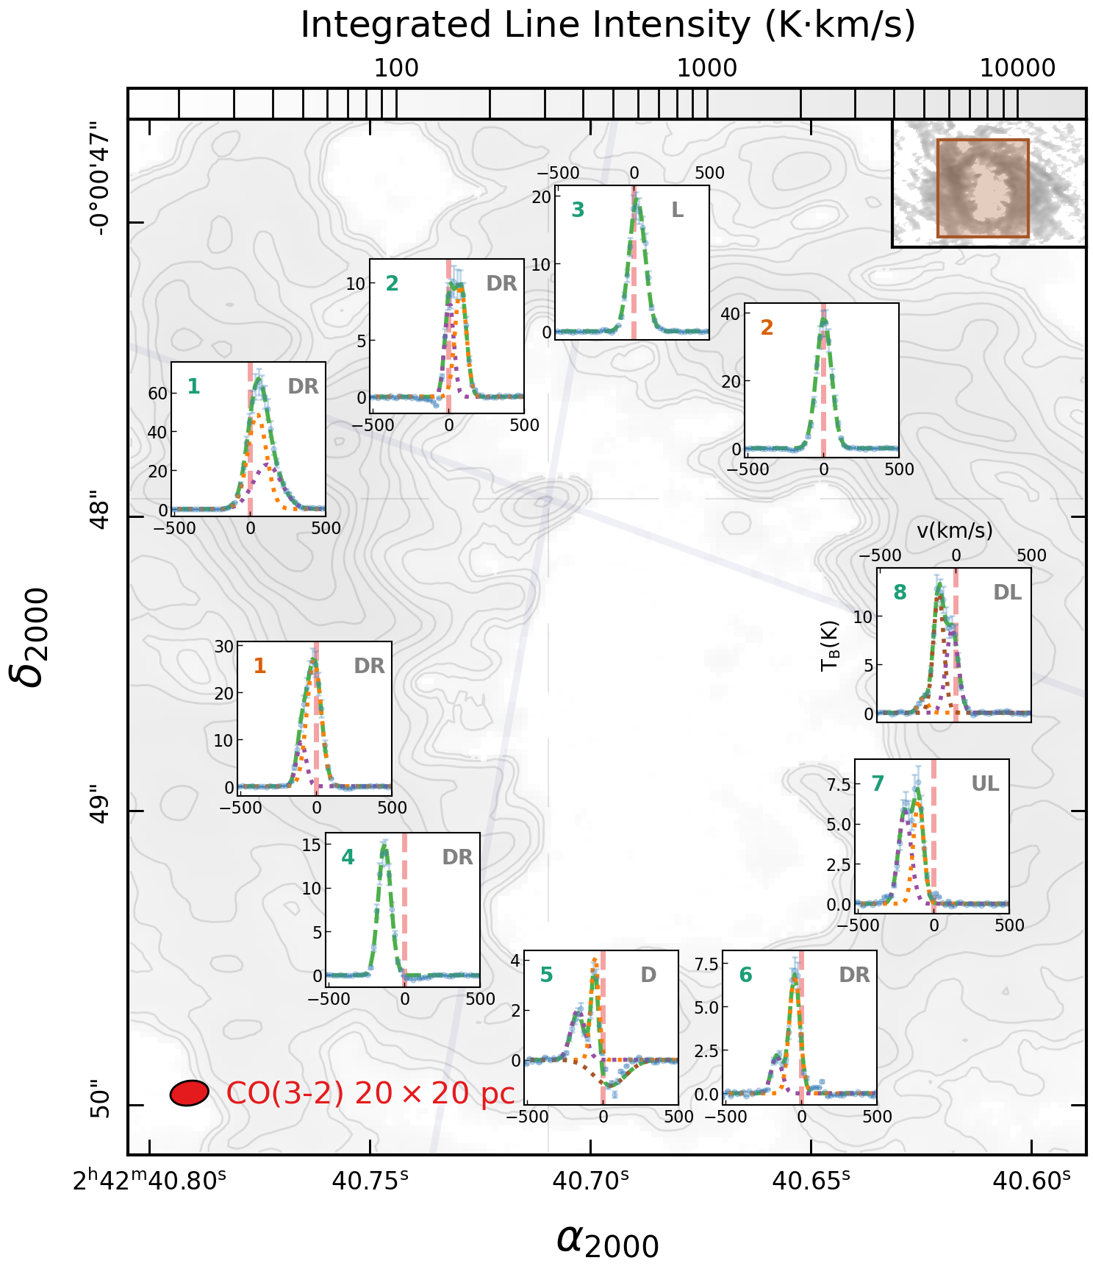
Investigate Line Profiles: Small V.S. Large Regions
?
Yuze Zhang - yuzezhang@mail.strw.leidenuniv.nl
8
Notes:
To break the homogeneity of the temperature and density behaviours across the CND, we decided to investigate the line profiles averaged within each region by fitting two different simple models to the line profiles, a weighted double Gaussian and a single Gaussian model. Then the two sets of fits were compared based on two criteria. First we check whether both Gaussian peaks from the double Gaussian profile is above 3 sigma level, so they are significant enough to be considered. Then we used an extra sum of squares F-test to compared the two sets of fits. So basically this test assumes a null hypothesis that the simpler model is better at fitting the lineprofile compared to a more complex model, so if we have a p value smaller than 0.05, we can use the weighted double Gaussian model, otherwise we stick to the simple Gaussian model. Later we also expanded the analysis to a comparison between the weighted triple Gaussian and the weighted double Gaussian models.
So here are the examples of the line profiles based on the original 40 by 40 pc regions on the left and more zoomed in regions on the scale of 20 by 20 pc on the right, and these zoomed in regions are centred at the midpoints of the original regions on the left. Again I provided the ionized AGN wind bicone on the plots. We found that most of the line profiles which can be fiteed with the weighted double Gaussian are either within the bicone or along the edge of the bicone, while most of the regions outside the bicone can only be fitted with a single Gaussian. The orange region one here can be fitted with the weighted double Gaussian with the secondary Gaussian component further blueshifted away from the systematic velocity marked by the vertical red line, indicating that the region might actually contain some of the outflowing gas. We also found that the line profiles in the northeast are more complex than in the south. So line profiles from green regions 1 and 2 can be fitted with the weighted double Gaussian model while line profiles from green regions 4 and 5 can only be fitted with a single Gaussian. This again kind of reflects the 3D outflow geometry. Since the gas in the northeast is at the working surface of the ionized AGN wind, so they exhibit more complex line profiles. I also want to highlight these three regions which potentially indicate the boundaries of molecular outflows.
Here are the examples of the CO 2-1 line profiles. On the right are line profiles defined on a scale of 20 by 20 pc, and these 20 by 20 pc regions are centered at the midpoints of the original 40 by 40 pc regions. The systematic velocity of the galaxy is also marked by red dashed lines within each inset plot. Again, I provided the AGN wind bicone with the two purple dashed lines. We found that most regions that can be fitted with the double gaussian are either within the bicone or along the edge of the bicone, while most of the regions outside the bicone can only be fitted with a single gaussian. We also found differences between the line profile behaviours in the northeastern and southern parts of the CND. The line profiles in green regions 1 and 2 can be fitted with a double gaussian while the line profile in green regions 4 and 5 can only be fitted with a single gaussian. This again reflects the three outflow geometry. The northeastern part of the CND is being directly swept by the ionized AGN wind, so the regions there have more complex line profiles compared to the southern regions. I also want to highlight these three regions. What we think marks the boundary of the molecular outflow, especially for orange region 1 outside the bicone. When we zoom to a smaller scale, it picks up the second gaussian component that is significantly blueshifted away from the systematic velocity as part of the molecular outflow.
(in the title, say 40 by 40 vs 20 by 20 so people can immediately tell)

Slide 11
Investigate Line Profiles: Asymmetric AGN Wind?
?
AGN
N CND
R2(DR)
AGN
S CND
Yuze Zhang - yuzezhang@mail.strw.leidenuniv.nl
8
Notes:
To break the homogeneity of the temperature and density behaviours across the CND, we decided to investigate the line profiles averaged within each region by fitting two different simple models to the line profiles, a weighted double Gaussian and a single Gaussian model. Then the two sets of fits were compared based on two criteria. First we check whether both Gaussian peaks from the double Gaussian profile is above 3 sigma level, so they are significant enough to be considered. Then we used an extra sum of squares F-test to compared the two sets of fits. So basically this test assumes a null hypothesis that the simpler model is better at fitting the lineprofile compared to a more complex model, so if we have a p value smaller than 0.05, we can use the weighted double Gaussian model, otherwise we stick to the simple Gaussian model. Later we also expanded the analysis to a comparison between the weighted triple Gaussian and the weighted double Gaussian models.
So here are the examples of the line profiles based on the original 40 by 40 pc regions on the left and more zoomed in regions on the scale of 20 by 20 pc on the right, and these zoomed in regions are centred at the midpoints of the original regions on the left. Again I provided the ionized AGN wind bicone on the plots. We found that most of the line profiles which can be fiteed with the weighted double Gaussian are either within the bicone or along the edge of the bicone, while most of the regions outside the bicone can only be fitted with a single Gaussian. The orange region one here can be fitted with the weighted double Gaussian with the secondary Gaussian component further blueshifted away from the systematic velocity marked by the vertical red line, indicating that the region might actually contain some of the outflowing gas. We also found that the line profiles in the northeast are more complex than in the south. So line profiles from green regions 1 and 2 can be fitted with the weighted double Gaussian model while line profiles from green regions 4 and 5 can only be fitted with a single Gaussian. This again kind of reflects the 3D outflow geometry. Since the gas in the northeast is at the working surface of the ionized AGN wind, so they exhibit more complex line profiles. I also want to highlight these three regions which potentially indicate the boundaries of molecular outflows.
Here are the examples of the CO 2-1 line profiles. On the right are line profiles defined on a scale of 20 by 20 pc, and these 20 by 20 pc regions are centered at the midpoints of the original 40 by 40 pc regions. The systematic velocity of the galaxy is also marked by red dashed lines within each inset plot. Again, I provided the AGN wind bicone with the two purple dashed lines. We found that most regions that can be fitted with the double gaussian are either within the bicone or along the edge of the bicone, while most of the regions outside the bicone can only be fitted with a single gaussian. We also found differences between the line profile behaviours in the northeastern and southern parts of the CND. The line profiles in green regions 1 and 2 can be fitted with a double gaussian while the line profile in green regions 4 and 5 can only be fitted with a single gaussian. This again reflects the three outflow geometry. The northeastern part of the CND is being directly swept by the ionized AGN wind, so the regions there have more complex line profiles compared to the southern regions. I also want to highlight these three regions. What we think marks the boundary of the molecular outflow, especially for orange region 1 outside the bicone. When we zoom to a smaller scale, it picks up the second gaussian component that is significantly blueshifted away from the systematic velocity as part of the molecular outflow.
(put the messagee in the title, AGN wind tilted wrt CND)

Slide 12
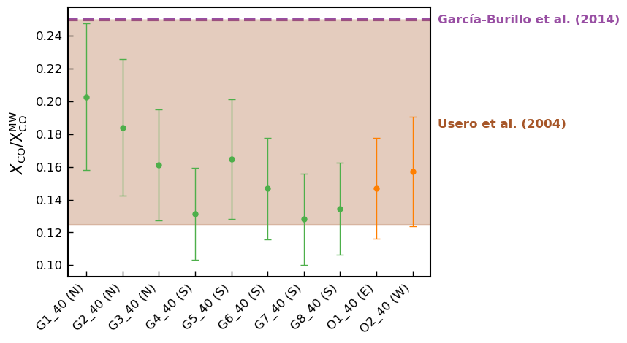
X_{CO} Factor in the CND
X_{CO} = N_{H2}/I_{CO(1-0)}
Most CO gas optically thin
Lower X_{CO} values
Yuze Zhang - yuzezhang@mail.strw.leidenuniv.nl
9
Notes:
We also made the moment 2 maps, and here is an example for the CO(2-1) transition linewidth map to trace the FWHM of the emission line around the CND. The gas in the northeastern part of the CND has large line wdiths while the gas in the southern part of the CND has narrow linewidhts. This kind of reflects the 3D outflow geometry. Since the ionized outflow is in front of the CND in the northeast and is behind the CND in the south, the large linewdiths we are seeing in the northeast indicate the working surface of the ionized AGN wind interacting with the molecular gas, while the gas we see in the south is being indirectly pushed by the ionized outflow.

Slide 13
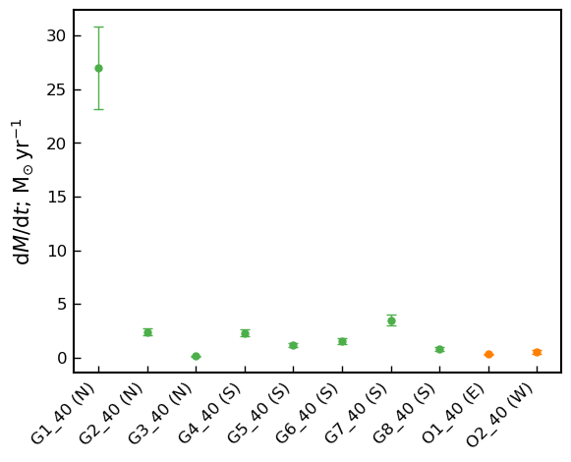
Molecular Mass Outflow Rate
Lower X_{CO}
Less molecular gas entrained in the outflow
Smaller mass outflow rate
Less dynamical impact from ionized outflow
García-Burillo et al. 2014
dM/dt_{CND}∼ 63 M☉/yr
Yuze Zhang - yuzezhang@mail.strw.leidenuniv.nl
10
Notes:
Make sure they understand that this is for the total molecular mass outflow rate of the CND

Slide 14
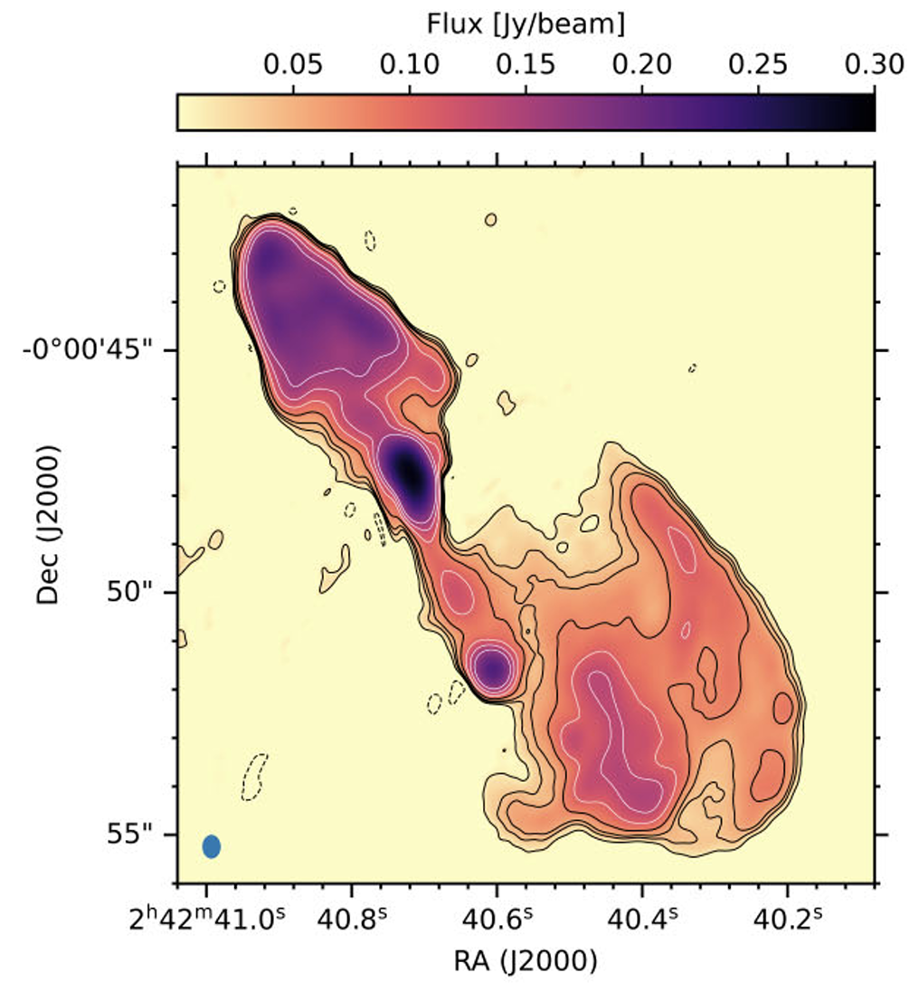
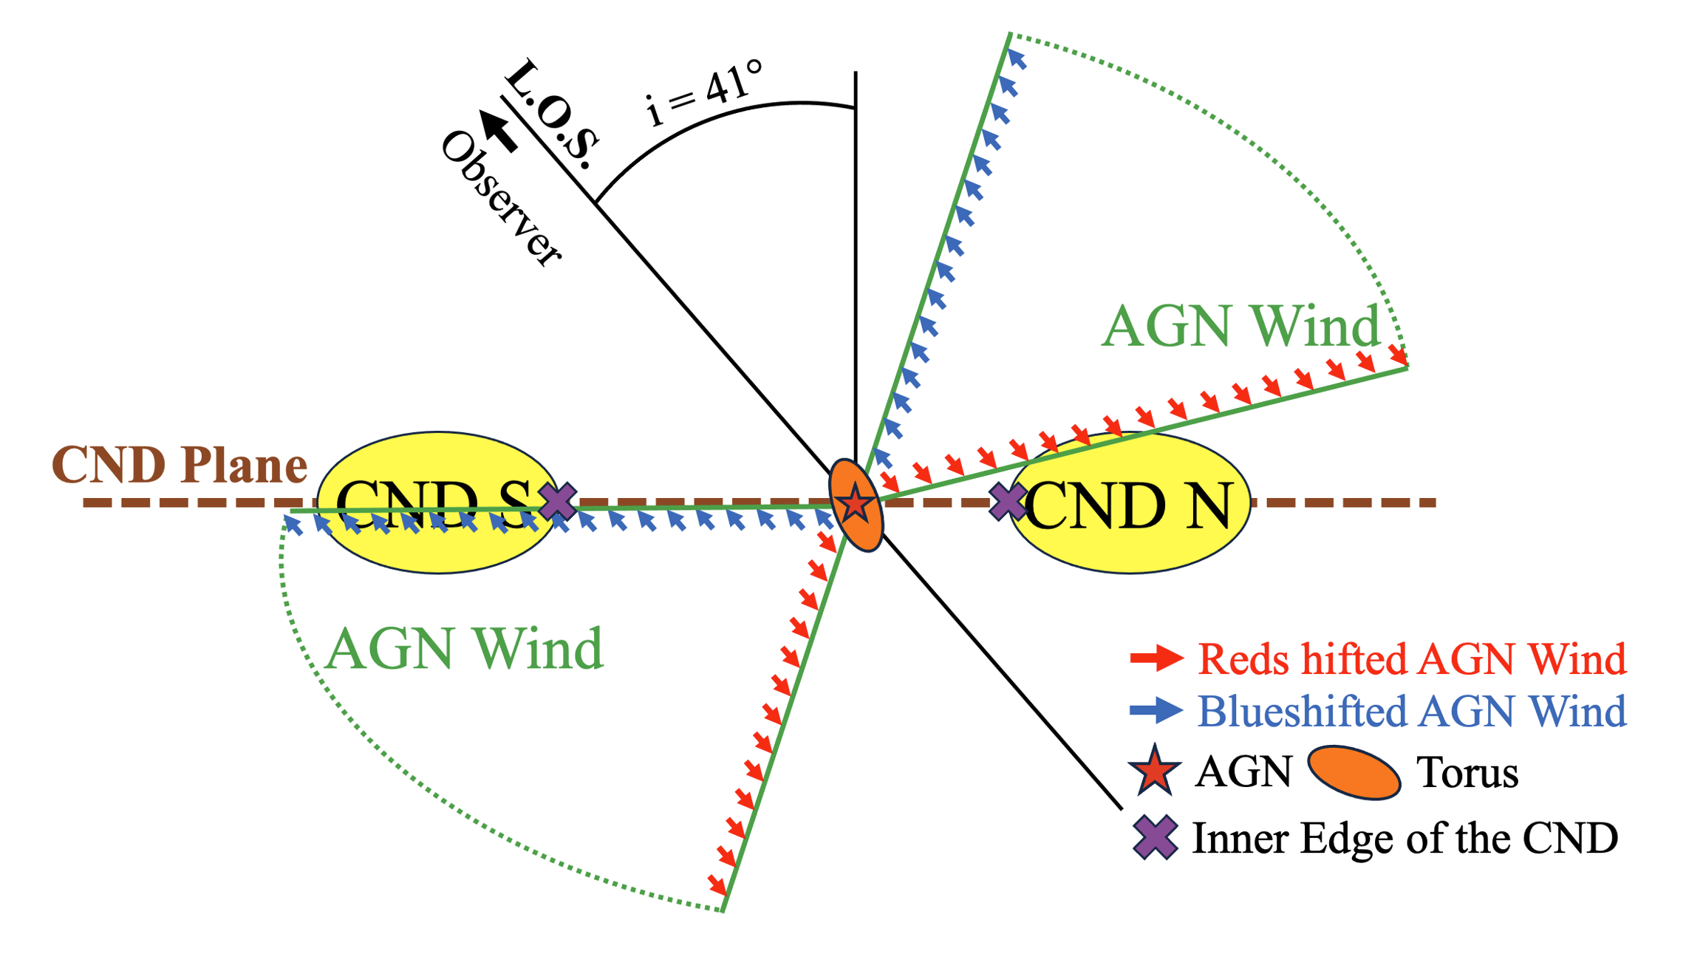
Main Conclusions
Asymmetry between the Northern and the Southern Outflow
Mismatch between the AGN wind bicone and molecular outflow
Lower X_{CO} inside the CND
Small molecular mass outflow rate in most of CND (except R1)
AGN
1
5
Mutie et al. 2024
Yuze Zhang - yuzezhang@mail.strw.leidenuniv.nl
11
Notes:
That is all for my project for now. I will leave the main conclusions here so everyone can ask questions.
Restate the question here, what I have done:
Can leave this for the audience to read in the end and take questions directly
To conclude, out observations matches the 3D outflow geometry I mentioned previously. Basically the gas behaviour in the northeastern part of the CND is different from the gas behaviour in the southern part of the CND. We also found a mismatch between the moelcular outflow and the ionized outflow, which has been seen from other galaxies as well.

Slide 15
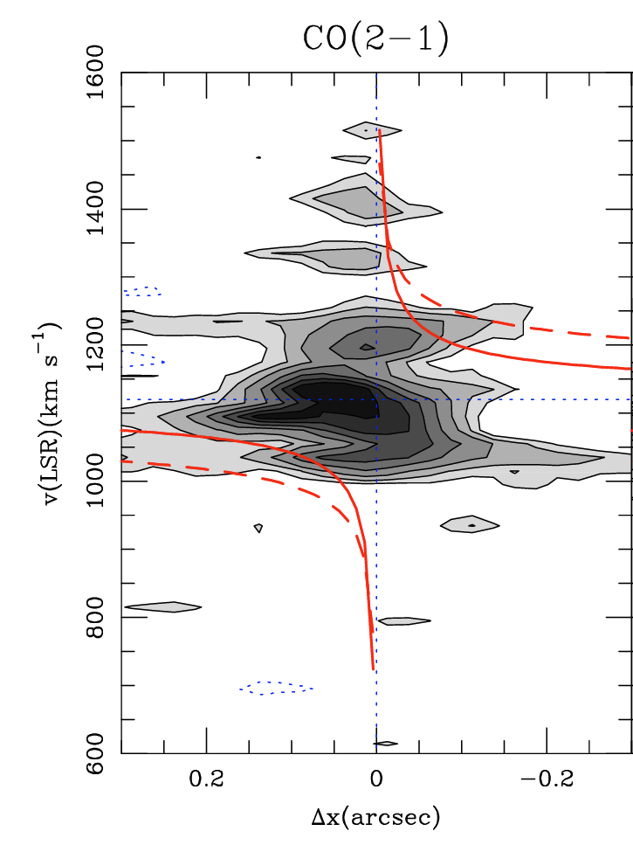
Kinematics of the Torus
Keplerian
& sub-Keplerian
rotation curves
Large portion of gas
García-Burillo et al. 2019
Yuze Zhang - yuzezhang@mail.strw.leidenuniv.nl
Notes:
Higher resolution also allows us to investigate kinematics of the molecular torus in more details. Previous observations has found counter rotation between the inner and outer torus components.
From this position-velocity diagram, the kinematics of supposedly the inner torus roughly follows the sub-Keplerian rotation curves derived based on the water megamaser observations. However, there are still significant portion of gas in the upper left and lower right quadrants of this plot, which potentially indicates counter rotation of supposedly the outer torus.
On top of the counter rotation, velocity gradients were also observed along the morphological minor axis of the torus, roughly aligned with the outflow direction.

Slide 16
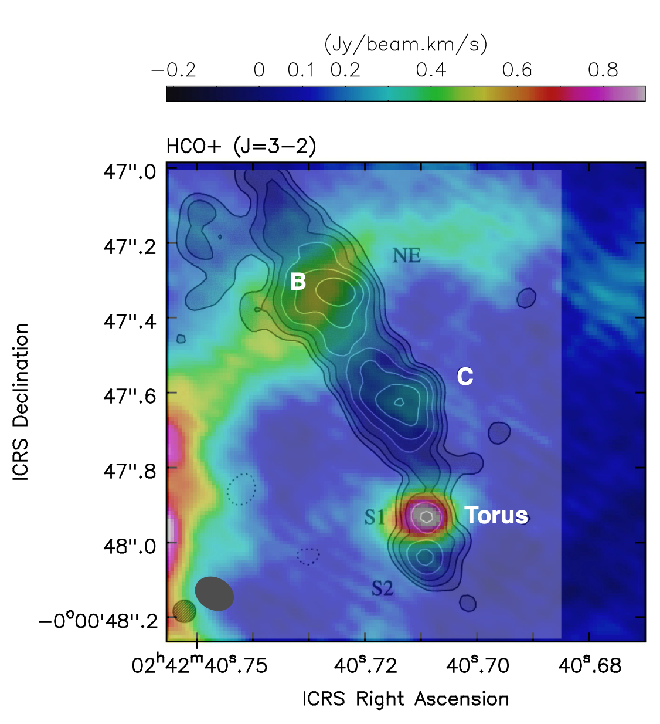
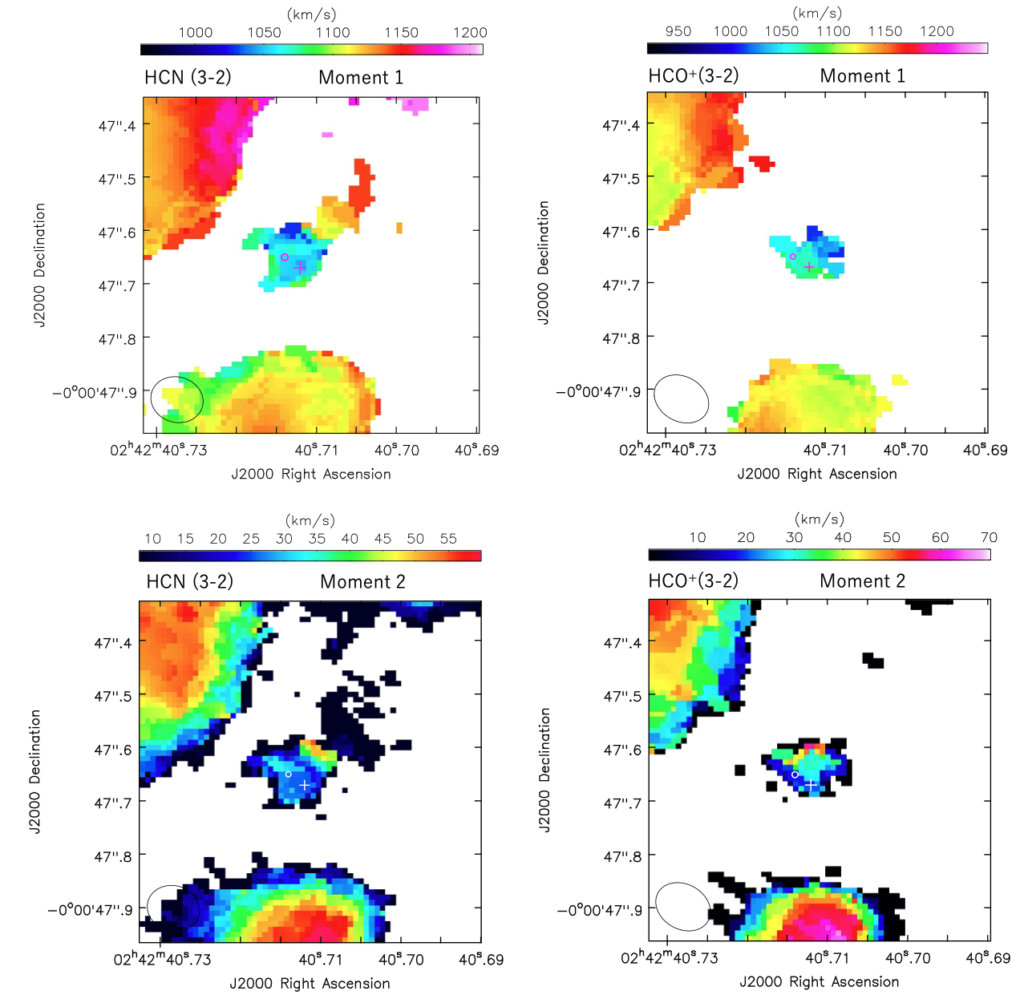
Recent Maser + Molecular Observations
Hagiwara et al. 2024
Yuze Zhang - yuzezhang@mail.strw.leidenuniv.nl
Notes:
After defining the regions, I also tried to make the moment 1 and 2 maps. So moment 1 map is showing the peak velocity distribution across the AGN and the CND, while moment 2 traces the line width. To begin with, since we are investigating the outflow of AGN, we need to subtract the rotational component of the galaxy to separate the outflow from galactic rotation. We used the galactic rotation curve fitted by Garcia Burillo et al. 2019 based on CO 21 transition in NGC1068 coordinate and projected it to the sky coordinate. So here on the left is the galactic rotation curve with the x axis in arcsecond from the galactic center, and y axis in km per second for the rotational velocity. On the right is the projected rotational velocities in the radial direction along the line of sight in the sky. We shifted all the pixels in an image cube based on this projected rotational diagram to get the residual cube. We can then go through the same procedure as the Moment 0 map to get the moment 1 and 2 maps.

Slide 17
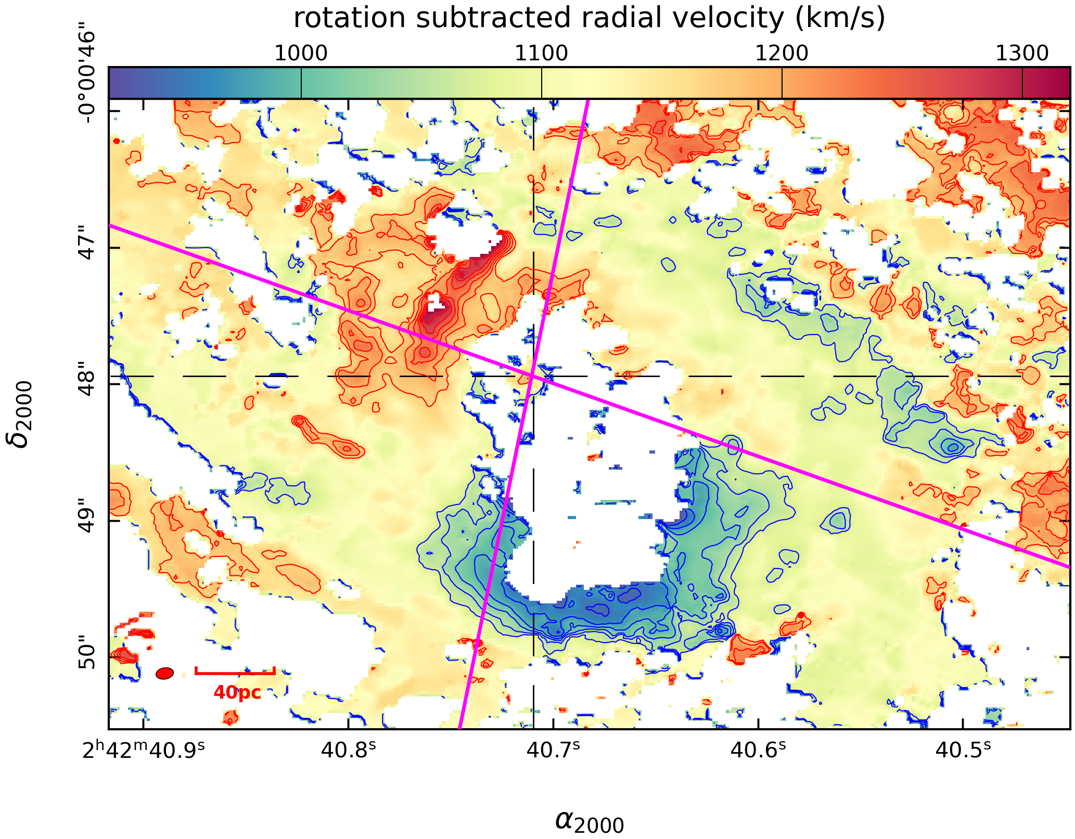
CO(2-1) Residual Velocity
(Moment 1) Map
Moment 1 Map
Northeast:
Redshifted Outflow
Southwest:
Blueshifted Outflow
Mismatch
Yuze Zhang - yuzezhang@mail.strw.leidenuniv.nl
14
Notes:
We first made the CO moment maps based on existing ALMA archive data. This is an example of the CO 2-1 residual velocity map. The reason we are using residual velocity is because we want to get rid of the contribution from galactic rotation so we can study the motion of the molecular outflow. I also provided the ionized AGN wind bicone model on this plot. The majority of the outflowing gas is within the AGN wind bicone. The gas in the northeastern part of the CND is part of the redshifted outflow, and the gas in the southern part of the CND is part of the blueshifted outflow. We also found a significant portion of the outflowing gas extends outside the AGN wind bicone into the eastern part of the CND. This can potentially indicate a mismatch between the ionized outflow and the molecular outflow.

Slide 18
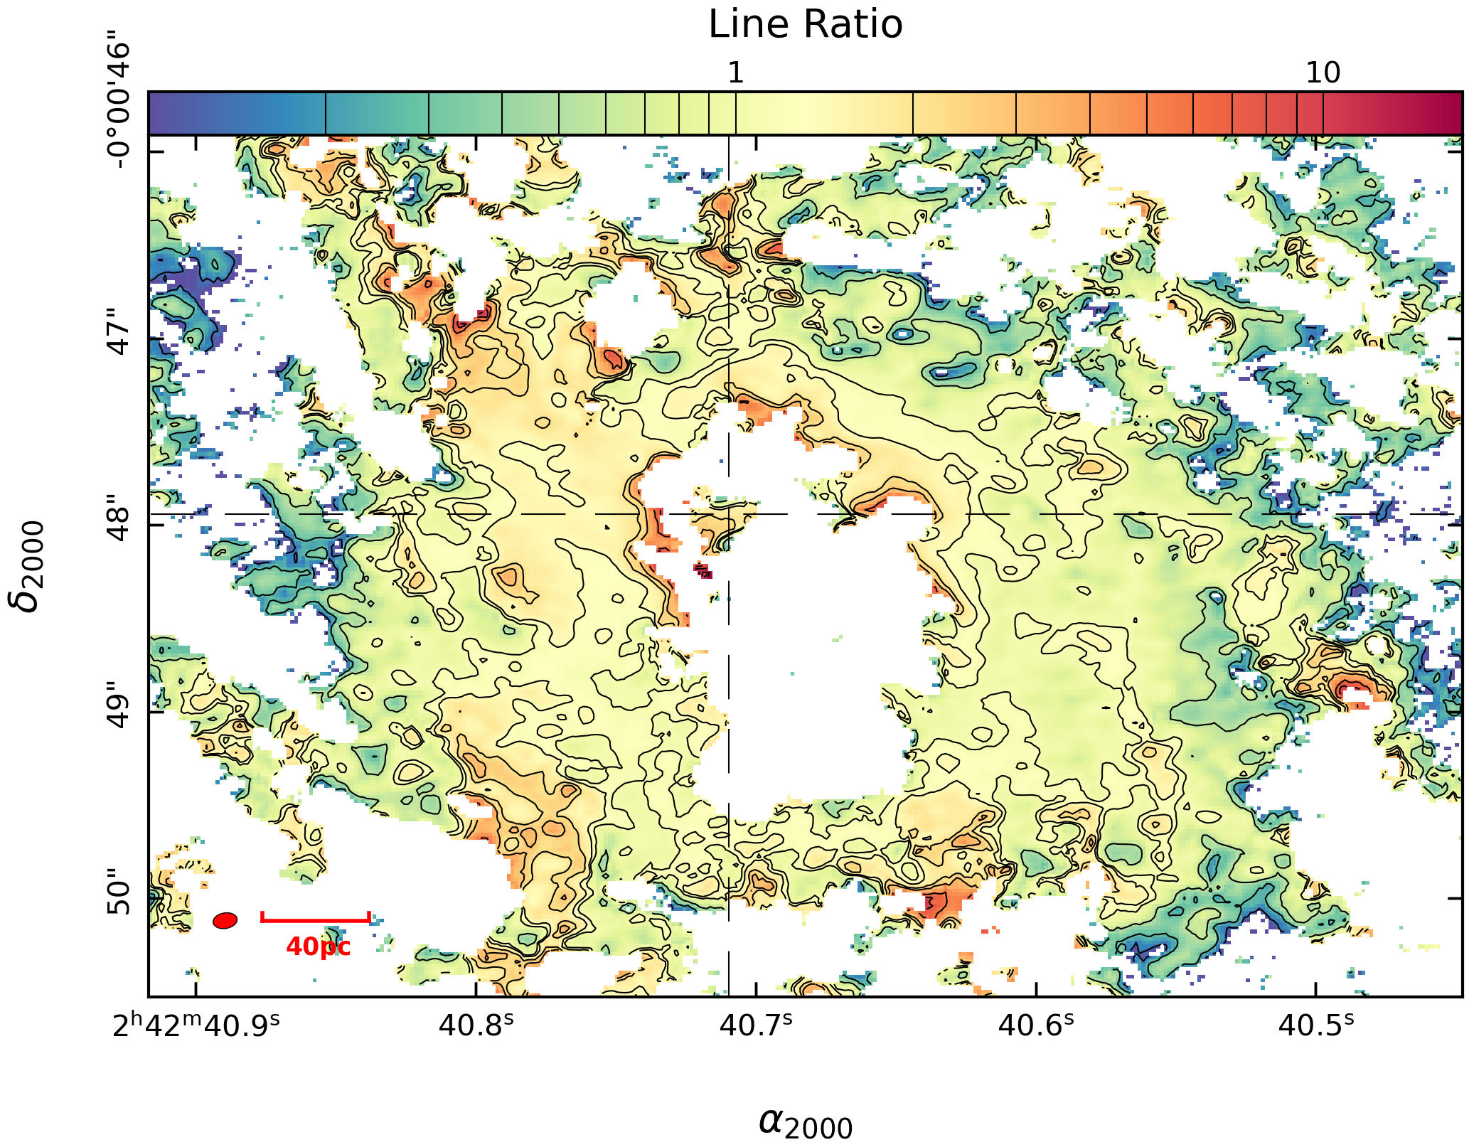
CO(3-2)/CO(2-1) Ratio Map
Ratio Maps
Outflow
Compression
NorthEast:
Compact
SouthWest:
Extended
Diffuse
Gas
Yuze Zhang - yuzezhang@mail.strw.leidenuniv.nl
Notes:
In general, outflow seems to be more compressed around the eastern region where we have compact molecular gas compared to the western region where the emission is more extended.

Slide 19
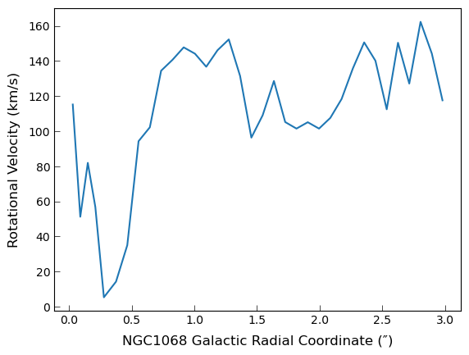
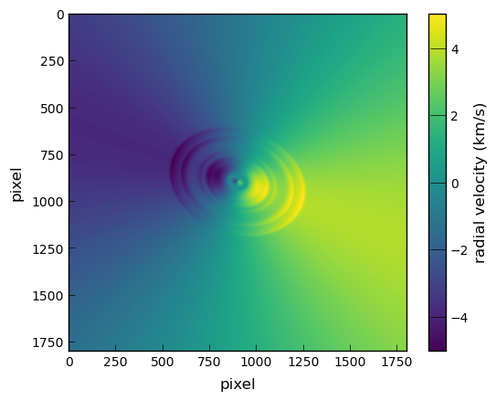
Rotation Curve Subtraction
Yuze Zhang - yuzezhang@mail.strw.leidenuniv.nl
Notes:
After defining the regions, I also tried to make the moment 1 and 2 maps. So moment 1 map is showing the peak velocity distribution across the AGN and the CND, while moment 2 traces the line width. To begin with, since we are investigating the outflow of AGN, we need to subtract the rotational component of the galaxy to separate the outflow from galactic rotation. We used the galactic rotation curve fitted by Garcia Burillo et al. 2019 based on CO 21 transition in NGC1068 coordinate and projected it to the sky coordinate. So here on the left is the galactic rotation curve with the x axis in arcsecond from the galactic center, and y axis in km per second for the rotational velocity. On the right is the projected rotational velocities in the radial direction along the line of sight in the sky. We shifted all the pixels in an image cube based on this projected rotational diagram to get the residual cube. We can then go through the same procedure as the Moment 0 map to get the moment 1 and 2 maps.

Slide 20
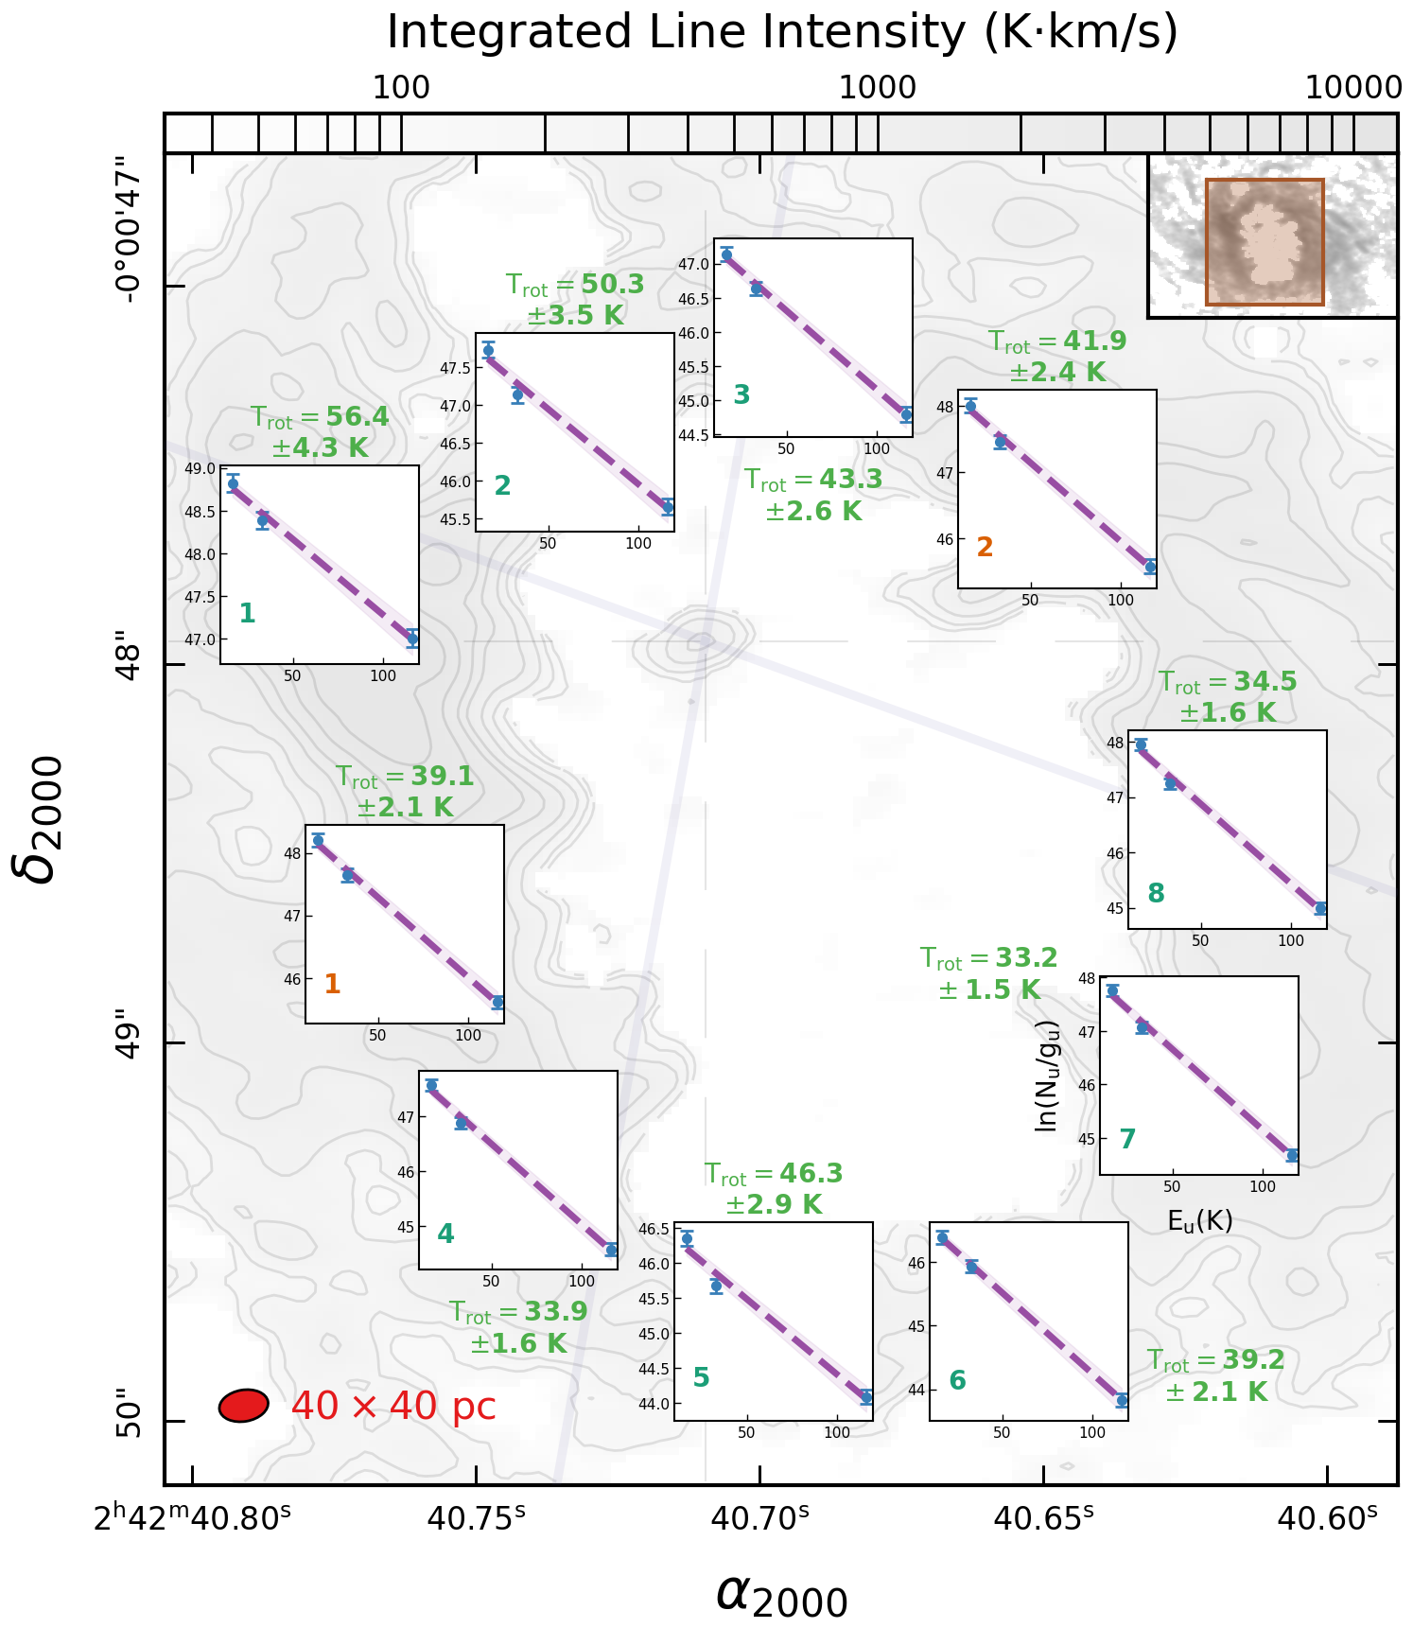
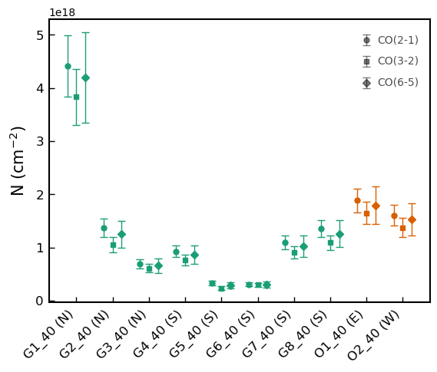
Rotation Diagrams & N_{CO} values
Yuze Zhang - yuzezhang@mail.strw.leidenuniv.nl
Notes:
After defining the regions, I also tried to make the moment 1 and 2 maps. So moment 1 map is showing the peak velocity distribution across the AGN and the CND, while moment 2 traces the line width. To begin with, since we are investigating the outflow of AGN, we need to subtract the rotational component of the galaxy to separate the outflow from galactic rotation. We used the galactic rotation curve fitted by Garcia Burillo et al. 2019 based on CO 21 transition in NGC1068 coordinate and projected it to the sky coordinate. So here on the left is the galactic rotation curve with the x axis in arcsecond from the galactic center, and y axis in km per second for the rotational velocity. On the right is the projected rotational velocities in the radial direction along the line of sight in the sky. We shifted all the pixels in an image cube based on this projected rotational diagram to get the residual cube. We can then go through the same procedure as the Moment 0 map to get the moment 1 and 2 maps.

Slide 21
Mass Outflow Rate Toy Model
Mass going through this surface per unit time
(mass flux)
Velocity ✕ density ✕ Area
1. M_{mol} of outflowing gas only
AGN
2. De-projected velocity
in the plane of the CND
3. r_{in} and r_{out} radius of this shell
Yuze Zhang - yuzezhang@mail.strw.leidenuniv.nl
Notes:
After defining the regions, I also tried to make the moment 1 and 2 maps. So moment 1 map is showing the peak velocity distribution across the AGN and the CND, while moment 2 traces the line width. To begin with, since we are investigating the outflow of AGN, we need to subtract the rotational component of the galaxy to separate the outflow from galactic rotation. We used the galactic rotation curve fitted by Garcia Burillo et al. 2019 based on CO 21 transition in NGC1068 coordinate and projected it to the sky coordinate. So here on the left is the galactic rotation curve with the x axis in arcsecond from the galactic center, and y axis in km per second for the rotational velocity. On the right is the projected rotational velocities in the radial direction along the line of sight in the sky. We shifted all the pixels in an image cube based on this projected rotational diagram to get the residual cube. We can then go through the same procedure as the Moment 0 map to get the moment 1 and 2 maps.

Slide 22
Animations
Yuze Zhang - yuzezhang@mail.strw.leidenuniv.nl
Notes:
After defining the regions, I also tried to make the moment 1 and 2 maps. So moment 1 map is showing the peak velocity distribution across the AGN and the CND, while moment 2 traces the line width. To begin with, since we are investigating the outflow of AGN, we need to subtract the rotational component of the galaxy to separate the outflow from galactic rotation. We used the galactic rotation curve fitted by Garcia Burillo et al. 2019 based on CO 21 transition in NGC1068 coordinate and projected it to the sky coordinate. So here on the left is the galactic rotation curve with the x axis in arcsecond from the galactic center, and y axis in km per second for the rotational velocity. On the right is the projected rotational velocities in the radial direction along the line of sight in the sky. We shifted all the pixels in an image cube based on this projected rotational diagram to get the residual cube. We can then go through the same procedure as the Moment 0 map to get the moment 1 and 2 maps.

